Slide 1





TETL Summer 2026
Access vs. Impact
What really matters?
Jillian Pratt, Scott Monroe

Slide 2



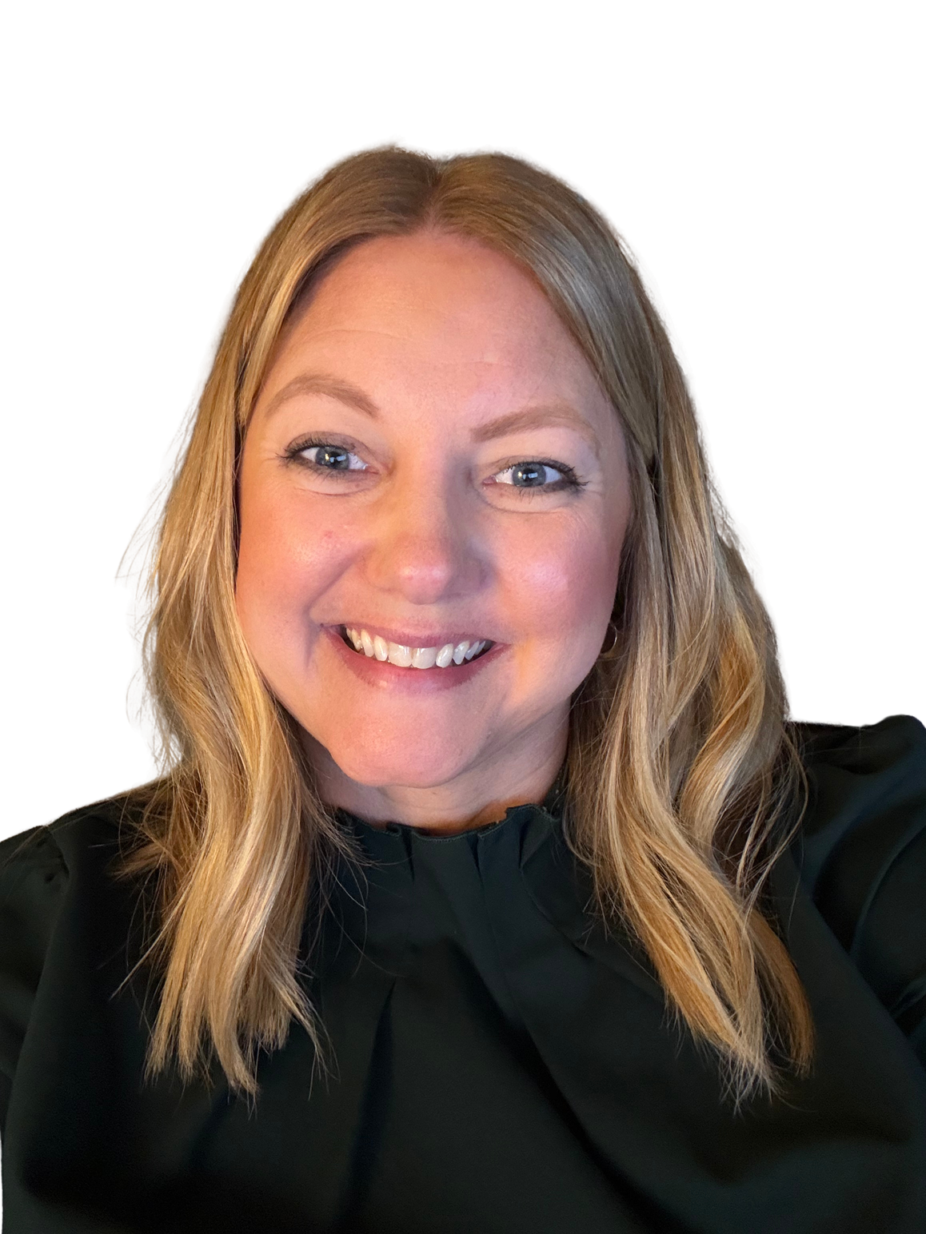

Jillian Pratt
Director of Digital Learning & Library Servces
Scott Monroe
Cheif Information Officer

Slide 3
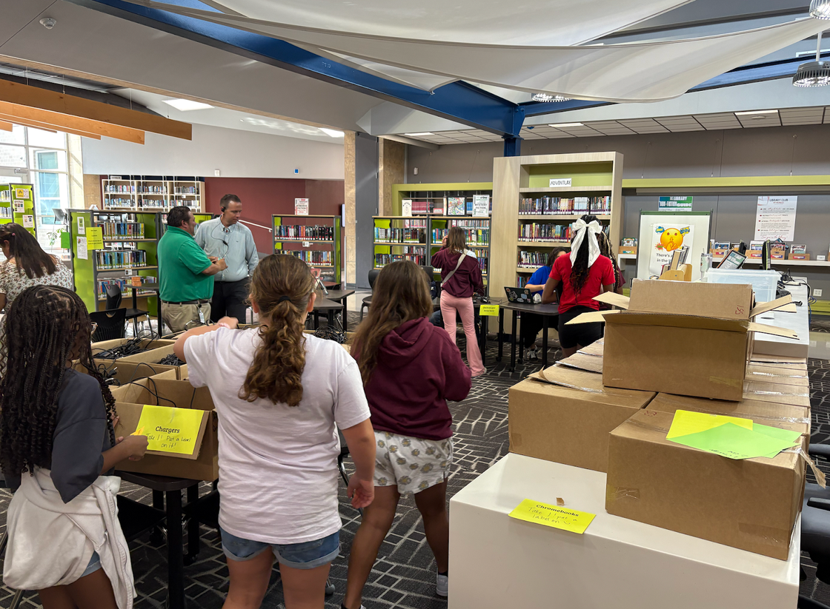
1:1 Journey
  August 2024- 1:1 Pilot at 2 campuses
  Spring 2025- deployed 5 more campuses
  August 2025- deployed the remaining 8 campuses

Slide 4

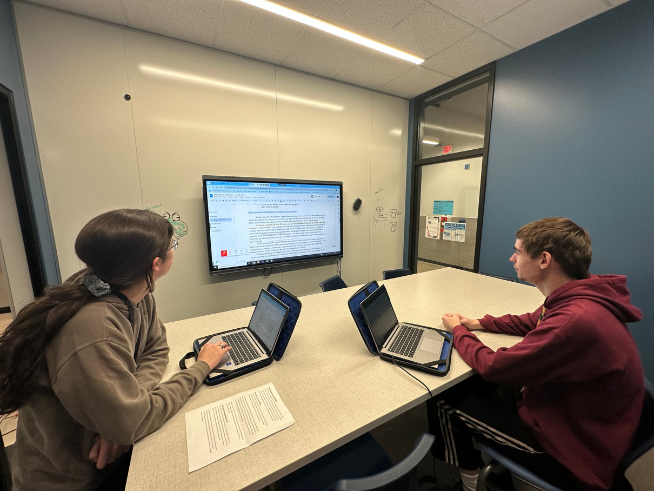
Student Access
Increase in digital resources and student engagment
Secondary students reported they were using devices for tasks beyond school work.
Secondary teachers reported an increase in completed work

Slide 5
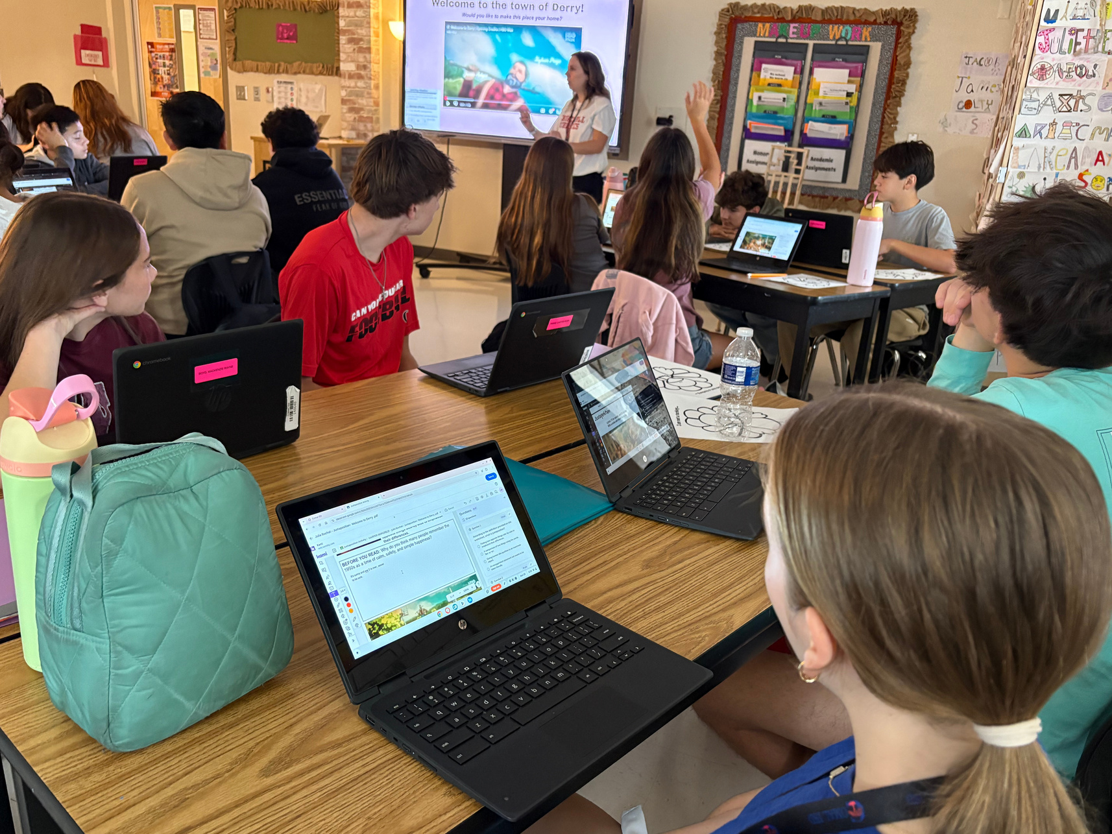
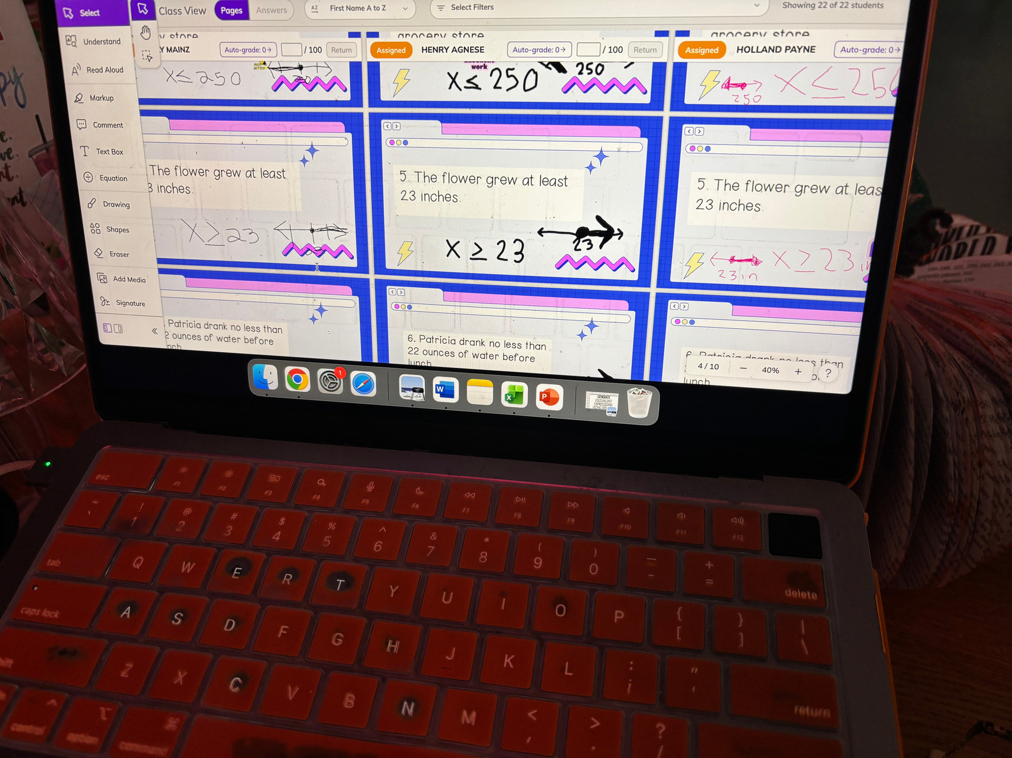
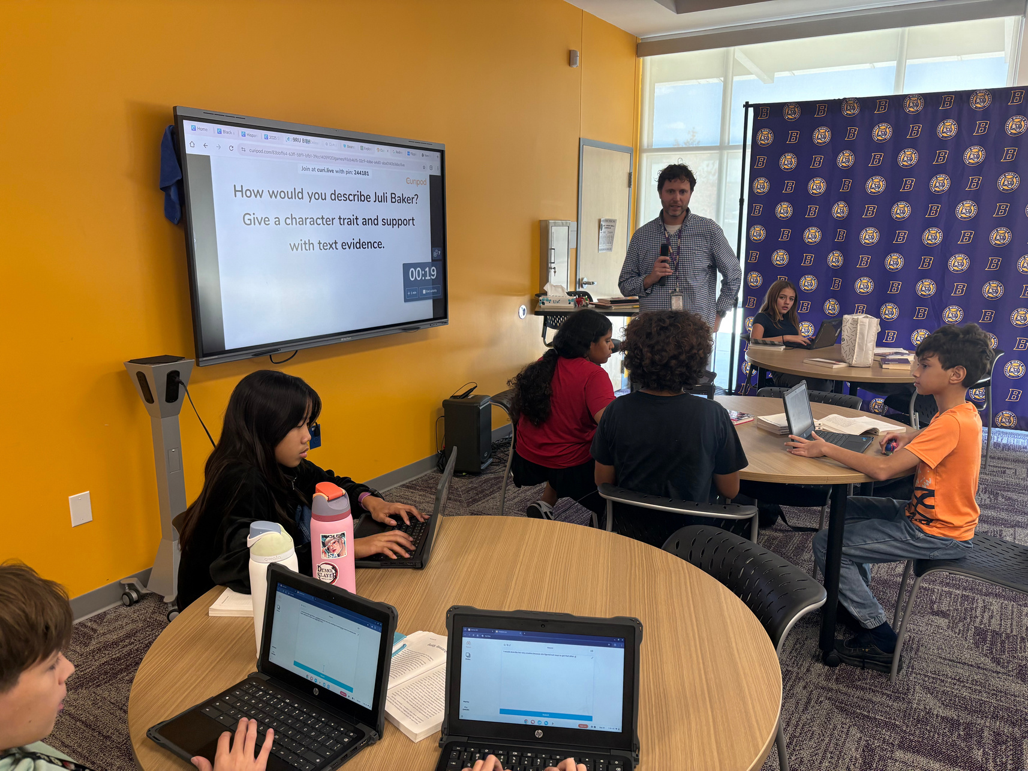

Slide 6
What are the biggest challenges with going 1:1?

Slide 7

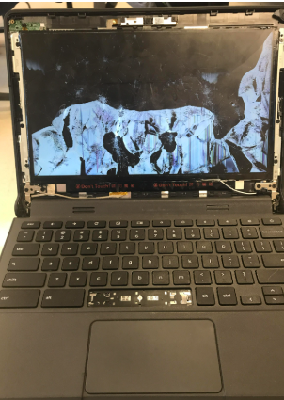
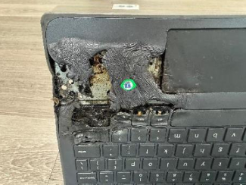

Intentional Damge, Oh my!

Slide 8

Where is MY device?
  Accidental device swaps.
    Student to Student
    Student to Classroom
  Labeling devices and chargers is a game changer.
Student Name
Grade
Id #

Slide 9



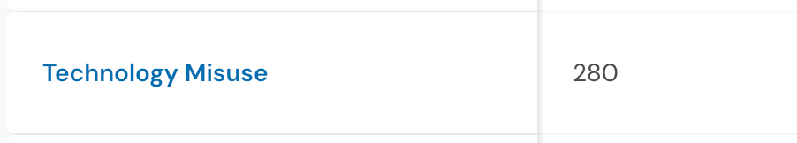
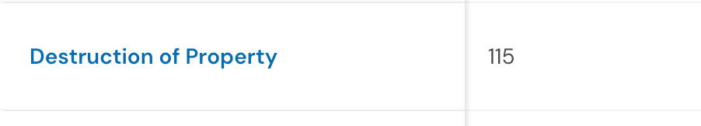
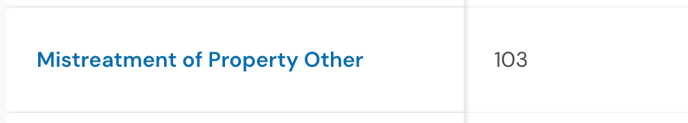
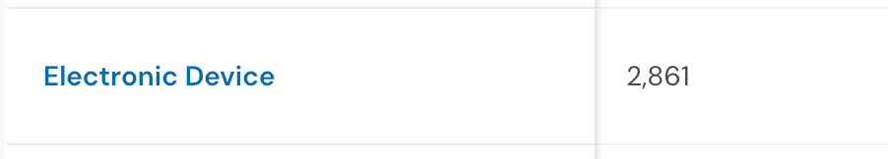
Behavoir Data

Slide 10
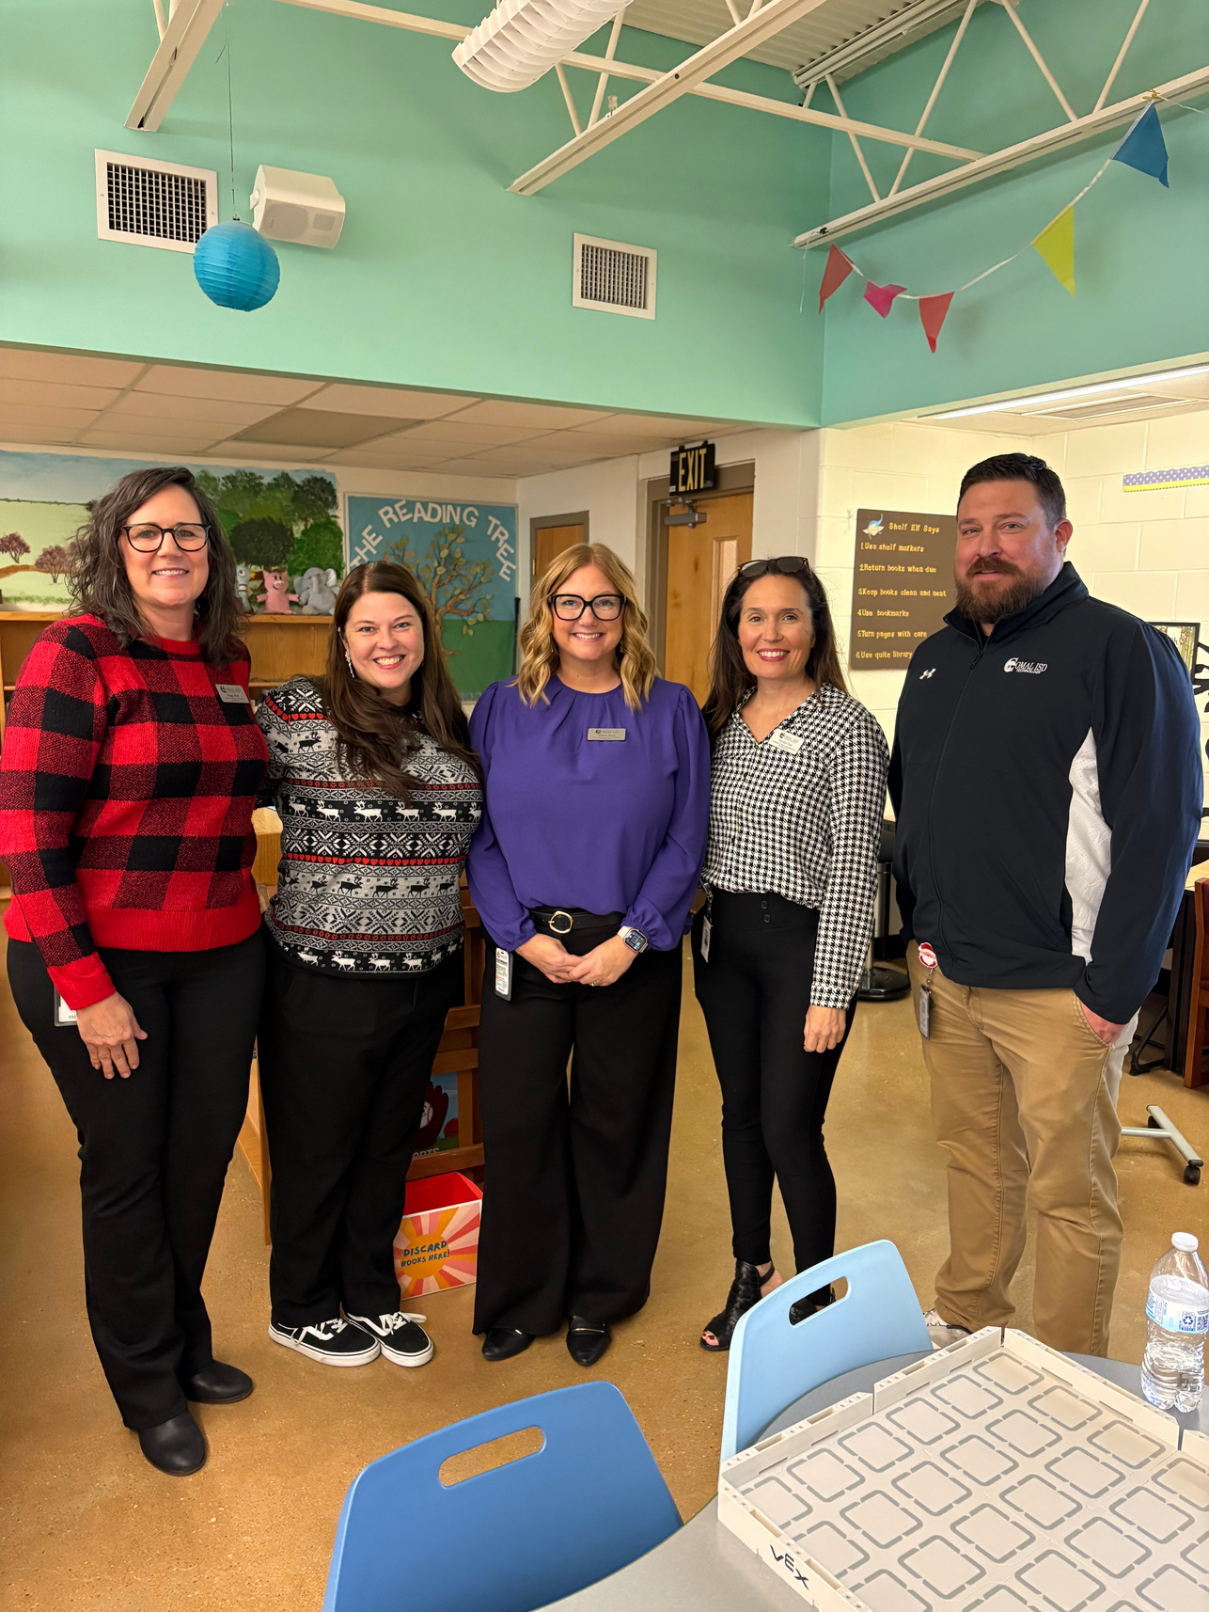
Digital Learning could not do this alone.

Slide 11
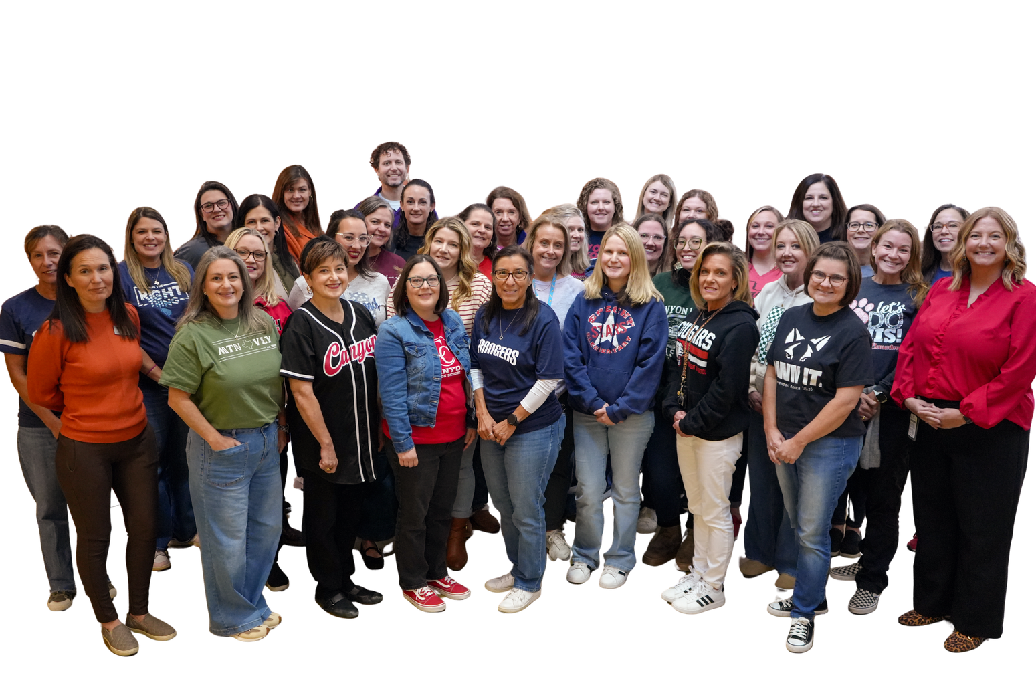

Digital Citizenship

Slide 12


MTSS
Teachers are not explicitly teaching device expectations.
Assumptions that students know how use to technology ethically.
Students are not aware of consequences for misuse and damage.
Classrooms lacked structure around device use.

Slide 13
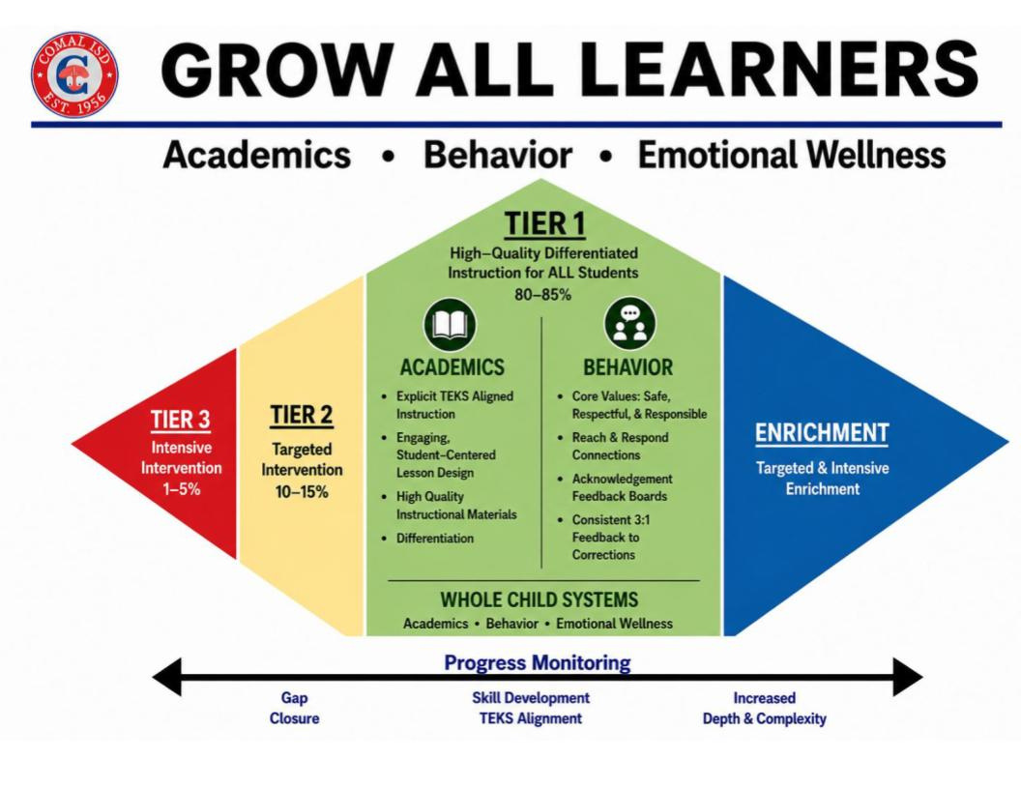

Slide 14

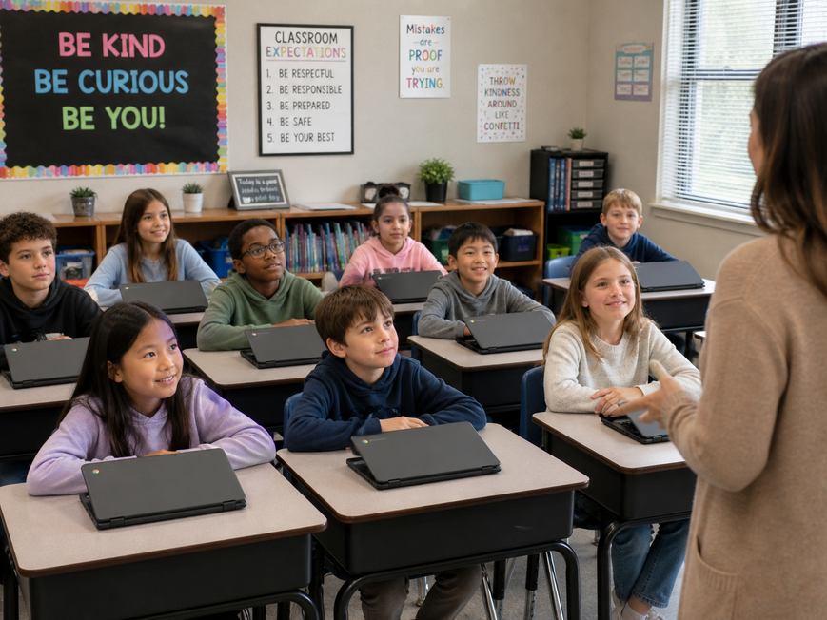
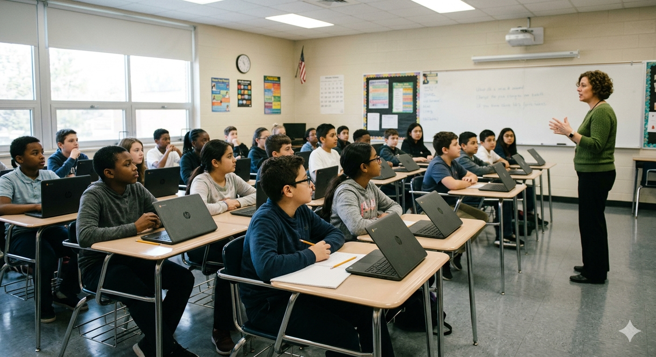
District Wide Attention Signal
“Lids Low, Eyes Up.”

Slide 15
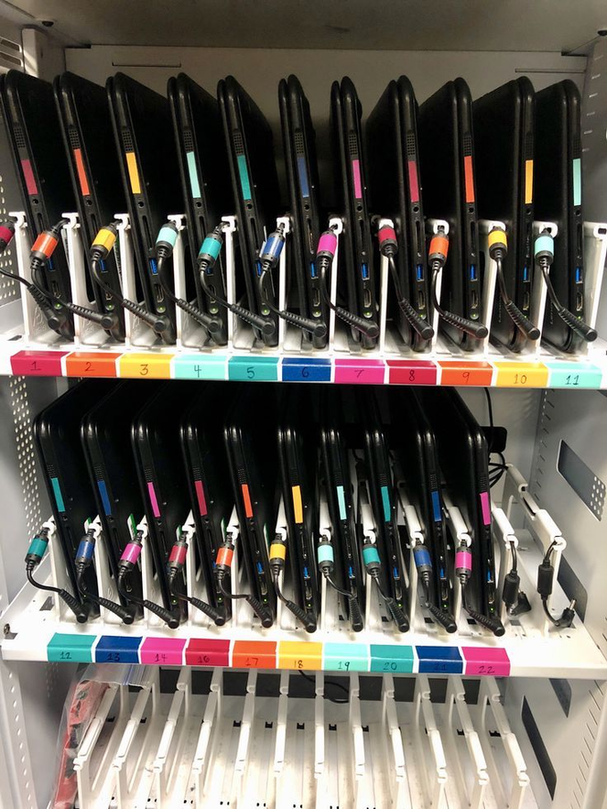
Elementary
Classroom Device Best Practice:
Elementary students need to be assigned and use the same device year round to build consistent routines, ownership, and responsibility.

Slide 16

With my device, I will:
Safe
  Keep my passwords private
  Never leave logged-in device unattended
  Handle my device carefully
  Only visit sites that are school appropriate
Respectful
  Follow my teachers expectations for device use
  Use kind, school-appropriate words on all devices
  Stay on assigned task
  Keep device clean
  Charge my device every day
  Report damage right away
Responsible

Slide 17

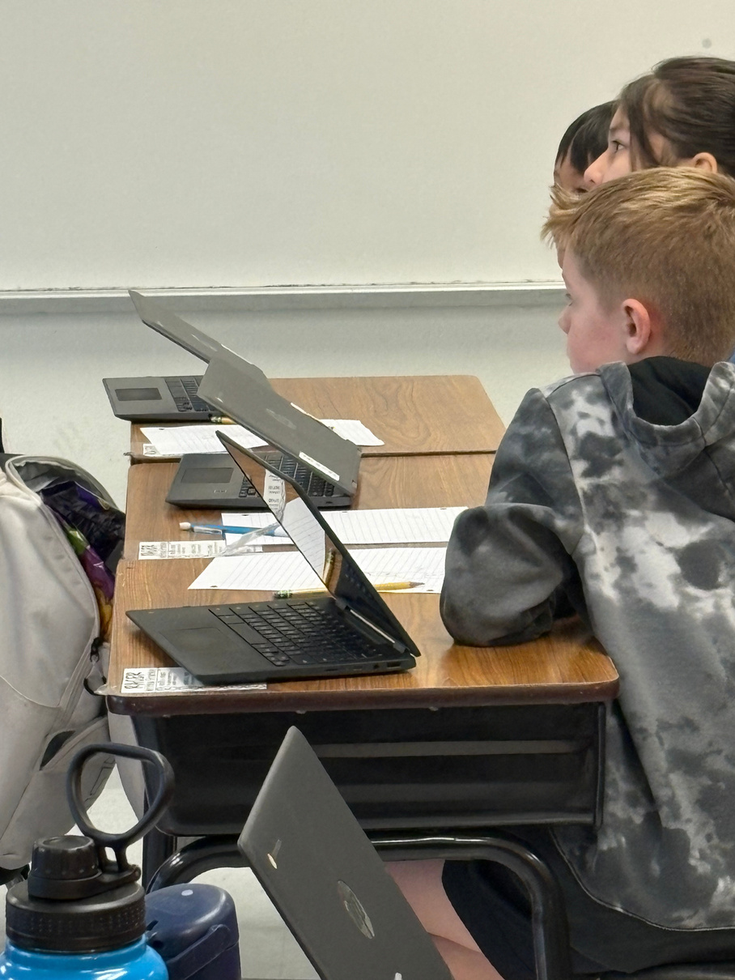
Elementary
“Shark Bite”: Teacher signals “Shark Bite” and students go into “lids low, eyes up.”
“Shark Attack”: Teacher signals “Shark Attack,” students go into “lids low, eyes up” and turn their screen towards the teacher.

Slide 18
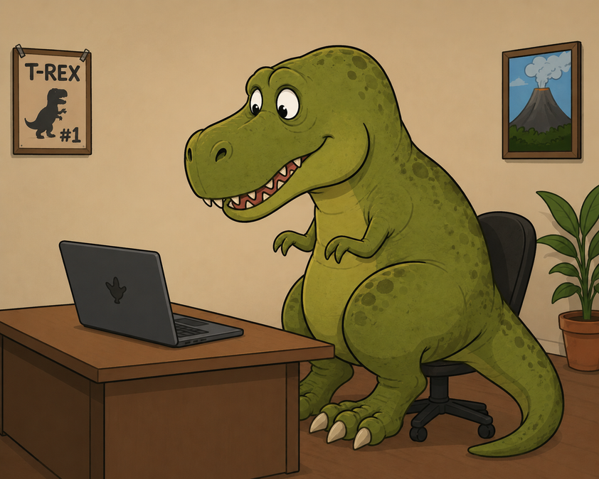
Elementary
"Clap it and Lap it": Teacher claps a rhythm, students clap back and then place hands in their laps, ensuring hands are off keyboards.
"T-Rex Arms": Students put their hands in the air with "T-Rex arms" to show they are not touching keyboards.

Slide 19
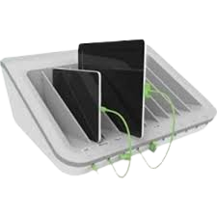
Secondary
Classroom Device Best Practice:
Secondary students who need to access a spare device from the classroom charging station must notify the teacher verbally or with a sign out system.

Slide 20
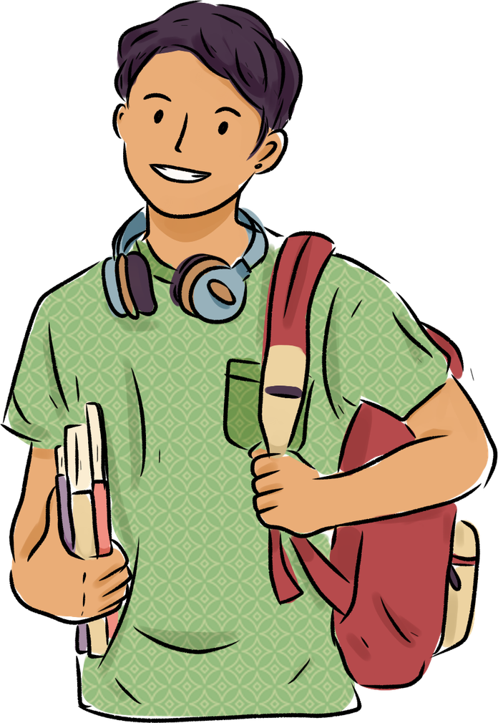
With my device, I will:
Safe
  Keep my passwords private
  Never leave logged-in device unattended
  Handle my device carefully
  Only visit sites that are school appropriate
Respectful
  Follow my teachers expectations for device use
  Use kind, school-appropriate words on all devices
  Stay on assigned task
  Keep device clean
  Bring my charged device every day
  Report damage right away
Responsible

Slide 21
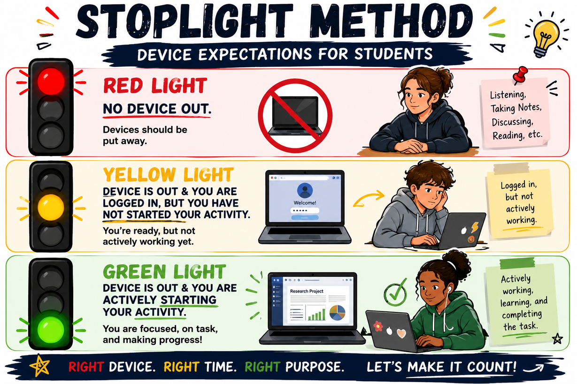
Secondary
Develop a practice of setting the expectation as soon as they enter the classroom.

Slide 22

Behavoir Data

Slide 23

Student Services
Support
  Consequences should follow the student code of conduct.

Slide 24
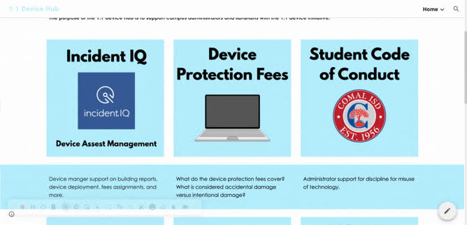

Slide 25
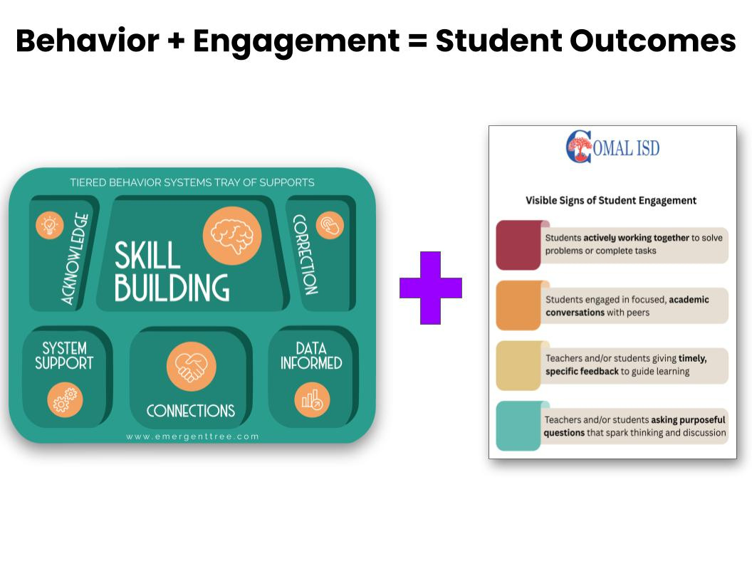
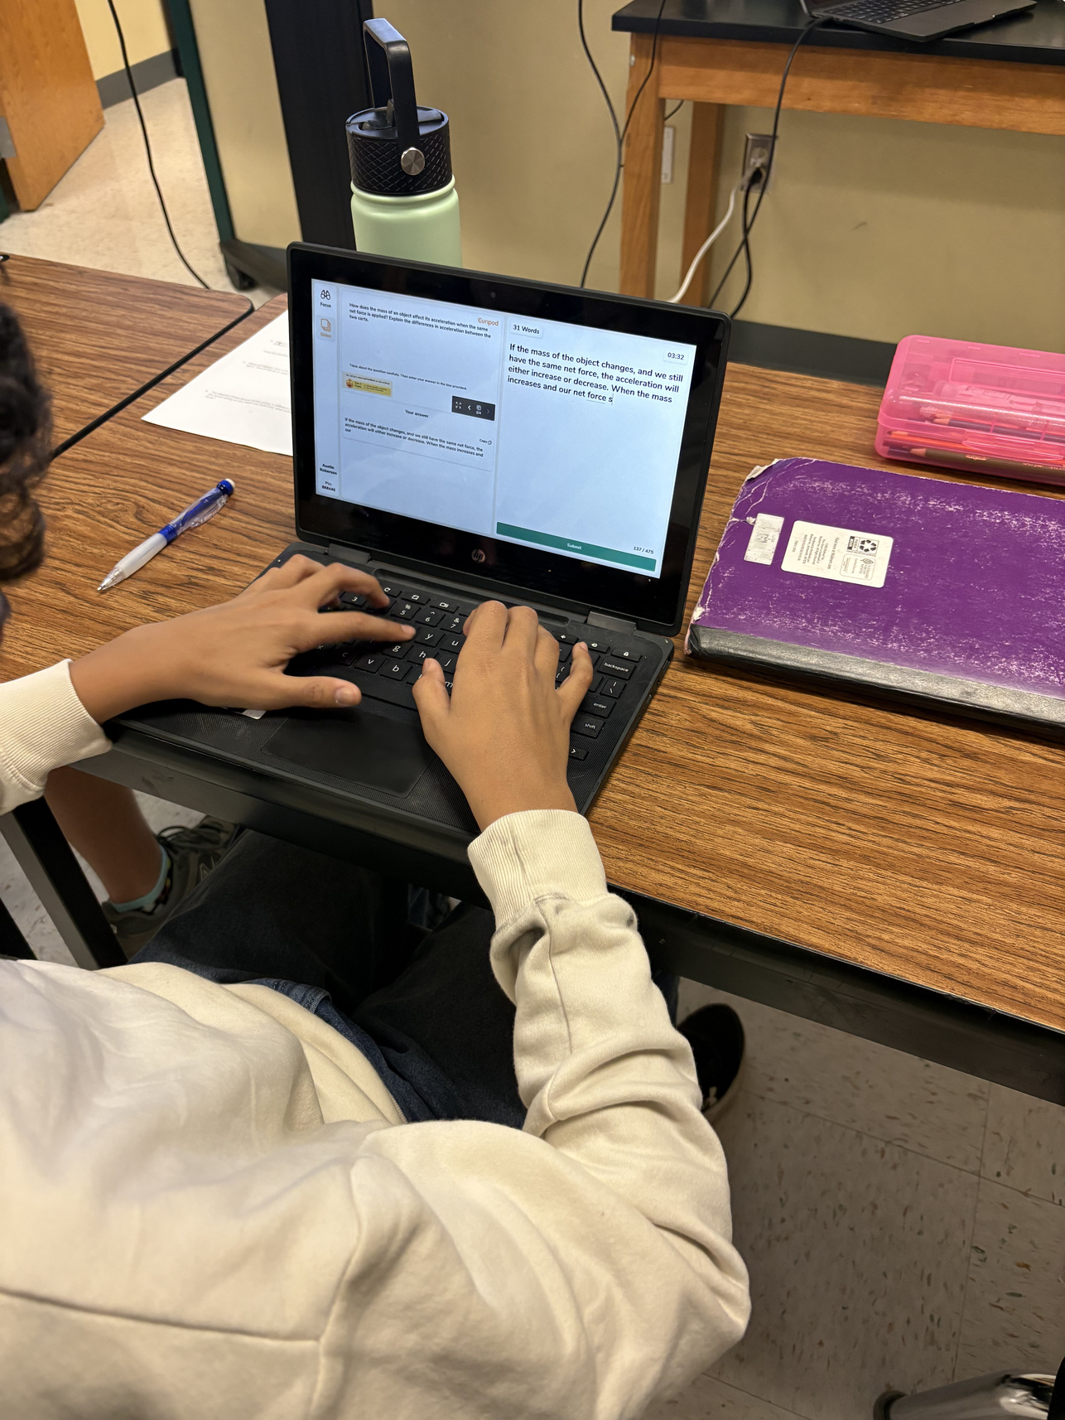

Slide 26
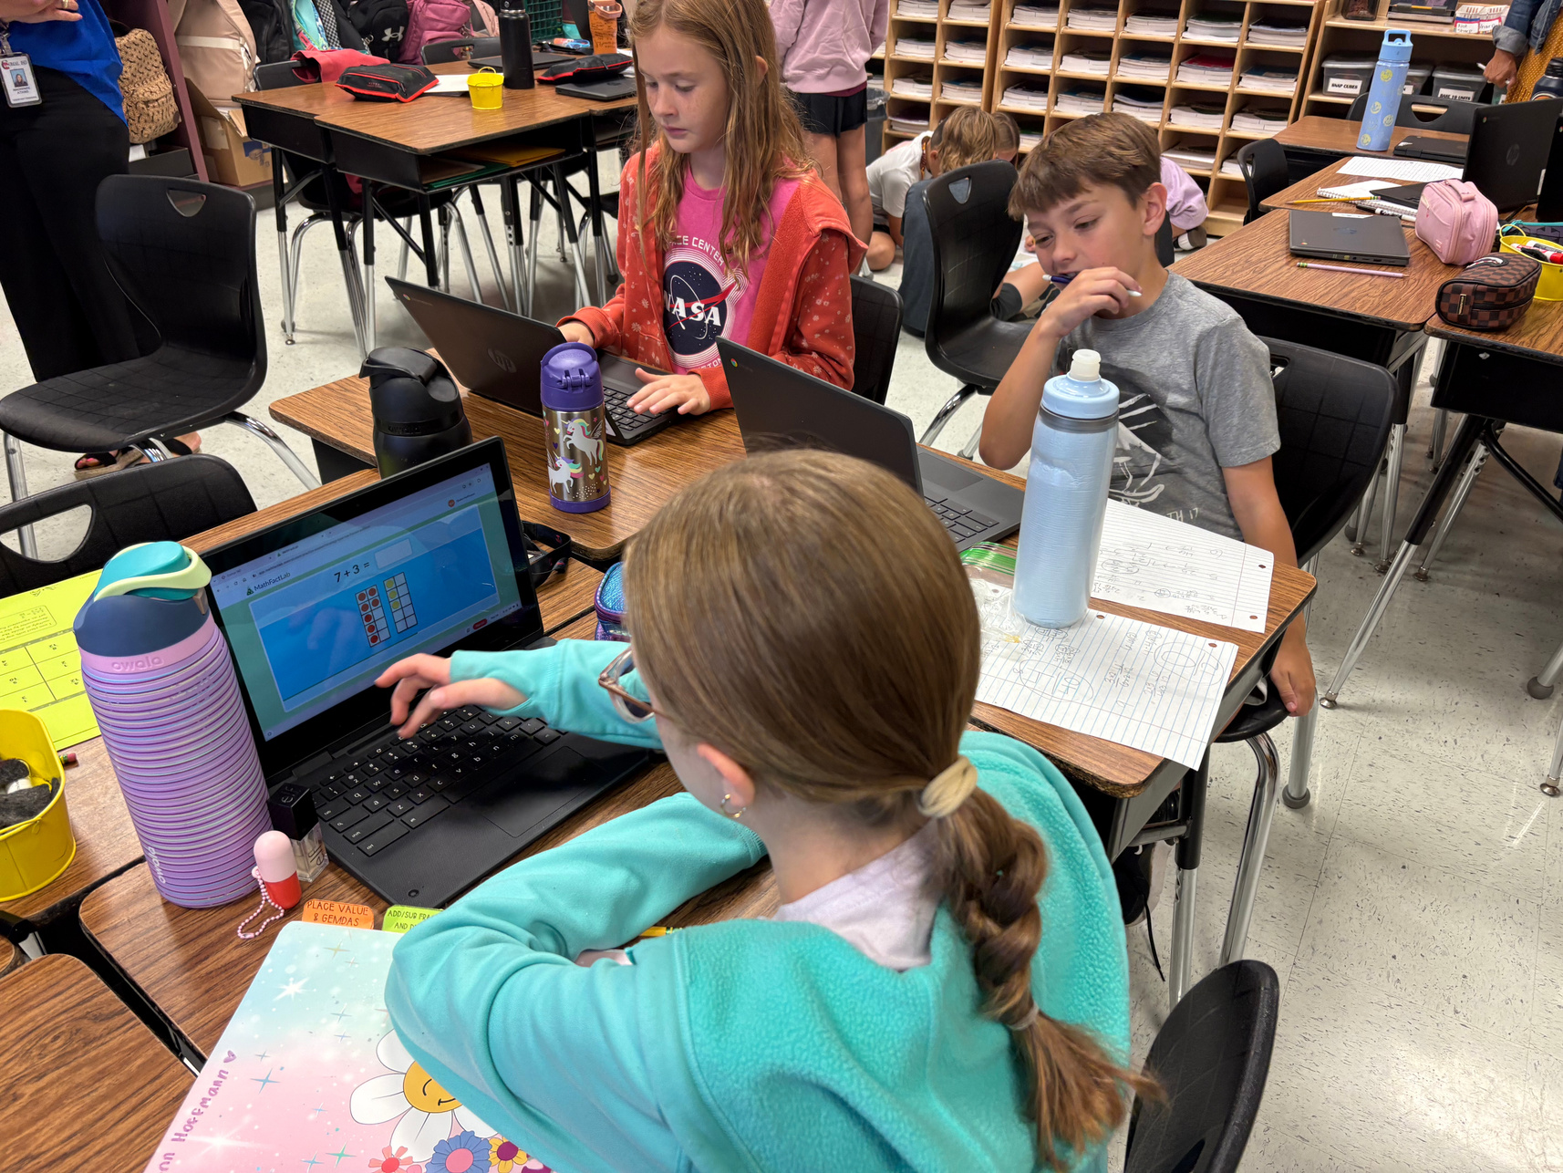
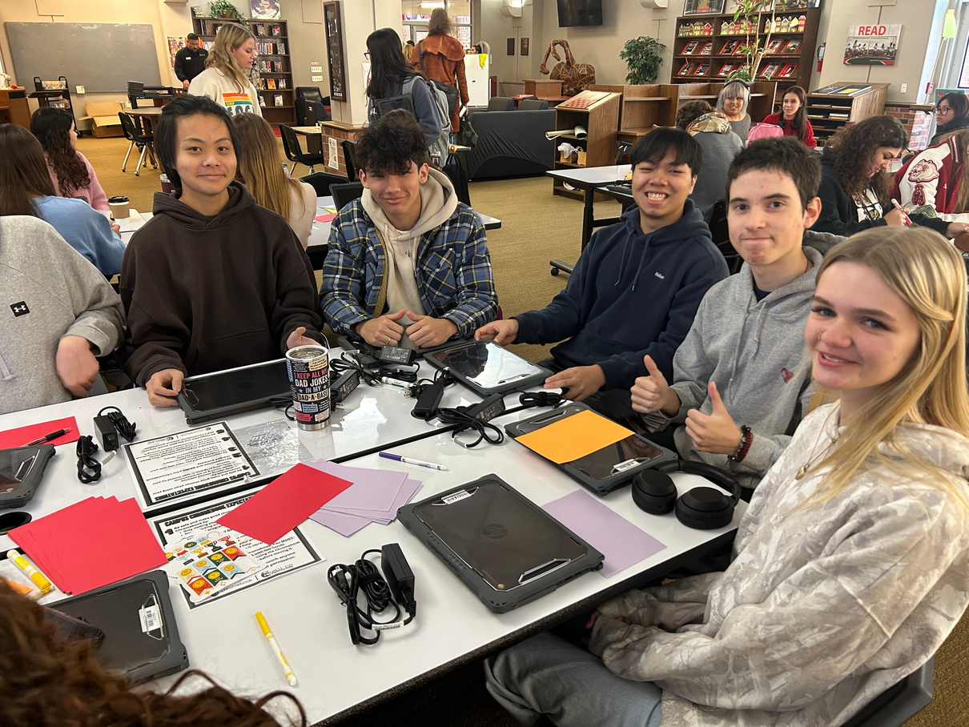

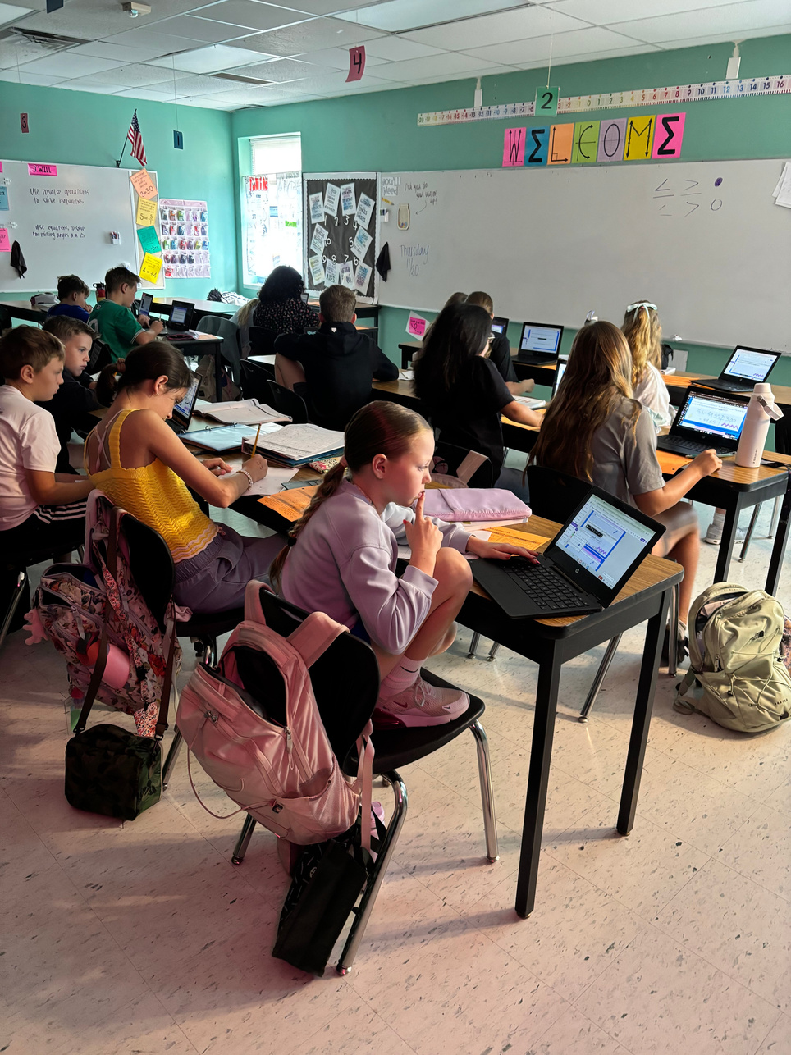
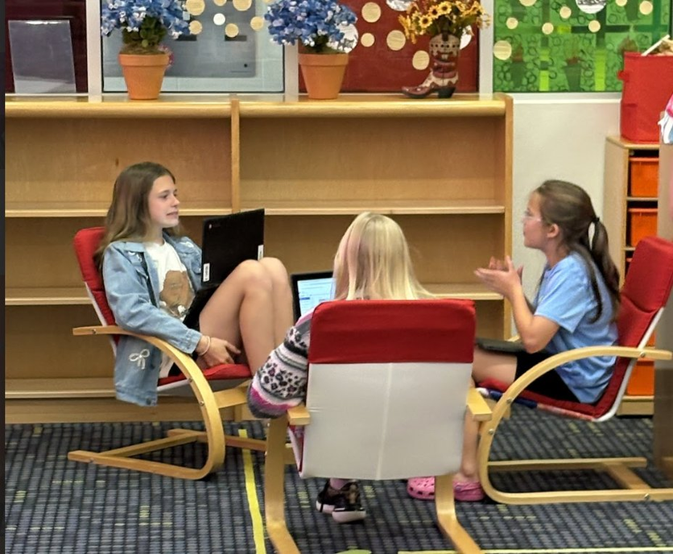


Slide 27
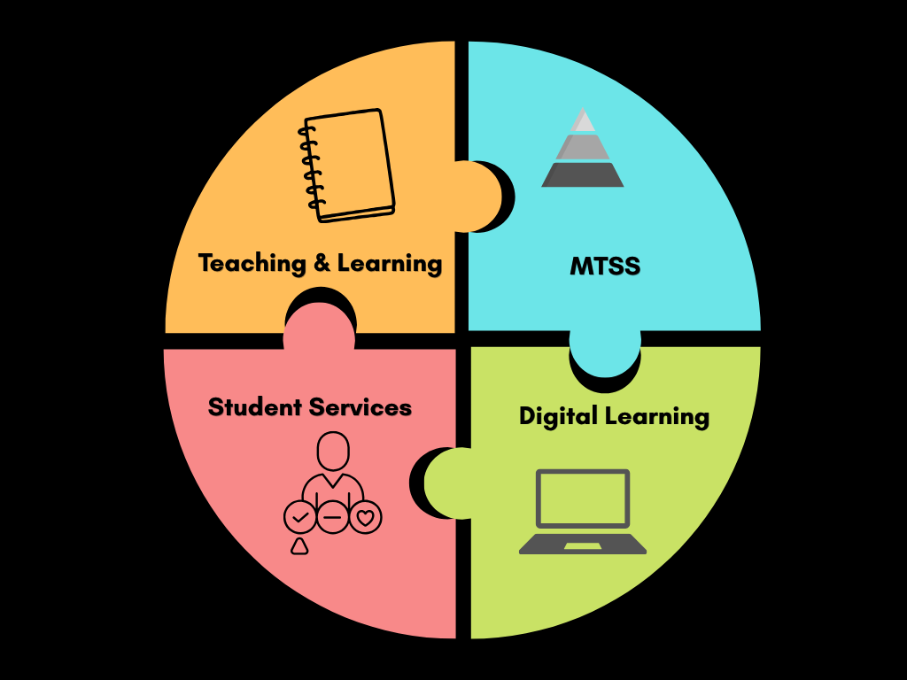

Slide 28


Questions?
Follow us:
@comaldl

