Slide 1


Legislative Stuff
You Should Know
USBE Student Data Privacy Team
UETN Tech Summit 2026
Nicole Sanchez
(a.k.a. “Josh”)
Katy Challis
(a.k.a. “Chuck”)

Slide 2
Today’s Agenda
Legislative Session Key Resources
Discussion of Privacy-Relevant Bills
  HB 55: Privacy Compliance for Educational Technology Vendors
  SB 267: Software in Education Amendments
  Cybersecurity Bills
    HB 44: School Security Personnel Standards
    S.B. 123 Privacy and Cybersecurity Amendments
Conclusion

Slide 3




Meet the USBE Data Privacy Team!
Our Key Roles
Support for Parents and Families
Collaboration with LEAs
Training & Empowering Education Professionals
Compliance Oversight
Conducting Investigations
Katy Challis
Director of Privacy
Nichole Clark
Administrative Assistant
Nicole Sanchez
Student Data Privacy Specialist
Matt Winters
AI Specialist
Jeremy Zabriskie
Data Privacy and Security Specialist
Melissa Preziosi
Data Privacy and Governance
LEAs
Technical Assistance
USBE

Slide 4
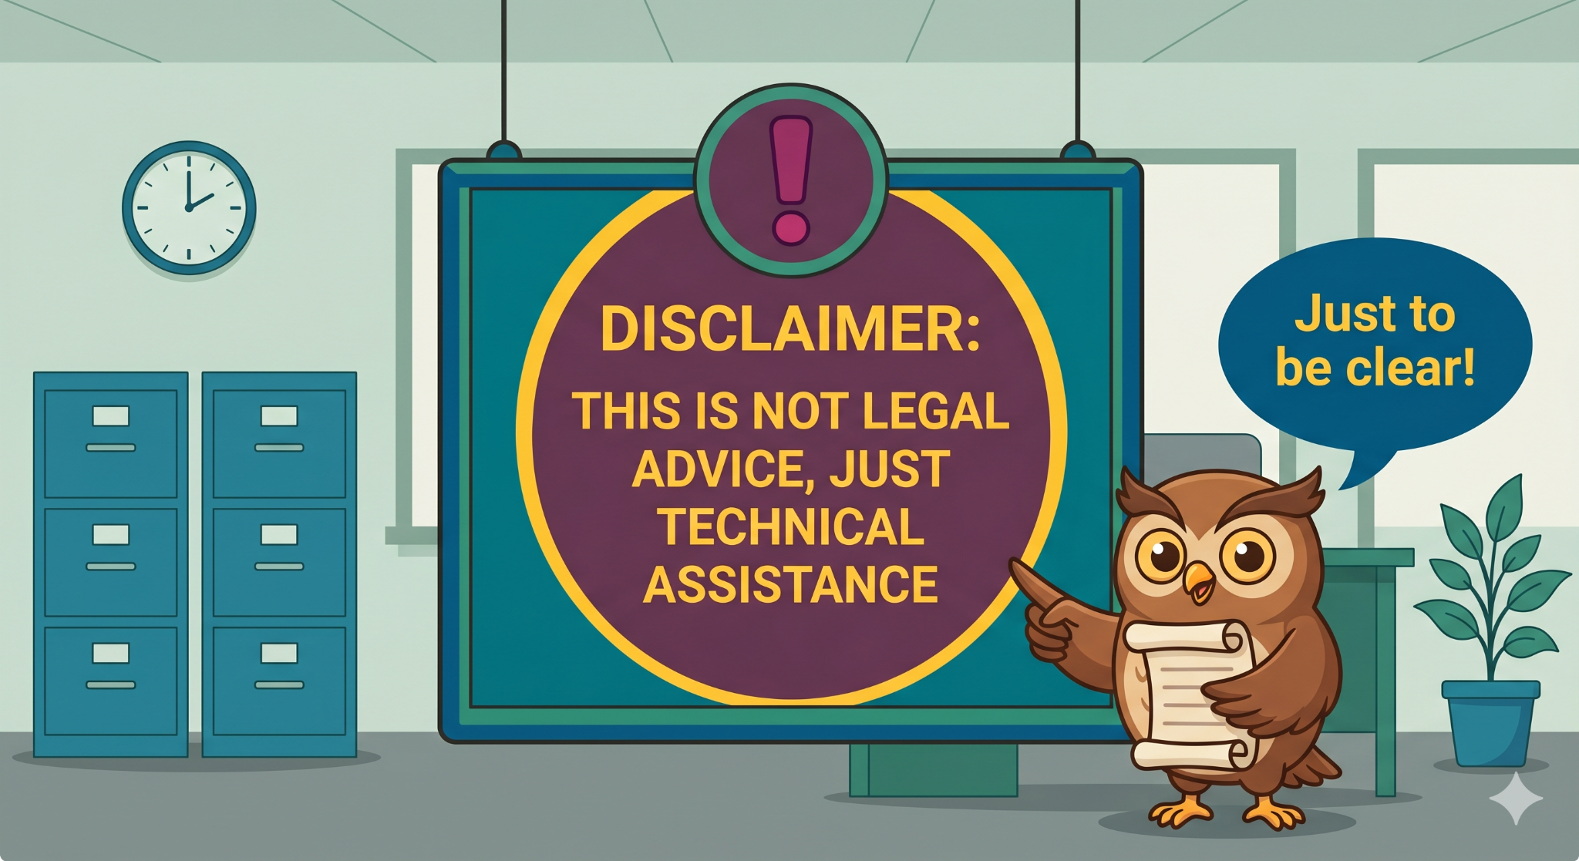

Slide 5
January-March
April-June
July and on
Utah’s Legislative Session
Preparation
Implementation
At just 45 days, Utah’s legislative session is short and moves fast.
USBE prepares and publishes its “bill book;” staff studies passed bills to determine how they will be implemented.
Most bills are effective by July 1.

Slide 6

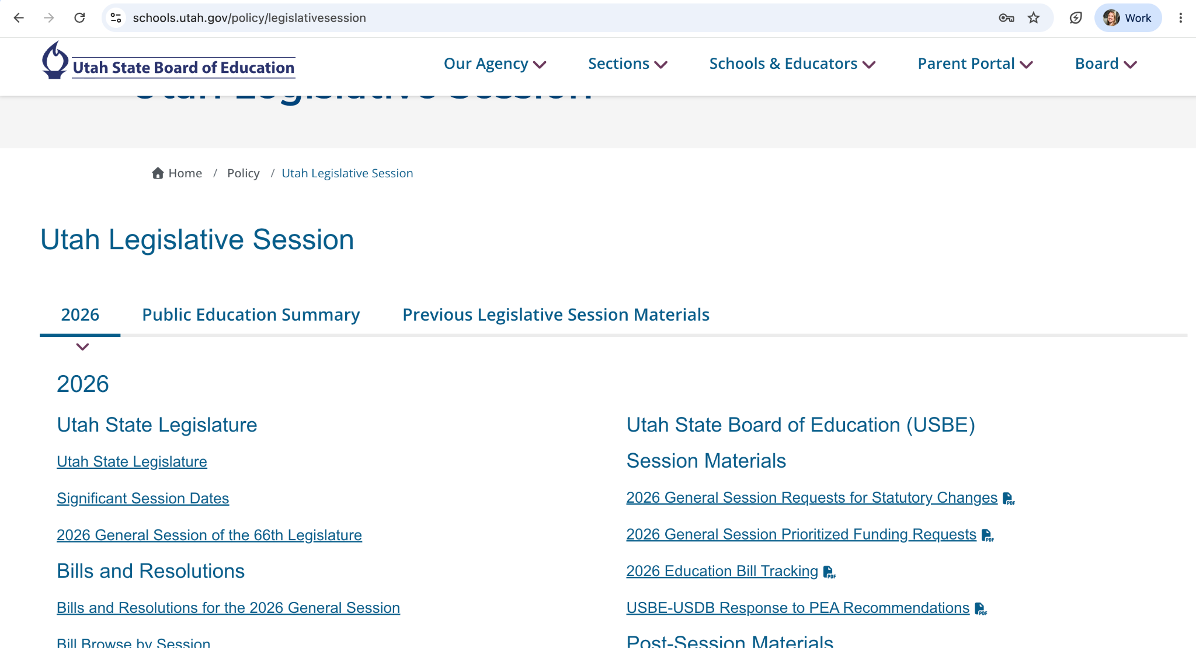
Helpful Resources
USBE’S Legislative Session Page
Most helpful during the session, but does contain interesting resources afterward
A document that lists the most impactful bills and what they mean for your LEA.
USBE’s “Bill Book”

Slide 7
Privacy Bills

Slide 8
HB 55: Privacy Compliance for Educational Technology Vendors
USBE
–Ensure contracts include necessary provisions
–Create a policy and reporting process
–Create resources for vendors
Summary
–Adds a new requirement for a contract provision
–Requires government entities to terminate contracts with vendors that fail to resolve privacy violations within 30 days
–Requires USBE to create a process for receiving and responding to reports of violations
LEA
–Ensure contracts include necessary provisions
–Provide notice of violation and duty to terminate
–Terminate contracts that are not remedied

Slide 9

Details
Previously true:
Before student data can be shared with a third party, certain contract provisions must be in place
Added with HB 55:
Contracts must include:
Provisions describing the education entity’s duty to terminate a contract in case of a privacy violation
Provisions prohibiting fees or financial liability in case of termination

Slide 10
Privacy Violation and Contract Termination Process

Slide 11
You must wait at least 30 days before you terminate the contract to allow the contractor to remedy the violation
30 Days
The contract can be maintained
The contractor remedies the violation AND makes effort to prevent reoccurance
The entity must notify the contractor of:
–the violation
–their duty to terminate the contract
An education or government agency discovers a violation
The contract must be terminated
The contractor cannot impose a fee, seek damages, or impose financial liability if the contract is terminated as a result of a violation
The contractor does not remedy the violation OR make efforts to prevent reoccurance
30 Days
You have 30 days from the discovery of a violation to notify the contractor

Slide 12
Reporting Process
Step 1
Step 2
Step 3
A person submits a report of a suspected violation to the data privacy team
The data privacy team conducts an initial investigation to determine whether the report is:
Credible
Relevant
Sufficiently specific to warrant action
If the report meets the three requirements, the data privacy team initiates a compliance audit or investigation

Slide 13
HB 55: Privacy Compliance for Educational Technology Vendors
USBE:
Tasks in Progress
USBE:
To Do List
Create a process for:
–allowing people to submit a report of a privacy violation
–conducting “an initial review to determine whether the report is credible, relevant, and sufficiently specific to warrant action”
–conducting an “audit or investigation of the relevant third party contractor”
–Update Exhibit G of the NDPA to include “provisions describing the education entity's or government agency's statutory
duty to terminate the contract in the case of a privacy violation”
–Create resources and materials for vendors

Slide 14
SB 267: Software in Education Amendments
USBE
–Conduct the study and provide a report to the Education Interim Committee as required
–Publish guidance and best practices identified through the study on its website by July 1, 2027.
Summary
–Requires the State Board to conduct a study on the use of software and devices in public schools and to identify best practices related to student learning, safety, and privacy.
*Does NOT require a new data privacy agreement
LEA
Awareness only

Slide 15
Cybersecurity Bills

Slide 16
HB 44: School Security Personnel Standards
USBE
–See next slides
Summary
–Largely about school safety measures
–Cybersecurity portion begins on line 1419
–Details on next slides
LEA
See next slides

Slide 17


Slide 18
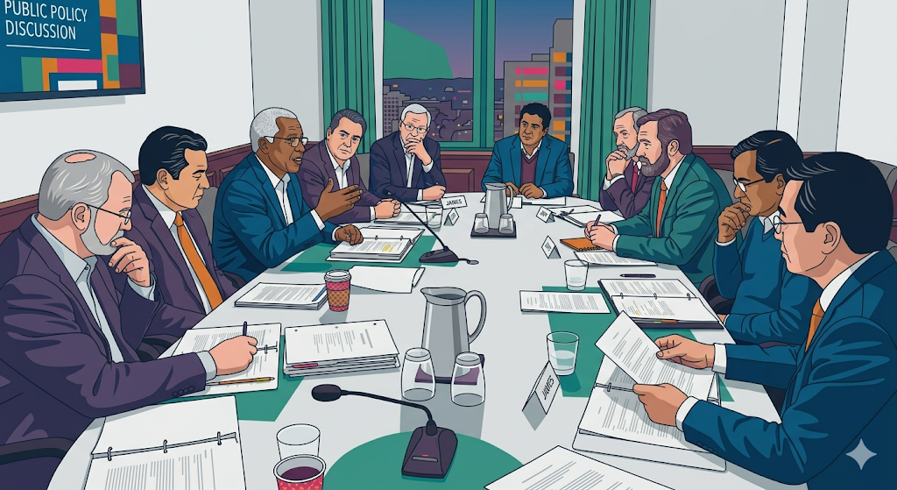
Cybersecurity Commission

Slide 19
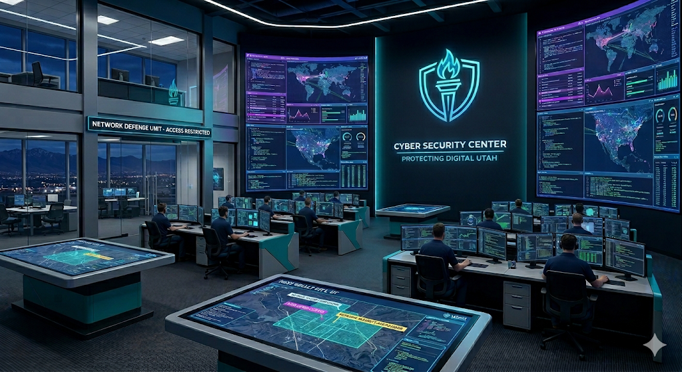
Cyber Center

Slide 20

UETN

Slide 21
USBE

Slide 22
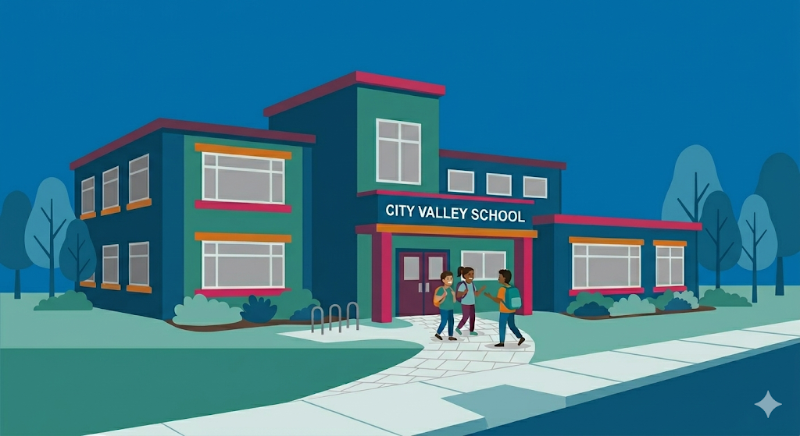
LEAs

Slide 24
Who does what?
Thing that needs to happen
Who does the thing
Cybersecurity Commission
Cyber Center
UETN
USBE
LEAs
Establish minimum cybersecurity standards for LEAs
Cybersecurity Commission
Develop a phased implementation timeline for those standards
Cybersecurity Commission
Develop implementation guidelines and technical resources to assist LEAs in meeting the standards
Cyber Center
UETN
USBE
Provide technical assistance and support to LEAs
Cyber Center
UETN
USBE

Slide 25
Who does what?
Thing that needs to happen
Who does the thing
Cybersecurity Commission
Cyber Center
UETN
USBE
LEAs
Coordinate the provision of cybersecurity services and resources to LEAs.
Cyber Center
UETN
USBE
(4)(a)The Cyber Center, the state board, and UETN shall coordinate services to LEAs
to:
(i)avoid duplication of efforts;
(ii)maximize the effectiveness of cybersecurity resources;
(iii)ensure LEAs receive consistent guidance and support; and
(iv)facilitate information sharing regarding cybersecurity threats and best practices.
(b)The coordination required under Subsection (4)(a) shall include:
(i)regular meetings among the entities to discuss LEA cybersecurity needs and
initiatives;
(ii)joint development of training materials and resources;
(iii)coordinated response to cybersecurity incidents affecting LEAs; and
(iv)alignment of cybersecurity standards and network infrastructure requirements.

Slide 26
Who does what?
Thing that needs to happen
Who does the thing
Cybersecurity Commission
Cyber Center
UETN
USBE
LEAs
Comply with the minimum cybersecurity standards
LEAs
Report data breaches to the Cyber Center
LEAs
Report data breaches to USBE within 24 hours of discovery
LEAs

Slide 27
Who does what?
Thing that needs to happen
Who does the thing
Cybersecurity Commission
Cyber Center
UETN
USBE
LEAs
Coordinate with UETN if the data breach involves network infrastructure or services provided by UETN
LEAs
Cooperate with the Cyber Center's investigation and response efforts
LEAs
Provide assistance to LEAs in responding to a data breach in the same manner they provide assistance to other governmental entities
Cyber Center

Slide 28
Who does what?
Thing that needs to happen
Who does the thing
Cybersecurity Commission
Cyber Center
UETN
USBE
LEAs
Participate in cybersecurity information sharing initiatives coordinated by the Cyber Center
LEAs
Designate a primary point of contact for cybersecurity matters
LEAs
Cooperate with statewide cybersecurity assessments and improvement initiatives
LEAs

Slide 29
S.B. 123 Privacy and Cybersecurity Amendments
USBE
–Awareness
Summary
–Expands the duties of the Utah Cyber Center to include support for LEAs
-Creates a restricted account for the Cyber Center
-Adds a representative from the Utah Education and Telehealth Network to the Cybersecurity Commission
LEA
–Awareness

Slide 30
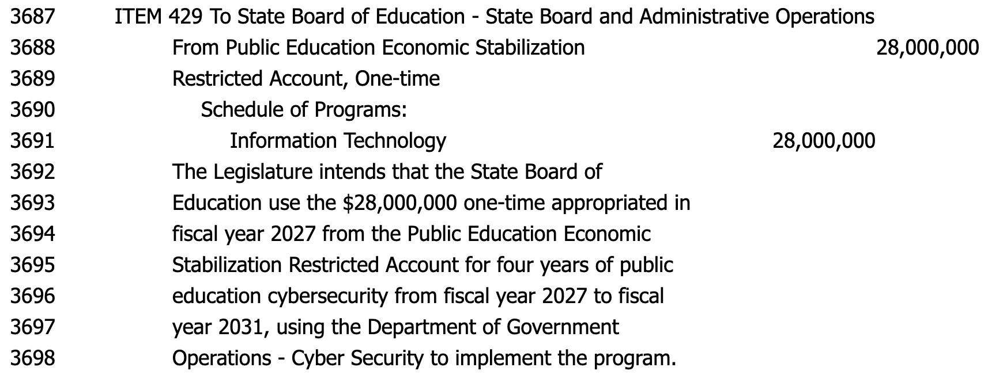
Cybersecurity Funding (H.B. 3)
We are still having conversations about how/where the funding will flow

Slide 31
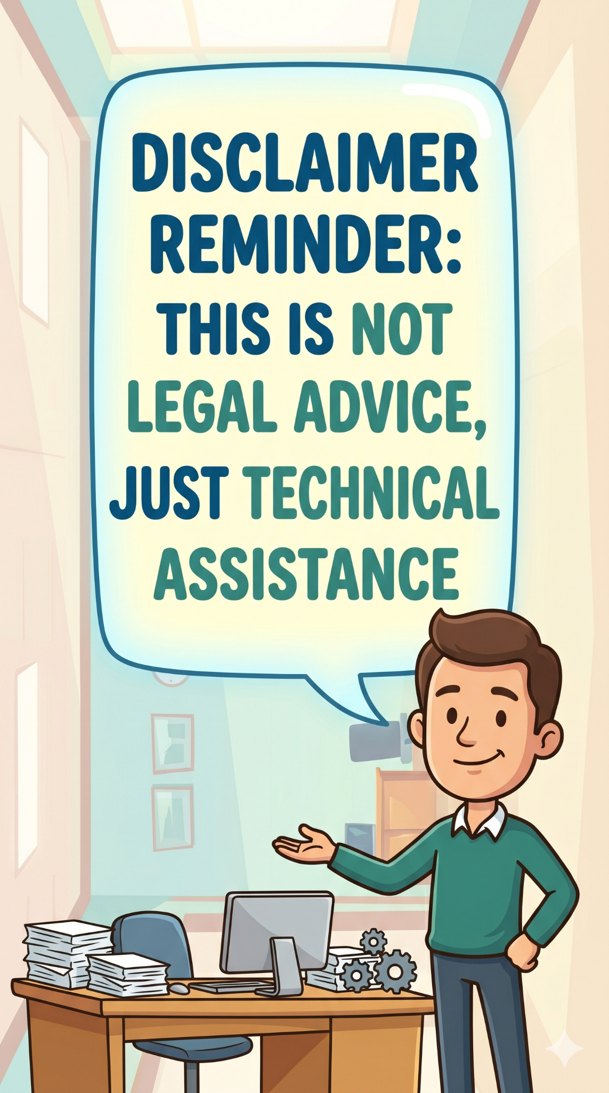
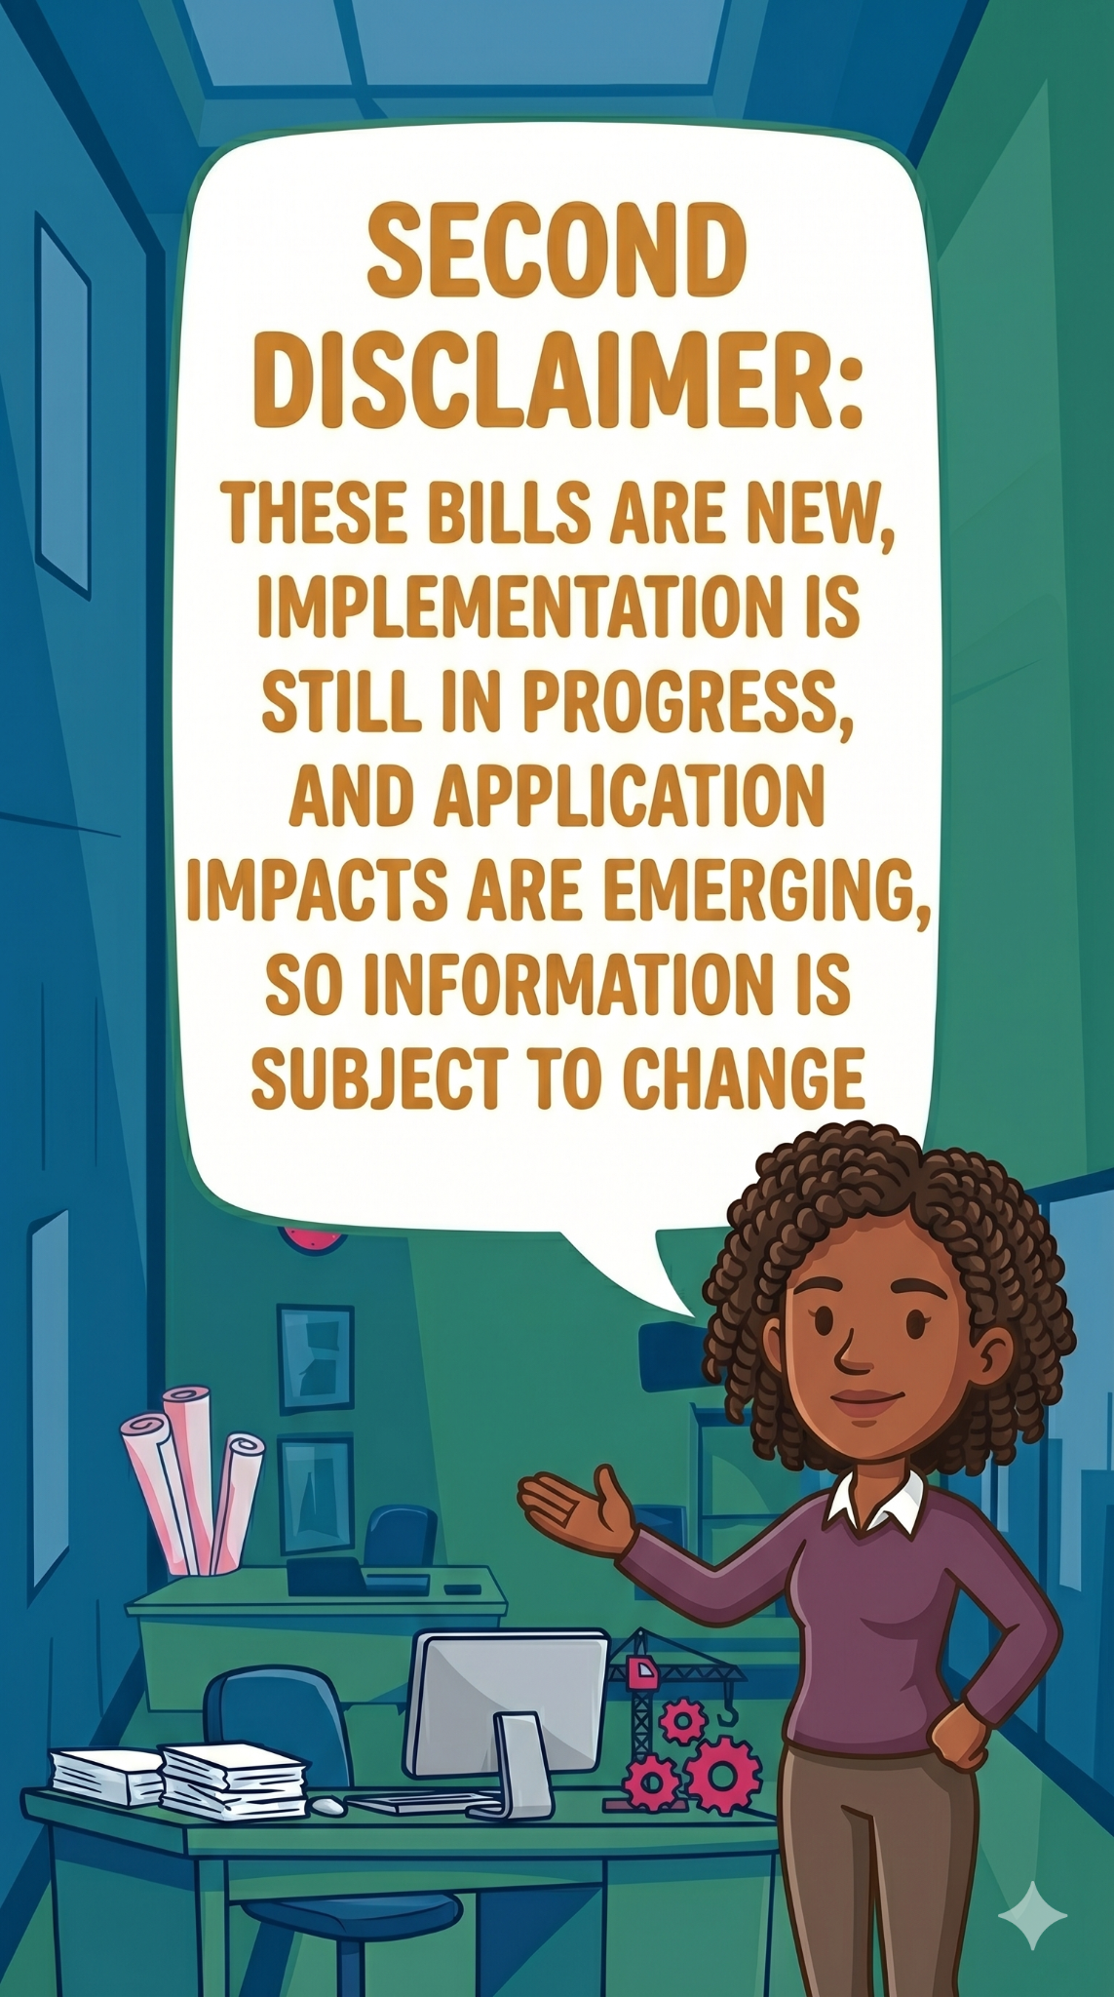


Slide 32
Questions?

Slide 33

Have more questions? Contact us!
Nicole Sanchez
Student Data
Privacy Specialist
nicole.sanchez
@schools.utah.gov

