Slide 1

Beyond the Survey
Modern Wi‑Fi Testing, Validation, and AI-Driven Network Assurance on a School Budget

Slide 2

Session Objectives
Understand modern assurance, testing tools, AI platforms, and assurance workflows.

Slide 3
The Evolution of Wi‑Fi Validation
Traditional surveys are no longer enough. User experience is the new success metric.

Slide 4
Why Networks Are Harder Today
Wi‑Fi 6E/7, cloud apps, voice/video, IoT

Slide 5
From Reactive to Proactive
Continuous validation and assurance replace reactive troubleshooting.

Slide 6
Network Assurance Lifecycle
Design → Validate → Monitor → Assure → Automate

Slide 7
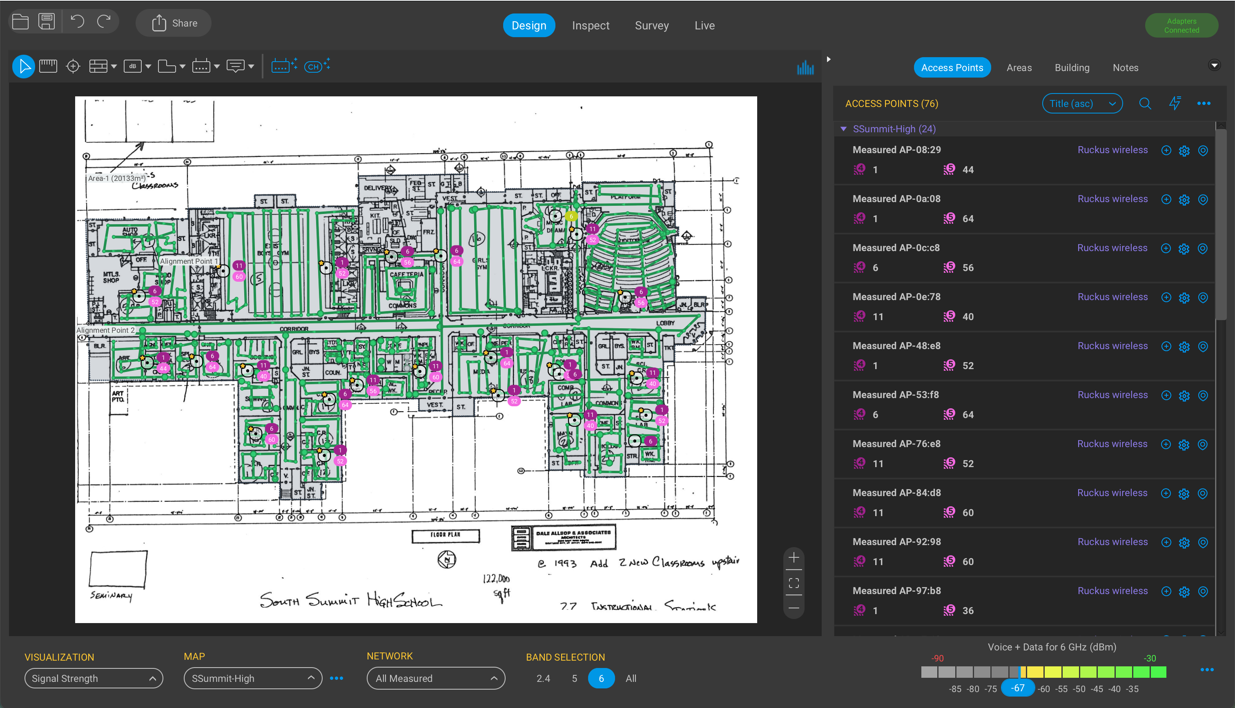

Ekahau and Speedtest.net
Predictive design, capacity planning, collaboration, and documentation.

Slide 8
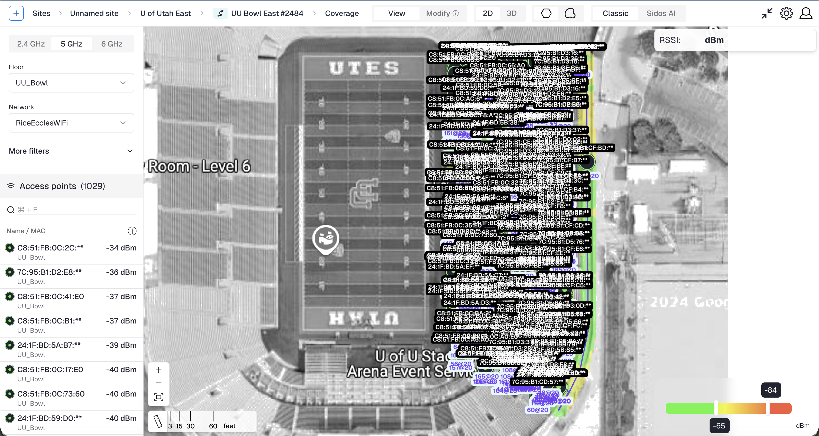
Sidos
Automated workflows, service assurance, and continuous testing.

Slide 9
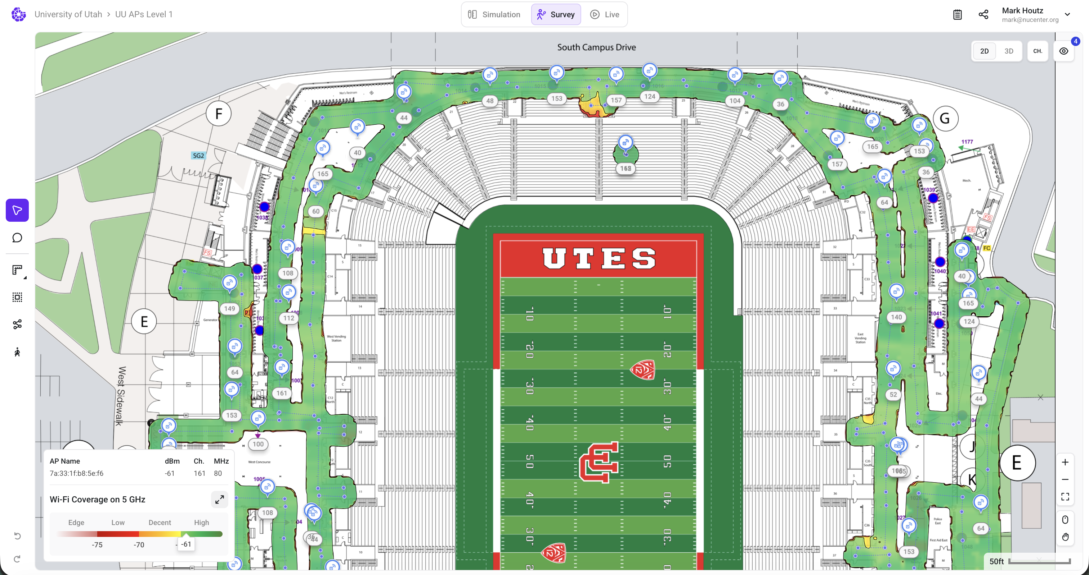
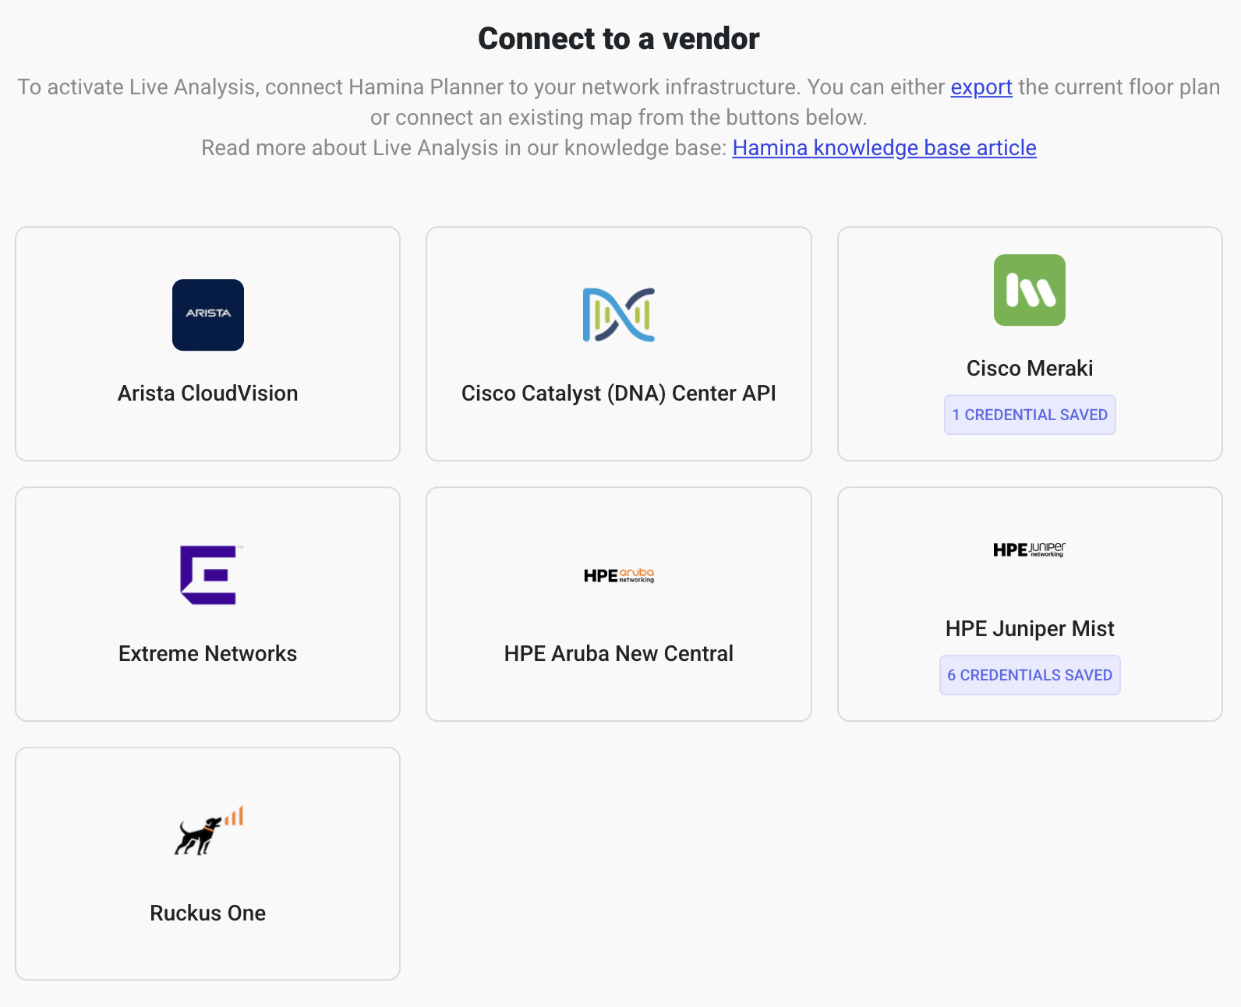
Hamina
Predictive design, capacity planning, collaboration, and documentation.

Slide 10
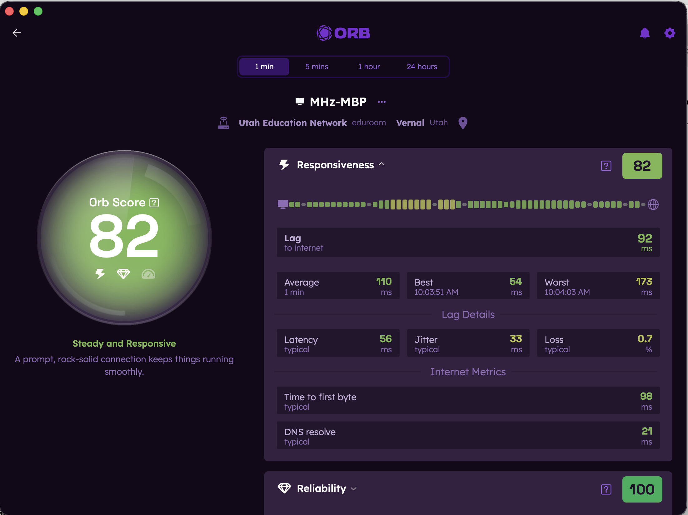
ORB.net
Synthetic testing, continuous validation, and user experience testing.

Slide 11
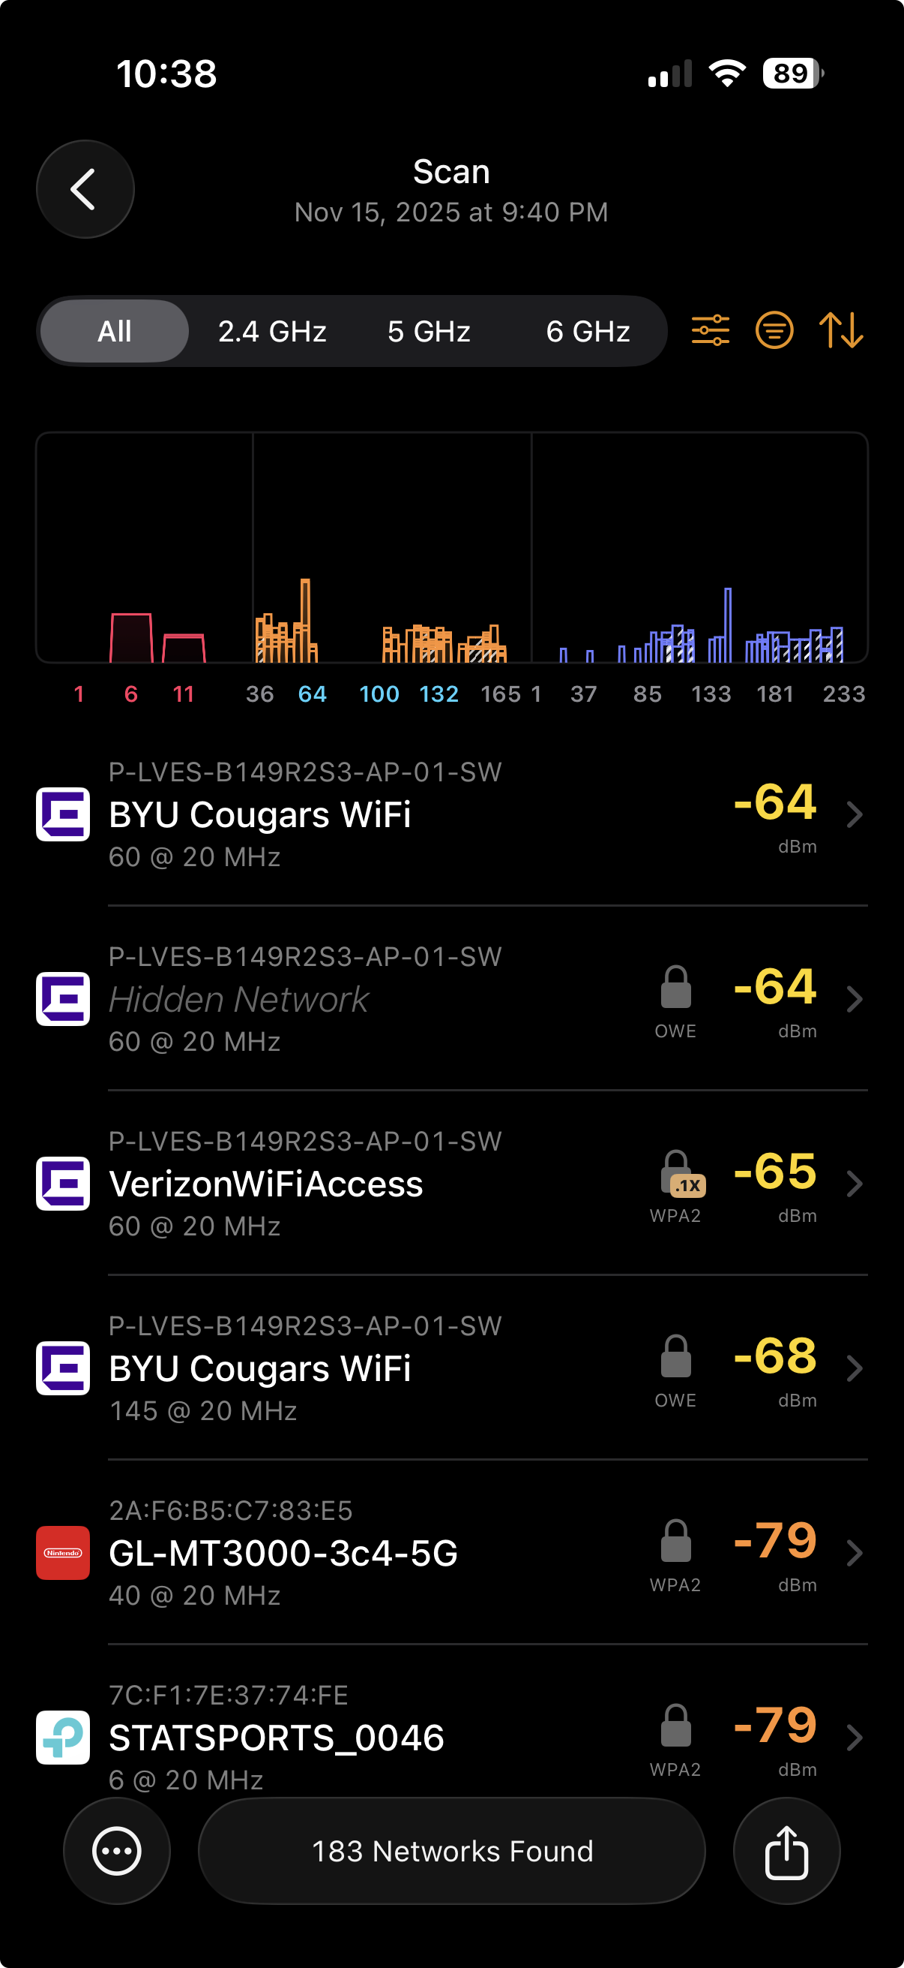
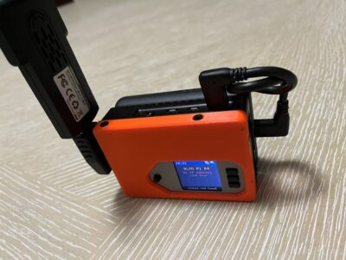
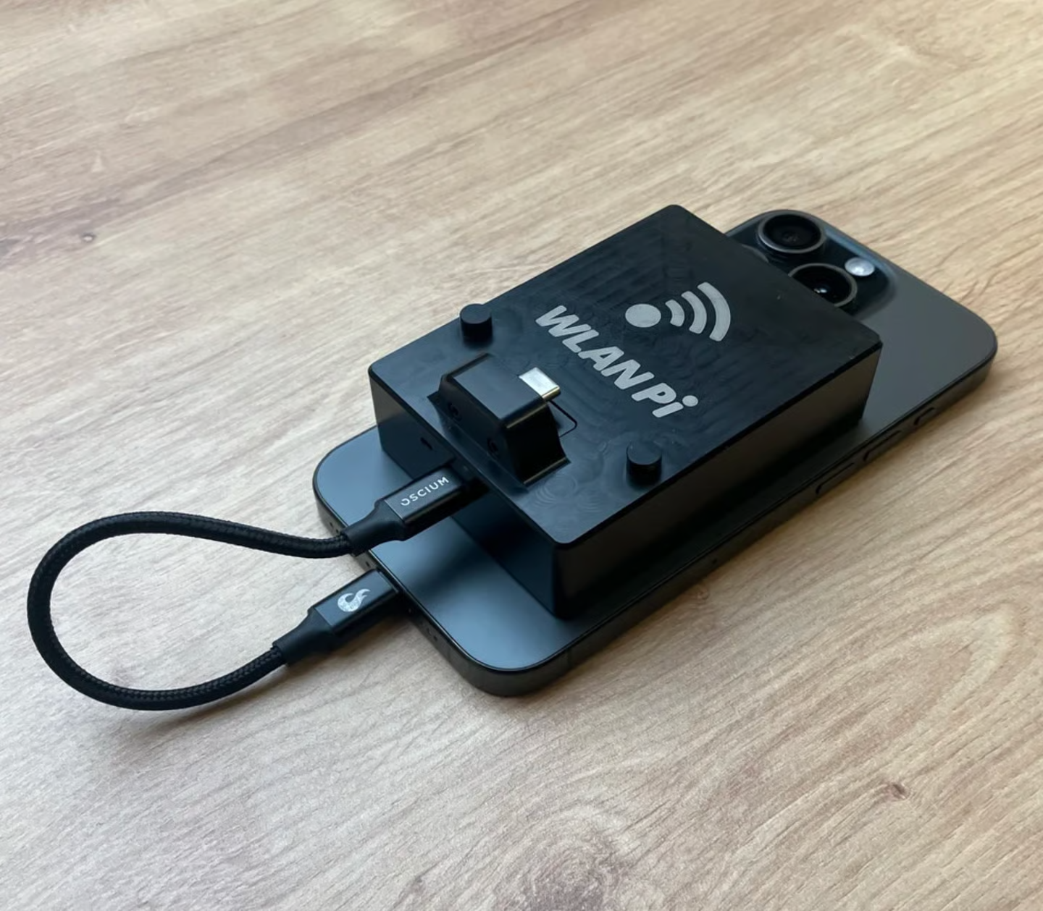
WLAN Pi
Portable engineering toolkit for validation, packet capture, and automation.

Slide 12
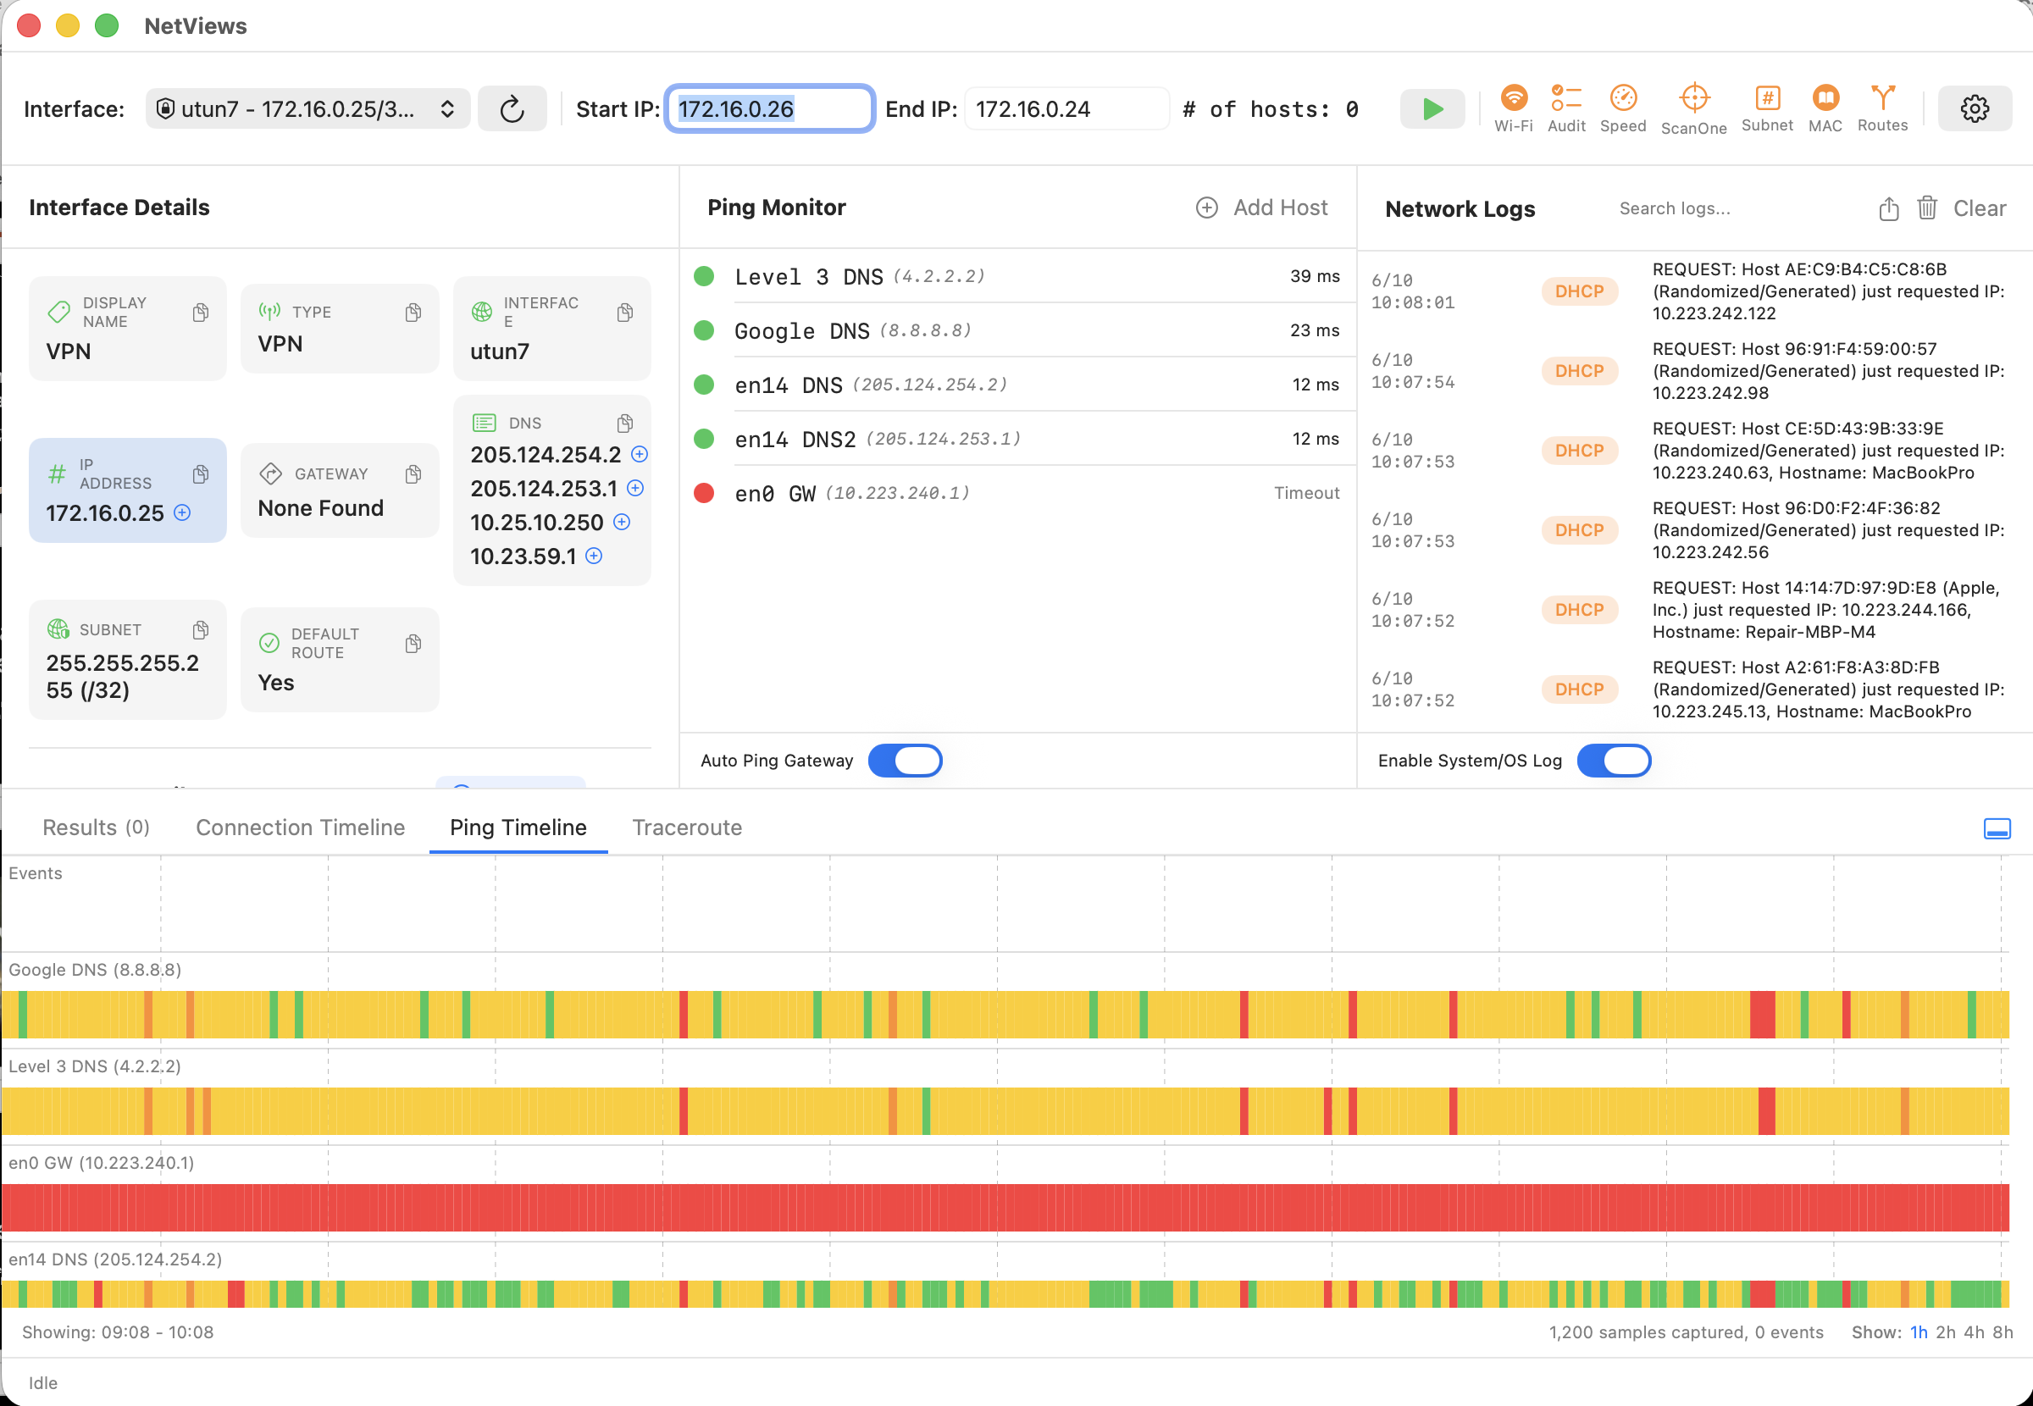
Netviews
Wired and Wireless Testing on MacOS

Slide 13
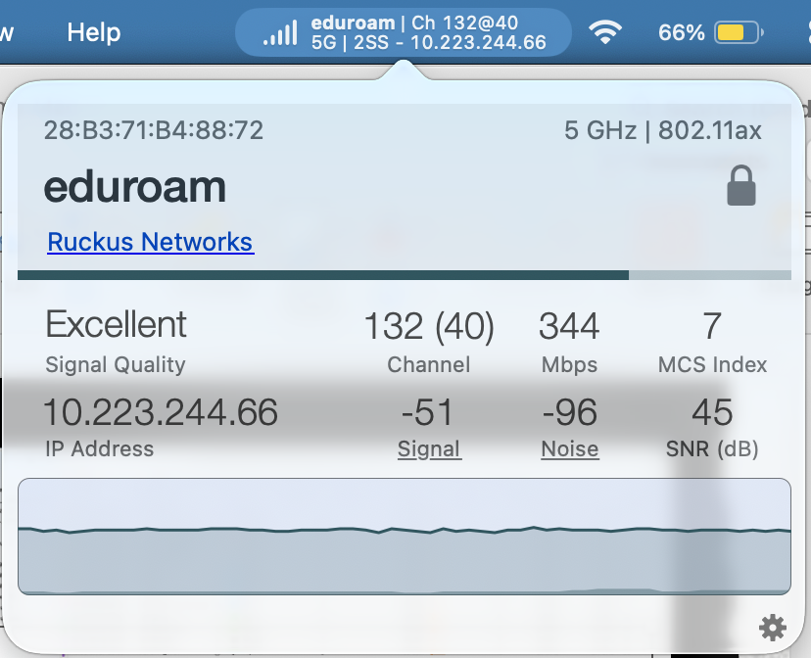
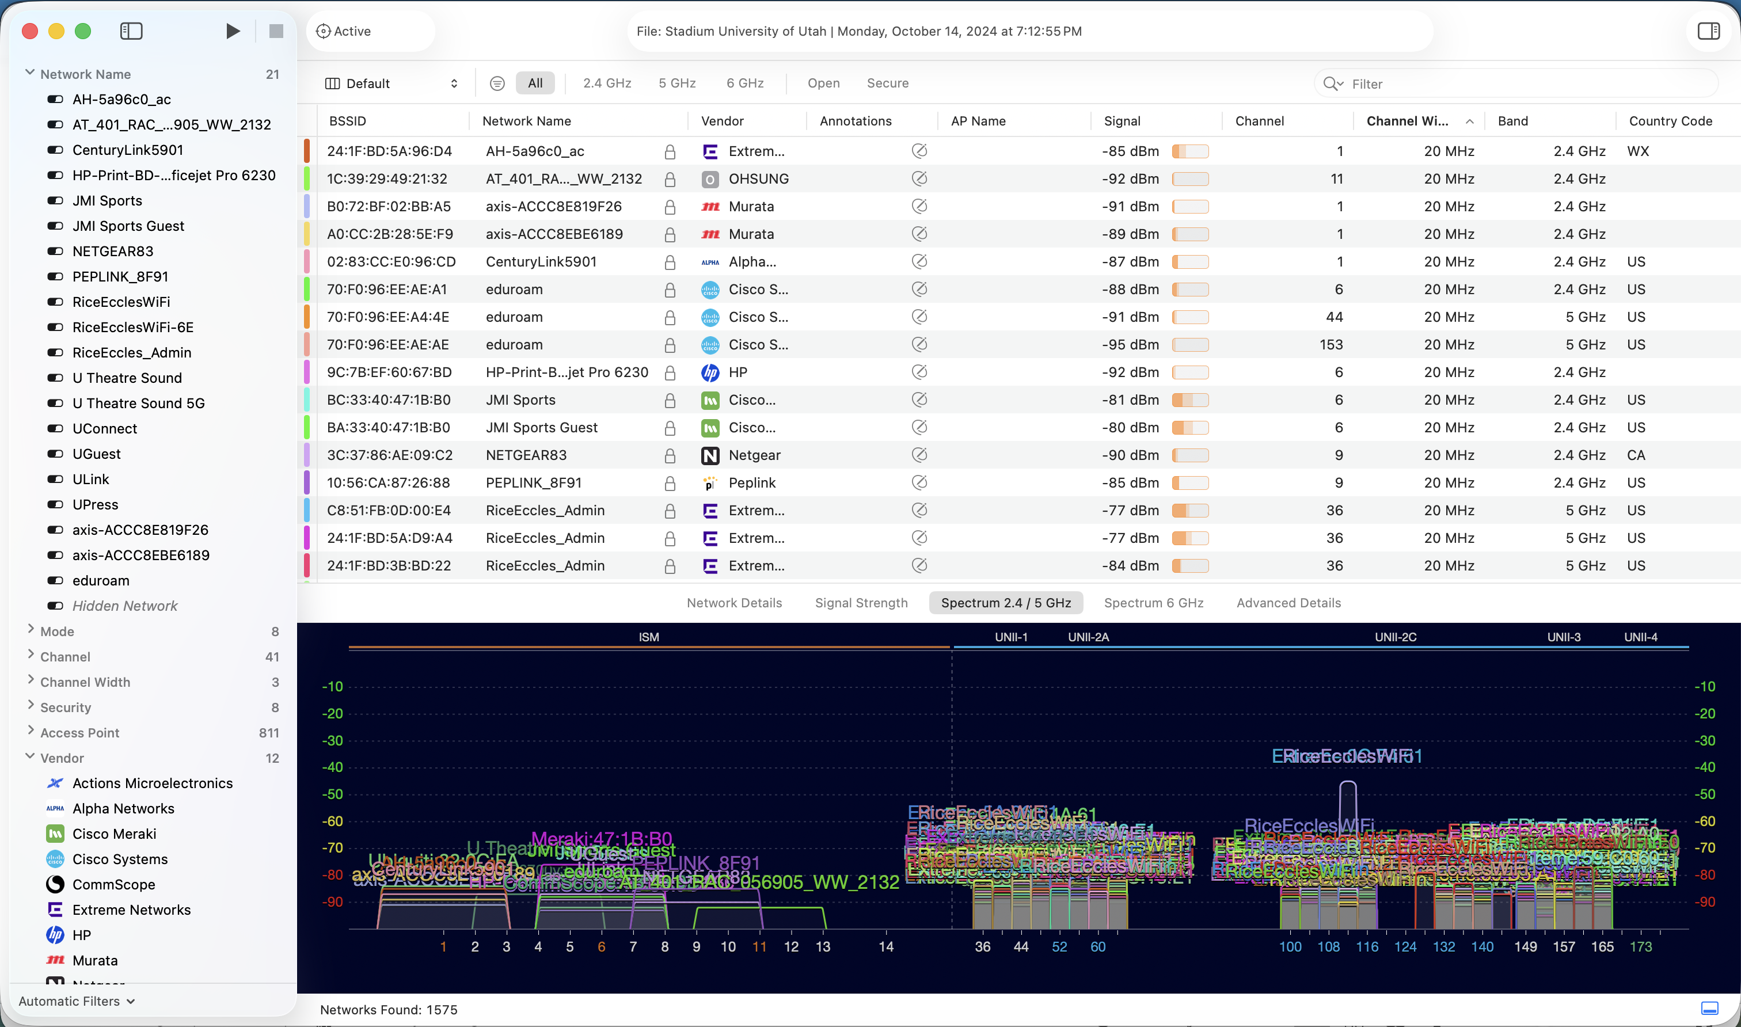
Wi-Fi Explorer Pro, WiFi Signal
Mac and Windows

Slide 14
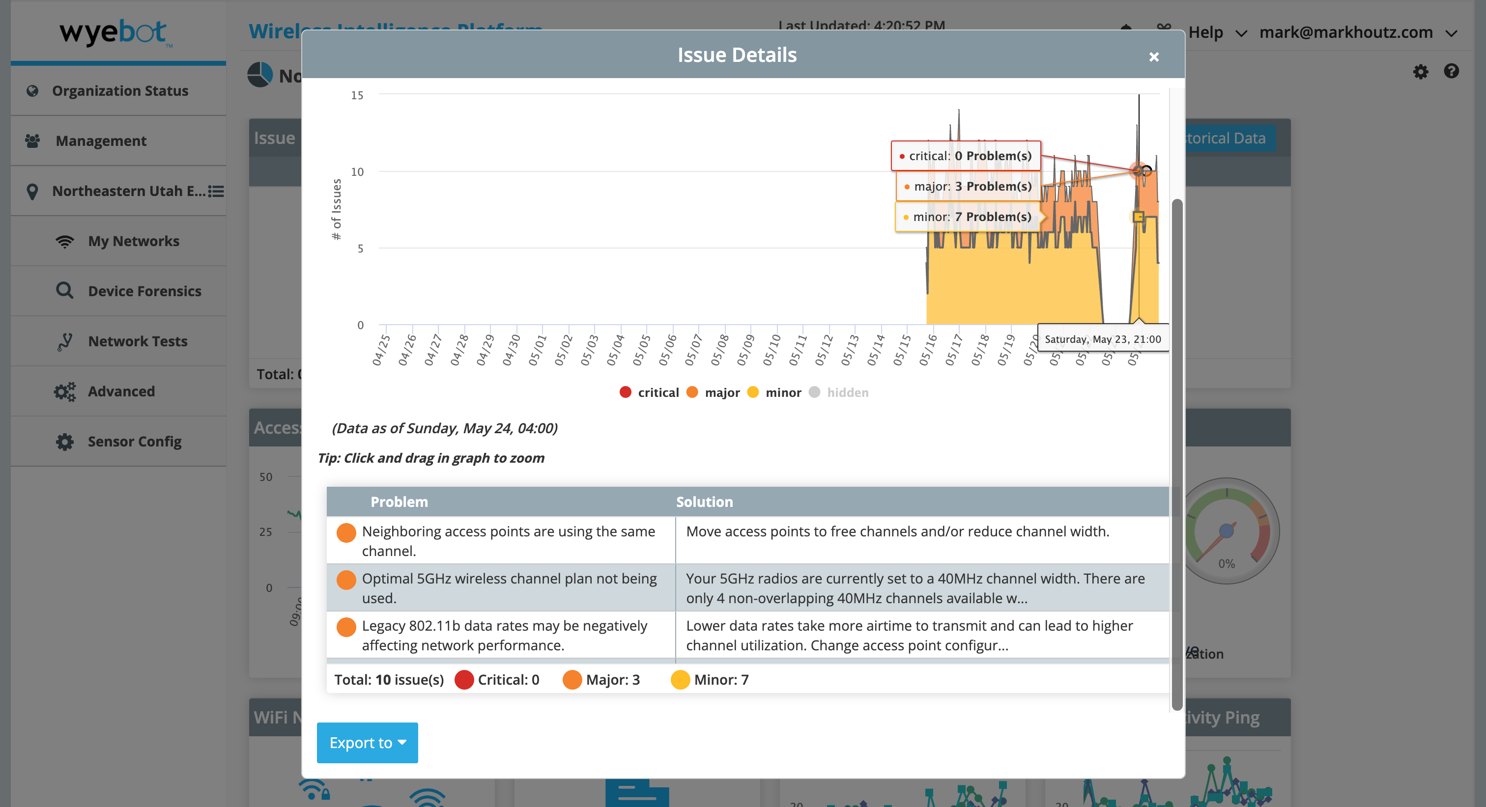
Wyebot
AI-assisted monitoring, analytics, and root-cause analysis. Extra cabling, switchports, POE required..

Slide 15
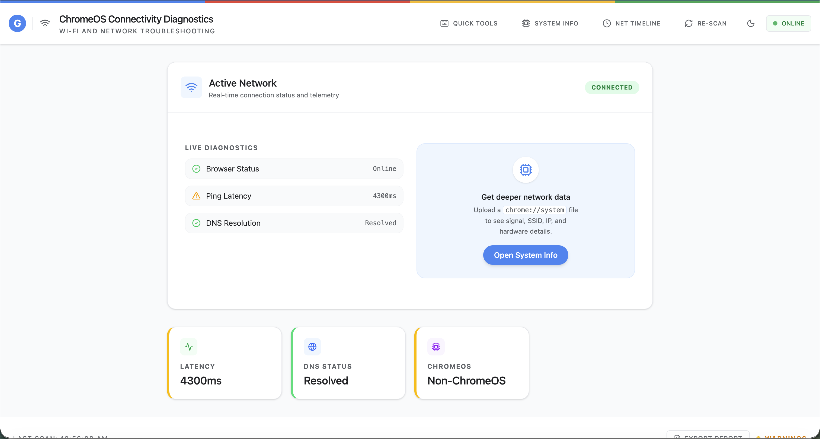
What about Chromebooks
https://wifrizzy.github.io/chromeos-wifi-fixer/

Slide 16
Directional Antennas
Omni vs directional antennas, coverage shaping, interference reduction

Slide 17
Why Antenna Choice Matters
Warehouses, stadiums, auditoriums, and high-density deployments… Even classrooms?
Are you at 1 AP per classroom?

Slide 18
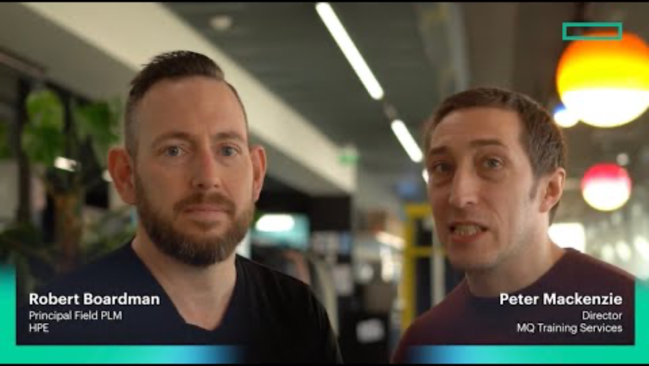

Slide 19
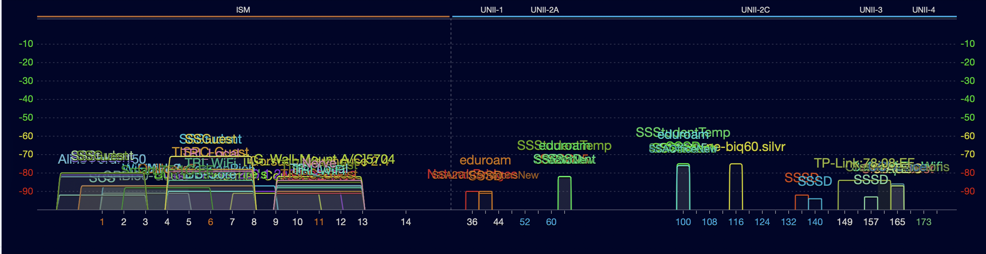
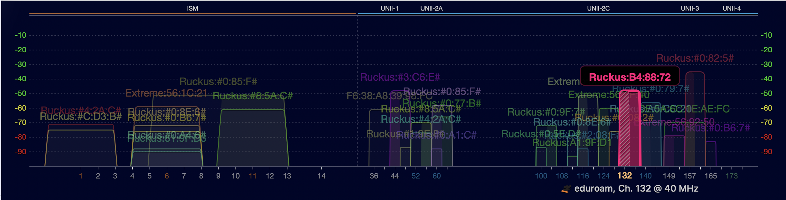
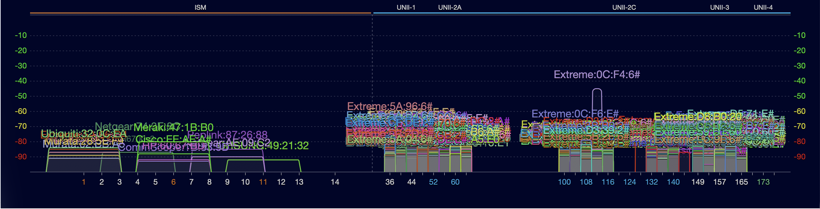

Slide 20
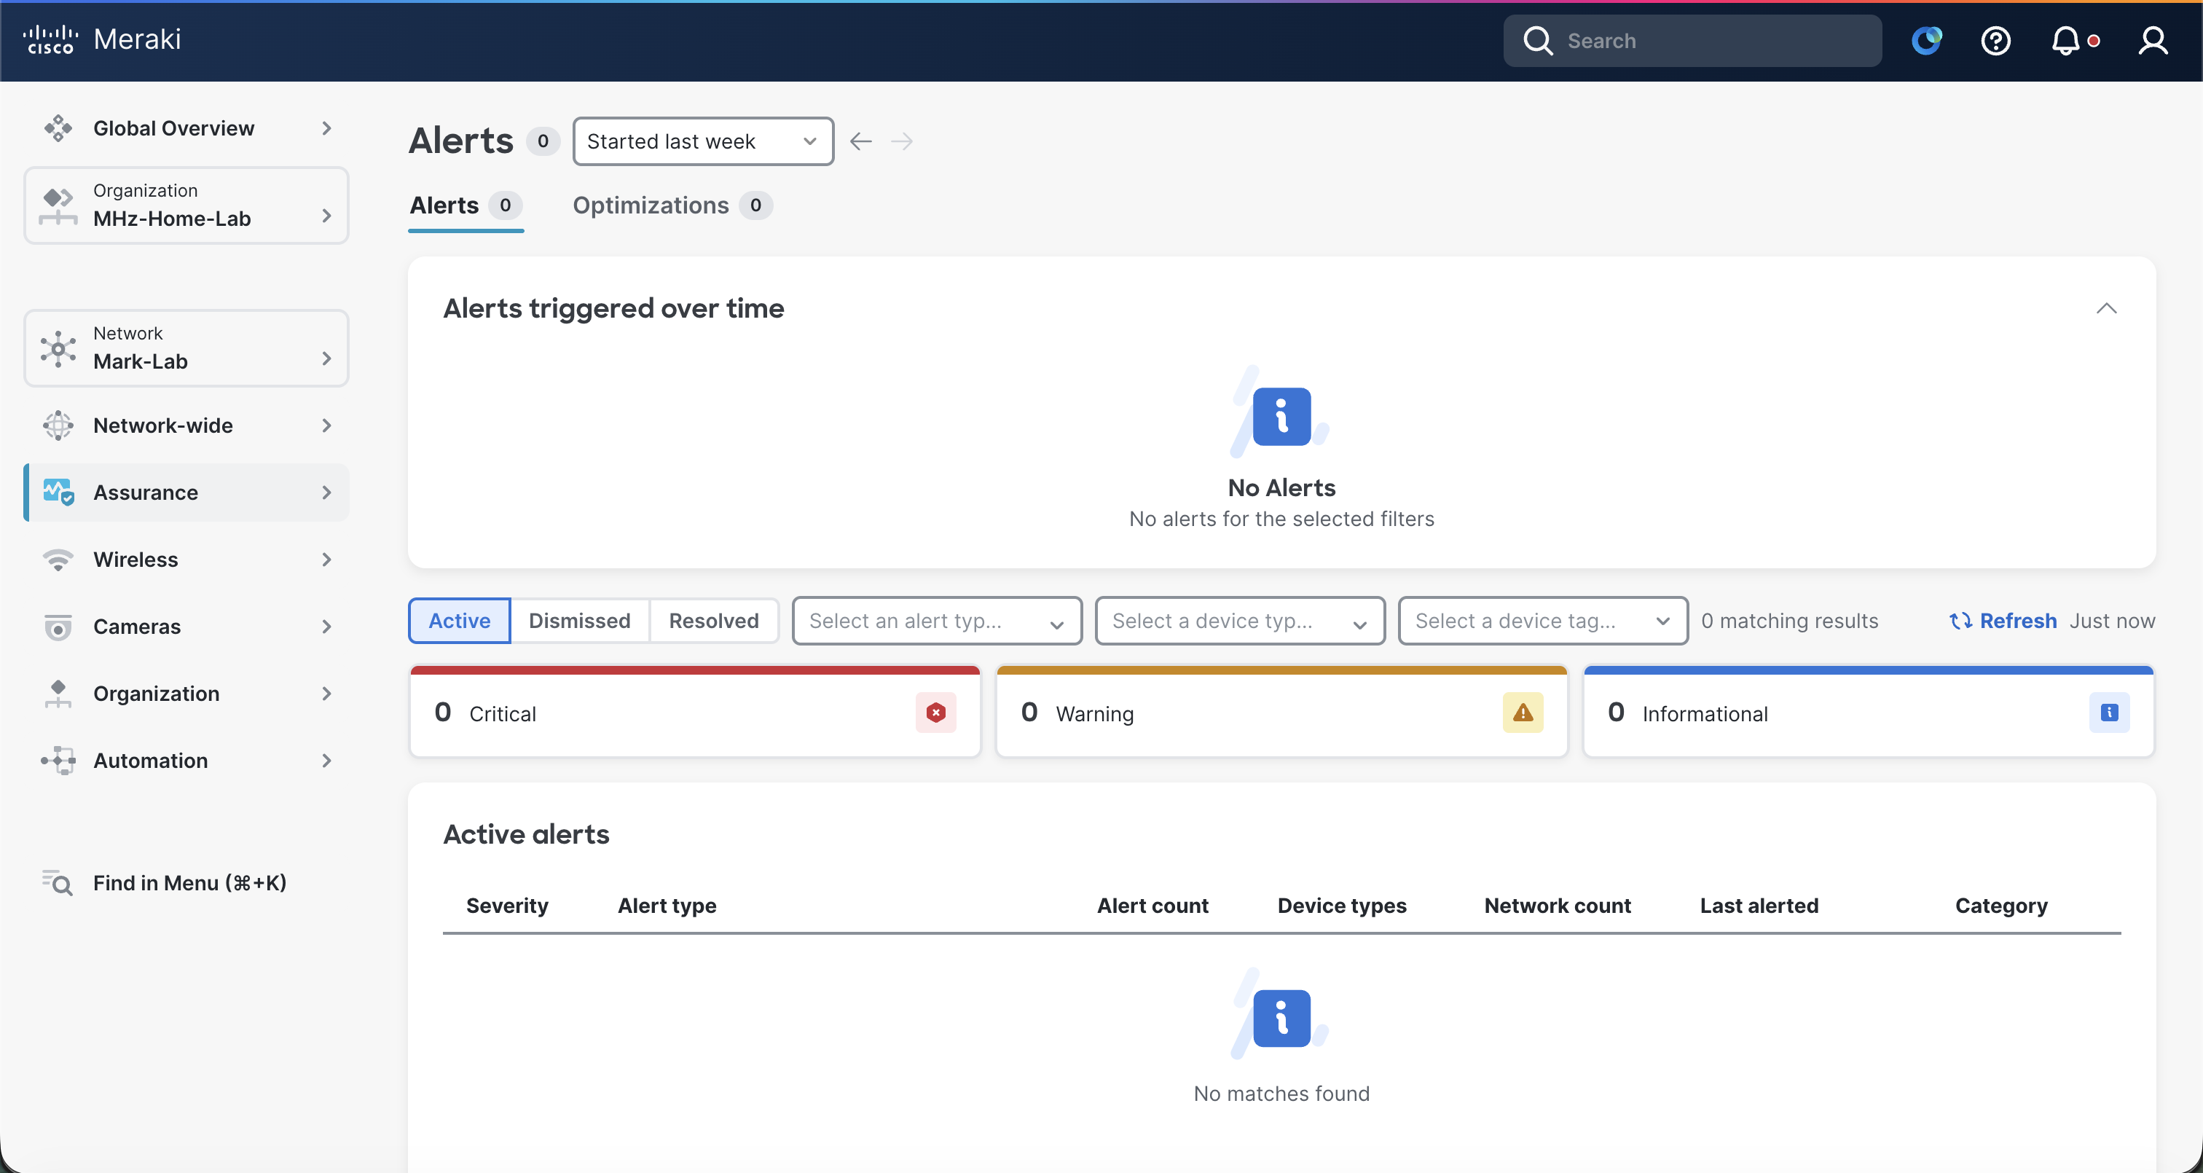
Cisco and Meraki
Meraki Assurance, Catalyst Center, ThousandEyes, end-to-end digital experience visibility.

Slide 21
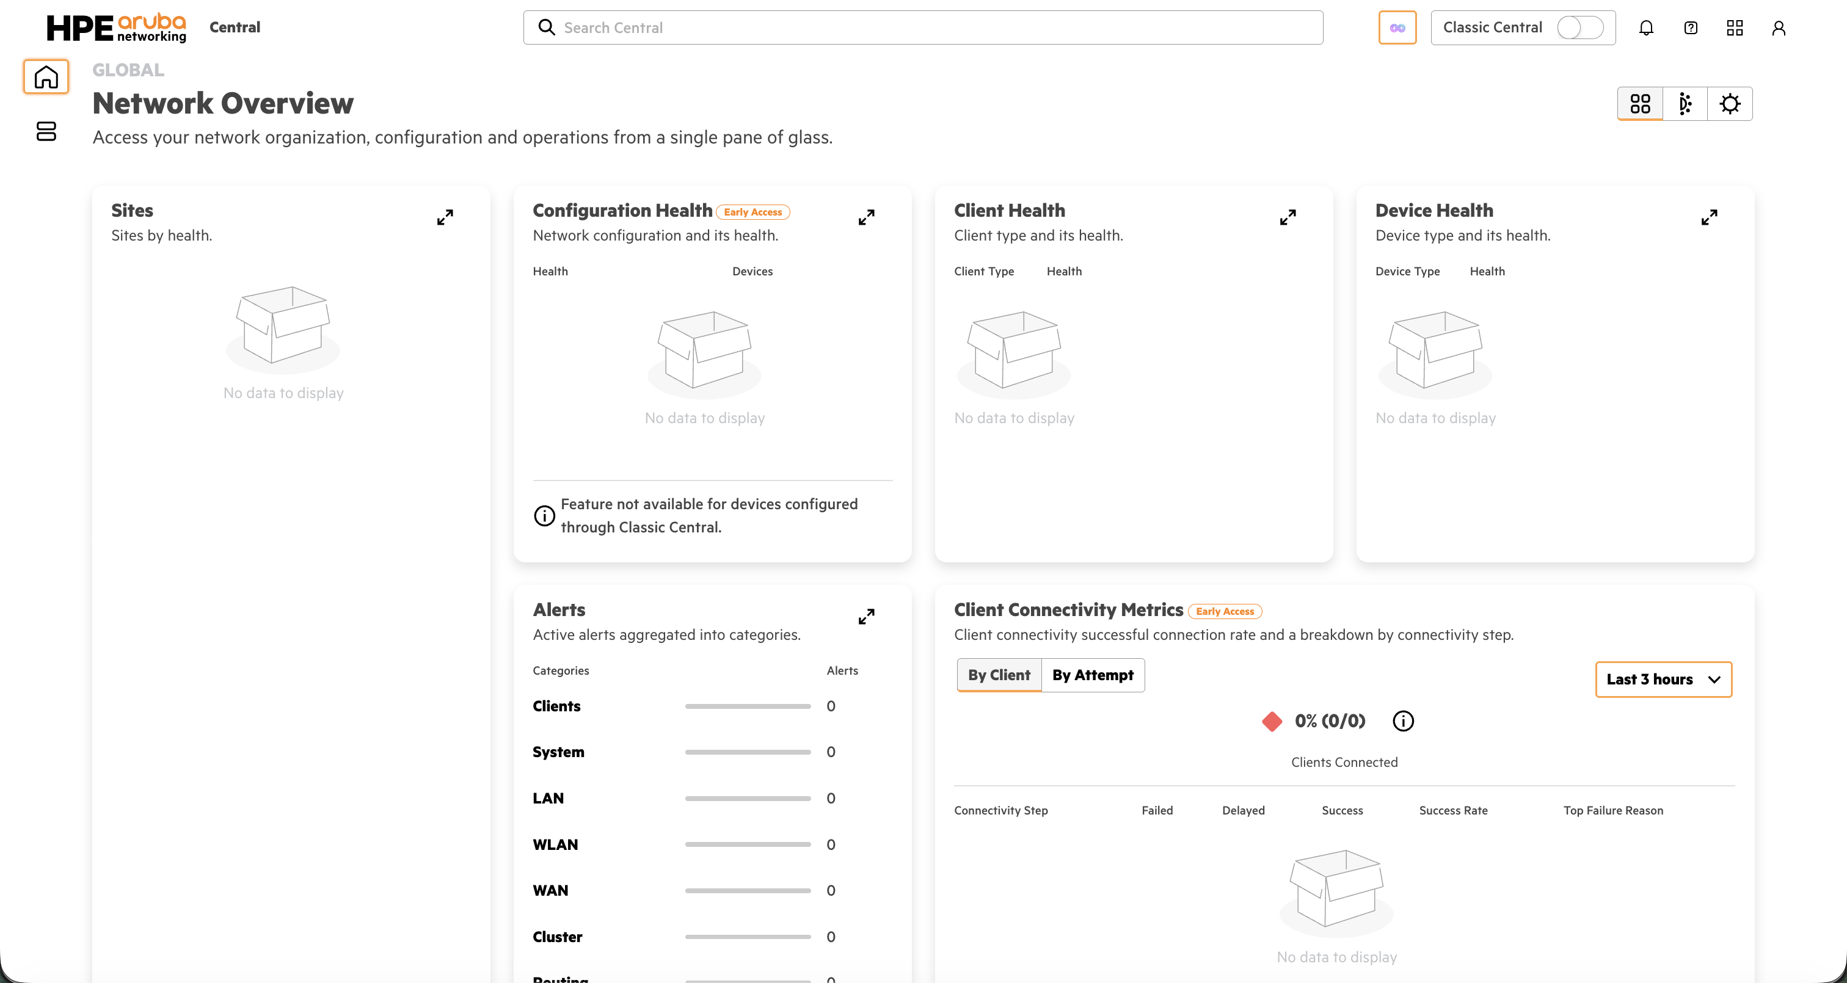
HPE Aruba
Central NG, Central NAC

Slide 22
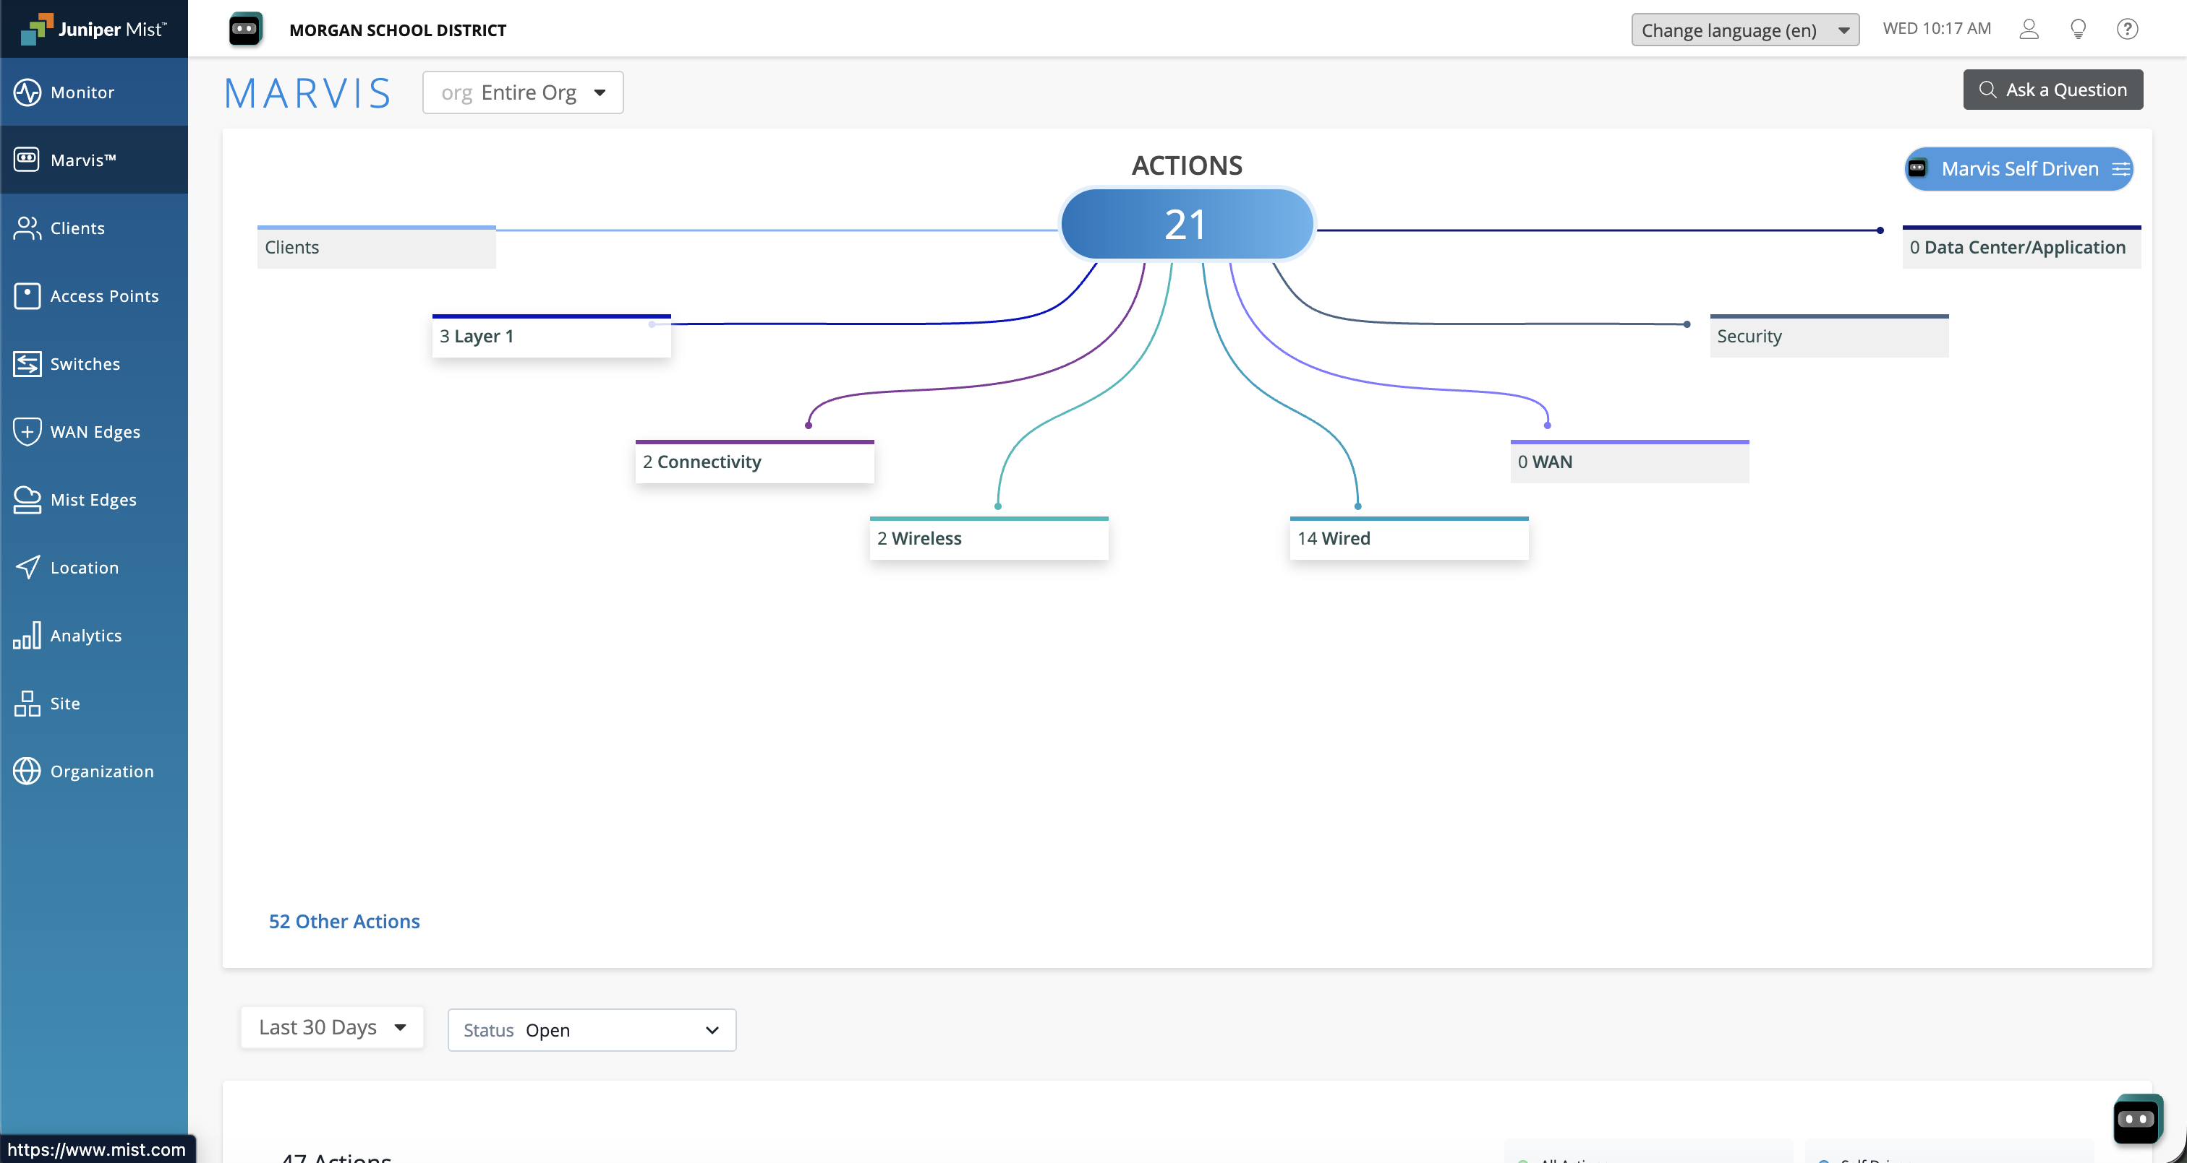
HPE Juniper Mist
Marvis AI, Service Levels, user-centric troubleshooting, AIOps, Access Assurance

Slide 23
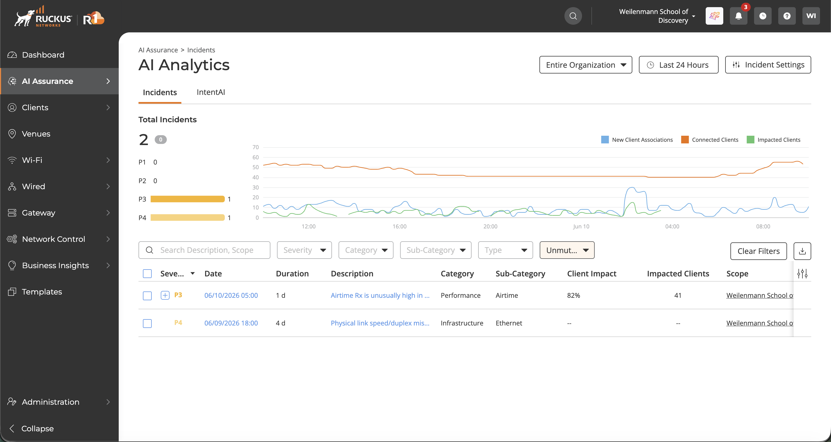
Ruckus
RF Performance & Adaptive Antennas

Slide 24
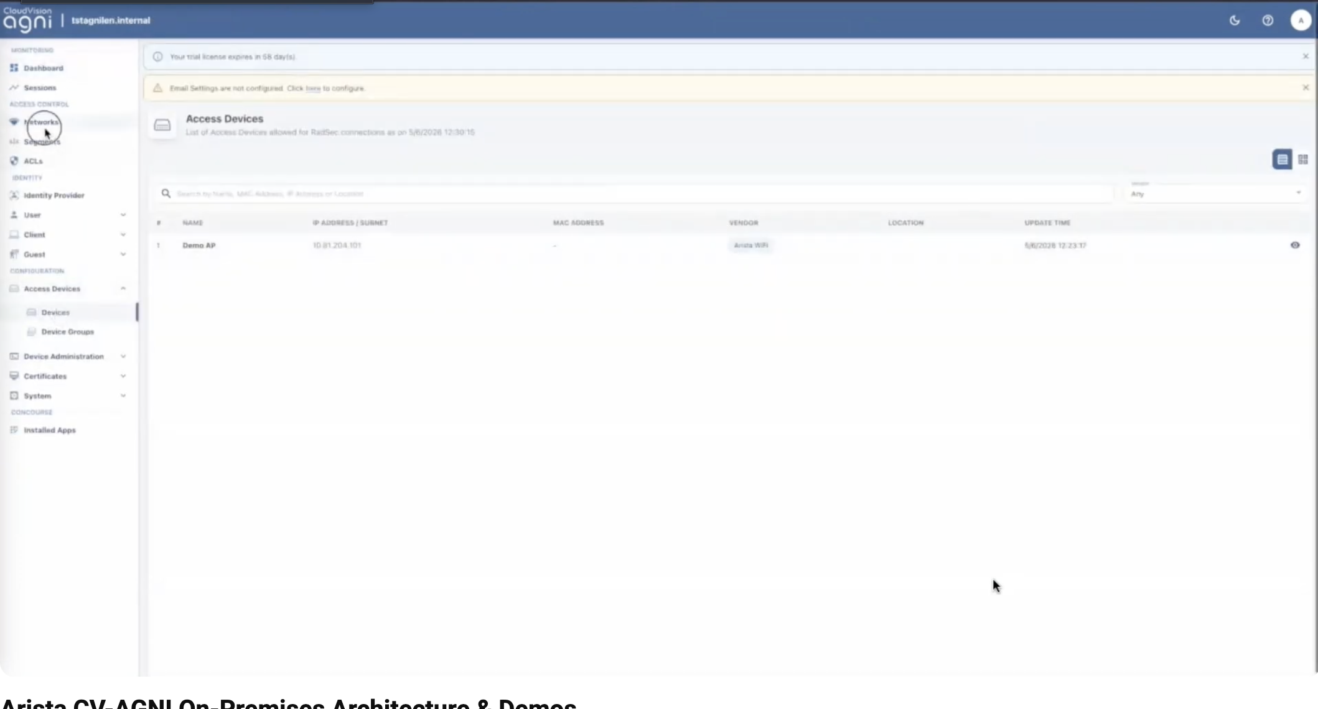
Arista
Agni, Cognitive Campus, CloudVision, telemetry, analytics, campus assurance, operational consistency.

Slide 25
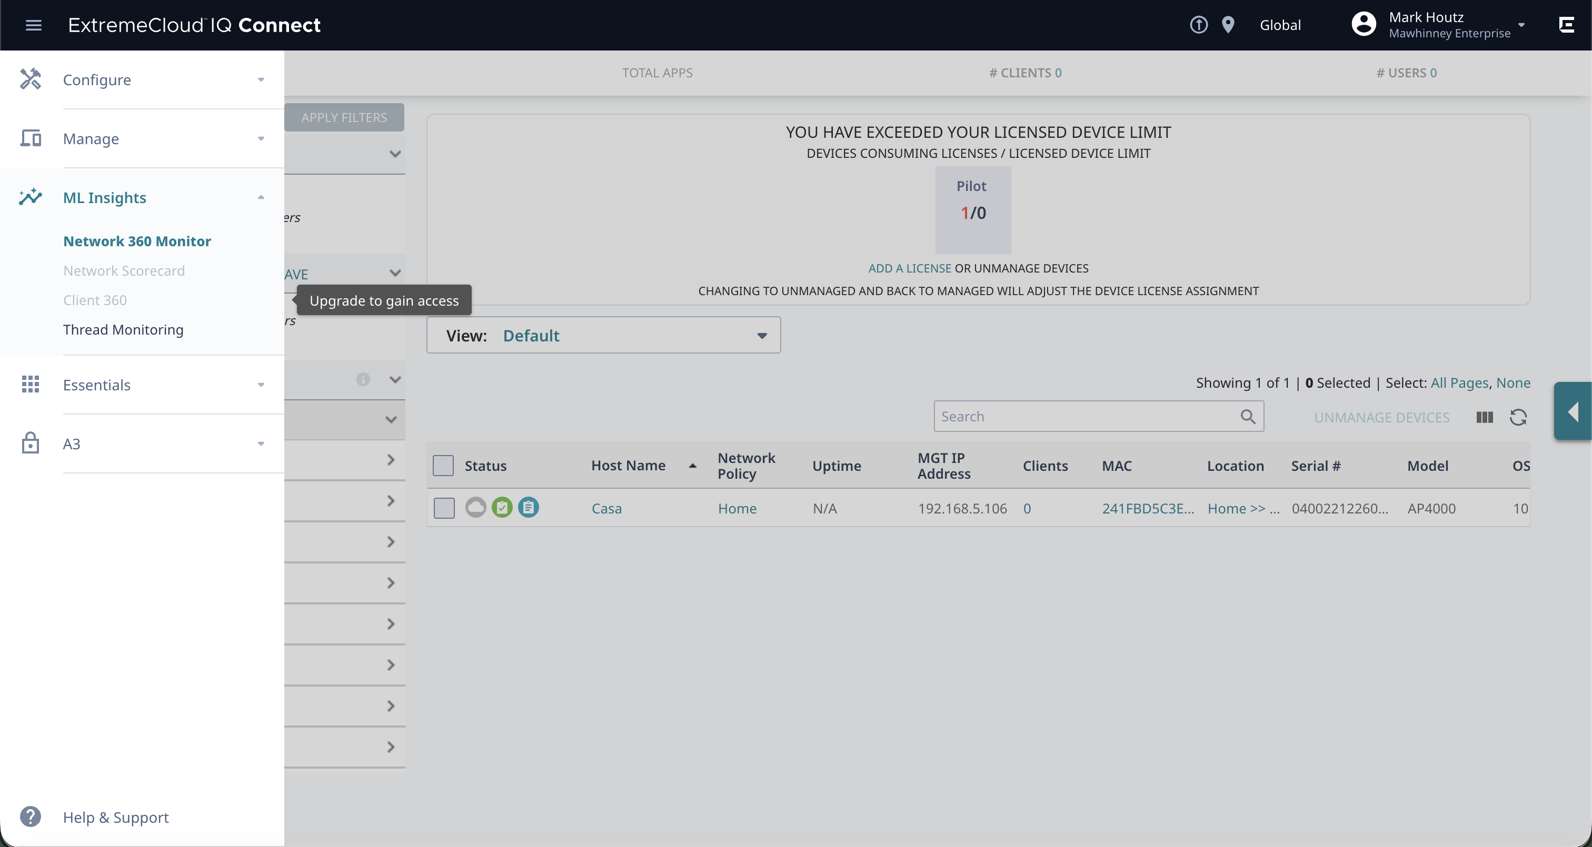
Extreme Networks
CoPilot, AI Expert, operational automation.

Slide 26
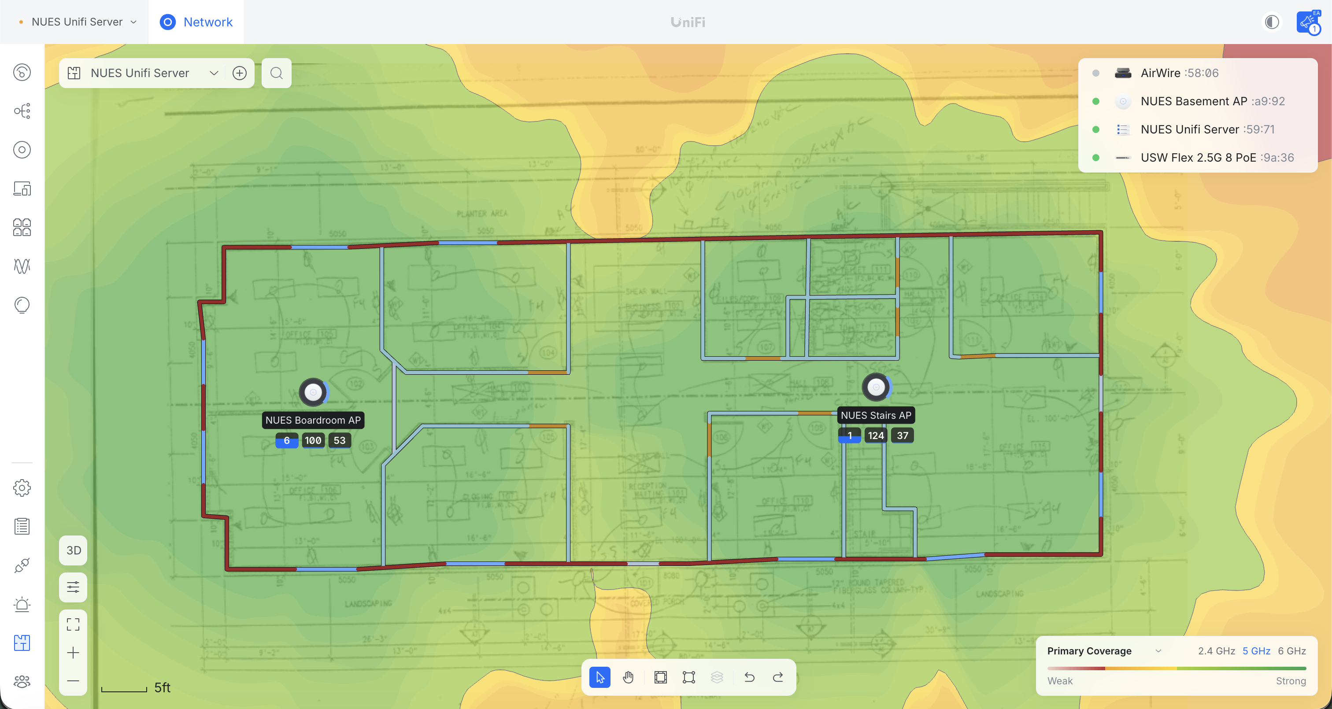
Ubiquiti
Visibility, analytics, and growing assurance capabilities.

Slide 27
Building a Modern Assurance Stack
Hamina + WLAN Pi + ORB + Sidos + Wyebot + WiFi Explorer Pro + Vendor AI platforms.

Slide 28
Future of Autonomous Networking
AI recommendations, automated remediation, self-healing networks.
MCP Servers

Slide 29
Key Takeaways
“The question is no longer whether the network is up. The question is whether users can successfully accomplish what they came to do. Modern network assurance shifts our focus from infrastructure health to user experience.”

