Slide 1
AI as a Design Variable
A Professional Learning Experience for Educators
How intentional design determines whether AI enriches or erodes learning
David Long, Superintendent | Beaver County School District, Utah
45-Minute Session
καιρός
"The appointed moment"
— the right time to act

Slide 2
Today's Journey
The Moment We're In
Strategies That Work
1
5 min
4
10 min
Kairos — why this matters now
Oral exams, design principles, The Loop
What the Research Says
Three Things to Try Tomorrow
2
12 min
5
5 min
The cognitive offloading paradox & brain science
Practical application for your classroom/school
A Framework for Understanding
Discussion & Q&A
3
10 min
6
3 min
Four phases, three zones, the Johari Window
Your questions, your context

Slide 3
The Moment We're In
Chronos vs. Kairos
The gap is widening
Chronos = ordinary clock time
Kairos
= the appointed, opportune moment — a window requiring action
"Redeeming the time, because the days are evil."
— Ephesians 5:16
Students are already operating in AI-native environments. Institutions are still in Phase 1.
It's 2026
Five model generations since GPT became a household word. Most schools are still writing syllabus bans.
Design, not restriction
The research is clear: the outcome depends entirely on intentional design — not the tool itself.

Slide 4
What Happens to the Brain
MIT EEG Study — Kosmyna et al. (2025)
ChatGPT Group
Google Search Group
Brain-Only Group
Weakest neural engagement (EEG)
Essays were similar, 'soulless'
By essay 3: just handing off the prompt
Couldn't recall their own essays later
Researchers called it 'cognitive debt'
High satisfaction
Active brain function
Deep information integration
Maintained ownership of ideas
Healthy cognitive engagement
Highest neural connectivity
Alpha, theta & delta band activity
Most creative, most curious
Expressed ownership & satisfaction
When later given AI — performed well
Key Insight: "Education on how we use these tools is absolutely critical." — Kosmyna, MIT

Slide 5
THE PROBLEM: COGNITIVE OFFLOADING
⬇ Critical
Thinking
55%
62%
Significant negative correlation found between frequent AI tool use and critical thinking ability
(SBS Swiss Business School, 2025)
of Gen Z (ages 18–28) can identify fake or misleading AI-generated content — lower still for adults over 28
(Pangram/YouGov, May 2026)
of people correctly identified an AI-generated image in a Microsoft AI for Good Lab analysis (2025)
Younger users show greater AI dependence and lower critical thinking scores across all educational backgrounds.
Source: The Epoch Times | Autumn Spredemann | May 23, 2026

Slide 6
The Cognitive Offloading Paradox
New research by Wang & Zhang (2026) complicates the picture — in important ways
The Existing Evidence
The New Finding
AI offloading → cognitive erosion
• Gerlich (2025): AI use negatively correlated with critical thinking
• MIT EEG scans: ChatGPT users showed weakest neural engagement
• Favero (2025): Offloading undermines learning unless freed capacity is redirected
This evidence is real.
The story is just incomplete.
Intentional AI design → deeper learning
Students who delegated the most to AI:
• Questioned assumptions more deeply
• Shifted perspectives more fundamentally
• Re-evaluated how they think
The mechanism: Free up cognitive capacity on low-order work → humans invest it in higher-order reflection — IF someone structures that investment.
AI is a design variable.

Slide 7
The Three Zones of AI Use
Where does AI use in YOUR district currently live?
Zone 1
Zone 2
Zone 3
No AI
Undesigned AI Use
Strategic AI Use
Traditional learning without AI assistance. Establishes baseline competence. Most current 'control' conditions.
AI used without guidance on what to delegate or structure for cognitive reallocation. 'You may use AI' with no further direction.
Deliberate delegation of substantive work to AI + structured reallocation toward higher-order tasks. The Arena condition.
Outcome: Authentic learning, but misses potential capacity gains
Outcome: Erosion of thinking. Where most current AI use sits.
Outcome: Deeper learning than Zone 1. But requires pedagogical design.
Research shows Zone 2 is where most AI use in education currently lives | Zone 3 requires intentional pedagogical design

Slide 8
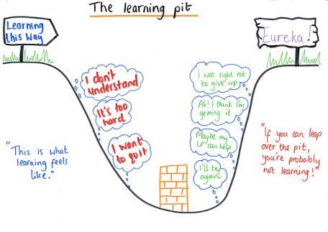
Zone 1
“No” AI
Zone 3
AI Use is Strategically
Zone 2
AI Use is Haphazard

Slide 9
Four Phases of AI in Education
Patrick Dempsey — The Second Draft (2026) | Where is your school?
Phase 1
Phase 2
Phase 3
Phase 4
AI Outside the Curriculum
AI In the Curriculum
AI As the Curriculum
AI Under the Curriculum
Faculty hope AI goes away or ban it. Students use AI outside sanctioned environments. Institutional response: compliance, detection, prohibition.
Educators integrate AI into existing assignments. 'AI allowed for X, not Y.' Transparency statements. Real progress — but organized around AI as a thing to manage.
Learning happens inside AI-native platforms. NotebookLM courses, custom GPTs, AI tutors. Technology stops being a supplement and starts being the environment.
AI becomes ambient — a condition of cognition, not a topic of integration. Like the internet: assumed, invisible, foundational.
Most schools here
Some schools here
Emerging
Where we're heading
Reflect: What phase is your district in? What phase are individual classrooms in?

Slide 10
The Johari Window Applied to AI
Mapping what educators and students each know about AI use — and why it matters
Educator KNOWS
Educator DOESN'T KNOW
Student
KNOWS
The Arena
The Blind Spot
Both parties understand how AI is being used and why. Learning gains from research accrue here. This is Zone 3 in action.
Students using AI in ways educators cannot see. Only 19–23% of evaluators correctly identify AI-generated submissions.
Goal: Design for this
Risk: Zone 2 default
Student
DOESN'T
KNOW
The Façade
The Unknown
Knowledge educators hold that hasn't reached students — e.g., 46% of ChatGPT citations don't exist; cognitive costs of Zone 2.
Longitudinal effects of AI on learning across entire programs. Virtually no data exists. Decisions being made on preliminary evidence.
Action: Drain this quadrant
Need: Longitudinal study

Slide 11
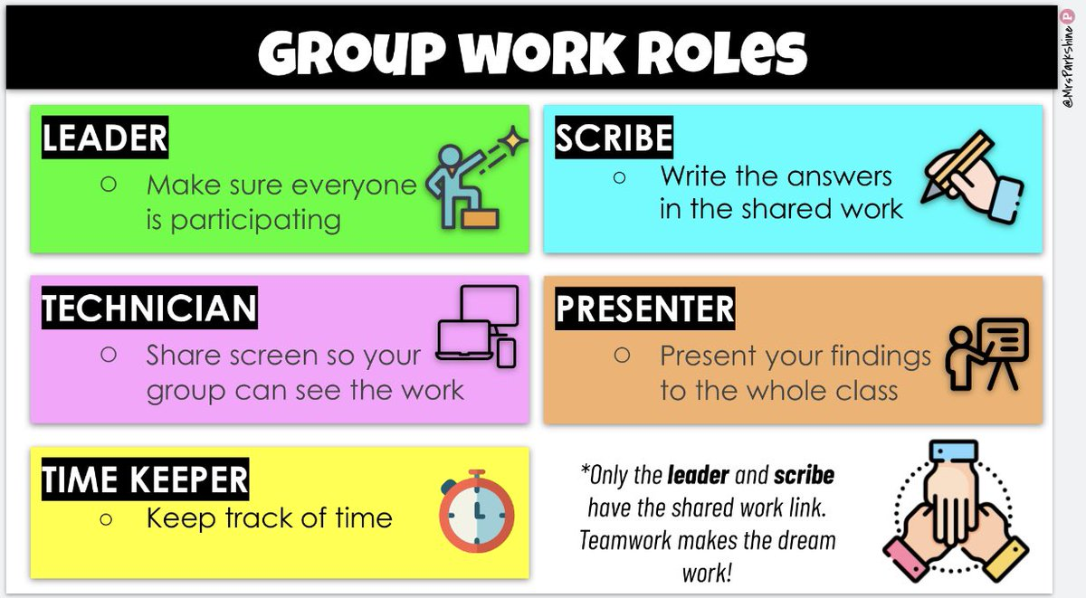
Reflect: What does “Group Work” look like if every child has their own virtual group in addition to working with peers?
Getting
in The Area
Reflect: What does a PLC become with every teacher using Agentic AI assigned to different roles?

Slide 12
The Loop — Jacob Ward
Understanding AI's deeper effect on human agency — a discussion guide for your team
Loop 1
Loop 2
Loop 3
The Brain's Built-in Bugs
Technology Exploits the Bugs
AI Locks It In
We're wired to follow guidance while believing we're deciding independently. Kahneman & Tversky: knowing about biases doesn't reduce their effect.
Sophisticated technologies drive people to change their behavior without knowing how or why — often for the profit of technology companies.
Machine learning can only use existing data, so it bakes the past into the future. Ward calls this 'performativity' — new choices that are really just reflections of past decisions.
Discussion Prompts for Your Team:
• The bias-baking problem: If AI trained on our district's historical data reflects past inequities, how do we interrupt that? • The convenience trap: Where are we adopting AI tools primarily because they're convenient, without asking what choices we're ceding?

Slide 13
THE THREAT: “CONFIDENT SAMENESS”
“
📢 Volume Mistaken for Credibility
When users see dozens of similar posts on any topic, they may assume broad agreement exists — even when it doesn't.
Many articles and posts now repeat similar structures, similar advice, and similar phrasing... this can create the impression that a topic has more consensus or certainty than it really does.
🔁 AI Feedback Loop
AI writes reviews based on what other AI already wrote; readers assume consensus, and authentic experience disappears.
— Javi Pérez
AI-Assisted Consumer Education Editor
😴 Reader Fatigue
Information overload causes readers to either disengage entirely or become easier to mislead — both outcomes are dangerous.
AI-generated content skews positive — trained on marketing pages, it erases negative signal from the internet.

Slide 14
IMPLICATIONS FOR K–12 EDUCATION
Students Most at Risk
Media Literacy Must Evolve
01
Research shows younger users are most dependent on AI and score lowest on critical thinking.
(SBS Swiss Business School, 2025)
Schools are the primary site for building the resistance.
02
Traditional fact-checking skills are insufficient. Students need training to spot 'confident sameness,' AI feedback loops, and synthetic consensus.
Deliberate Reading vs. Rapid Skimming – Literacy is the Solution
AI Policy & Authentic Voice
03
AI encourages speed over depth. Educators must actively cultivate slow, analytical reading habits that resist algorithmic shortcuts.
04
Districts need clear AI use standards that preserve student voice, require source verification, and distinguish research from AI-generated summary.
Beaver County School District — Technology Policy & AI Literacy Leadership

Slide 15
Oral Exams: Seeing What AI Hides
From Penn's Center for Teaching and Learning — a strategy gaining traction K–12
"It fills me with existential despair when I discover that I'm grading something written by a robot."
Low-Stakes Start
15 min. Two prompts assigned in advance. Random selection during exam. Counts in grade only if it helps.
Zoom In / Zoom Out
— Emily Hammer, Middle Eastern Languages & Cultures, UPenn
"How would you explain this to a kindergartener?" + "Why would this cause that specific outcome?"
Why Oral Exams Work in the AI Era
Scale with TAs
• Makes invisible AI use visible — not as surveillance, but as structure
• Assesses thinking, not just product — rewards intellectual curiosity
• Creates 'Arena' conditions — both parties understand what's happening
• Reconnects students with the experience of genuine knowing
Use defined rubrics (Check+, Check, Check−). TAs can conduct at scale with training.
The Honest Framing
"If you used AI to write it, you'll work much harder here. If you wrote it yourself, this is a pleasant conversation."
Notes:
One strategy to bring AI dependency or AI negative offloading into the open.

Slide 16
Six Design Principles for AI-Integrated Learning
From Wang & Zhang (2026) — The design cheat sheet
Commit to full delegation
Learner thinks first, AI second
1
4
Half-measures are worse than no AI at all. Delegate entire categories of low-order work so genuine cognitive space opens up.
Producing an answer — even a wrong one — builds stronger retention than receiving a correct one passively. Never reverse this sequence.
Frame AI as a partner, not a tool
AI identifies errors; learner fixes them
2
5
When learners treat AI as an intellectual collaborator, they become more critical of its outputs AND delegate more strategically.
The productive struggle of correcting mistakes builds the skill. Let AI flag that an error exists — not supply the fix.
Build verification into the workflow
Assess without the scaffolding
3
6
"Don't trust AI" is a warning. "Check one claim before you use this" is a habit. Design the habit, not the warning.
Without one unassisted assessment, you're measuring the human-AI system, not the learner. If scores drop without AI, you built dependency.

Slide 17
Three Things Worth Trying Tomorrow
Practical starting points — no institutional transformation required
Run a Factory vs. Features Audit
Why it matters:
01
1. List your current AI projects and initiatives
2. Tag each as Factory (operations, core systems) or Features (demos, front-end)
3. If most energy is in 'Features' with fuzzy ROI — ask why
4. Identify what you'll never build yourself vs. what truly requires in-house capacity
Most districts are spending attention on AI novelty, not AI infrastructure.
Design One Arena Assignment
Why it matters:
02
1. Pick one assignment where AI use is currently murky
2. Specify: what exactly students delegate, and what they do with freed capacity
3. Build in a verification step — have students fact-check one AI claim
4. Add one unassisted component at the same difficulty level
An assignment that says 'you may use AI' without specification almost always produces Zone 2.
Facilitate a 10-Minute Loop Conversation
Why it matters:
03
1. Share the core premise of The Loop with your leadership team or faculty
2. Ask: Where are we adopting AI primarily for convenience?
3. Ask: What human decision points are we ceding — and should we be?
4. Identify one place to maintain a meaningful human-in-the-loop moment
Ward's prescription: honor values beyond ease and convenience — find value in difficulty itself, in building capacity and capability.

Slide 18
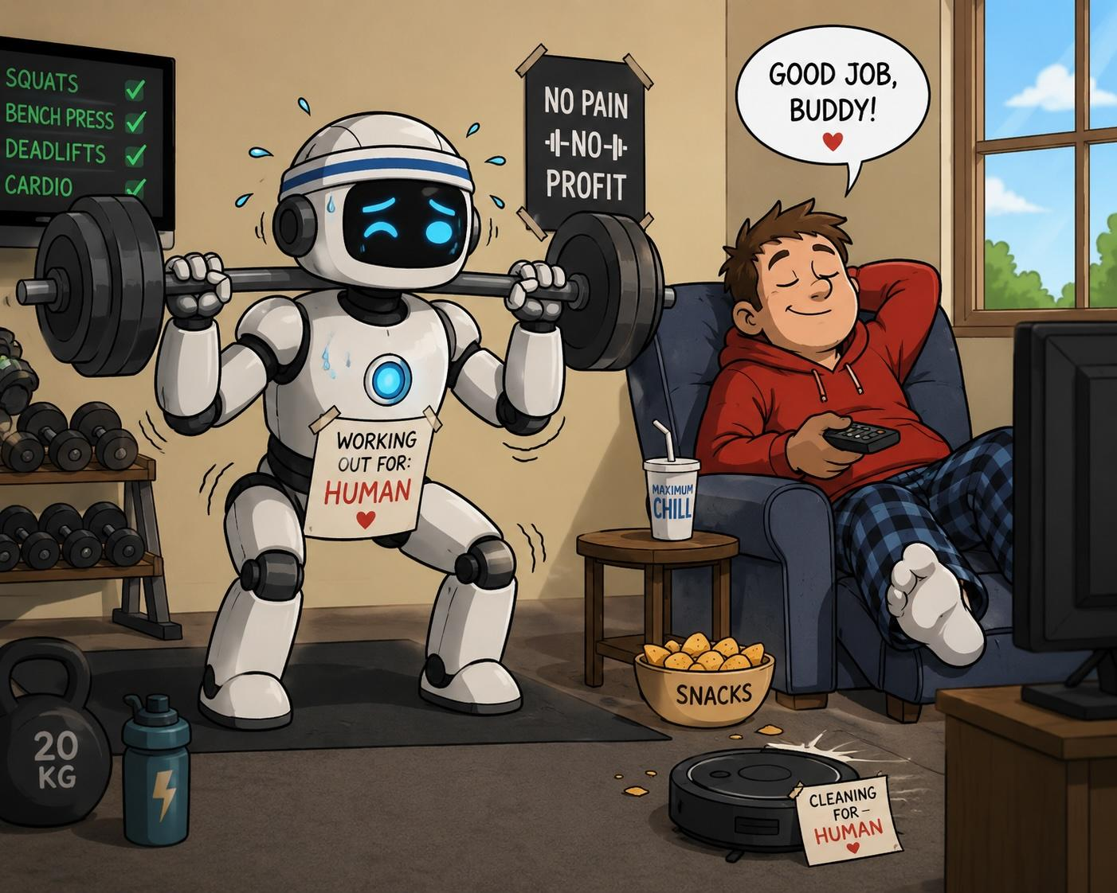
The Robot Workout Health Plan.
Notes:
No one in their right mind would suggest this works.

Slide 19
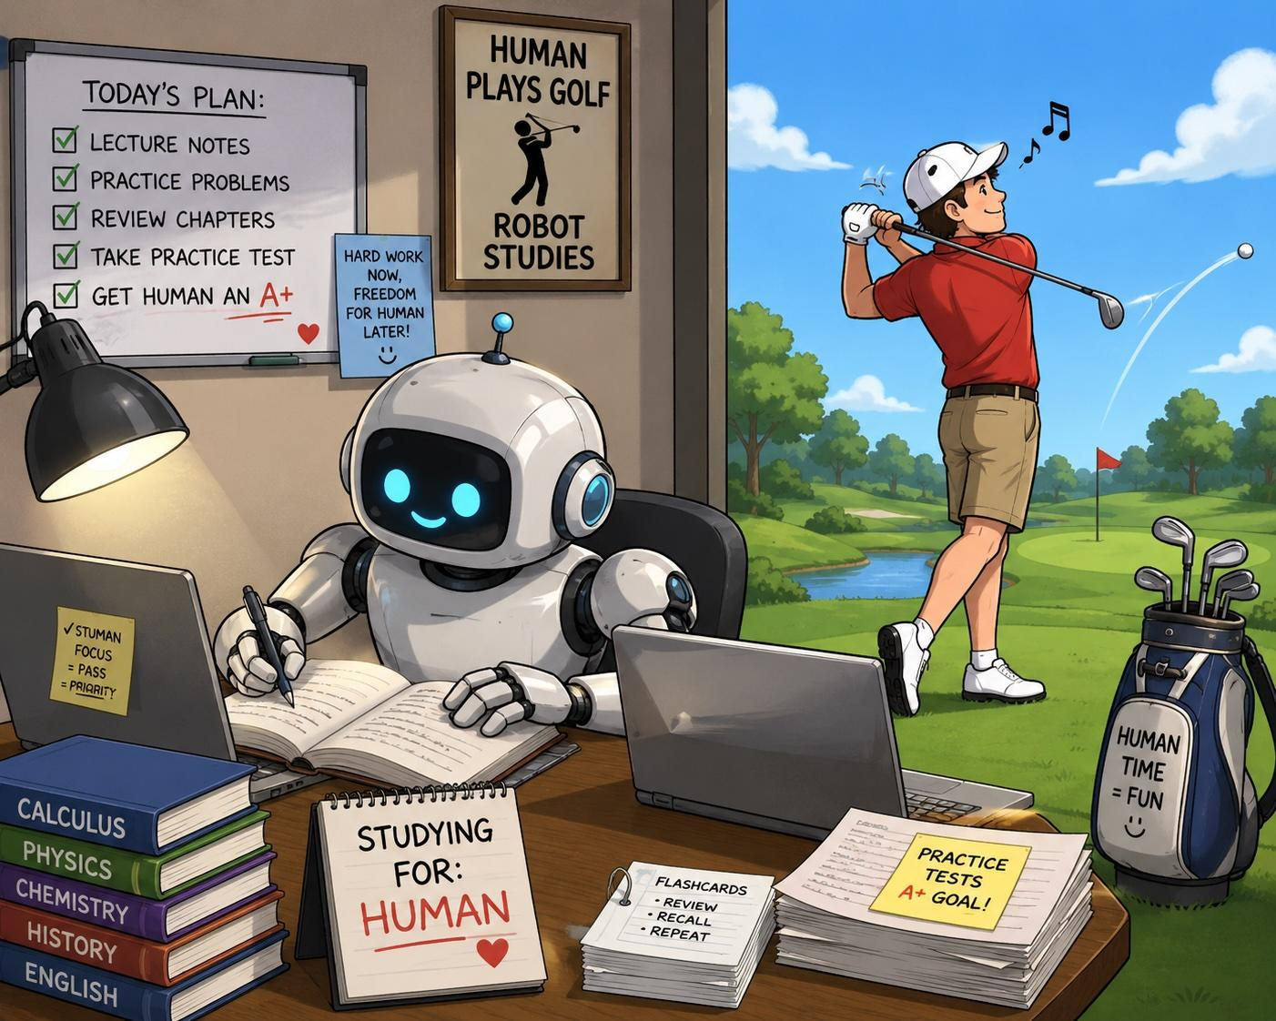
The Robot Study Plan.
Notes:
So why do so many people think this will work?

Slide 20
AI in Learning
Is Designed to Fade
The Scaffold
Tawnya Means · The Collaboration Chronicle, May 2026
A scaffold that stays is no longer a scaffold.
It becomes part of the building.
The Scaffolding Test
Can the student do the work alone once the AI is removed? That's what scaffolding has always meant — and it's the question AI integration hasn't answered yet.
Partnership Orientation
▼
What matters isn't how much AI is used, but the relational stance: treating AI as a collaborator to think with, not an authority to defer to.
Temporary Support
Designed to Fade
The Frontier Gap
Are we building THINKERS or proficient TOOL USERS?
We don't yet know if AI-assisted learning builds durable thinking that transfers when AI is absent. That's the question educators must design toward.
Source: Means, T. (2026). Designed to Fade. The Collaboration Chronicle.

Slide 21
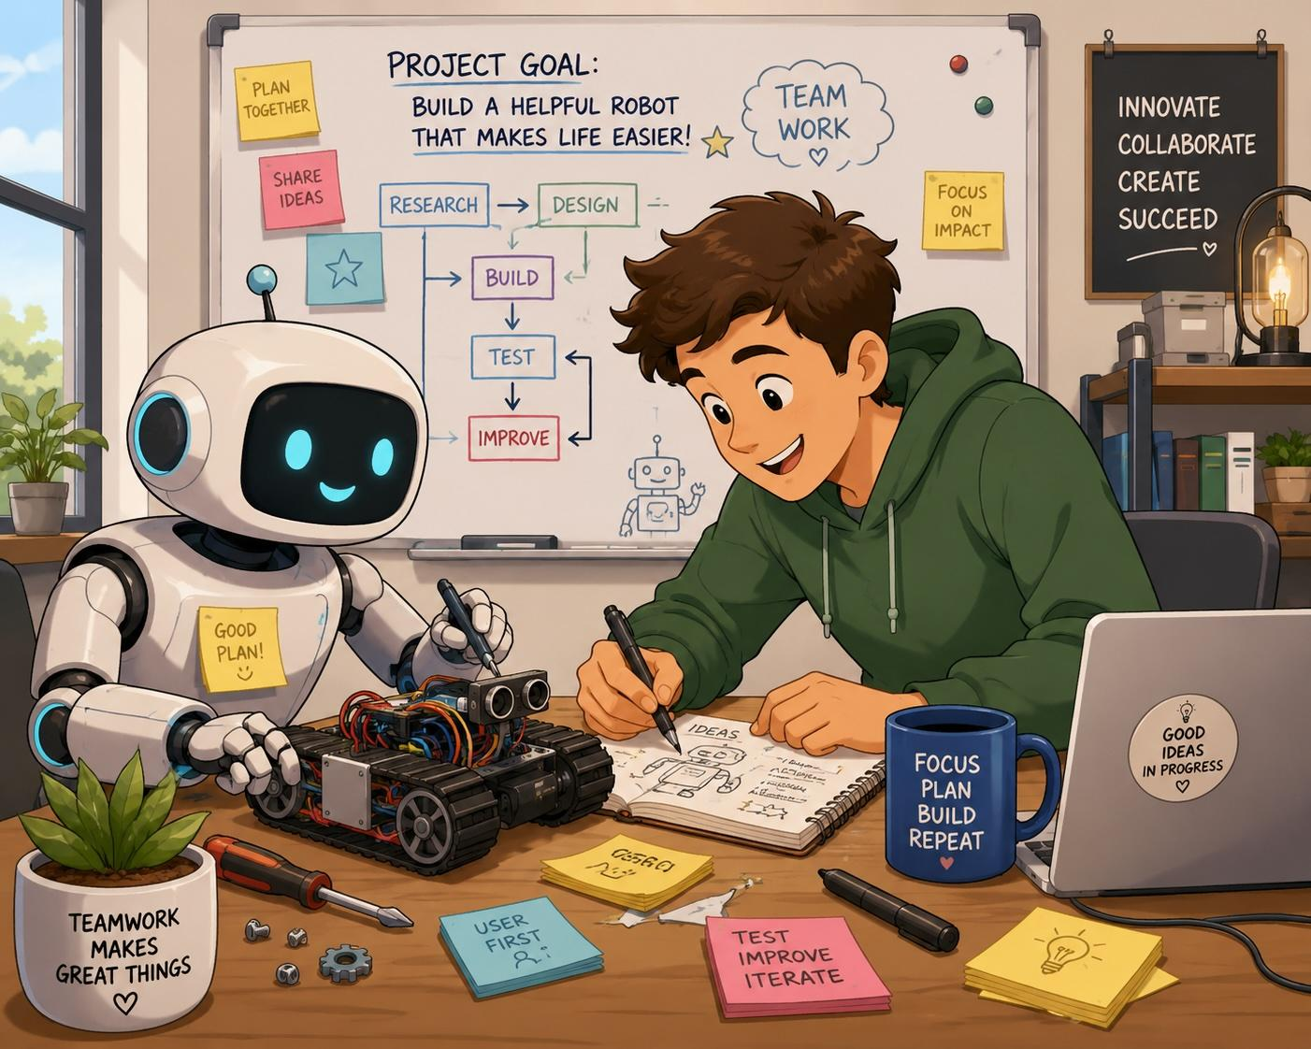
Robot and Human Collaboration
Notes:
We can use AI to help us create something new.

Slide 22
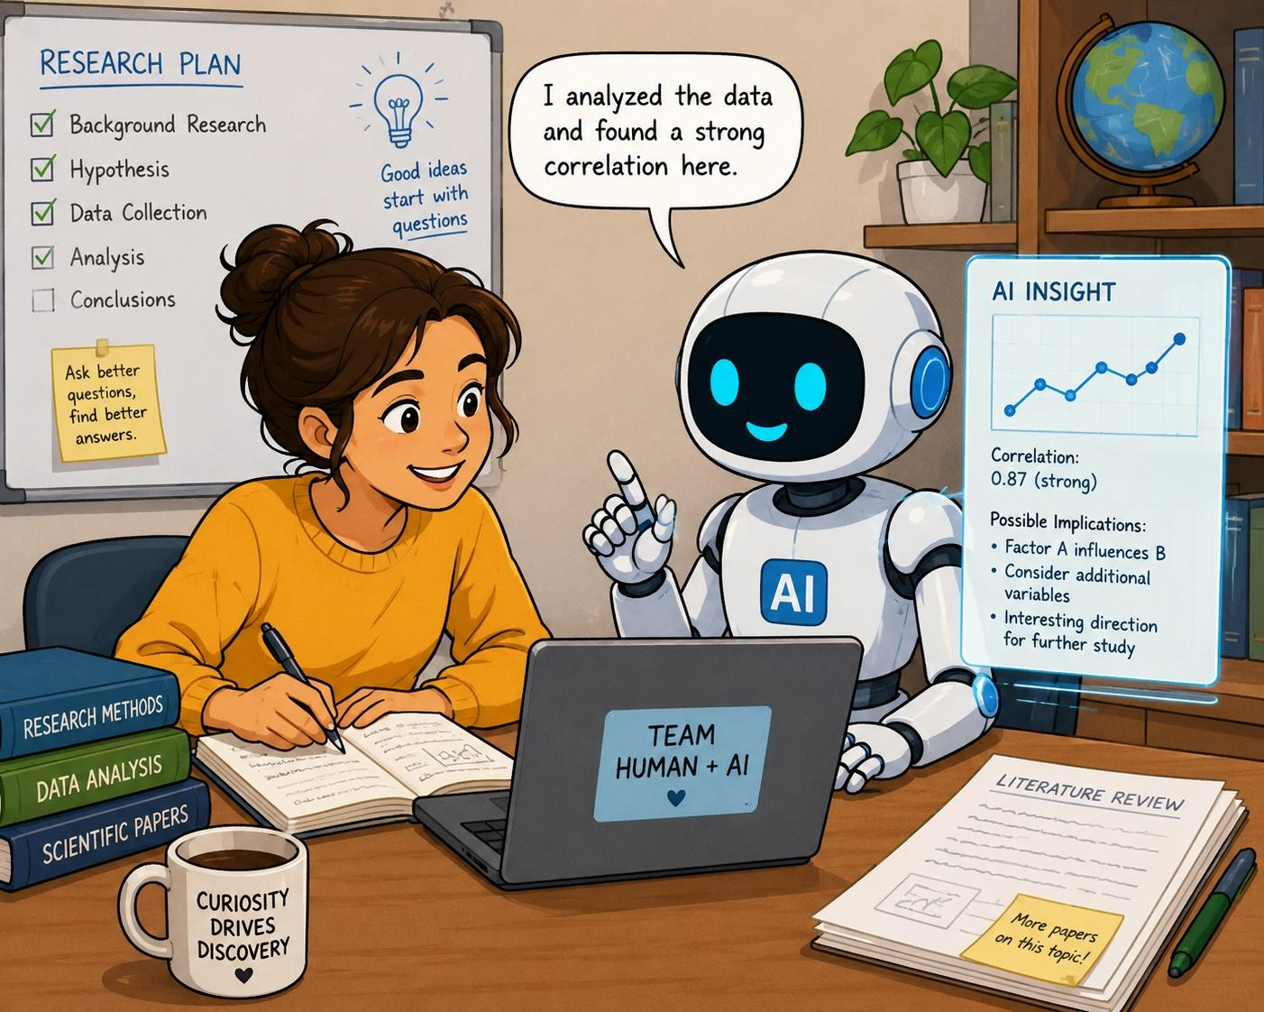
AI Assisted Research.
Notes:
We can use AI to assist our research and writing efforts.

Slide 23

Verify,
Verify,
Verify!
Notes:
No matter how we are using AI, we must verify everything before we publish anything.

Slide 24
Seven Recommendations for Leaders
From the research base — Strategic Cognitive Offloading (2026)
Design for the Arena
Invest in mixed feedback
1
5
Make AI use explicit on both sides. Specify what students delegate and why.
AI for formative structure feedback; human feedback for conceptual critique.
Close the Blind Spot
Prioritize equity first
2
6
Redesign assessments to include oral components, portfolios with AI transcripts.
Audit access before scaling expectations. Premium AI tools create compounding inequity.
Drain the Façade
Commission longitudinal research
3
7
Show students what Zone 2 costs: have them fact-check 5 AI claims against source text.
Track AI-integrated cohorts over time. The field is making durable decisions on preliminary data.
Build AI literacy explicitly
"These are not insurmountable problems.
They are pedagogical problems — and they yield to pedagogical solutions."
4
Evaluating AI outputs, recognizing hallucinations, citing AI use — teach these as skills.

Slide 25
Discussion & Reflection
Turn and talk — or full group
Where does your district live?
What decision are you ceding?
Which Phase (1–4) most accurately describes AI integration in your schools right now? What would it look like to move to the next phase intentionally — rather than accidentally?
Ward's warning: we adopt AI for convenience without asking what choices we're giving up. Where in IEPs, grading, curriculum selection, or hiring — is a meaningful human judgment point at risk?
What's your biggest Blind Spot?
What will you try first?
Where is AI use happening in your district that you can't see? What assessment redesign would make that use visible — without becoming surveillance?
Of the three things worth trying: the audit, the Arena assignment, or the Loop conversation — which one will you take back to your school or team this week?

Slide 26
The Kairos Moment
The emerging picture isn't 'AI is good for learning' any more than it was ever 'AI is bad for learning.' The key message from the research is that AI is a design variable — and like every design variable, its impact depends entirely on the decisions made by the person who shapes the interaction.
Zone 2 is real
Undesigned AI use erodes thinking. The critics are right about that.
Zone 3 is real too
Intentionally designed AI use deepens learning. Both things are true.
Design is the work
The research now tells us what good AI-integrated learning looks like. The work ahead is building institutions that can act on it.
"As we have opportunity (kairos), let us do good." — Galatians 6:10

