Slide 1
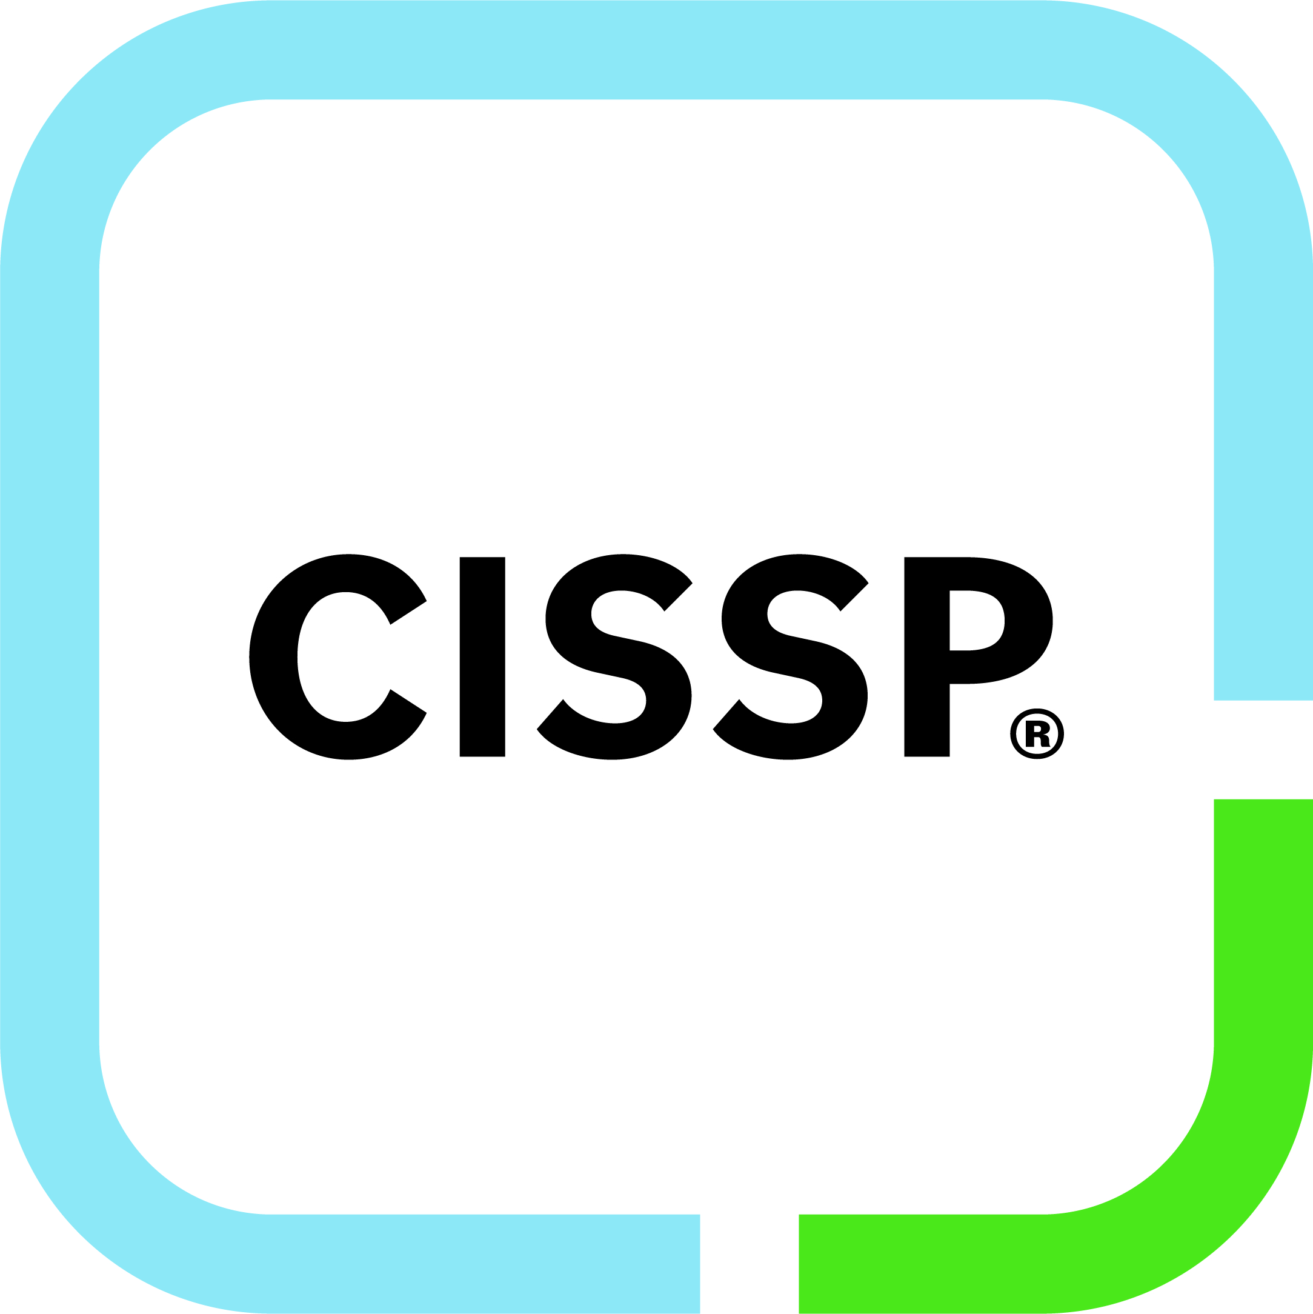

Are in interested in taking the CISSP?
Presented by Sam Quantz, CISSP​

Slide 2
Agenda
Cybersecurity Certification Options
What is the CISSP and why I chose it
My preparation journey
Taking the test
Getting and staying certified
Q&A

Slide 3

Cybersecurity Certifications
CompTIA Security+ - Entry Level
CompTIA CySA+ (Cybersecurity Analyst) – Threat detection and incident response
GIAC certifications – security operations, analysis, incident response, etc.
ISC2 Certified Information Systems Auditor (CISA) – Auditing and compliance
ISC2 Certified Information Systems Manager (CISM) – Security management and detection
ISC2 Certified Information Systems Security Professional (CISSP) – Broad, enterprise-wide security leadership
This Photo by Unknown Author is licensed under CC BY-NC-ND

Slide 4
Eight CISSP Domains (scaled score 700/1000 Passing)
Domain | Description | % of Test
Security and Risk Management | Security policies, standards, and procedures Risk management frameworks (e.g., NIST, ISO 27001) Legal, regulatory, and compliance requirements Business continuity and disaster recovery concepts Ethics and professional conduct | 16%
Asset Security | Data classification (public, confidential, etc.) Data ownership and stewardship Data lifecycle management (creation → storage → destruction) Privacy protection and handling sensitive data | 10%

Slide 5
CISSP Domains Cont.
Domain | Description | % of Test
Security Architecture and Engineering | Security models (e.g., Bell-LaPadula, Biba) Cryptography and encryption methods Hardware and system security Secure design principles (e.g., least privilege, defense in depth) Vulnerability mitigation | 13%
Communication and Network Security | Network architecture and secure design Firewalls, VPNs, IDS/IPS Secure communication protocols (TLS, IPsec) Network attacks and mitigations | 13%

Slide 6
CISSP Domains Cont.
Domain | Description | % of Test
Identity and Access Management | Authentication (MFA, biometrics) Authorization and access control models (RBAC, ABAC) Identity lifecycle management Privileged access management | 13%
Security Assessment and Testing | Vulnerability assessments and penetration testing Security audits and compliance checks Testing strategies and metrics Continuous monitoring | 12%

Slide 7
CISSP Domains Cont.
Domain | Description | % of Test
Security Operations | Incident response and handling Logging and monitoring (SIEM) Disaster recovery execution Change management Physical security | 13%
Software Development Security | Secure SDLC (Software Development Life Cycle) Application vulnerabilities (OWASP Top 10) Code review and testing DevSecOps practices | 10%

Slide 8

My Study Tools
Physical textbook
Audio textbook
Pluralsight course
ISC2 Official Exam Prep App – Subscription cost
Picked topics for discussion in my weekly team meetings
Offered Training at UETN Tech Summit 2025
Other Recommended
Study Group

Slide 9
Taking the test
Cost
  $749 ($50 reschedule fee, $100 cancellation fee)
  For about $249 more, you can purchase the exam plus a retake
Provider
  Pearson Vue
Length
  3 hours

Slide 10
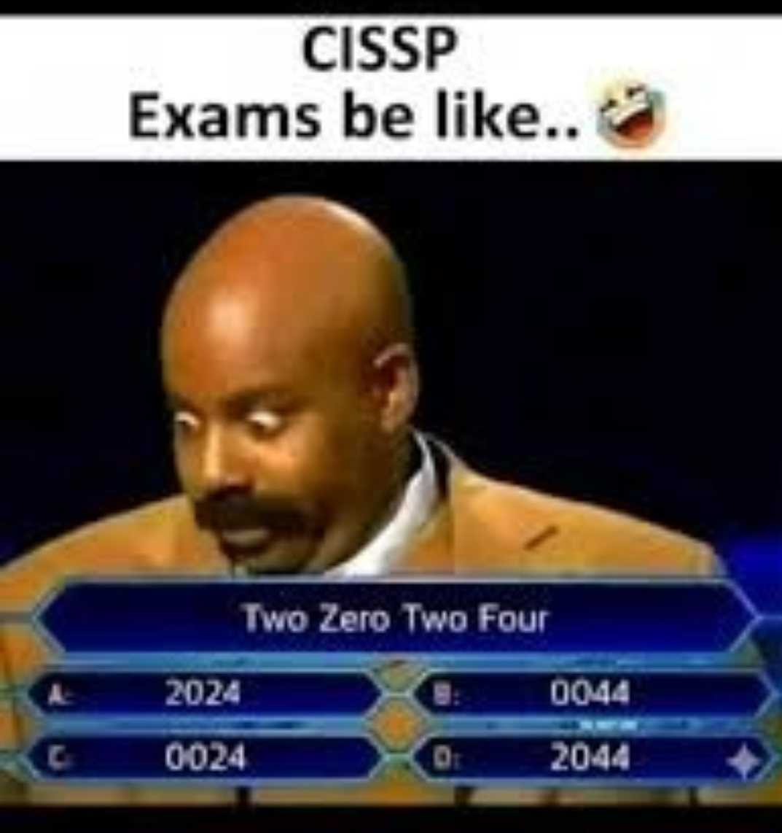

Slide 11

Getting and Remaining Certified
Certification Requirements
Experience: 5 years full-time in 2+ domains (4 years with degree or approved credential)
Education/Credential Waiver: 1-year reduction possible
Associate Pathway: 6 years to complete experience if exam passed early
Exam: CISSP exam covering 8 domains, minimum 700/1000 points
Endorsement: Required from an ISC2-certified professional
Maintenance: 120 Continuing Professional Education (CPE) Credits over 3 years.

Slide 12
Q&A

