Slide 1

Widening WIDA Speaking Opportunities
Greg Davis, Tumwater School District
Widening WIDA Speaking Opportunities - WABE 2026 - Greg Davis, Tumwater School District

Slide 2
Agenda
Audience Polling
Speaker Journey
Speaking Prompts
Rubric Practice
AI Prompting
Q&A
Widening WIDA Speaking Opportunities - WABE 2026 - Greg Davis, Tumwater School District

Slide 3
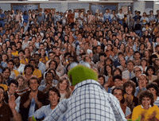
Who’s in the room?
Teachers
Elementary
Middle
High
Administrators
Support Personnel
Widening WIDA Speaking Opportunities - WABE 2026 - Greg Davis, Tumwater School District

Slide 4
Agenda
Audience Polling
Speaker Journey
Speaking Prompts
Rubric Practice
AI Prompting
Q&A
Widening WIDA Speaking Opportunities - WABE 2026 - Greg Davis, Tumwater School District

Slide 5
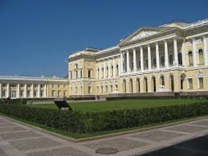


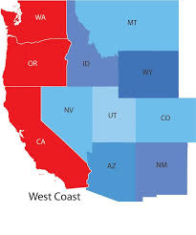





Journey
Widening WIDA Speaking Opportunities - WABE 2026 - Greg Davis, Tumwater School District

Slide 6
Agenda
Audience Polling
Speaker Journey
Speaking Prompts
Rubric Practice
AI Prompting
Q&A
Widening WIDA Speaking Opportunities - WABE 2026 - Greg Davis, Tumwater School District

Slide 7
Key Language Uses (KLU)
Task 1
Daily #1-4: Inform
Summative #5-6: Narrate (Argue)
Widening WIDA Speaking Opportunities - WABE 2026 - Greg Davis, Tumwater School District

Slide 8




Task 1.1
What things do you see in the picture? Make a list.
Describe what is happening in the picture.
How do you relate to this picture (reminder, past experience, etc.)?

Slide 9
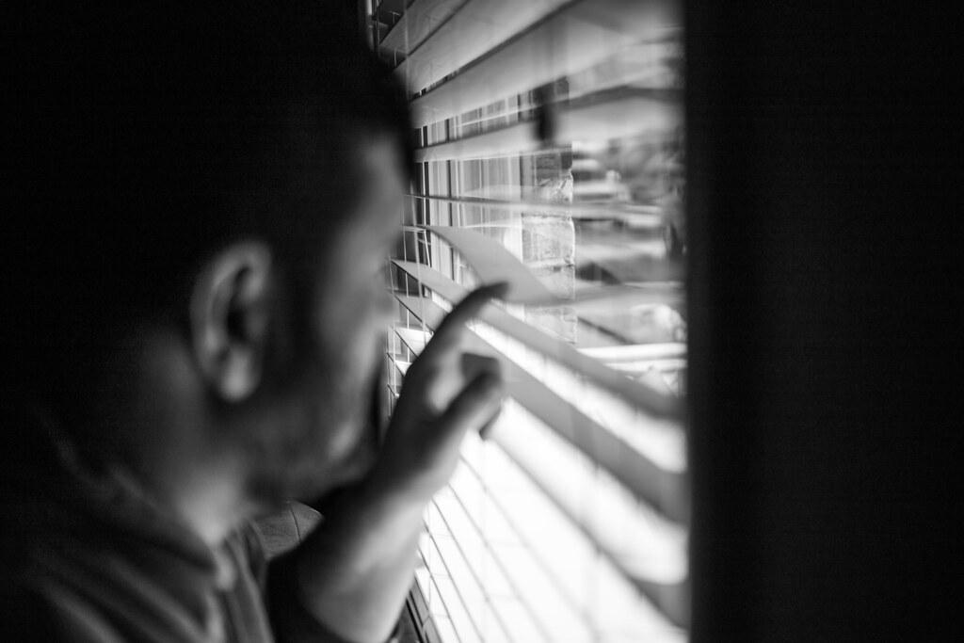
Task 1.2
What things do you see in the picture? Make a list.
Describe what is happening in the picture.
How do you relate to this picture (reminder, past experience, etc.)?

Slide 10
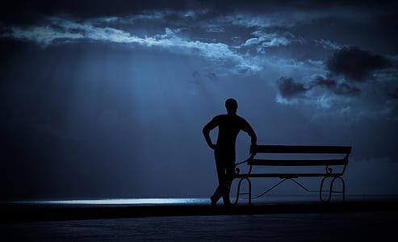
Task 1.3
What things do you see in the picture? Make a list.
Describe what is happening in the picture.
How do you relate to this picture (reminder, past experience, etc.)?

Slide 11
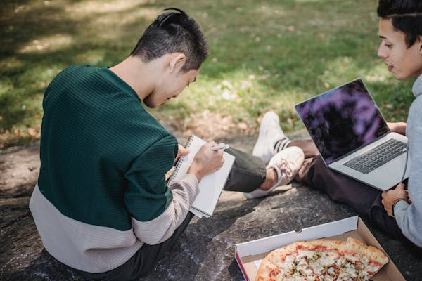
Task 1.4
What things do you see in the picture? Make a list.
Describe what is happening in the picture.
How do you relate to this picture (reminder, past experience, etc.)?

Slide 12






Task 1.5
Look at the pictures. They show a story about Peter trying to study.
Tell the story from start to finish.
(Discuss which part was your favorite? Why?)

Slide 13
Key Language Uses (KLU)
Task 2
Daily #1-4: Inform
Summative #5-6: Explain
Widening WIDA Speaking Opportunities - WABE 2026 - Greg Davis, Tumwater School District

Slide 14


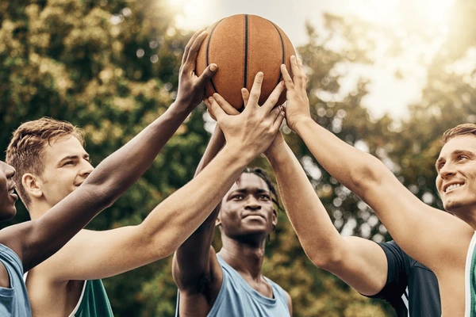
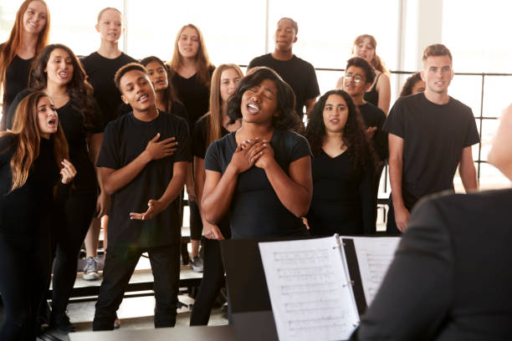
Task 2.5
Look at the pictures. They show a number of different clubs that are available to join.
Chess Club
Diversity Club
Explain which club you prefer to join. Give reasons for your decision. Use academic English rather than slang.
Music Club
Basketball Club

Slide 15
Key Language Uses (KLU)
Task 3
Daily #1-5: Inform
Summative #6: Explain #7-8: Narrate
Widening WIDA Speaking Opportunities - WABE 2026 - Greg Davis, Tumwater School District

Slide 16
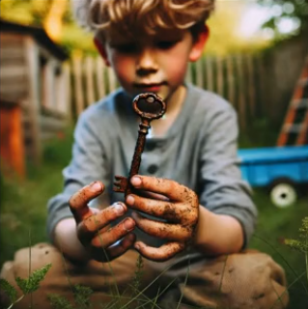
Task 3.1
1. What things do you see in the picture? Make a list.
2. Describe what is happening in the picture using a complex sentence(s)
3. How do you relate to this picture (Start with “How I relate to this picture…”)?

Slide 17
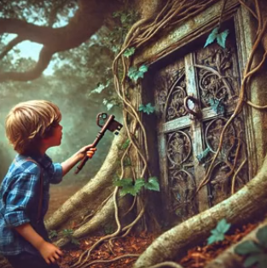
Task 3.2
1. What things do you see in the picture? Make a list.
2. Describe what is happening in the picture using a complex sentence(s)
3. How do you relate to this picture (Start with “It seems like …”)?

Slide 18
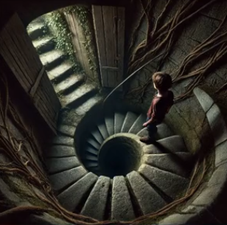
Task 3.3
What things do you see in the picture? Make a list.
Describe what is happening in the picture using a complex sentence(s)
How do you relate to this picture (Start with “Seeing this picture makes me …”)?

Slide 19
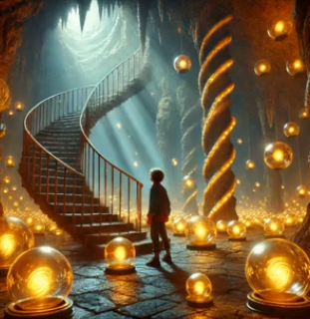
Task 3.4
What things do you see in the picture? Make a list.
Describe what is happening in the picture using a complex sentence(s)
How do you relate to this picture (Start with “I imagine that …”)?

Slide 20
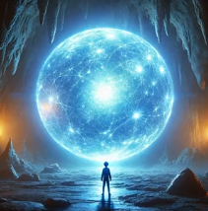
Task 3.5
1. What things do you see in the picture? Make a list.
2. Describe what is happening in the picture using a complex sentence(s)
3. How do you relate to this picture (Start with “He appears to have …”)?

Slide 21

Task 3.7
Look at the pictures. They show a story about Bradley.
Tell Bradley’s story from start to finish. Add appropriate supporting details to make this more interesting for your audience. Don’t forget to include transitions between ideas and scenes.

Slide 22
Key Language Uses (KLU)
Task 4
#1-4: Inform
#5-10: Inform & Explain
Widening WIDA Speaking Opportunities - WABE 2026 - Greg Davis, Tumwater School District

Slide 23
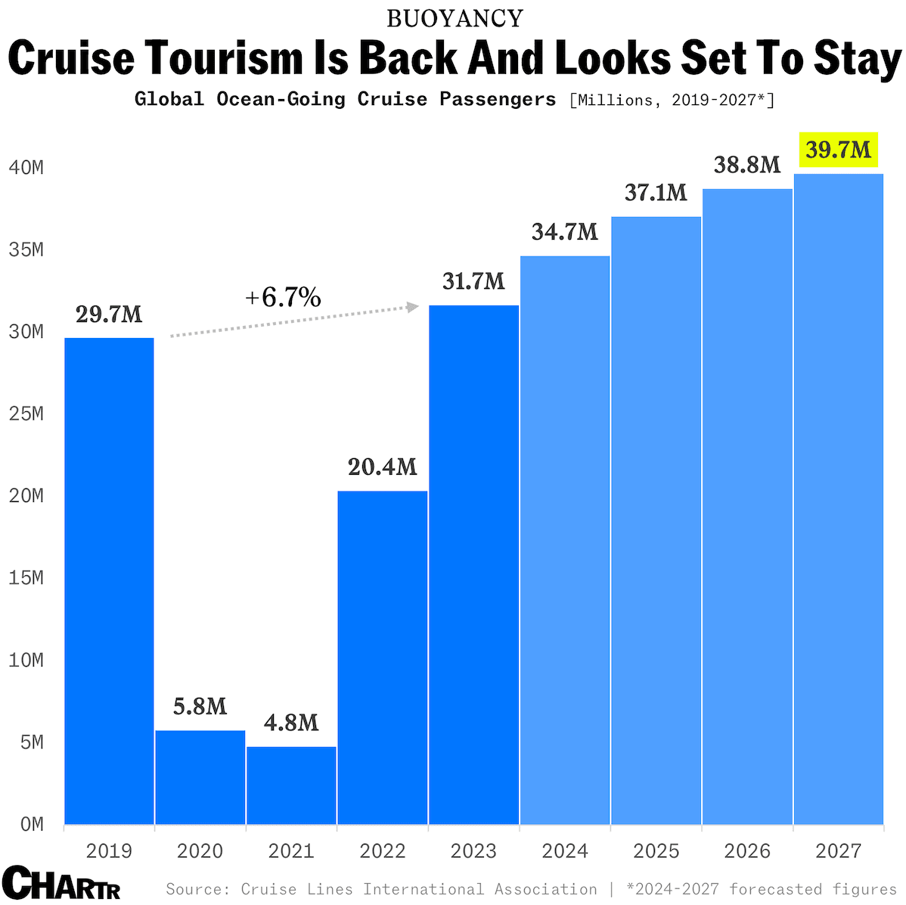
Task 4.2
1. What things do you notice about the chart? Make a list.
2. What do you wonder about this chart? Make a list of questions.
3. Add vocab from the board after the discussion.
Notes:
With cruise passengers now exceeding pre-pandemic levels, per data from the Cruise Lines International Association, companies like Virgin and Villa Vie are picking up on the world’s growing appetite for cruises.
Interestingly, in huge news for anyone looking to celebrate Bitcoin’s recent surge, the annual pass is also the first cruise product to accept the cryptocurrency as payment — perhaps reflecting the growing number of young people taking to the sea, with 1 in 2 passengers on Royal Caribbean cruises reportedly millennials or younger.

Slide 24
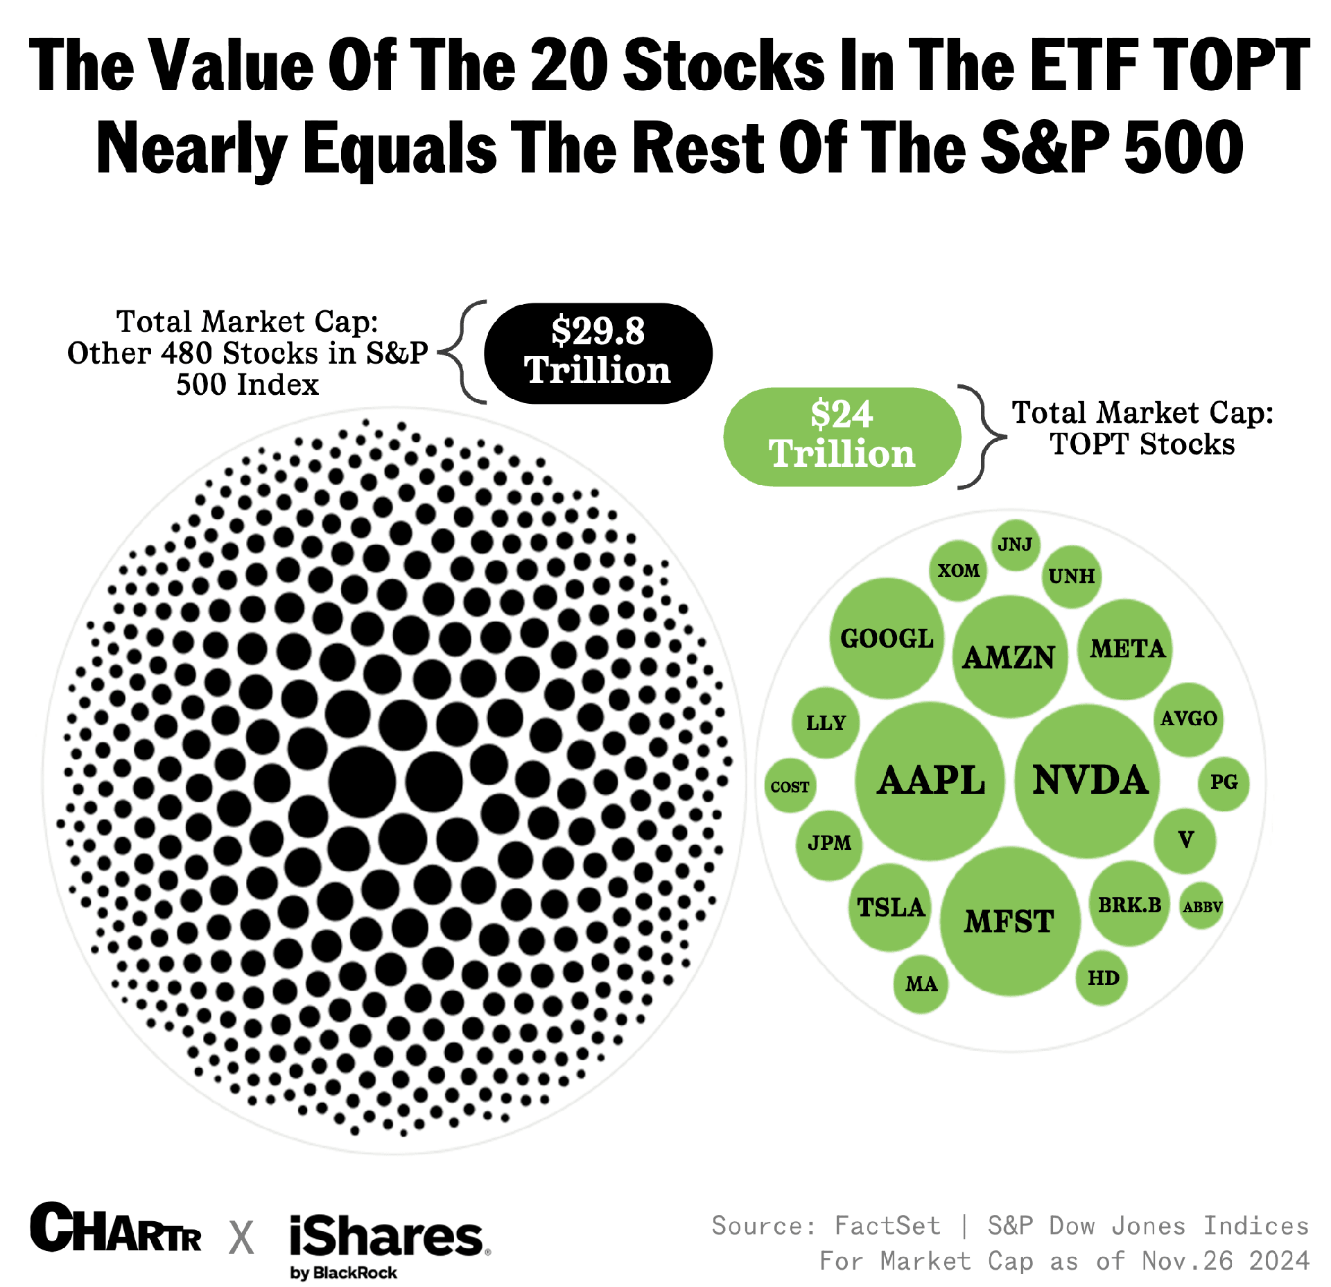
Task 4.3
1. What things do you notice about the chart? Make a list.
2. What do you wonder about this chart? Make a list of questions.
3. Add vocab from the board after the discussion.

Slide 25
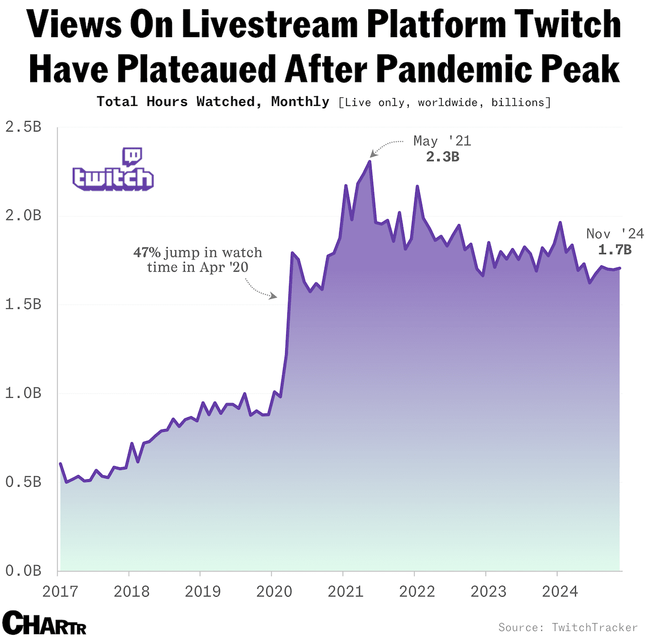
Task 4.4
1. What things do you notice about the chart? Make a list.
2. What do you wonder about this chart? Make a list of questions.
3. Add vocab from the board after the discussion.

Slide 26
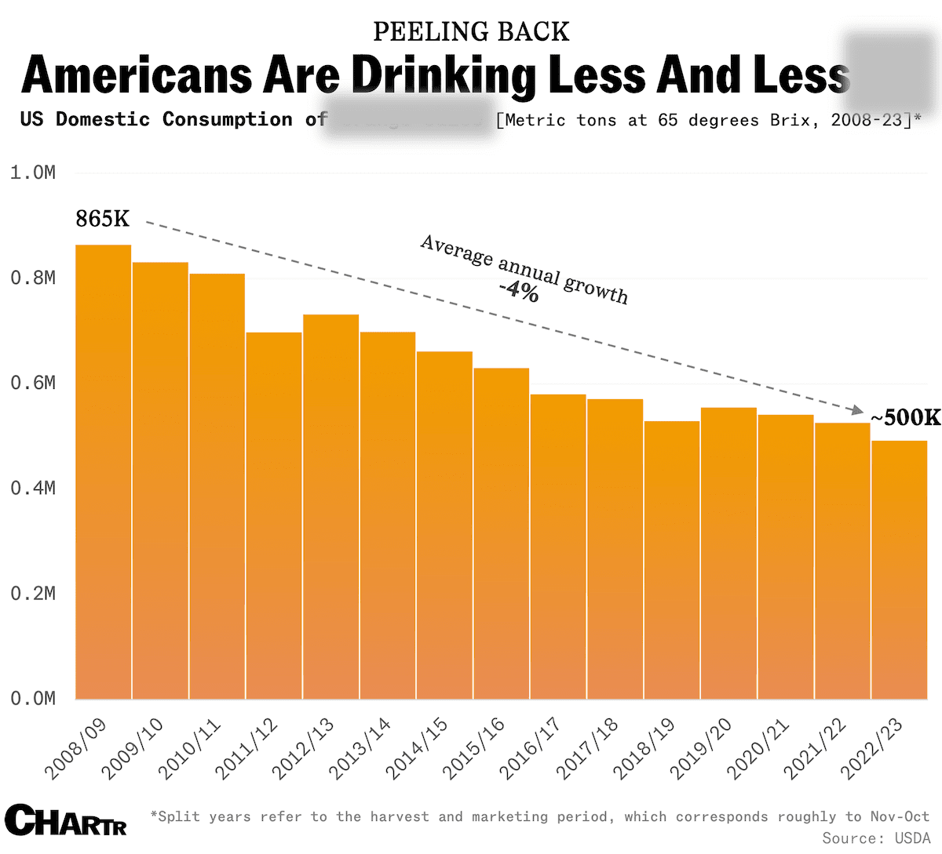
Task 4.5
1. What things do you notice about the chart? Make a list.
2. What do you wonder about this chart? Make a list of questions.
3. What drink do you think this chart is referring to? What evidence makes you think that?

Slide 27
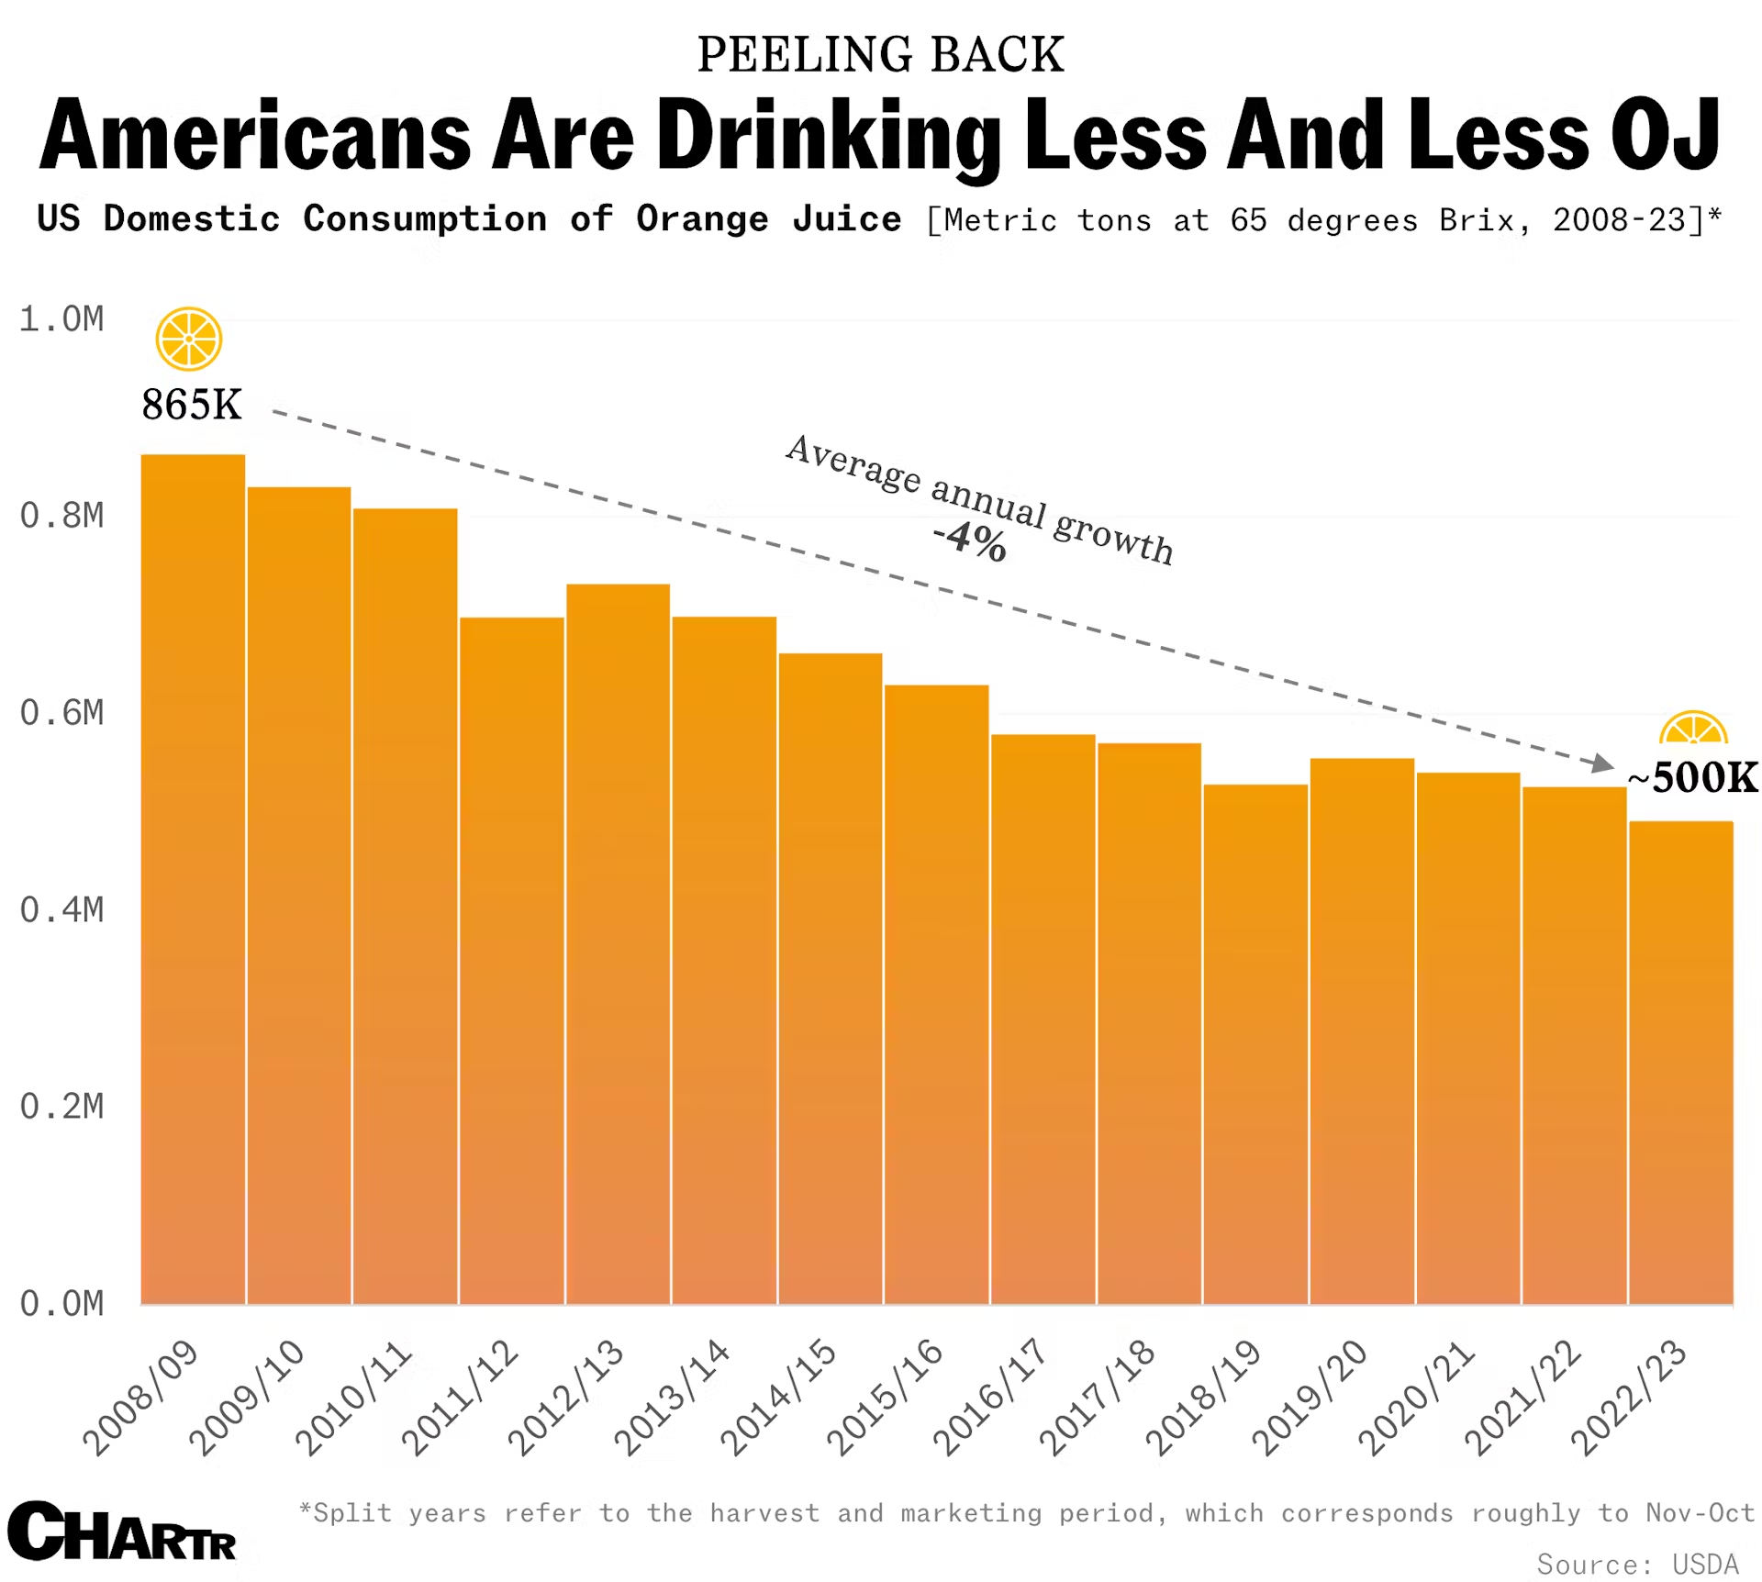
Task 4.5 cont.
1. What things do you notice about the chart? Make a list.
2. What do you wonder about this chart? Make a list of questions.
3. What drink do you think this chart is referring to? What evidence makes you think that?

Slide 28
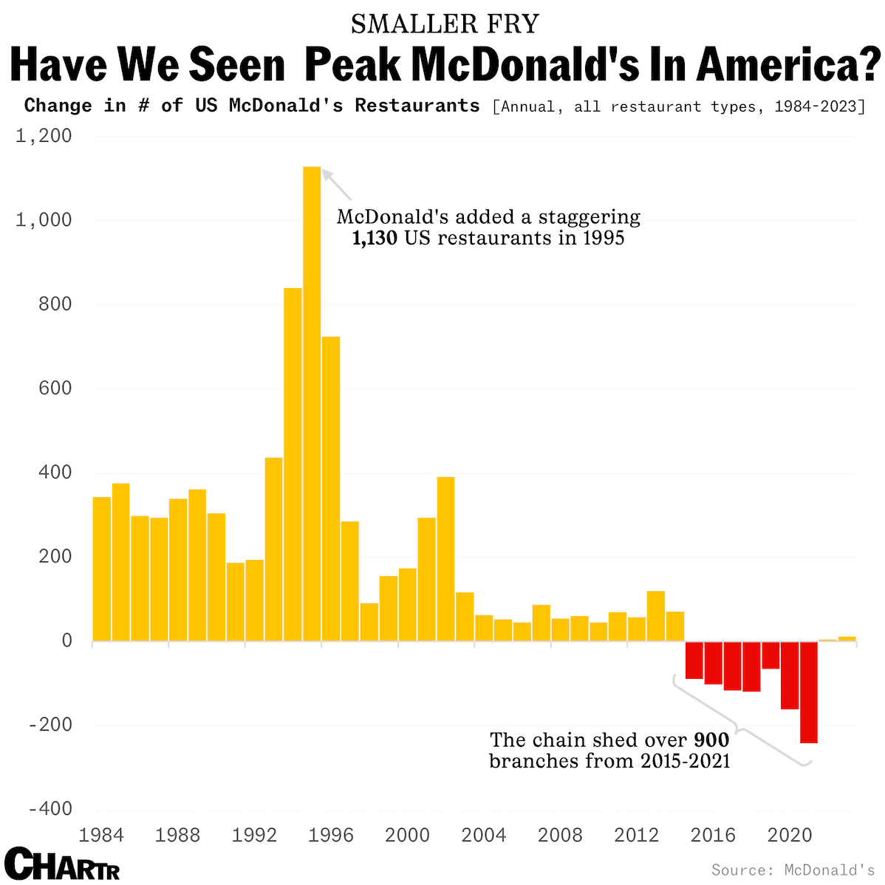
Task 4.6
1. What things do you notice about the trends in the chart? Make a list.
2. What do you wonder about this chart? Make a list of questions.
3. Write 1-2 complex sentences describing what the data in this chart communicate.

Slide 29
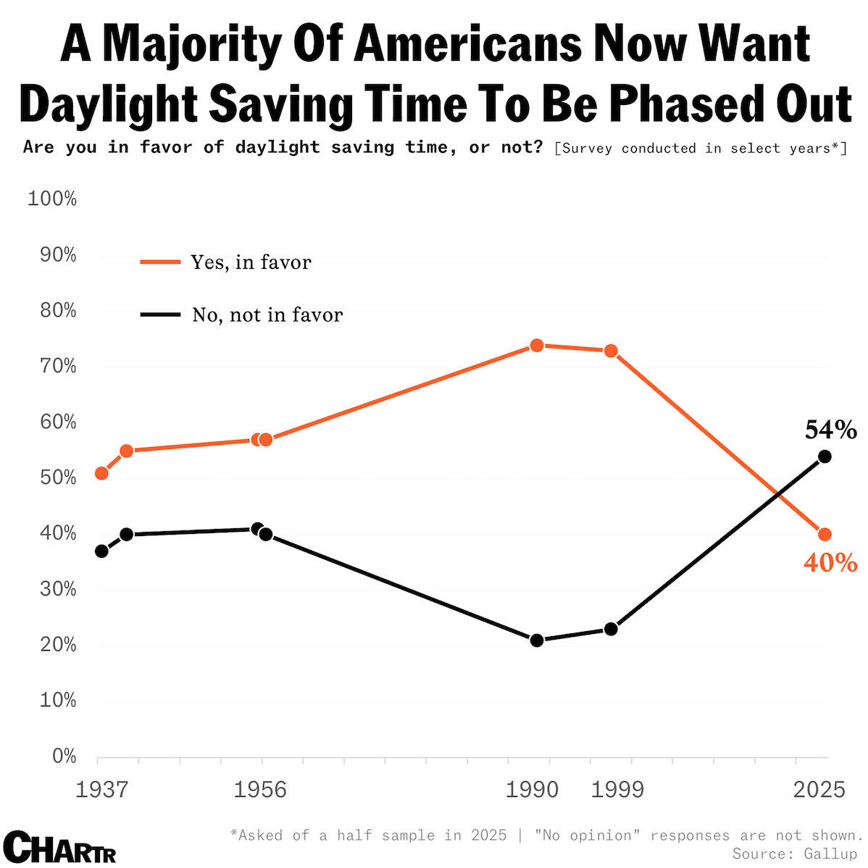
Task 4.7
1. What things do you notice about the chart? Make a list.
2. What do you wonder about this chart? Make a list of questions.
3. Write 1-2 complex sentences describing what the data in this chart communicate.

Slide 30
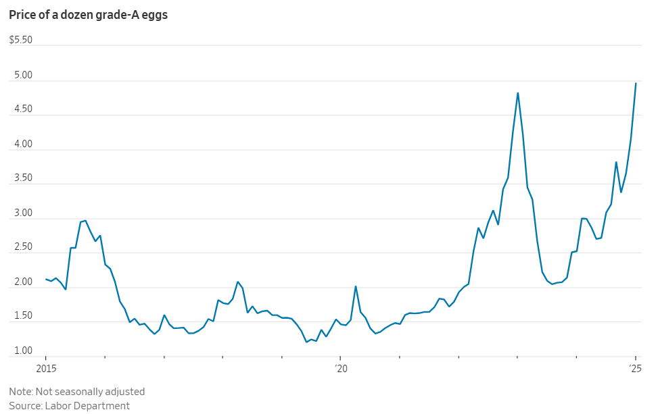
Task 4.8
1. What things do you notice about the chart? Make a bullet list.
2. What do you wonder about this chart? Write 1 question.
3. Write 1-2 complex sentences describing what the data in this chart communicate.

Slide 31
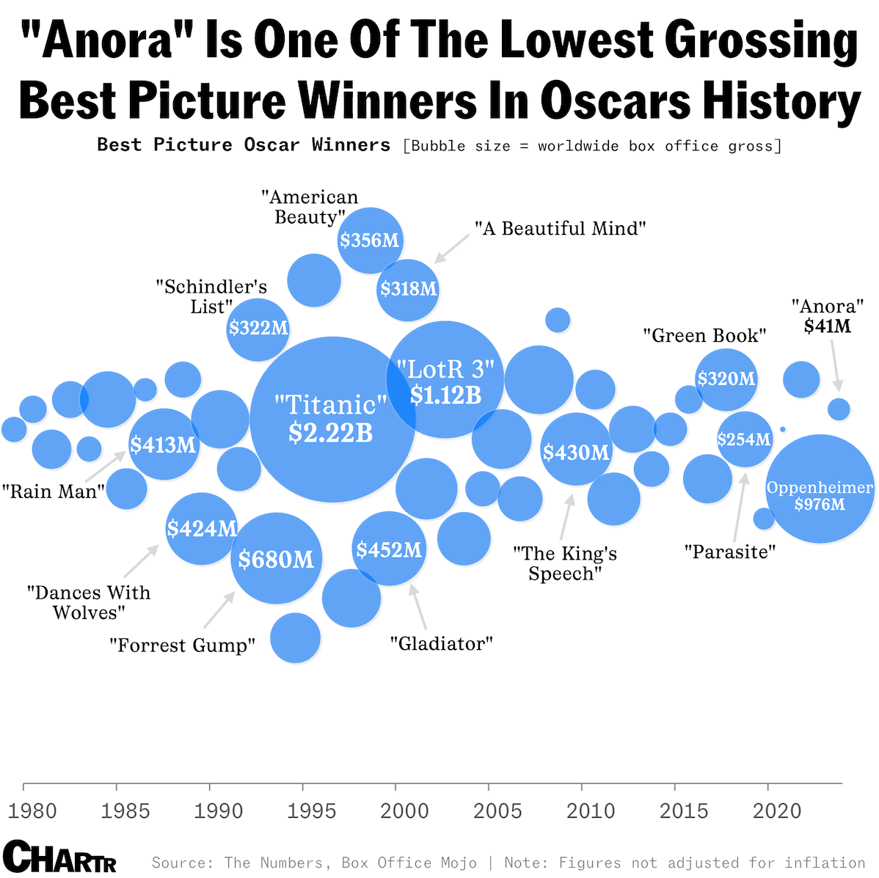
Task 4.9
1. What things do you notice about the chart? Make a list.
2. What do you wonder about this chart? Make a list of questions.
3. Add vocab from the board after the discussion.

Slide 32
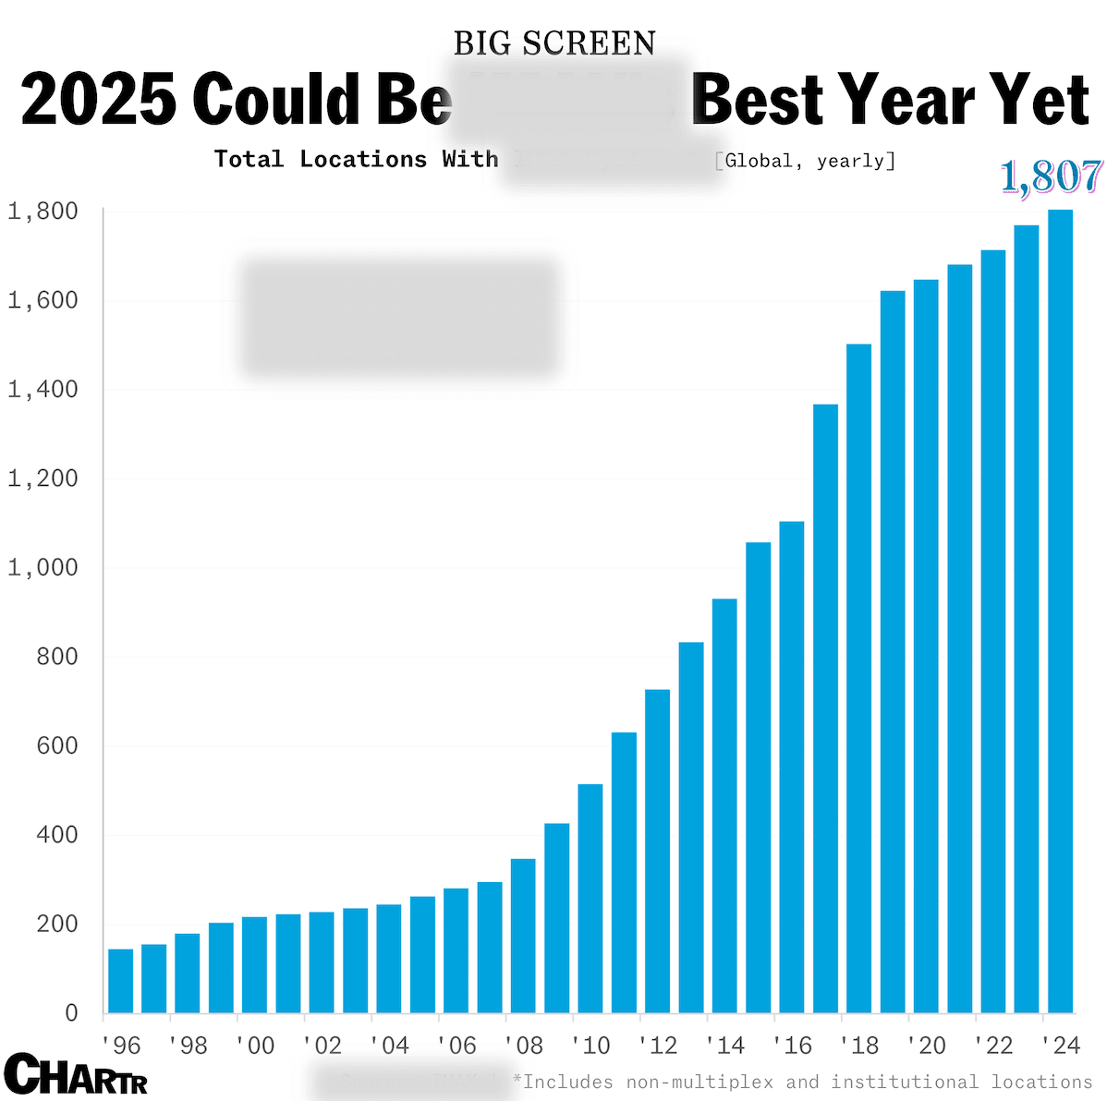
Task 4.10
1. What things do you notice about the chart? Make a list.
2. What do you wonder about this chart? Make a list of questions.
3. What type of theater do you think this chart is referring to? What evidence makes you think that?

Slide 33
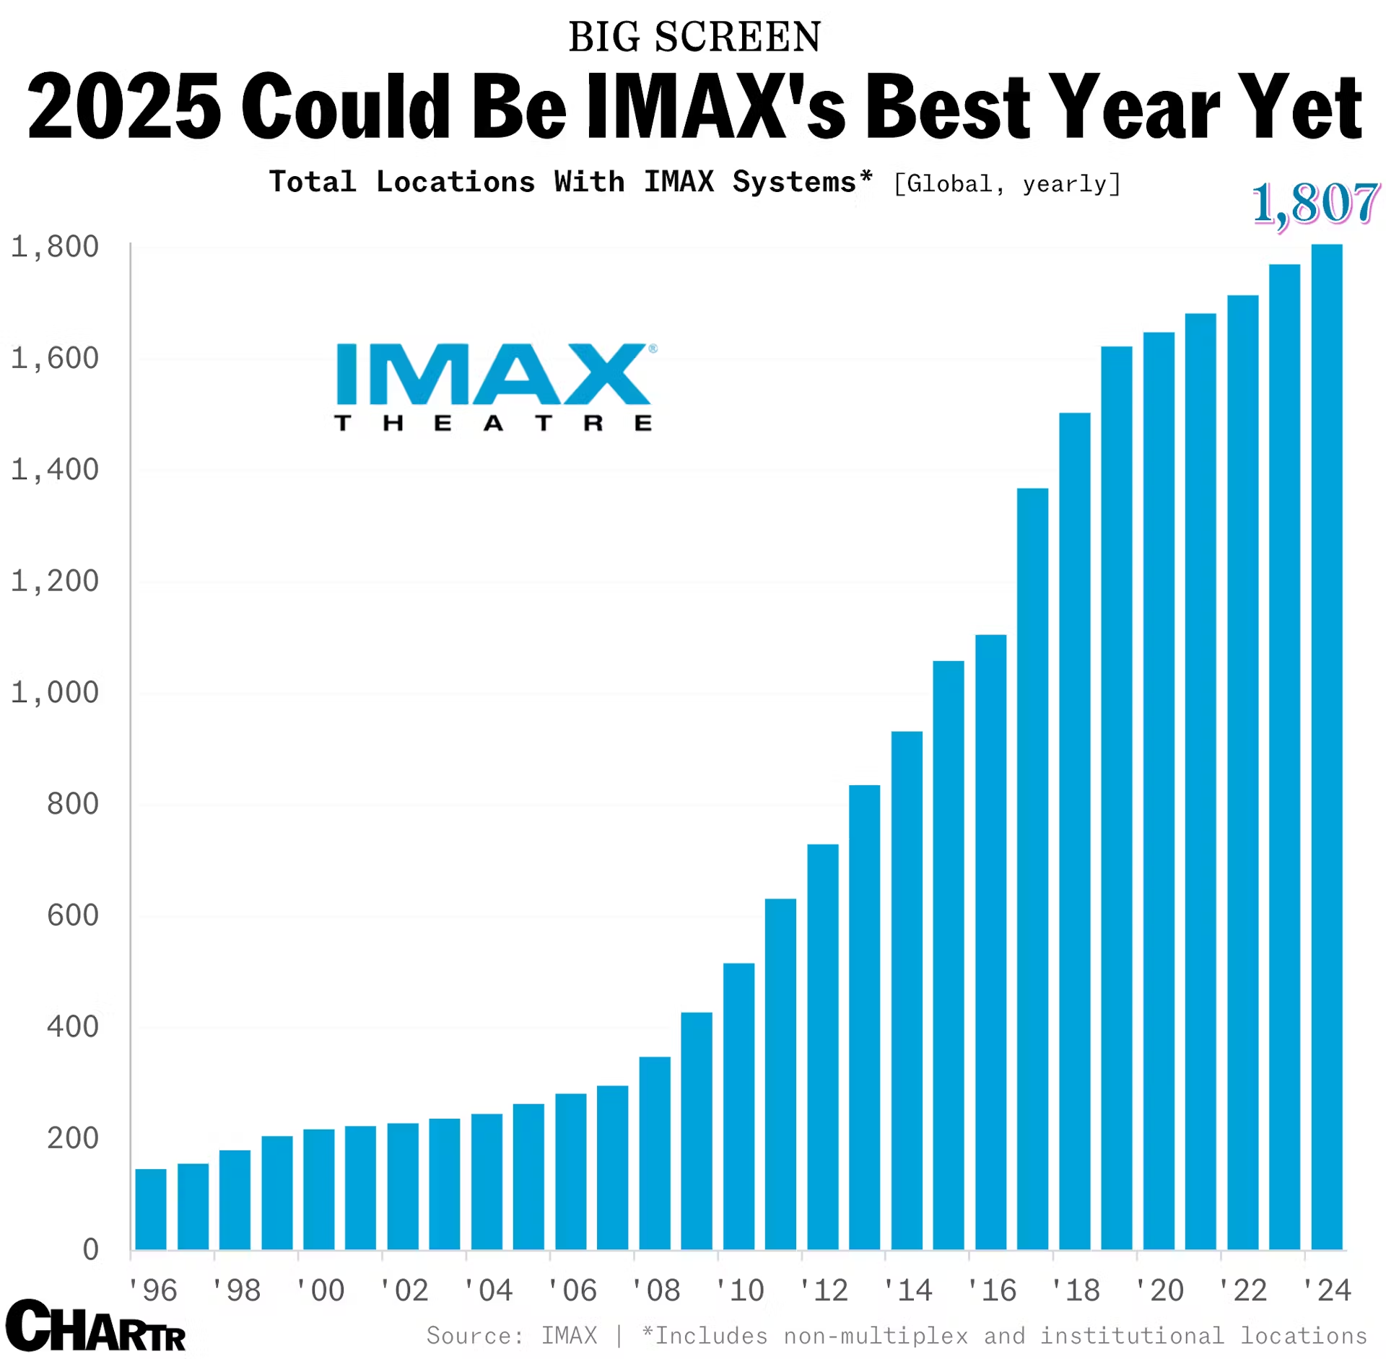
Task 4.10 cont.
1. What things do you notice about the chart? Make a list.
2. What do you wonder about this chart? Make a list of questions.
3. What type of theater do you think this chart is referring to? What evidence makes you think that?

Slide 34
Key Language Uses (KLU)
Task 5
#1-5: Inform
#6-7: Narrate
Widening WIDA Speaking Opportunities - WABE 2026 - Greg Davis, Tumwater School District

Slide 35

Task 5.1
1. What things do you see in the picture? Make a list.
2. Describe what is happening in the picture using a complex sentence(s)
3. How do you relate to this picture (Start with “How I relate to this picture…”)?

Slide 36

Task 5.2
1. What things do you see in the picture? Make a list.
2. Describe what is happening in the picture using a complex sentence(s)
3. How do you relate to this picture (Start with “From the look in her eyes, I can tell …”)?

Slide 37
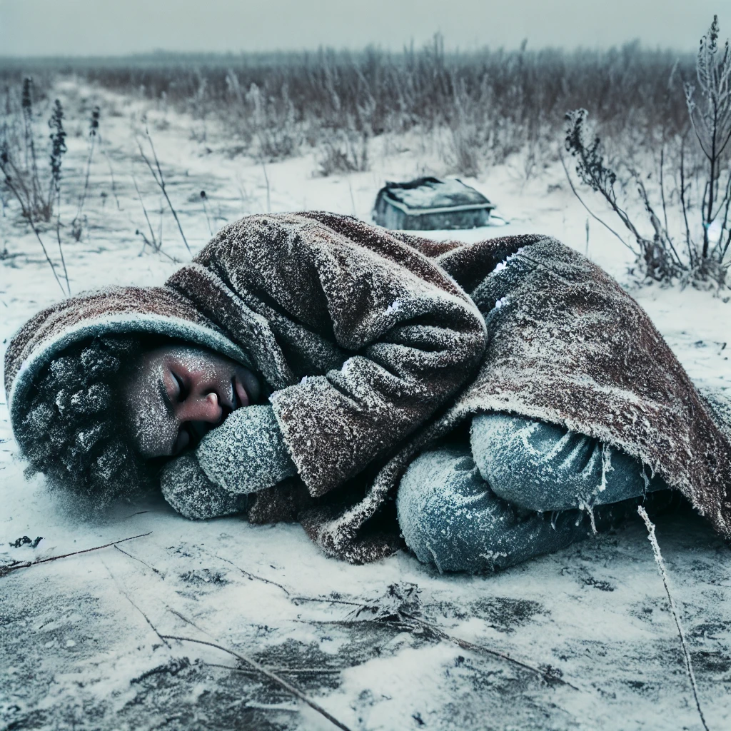
Task 5.3
What things do you see in the picture? Make a list of 5 things.
Describe what is happening in the picture using 3 sentences. (Remember to use complex and compound structures.)

Slide 38

Task 5.4
What things do you see in the picture? Make a list of 5 things.
Describe what is happening in the picture using a complex sentence(s)
How do you relate to this picture (Start with “If I were in that situation, …”)?

Slide 39

Task 5.5
1. What things do you see in the picture? Make a list.
2. Describe what is happening in the picture using a complex sentence(s)
3. How do you relate to this picture (Start with “I would be feeling ___ if I …”)?

Slide 40
Task 5.6
Look at the pictures. They show a story about Rikeesha.
Tell Rikeesha’s story from start to finish. Add appropriate supporting details to make this more interesting for your audience. Don’t forget to include transitions between ideas and scenes.

Slide 41
Key Language Uses (KLU)
Task 6
#1-4: Inform
#5-6: Explain
Widening WIDA Speaking Opportunities - WABE 2026 - Greg Davis, Tumwater School District

Slide 42
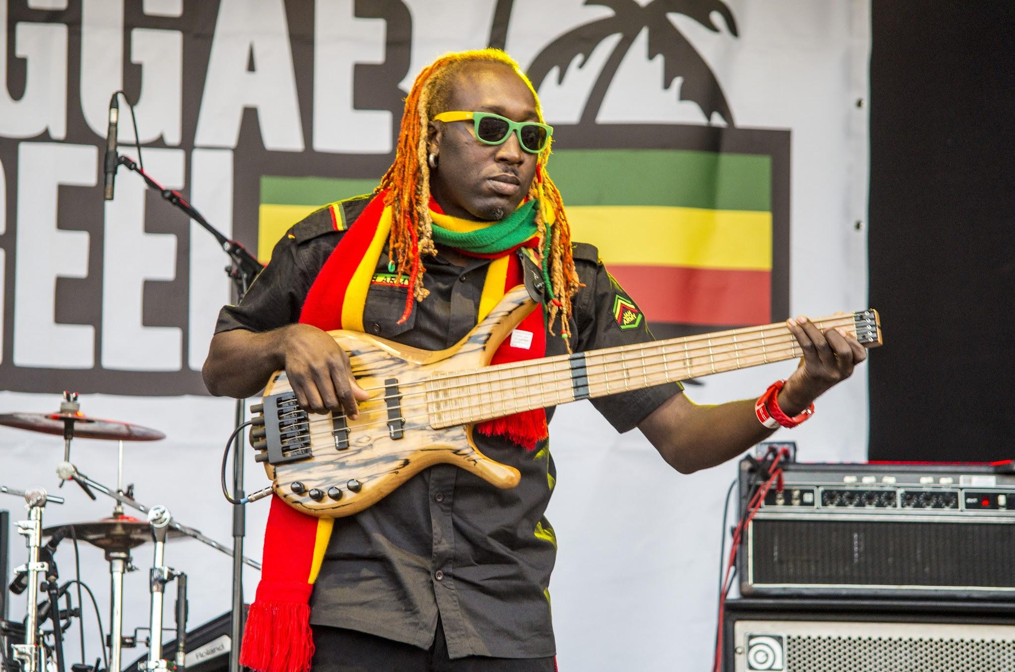
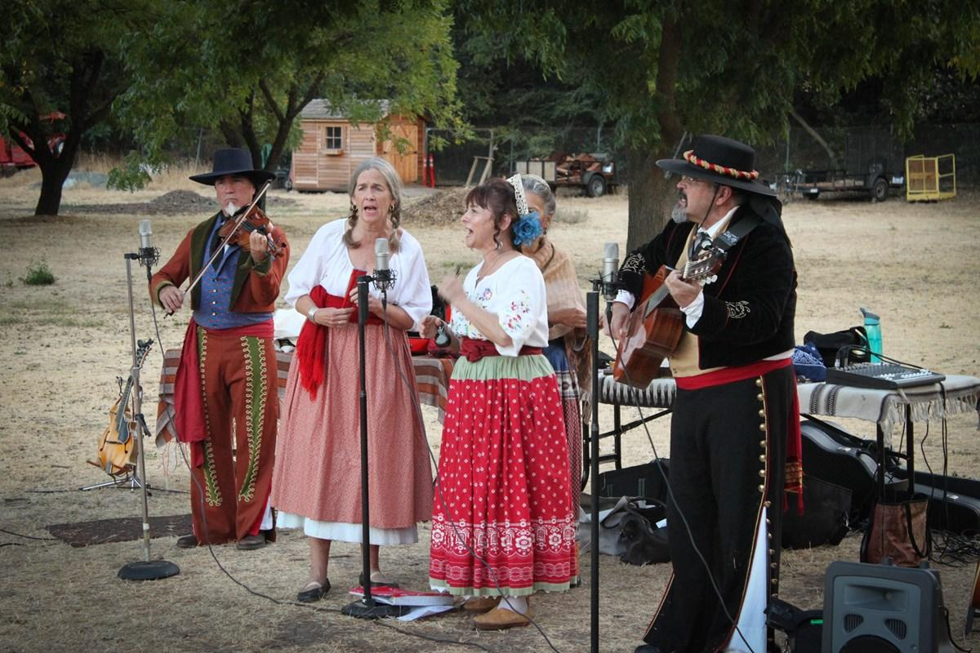
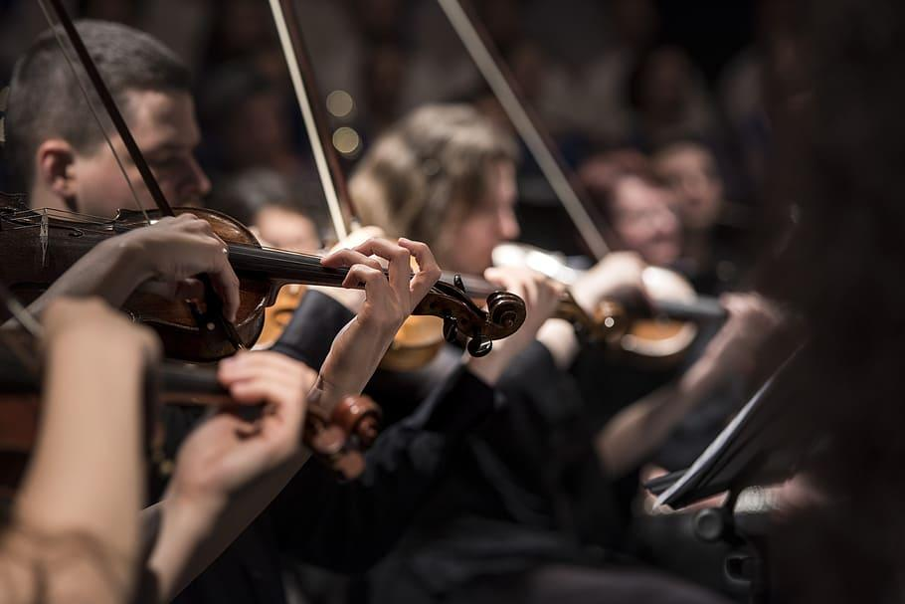
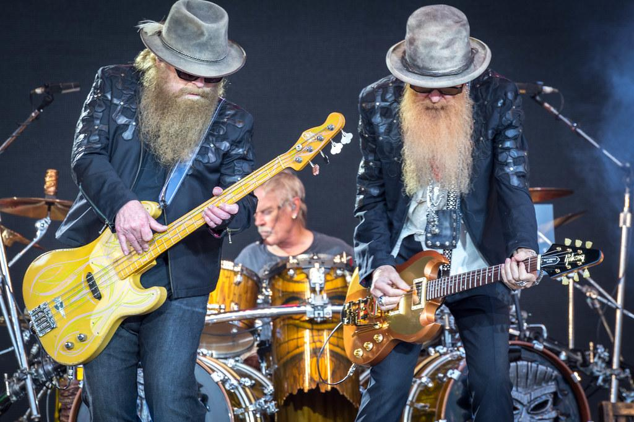
Task 6.5
Look at the pictures. They show a number of different styles of music.
Reggae
Folk
Record yourself telling which music style or styles you prefer. Give examples and reasons for your decision. Speak for 45 seconds to 1 minute using academic English.
Classical
Heavy Metal

Slide 43
Key Language Uses (KLU)
Task 7
#1-4: Inform
#5-6: Narrate #7: Argue
Widening WIDA Speaking Opportunities - WABE 2026 - Greg Davis, Tumwater School District

Slide 44
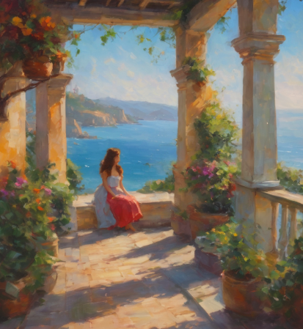
Task 7.1
What things do you see in the picture? Make a list of 5 things.
Describe what is happening in the picture using 3 sentences. (Remember to use complex and compound structures.)

Slide 45
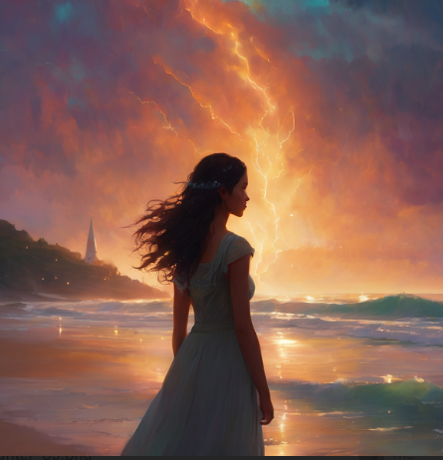
Task 7.2
What things do you see in the picture? Make a list of 5 things.
Describe what is happening in the picture using 3 sentences. (Remember to use complex and compound structures.)

Slide 46
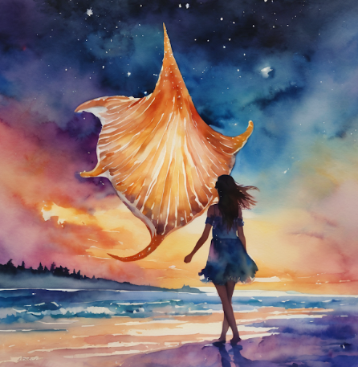
Task 7.3
What things do you see in the picture? Make a list of 5 things.
Describe what is happening in the picture using 3 sentences. (Remember to use complex and compound structures and include descriptive vocabulary.)

Slide 47
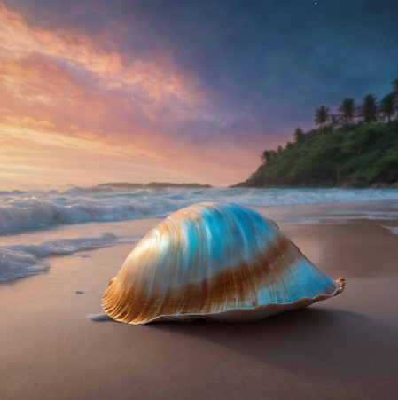
Task 7.4
What things do you see in the picture? Make a list of 5 things.
Describe what is happening in the picture using 3 sentences. (Remember to use complex and compound structures.)

Slide 48
Task 7.5
Look at the pictures. They show a story about Anna.
Record yourself telling Anna’s story. Be sure to include appropriate supporting details to make this more interesting for your audience. Don’t forget to include conflict, climax, and resolution.

Slide 49
Task 7.7
Look at the pictures. They show a story about Anna.
Which picture or scene from the story is the most powerful? Give reasons to justify why you believe it is the most compelling. Be sure to refute a counterargument in your response.

Slide 50
Agenda
Audience Polling
Speaker Journey
Speaking Prompts
Rubric Practice
AI Prompting
Q&A
Widening WIDA Speaking Opportunities - WABE 2026 - Greg Davis, Tumwater School District

Slide 51
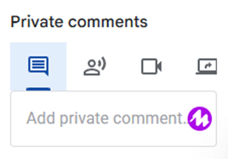
Rubric Practice
Students record their responses & submit them.
Provide feedback in multiple ways
Written feedback
Oral feedback (Google or Mote)
Video feedback
Screen recording?
Grading
15 points for initial recording
5 points for response to feedback
Example Mote
Widening WIDA Speaking Opportunities - WABE 2026 - Greg Davis, Tumwater School District

Slide 52
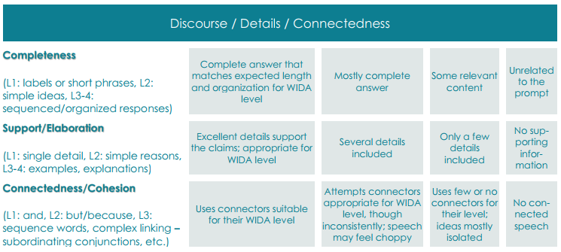
Rubric Practice
Sample 1
Prompt: 9/11
R 4.6
L 3.2
S 1.0
W 4.0
Overall (3.2)
Widening WIDA Speaking Opportunities - WABE 2026 - Greg Davis, Tumwater School District

Slide 53
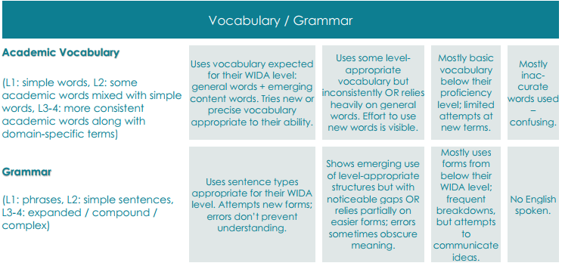
Rubric Practice
Sample 1
Prompt: 9/11
R 4.6
L 3.2
S 1.0
W 4.0
Overall (3.2)
Widening WIDA Speaking Opportunities - WABE 2026 - Greg Davis, Tumwater School District

Slide 54
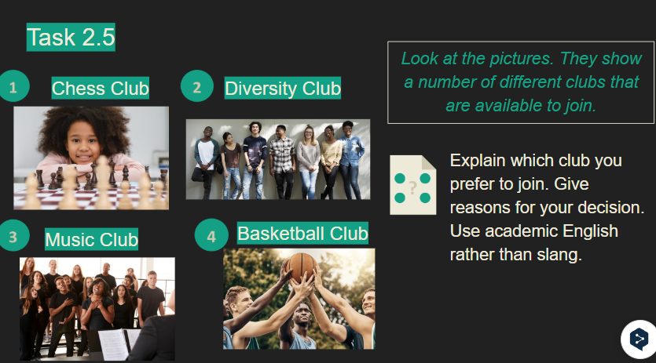
Rubric Practice
Sample 2
Prompt: Task 2.6 Clubs
R 3.0
L 4.3
S 1.8
W 2.8
Overall (2.9)
Widening WIDA Speaking Opportunities - WABE 2026 - Greg Davis, Tumwater School District

Slide 55
Rubric Practice
Sample 2
Prompt: Task 2.6 Clubs
R 3.0
L 4.3
S 1.8
W 2.8
Overall (2.9)
Widening WIDA Speaking Opportunities - WABE 2026 - Greg Davis, Tumwater School District

Slide 56

Rubric Practice
Sample 3
Prompt: Ch. 1 Novel
R 2.5
L 1.9
S 2.6
W 1.9
Overall (1.8)
Widening WIDA Speaking Opportunities - WABE 2026 - Greg Davis, Tumwater School District

Slide 57
Rubric Practice
Sample 3
Prompt: Ch. 1 Novel
R 2.5
L 1.9
S 2.6
W 1.9
Overall (1.8)
Widening WIDA Speaking Opportunities - WABE 2026 - Greg Davis, Tumwater School District

Slide 58
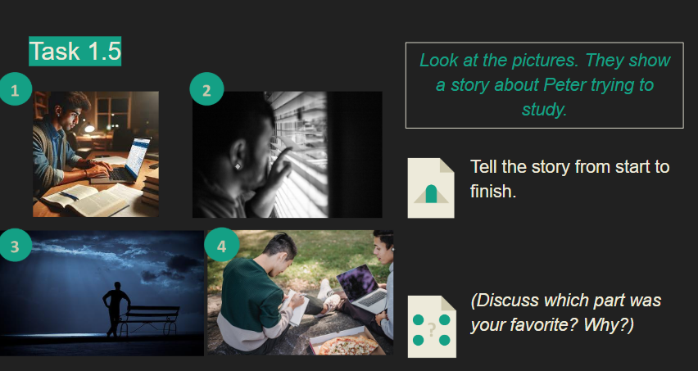
Rubric Practice
Sample 4
Prompt: Peter’s Story
R 1.0
L 1.0
S 1.0
W 1.0
Overall (1.0)
Widening WIDA Speaking Opportunities - WABE 2026 - Greg Davis, Tumwater School District

Slide 59
Rubric Practice
Sample 4
Prompt: Peter’s Story
R 1.0
L 1.0
S 1.0
W 1.0
Overall (1.0)
Widening WIDA Speaking Opportunities - WABE 2026 - Greg Davis, Tumwater School District

Slide 60
Agenda
Audience Polling
Speaker Journey
Speaking Prompts
Rubric Practice
AI Prompting
Q&A
Widening WIDA Speaking Opportunities - WABE 2026 - Greg Davis, Tumwater School District

Slide 61
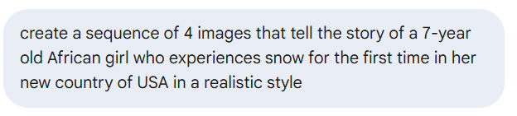
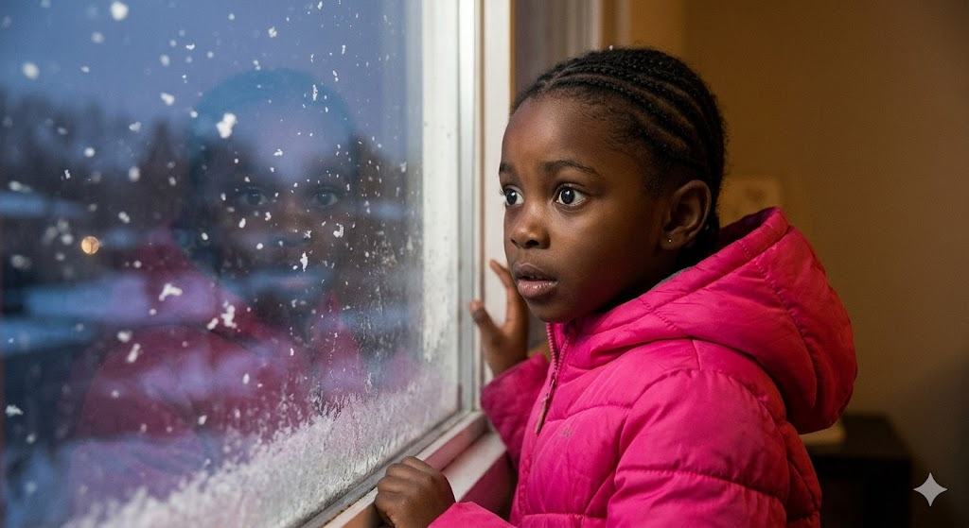
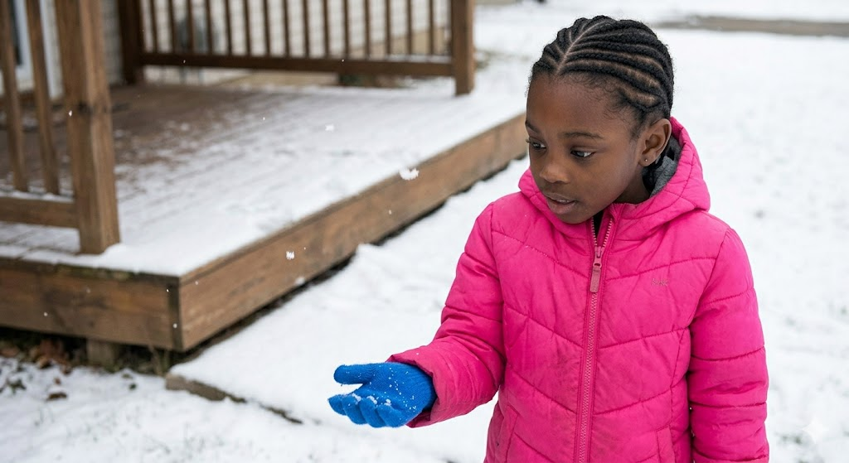
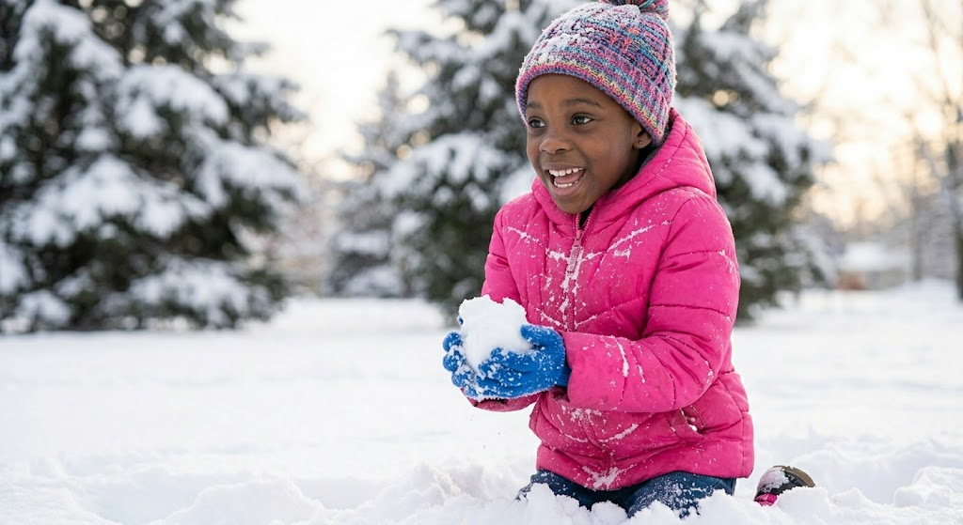
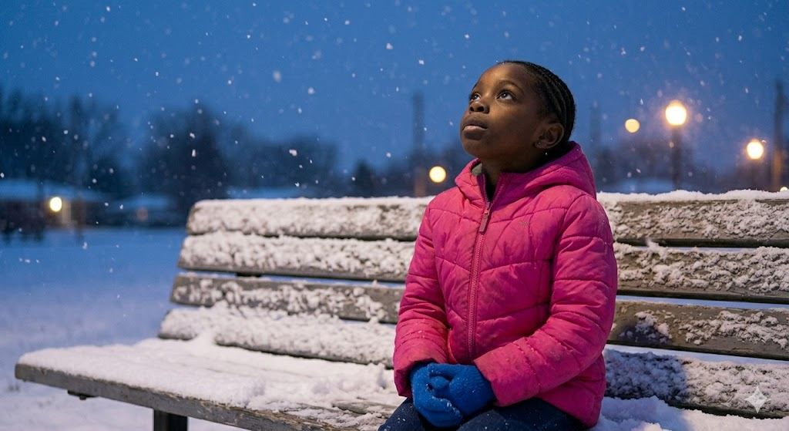
AI Prompting

Slide 62
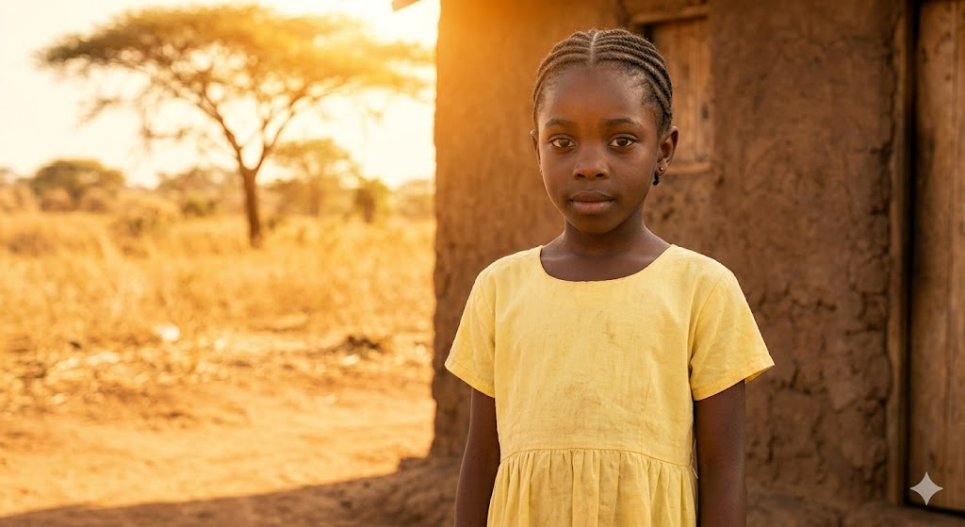
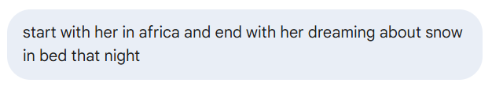
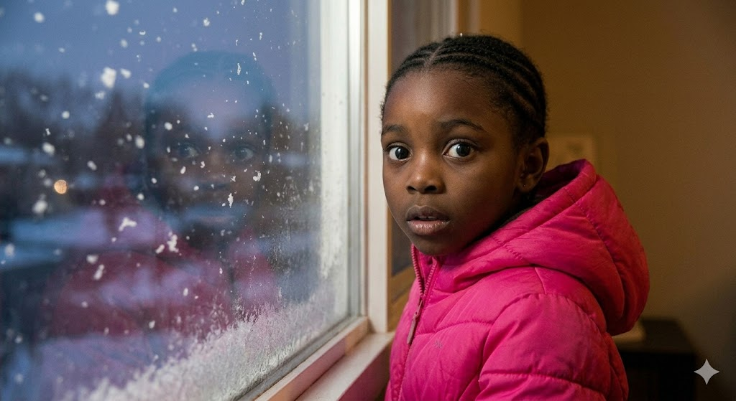
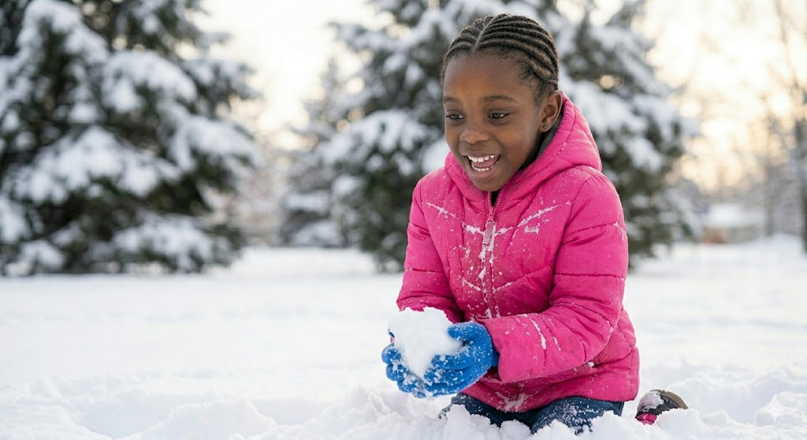
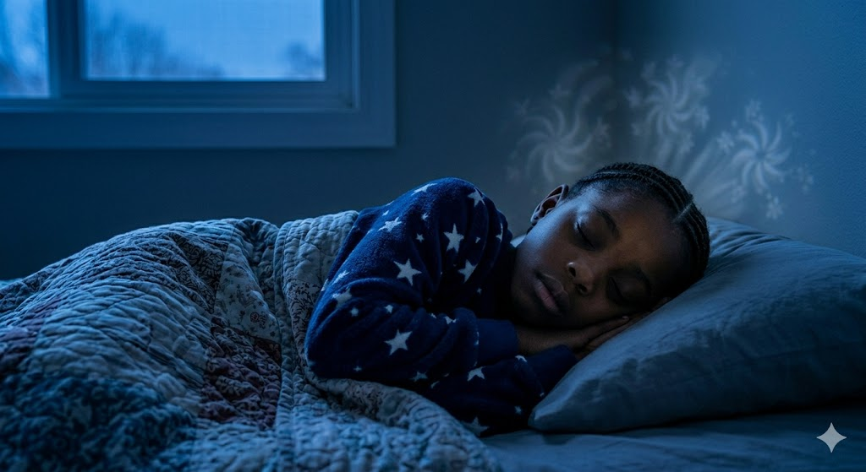
AI Prompting
Notes:
Here is the updated four-image sequence that traces the girl’s journey from her home in Africa to her dream that very same night.
The Journey of Snow: Africa to a Dream
This sequence follows the 7-year-old girl, identified throughout by her neat cornrow braids and a transition from warm-toned clothing to a bright, puffy pink jacket for her winter adventures. We trace her path from golden-hour warmth to the joyful chill of her first snow, and finally to a peaceful dream.
Image 1: The Golden Origin
Our story begins with a photo-realistic, warm-toned portrait. The young girl stands near her modest, mud-brick home in rural Africa. She is wearing a simple, lightweight yellow cotton dress, and her neat cornrow braids are established. The intense, warm sun of the golden hour bathes the dry, golden-brown savannah and a distant acacia tree. Her expression is calm, grounding the narrative in her place of origin.

Slide 63
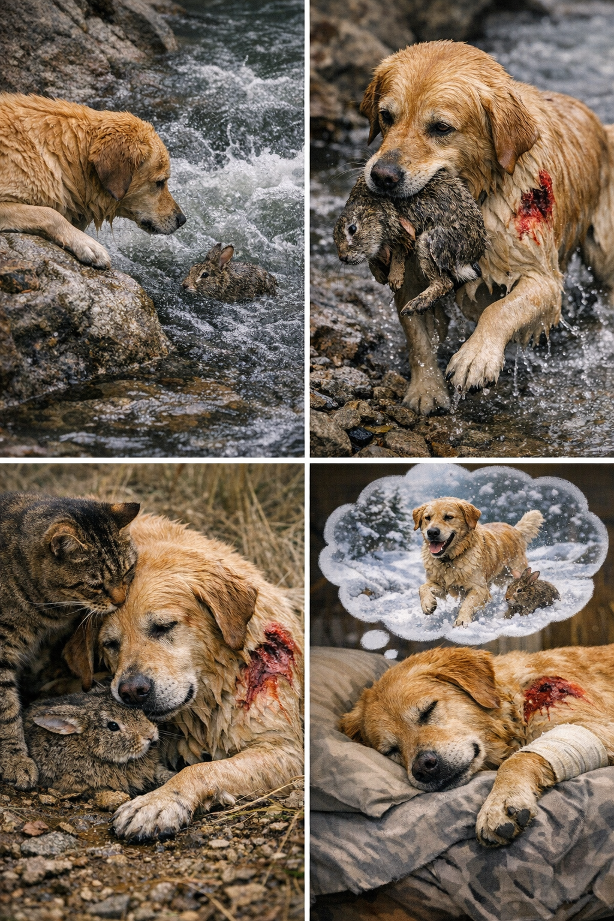
AI Prompting 2
Create a series of 4 pictures that show an animal who gets injured while helping another animal of a different species

Slide 64
Agenda
Audience Polling
Speaker Journey
Speaking Prompts
Rubric Practice
AI Prompting
Q&A
Widening WIDA Speaking Opportunities - WABE 2026 - Greg Davis, Tumwater School District

Slide 65

Q&A
Questions
Widening WIDA Speaking Opportunities - WABE 2026 - Greg Davis, Tumwater School District

Slide 66
Resources
Google Classroom
Multilevel Classroom Speaking Rubric (import into GC)
How to import a rubric into GC
Vocaroo - www.vocaroo.com (for recording voice - creates link or file to download)
Mote - https://www.mote.com/ (for providing verbal feedback to students through the Chrome extension)
Chartr - https://sherwood.news/chartr/newsletters/ (an email service with charts and graphs for free)
AI
Gemini → Copilot (desktop app w/ school account) → ChatGPT
Widening WIDA Speaking Opportunities - WABE 2026 - Greg Davis, Tumwater School District

