Slide 1
Design with the End in Mind: Backwards Planning for ELD with Key Language Uses
Friday, April 24
WABE 2026

Slide 2
Objectives
Identify the steps our district used to collaboratively develop units of instruction for our Secondary English Language Development Classes centering on the WIDA Key Language Uses, functions, and features.
Identify successes and challenges to developing systematic English Language Development courses across multiple buildings and grade levels.
ELD Course Structure
Backwards Planning
Progress Monitoring/ Data
Next Steps

Slide 3

Introductions
Megan Anderson Reilly YSD TOSA | Marbella Aparicio Wilson Middle School ELD | Linnea Fletcher Franklin Middle School ELD
Ana Garcia Washington Middle School ELD | Jamie Holden Washington Middle School ELD | Angelica Avila Washington Middle School ELD
Carrie Osorio Lewis and Clark Middle School ELD | Blanca Manrique Lewis and Clark Middle School ELD
Notes:
Marbella

Slide 4
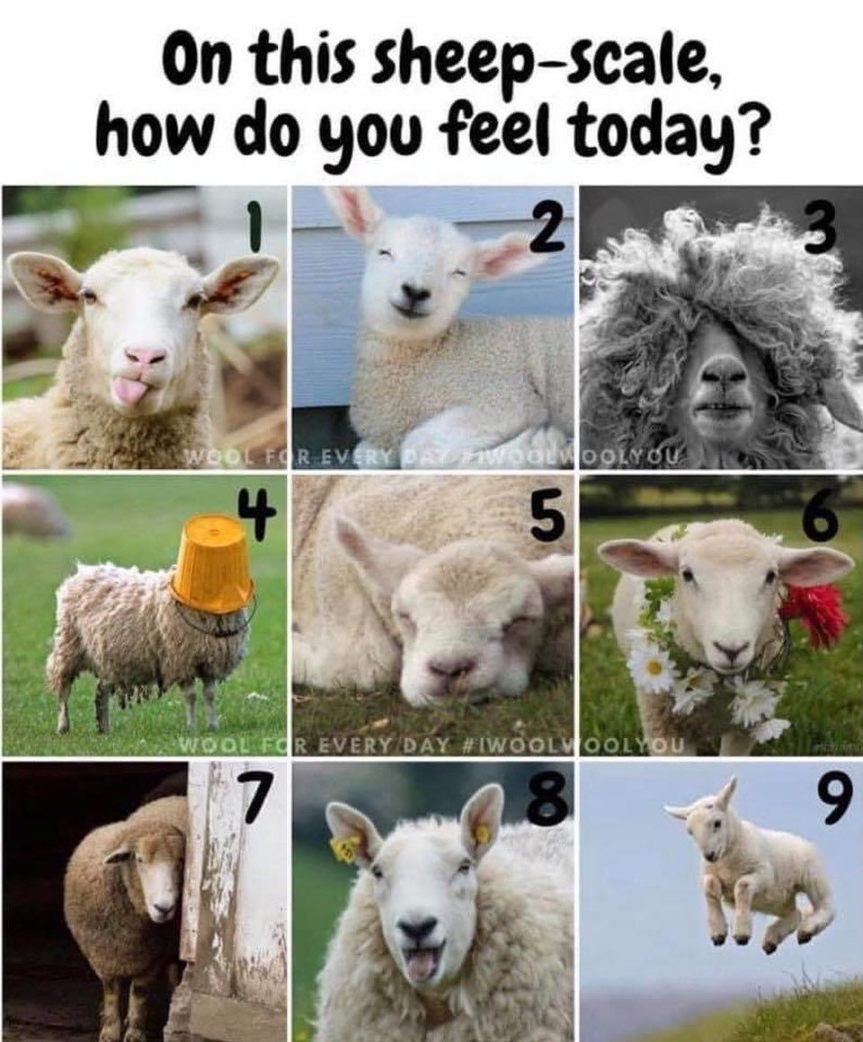

Welcome!
Introduce yourself
Which sheep represents you today?
Notes:
Marbella

Slide 5

Turn and Talk
Does your district offer English Language Development classes?
If so, what is the placement criteria?
What’s working in your current structure?
What are the challenges?
ELD Course Structure
Backwards Planning
Progress Monitoring/ Data
Next Steps

Slide 6
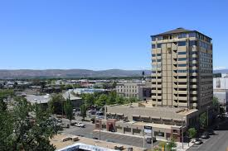
Yakima School District Demographics
Student Enrollment: 15,222 Students
Total number of MLs: 4,975
32% of student population

Slide 7
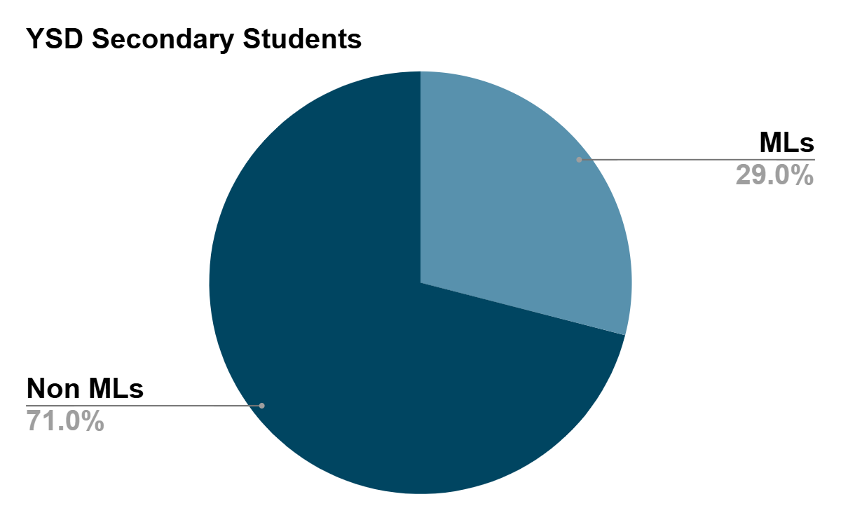
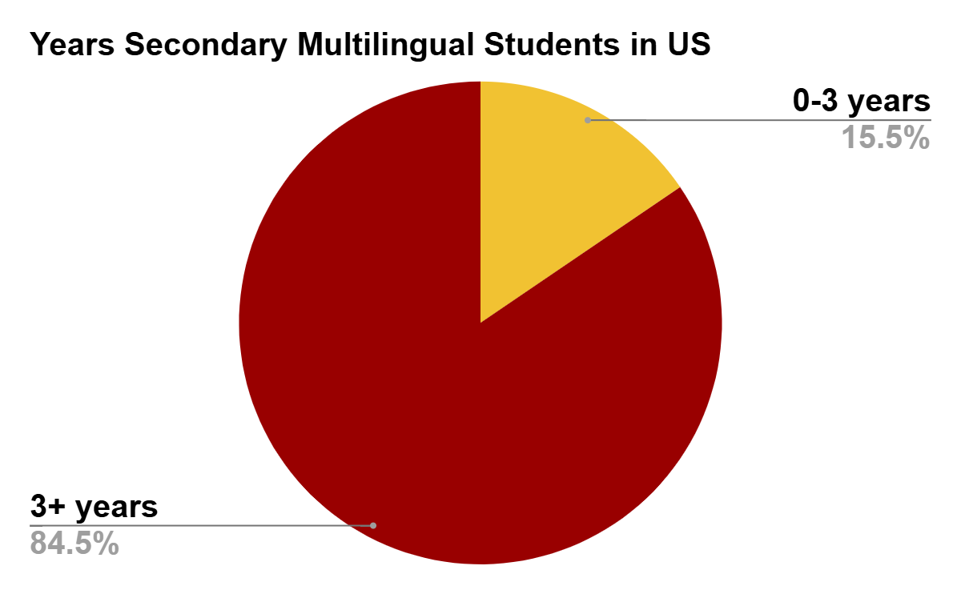
Secondary MLs in YSD
Total Secondary Students: 7,368
Total Secondary Multilingual Students: 2,137
  Less than 3 years in US Schools: 331 (15% of MLs)
  More than 3 years in US Schools: 1,806 (85%)

Slide 8
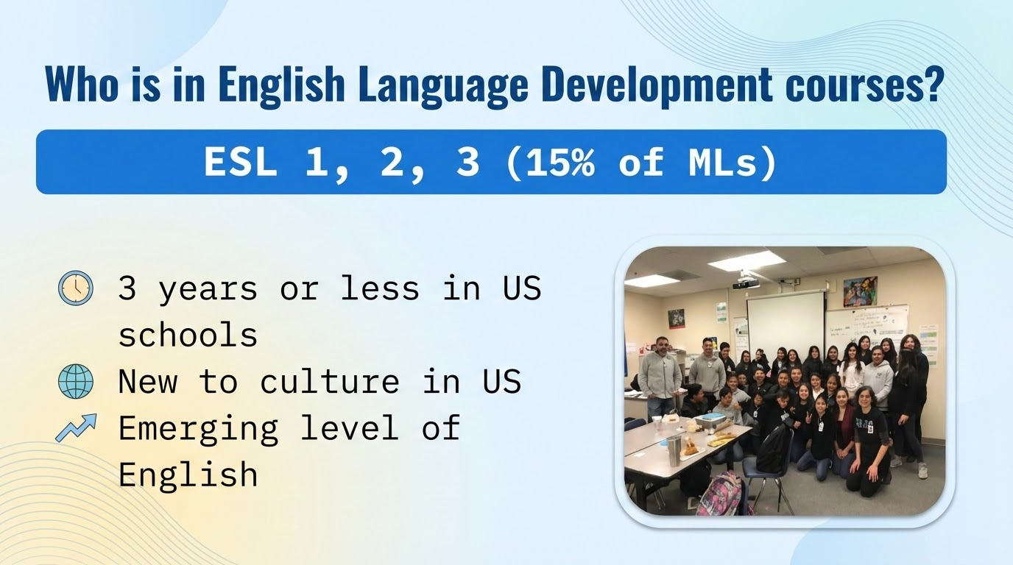

Slide 9
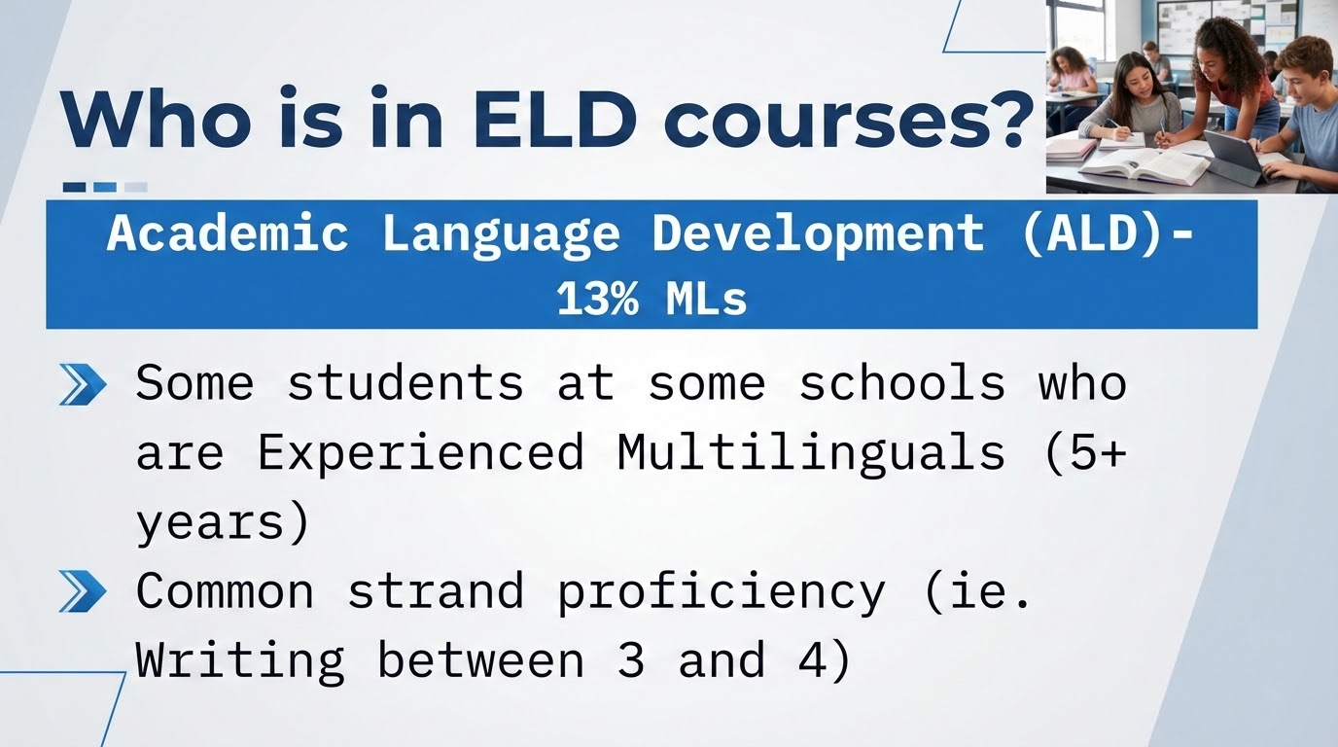

Slide 10
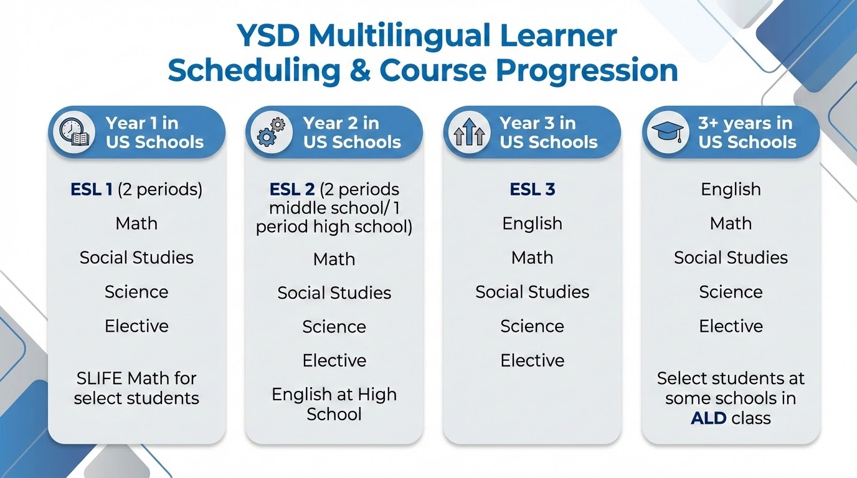

Slide 11
Turn and Talk
What does district wide collaboration look like in your context?
How are you currently backwards planning?
ELD Course Structure
Backwards Planning
Progress Monitoring/ Data
Next Steps

Slide 12


The Need for Backwards Planning
2023-2024 | 2024-2025 | 2025-2026
How do we strategically use resources to teach do we ensure students are getting what they need? WIDA framework | How do we get a common, district wide, systematic approach to our English Language Development Courses? | How do we differentiate between grade levels and proficiency levels while maintaining a consistent, intentional approach across buildings?
Notes:
Megan
We are a big system- as students progress from one grade level to next, we had lack of consistent entry and exit criteria for each course- for example, someone in ESL 1 in one school would be in ESL 3- or no course at all in another. Students were repeating same level multiple times. Many new teachers to ELD and the resources, Edge and Inside- has a lot for a lot of things- how do we narrow the scope. How is our course different than and ELA class- how do we make sure that students will get what they need in the next level, etc.?
23-24- started with a few teachers- focused on 2 units- use of Edge/Inside- lacked the intentionality that we wanted for our courses. How to focus the learning and align to WIDA framework?
24-25- all ESL ⅔ teachers came- built common units around WIDA- common language objectives, shared resources

Slide 13
One Key Language Use Per Quarter
Quarter 1: Inform | Quarter 2: Argue
Quarter 3: Narrate | Quarter 4: Explain
Notes:
Megan
Briefly describe what is the language in each one- ie. Inform- summarizing, reading graphs and charts- compare and contrast etc/ Argue- language of claim, evidence, reasoning- narrate- sequence, descriptive language/ explain- sequence, cause and effect, etc.

Slide 14

Backwards Planning
ESL 2/3/ALD
4 Backwards planning days per year
  2 weeks before the end of the quarter
    Reflect on current unit
    Look at student work
    Identify progress monitoring tools
    Develop upcoming unit
Notes:
Blanca?

Slide 15
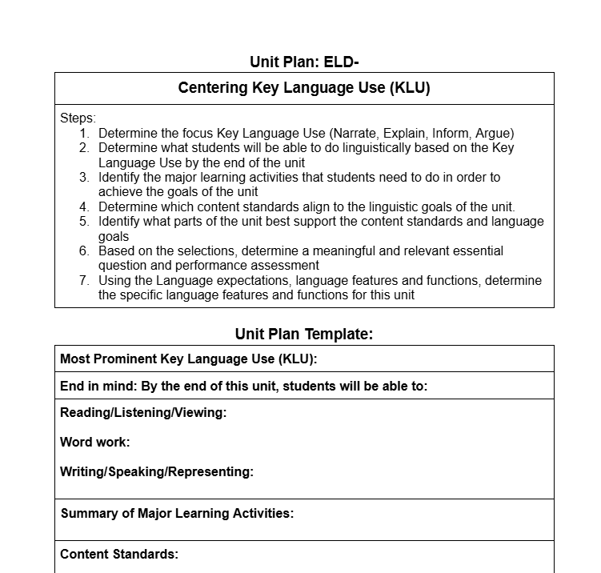
Backwards Planning Template
Notes:
Blanca?
https://docs.google.com/document/d/155AYxN4Sljf617WgTkKBVWjcGn94a8LUESi0Yuu-y3M/edit?usp=sharing
This is the template we initially used. Colleague had been to a conference- maybe WABE- and had seen something similar so we adjusted and tried it out. Different teams have different variations depending on what works best for them-

Slide 16
15 day grid
Notes:
Blanca?

Slide 17
Turn and Talk
How do you monitor progress for your students throughout the year?
What’s working in your model?
What is a challenge?
What might you try?
ELD Course Structure
Backwards Planning
Progress Monitoring/ Data
Next Steps

Slide 18
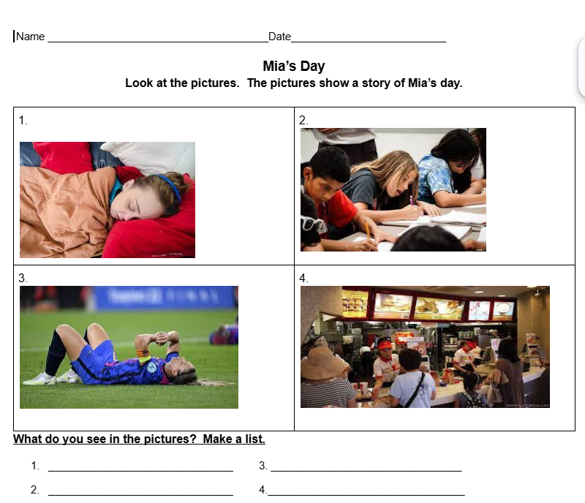
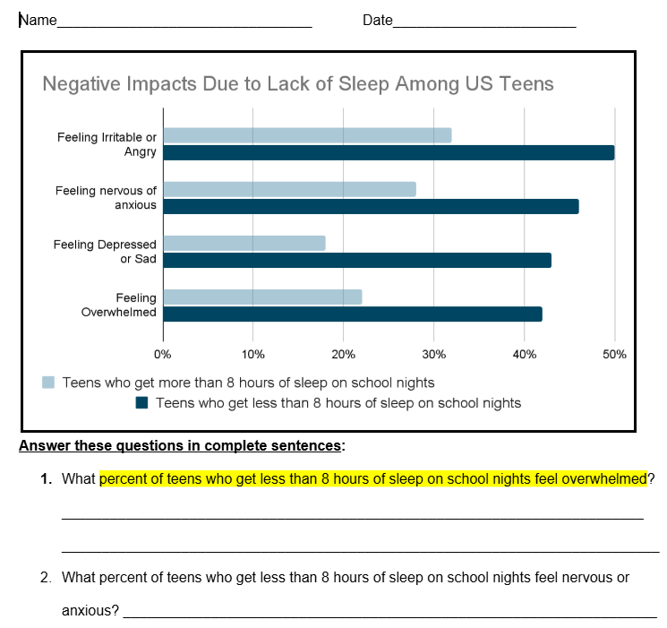
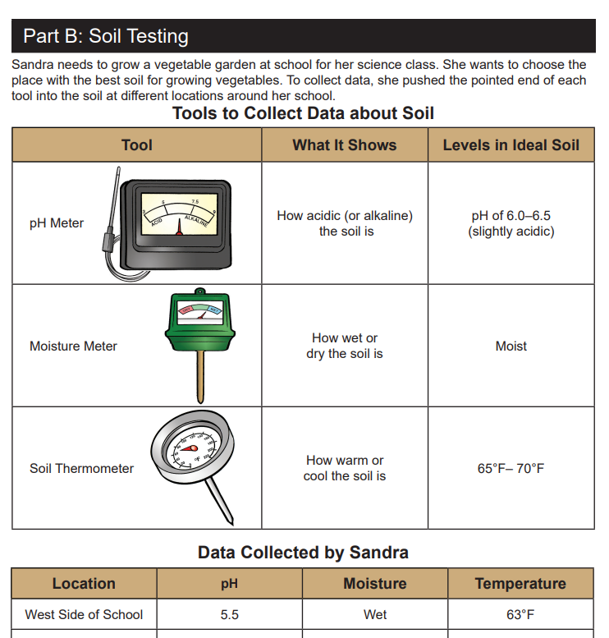
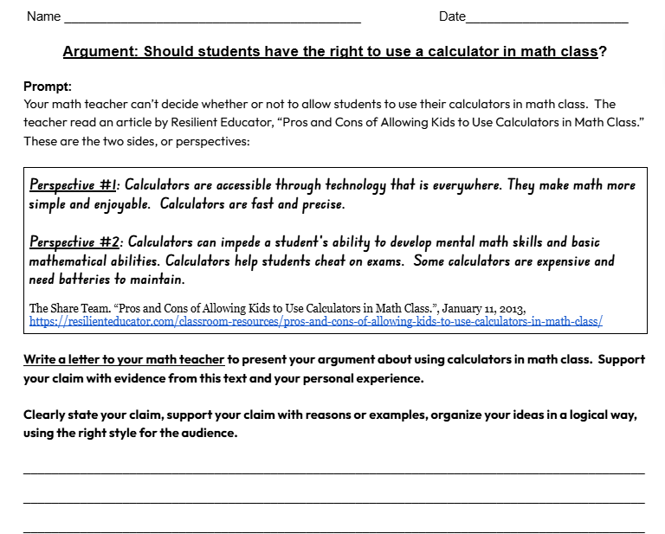
Common Progress Monitoring Tools and Writing Rubric
Notes:
Jamie
Need for common language- making sure we are growing students in a similar way.
ESL 1 is using Bridges and writing rubric- so we adapted the rubric for our purposes (aligned to WIDA)
We give the KLU progress monitoring assessment as a pre and post for every unit- and record the data by dimension of language to better give information regarding where kids are growing and where they need to grow.
We take pre-assessment to identify the language students will need to have
Allows us to norm writing- have a common understanding of writing

Slide 19
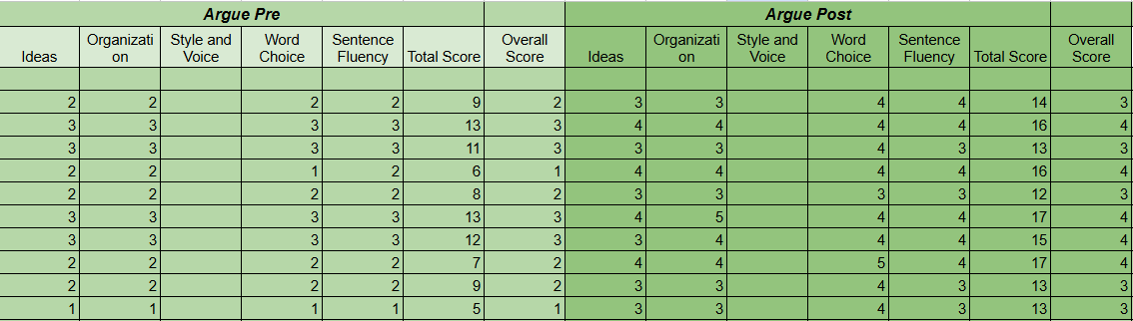
Data Collection Tools
Notes:
Jamie

Slide 20
Benefits
Common language
Systematic Approach
Monitor progress
Allows for norming
Increased intentionality
Notes:
Carrie?

Slide 21
Challenges
Time
Change of staff and courses taught
Deliniating the key language forms and functions taught at each level
How to reduce the amount to teach
Notes:
Carrie?

Slide 22
Next Steps for 2026-2027 School Year
Incorporation of WIDA Language Charts to Unit plans
Incorporation of common formative assessments
ML Task Force
  Taking intentionality beyond our classrooms to plan for all classrooms
  Pushing it out
  Beginning stages
  Goals- aligned to OSPI- narrowed down to most important
ELD Course Structure
Backwards Planning
Progress Monitoring/ Data
Next Steps
Notes:
Carrie?

Slide 23

Reflection
What can you take from this workshop to implement tomorrow/ this year/ next year?

Slide 24


