Slide 1

WIDA -Like Speaking & Writing Tasks Sampler
© Greg Davis 2026
Widening WIDA Speaking Opportunities - WABE 2026 - Greg Davis, Tumwater School District

Slide 2
Key Language Uses (KLU)
Task 1
Daily #1-4: Inform
Summative #5-6: Narrate (Argue)
Widening WIDA Speaking Opportunities - WABE 2026 - Greg Davis, Tumwater School District

Slide 3




Task 1.1
What things do you see in the picture? Make a list.
Describe what is happening in the picture.
How do you relate to this picture (reminder, past experience, etc.)?

Slide 4

Task 1.2
What things do you see in the picture? Make a list.
Describe what is happening in the picture.
How do you relate to this picture (reminder, past experience, etc.)?

Slide 5
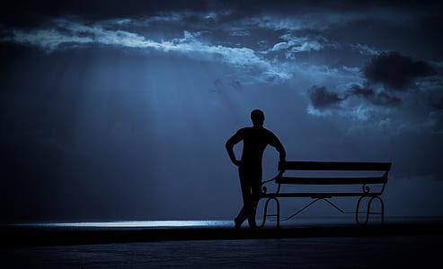
Task 1.3
What things do you see in the picture? Make a list.
Describe what is happening in the picture.
How do you relate to this picture (reminder, past experience, etc.)?

Slide 6

Task 1.4
What things do you see in the picture? Make a list.
Describe what is happening in the picture.
How do you relate to this picture (reminder, past experience, etc.)?

Slide 7






Task 1.5
Look at the pictures. They show a story about Peter trying to study.
Tell the story from start to finish.
(Discuss which part was your favorite? Why?)

Slide 8
Task 1.6
Look at the pictures. They show a story about Peter trying to study.
Write a paragraph telling the story from start to finish. Write 4 to 6 sentences.
(Which part was your favorite? Why?)

Slide 9
Key Language Uses (KLU)
Task 2
Daily #1-4: Inform
Summative #5-6: Explain
Widening WIDA Speaking Opportunities - WABE 2026 - Greg Davis, Tumwater School District

Slide 10

Task 2.1
What things do you see in the picture? Make a list.
Describe what is happening in the picture.
How do you relate to this picture (reminder, past experience, etc.)?

Slide 11

Task 2.2
What things do you see in the picture? Make a list.
Describe what is happening in the picture.
How do you relate to this picture (reminder, past experience, etc.)?

Slide 12

Task 2.2
What things do you see in the picture? Make a list.
Describe what is happening in the picture.
How do you relate to this picture (reminder, past experience, etc.)?

Slide 13

Task 2.3
What things do you see in the picture? Make a list.
Describe what is happening in the picture.
How do you relate to this picture (reminder, past experience, etc.)?

Slide 14

Task 2.3
What things do you see in the picture? Make a list.
Describe what is happening in the picture in a complex sentence.
How do you relate to this picture (reminder, past experience, etc.)?

Slide 15

Task 2.4
What things do you see in the picture? Make a list.
Describe what is happening in the picture.
How do you relate to this picture (reminder, past experience, etc.)?

Slide 16
Task 2.5
Look at the pictures. They show a number of different clubs that are available to join.
Chess Club
Diversity Club
Explain which club you prefer to join. Give reasons for your decision. Use academic English rather than slang.
Music Club
Basketball Club

Slide 17
Task 2.6
Look at the pictures. They show a number of different clubs that are available to you.
Chess Club
Diversity Club
Write a unified paragraph telling which club you prefer to join. Give reasons for your decision. Write 6 to 8 sentences. Use a variety of sentences, including complex sentences.
Music Club
Basketball Club

Slide 18
Key Language Uses (KLU)
Task 3
Daily #1-5: Inform
Summative #6: Explain #7-8: Narrate
Widening WIDA Speaking Opportunities - WABE 2026 - Greg Davis, Tumwater School District

Slide 19

Task 3.1
1. What things do you see in the picture? Make a list.
2. Describe what is happening in the picture using a complex sentence(s)
3. How do you relate to this picture (Start with “How I relate to this picture…”)?

Slide 20

Task 3.2
1. What things do you see in the picture? Make a list.
2. Describe what is happening in the picture using a complex sentence(s)
3. How do you relate to this picture (Start with “It seems like …”)?

Slide 21
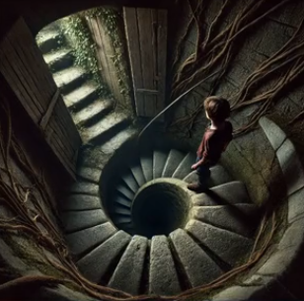
Task 3.3
What things do you see in the picture? Make a list.
Describe what is happening in the picture using a complex sentence(s)
How do you relate to this picture (Start with “Seeing this picture makes me …”)?

Slide 22
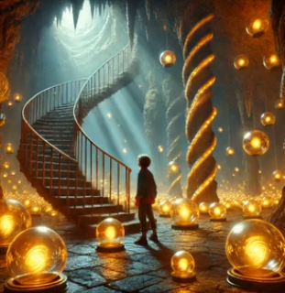
Task 3.4
What things do you see in the picture? Make a list.
Describe what is happening in the picture using a complex sentence(s)
How do you relate to this picture (Start with “I imagine that …”)?

Slide 23
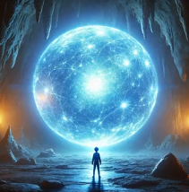
Task 3.5
1. What things do you see in the picture? Make a list.
2. Describe what is happening in the picture using a complex sentence(s)
3. How do you relate to this picture (Start with “He appears to have …”)?

Slide 24

Task 3.6
Look at the pictures. They show a story about Bradley.
Which part / picture was your favorite? Why? Give reasons and details to support your opinion. Write a paragraph with 7-8 sentences. Use complex sentences for at least 5 of the sentences.

Slide 25
Task 3.7
Look at the pictures. They show a story about Bradley.
Tell Bradley’s story from start to finish. Add appropriate supporting details to make this more interesting for your audience. Don’t forget to include transitions between ideas and scenes.

Slide 26
Task 3.8
Look at the pictures. They show a story about Bradley.
Write Bradley’s story from start to finish in paragraph format. Write 8 to 10 sentences. Be sure to include a descriptive title centered at the top. Add appropriate supporting details to make this more interesting for your audience. Don’t forget to include transitions between ideas and scenes.

Slide 27
Key Language Uses (KLU)
Task 4
#1-4: Inform
#5-10: Inform & Explain
Widening WIDA Speaking Opportunities - WABE 2026 - Greg Davis, Tumwater School District

Slide 28
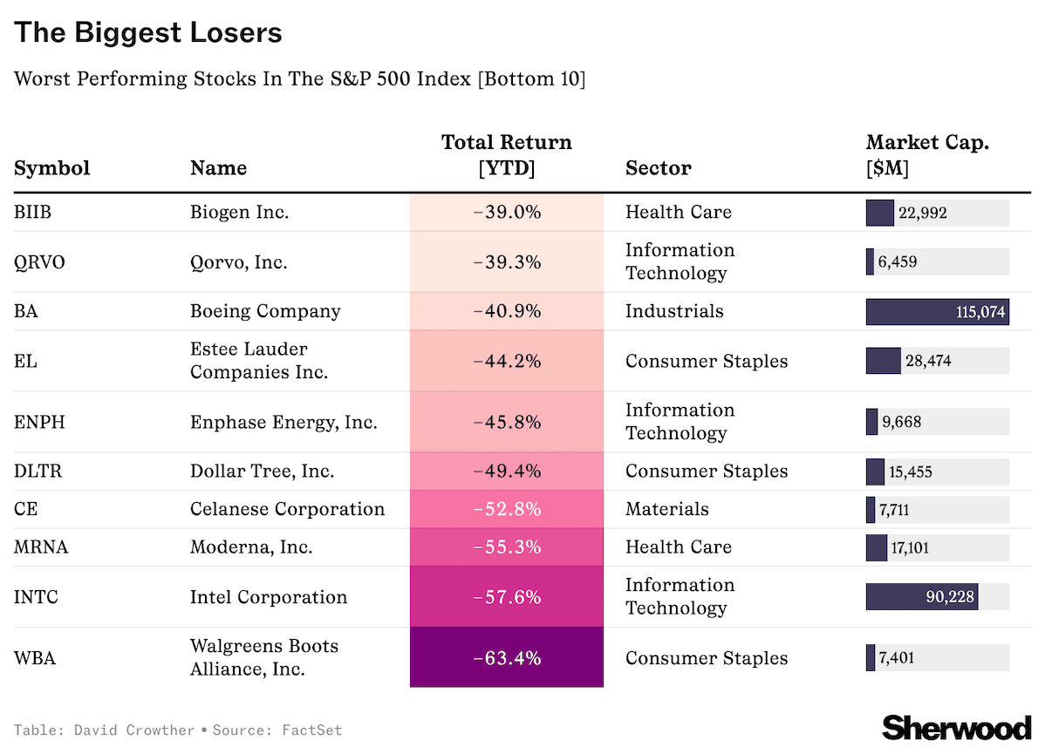
Task 4.1
1. What things do you notice about the chart? Make a list.
2. What do you wonder about this chart? Make a list of questions.
3. Add vocab from the board after the discussion.
Notes:
It’s been quite a year for the stock market.
At the time of writing, America’s flagship S&P 500 Index is currently on track for a more than 28% return in 2024, with AI hype driving tech — and some non-tech — stocks higher. But not every company is thriving. In fact, more than 110 stocks in the S&P 500 Index are down this year.
So, which are the 10 worst performers? Here’s the list:

Slide 29
Task 4.1 cont.
Boeing: continues to struggle to bounce back from a series of safety failures and labor strife, as European rival Airbus chases its own ambitious targets for aircraft deliveries.
Estée Lauder: the iconic beauty and cosmetics company has seen sales slip this year, leading management to slash its all-important dividend — which sent the stock crashing more than 20% in a single day in October.
Dollar Tree: a stock you might expect to have done well with inflation-weary consumers looking for bargains has also struggled this year, with consumers choosing to shop elsewhere and the company losing its CEO a month ago.
Moderna: one of the most visible companies during the pandemic, the Massachusetts-based company has struggled to move on, spending billions on R&D in search of its next product with little to show for it so far, with revenue slumping sharply since 2021.
Intel: at one time the world’s largest producer of computer chips, Intel is another company you’d not necessarily expect to find on this list, but the chipmaker has missed the AI boom many of its peers have capitalized on.
Walgreens: battling a huge debt load, a botched acquisition of primary provider VillageMD, and online competition, the retailer has been deeply out of favor with investors this year, dropping 64%.
1. What things do you notice about the chart? Make a list.
2. What do you wonder about this chart? Make a list of questions.
3. Add vocab from the board after the discussion.
Notes:
It’s been quite a year for the stock market.
At the time of writing, America’s flagship S&P 500 Index is currently on track for a more than 28% return in 2024, with AI hype driving tech — and some non-tech — stocks higher. But not every company is thriving. In fact, more than 110 stocks in the S&P 500 Index are down this year.
So, which are the 10 worst performers? Here’s the list:

Slide 30

Task 4.2
1. What things do you notice about the chart? Make a list.
2. What do you wonder about this chart? Make a list of questions.
3. Add vocab from the board after the discussion.
Notes:
With cruise passengers now exceeding pre-pandemic levels, per data from the Cruise Lines International Association, companies like Virgin and Villa Vie are picking up on the world’s growing appetite for cruises.
Interestingly, in huge news for anyone looking to celebrate Bitcoin’s recent surge, the annual pass is also the first cruise product to accept the cryptocurrency as payment — perhaps reflecting the growing number of young people taking to the sea, with 1 in 2 passengers on Royal Caribbean cruises reportedly millennials or younger.

Slide 31
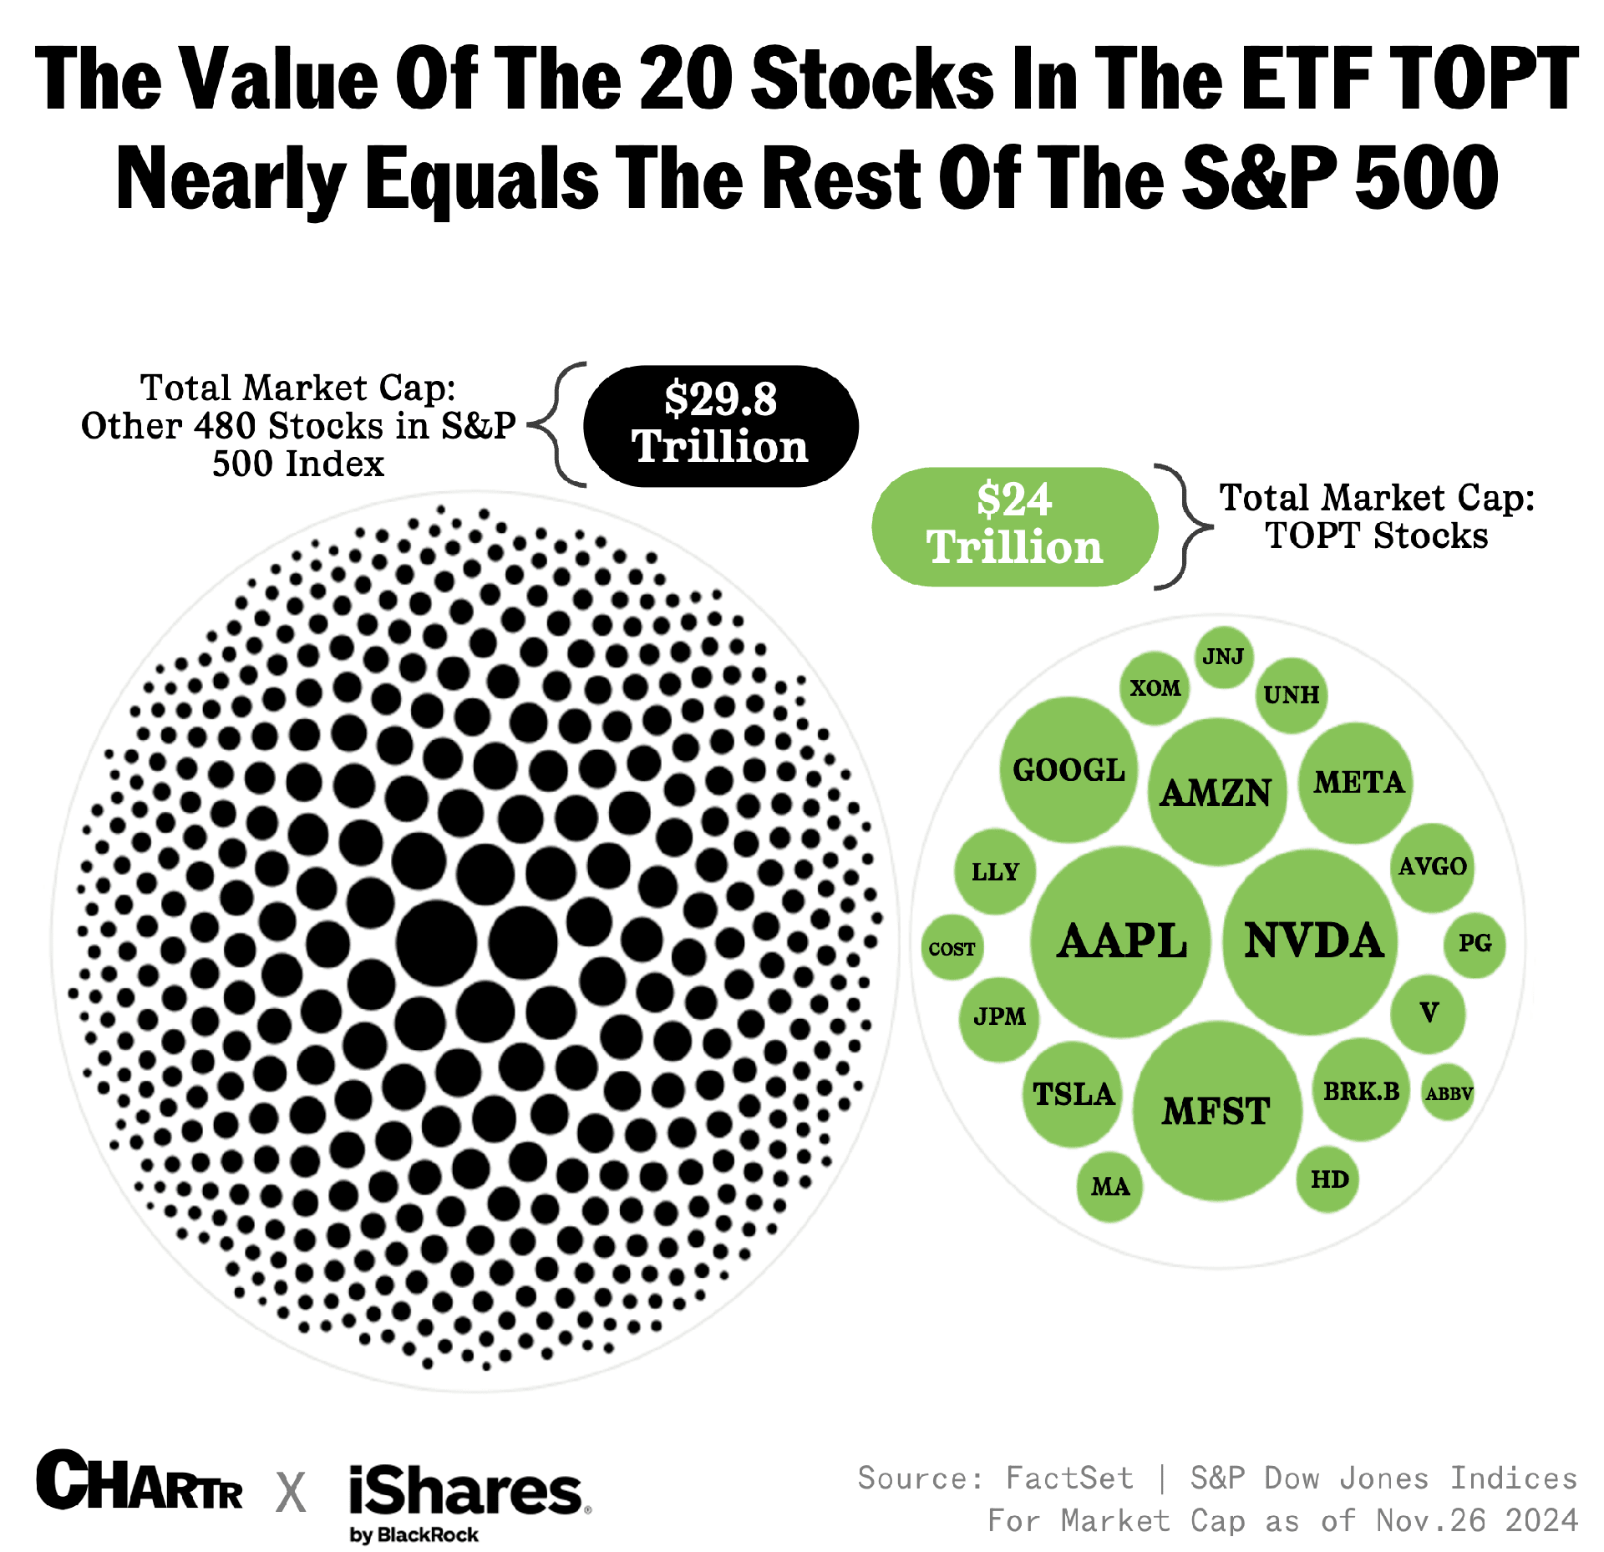
Task 4.3
1. What things do you notice about the chart? Make a list.
2. What do you wonder about this chart? Make a list of questions.
3. Add vocab from the board after the discussion.

Slide 32

Task 4.4
1. What things do you notice about the chart? Make a list.
2. What do you wonder about this chart? Make a list of questions.
3. Add vocab from the board after the discussion.

Slide 33
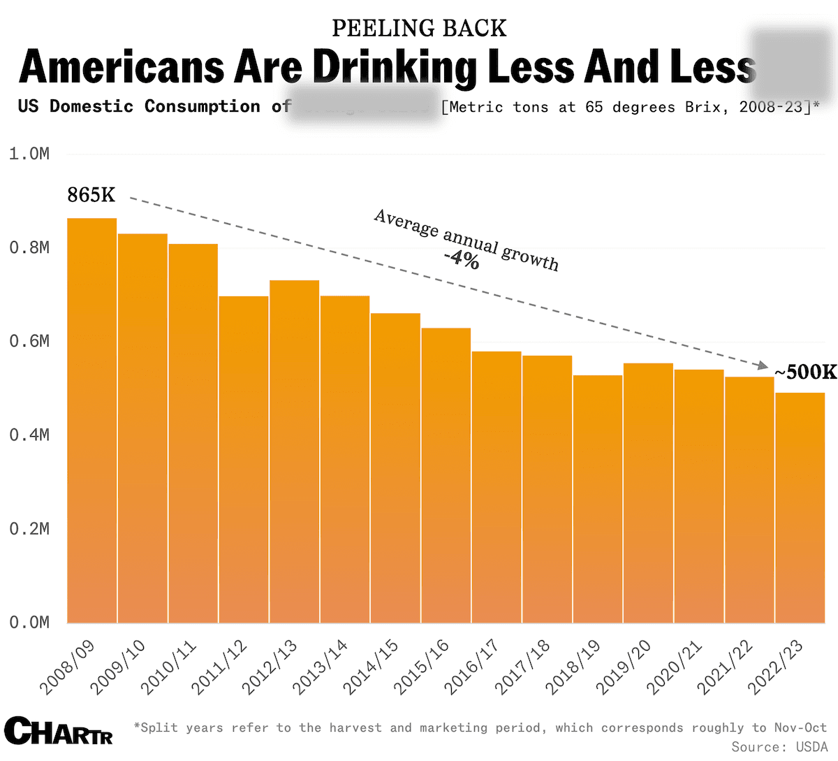
Task 4.5
1. What things do you notice about the chart? Make a list.
2. What do you wonder about this chart? Make a list of questions.
3. What drink do you think this chart is referring to? What evidence makes you think that?

Slide 34
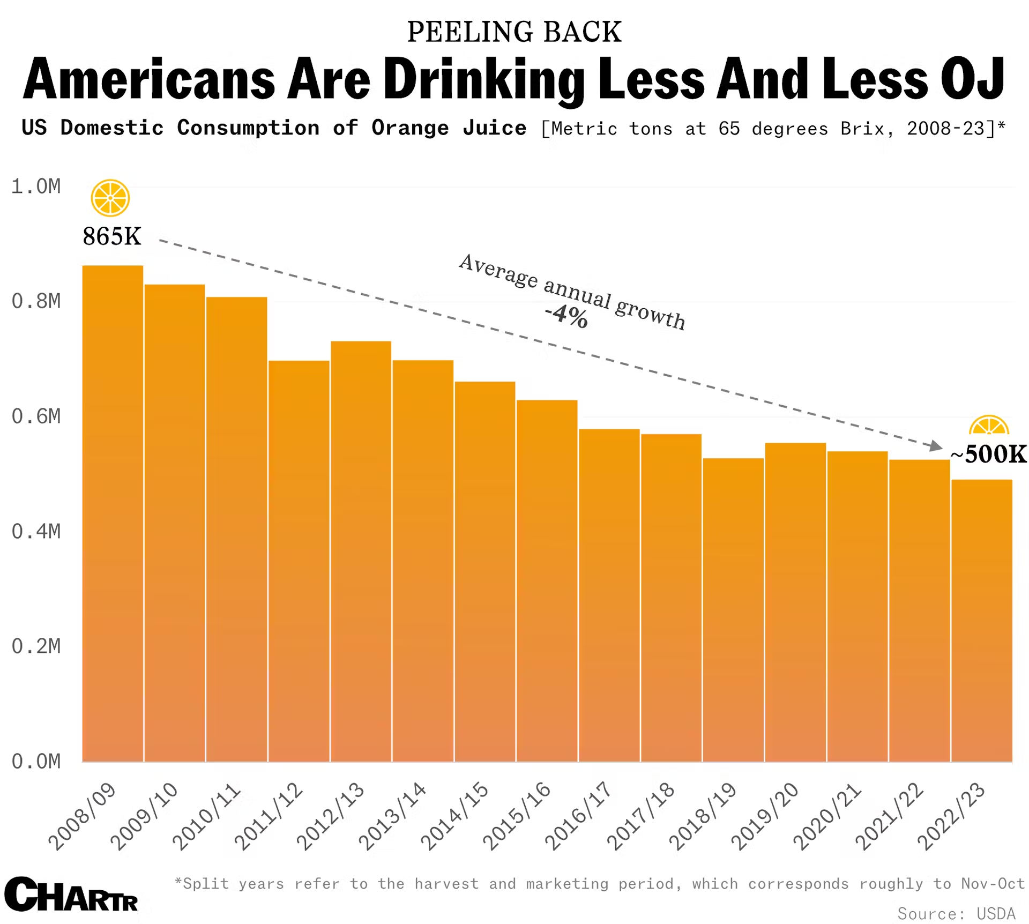
Task 4.5 cont.
1. What things do you notice about the chart? Make a list.
2. What do you wonder about this chart? Make a list of questions.
3. What drink do you think this chart is referring to? What evidence makes you think that?

Slide 35
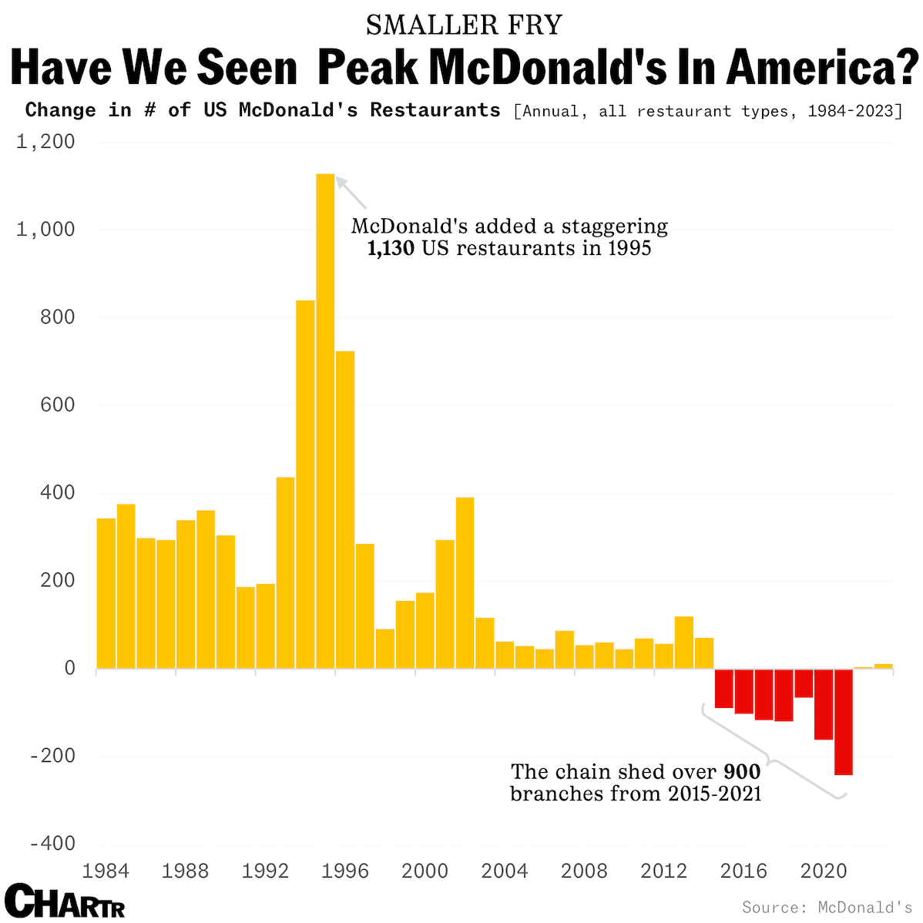
Task 4.6
1. What things do you notice about the trends in the chart? Make a list.
2. What do you wonder about this chart? Make a list of questions.
3. Write 1-2 complex sentences describing what the data in this chart communicate.

Slide 36
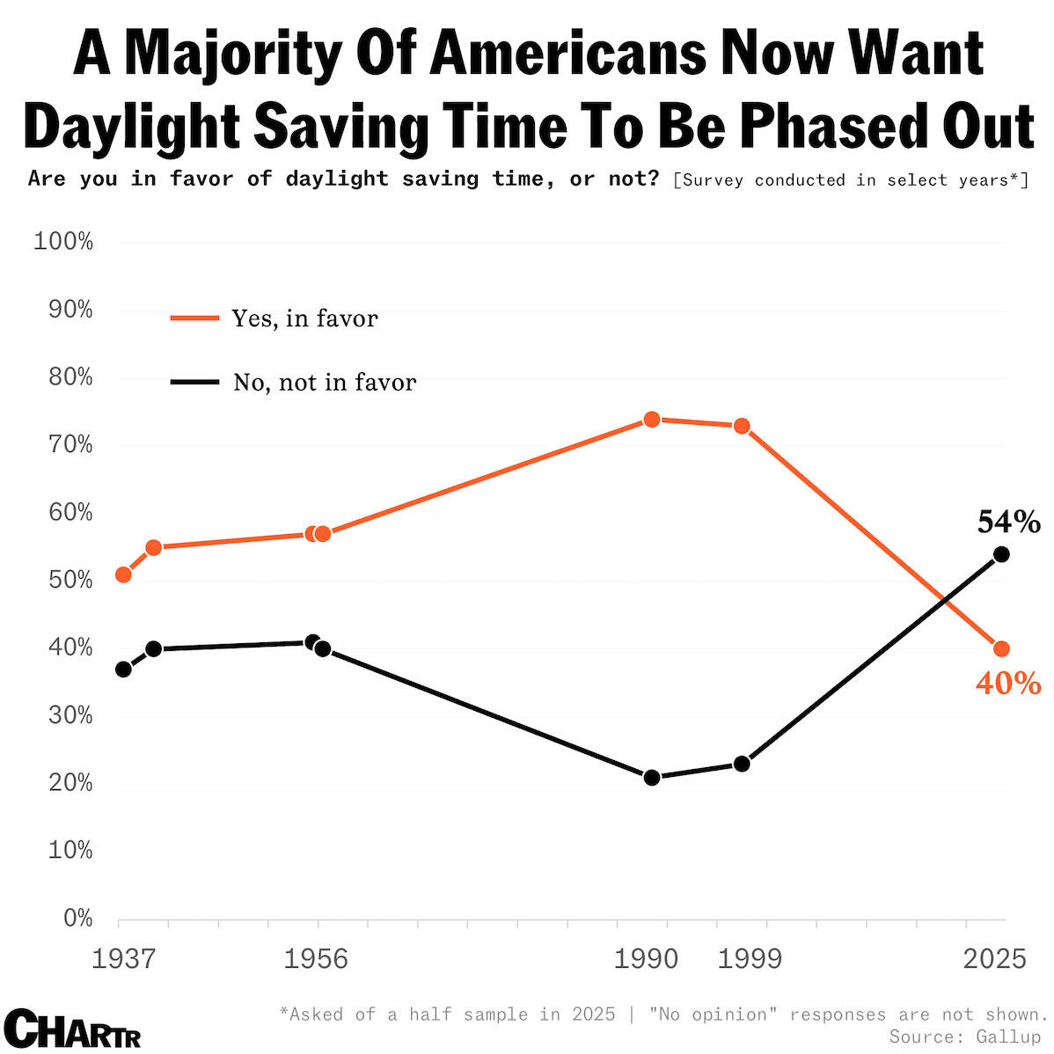
Task 4.7
1. What things do you notice about the chart? Make a list.
2. What do you wonder about this chart? Make a list of questions.
3. Write 1-2 complex sentences describing what the data in this chart communicate.

Slide 37
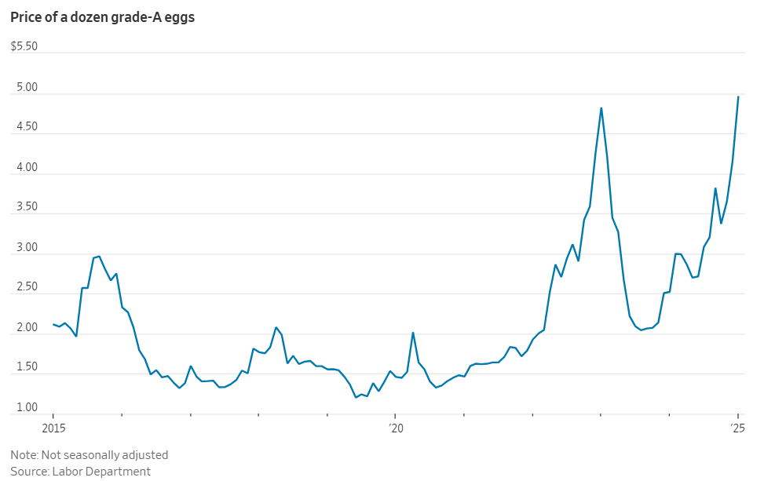
Task 4.8
1. What things do you notice about the chart? Make a bullet list.
2. What do you wonder about this chart? Write 1 question.
3. Write 1-2 complex sentences describing what the data in this chart communicate.

Slide 38
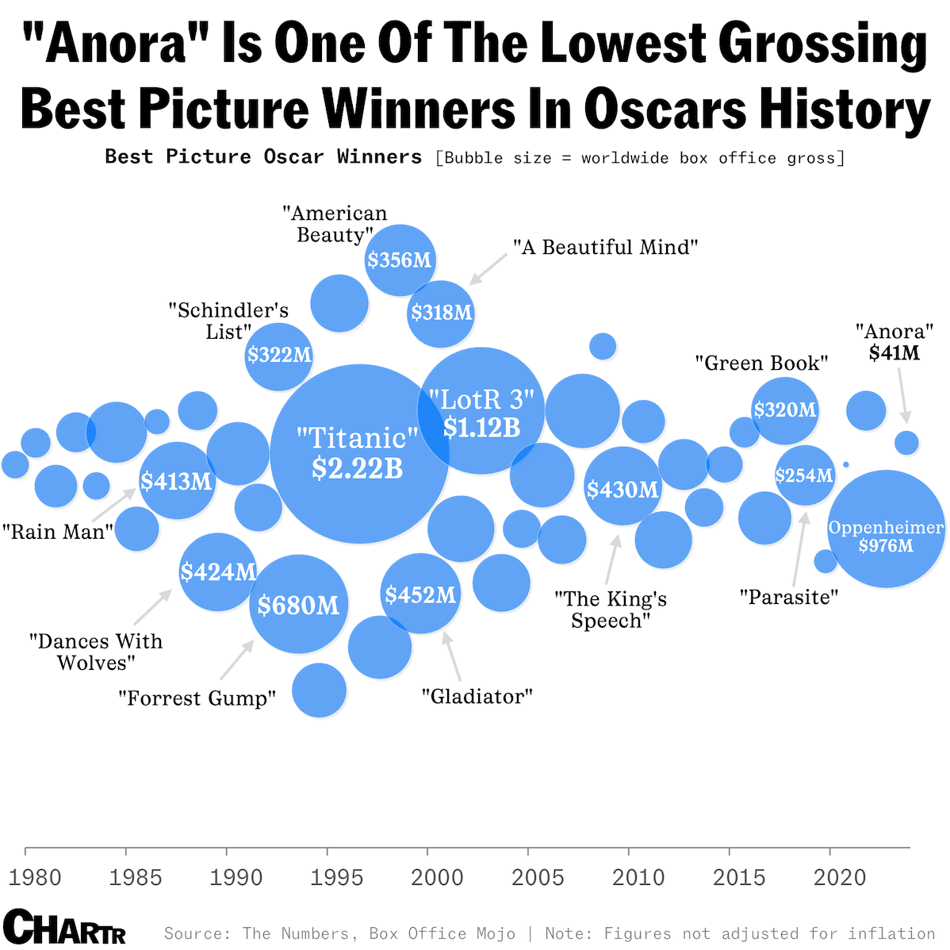
Task 4.9
1. What things do you notice about the chart? Make a list.
2. What do you wonder about this chart? Make a list of questions.
3. Add vocab from the board after the discussion.

Slide 39
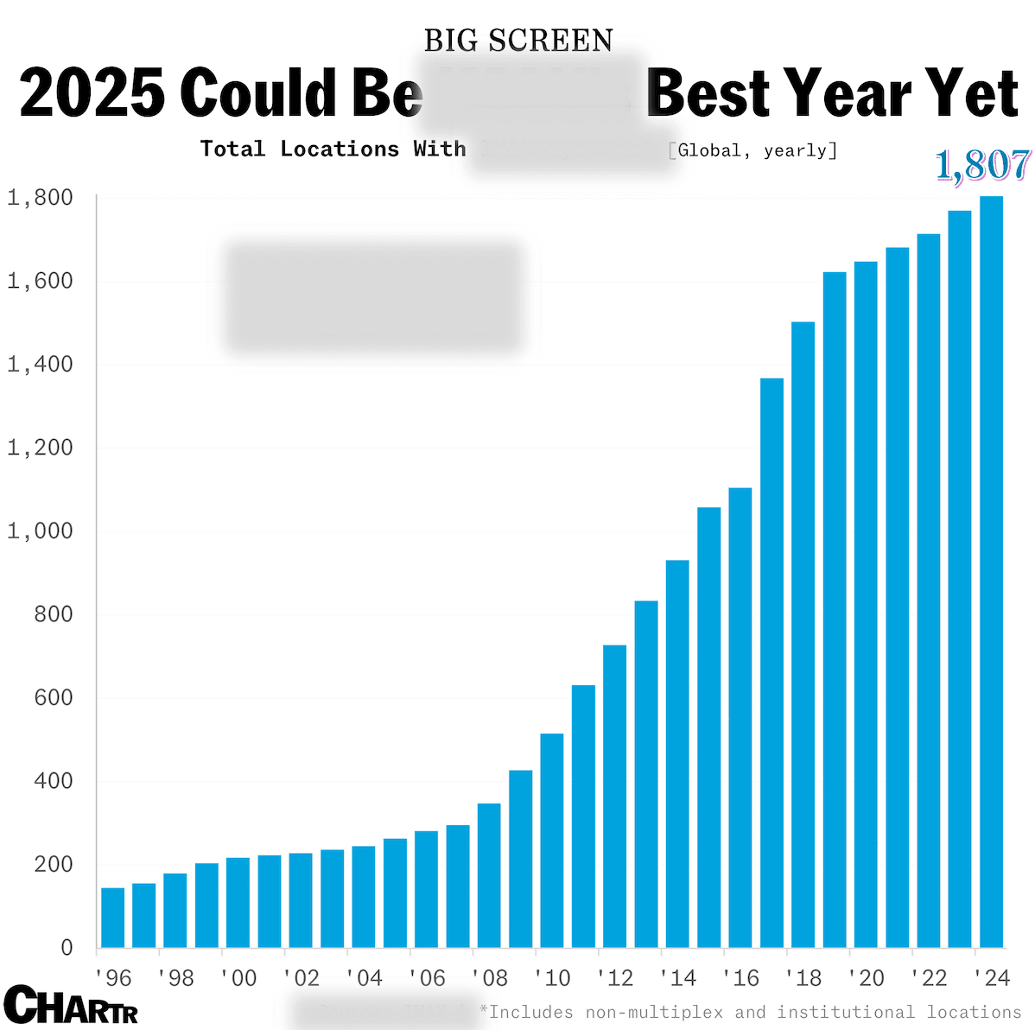
Task 4.10
1. What things do you notice about the chart? Make a list.
2. What do you wonder about this chart? Make a list of questions.
3. What type of theater do you think this chart is referring to? What evidence makes you think that?

Slide 40
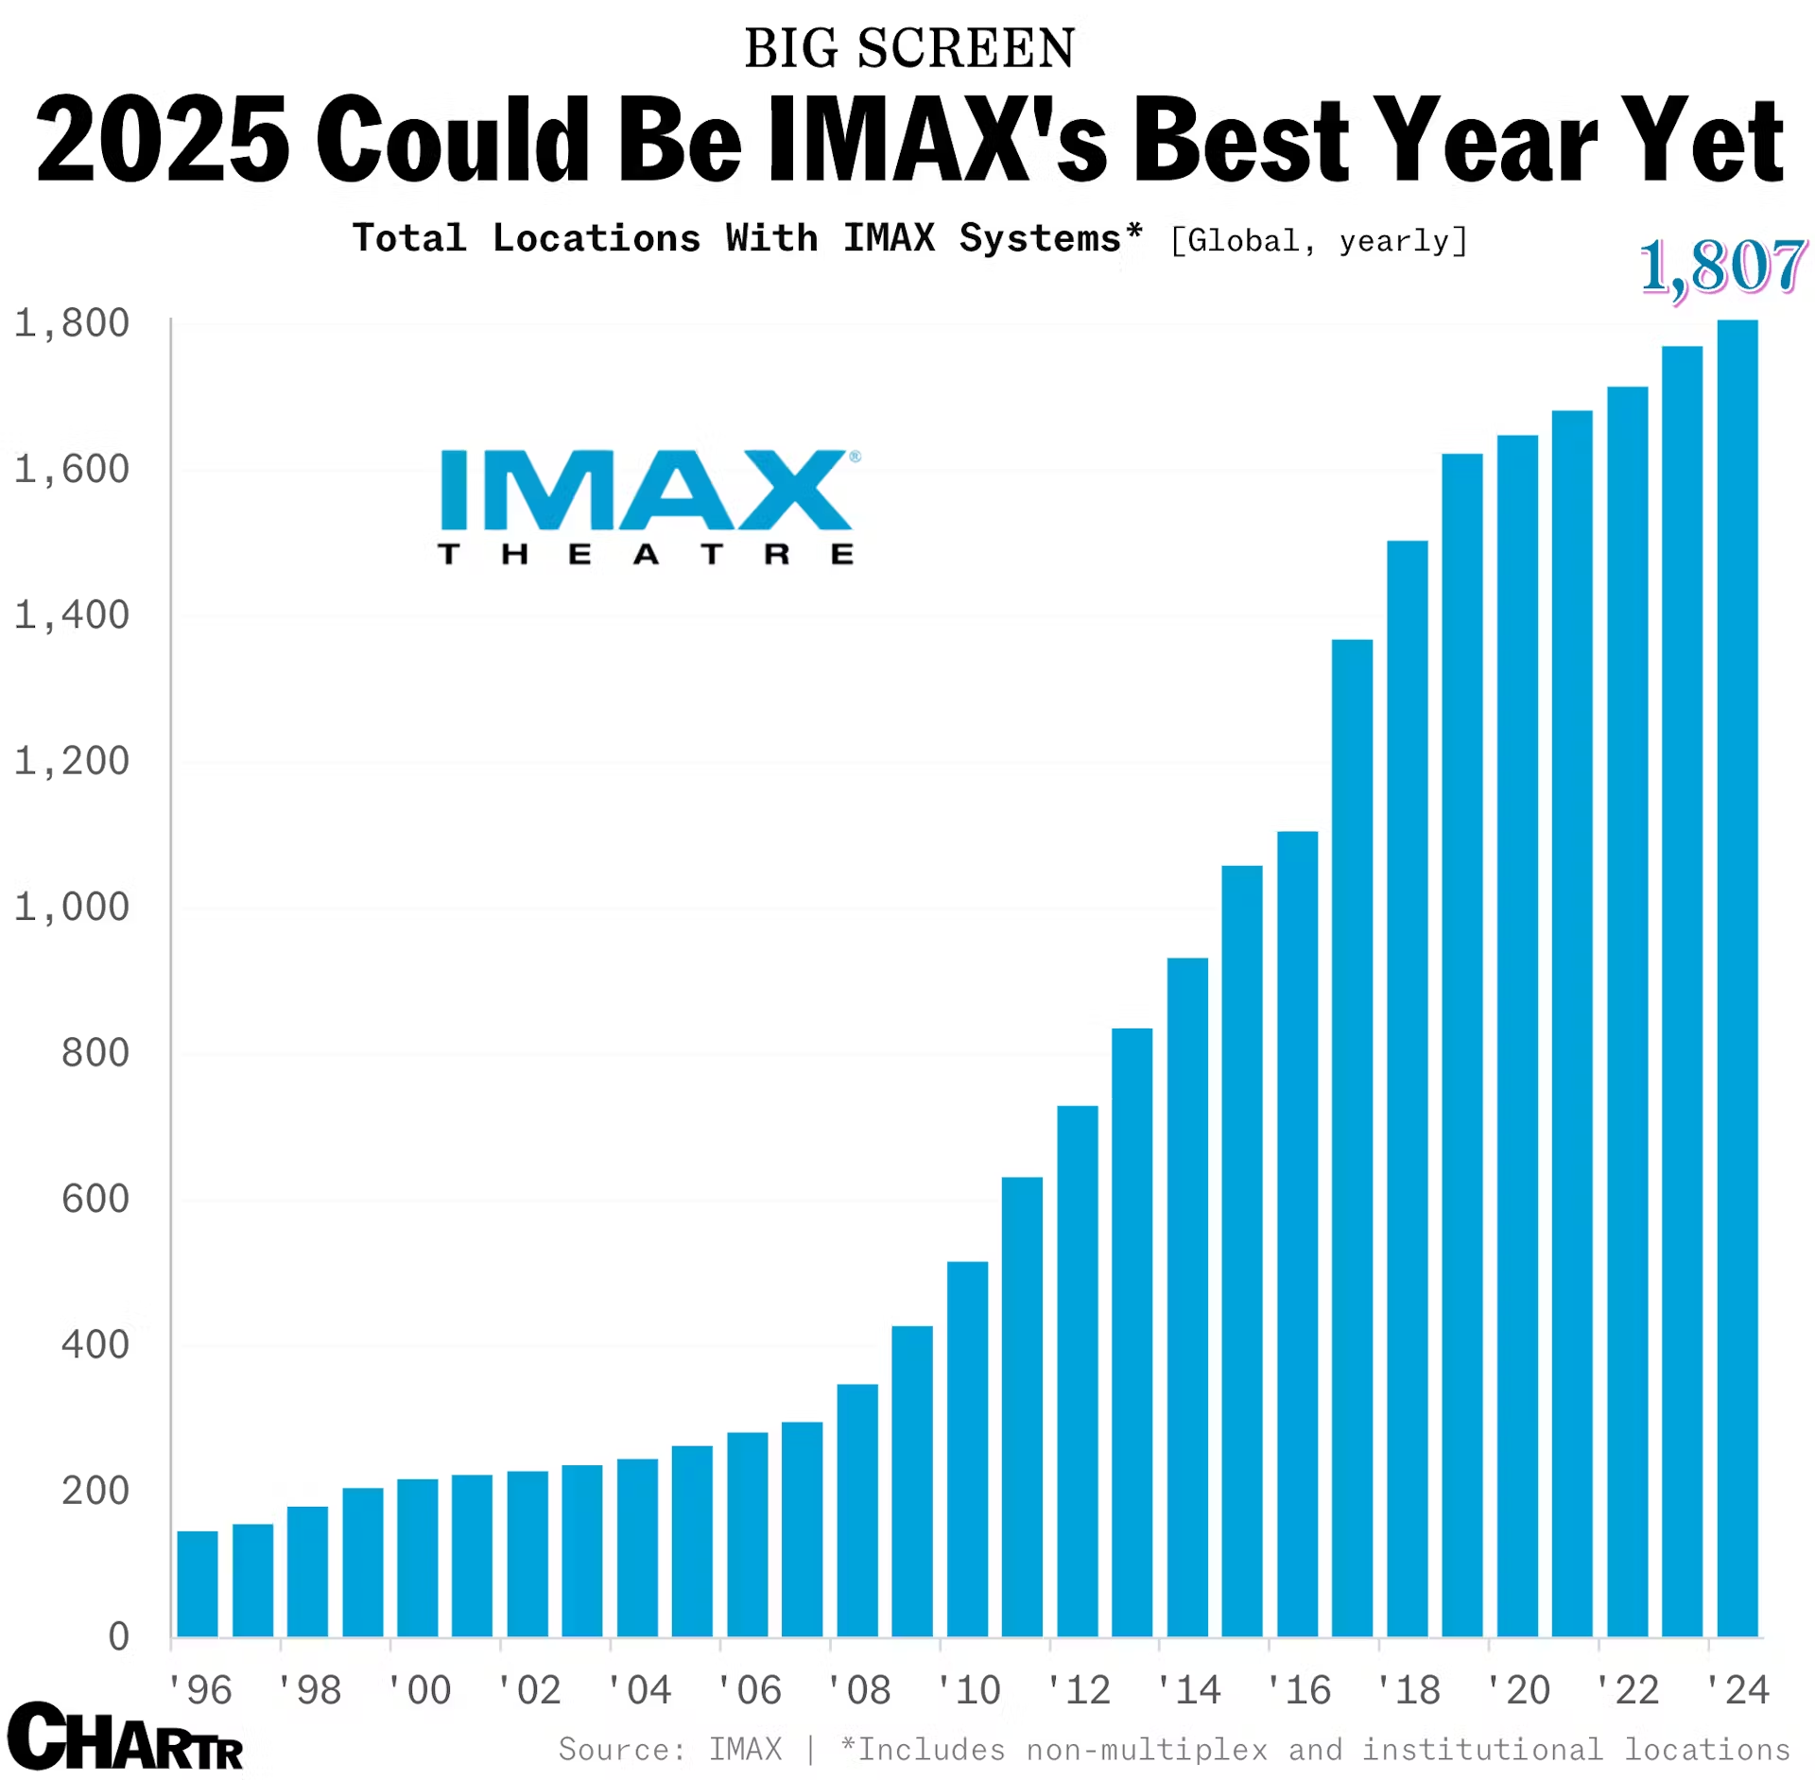
Task 4.10 cont.
1. What things do you notice about the chart? Make a list.
2. What do you wonder about this chart? Make a list of questions.
3. What type of theater do you think this chart is referring to? What evidence makes you think that?

Slide 41
Key Language Uses (KLU)
Task 5
#1-5: Inform
#6-7: Narrate
Widening WIDA Speaking Opportunities - WABE 2026 - Greg Davis, Tumwater School District

Slide 42

Task 5.1
1. What things do you see in the picture? Make a list.
2. Describe what is happening in the picture using a complex sentence(s)
3. How do you relate to this picture (Start with “How I relate to this picture…”)?

Slide 43

Task 5.2
1. What things do you see in the picture? Make a list.
2. Describe what is happening in the picture using a complex sentence(s)
3. How do you relate to this picture (Start with “From the look in her eyes, I can tell …”)?

Slide 44
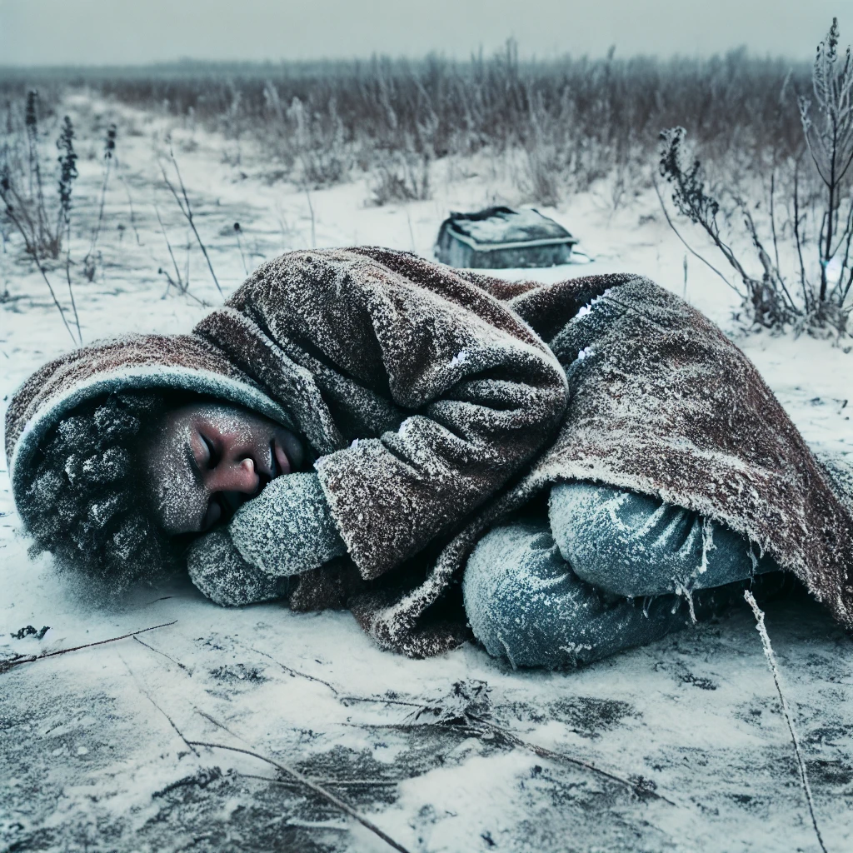
Task 5.3
What things do you see in the picture? Make a list of 5 things.
Describe what is happening in the picture using 3 sentences. (Remember to use complex and compound structures.)

Slide 45

Task 5.4
What things do you see in the picture? Make a list of 5 things.
Describe what is happening in the picture using a complex sentence(s)
How do you relate to this picture (Start with “If I were in that situation, …”)?

Slide 46

Task 5.5
1. What things do you see in the picture? Make a list.
2. Describe what is happening in the picture using a complex sentence(s)
3. How do you relate to this picture (Start with “I would be feeling ___ if I …”)?

Slide 47
Task 5.6
Look at the pictures. They show a story about Rikeesha.
Tell Rikeesha’s story from start to finish. Add appropriate supporting details to make this more interesting for your audience. Don’t forget to include transitions between ideas and scenes.

Slide 48
Task 5.7
Look at the pictures. They show a story about Rikeesha.
Write Rikeesha’s story from start to finish in paragraph format. Write 8 to 10 sentences. Be sure to include a descriptive title centered at the top. Add appropriate supporting details to make this more interesting for your audience. Don’t forget to include transitions between ideas and scenes.

Slide 49
Key Language Uses (KLU)
Task 6
#1-4: Inform
#5-6: Explain
Widening WIDA Speaking Opportunities - WABE 2026 - Greg Davis, Tumwater School District

Slide 50
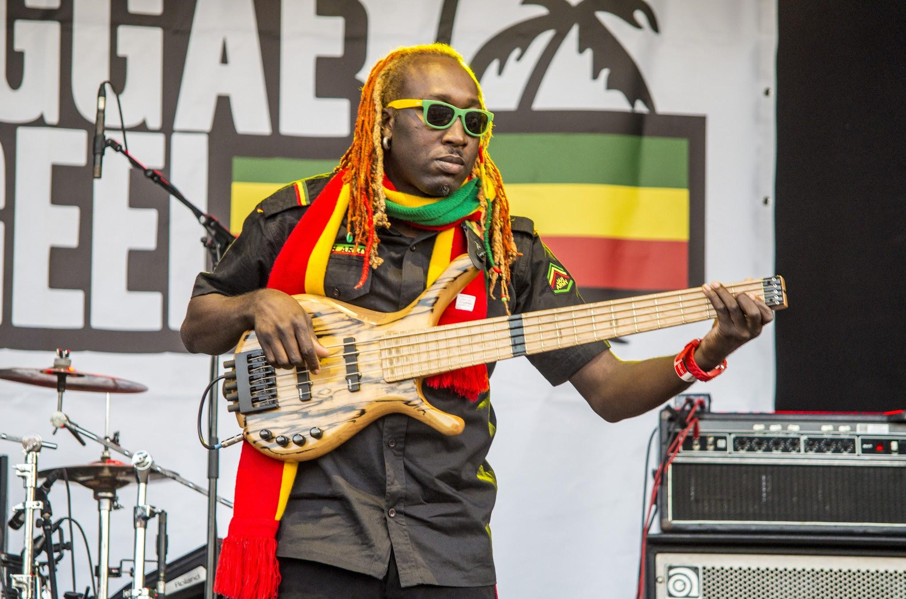
Task 6.1
What things do you see in the picture? Make a list.
Describe what is happening in the picture in 1-2 complex sentences.
What is your opinion on this style of music? How often do you listen to it?
Notes:
Play clip of reggae music while students are completing this entry task.

Slide 51
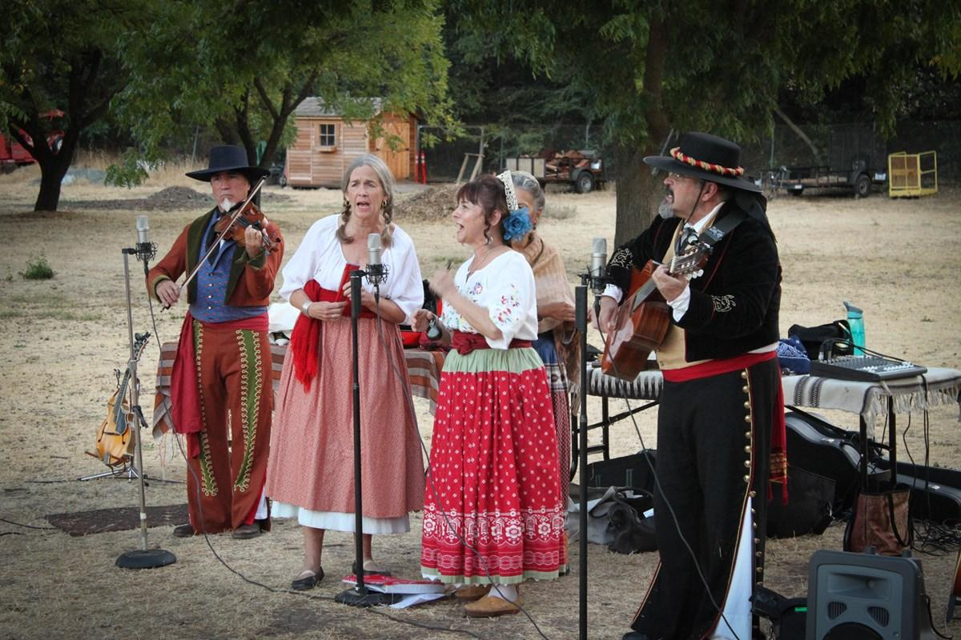
Task 6.2
What things do you see in the picture? Make a list.
Describe what is happening in the picture in 1-2 complex sentences.
What is your opinion on this style of music? How often do you listen to it?
Notes:
Play clip of Mexican folk music while students are completing this entry task.

Slide 52

Task 6.3
What things do you see in the picture? Make a list.
Describe what is happening in the picture in 1-2 complex sentences.
What is your opinion on this style of music? How often do you listen to it?
Notes:
Play clip of classical music while students are completing this entry task.

Slide 53
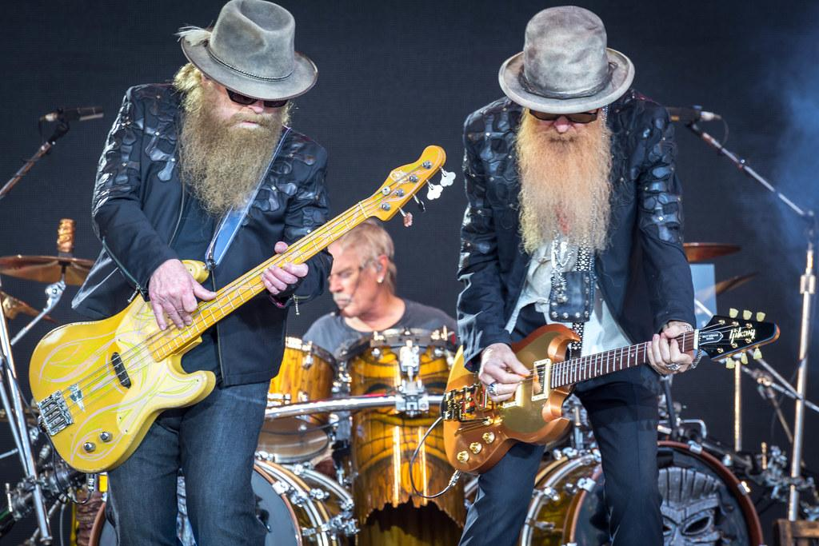
Task 6.4
What things do you see in the picture? Make a list (4).
Describe what is happening in the picture in 1-2 complex sentences.
What is your opinion on this style of music? How often do you listen to it?
Notes:
Play clip of ZZ Top or other heavy metal music while students are completing this entry task.

Slide 54
Task 6.5
Look at the pictures. They show a number of different styles of music.
Reggae
Folk
Record yourself telling which music style or styles you prefer. Give examples and reasons for your decision. Speak for 45 seconds to 1 minute using academic English.
Classical
Heavy Metal

Slide 55
Task 6.6
Look at the pictures. They show a number of different styles of music.
Reggae
Folk
Write a unified paragraph telling which music style or styles you prefer. Give examples and reasons for your decision. Write 6 to 8 sentences. Use a variety of sentences, including complex sentences.
Classical
Heavy Metal

Slide 56
Key Language Uses (KLU)
Task 7
#1-4: Inform
#5-6: Narrate #7: Argue
Widening WIDA Speaking Opportunities - WABE 2026 - Greg Davis, Tumwater School District

Slide 57

Task 7.1
What things do you see in the picture? Make a list of 5 things.
Describe what is happening in the picture using 3 sentences. (Remember to use complex and compound structures.)

Slide 58

Task 7.2
What things do you see in the picture? Make a list of 5 things.
Describe what is happening in the picture using 3 sentences. (Remember to use complex and compound structures.)

Slide 59

Task 7.3
What things do you see in the picture? Make a list of 5 things.
Describe what is happening in the picture using 3 sentences. (Remember to use complex and compound structures and include descriptive vocabulary.)

Slide 60
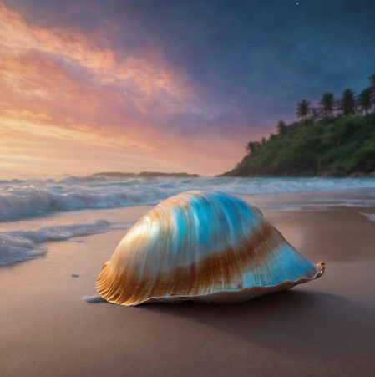
Task 7.4
What things do you see in the picture? Make a list of 5 things.
Describe what is happening in the picture using 3 sentences. (Remember to use complex and compound structures.)

Slide 61
Task 7.5
Look at the pictures. They show a story about Anna.
Record yourself telling Anna’s story. Be sure to include appropriate supporting details to make this more interesting for your audience. Don’t forget to include conflict, climax, and resolution.

Slide 62
Task 7.6
Look at the pictures. They show a story about Anna.
Write Anna’s story from start to finish in paragraph format. Write 8 to 10 sentences. Be sure to include a descriptive title centered at the top. Add appropriate supporting details to make this more interesting for your audience. Don’t forget to include transitions between ideas and scenes.

Slide 63
Task 7.7
Look at the pictures. They show a story about Anna.
Which picture or scene from the story is the most powerful? Give reasons to justify why you believe it is the most compelling. Be sure to refute a counterargument in your response.

