Slide 1
Finding Their Math Voice: Open Tasks that Build Agency and Access for Multilingual Learners
Ricardo Sinclair
April 24, 2026

Slide 2
0.6

Slide 3

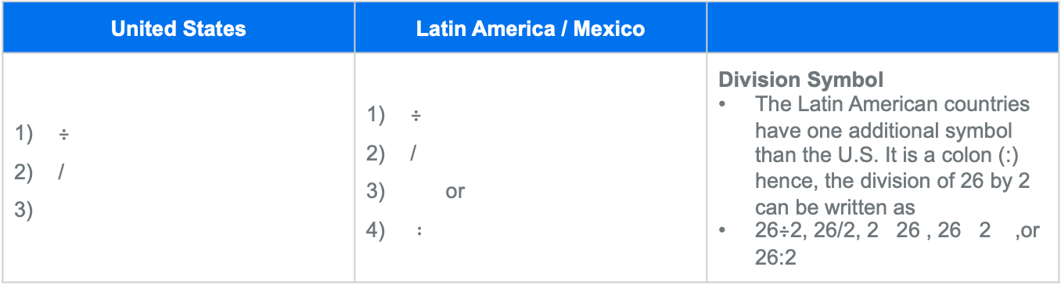
Math Symbols Around The World
United States | Latin America / Mexico
÷ / | ÷ / or $∶$ | Division Symbol The Latin American countries have one additional symbol than the U.S. It is a colon (:) hence, the division of 26 by 2 can be written as 26÷2, 26/2, 2 26 , 26 2 ,or 26:2

Slide 4
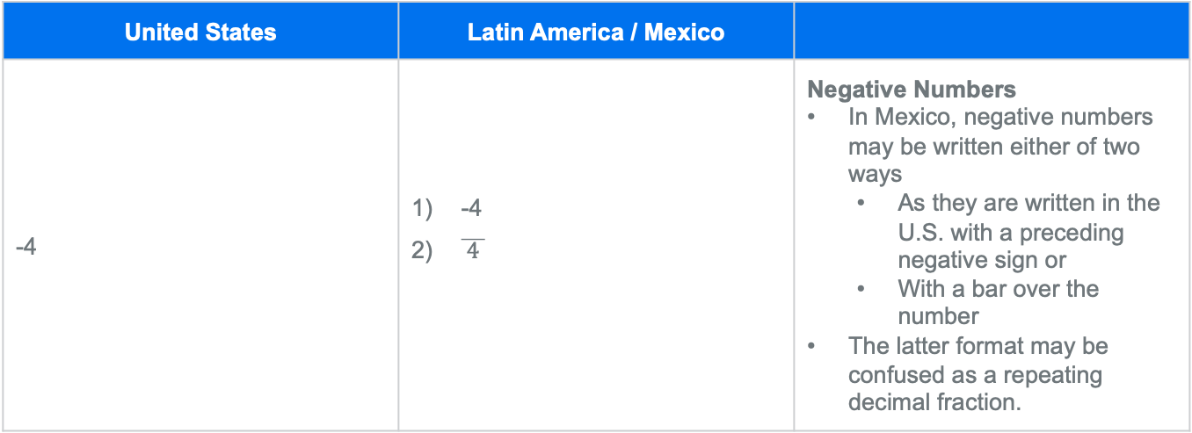
Math Symbols Around The World
United States | Latin America / Mexico
-4 | -4 $\overline{ 4 }$ | Negative Numbers In Mexico, negative numbers may be written either of two ways As they are written in the U.S. with a preceding negative sign or With a bar over the number The latter format may be confused as a repeating decimal fraction.

Slide 5
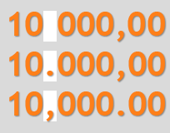

Math Symbols Around The World
United States | Latin America / Mexico
5.25 | 5.25 5,25 | Decimal Numbers United States (U.S.) currency is formatted with a decimal point (.) as a separator between the dollars and cents. Some countries use a comma (,) instead of a decimal to indicate that separation. In addition, while the U.S. and a number of other countries use a comma to separate thousands, some countries use a decimal point for this purpose.

Slide 6
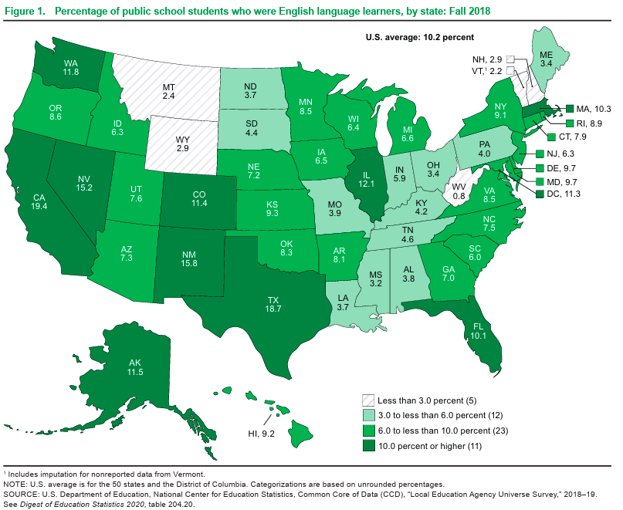

Slide 7
“Amplify, Don’t Simplify” – Walqui & Van Lier’s

Slide 8
Who Do We Support?
Provide instructional support that promotes development of language modalities in mathematics for:
All students as they learn new mathematical language during the year.
Striving readers and writers who are below grade level in acquiring written language.
Multilingual Learners (MLL’s) who may be at various levels of English proficiency.

Slide 9
Receptive
Language
Reading
Listening
Written
Language
WIDA Language Modalities
Oral
Language
Representing
Writing
Productive
Language
Speaking

Slide 10
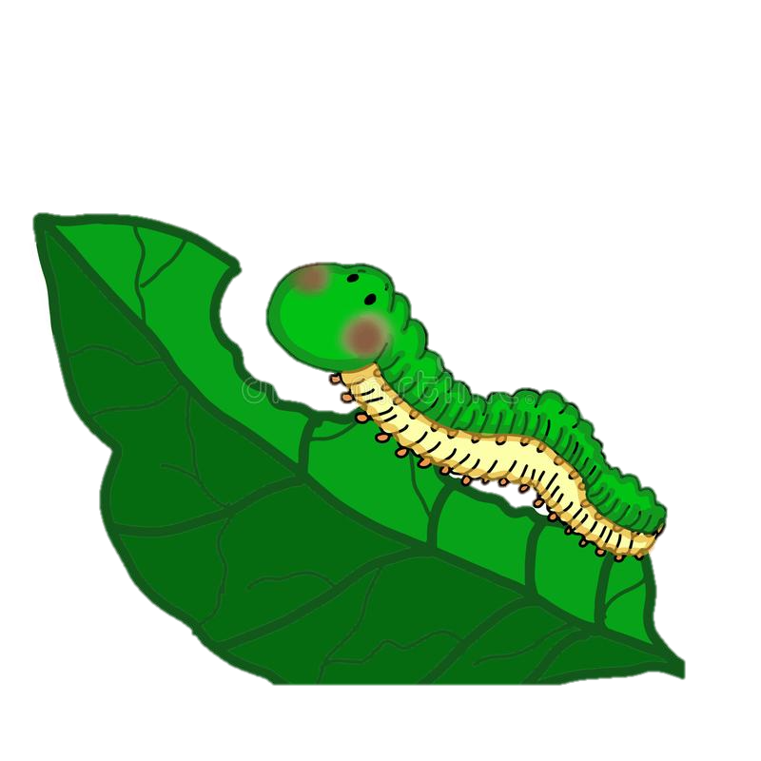
What do you know about caterpillars?

Slide 11
Leaves and Caterpillars: The Case of David Crane
A fourth-grade class needs 5 leaves each day to feed 2 caterpillars. How many leaves would the students need each day for 12 caterpillars?
**Solve the problem any way to choose**

Slide 12
Leaves and Caterpillars: The Case of David Crane
Think...
Pair...
Share!
**Solve the problem any way to choose**

Slide 13
Leaves and Caterpillars: The Case of David Crane
A fourth-grade class needs 5 leaves each day to feed 2 caterpillars. How many leaves would the students need each day for 12 caterpillars?
**Solve the problem any way to choose**

Slide 14
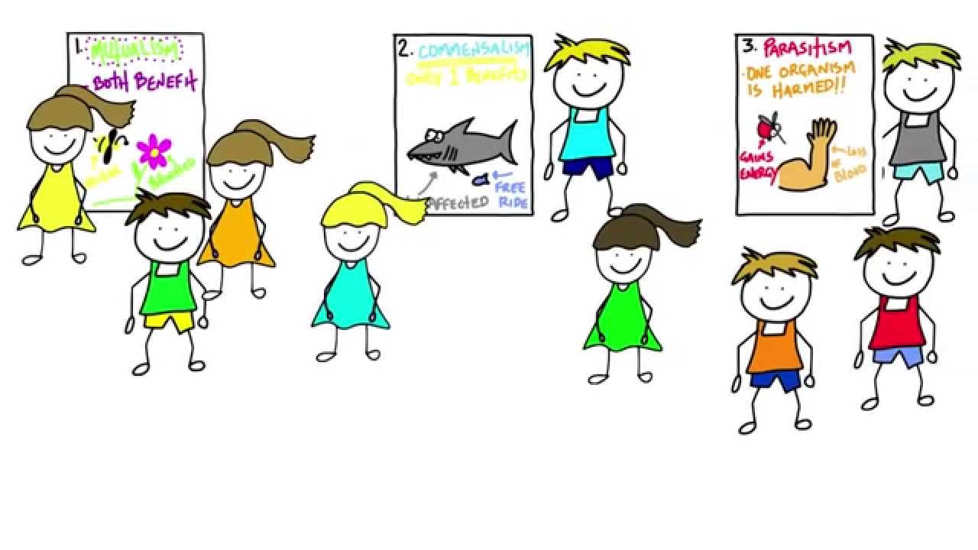
Gallery Walk

Slide 15
What was the Lesson Objective?
What is the Objective of the lesson?

Slide 16
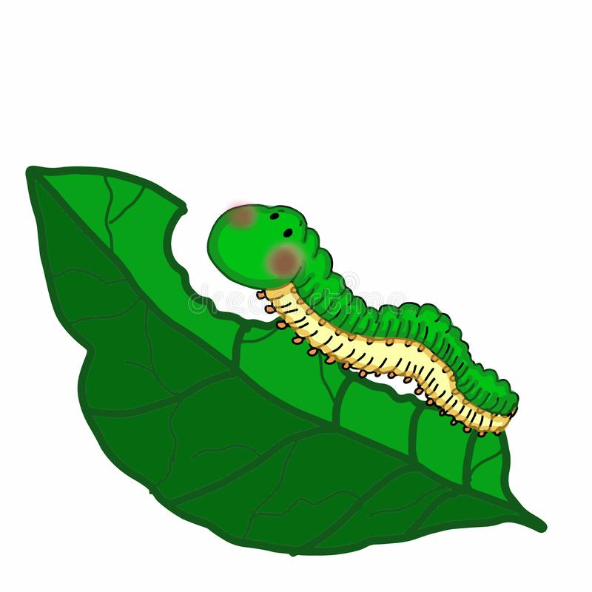
Gallery Walk
Organize the strategies from 1-4 that you would have students share out first, second, third and fourth?
Why did you select this sequence?

Slide 17
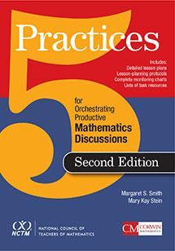
What Are the 5 Practices?
Chapter 1 : Introducing the Five Practices
Anticipating
Monitoring
Selecting
Sequencing
Connecting

Slide 18
What Are the 5 Practices?
Anticipating
Monitoring
Selecting
Sequencing
Connecting

Slide 19
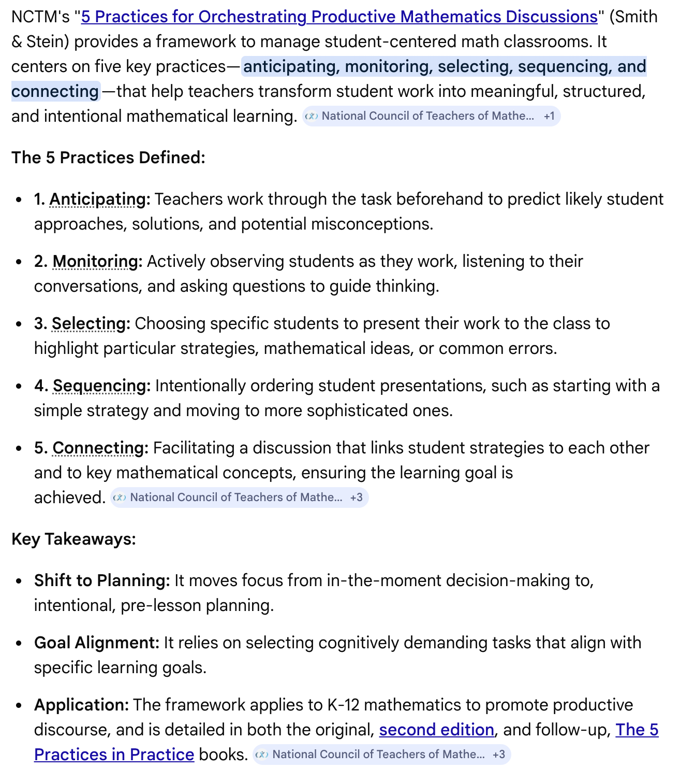
What Are the 5 Practices?

Slide 20
Questions
What type of support do teachers need to effectively make the right connections when showing student strategies?
2. What are ways to monitor a student’s progress?

Slide 21
Lightning Round!
Based on the 5 practices, what comes to mind when planning the following open tasks?
Anticipating
Monitoring
Selecting
Sequencing
Connecting

Slide 22
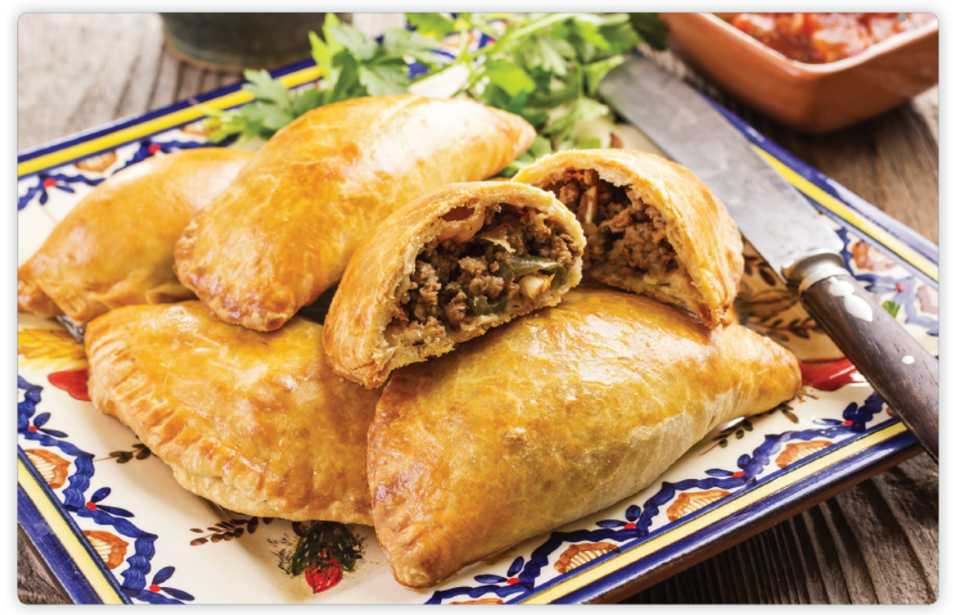
Let’s Investigate!
¿Cuánto Queso?

Slide 23
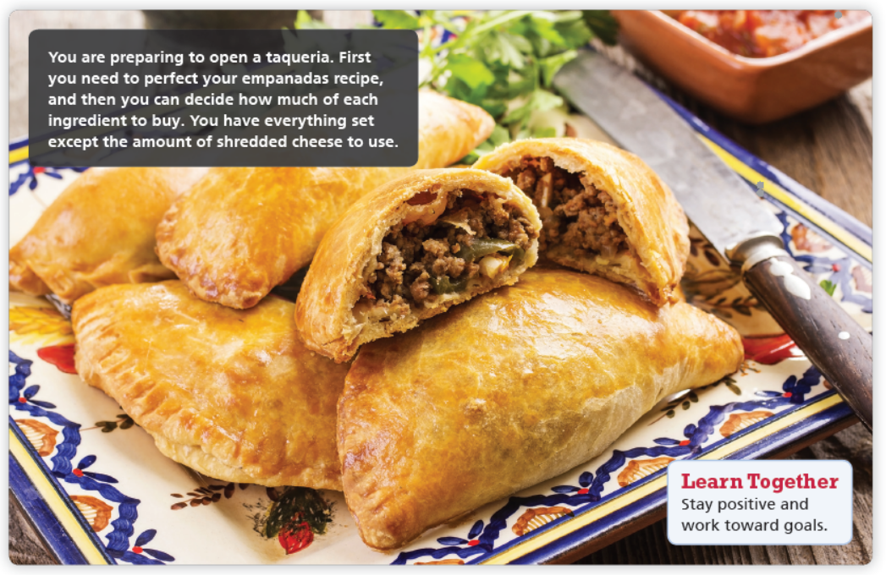
Let’s Investigate!

Slide 24

Let’s Investigate!
Can You Build It?

Slide 25
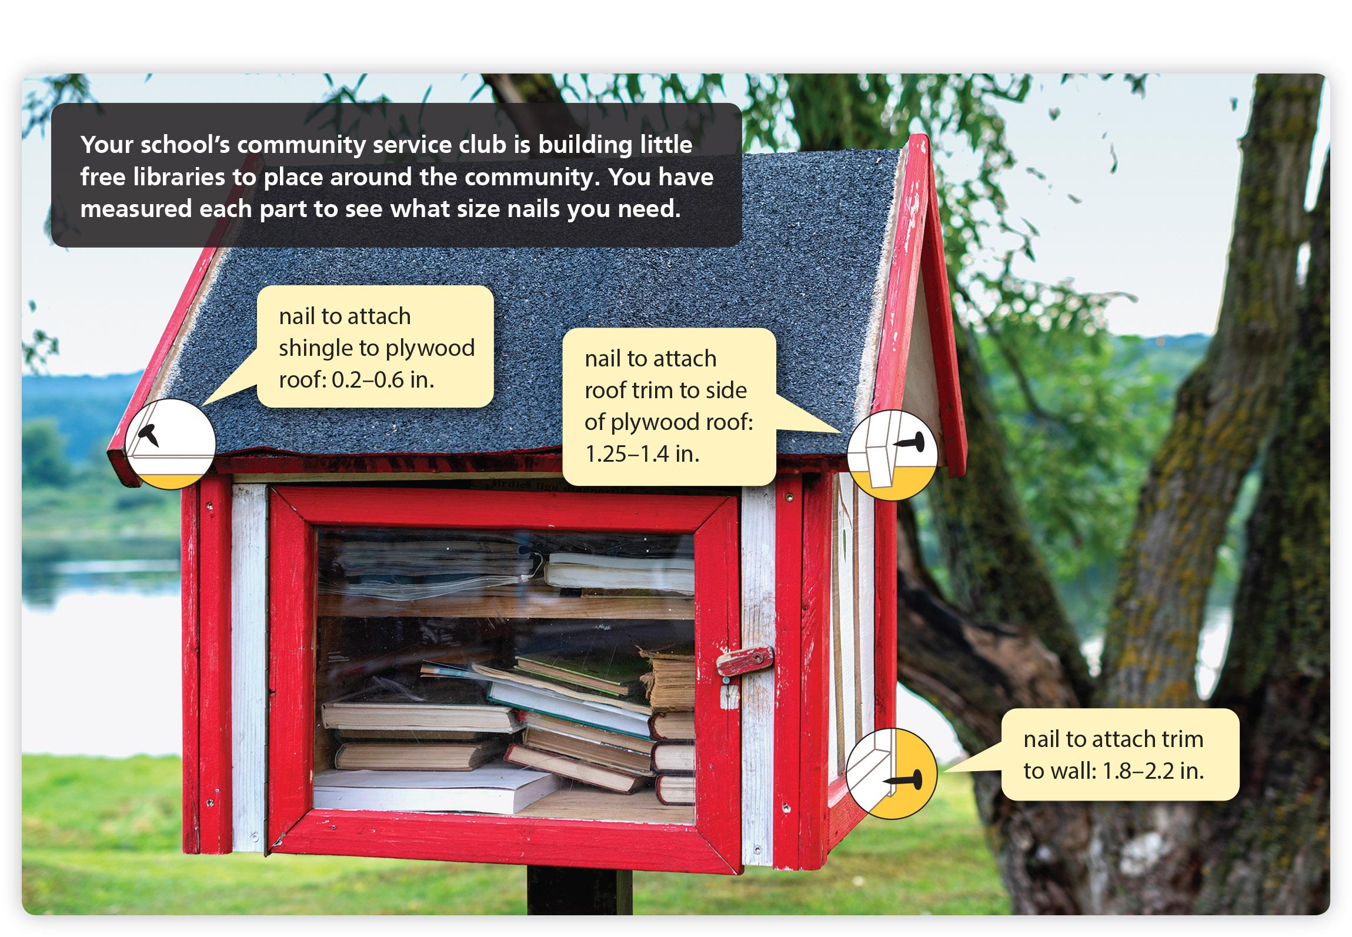
Let’s Investigate!

Slide 26
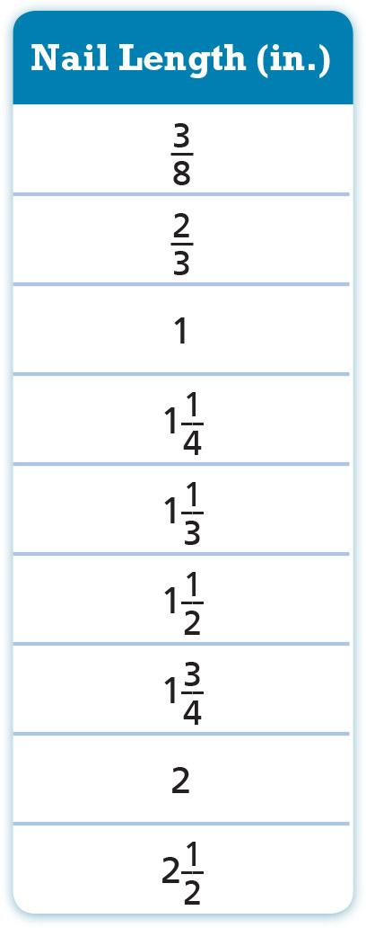
Let’s Investigate!
EXPLORE The table shows the types of nails available at your hardware store. Identify which size nail to buy for each part of the little library.

Slide 27
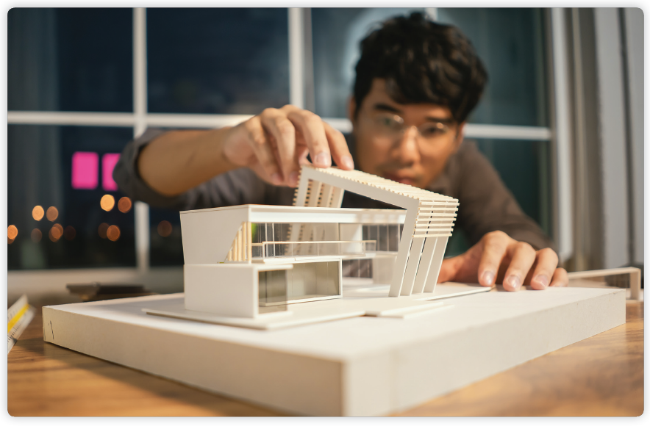
Let’s Investigate!
An Even Bigger Puzzle

Slide 28

Let’s Investigate!

Slide 29
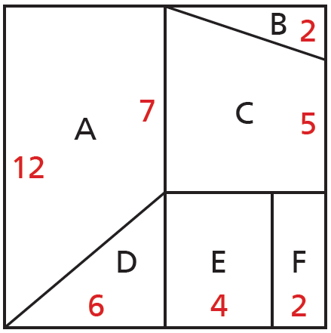
Let’s Investigate!
In this activity, you need to make a larger puzzle from a smaller drawing. You will know if you have done the enlargement correctly if the new puzzle pieces fit together in the right way.
EXPLORE Use the information in this drawing of the puzzle to make a larger version of the puzzle in which the segment that measures 4 cm in the picture measures 7 cm in the new puzzle. All red measurements are in centimeters.

Slide 30
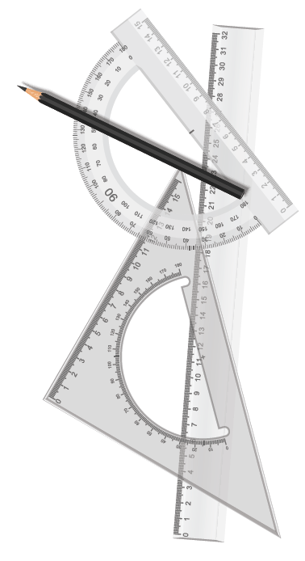
Let’s Investigate!
Be Precise Describe how you determined each measurement for the new puzzle.

Slide 31
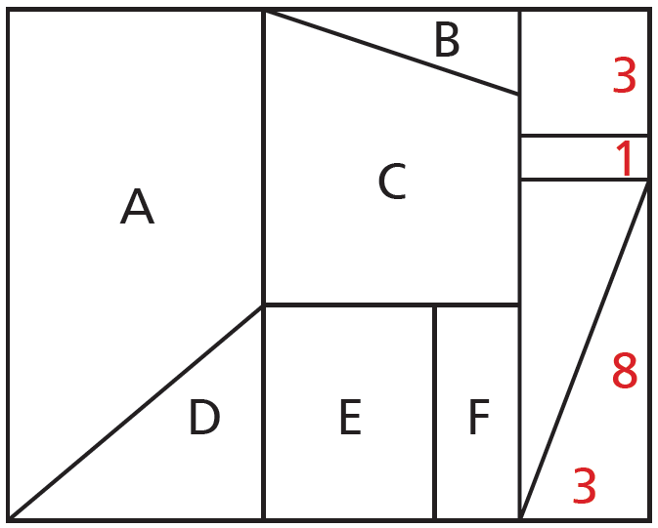
Let’s Investigate!
Generalize The puzzle is expanded to include the rectangular section below. Write an equation that can be used to figure out the lengths of the new measurements.

Slide 32
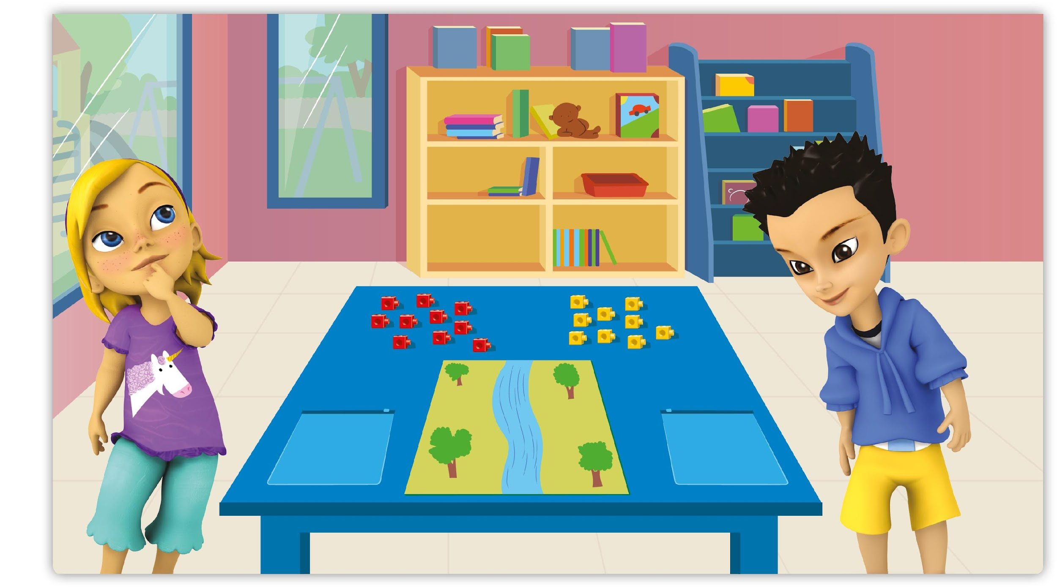
Let’s Investigate!
Make It Fair
Directions Say: River and Emily want to enter the “Build a Bridge” contest. First, they must share the cubes on the table. To be fair, Emily and River must each get the same number of red and yellow cubes. How many red cubes should they each get to be equal, or fair? How many yellow cubes should they each get to be equal, or fair? Say: Explain how you know that River and Emily get a fair or equal number. Do you have any extra cubes left over? How many?

Slide 33

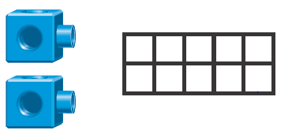
Let’s Investigate!
Directions Say: Use cubes, numbers, or colored drawings to show how many cubes Emily and Daniel each get. Show how you know they each get an equal number. If you want students to build a bridge over a (paper) river, say these contest rules, and replace “red” and “yellow” with the colors students have: A bridge must be made up of only red and yellow cubes. A red cube can NOT touch another red cube and a yellow cube can NOT touch a yellow cube.

Slide 34
You can make your own!
You know your students better than anyone else!

Slide 35
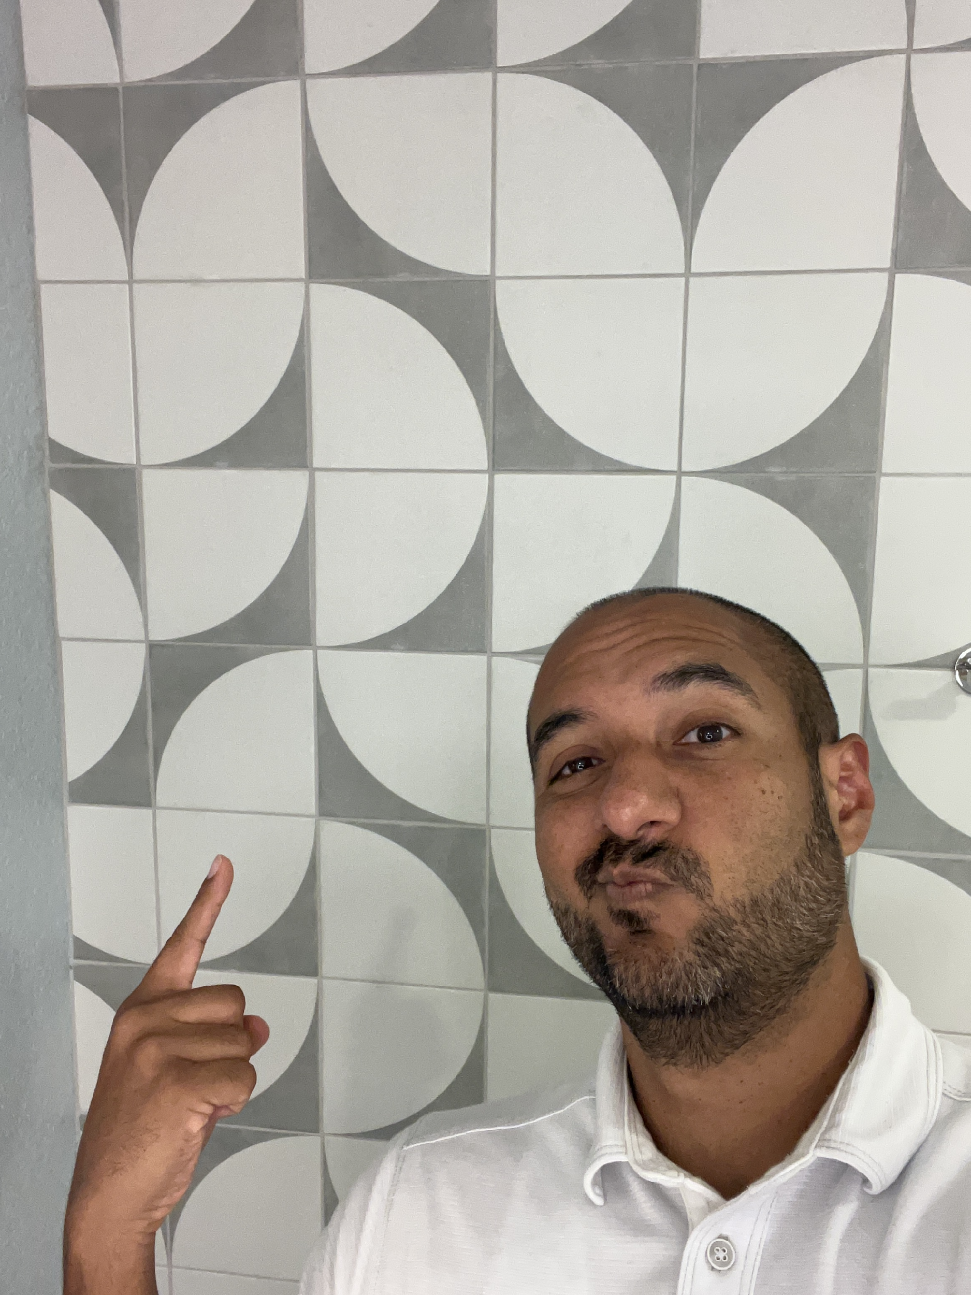
You can make your own!

Slide 36
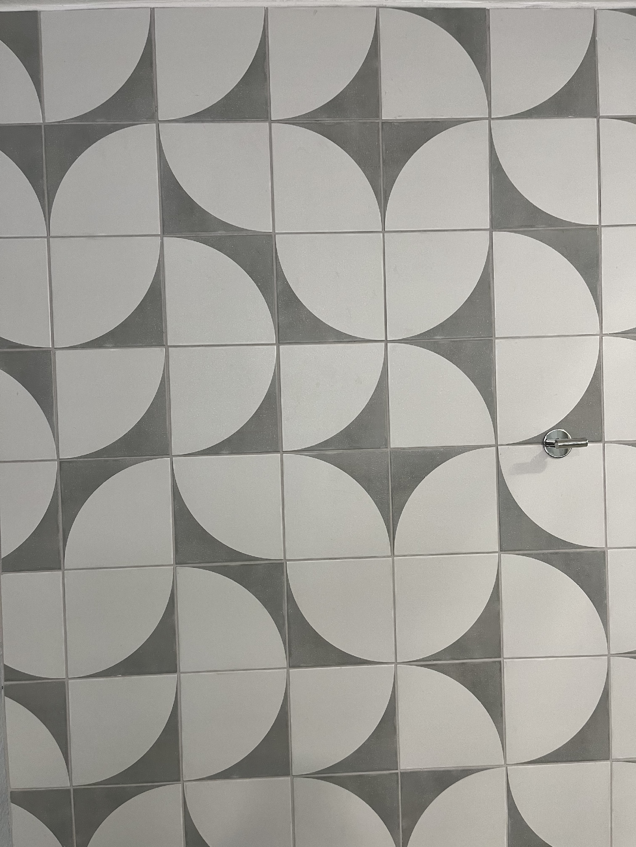
You can make your own!

Slide 37
Reading in Mathematics
Receptive Written Language
Support reading in a math classroom
Students read math instruction, direction, exercises in print and digital, and written work of other students
Includes reading specialized math vocabulary and math representations
Support reading math word problems
Understanding math word/story problems requires more than decoding
Students need to identify quantities and how they are related
Help students with unfamiliar words
Ask students which words are unfamiliar
Relate the words to students’ experiences
Use technology that reads or translates text
Use digital read aloud text
Allow ELLs to use tech to translate unfamiliar words
Reading

Slide 38
Writing in Mathematics
Productive Written Language
Provide many writing opportunities for all students
Students use words as well as drawings, numbers, and symbols when they show their thinking on paper, justify their work, or critique the explanation of others
Provide writing prompts using sentence frames
Example, “I think my equation fits the problem because ____.”
Have students write in journals
Record new language
Record the questions they have
Writing

Slide 39
Listening in Mathematics
Receptive Oral Language
Use non-linguistic support
Use gestures, facial expressions, tone of voice, objects, manipulatives, pictures, and drawings that help make oral communication comprehensible
Write key spoken words during class discussions
Allows students to read them at their own pace
Make language modification for ELLs
Do not lower expectation but explain the task using language that is appropriate for the linguistic level of the ELLs in class
Speak clearly and with frequent pauses to check for understanding
Improved listening improves speaking, which improves writing
Becoming more proficient in listening leads to greater proficiency in productive language (writing and speaking)
Listening

Slide 40
Speaking in Mathematics
Productive Oral Language
Provide many speaking opportunities for all students
Students should verbally explain, clarify, justify, conjecture, generalize, and ask purposeful questions
Have students think aloud (exploratory talk)
Encourage going beyond brief, single-word responses
Encourage multisensory communication
Students use objects, drawings, and gestures to support their communication
Do oral communication activities
Tell or retell a math story
Role play to act out a problem
Speaking

Slide 41
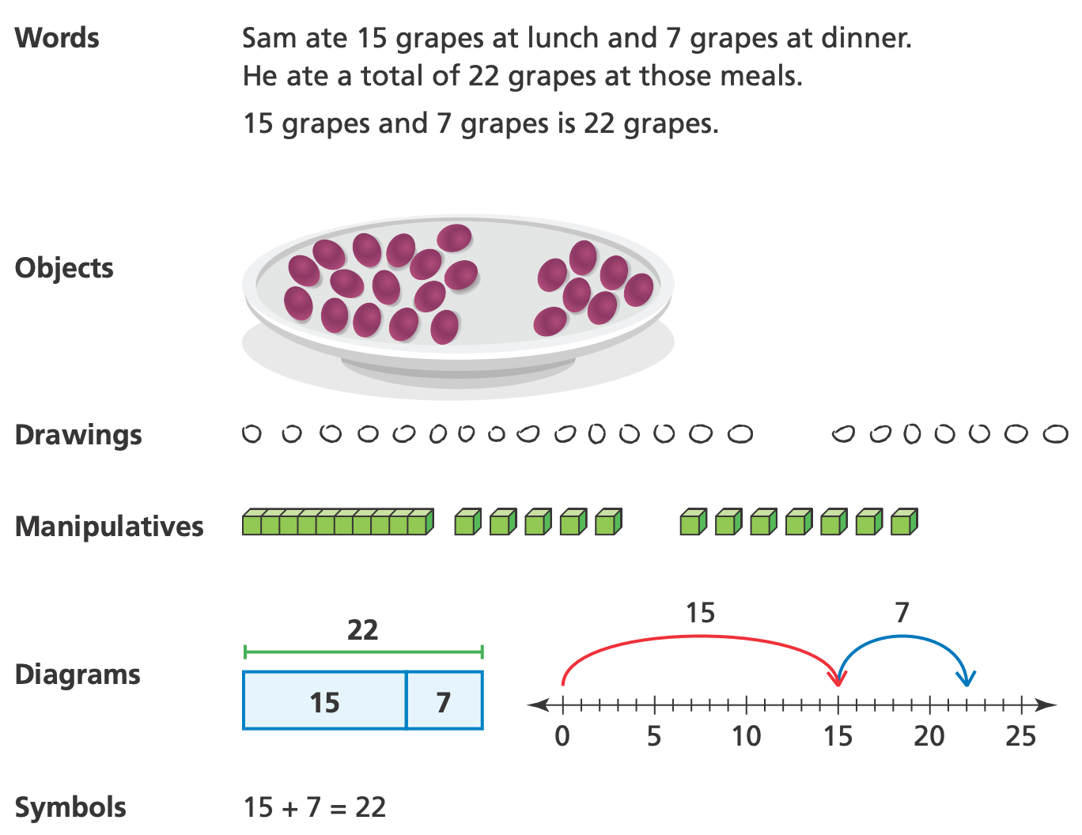
Representing in Mathematics
Interpreting and Creating Representations
Use and connect multiple representations
Concrete examples include objects and manipulatives
Pictorial representations include pictures of objects and manipulatives, drawings, diagrams, number lines, graphs, and tables
Abstract representations include words, numbers, and symbols
Interpreting and creating representations and moving from one representation to an equivalent representation are at the heart of doing mathematics
Representing

Slide 42
Receptive
Language
Reading
Listening
Written
Language
Oral
Language
Representing
Writing
Productive
Language
Speaking

Slide 43



The Hexagon Task Video
School: Austin Independent School District
Teacher: Ms. Patricia Rossman
Many of the students in the classroom have recently arrived to the United States. The students are in a dual language program.
Group 1: Reading
Group 2: Writing
Group 3: Listening
Group 4: Speaking
Group 5: Representing

Slide 44

The Hexagon Task Video
Trains 1, 2, 3, and 4 are the first 4 trains in the hexagon pattern. The first train in this pattern consists of one regular hexagon. For each subsequent train, one additional hexagon is added. For the hexagon pattern:
Compute the perimeter for the first 4 trains.
Determine the perimeter for the tenth train without constructing it.
Write a description that could be used to compute the perimeter of any train in the pattern. Explain how you know it will always work. (Use the edge length of any pattern block or the length of a side of a hexagon as your unit of measure.)

Slide 45
Compare what you saw and discuss how what you saw might be beneficial to an ELL students’ learning process.
Would you have done anything differently as the teacher to incorporate your group’s assigned language modality?
Pick someone to present your group’s ideas (unmute and talk).
Receptive
Language
Reading
Group 1
Listening
Group 3
Written
Language
Oral
Language
Representing
Group 5
Writing
Group 2
Productive
Language
Speaking
Group 4

Slide 46
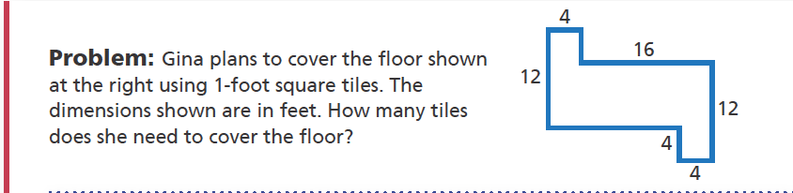
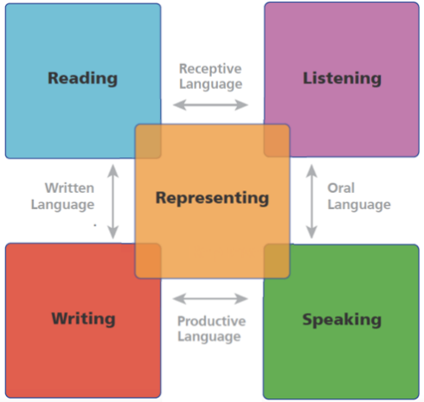
What teacher actions would you make to elicit these language modalities?

Slide 47
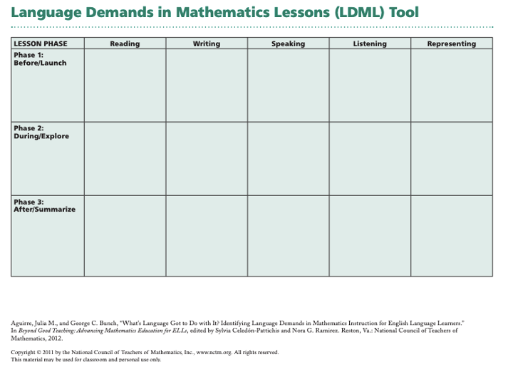

Slide 48
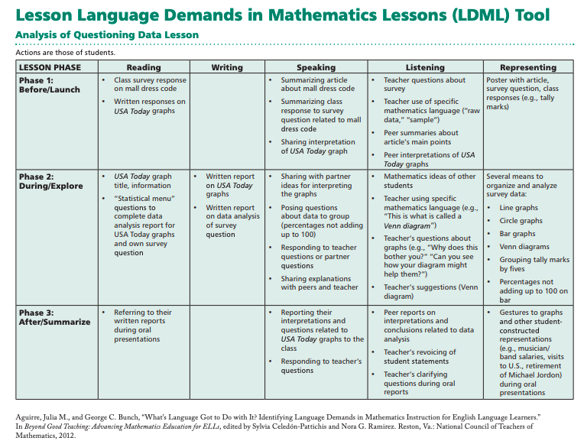

Slide 49
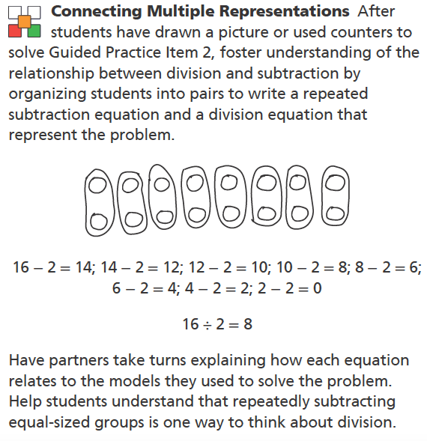
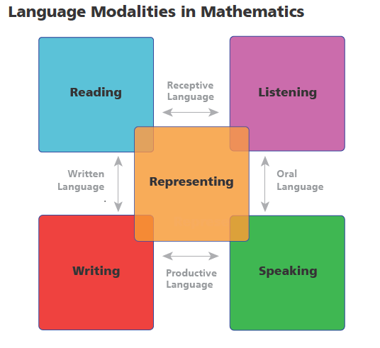

49

Slide 50
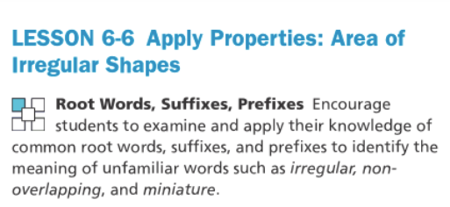
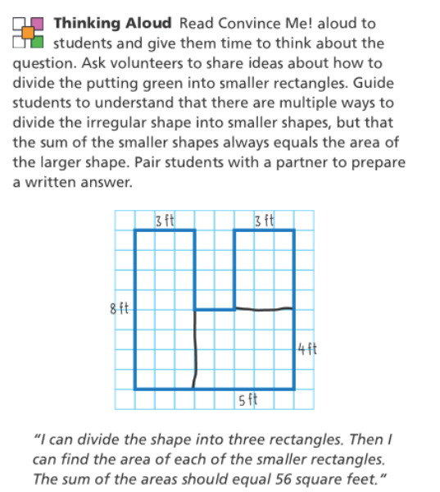
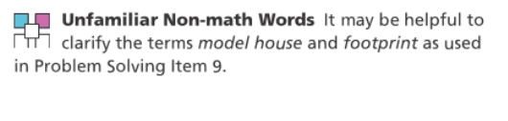

Slide 51
Academic Vocabulary Instruction
From… |  | To…
Approaching vocabulary instruction as stand-alone strategy |  | Organizing vocabulary instruction within content-based units of study that involve reading, writing, and dialogue
Starting with long lists of words |  | Selecting a small set of useful and complex words, then complementing this instruction with word-learning strategies
Teaching words through a series of memorization and spelling activities and independent worksheets |  | Studying words and concepts using multiple methods and formats, including collaboration
Relying on wide reading to build word knowledge |  | Reading a small set of thematically-related texts deeply to build knowledge of words and concepts

Slide 52

Do you know how smart I am in ______?

Slide 53


Resources

Slide 54
Thank you for everything you do!

