Slide 1

Creating Equitable Opportunities for Multilingual Learners’ Academic Discourse
An Exploration of Evidence-Based
Strategies & Teacher Agency
Sally Baer, NBCT, M.Ed., MA
Multilingual Learning Specialist, Renton School District
NBCT Regional Coordinator, Office of the Superintendent of Public Instruction
PhD Doctoral Student, Seattle Pacific University
WABE Conference | April 25, 2026
Notes:
Bom dia
Buenos Dias

Slide 2

Today’s
Roadmap
Mindful Opener & Community Building
Content & Language Learning Targets
Grounding in Theory
Evidence-Based Strategies
Reflection, Call to Action & Staying Connected
Exploration & Collaboration

Slide 3


Learning Community Norms
Be present, mindful and engaged
Enter with curiosity, vulnerability and open-mindedness
Speak your truth, share with authenticity and empathy
Create space for ALL opinions and learning
Take care of yourself and honor your personal needs

Slide 4




Visual Icon Key
Think, Reflect, then “Stop and Jot”
Partner or Group Collaboration
Learning Target
Timer for discussions or activities
Notes:
I like to use icons to support every learner!
Take a pic or screen shot

Slide 5


Mindful Opener Intention Setting
"Cuando estableces una intención, es probable que tomes decisiones que la apoyan—en lo que haces o piensas. Puede que hoy olvides tu intención, pero una pequeña parte de tu mente la recuerda.“
“When you set an intention, you’re likely to make choices that support it—in what you do or think. You might forget all about your intention today, but some little part of your mind remembers it.”
-Elena Aguilar, 2014
Notes:
I’m grateful you are here today! Let’s stay mindful and present in our learning today – If you so choose, I invite you to turn off your cameras and engage in a quiet grounding activity:
4-4-4 breathing – feet, body – notice how your feet feel on the ground, your body in the chair…think about your body being supported by the chair, the chair being supported by the floor, the floor being supported by the Earth.
Breath in for 4, hold for 4, exhale for 4

Slide 6



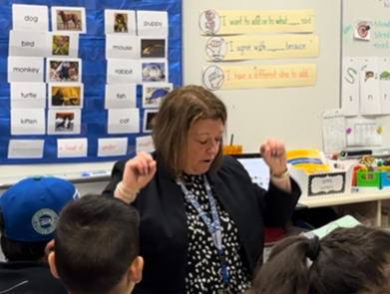


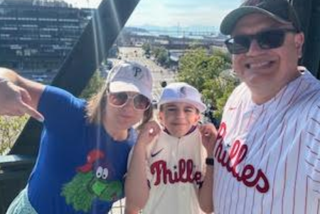
Building Community
My name is…
My role in education is…
One interesting thing about me is…
My goal or intention for today’s session is…
Revoicing: “I heard you say…”
Notes:
With a partner, revoice what they said to you. “I heard you say….”

Slide 7
Content & Language Learning Targets
Content Learning Targets
Language Learning Targets
Narrate & Explain Theories of 2nd Language Acquisition and How it Informs our Work
Narrate Revoicing Strategies During Our Time Together
Narrate & Explain Evidence-Based Strategies to Create Equitable Opportunities and Build Teacher Agency
Review & Explore Theories of 2nd Language Acquisition
and How it Informs our Work
Understand How Revoicing Makes Student Discourse “Accountable”
Explore Evidence-Based Strategies to Create Equitable Opportunities and Build Teacher Agency
Notes:
T Agency: a teacher’s capacity and autonomy to make shape instruction and make decisions that are best for student outcomes – that includes having the correct set of tool in your kits

Slide 8
Theories of Second Language Acquisition
Krashen + Cummins
"平等是给每个人一只鞋。 公平就是给每个人一双合脚的鞋子"
“Equality is giving everyone a shoe. Equity is giving everyone a shoe that fits.”
- Susan K. Gardener

Slide 9

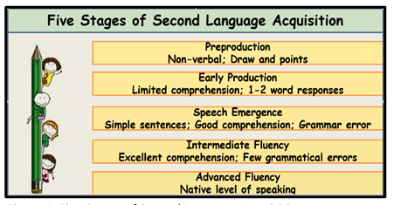
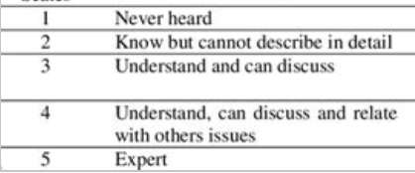
Stephen Krashen’s 5 Stages of Second Language Acquisition & Affective Filter Hypothesis
ELD Strategies such Visuals, Sentence Stems and “Think, Pair, Share” reduce affective filter. Affective filter is defined as a psychological barrier that can influence a student’s language acquisition, such as anxiety, motivation or self-esteem. (Krashen’s Affective Filter Hypothesis)
Visual of Krashen’s “5 Stages Of Second Language Acquisition”
Notes:
Activating Prior knowledge through st self-reflection -- gives us an idea of what our students already know when are learning about a topic – great T move to use with our sts (or staff)
Where might our newcomer students fall? Even in the silent period, sts are still acquiring language
Think about where the sts in your school or district may fall

Slide 10
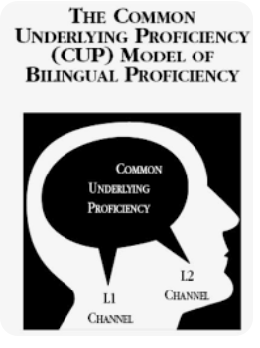
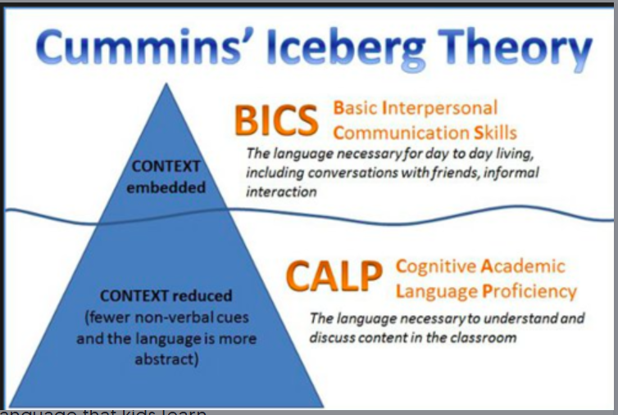
Jim Cummins: CUP, BICS + CALP
Common Underlying Proficiency (CUP)
Basic Interpersonal Communication Skills (BICS)
Cognitive/Academic Language Proficiency (CALP)
Learner's L1 proficiency provides a foundation for L2 learning
Knowledge, concepts, and skills developed in one language can be transferred to another
The everyday, social language used in informal settings
Acquired relatively quickly
Relies on social cues and shared understanding
Represents the more formal, academic language needed for success in school
Takes much longer to acquire
Requires explicit language to convey meaning
Notes:
CUP – transfer of L1 skills to subsequent languages (L2, L3, etc)
BICS – Social language; CALP – academic language (which takes approx. 5-7 years to acquire)
What are some examples of BICS? CALP? Drop into the chat

Slide 11
Evidence-Based ELD Strategies
Mỗi ngày giáo viên của Mỹ thay đổi cuộc sống, và mỗi ngày những cuộc sống đó thay đổi thế giới.
“Everyday America's teachers change lives, and every day those lives change the world.”
-Miguel Cardona, Educator, 12th U.S. Secretary of Education
Notes:
Now that we are grounded in some data and language acquisition theory, let’s dive in into 3 ELD strategies that elevate accountable talk and cultivate teacher agency

Slide 12
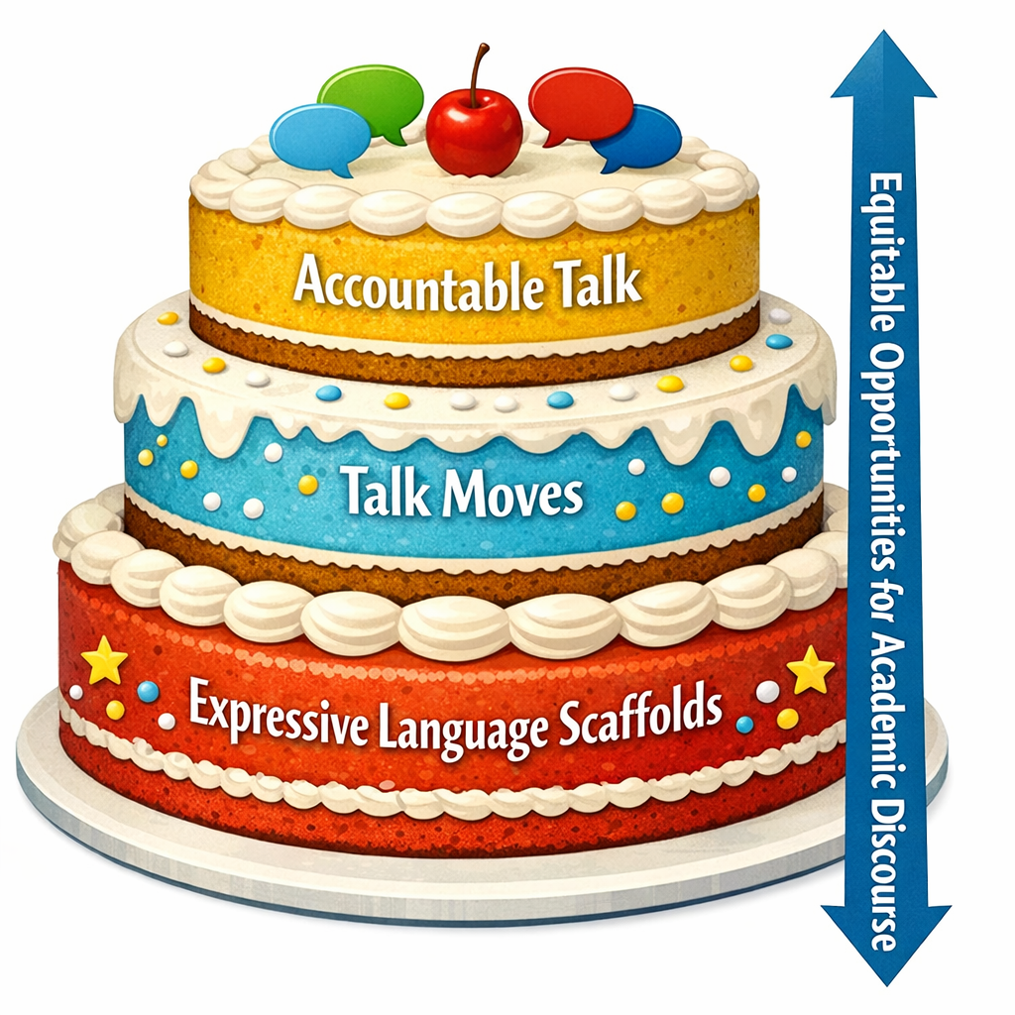
Layer Concept
Supporting ELD Strategies with Strong Bottom Layer/Base of Expressive Language Scaffolds
Opportunities for Differentiation
Supports Vygotsky’s Social Learning Theory and Zone of Proximal Development (ZPD)
Cultivates Teacher Agency
Reduces Affective Filter and Creates Student Autonomy & Accountability

Slide 13
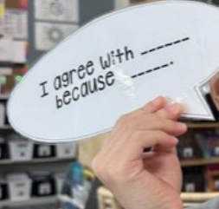
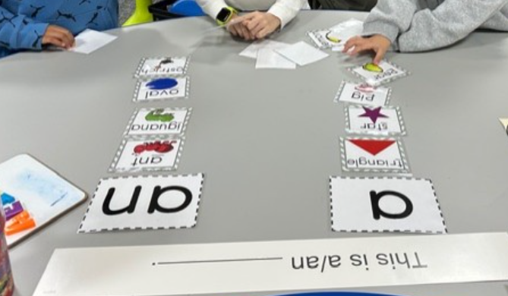
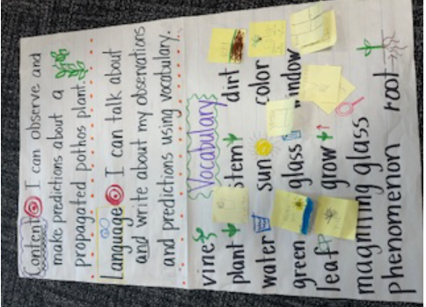
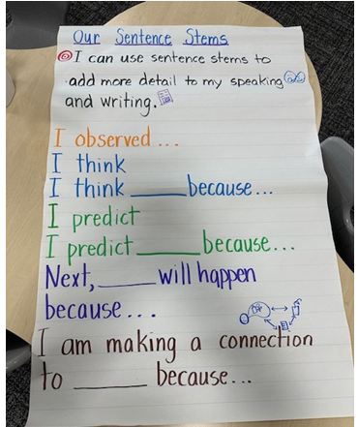
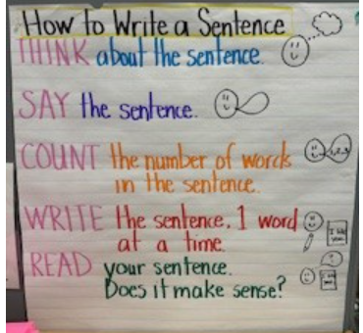
Strategy #1: Expressive Language Scaffolds
Content & Language Targets
Frontload Vocabulary, Word Banks (when appropriate)
High Rigor with Differentiated Sentence Stems
Use of icons, pictures, realia, gestures, TPR
“Portable” Speech Bubbles
Co-created, paper anchor charts
Notes:
Learning targets – content is the WHAT, language is the HOW – backwards design
What might be a time where you do not want to frontload vocab?
Create portable speech bubbles or sent stems – easily moved around your space -- Were are some spaces/places you might move these tools and why?

Slide 14
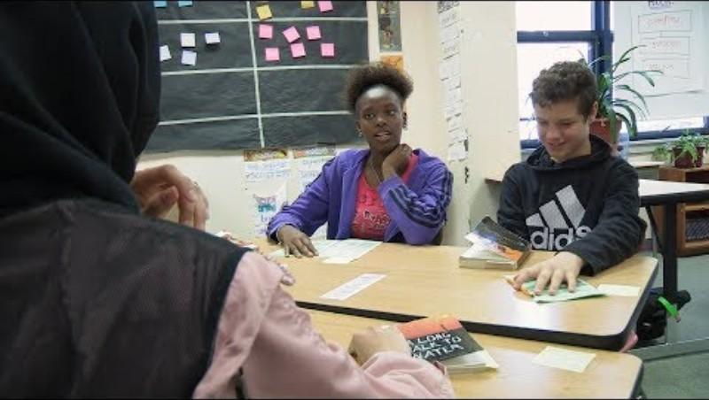
Strategy #2: Talk Moves

Slide 15
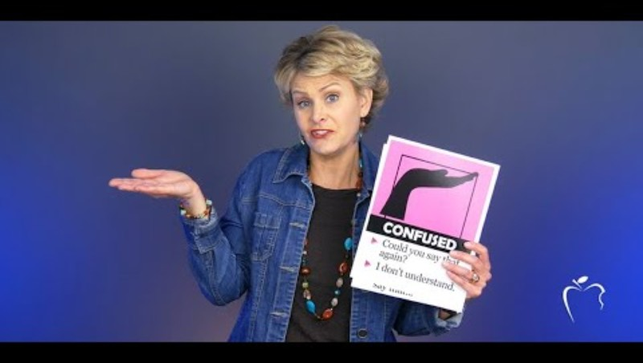
Strategy #2: Talk Moves

Slide 16


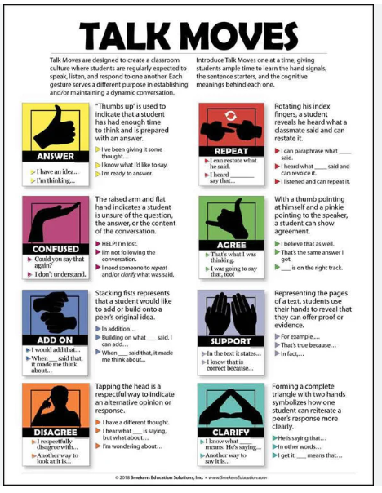
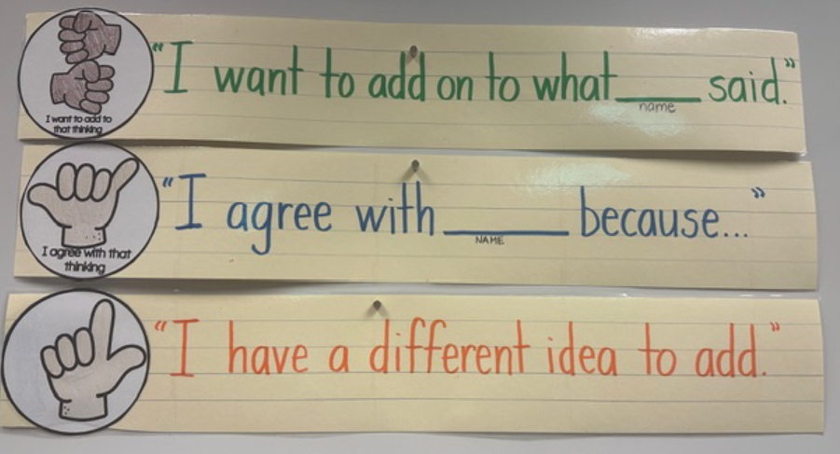
Strategy #2: Talk Moves Reflection
Guiding Questions
What “Talk Moves” resonated with me? Why?
What am I already doing in my work with MLLs? How can I elevate this work? What are my next steps?
What “Talk Move/s” will I easily integrate into my practice? How? Who will I need to collaborate with to accomplish this?
Sentence Stems
I am wondering about______ because……
I made a connection to _______ because……
When I do __________ my students will ……
Next, I will ______ because …… Talk Moves Poster
Notes:
Hand gestures can be a really powerful tool for creating equitable opportunities for student talk …. What if instead of kids raising hands, they all used gestures to enter into a discussion?

Slide 17
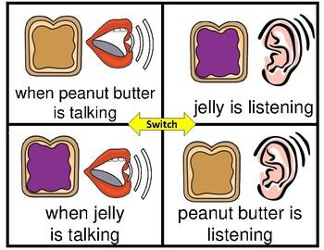

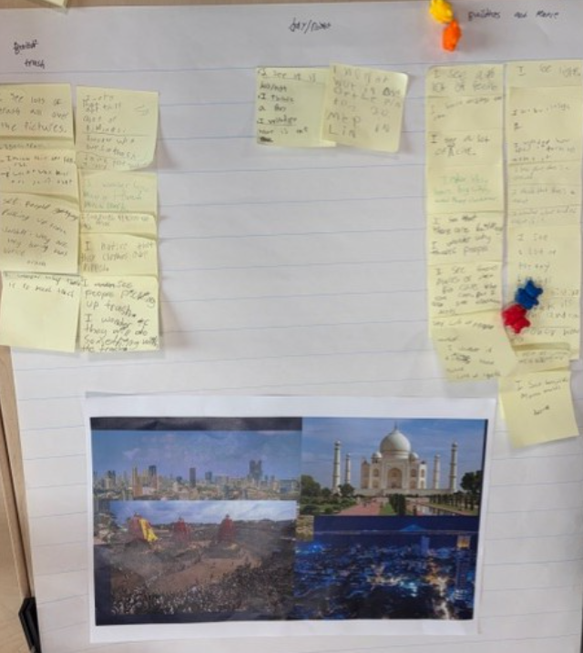
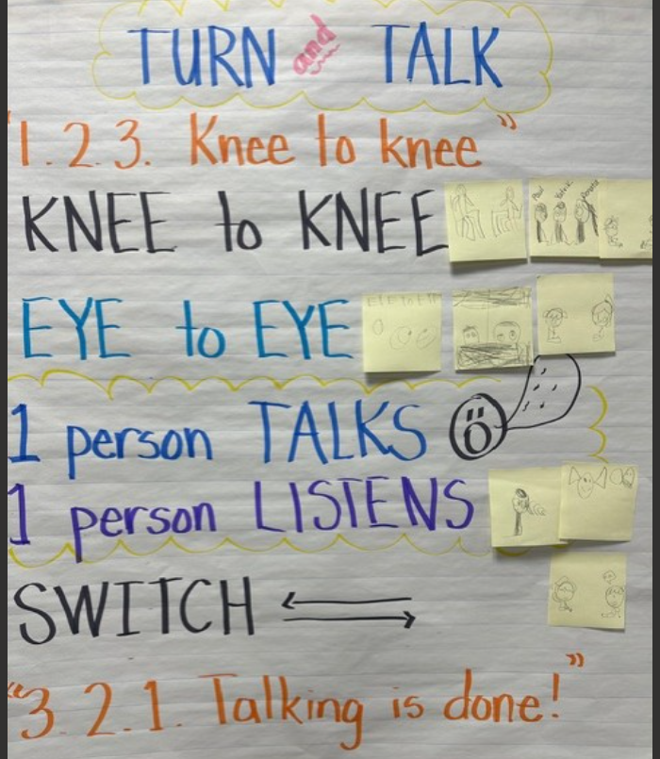
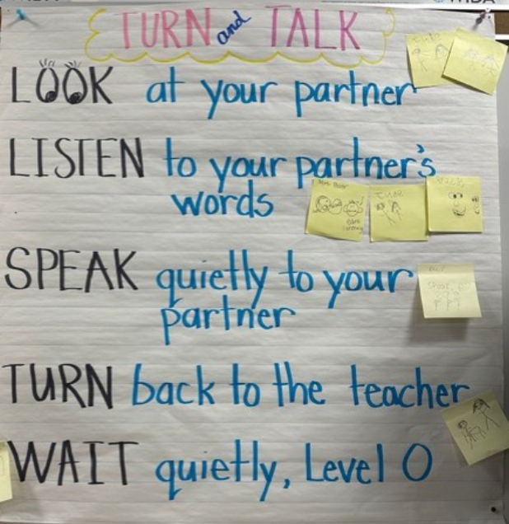
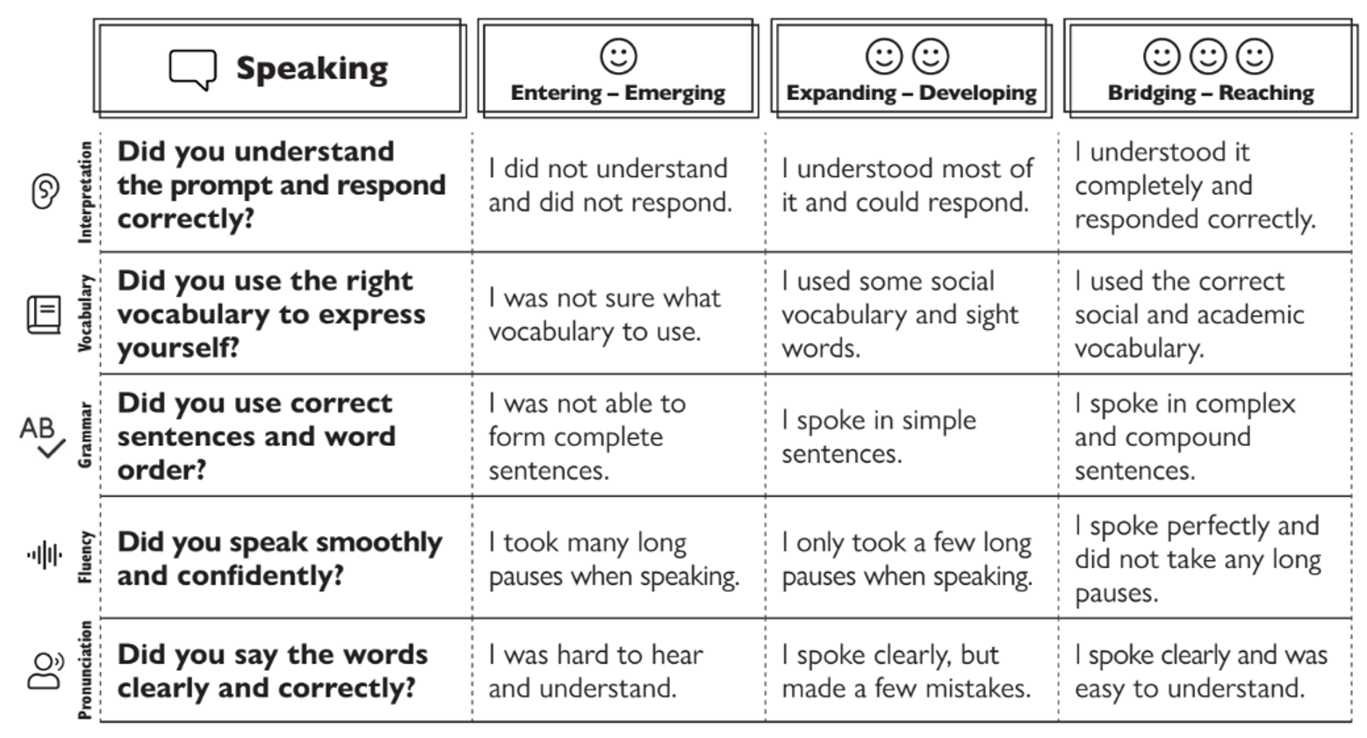
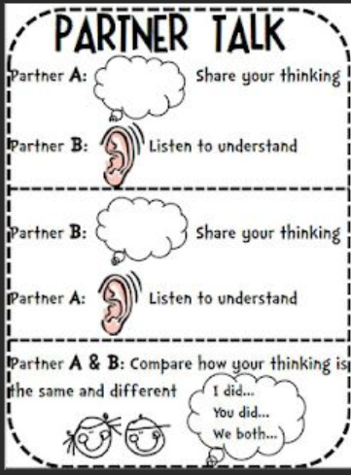

Strategy #3: Accountable Partner & Small Group Sharing
Talking pieces and revoicing -
“I heard you say…..is that correct?” and/or “Can you please repeat?
Student/Group Rubrics or Checklists
Activities that promote higher level thinking and collaboration
Co-created, established protocols with pictures, visuals – anchor charts posted and accessible
Intentional partnerships and/or groupings
Notes:
Lay a strong foundation by co-creating protocols – kids add to the anchor chart (cognates, pictures, phrases, connections, etc)
Be intentional about groupings or partners (similar L1, beginning EL and an intermediate EL, etc)
REVOICING!!! Establish a common sentence stem
Talking piece protocol/ideas – how many of you have used talking pieces? How? Why?
We can build st efficacy through st self-assessment/reflection or thru peer feedback
High level/rigor – word or concept sorts, analyzing primary sources,,,,other examples?

Slide 18

Reflection: Final Thoughts & “ah ha” Moments
How did you feel during this session?
        “I felt ________ because…”
        “I felt ________ when…”
        “This experience was __________ because…”
        “It was challenging when _______ because…”
What did you learn today?
        “I learned __________ .”
        “I will focus on______ strategy or idea because….”
How will I ensure every student has equitable opportunities to engage in academic discourse and accountable languaging?
        “I will integrate __________ into my practice because…….”
        “When I use _________ my students will be able to ………”
        “As an educator dedicated to equitable educational practices, I will ________ because …….”
Revoicing: “I heard you say…”

Slide 19
Content & Language Learning Targets
Content Learning Targets
Language Learning Targets
Narrate & Explain Theories of 2nd Language Acquisition and How it Informs our Work
Narrate Revoicing Strategies During Our Time Together
Narrate & Explain Evidence-Based Strategies to Create Equitable Opportunities and Build Teacher Agency
Review & Explore Theories of 2nd Language Acquisition
and How it Informs our Work
Understand How Revoicing Makes Student Discourse “Accountable”
Explore Evidence-Based Strategies to Create Equitable Opportunities and Build Teacher Agency
Notes:
T Agency: a teacher’s capacity and autonomy to make shape instruction and make decisions that are best for student outcomes – that includes having the correct set of tool in your kits

Slide 20

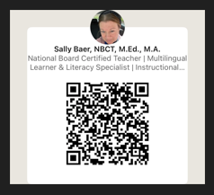

¡Gracias! Thank You!
Call to Action
Share your learning with your colleagues, administrators and communities
Look through the asset-based lens every day – continue to elevate the rich experiences our MLLs bring to our communities
Cultivate belonging for ALL – continue to advocate on behalf of our MLLs, empower them and their families
Support your colleagues during these challenging times: fix and shine their crowns, have hands on their backs, bring your teammate coffee, etc…
Take care of yourself - setting boundaries is never selfish; it is self-care!
Connect With Me and Each Other
baers1@spu.edu
Share the amazing work you are doing!
Continue to share resources, best practices, etc.

Slide 21
References
Aguilar, E. (2014). Setting Intentions: A Powerful Tool to Help Us Learn. https://www.edutopia.org/blog/setting-intentions-powerful-tool-help-us-learn-elena-Aguilar.
Dove, M. & Honigsfeld, A. (2022). Co-Planning. 5 Essential Practices to Integrate Curriculum and Instruction for English Learners. Corwin.
Ferlazzo, F. (2002). Visualization of Krashen’s 5 Stages of Second Language Acquisition. https://larryferlazzo.edublogs.org/2022/11/19/nice-visualization-of-dr-krashens-5-stages-of-second-language-acquisition/.
Ernst-Slavit, G. & Gottlieb, M. (2025). Academic Languaging: Engaging Multilingual Students in Content Area Learning Corwin.
Krashen, S. P. (2026). Books and Articles by Stephen P. Krashen. https://www.sdkrashen.com/.
Loyola Marymount University. (2026). Featured Speaker: Jim Cummins, PhD. https://soe.lmu.edu/centers/ceel/professionallearning/featuredspeakers/featuredspeakerjimcumminsphd/.
Microsoft. (2026). Copilot (April 10 version)[Image generator]. https://copilot.microsoft.com/
O’Connor, M., Anderson, N. & Chapin, S. (2022). Talk Moves: A Teacher’s Guide for Using Classroom Discussions in Math K-6. Heinemann Educational Books.
Office of English Language Acquisition (OELA). (2026). Top languages of English learners. https://ncela.ed.gov/sites/default/files/2026-01/toplanguages_12192025-508.pdf.
Sandoval, M. & Nelson, K. (2025, April 2). Owning the conversation: Building accountable talk in multilingual classrooms (Episode 19) [Audio podcast episode]. In Literacy Across Languages. Apple. Ihttps://podcasts.apple.com/us/podcast/literacy-across-languages/id1860605501?i=1000758854485
Smekens Education Solutions, Inc. (2025). Require students to listen during conversations with Talk Moves. https://www.smekenseducation.com/require-students-to-listen-during-conversations-with-talk-moves/.
Vaucher, B. (2021-2025). Equipping ELLs Podcast. Inspiring Young Learners. https://www.inspiringyounglearners.com/podcast/.
WIDA. (2020). WIDA English Language Development Standards Framework, 2020 Edition Kindergarten—Grade 12. Board of Regents of the University of Wisconsin System.

Slide 22
Cultivating Teacher Agency Exploration, Collaboration & Choice Time
"Hoggaamiye kasta oo weyn si cad ayuu wax u barayaa, macallin kasta oo weynna wuu hogaaminayaa.“
“Every great leader is clearly teaching and every great teacher is leading.”
-Robert Marzano
Notes:
Rest of the time you can explore the choice board OR stay in the room and Q&A, share best practices

Slide 23





Build Your Own Learning Adventure
Supporting MLLs’ Academic Discourse and Cultivating Teacher Agency Choice Board
Read: Academic Languaging https://www.corwin.com/docs/default-source/resources-documents/ernst-slavit_academic-languaging_support-mls-to-use.pdf?sfvrsn=87eec055_1 | Listen: Inspiring Young Learners Equipping ELLs Podcast Episode #169 https://www.inspiringyounglearners.com/empowering-ells-through-speaking-5-practical-oracy-routines/ | Explore: WIDA https://wida.wisc.edu/ https://wida.wisc.edu/about/consortium/wa | Explore: Colorin Colorado! https://www.colorincolorado.org/teaching-english-language-learners
Explore + Journal: Watch or Rewatch Videos from our Presentation and Engage in Quiet, Personal Reflection | Plan: Sentence Frames Speech Bubbles https://www.teacherspayteachers.com/Product/Sentence-Frame-Speech-Bubble-FREEBIE-5205224 | Collaboration + Building Community: Connect or Reconnect with a Collegue and Make Space for New Ideas, Sharing Best Practices, etc. | Listen: Literacy Across Language Podcast Episode #19 Owning the Conversation: Building Acct Talk in MLL Classrooms
Video: Jim Cummins What Do School Leaders Need to Know Jim Cummins Video | Listen: Teaching MLs Academic Languaging Episode #210 https://empoweringlls.podbean.com/e/210-academic-languaging-w-dr-gisela-ernst-slavit-dr-margo-gottlieb/ | Explore + Journal: Review Slides from Presention and Engage in Personal Reflection | Video: Stephen Krashen Language Acquisition Stephen Krashen: Language Acquisition

Slide 24
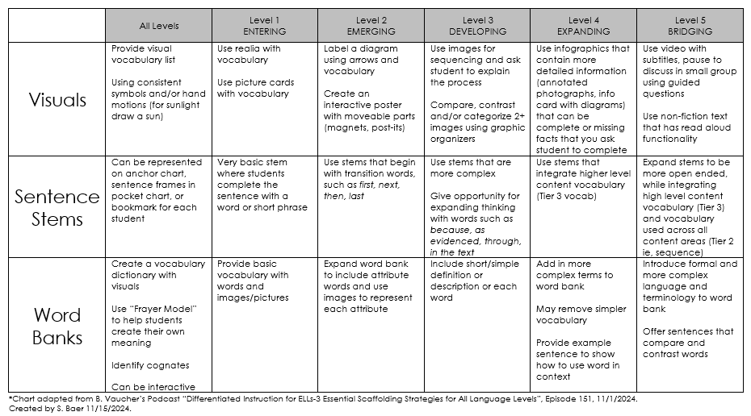
3 Essential Scaffolding Strategies for All Language Levels*

