Slide 1

Experience Builder: Beyond the Map
From Spatial to Story: Rethinking How Users Engage with GIS Content
Notes:
Introduction

Slide 2
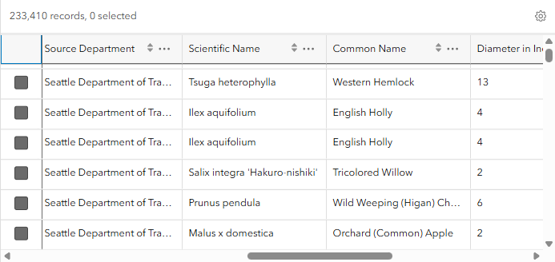
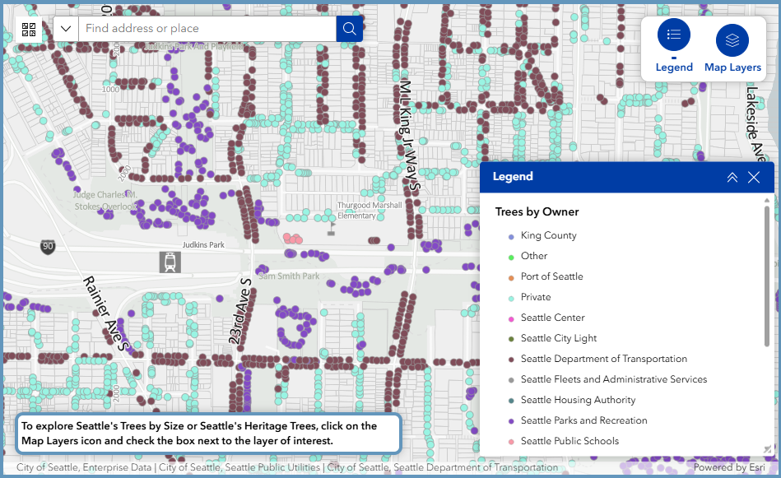
GIS: In the beginning
Freed data from tables
Maps provided a means to visualize patterns
Made complex information more approachable
Notes:
For many years when asked what I do for a living I’ve often tried explaining that GIS is about analyzing spatial data. I usually ended up saying “I make maps.” And when Google maps came along, I just had to add, “You know, like Google Maps.” And everyone would nod their heads.
Early on in my GIS career I recall a meeting where my supervisor pointed to a picture of a spreadsheet and said this isn’t GIS, then pointed to a map and said this is what GIS is about. At the time I remember thinking, “But the data is still important. Maps are just a different way of looking at the data.”
Don’t get me wrong, I love maps. And I love designing beautiful maps. No reason to put an ugly map out there when you can make a beautiful one. But I think there’s so much more GIS can do to provide ways to visualize and explore data, other ways to make complex information approachable.

Slide 3
Why It’s Time to Think Beyond the Map
Map-centric applications can limit accessibility
Some trends and patterns may be more apparent when viewed in other formats besides a map
Charts or data-reactive narratives provide alternate ways to interact with geospatial data
Accessible label:
Interactive map centered on Seattle with a pale gray background showing street names and property boundaries. By default, the trees in Seattle's inventory are displayed as points with colors corresponding to the ownership category. The option is available to display trees in Seattle's inventory by size with points that range from light green (smallest diameter) to dark green ( largest diameter). The option is also available to display Seattle's Heritage trees, which are shown as yellow tree-shaped icons. Streams are also displayed as a blue dashed line.
Notes:
Accessibility. This topic has become a major focus for many public agencies since the U.S. Department of Justice’s 2024 update to ADA Title II which requires state and local governments to meet specific technical accessibility standards for all public‑facing digital services. The rule ensures people with disabilities have equal access to government information and services delivered through websites and mobile applications. Anyone who is working on mitigating GIS applications for accessibility no doubt recognizes the challenges of making a map more accessible. And though application interfaces like Experience Builder now provide the ability to add accessible labels to maps, even the best accessible label lacks the ability to fully convey the meaning behind the data being visualized.
So, today I will be looking at ways in which Experience Builder can be used to build applications that provide alternate ways of interacting with geospatial data, like built in charts and dynamic text-based narratives.

Slide 4
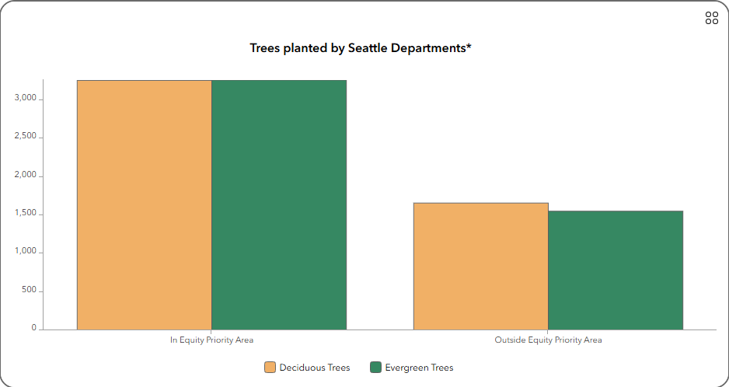
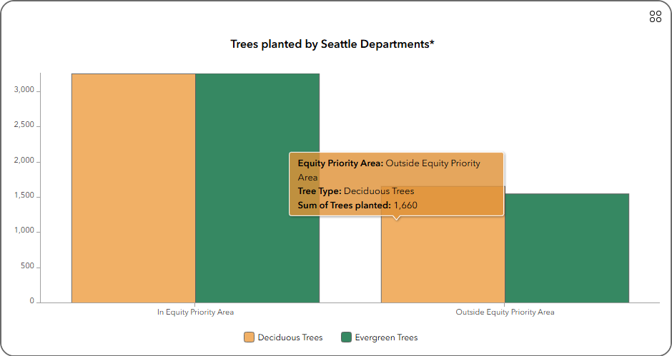
Experience Builder: Beyond the Map
Using interactive components to help users explore data outside of the map interface
Dashboard-style charts
  Easy to understand at a glance
  Offer quick insight into trends and patterns
  Puts the focus on “what is happening” rather than “where”
Notes:
In the application I’ll be demonstrating, dashboard-like charts are created natively in Experience Builder, rather than creating them separately in a Dashboard app, then embedding them in the main application. Like the example shown, trends may be more easily recognized in a chart – like here where Deciduous and evergreen trees are being planted in near equal numbers, but both are being planted in far greater numbers inside Equity Priority Areas. And built in captions summarize the data in a concise, easily understood way.

Slide 5
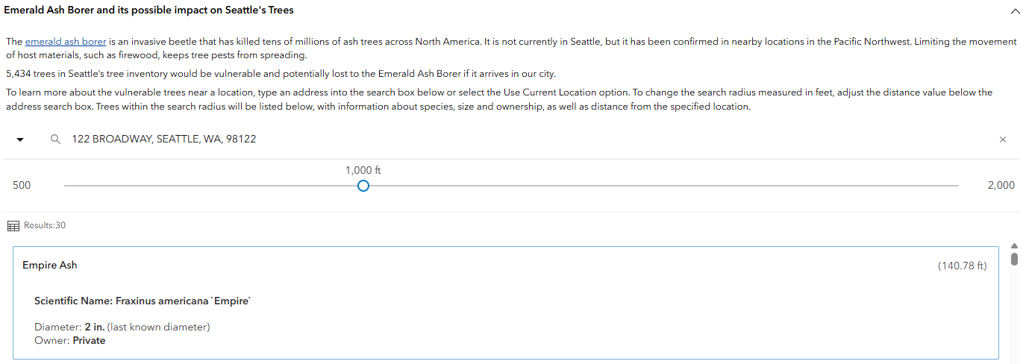
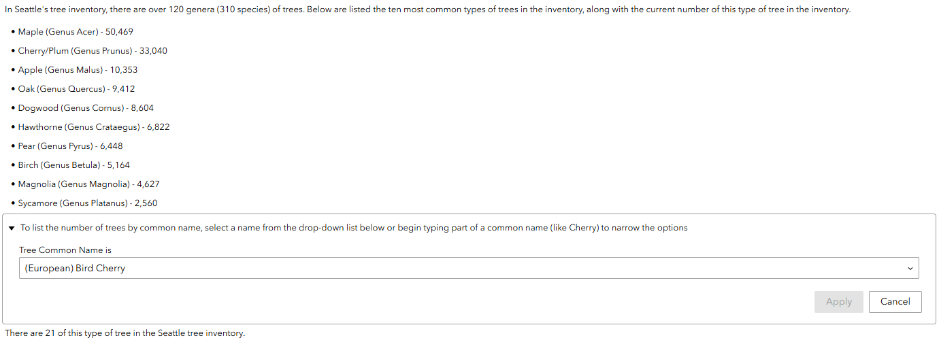
Experience Builder: Beyond the Map
Using interactive components to help users explore data outside of the map interface
Text-based Research Tool
  Tied to real-time data
  Utilizes filter, data views, dynamic text and embedded Nearby Instant Apps
  Keyboard friendly way to allow for data exploration
Notes:
Today’s featured Experience Builder application also uses various interactive components that allow users to explore data outside of a map interface. Users can ask questions using filters and embedded instant apps, and can read facts about topics of interest that change in response to changes in the data. The data-reactive text is linked to a number of data views, where each view is filtered to show the current value for a specific category or subject. Likewise, the interactive filters are all tied to data views and reactive text that changes when the user selects a value.

Slide 6

Trees for Seattle: Urban Forestry Maps and Data
Produced in partnership with the City of Seattle’s Office of Sustainability & Environment.
All data and the majority of written content provided by the City of Seattle.
City of Seattle
Live Demo
Notes:
All topics, whether map-based, chart-centric or in narrative form, are organized in the same accordion-style navigation, which allows for a cohesive style across the entire application.

Slide 7
Moving Forward
What this approach means for the future of GIS applications
Building intuitive, map-optional applications
New opportunities for storytelling, exploration, and decision-making
Expanding access for diverse audiences

