Slide 1

Technology AND The Classroom
Simplify Your Life
Notes:
🍐 This is a Pear Deck Web Slide.
🍐 To edit the type of question, go back to the "Ask Students a Question" in the Pear Deck sidebar.
https://miro.medium.com/max/3840/1*wJt3v7Gs46uticTUj4y9zg.gif

Slide 2
How can technology help teachers in the classroom?
Grading is easier, and less time consuming for testing….
You can save time creating lesson plans, and assignments…
Create formative assessments to provide immediate feedback to teachers and students…
Documentation of student progress is saved in a digital format…
Create and convert documents easily….
Grade essays, and other assignments, with feedback….

Slide 3
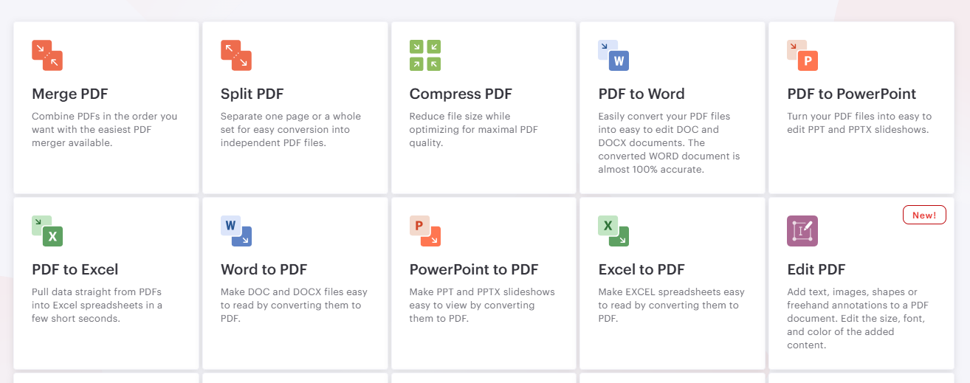
ILovePDF.com

Slide 4
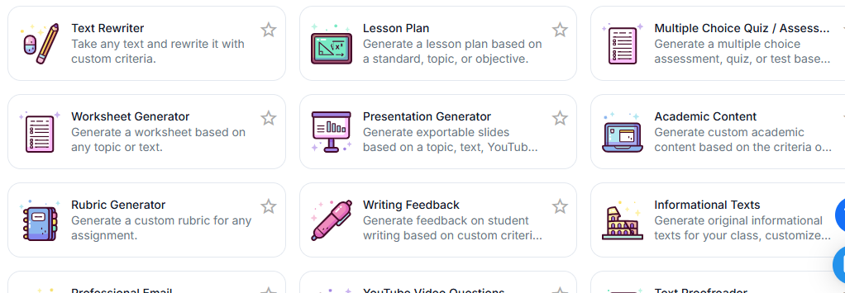
Magic School AI

Slide 5
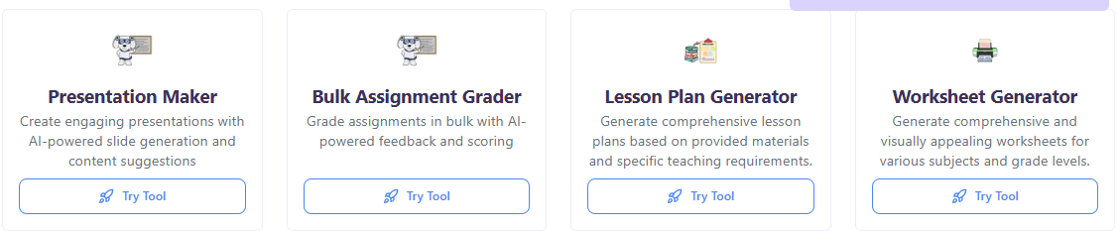
Study Fetch

Slide 6
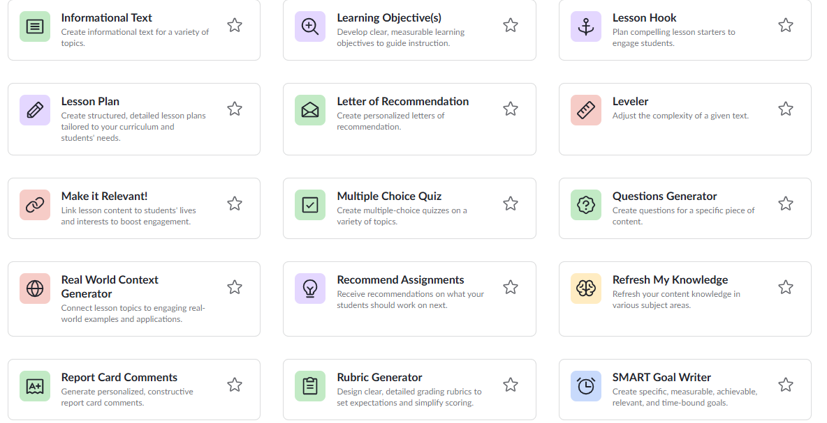
Khanmigo

Slide 7
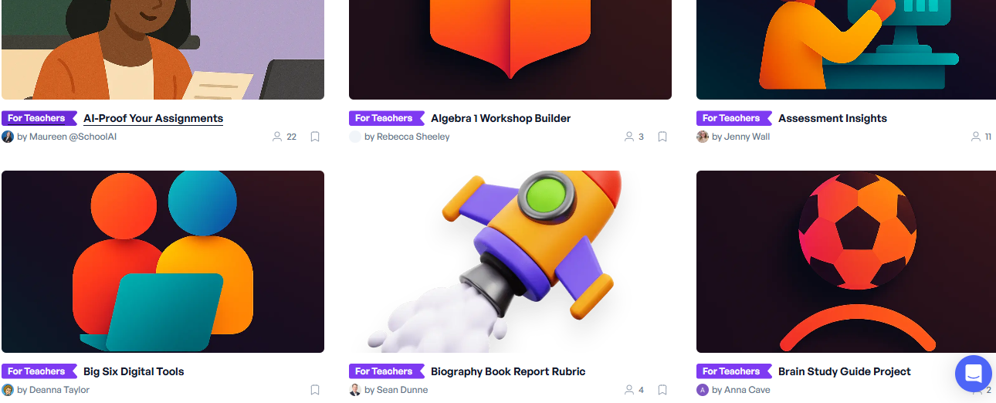
School AI

Slide 8
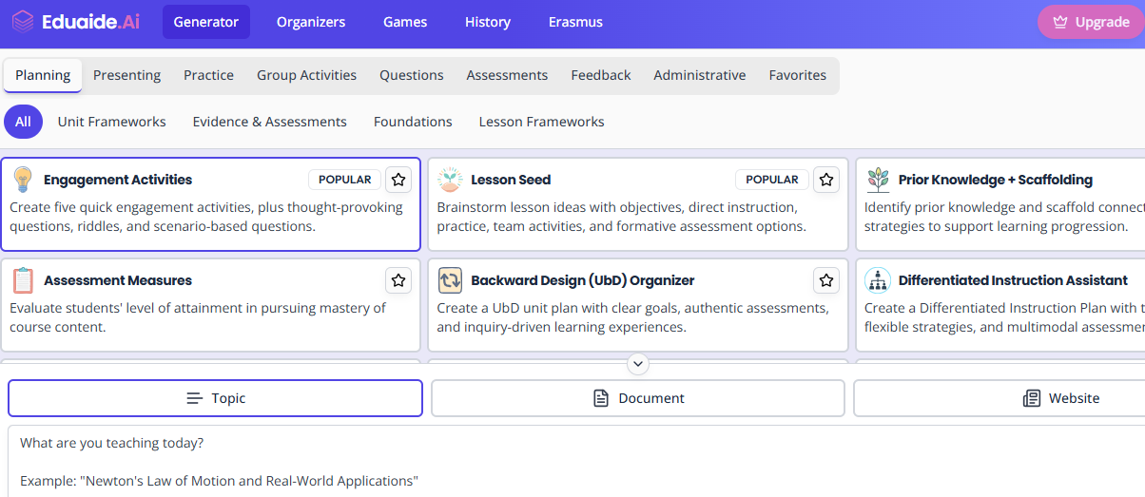
Eduaide AI

Slide 9
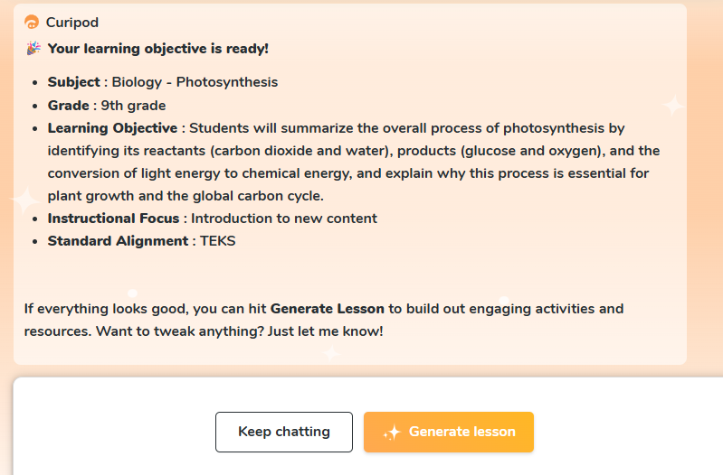
Curipod

Slide 10
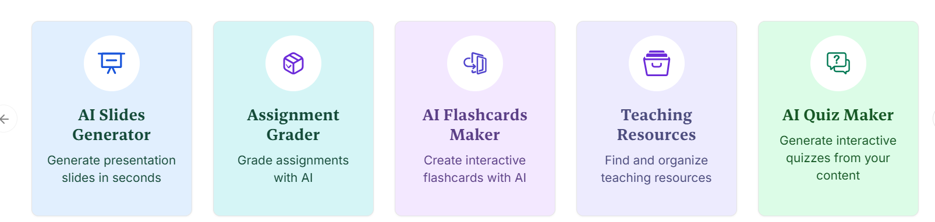
EdCafe.AI

Slide 11
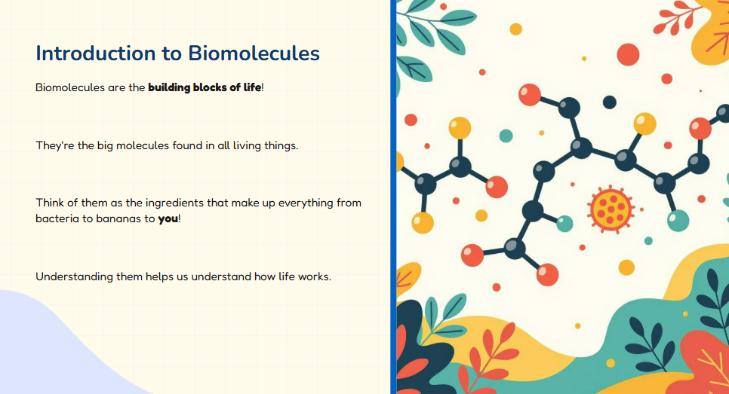
Slides AI Extension

Slide 12
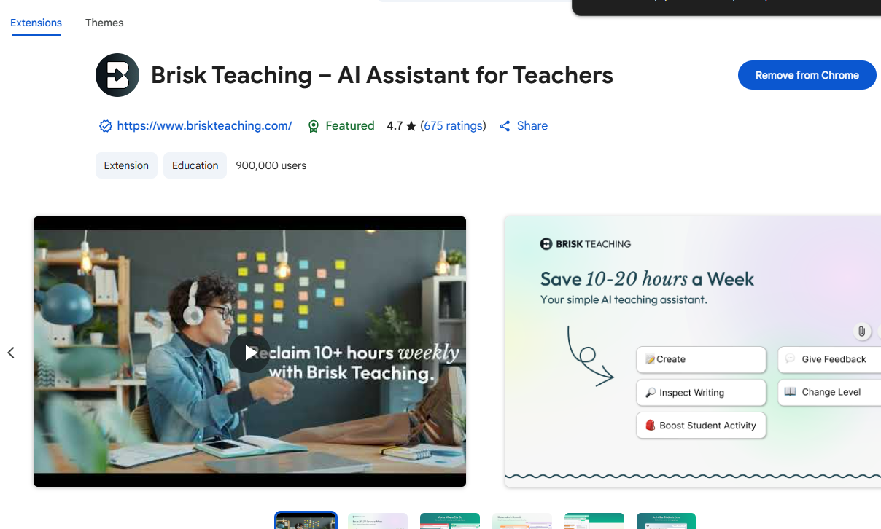
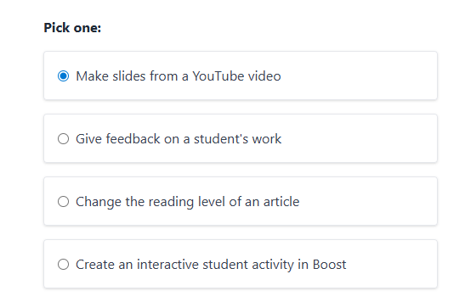
Brisk Teaching Chrome Extension
LINK

Slide 13
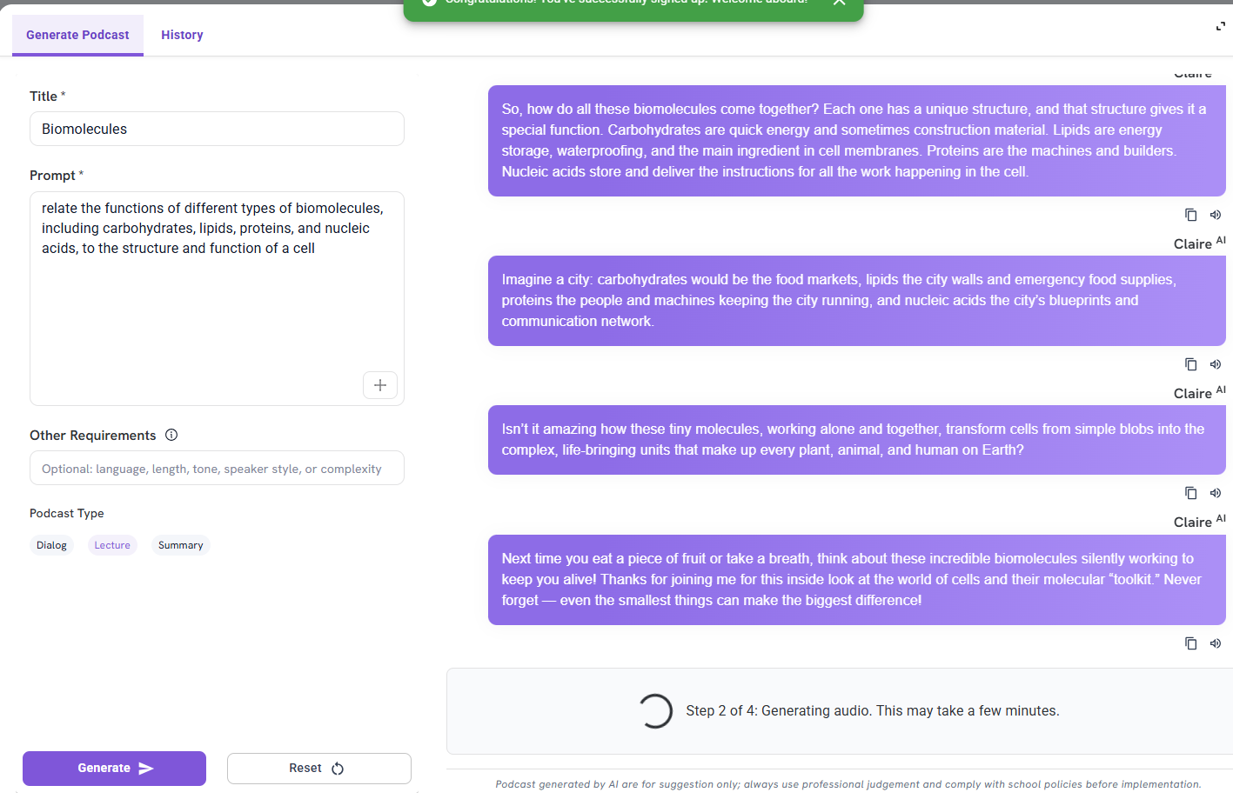
Colleague AI
Podcast Link

Slide 14
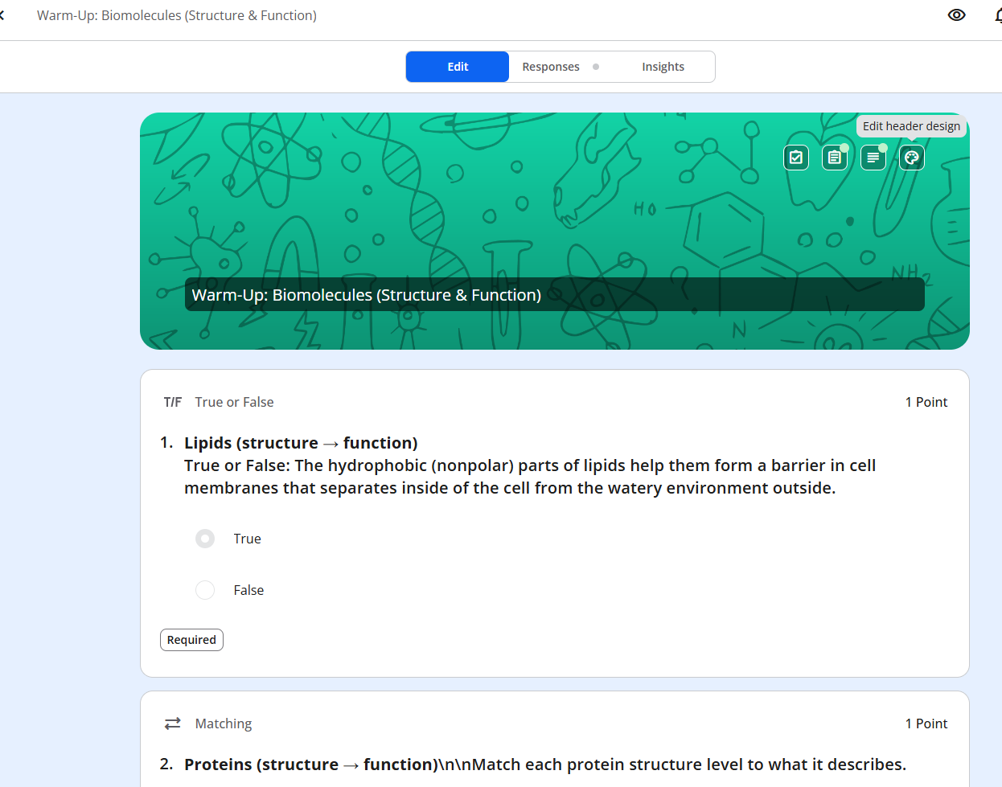
Formative.com

Slide 15

PearDeck

Slide 16
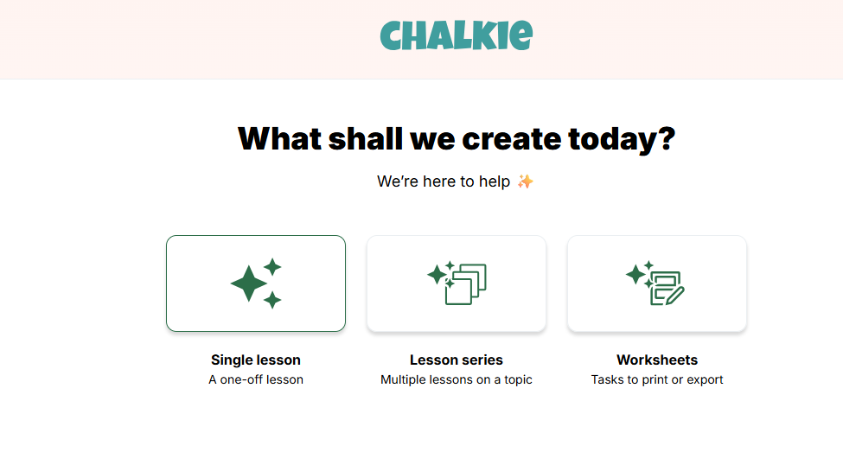
Chalkie AI
LINKED EXAMPLE

Slide 17
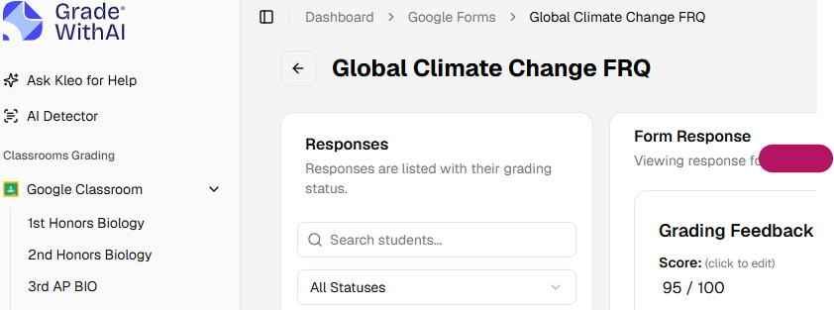
AI Grader

Slide 18
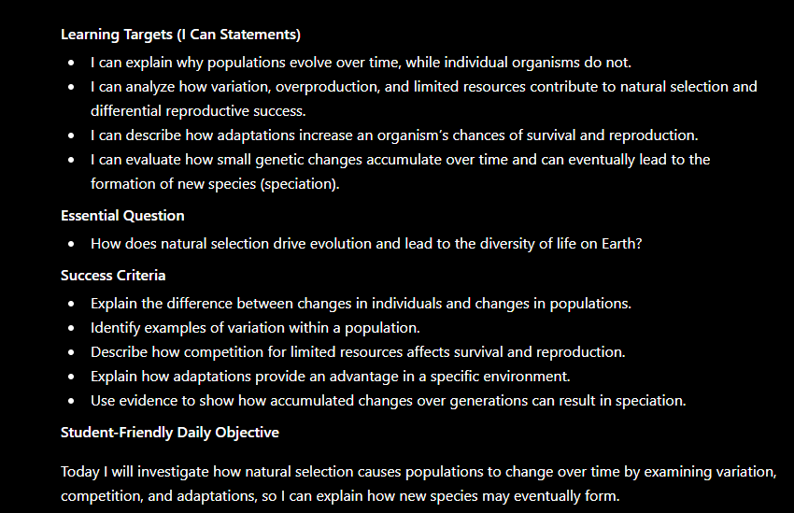
ChatGPT for Teachers

Slide 19
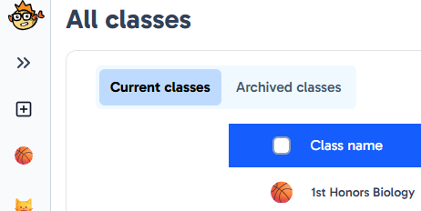
Grouper

Slide 20
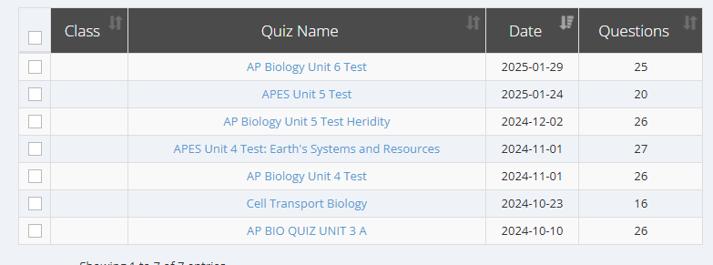
Zip Grade

Slide 21
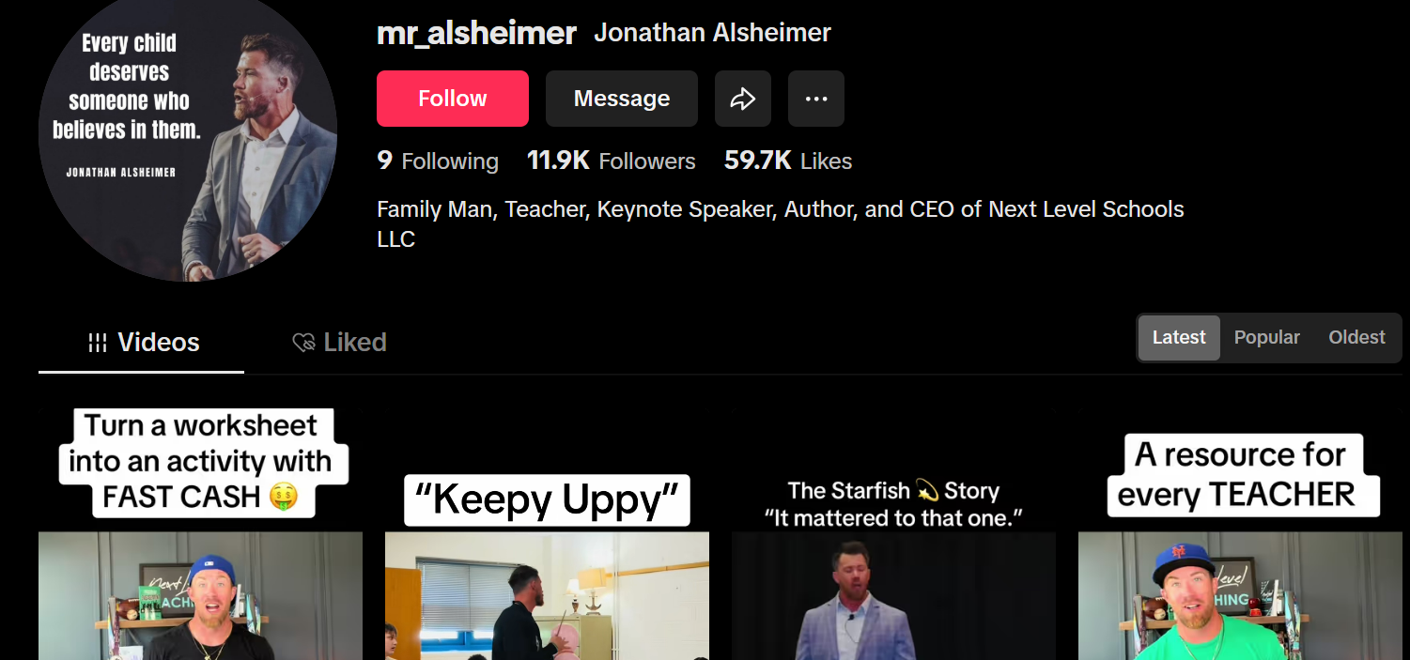
TikTok Ideas

Slide 22
Pear Deck 2nd Grade ELA Example Slides
Pear Deck 5th Grade Math Example Slides
Pear Deck Science Potential and Kinetic Energy Example Slides
Pear Deck Latitude and Longitude Example Slides
Pear Deck ELA Narrative Example Slides
Pear Deck Math Coordinate Plane Example Slides

Slide 23
Other Technology Resources
Quizizz Plickers ZipGrade
Blooket Socrative Studyfetch
GimKit Legends of Learning MagicSchool
Quizalize Online Buzzer
Screencastify Choice Board
Kahoot Magic Squares Template Self-Check
Pear Deck Random Wheel
Quizlet Gizmo
Breakout Escape Rooms Generation Genius
Google Form Escape Rooms PHET Simulations
FlipGrid NearPod
EdPuzzle Goosechase
EduSmart Playfactile

