Slide 1

Creating Connections to
School & Community
for
Justice Impacted Youth

Slide 2
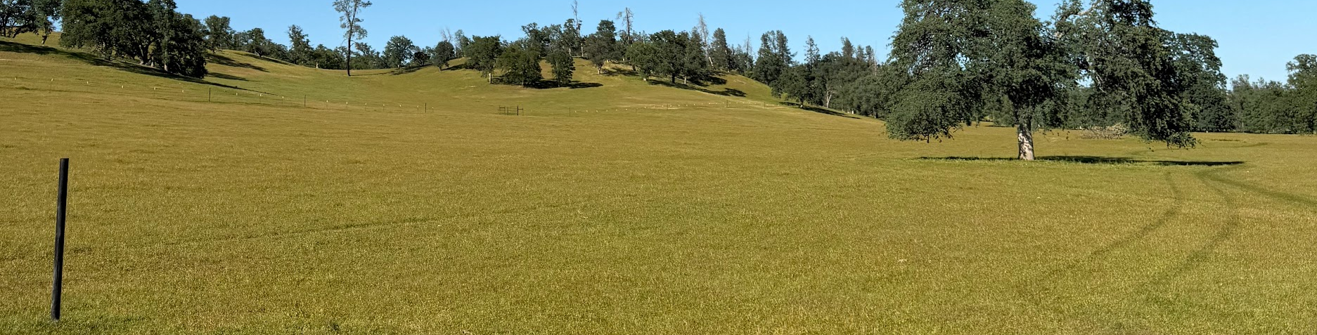
The Reason for this Work

Slide 3
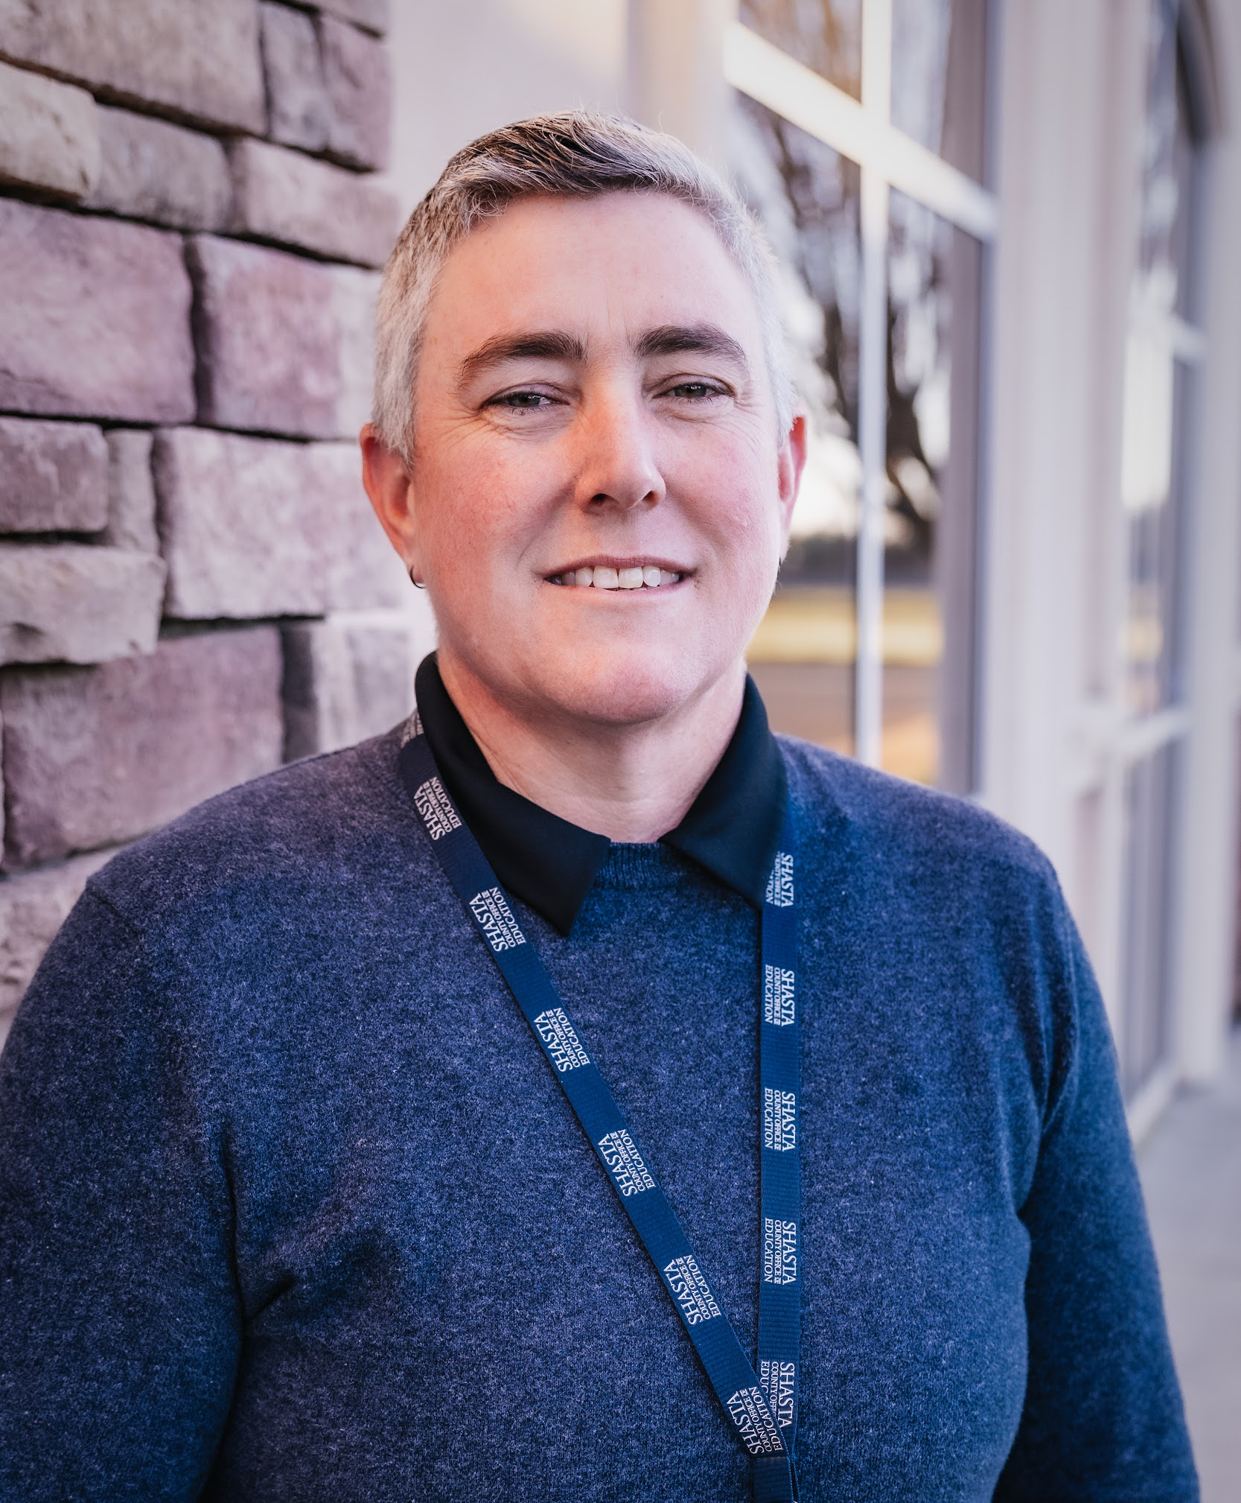

JILL J.
NORTH
Principal - Student Programs
Shasta County Office of Education
Tri Mountain Academy

Slide 4
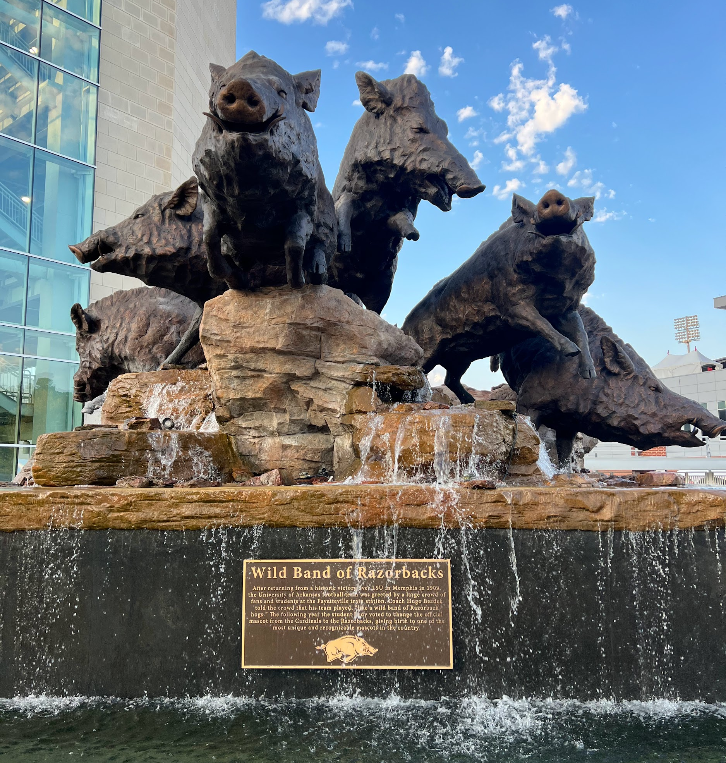

WHY THIS WORK IS IMPORTANT TO ME
Students that I serve
Staff that I support
EdD Program I attend
Fighting Stigma in Alt Ed & Juvenile Court Schools

Slide 5
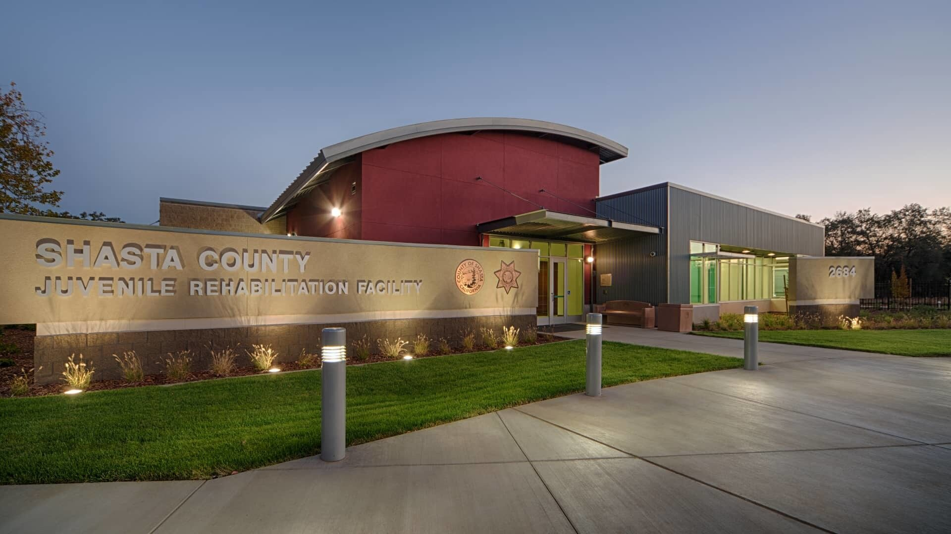
BACKGROUND
Shasta County JRF
  Population
  Contracted Counties
Shasta County Tri Mountain Academy
  The History of our Name
  The GOATs
Juvenile Court Schools

Slide 6
Our Students
Population of Residents
7-12 Grade students are served
Ages 12-25
High ACEs & 100% SED
Contracted Counties
Lassen
Siskiyou
Trinity
Lassen
Modoc
Plumas
Mendicino

Slide 7

What's in a Name?

Slide 8
What's in a Name?

Slide 9



Do not edit
How to change the design
Perceptions of Justice Impacted Youth
Presenting with animations, GIFs or speaker notes? Enable our Chrome extension
Notes:
📣 This is Slido interaction slide, please don't delete it.
✅ Click on 'Present with Slido' and the poll will launch automatically when you get to this slide.

Slide 10

The Current Landscape

Slide 11


BEST
PRACTICE
Barriers are common for our population of students.
ACEs
Family
School
SED
I am not an expert and will not attempt to tell you how to run your program.
However, I can speak to researched based best practices when supporting justice impacted youth to build connection to community and school.
The goal to to provide you with some ideas and resources that may help to change your perception of students.
The horizon is what we are looking toward.
CTE
Academic Rigor
Community Connection
Post Secondary Options

Slide 12
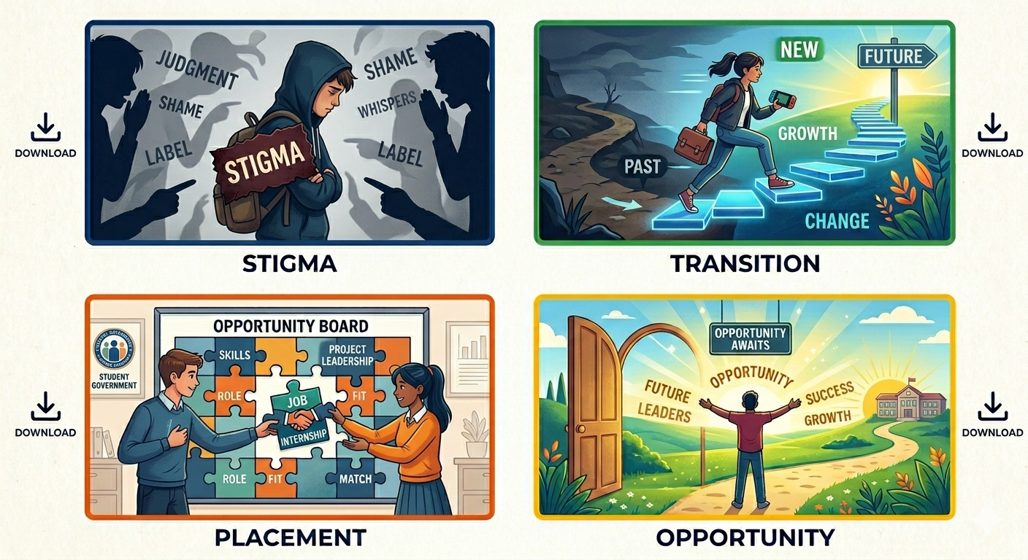
Barriers Our Student Face
Stigma
Re-Entry to Districts
Enrollment in Alternative Programs
Lack of Pro-Social Opportunities

Slide 13
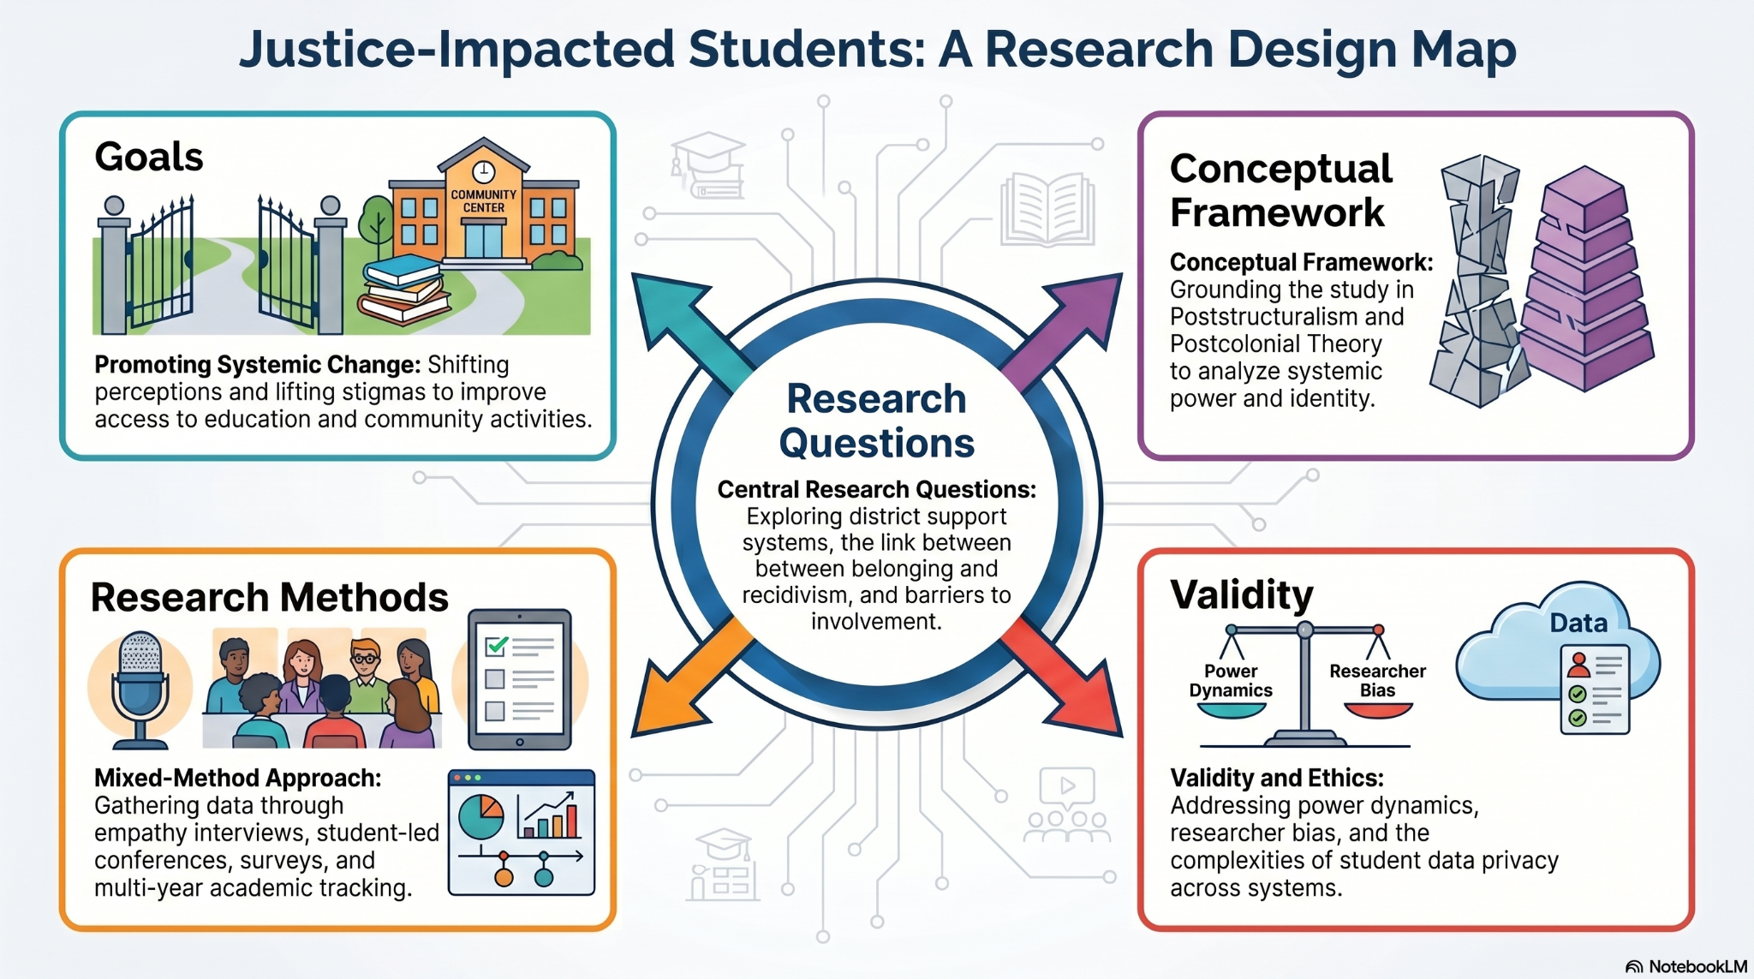

Slide 14



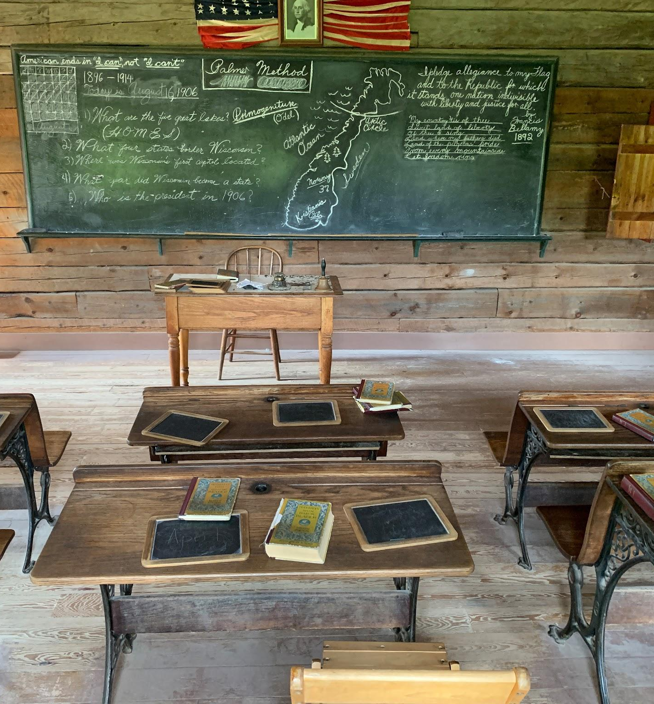
THE REALITY OF REENTRY
Students often face difficulties in returning to school. The barriers can often be overwhelming for students and their families.
Navigating Enrollment
Placement
Credit Alignment
Behavior

Slide 15
WHAT WE HEAR
Scared to return to a comprehensive site
Not sure if they are even welcome back on campus or if they are expelled
“If your school shows up on their transcript the comp site will not take them back.” - Probation Officer
Families do not know how to navigate the system to re-enroll their student
There is an assumption that students do not want to return to the comprehensive sites
Disruption of coming back to TMA will not allow them to return to their school or disrupt their credits they were working on

Slide 16

The Goal

Slide 17
GOALS
Help to change the educational system perception of justice impacted students to promote more support to develop a sense of belonging in rural communities.
The primary goal is to change how the educational system perceives justice-impacted students to foster a more supportive environment
Targeted support is needed to help these students develop a sense of belonging, particularly in rural communities
Help to lift the stigma that is placed on students who are justice impacted and in turn affecting their access to education, extracurricular activities, and other community activities that develop a sense of belonging.

Slide 18
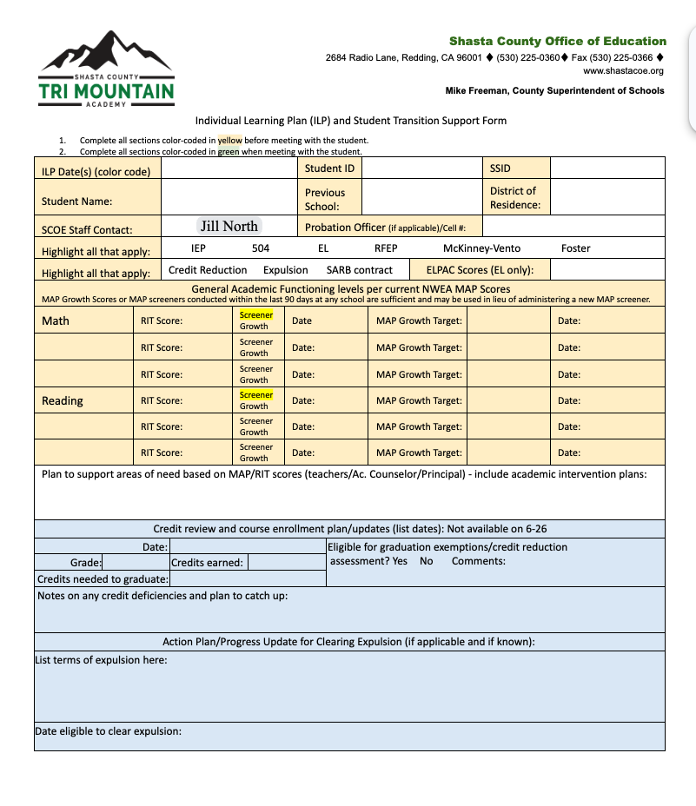
TRANSITION PLANNING
Planning for transition back to districts or for students post secondary goals
Developing a record of support that is offered within the facility to help inform next placement
Working with Probation to ensure that transition back to the district of residence is a smooth transition for student and their guardians to navigate
Includes information helpful to districts in supporting students returning to their schools

Slide 19
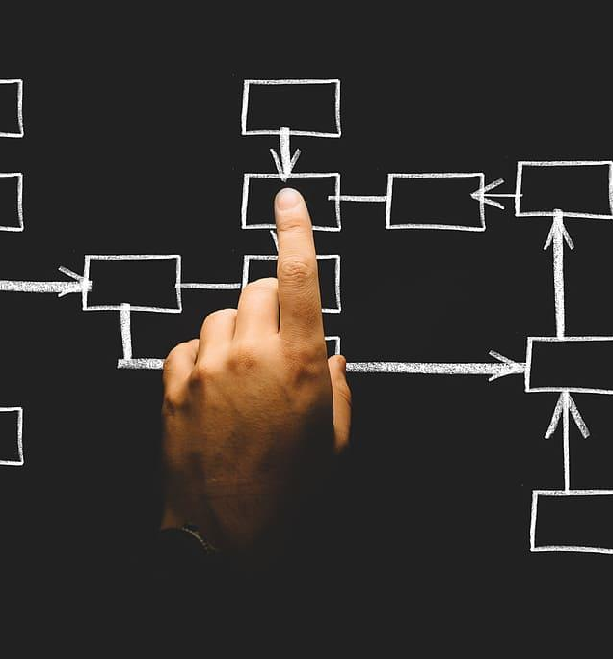



ILP BASICS
ILP - Individual Learning Plan & Student Transition Support Form
Overview & Assessments
Interview
Counselor Notes
Community Connect

Slide 20
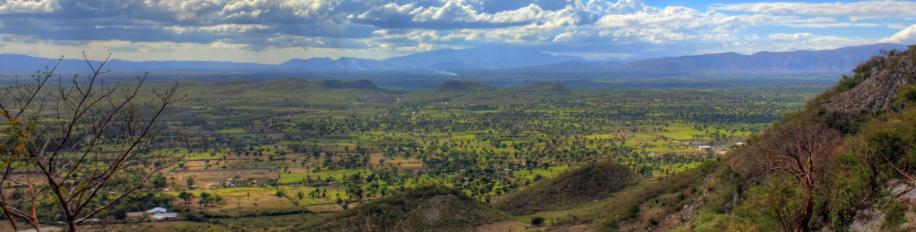
What Can We Do Now?

Slide 21
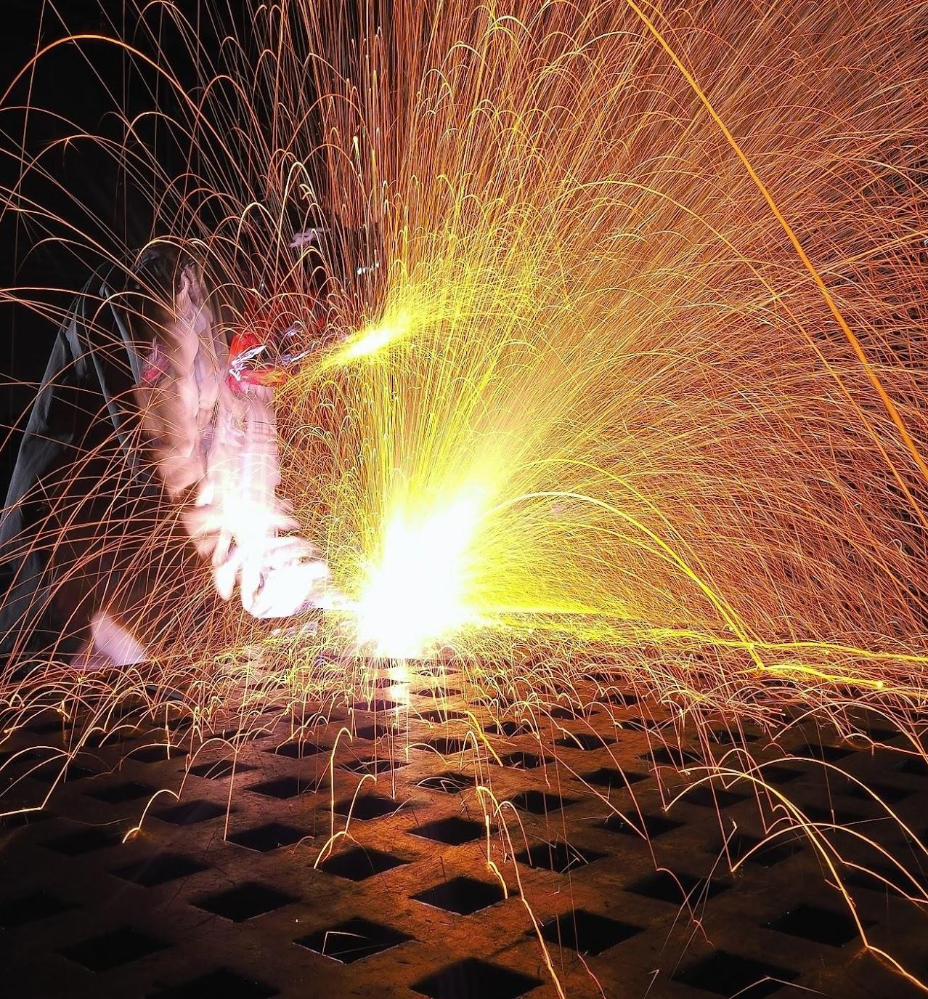

PRO SOCIAL
ACTIVITIES
CTE Program Access
Clubs - FFA, 4H, Student Government
Theater Arts & Band
Career Exploration
Access to educational opportunities help to reduce recidivism in justice impacted youth. The sense of belonging they gain from participating in community based activities has a lasting impact.
Pro Social activities are part of the probation transition process. Often students have to seek private opportunities that have a cost families cannot afford.
Organized Sports
Intramural Sports
Activities Clubs
Field Trips

Slide 22

HIGH
EXPECTATIONS
Dual Enrollment Opportunities
College Prep Classes
Placement in programs that support a variety of learning styles
Accountability with compassion
Restorative practices

Slide 23


BELONGING &
COMMUNITY
These students are members of our community and will be after graduation.
Developing a sense of community and belonging starts with school
Inclusion in school and community fosters a sense of belonging for students

Slide 24

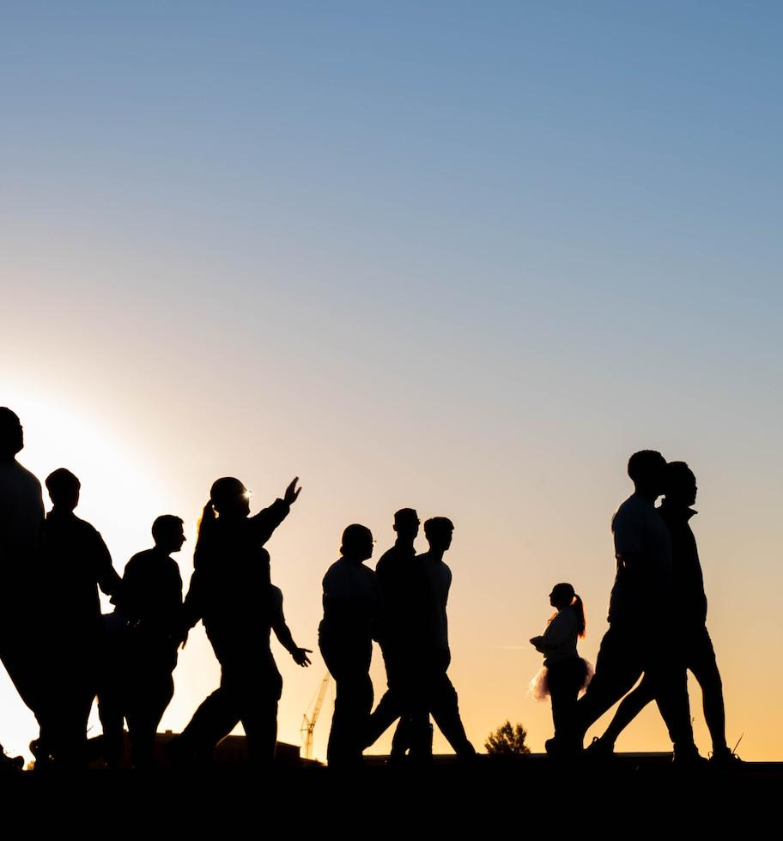


SOCIAL EMOTIONAL LEARNING
For justice impacted students, learning skills to navigate challenges and confrontation is crucial. Mentorship and modeling of behaviors is something that we can offer though leadership and in the classroom. Many students share they do not feel seen at school or that the do not think that school staff care about them.

Slide 25
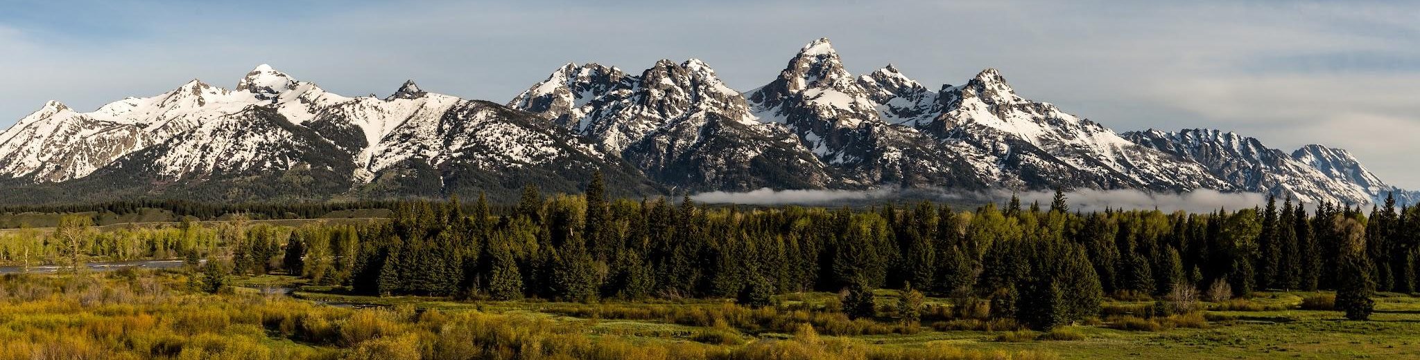
What We Do TMA

Slide 26

Unsent Note of Appreciation
Think of someone who helped you recently. Spend two minutes writing a brief, private note of thanks on a notepad or notebook (no need to send it).

Slide 27


REFLECTION
How does acknowledging someone else’s impact make you feel more connected to others?

Slide 28

Do not edit
How to change the design
Would you be willing to participate in an interview regarding justice impacted youth?
Presenting with animations, GIFs or speaker notes? Enable our Chrome extension
Notes:
📣 This is Slido interaction slide, please don't delete it.
✅ Click on 'Present with Slido' and the poll will launch automatically when you get to this slide.

Slide 29

Questions?

Slide 30


