Slide 1
Critical Outputs: Analyzing the Publications that Faculty Cite
Laurie Neuerburg, Sciences Librarian, University of Iowa Libraries
May 29, 2026

Slide 2
To Begin: Credit and Thanks!
Institutional Repository and Metadata Librarian Wendy Robertson used Iowa Research Online to create a list of faculty publications to begin the analysis
Engineering & Informatics Librarian Qianjin “Marina” Zhang created the code and framework for the analysis
  Marina deserves all of the credit for originally designing the study and writing the Python code
  She originally carried out this study for Engineering departments
  Her coding work is available at GitHub https://github.com/qianjzhang/ReferenceAnalysis

Slide 3
Starting the Study: List of Faculty Publications
Iowa Research Online
  Our institutional repository
    Research, scholarship, and creative work by faculty, students, and staff
    Clarivate’s Esploro
  3,049 publications by 163 faculty from five departments and one school
    Department of Biology
    Department of Chemistry
    Department Physics and Astronomy
    Department of Mathematics
    Department of Statistics and Actuarial Science
    School of Earth, Environment, and Sustainability

Slide 4
Gathering Citations for the Study
Tools used in the analysis
  Scopus API
  Acaconda Navigator 2.7.0
    a open-source distribution of the Python and R programming languages with pre-configured, quick start environments
    Jupyter Notebook 7.4.5, a web-based, interactive computing notebook environment to run Python
Collected citations based on original list of 3,049 faculty publications
  Found 393,628 total citations
  Analysis with an Excel pivot table showed 3,551 unique publication titles

Slide 5
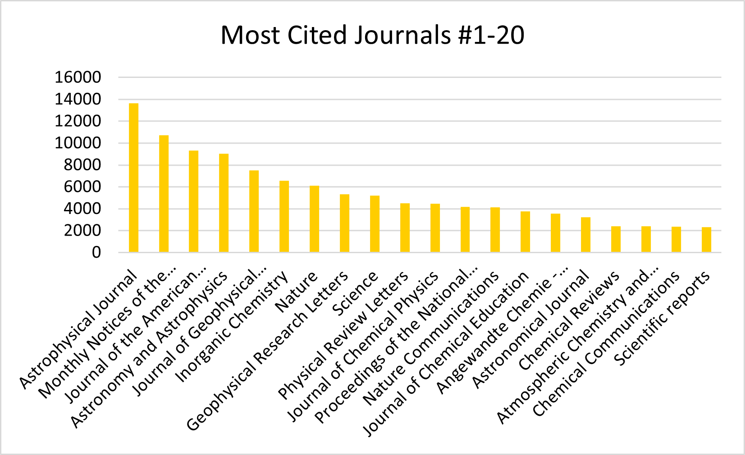

Slide 6
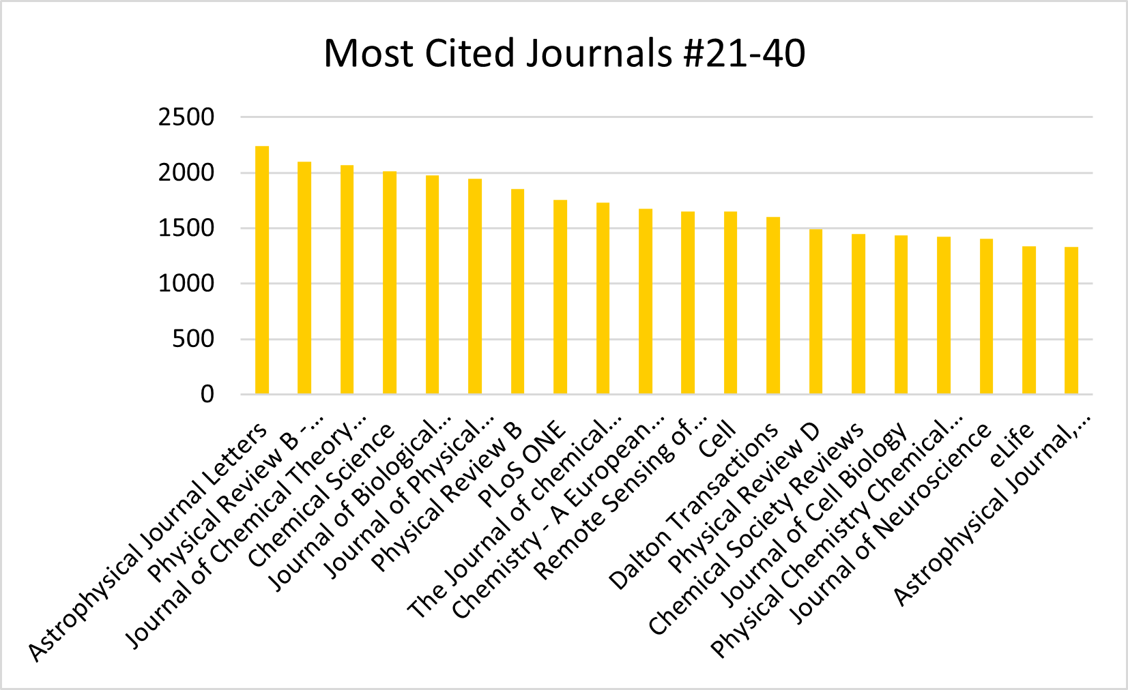

Slide 7
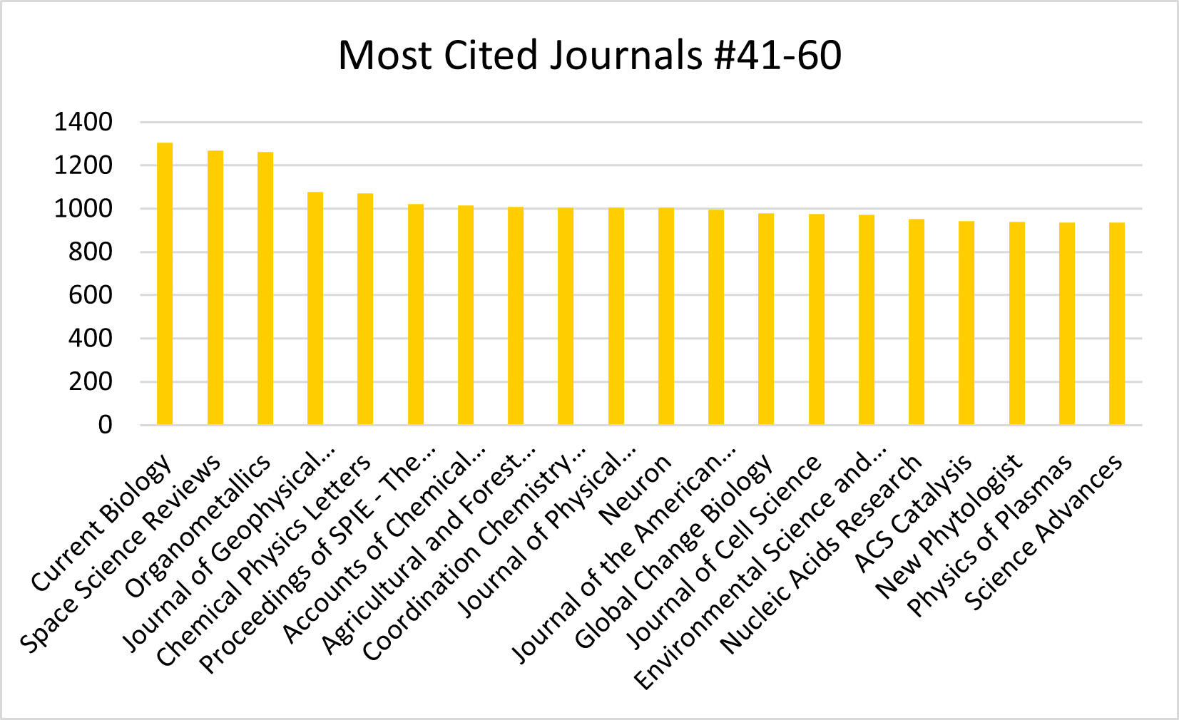

Slide 8
Limitations
Some publications were not included
  Publications without DOIs
  Publications with parentheses in the DOIs were excluded
  Some publications were “not found” in the analysis
Time and technology requirements
  Due to the volume, multiple sessions and API keys were required
    The sessions were run over 11 separate sessions spanning multiple hours to gather all of the data
    Multiple API keys were required due to volume constraints

Slide 9
Future Directions
Use citation analysis data to
  Identify journals heavily cited by faculty for possible new subscriptions
  Analysis of data within a subject
  Use to identify trending areas of faculty research
Try a similar study using OpenAlex, a free alternative to Scopus

Slide 10
References
Zhang, M. (2025). Assessing Engineering Library Journal Subscriptions Using Faculty Publications, References and Grant Information: Identifying the Gap within a Limited Timeframe! https://iro.uiowa.edu/esploro/outputs/presentation/Assessing-Engineering-Library-Journal-Subscriptions-Using/9984847540702771/filesAndLinks?index=0

Slide 11
Questions? Feel free to contact me.
Laurie Neuerburg
Sciences Librarian
University of Iowa Libraries
319-467-2016
laurie-neuerburg@uiowa.edu
lib.uiowa.edu/sciences

