Slide 2
The effects of typography on the readability of text
Clint Wrede
University of Northern Iowa

Slide 3
Can you read this?

Slide 4
Can you read this?

Slide 5
Can you read this?

Slide 6
Can you read this?

Slide 7
Can you read this?

Slide 8
How do you feel about this?

Slide 9
How do you feel about this?

Slide 10
How do you feel about this?

Slide 11

How do you feel about this?

Slide 12
Typography and readability are multidisciplinary affairs
Definitions
Multidisciplinary
Typography is a design element: the art, technique, and arrangement of type.
Readability is a performance metric: a measure of how effortlessly a reader can scan, comprehend, and absorb a body of text.
Together, they encompass research by practitioners of:
cognitive science and psychology
communication studies and media
communication disorders
computer science, human-computer interaction, and informatics
information science
education and instructional design
graphic design
biological vision
accessibility

Slide 13
Why is this relevant to libraries?
Readability matters to our patrons
When our patrons use electronic resources we provide and digital resources we create, they’re affected by the readability of the typography.
While we and our users often have little control over the publications we buy and lease from providers, we can sometimes guide patrons to print-like PDFs and settings that some providers offer.

Slide 14
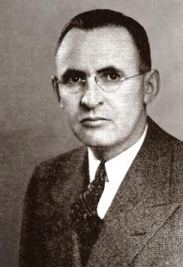
Trivia: Who is this man?

Slide 15
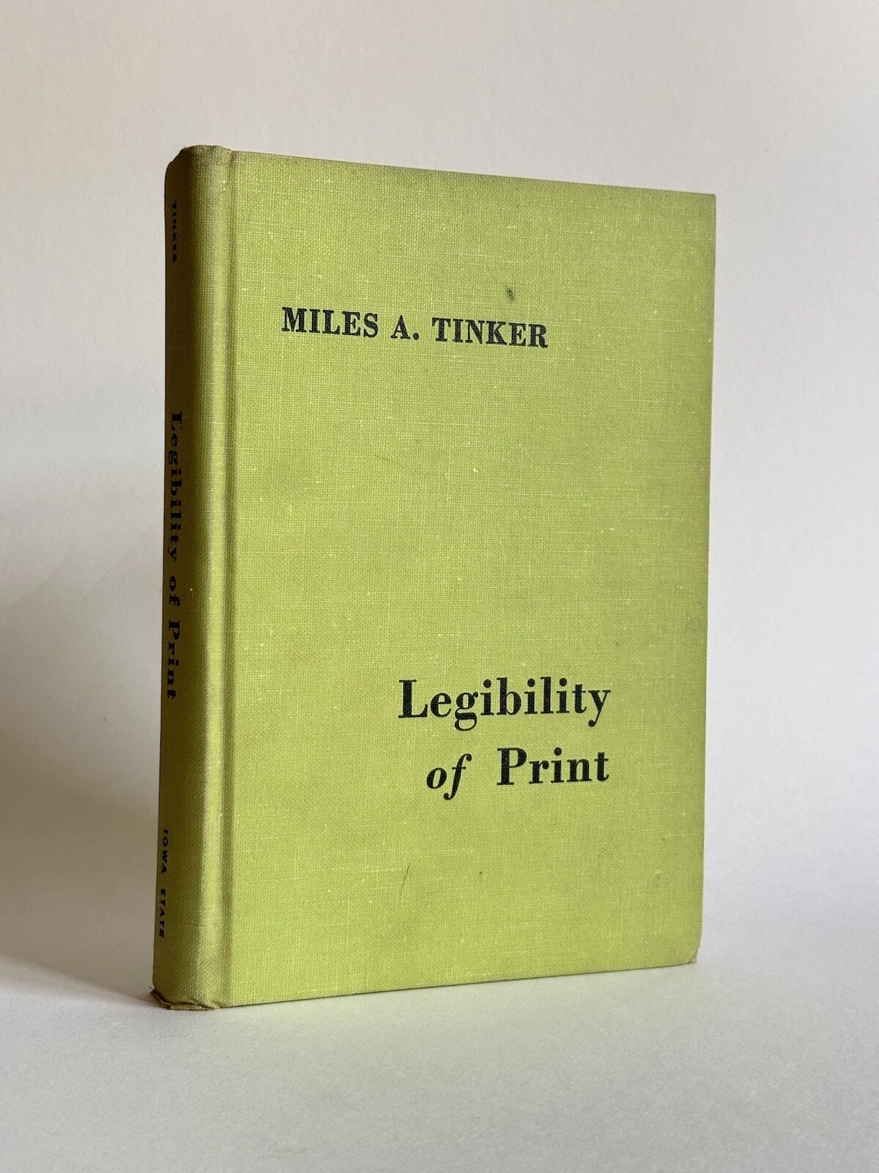
Trivia: Who is this man?

Slide 16
Type families
  Serif
  Sans serif
  Script
  Display

Slide 17
Type size
  Really pretty big
  Large
  Small
  Unbearably tiny

Slide 18
Type weight
  Black
  ExtraBold
  SemiBold
  Display
  Light

Slide 19
Type style
  Garamond
  Georgia
  Bodoni MT
  Rockwell
  Times New Roman

Slide 20
Line spacing
  Tight line spacing. Nullam pulvinar ante tellus, sed interdum ex facilisis eu. Sed sed aliquet dolor, eu tristique nunc. Suspendisse potenti. Cras sapien.
  Single line spacing. Nullam pulvinar ante tellus, sed interdum ex facilisis eu. Sed sed aliquet dolor, eu tristique nunc. Suspendisse potenti. Cras sapien.
  Loose line spacing. Nullam pulvinar ante tellus, sed interdum ex facilisis eu. Sed sed aliquet dolor, eu tristique nunc. Suspendisse potenti. Cras sapien.

Slide 21
Type background
  The advent of dark mode and other user settings

Slide 22
The effects of disfluency
  Is Sans Forgetica forgettable?
  g a e p f t
  R G A V E S

Slide 23
Thank you.
clint.wrede@uni.edu

