Slide 1
Time to Think: Critical Information Literacy in Credit Teaching
ILA/ACRL & IPAL
Spring 2026 Conference
Notes:
AC

Slide 2
Introductions
Angie Cox | Health Sciences Librarian
angela.cox@uni.edu
Amandajean F. Nolte | Arts and Humanities Librarian
amandajean.nolte@uni.edu
Notes:
Both

Slide 3
Table of contents
01
Credit Teaching
03
Critical Thinking: Library 1100
02
Critical Thinking: Library 2100
04
Meaningful Work
Notes:
AC

Slide 4
01
Credit Teaching
Notes:
AJN

Slide 5
Seized an Opportunity
New General Education
Supportive Administrator
Changing Liaison Work
Notes:
AJN

Slide 6
Information Literacy Program 2023-2028
Goal 1: Collaborate with colleagues.
Collaborate with colleagues and external stakeholders to integrate information literacy objectives into university curriculum using best practices.
Goal 2: Expand asynchronous instruction.
Expand use of asynchronous, self-paced information literacy instruction ideally with opportunities for practice and assessment.
Goal 3: Develop credit-based instruction.
Develop and deploy credit-based instruction in information literacy for UNI students.
Goal 4: Assess local practice.
Assess local information literacy practice to improve existing initiatives and create opportunities for new ones.
https://library.uni.edu/about-us/our-people/liaison-librarians/information-literacy-program
Notes:
AJN

Slide 7
Current Offerings
Library 1100
Library 2300*
Library 2100
Library 6100
AI, Algorithms and (Y)our Future
Beyond the Hype: Artificial Intelligence as Information
Who’s Controlling (Y)our Information: Access, Authority, and Technology
Information Literacy: Learning to Question in the 21st Century
Notes:
AJN

Slide 8
Notes:
AJN

Slide 9
—Nicole Pagowsky
One-shot models essentially create a checkbox that gives us the appearance of success based on numerical accomplishments. What we are valuing clashes with a deeper characterization of “effective” teaching and our own wellbeing.
Notes:
AJN

Slide 10
02
Critical Thinking: Library 2100
Notes:
AC

Slide 11
The Assignment
Why Discussion

Slide 12
The Experience

Slide 13
Set-up
Semester-long
  Classroom agreement
  Engagement assignment
Week of activity
  Weekly readings
  Journals
Day of activity
  Review of classroom agreement
  Review the engagement assignment categories and individually choose one to focus on for the class period

Slide 14
Practicing Critical Thinking
Small group discussion (Think and Discussion Protocol)
  Example: Week 11 Privacy Discussion II
  Individual time to reflect on the discussion questions
  Small group discussion on those same questions
Critical thinking is facilitated through:
  Types of discussion prompts provided
  Time to reflect individually that allows students to speak more deeply in a small group
  Small group discussion that allows students to build on their own understanding, consider different perspectives, and connect more deeply with content

Slide 15
The Reflection

Slide 16
Reflective Learning
“I improved my critical thinking by better analyzing new information, questioning assumptions, and thinking more carefully about ideas rather than accepting them at face value.”
“I think that this is the most that I have thought about topics in my life (and it’s in a good way) but it’s like okay. I like that I can go more in depth but I never thought that I would be able to pull ideas and be relatable in the topics that we were learning.”

Slide 17
Reflective Teaching
Mid-semester changes
  Discussions: Added time for students to reflect (literally write thoughts down) on questions before discussing as a group
  Journals: Provided more feedback and questions for them to respond to in their journals
Future changes
  Adjust journal prompts to push deeper critical thinking
  Add time for individual reflection to each discussion protocol
  Revise discussion questions to foster critical thinking

Slide 18
03
Critical Thinking: Library 1100
Notes:
AJN

Slide 19
The Assignment
Why Labs

Slide 20
The Experience

Slide 21
Set-up
Lecture
  Delivered asynchronously in online course module
Readings
  Current articles, podcasts, and videos
Lab 3: Generating–Activity
  Use UNI promoted AI tools (UNI Copilot or UNI Gemini).
  Generate at least 3-5 distinct images for the same job
  Now, generate at least 3-5 distinct images for a group of people in that job

Slide 22
Practicing Critical Thinking
Lab 3: Generating–Reflection
  Describe the experience. What did you notice?
  Connect to materials from the week. What have you learned this week (course) that helps explain what you experienced?
  Broader conclusions. What does this tell us about using AI image generators beyond this course activity?
Critical thinking is facilitated through:
  Types of questions asked
  Time to reflect on the experience of using artificial intelligence as a process and not just on the end product.

Slide 23
The Reflection

Slide 24



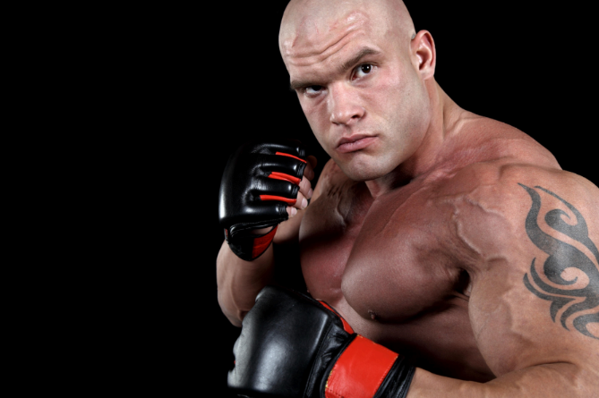
Reflective Learning
“AI is a reflector of online media that can put out harmful real-world stereotypes because it can be trained on biased data. People that use AI for image generation have to be careful to not put out images that reinforce negative stereotypes.”

Slide 25
Reflective Teaching
Mid-semester changes
  Clarification of directions
Future changes
  Move learning from individual to collective
  Beyond generative AI into coding and agents, and more
  “Is reflection necessary?”

Slide 26
04
Meaningful Work
Notes:
AC

Slide 27
—Char Booth
To exercise reflective practice, you have to maintain the desire to learn more about yourself as an educator and the intent to commit to iterative improvement.

Slide 29
Bibliography
Allison, L., & DeRewal, T. (2024). Where knowledge begins? Generative search, information literacy, and the problem of friction. Critical AI, 2(2). https://doi.org/10.1215/2834703X-11556038
Booth, C. (2011). Reflective teaching, effective learning: Instructional literacy for library educators. American Library Association.
Bowen, J. A., & Watson, C. E. (2025). Teaching with AI: A practical guide to a new era of human learning. JHU Press.
Brookfield, S. (2012). Teaching for critical thinking : Tools and techniques to help students question their assumptions. Jossey-Bass.
Brookfield, S. D. (2015). The skillful teacher: On technique, trust, and responsiveness in the classroom. John Wiley & Sons.
Critical AI. (2026). Design Justice Labs. https://criticalai.org/design-justice-labs/
Darby, F. (2026). The joyful online teacher: Finding our fizz in asynchronous classes (Vol. 8). University of Oklahoma Press.
Darby, F., & Lang, J. M. (2019). Small teaching online: Applying learning science in online classes. John Wiley & Sons.
hooks, b. (2010). Teaching critical thinking: Practical wisdom. Routledge.

Slide 30
Bibliography
Kolb, D. A. (1984). Experiential learning: Experience as the source of learning and development. Prentice-Hall.
Lang, J. M. (2021). Small teaching: Everyday lessons from the science of learning. John Wiley & Sons.
McMurtie, B. (2025, September 9). The student brain on AI. Chronicle of Higher Education. https://www.chronicle.com/article/the-student-brain-on-ai
Mollick, E. (2024). Co-intelligence: Living and working with AI. Penguin.
Pagowsky, N. (2021). The contested one-shot: Deconstructing power structures to imagine new futures. College & Research Libraries, 82(3), 300-309. https://doi.org/10.5860/crl.82.3.300
Ragsdale, S., & Saylor, A. (2019). Great group reflections: 60 compelling challenges to prompt self-discovery & critical thinking. Write Creations Group, LLC.
Stevens, D. D., & Cooper, J. E. (2009). Journal keeping: How to use reflective writing for effective learning, teaching, professional insight, and positive change. Stylus Publishing.
Tully, S. M., Longoni, C., & Appel, G. (2025). Lower artificial intelligence literacy predicts greater AI receptivity. Journal of Marketing, 89(5), 1–20. https://doi.org/10.1177/00222429251314491

Slide 31
Thanks
What questions do you have for us?
angela.cox@uni.edu
amandajean.nolte@uni.edu
Notes:
AJN

