Slide 1
Thinking Critically About AI Use: Discussion Activity
Alison Tollas, St. Ambrose University Library

Slide 2
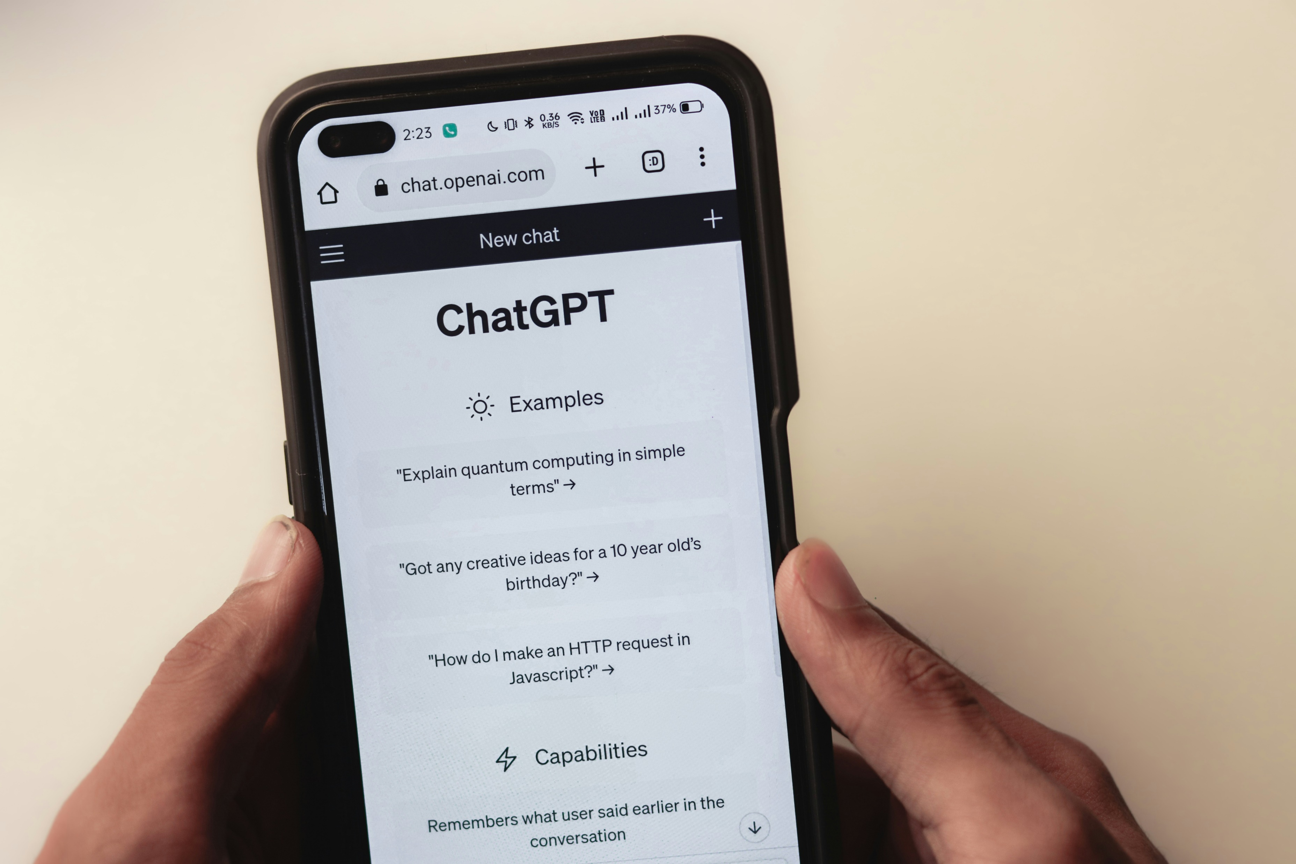
GenAI and Research Activity
Context:
  In-person
  Credit-bearing information literacy course
Generative AI (GenAI) tools:
  Chatbots
  Image generators
Photo by Sanket Mishra on Unsplash

Slide 3
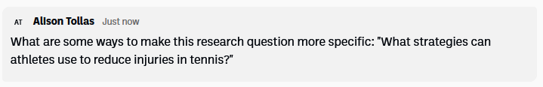
Goals
Evaluate the effectiveness of specific uses of GenAI tools for research tasks
  Discuss issues related to specific uses of GenAI tools
  Discover effective strategies for using GenAI tools to assist with research

Slide 4

Activity
Students discuss in small groups
  Each group focuses on a different stage of the research process and adds notes to a shared document
Groups share one or two tasks during a full class discussion at the end
Photo by Brooke Cagle on Unsplash

Slide 5
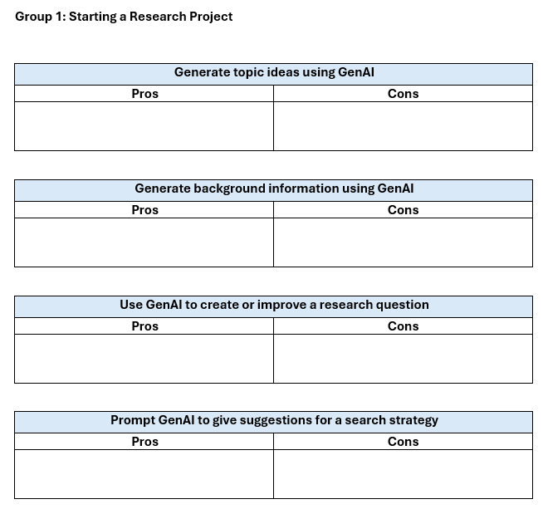

Slide 6
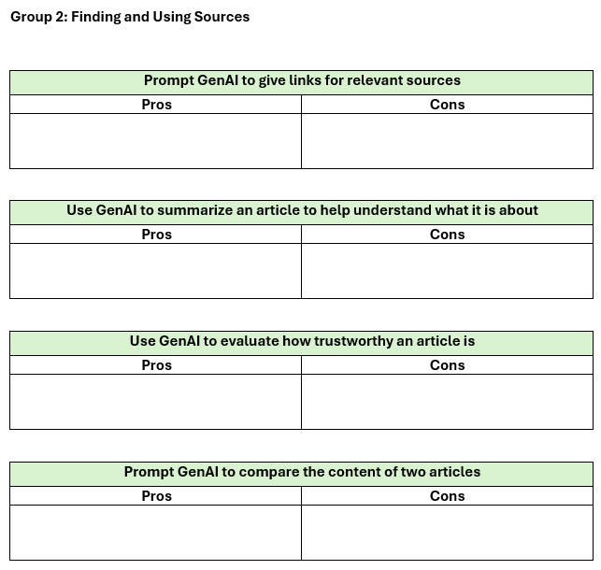

Slide 7
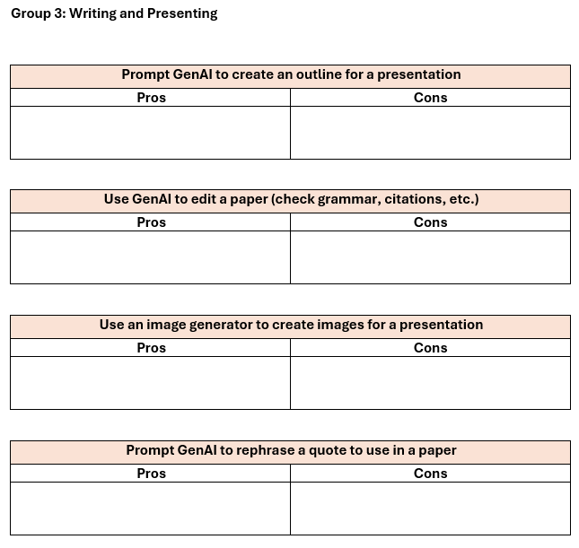

Slide 8
Student Takeaways
End-of-class reflections focused on disadvantages on GenAI use
Issues identified included reliability, academic integrity, and oversimplification
Many students concluded that GenAI tools can be helpful for research tasks if used cautiously

Slide 9
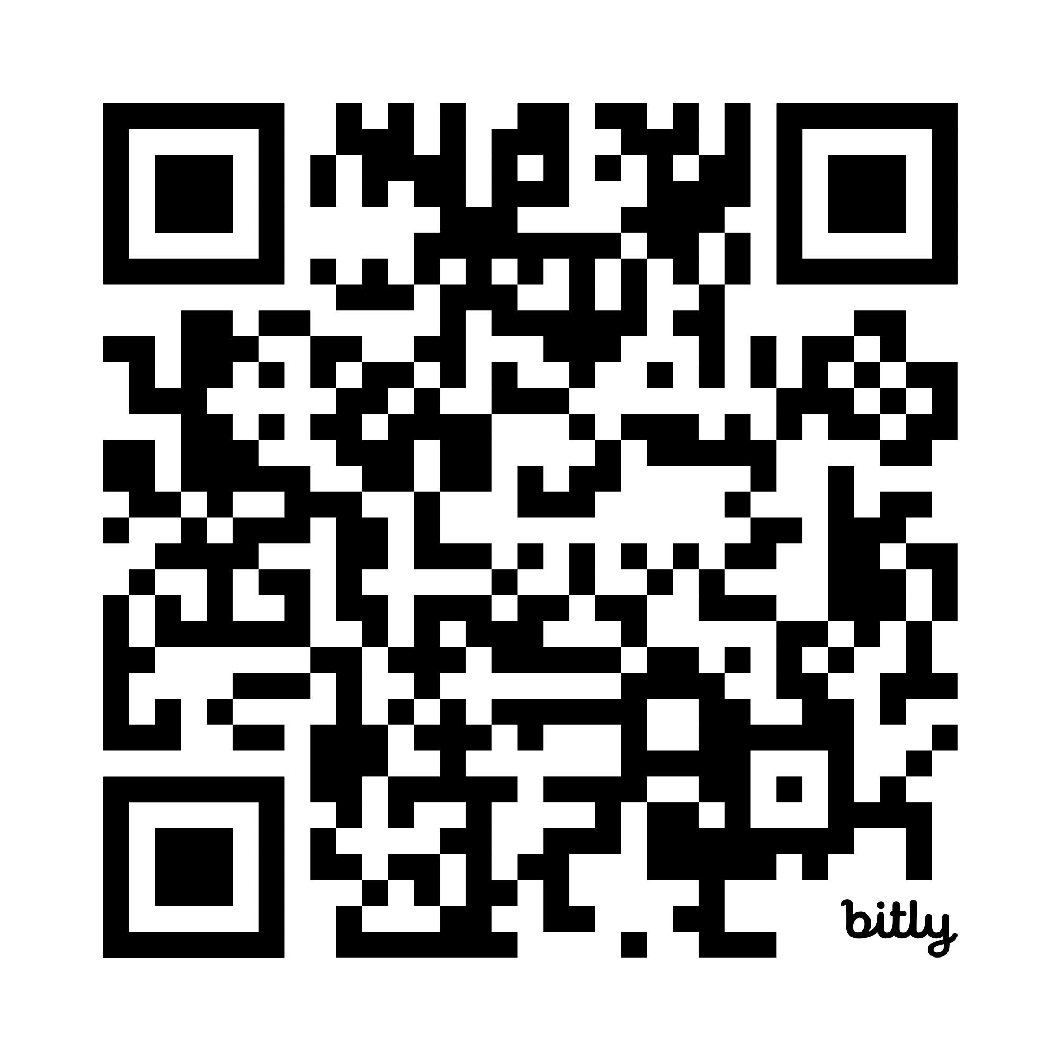
GenAI and Research Template
bit.ly/genai-template
Alison Tollas (TollasAlison@sau.edu)

