Slide 1
BINGO!
Cultivating academic library joy through gamification
Jennifer Smith, MLIS, AHIP
Head Librarian of Public Services
David D. Palmer Health Sciences Library
Notes:
Hello and Welcome! My name is Jennifer Smith and I'm the public services librarian at Palmer College of Chiropractic.
Today I'll be explaining how the David D. Palmer Health Sciences Library created a low-cost library orientation program to promote library resources and services to graduate students with bingo.

Slide 2
OVERVIEW
1
Background
2
Why bingo?
3
Planning
4
Let’s play!
Notes:
Here's our overview for this interactive session! I’m going to share my experience planning and running a library orientation session with bingo and then YOU get to play!

Slide 3
PALMER COLLEGE OF CHIROPRACTIC
LOCATIONS
POPULATION
Main Campus
Davenport, IA
Florida Campus
Port Orange, FL
13 library staff
1900+ Doctor of Chiropractic (DC) students
30+ Bachelor of Sciences (BS) students
120+ faculty
Notes:
Here's some background on our institution.
Intensive trimester system with one week breaks between summer and fall trimesters and 4 weeks after spring trimester. DCs graduate after 10 trimesters
My role as head of public services includes reference, instruction, outreach, and circulation. On my campus, I’m the only librarian providing instruction for the library, information literacy and evidence based clinical practice. Our archivist provides archival research instruction.
Many years ago, there was a required information literacy class, but it no longer exists. Now I do one-off instruction sessions when invited into classrooms, plus lots of one-on-one instruction sessions in-person and online with students, faculty and staff and create online training materials.

Slide 4


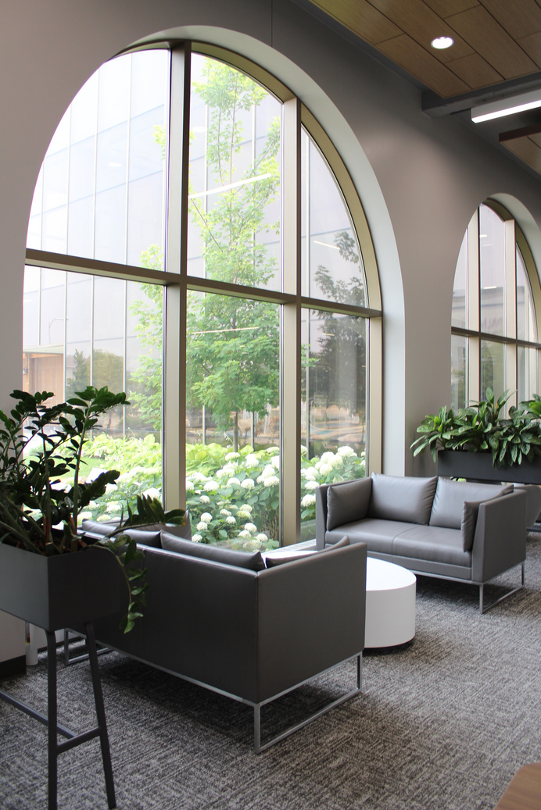
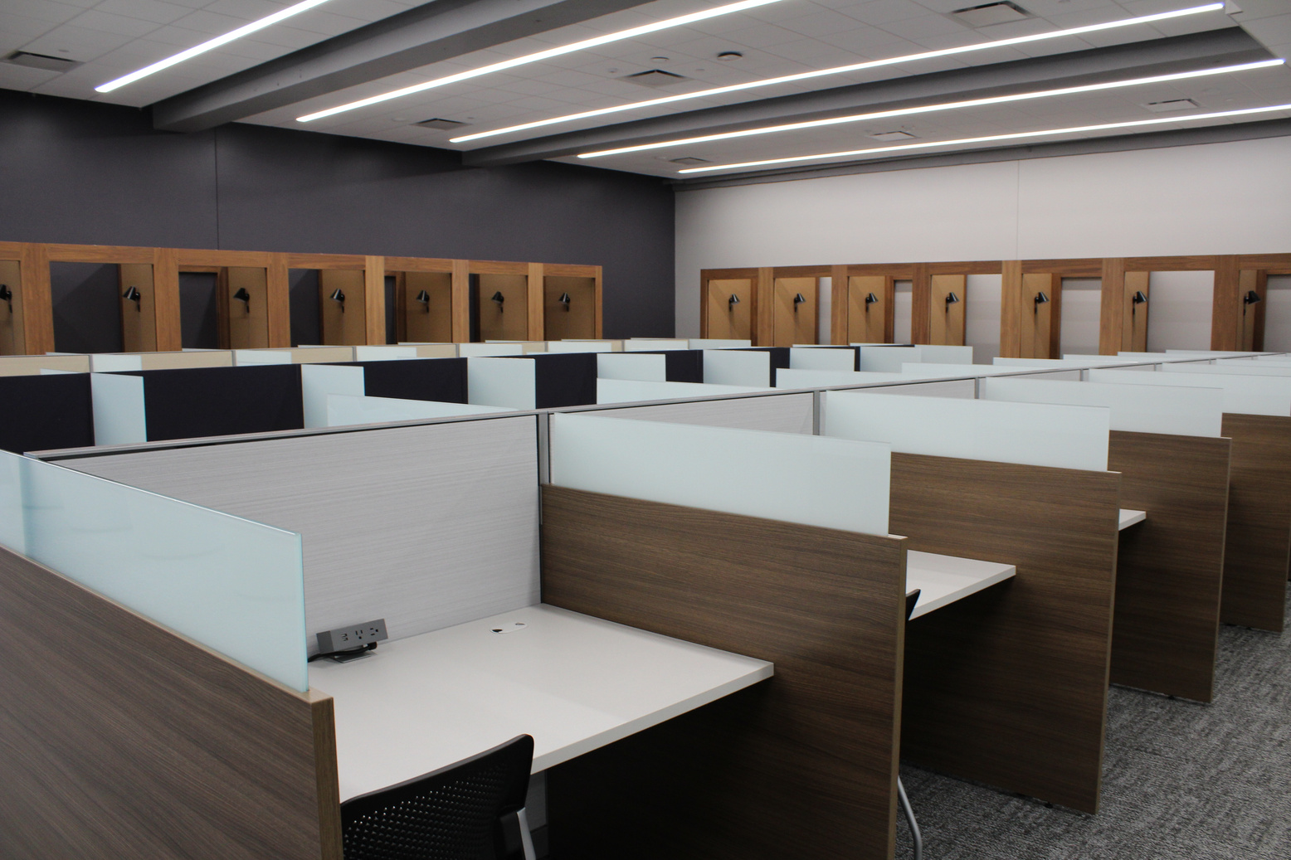
Notes:
The library on Main campus was remodeled in 2021 with lots of seating and study areas but does not have a classroom space or area suitable for presentations with AV equipment. We have a large space suitable for groups (which is where we hold bingo), plus a quiet study area and study rooms.
In the past, all new students visited the library during their new student orientation and we had 5 minutes to promote key library services and resources.
A couple of years ago, new student orientation underwent a massive overhaul, and we lost that 5 minute face-to-face encounter inside the library.
Our dilemma is that students still need to know what the library has to offer, but how can we deliver that information or help them discover it?
Despite many creative attempts, face-to-face drop-in instruction has not been well attended, so we pivoted to online video tutorials and a virtual scavenger hunt. The success of that got us thinking about other ways to turn our content into a game.
We considered an escape room, but couldn't figure out how to make it work for our space.
I asked my team to brainstorm fun alternative orientation activities and one of them suggested Bingo. We instantly loved the simplicity of it.

Slide 5
WHY BINGO?
AFFORDABLE
FUN
FLEXIBLE
LOW EFFORT

Slide 6
LOW EFFORT
Students
Many familiar with the game
Quick and easy to learn
Library staff
Use existing content
Not complicated
Notes:
For students, many are already familiar with the game and for those that are not, it is easy to learn.
On the staff end, this was one of the fastest programs for me to plan from idea to execution.

Slide 7
FLEXIBLE
Group size
Large or small
Space
Tables or desks
AV not required
Duration
# of terms
Content
Notes:
Participants (large or small groups)
Space - tables or desks. We even have students choose couches. No AV required.
Duration is variable – the more bingo terms you use, the longer game; You can also end it at any time after someone calls bingo Usually about 25 minutes at my institution, which allows students plenty of time before the next class period.
Content – can be general library information or specific to a course, major, topic, etc

Slide 8
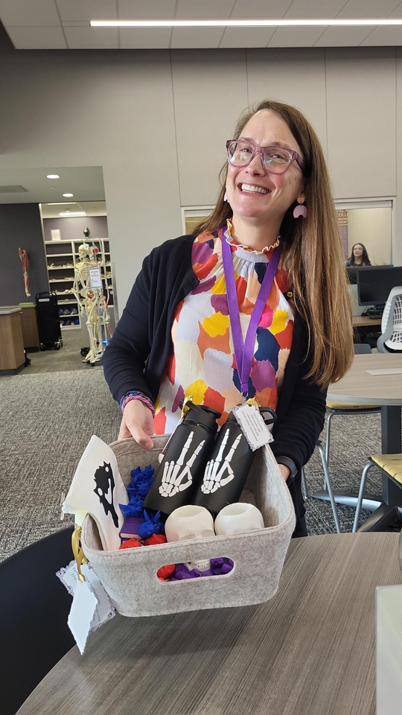
AFFORDABLE
Free online tool
Highlighters
Snacks
Prizes
Printing
Notes:
I used a free website called Myfreebingocards.com to create it. I’ll tell you more later.
Instead of bingo chips we give out highlighters for marking the bingo cards. They are branded highlighters we used to distribute at new student orientation. So save money, you could have attendees use their own pens/pencils/markers
Snacks – I got a few large boxes of rice Krispie treats from staples. Spent less than $50 for 40-60 participants
Prizes – from our budget for promotional materials
Made by library staff on 3D printer and Cricut
Keychains, skull pots, water bottles, pencil bags, totes
(Show examples) Printing bingo cards

Slide 9

FUN
Students
Library staff
Joy!
Notes:
Students are stressed. It’s hard to get them to attend programming that feels like homework. (Example – journal club) AND
This is an opportunity for new students to interact with each other in a low stakes environment.
We all know that higher ed is stressful, with academic institution feeling the squeeze of demographic cliff, BBB, etc.
And library workers feeling the strain of political attacks.
We need library joy!
The content in this program is an expanded version of what we shared in our 5 minute orientation and the vibe is SO much better. The orientation tour was at the end of a long morning and students were hungry and tired and the next stop was lunch. During bingo students are relaxed and chatting and genuinely excited about the prizes.
Initially I was pretty sad to lose that 5 minute tour time, but I'm really pleased with the quality of the student experience during Bingo.

Slide 10
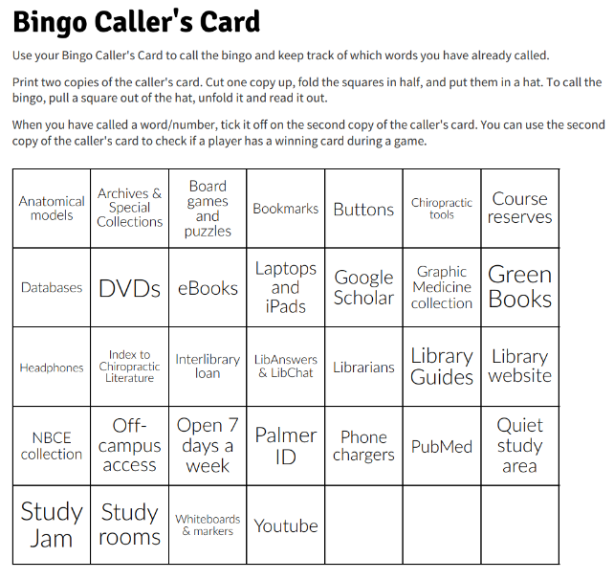
PLANNING
Create content
myfreebingocards.com
30 different cards for free
Select space and time
Advertise, cross-promotion
Gather materials
Notes:
Can be run by just one staff member
Used myfreebingocards.com
I turned my new student orientation talking points into bingo terms - about 35 words/phrases
They provide 30 different cards and bingo callers card for free. You can pay more if you want more unique cards. I haven’t tried it, but they also make virtual bingo cards!
I worked with campus partners like Student Services to identify a time when other events weren't occurring and then got their support to promote the event.
In addition to the usual campus Marketing emails and we cross-promotion with new student orientation and on social media.
Turnout has ranged between 40-60 students each time.

Slide 11
LET’S PLAY
Notes:
Explain game play:
pass out bingo cards
Use your highlighter to mark five consecutive squares in any direction based on the terms I call out. Then you get to shout bingo and come grab a prize!
Display prizes and bingo caller supplies

Slide 12
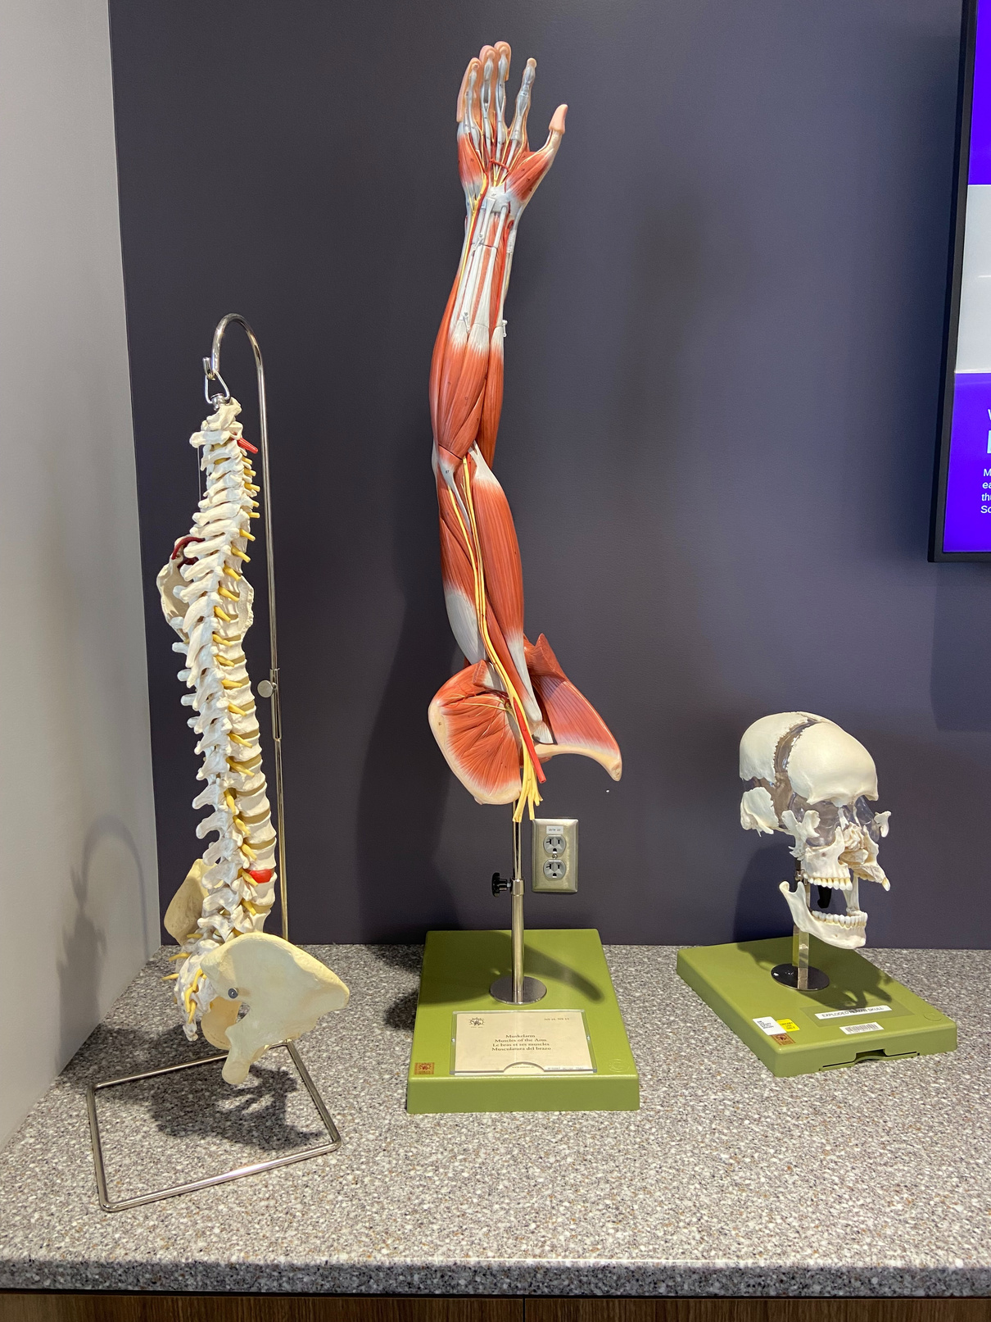
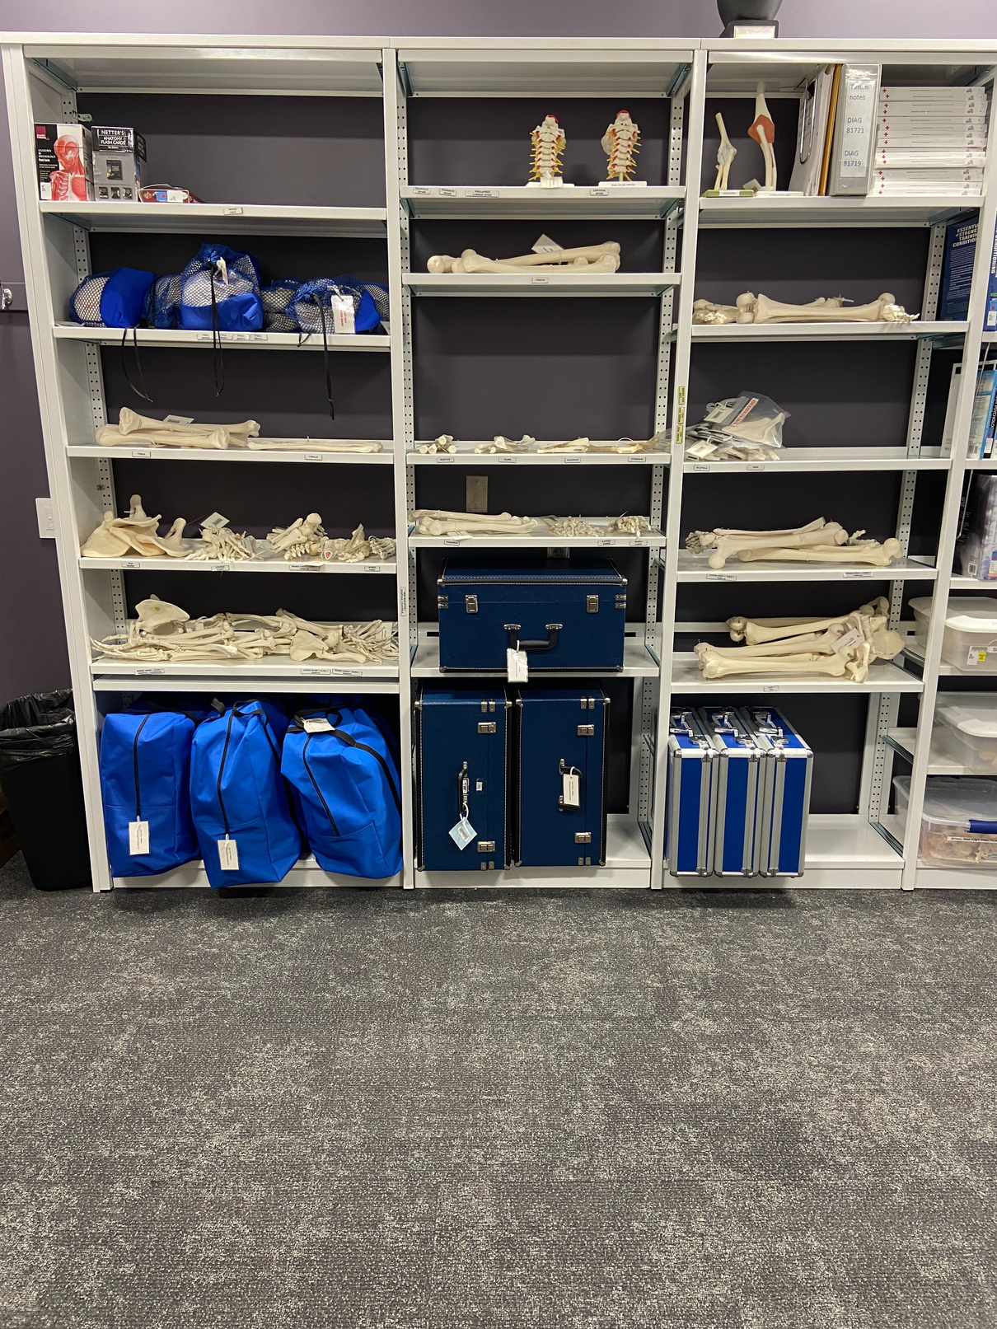
ANATOMICAL MODELS

Slide 13
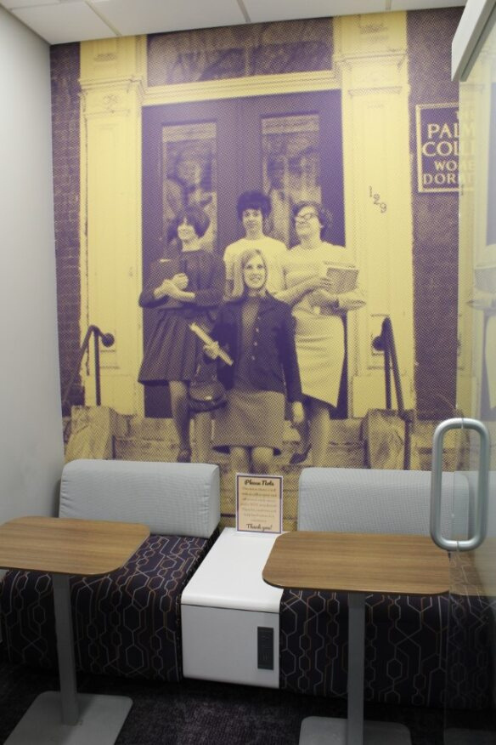
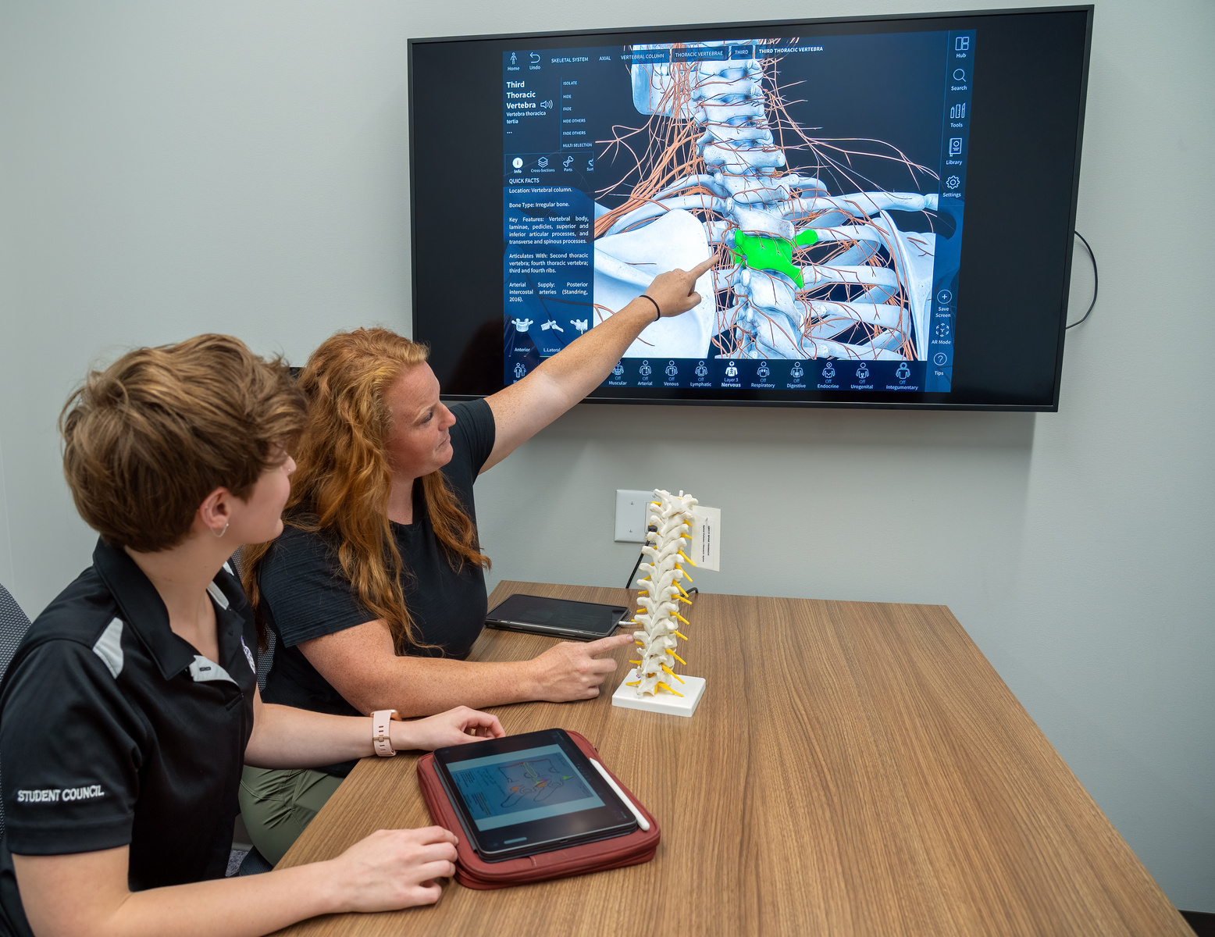
STUDY ROOMS

Slide 14
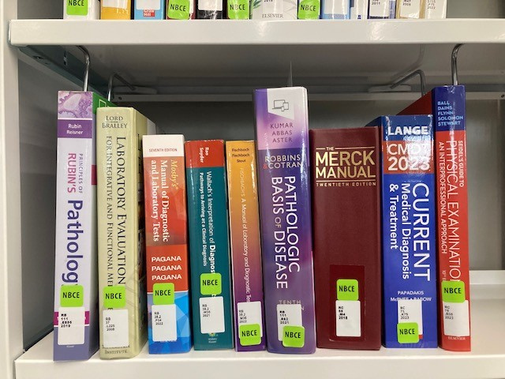
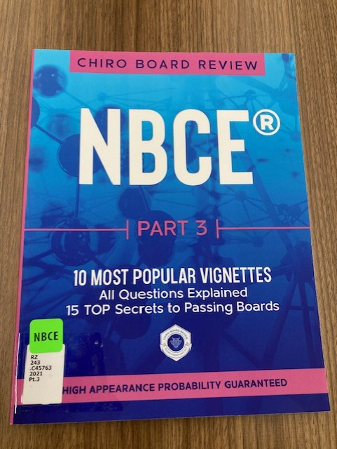
NBCE COLLECTION

Slide 15
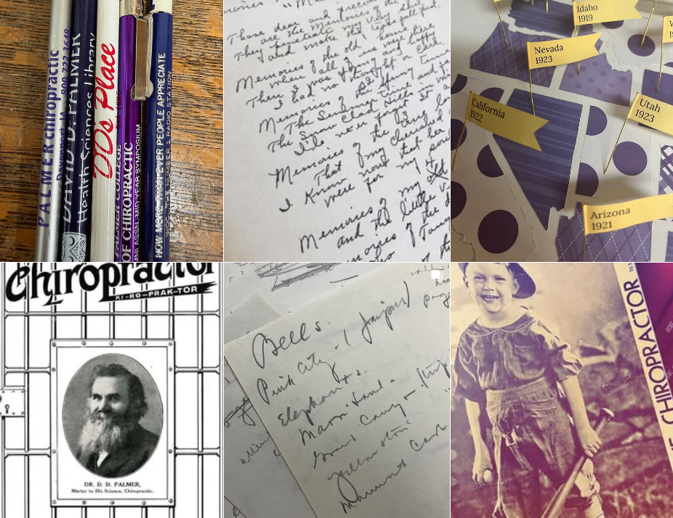
SPECIAL COLLECTIONS & ARCHIVES

Slide 16

PHONE CHARGERS

Slide 17
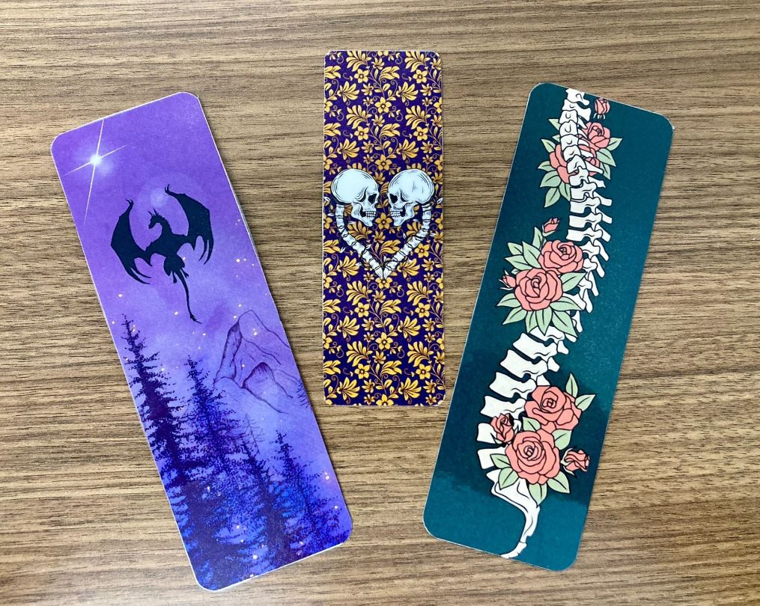
BOOKMARKS

Slide 18
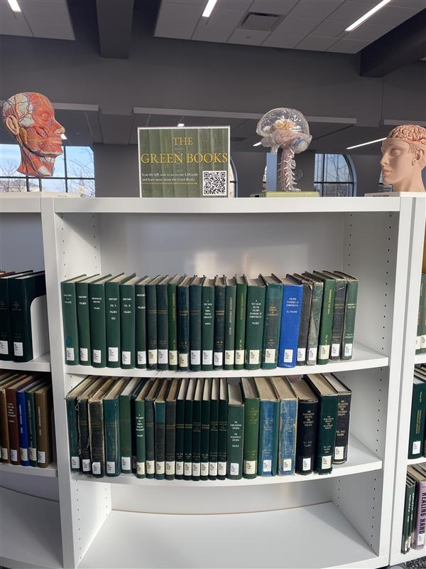
GREEN BOOKS

Slide 19
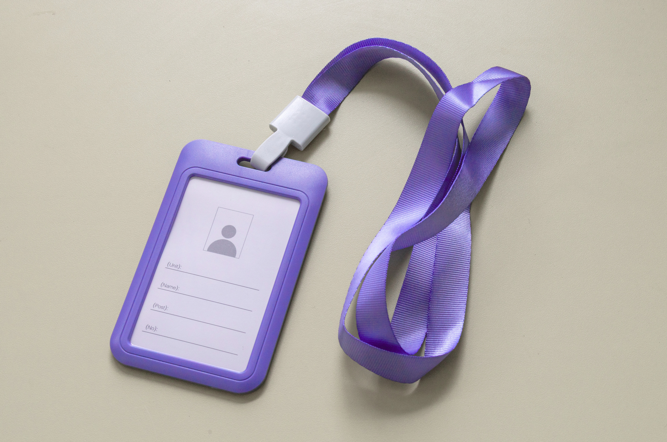
PALMER ID

Slide 20
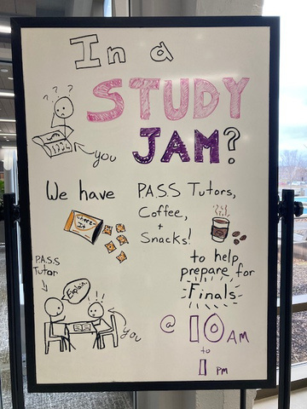
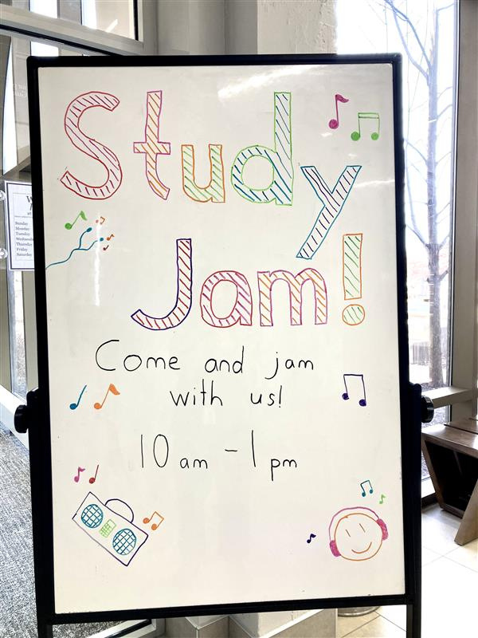
STUDY JAM

Slide 21
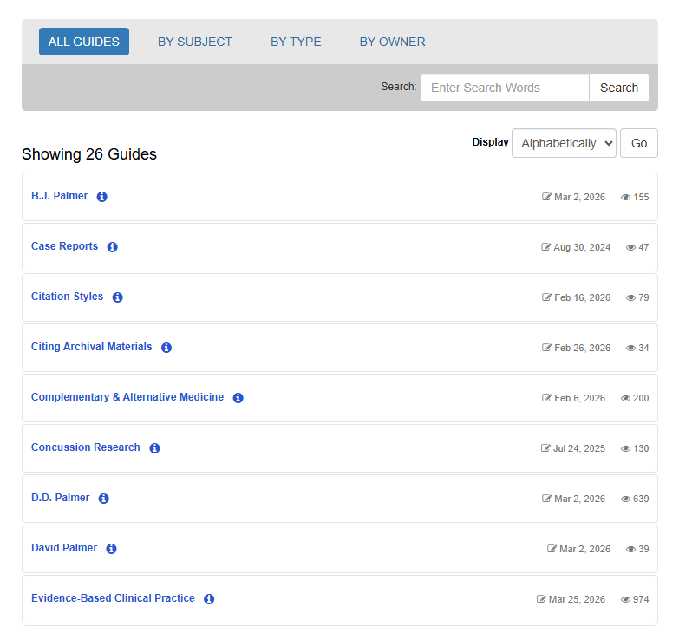
LIBRARY GUIDES

Slide 22
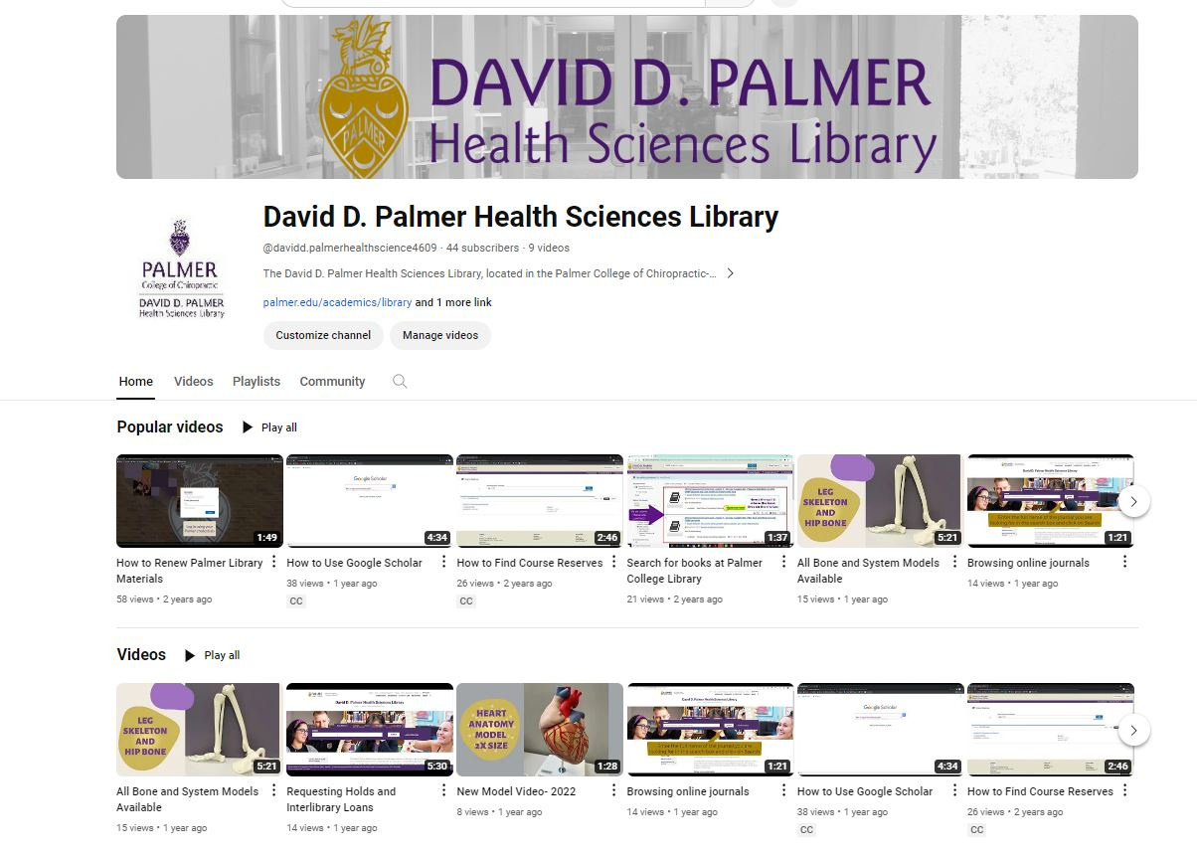
YOUTUBE

Slide 23

INTERLIBRARY LOAN

Slide 24
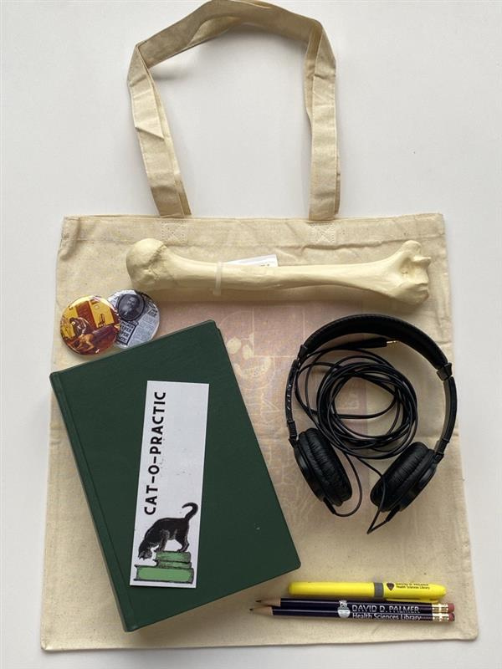
HEADPHONES

Slide 25
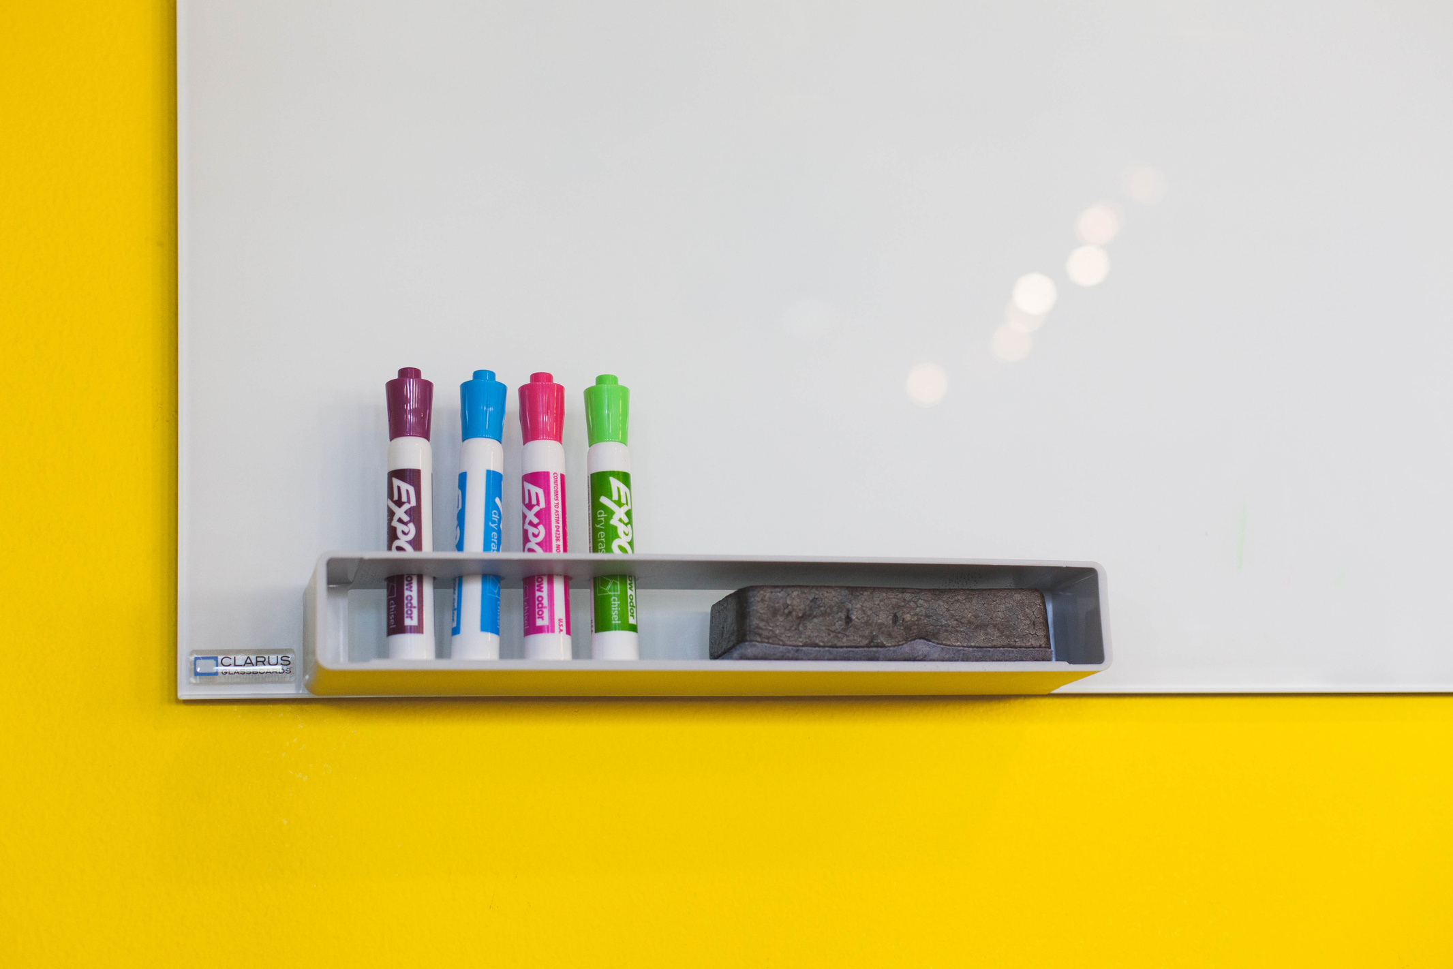
WHITEBOARDS & MARKERS

Slide 26
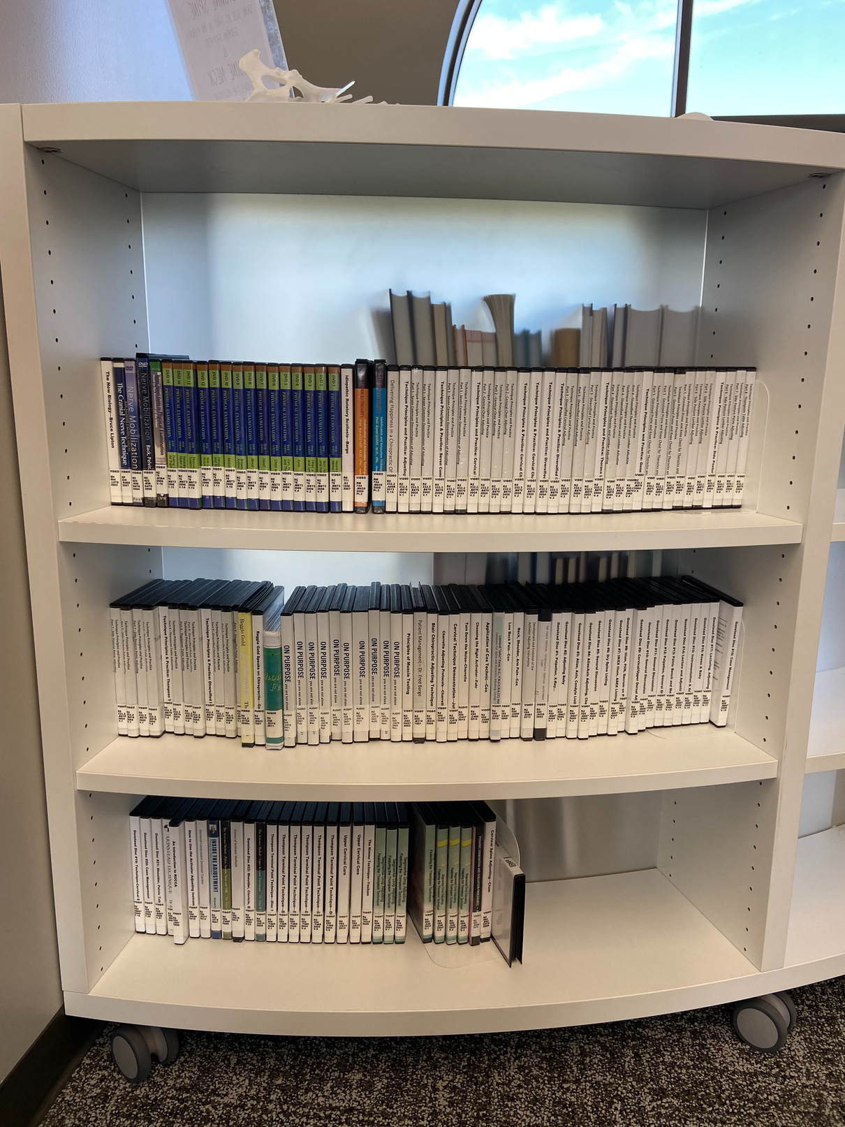
DVDS

Slide 27
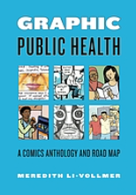
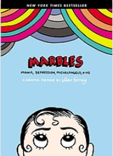

GRAPHIC MEDICINE COLLECTION

Slide 28

LAPTOPS & IPADS

Slide 29
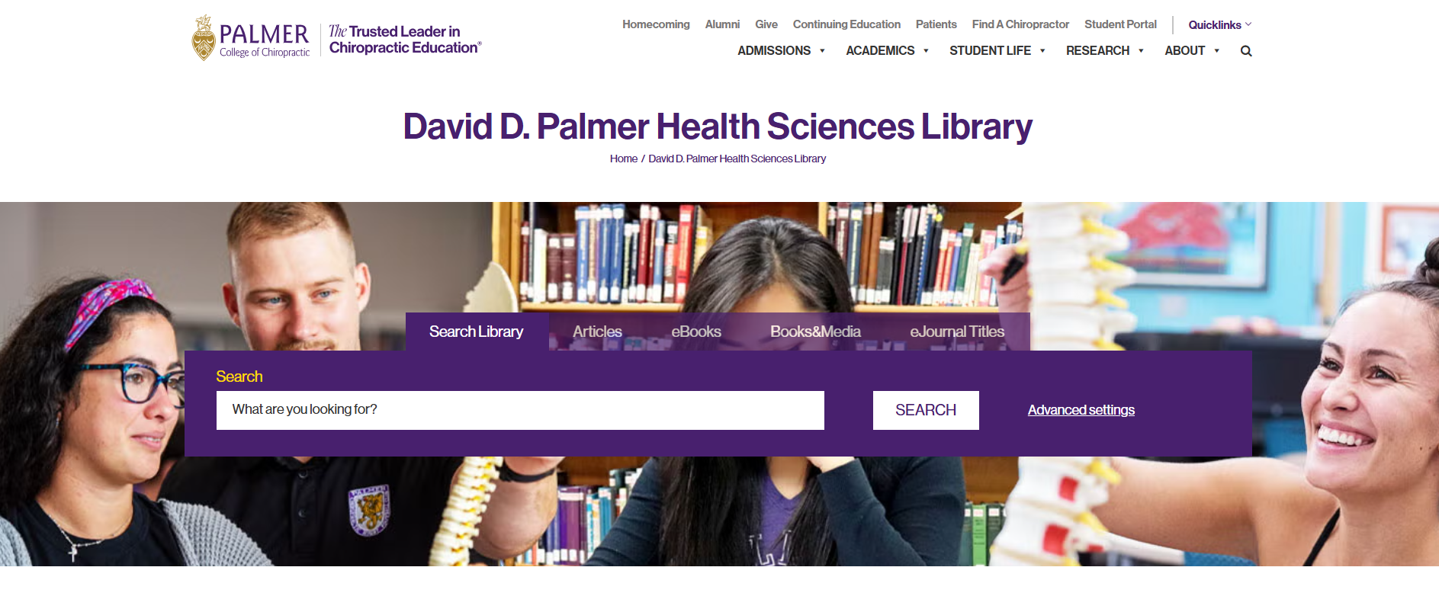
LIBRARY WEBSITE

Slide 30
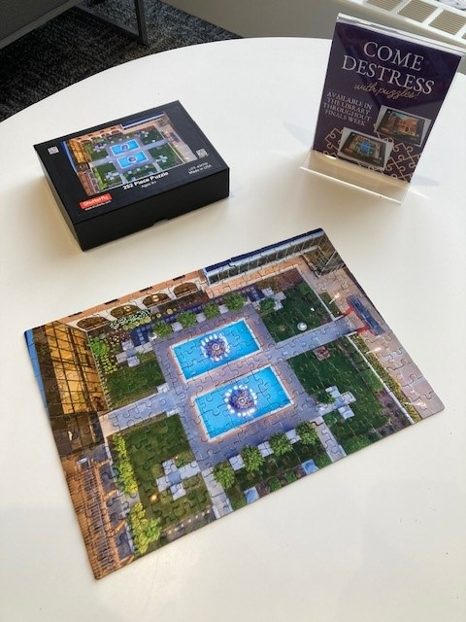
BOARD GAMES & PUZZLES

Slide 31
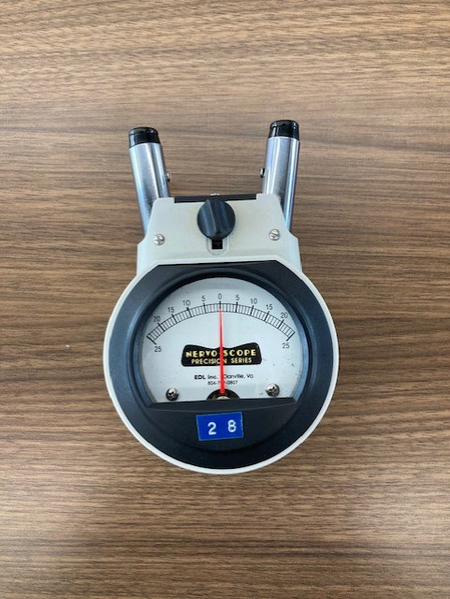
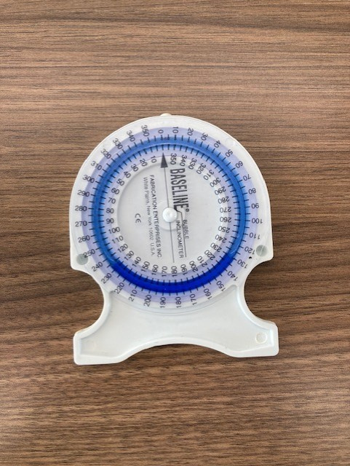
CHIROPRACTIC TOOLS
Notes:
Nervoscopes Inclinometers Stethoscopes Blood pressure cuffs

Slide 32
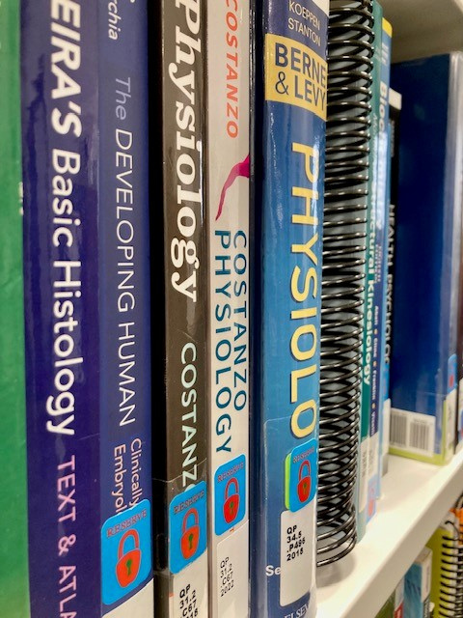
COURSE RESERVES

Slide 33
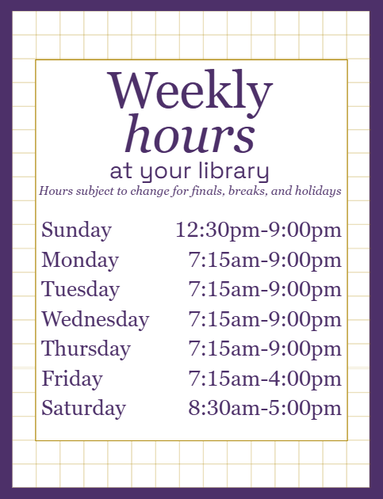
OPEN 7 DAYS A WEEK

Slide 34

E-BOOKS

Slide 35

ASK A LIBRARIAN

Slide 36
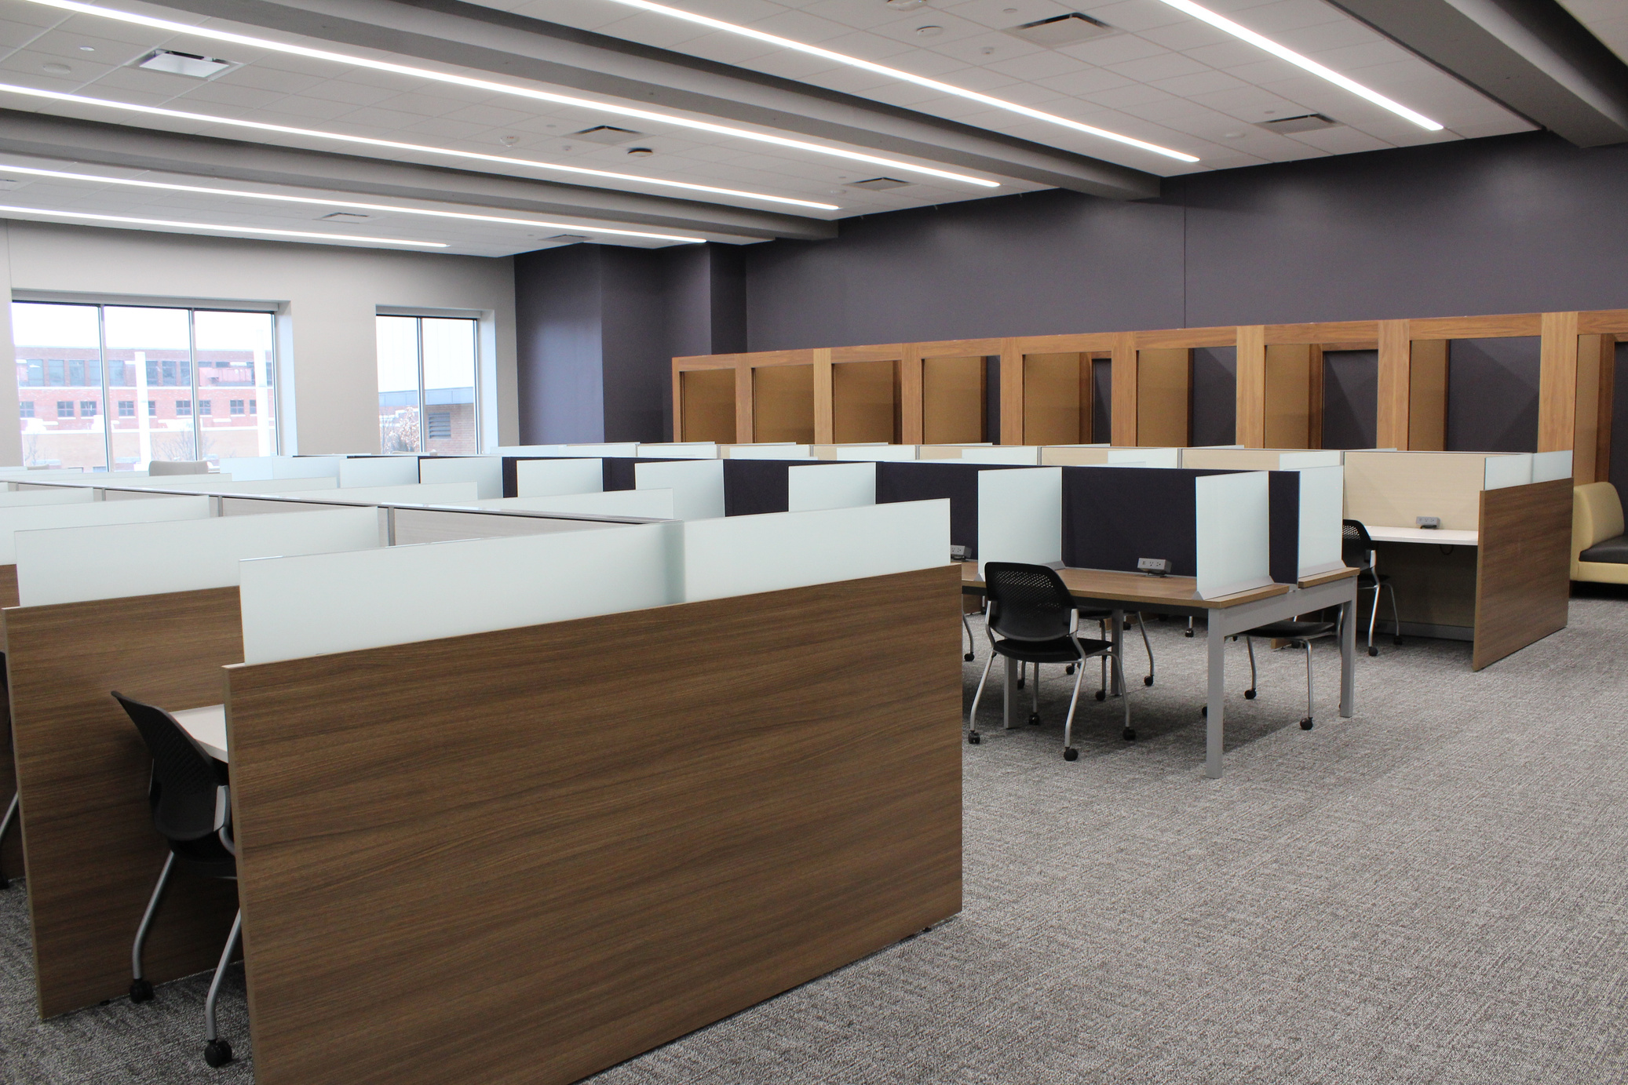
QUIET STUDY AREA
Notes:
Ear plugs

Slide 37
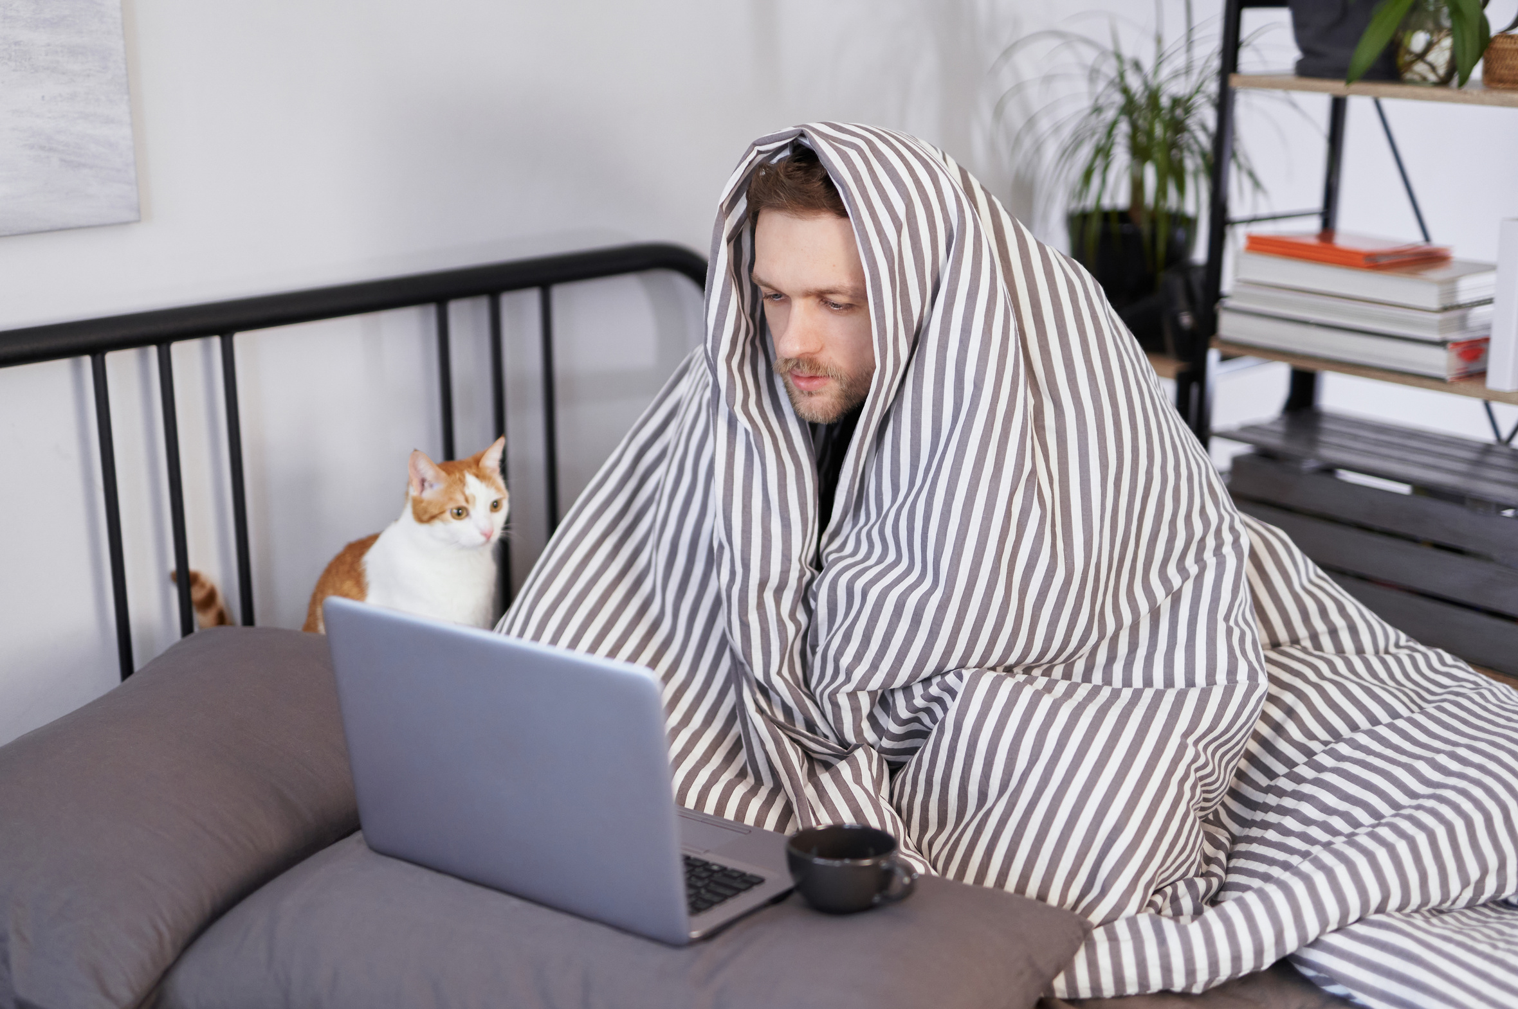
OFF-CAMPUS ACCESS
Notes:
Proxy server Microsoft credentials Cat not included

Slide 38
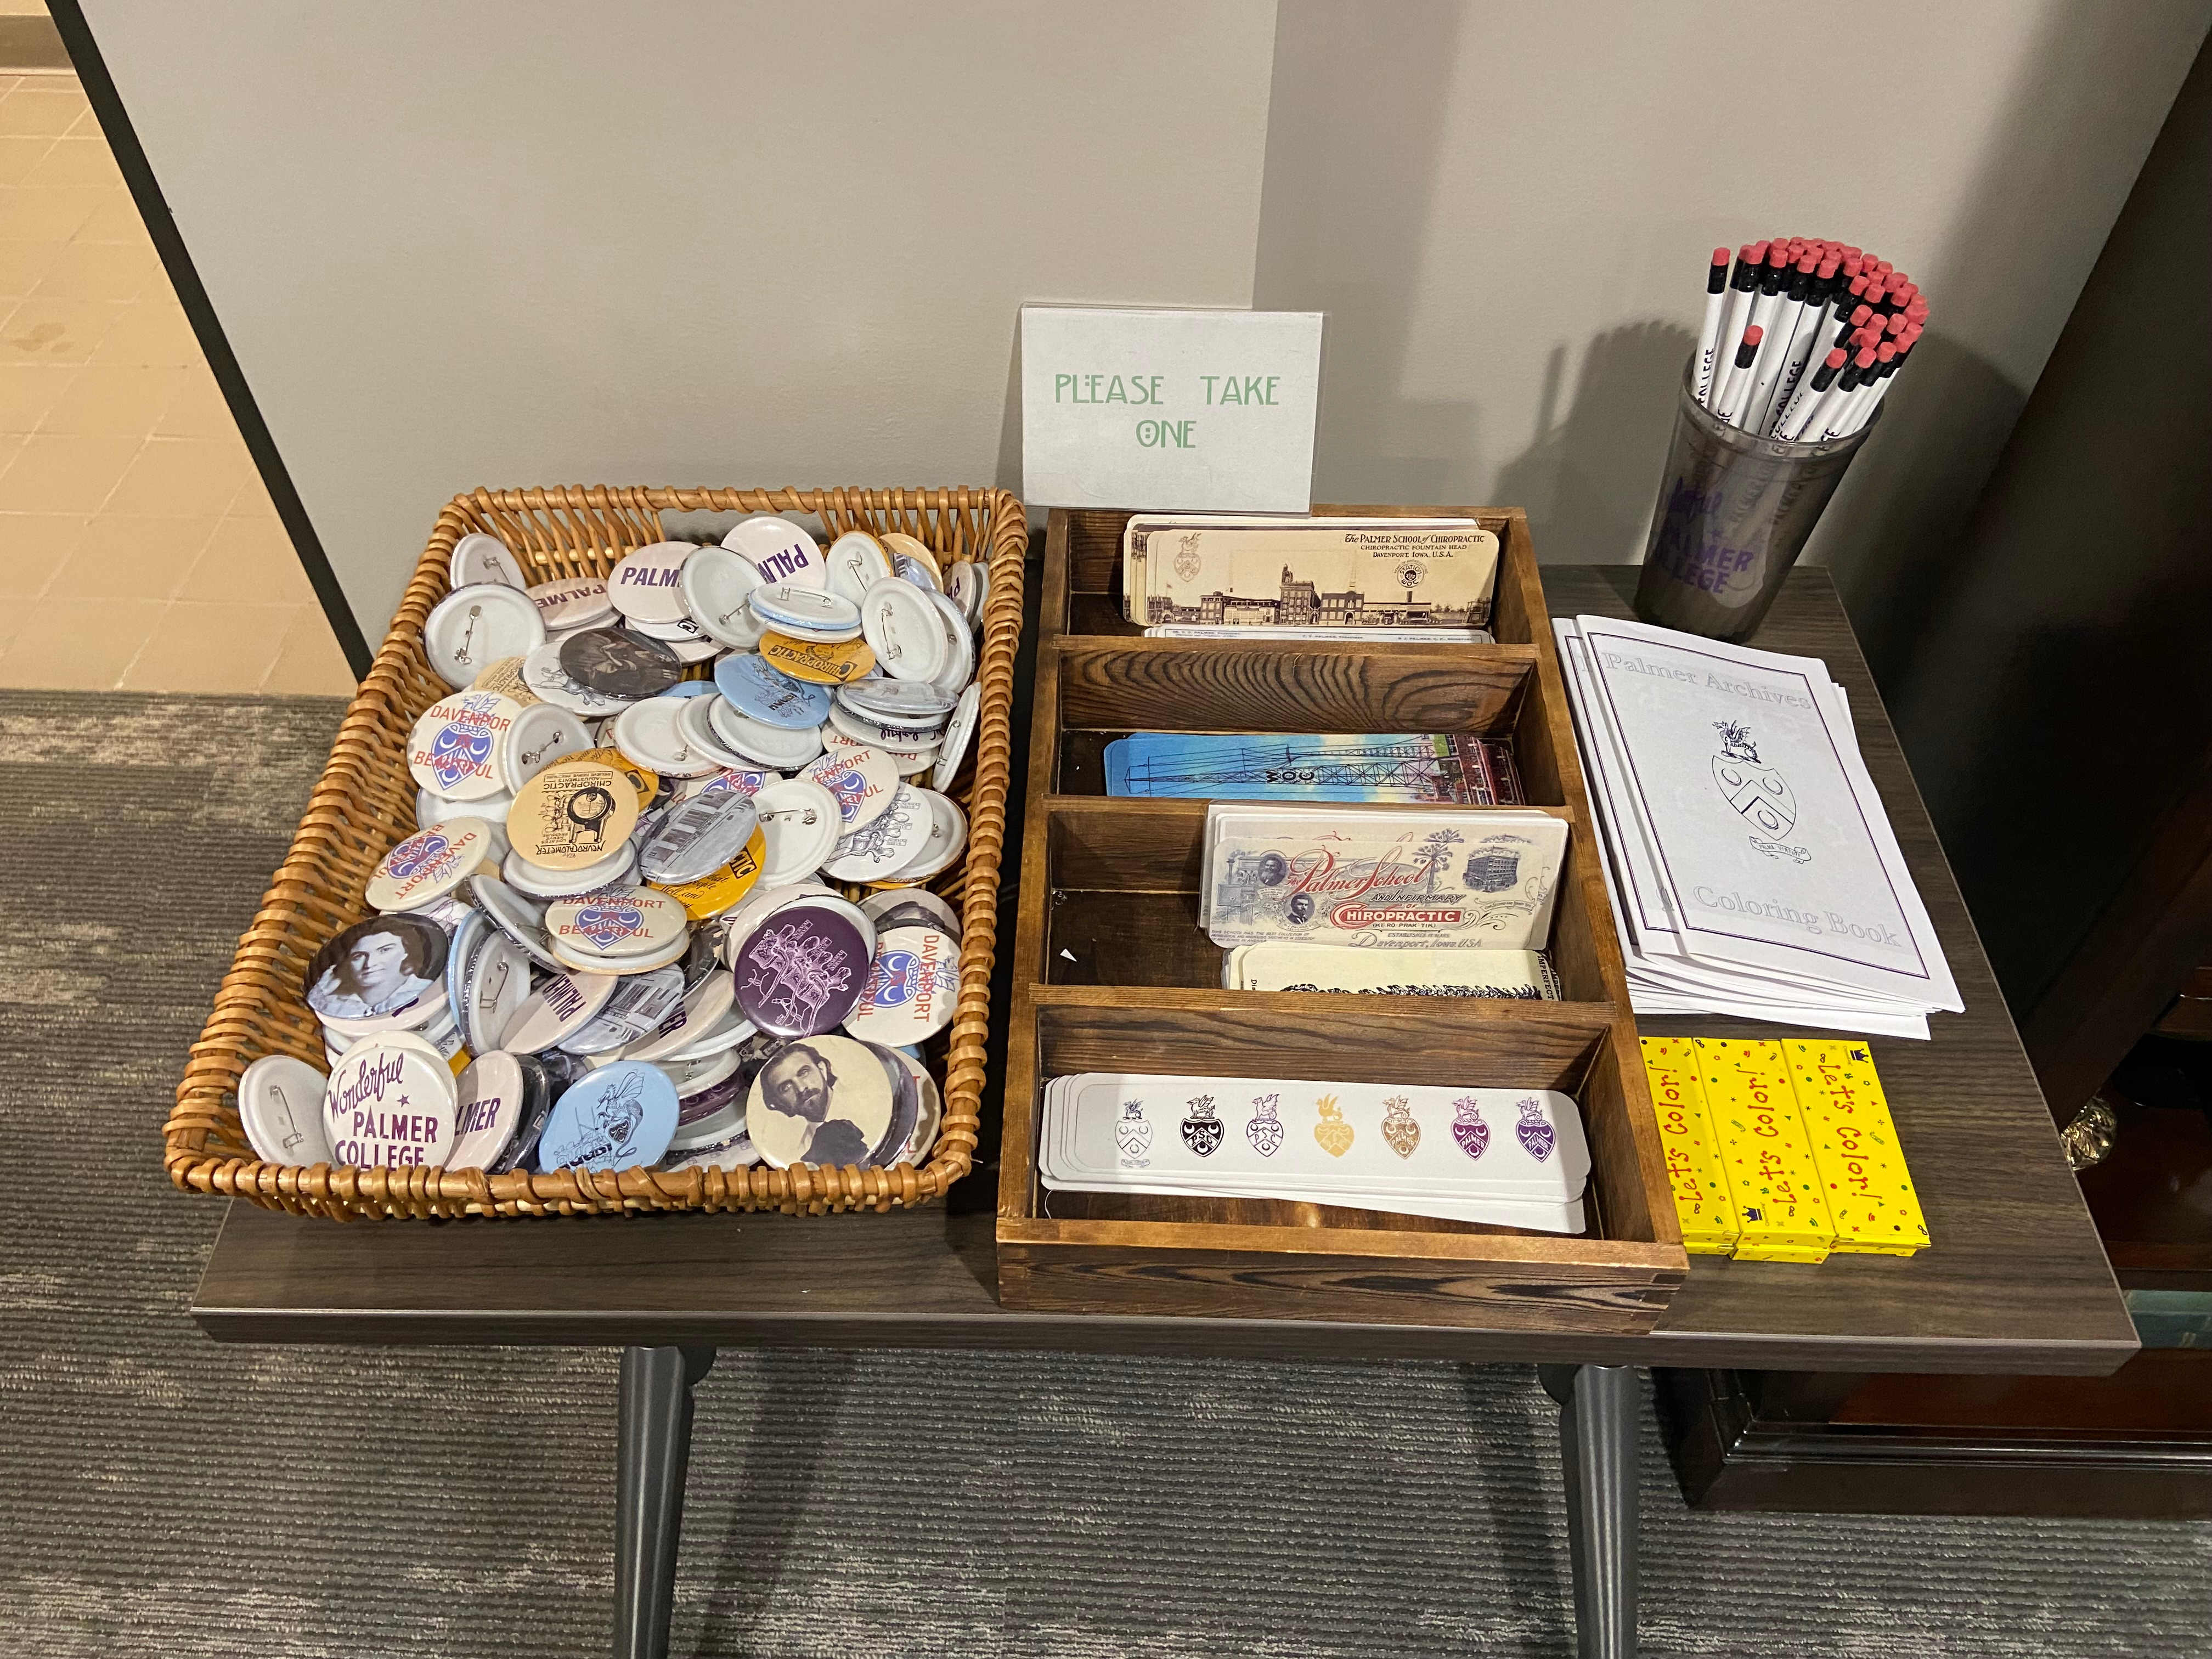
BUTTONS

Slide 39
RESOURCES
Adare-Tasiwoopa ápi, S. (2025). Gamify Your College Classroom: Strategies to Foster Critical Thinking and Life Skills Across Disciplines. Taylor & Francis Group.
Crowe, S. & Sclippa, E. (Eds.) (2020). Games and Gamification in Academic Libraries. Association of College and Research Libraries.

Slide 40
THANK YOU!
Any Questions?
jennifer.smith@palmer.edu
Notes:
Thank you for joining me today!
Before we wrap up, do you have any questions?

