Slide 1
Iowa ACRL/ILA Conference
May 28-29, 2026

Slide 2
Training Library Student Employees: Always Evolving
Presented by:
Renée Barney, Information Literacy & Technology Librarian
Meredith Borchardt, Student Employment & Circulation Services Supervisor
Julie Fedeler, Interlibrary Loan & Evening Supervisor
Notes:
Welcome to this session on library student employee training; our main purpose for training is to develop teams that can provide positive patron interactions and quality customer service.

Slide 3
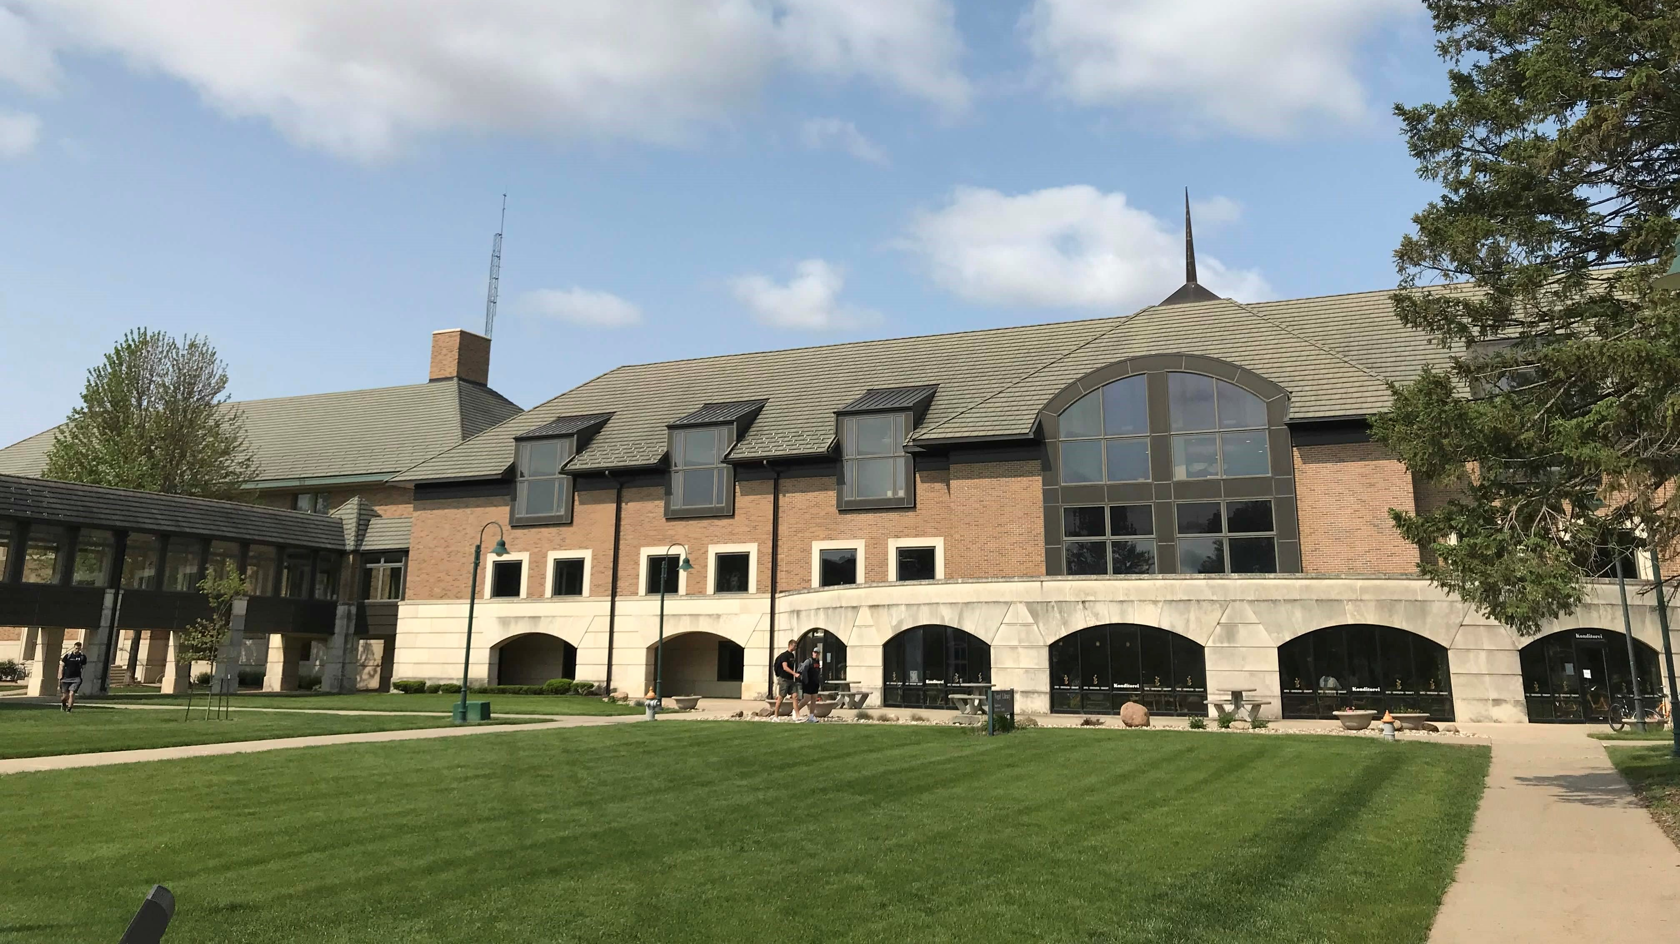
Vogel Library, Wartburg College
1500 FTE undergraduate students
21 graduate students
25% of students are Business Administration majors
The college is named after the Wartburg Castle in Eisenach, Germany
Notes:
Before we dive into that, we want to share a little background on our institution, including some student demographics...

Slide 4
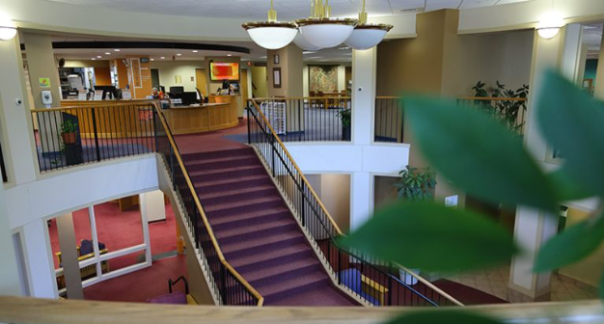
Vogel Library, Wartburg College
The collection includes 95,367 physical titles and 331,712 digital titles
For the 2024-25 academic year physical circulation was 6,729
Organized with the Dewey Decimal System
Notes:
And our library, these are some numbers pulled from IPEDs data,

Slide 5
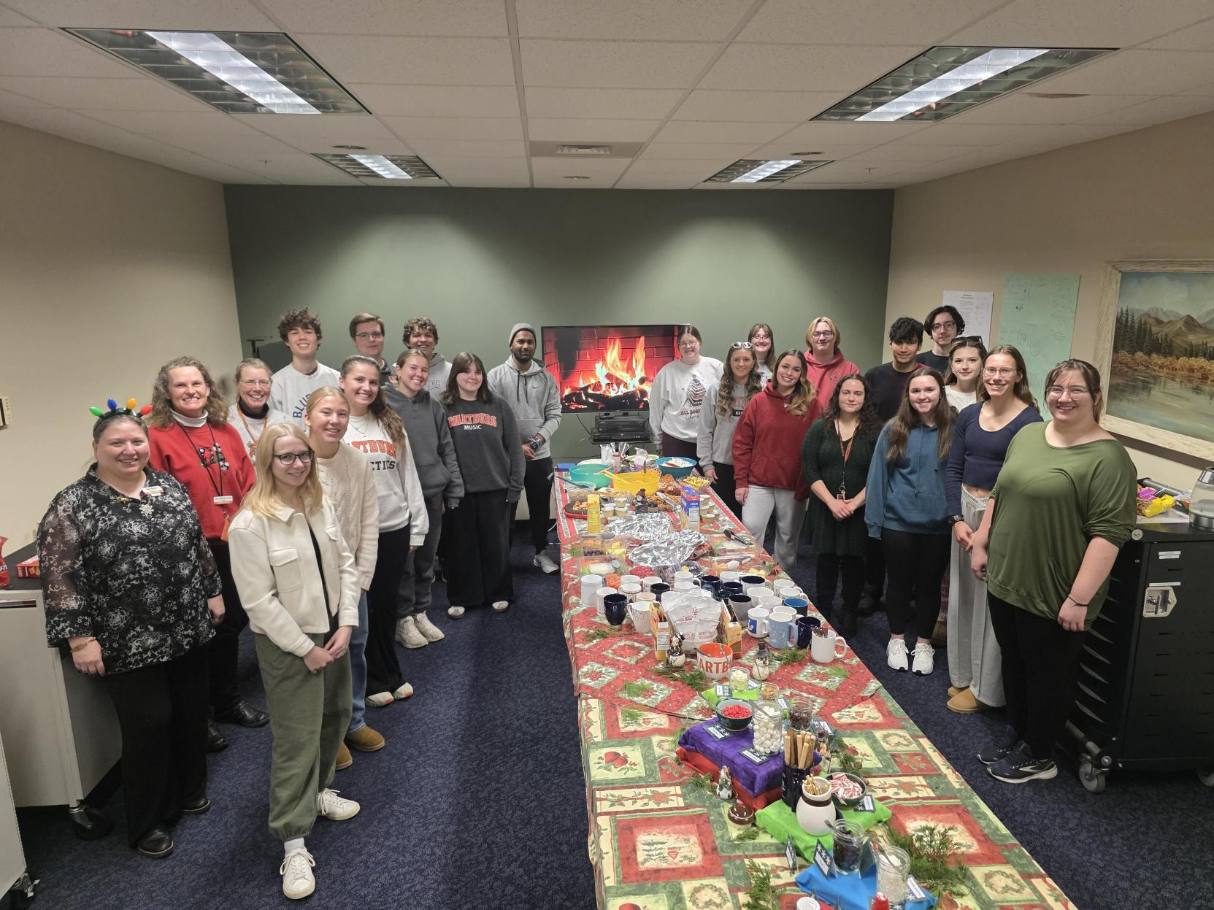
Our library team
Seven permanent staff members include our director, 2 faculty librarians, 3 staff and our archivist.
We employ about 30 students during the academic year with a wide variety of majors and backgrounds.
Notes:
And finally, our people. Out team is made of up a mix of permanent staff and students – 7 permanent staff and about 30 students during the academic year and a few in the summer.

Slide 6
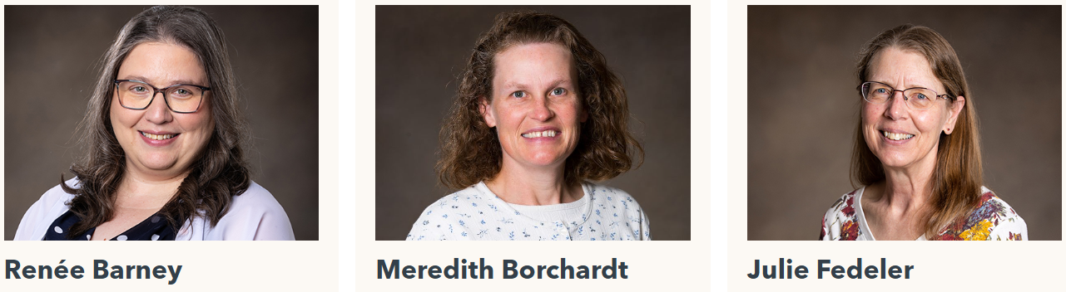
Student Employee Supervisors
Information Literacy & Technology Librarian
Student Employment & Circulation Services Supervisor
Interlibrary Loan & Evening Supervisor
Notes:
A little bit more about us...we all wear a lot of hats, as many of you probably do...
I'm Meredith Borchardt, Student Employment & Circulation Supervisor
My responsibilities include:
Payroll and budgeting for student employment
Managing Fines and Fees, Missing and Lost Items
Coordination of Inventory and Weeding Processes
Scheduling library room spaces
My hours are Mon – Fri 7:00-3:30
Renée Barney, ELITE Supervisor
Information Literacy and Technology Librarian. My responsibilities at Vogel Library include:
ILS Administrator
ELITE Supervisor
Instruction Faculty (Information Literacy sessions)
Liaison to STEM, Health programs, Sport Science programs, and Information Technology Services
Manager of the Circulating Technology collection
Librarian. Shift 11am-8pm, Mon-Fri
Julie Fedeler, Evening Supervisor
Assist with supervising both Circulation and ELITE teams
I am also responsible for:
interlibrary loan
managing our Makerspace
and creating our monthly newsletter
My hours are 1:00 – 10:30 PM Monday-Thursday, and 1:00 – 5:00 PM on Fridays

Slide 7
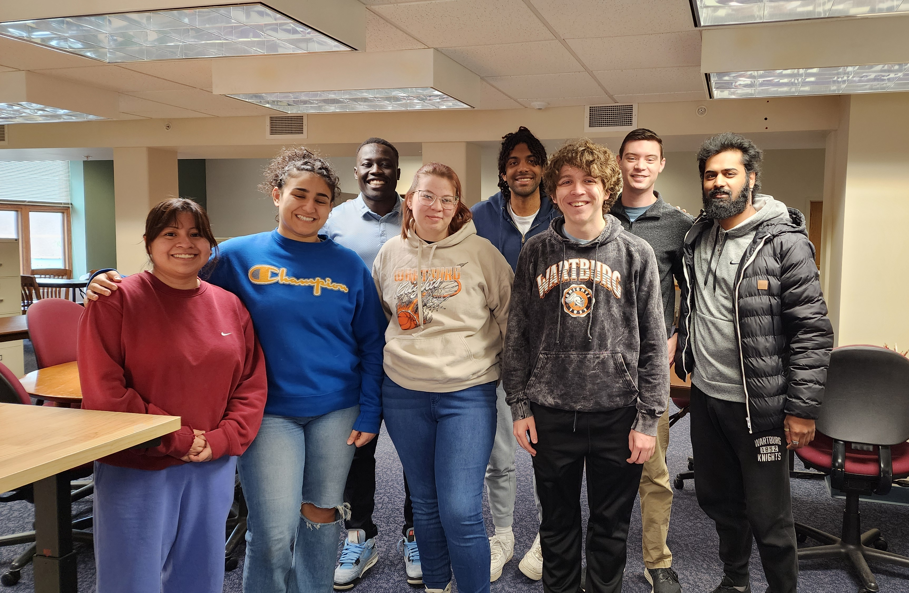
Library Student Teams
Circulation
ELITE (Emerging Leaders in Technology Education)
Archives
The 2024-25 ELITE Team
Notes:
Our students are on one of three teams:
Circulation Assistants- largest team, ~20
Circulation Assistants are the welcoming face of the library, providing the first line of customer service at the circulation desk. In addition, they assist in maintaining the library collection and help make the library's spaces and services inclusive.
ELITE (Emerging Leaders in Technology Education) ~8
ELITE Consultants provide first level customer service on questions relating to software, applications, and hardware that are used on campus. In addition, they assist in maintaining and circulating the library's technology and equipment collections and help to ensure the library's spaces and services are inclusive.
Archives Assistants – smallest team, ~3-4
We also have 3 to 4 student employees who work in the Archives, supervised by our Archivist, Kay. Their work is specific to the archives which requires very different, specific training that Kay provides.
Although they do not attend our weekly student employee meetings, they are invited to our end-of-term parties.

Slide 8
A Little About You
How many of you supervise student employees at your institution?
How many of you are new to that role (a year or less)?
How about 1-5 years? Any over 5 years?
Notes:
That's a lot about us, we'd like to learn a little more about you. Can we please get a show of hands of those who currently supervise student employees? How many have been supervising student employees for a year or less? 1-5 years? 5 or more years?

Slide 9

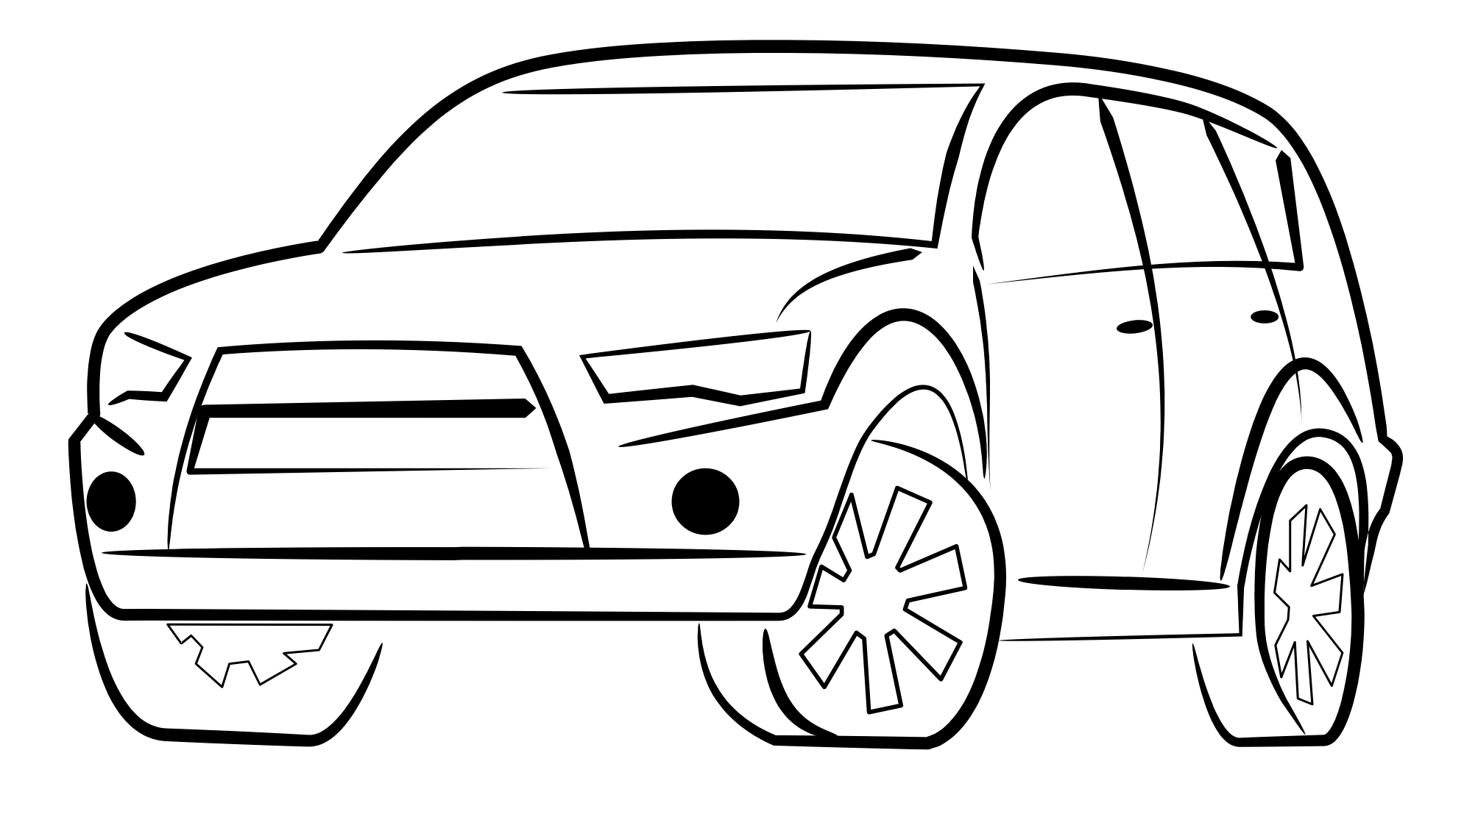

Presentation Overview
Onboarding
On-going Training
Communication Methods
Lessons Learned
Time to Share
Watch for these symbols to indicate:
The Past
The Present
The future
Notes:
Over the past 5 years we have experienced a rather rapid evolution in how we train our student employees. So, we want to take you on a journey through time as we look at where we’ve been, internal and external changes we have experienced that have prompted change, where we are today, and how we are yet evolving for the future. We have provided paper on the tables for you to write down your questions, ideas and stories you would like to share. We will allow about 10 minutes at the end for group discussion.
And watch for the car symbols throughout the presentation which indicate things we do now, things we’ve done in the past, and things we plan to do in the future.

Slide 10
Onboarding
Notes:
The first way that we provide training for student employees is through onboarding. A reality of any college workplace is that there are new students coming on and others graduating on an annual basis, so this is an every year process.

Slide 11
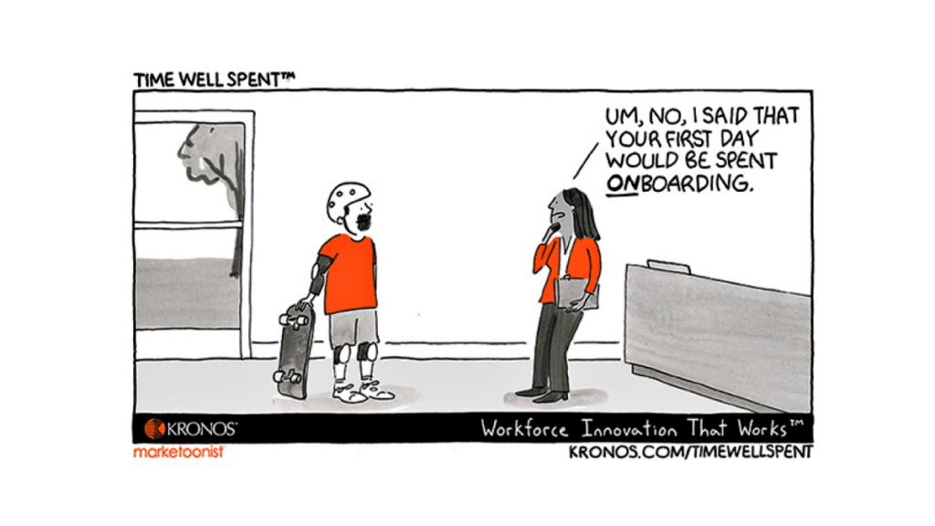
Onboarding
Key elements include:
Fall orientation
Student managers serving as mentors
Online training
Notes:
Fall orientation at the beginning of a new academic year is a key part of onboarding new team members, and there are a few other things that we consider to be under the onboarding umbrella.

Slide 12
Fall Orientation
Notes:
One of the primary challenges we face with fall orientation is scheduling. Our students (probably like your students) are incredibly busy, and there is a lot going on just before classes start. Over time, we’ve decreased the amount of in-person time at fall orientation and thought long and hard about what to include in the limited minutes that we have together in person.

Slide 13

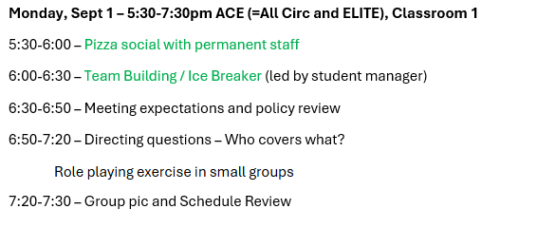
Fall Orientation Schedule, Day 1
Notes:
This year we spent about 5 hours total, spread over the late afternoons/evenings of the two days before classes started. You’re looking at the schedule for Day 1, when a key emphasis is team-building. This is critical to our success and can’t be accomplished in other ways. We spent half of the time (the first hour in green) on fun time getting to know each other. We also utilized this time all together to build a common understanding of the most important policies and work expectations.

Slide 14
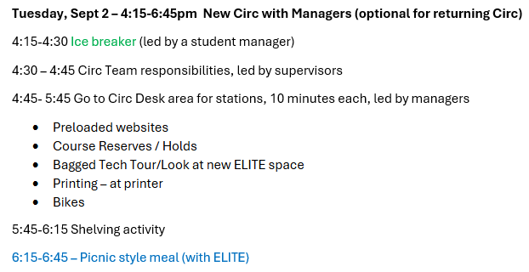
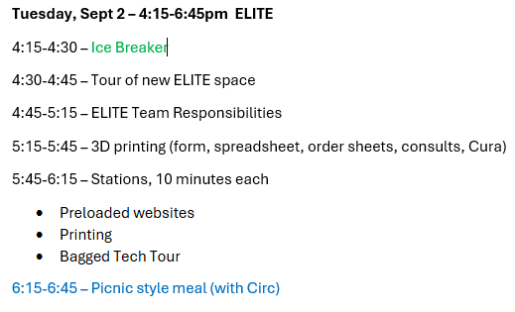
Fall Orientation Schedule, Day 2
Notes:
On the 2nd day, we are split apart. The small group sizes are intentional and especially consider first year students who already may be overwhelmed with general new student orientation activities. This day was optional for our returning Circ students who wanted a refresher. Both groups again started with team-building, and ended the day all together with a meal. Food is an important part of training!

Slide 15
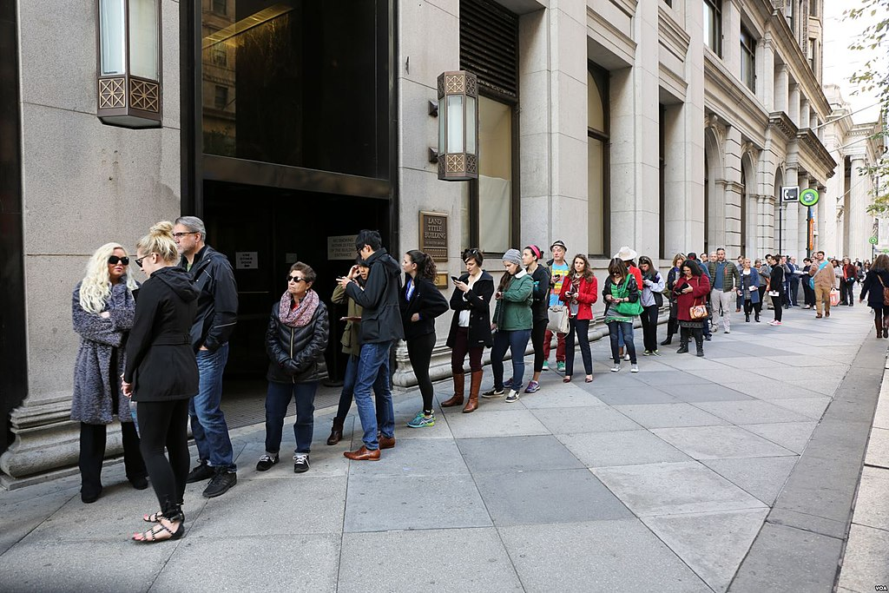
Fall Orientation
The Circ Desk is a busy place at the beginning of the year
What's important to know on day one?
Notes:
The circ desk is a busy place at the beginning of the semester and there can be lines of patrons. In terms of choosing content, we ask ourselves what is important that students hear/ learn/ refresh on before day one of classes and what things might be covered in another way at another time.

Slide 16

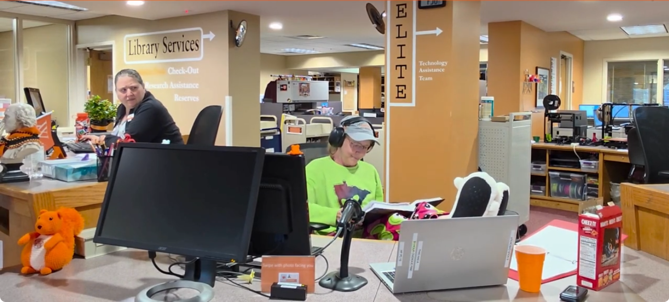
Fall Orientation, Skits
Notes:
We added skits in the fall of 2023 to help illustrate work expectations – for example good, and not-so-good customer service. At that time, we paused throughout to discuss what things students were observing. The skit added humor and showed a fun side of supervisors. However, some students were not able to be present at the time of the skits, and there wasn’t a way for them to make it up.
Last summer we filmed skits and paired them with a quiz in Canvas for an assignment this year. We’ll be able to reuse these award-winning short films in the future, and all students had a chance to view and respond to them. We also involved a few willing students in the skits- both as actors and with filming. Here's a short clip from the video "Bad Day at the Circ Desk" to give you a flavor of what they are like. https://youtu.be/DKKeB75W32U?si=Vatg8pBMYC2pWEUK&t=324

Slide 17
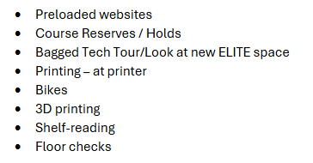
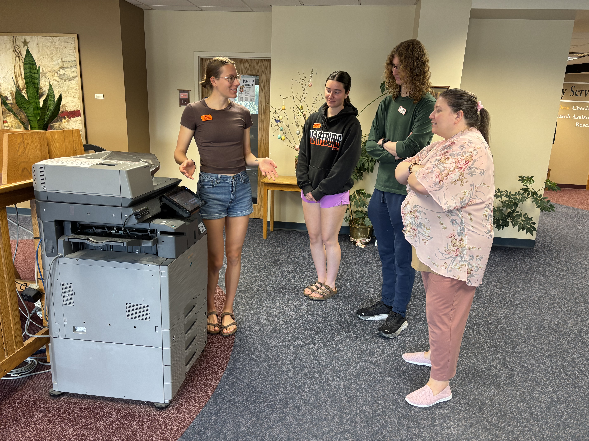
Fall Orientation
Stations used at orientation
Notes:
Student managers help us plan orientation and lead parts of it, such as ice breakers and stations. We do a video call with them in August to help prepare and be on the same page at orientation. Stations allow for peer-to-peer, hands on learning on a variety of topics. For example, a group of 2-3 students will meet with a manager for ~10 minutes at a printer to learn about printing/scanning/copying, and then rotate to the Hold Shelf to learn about finding and processing ILL's, TRAC's, and holds, and finally move to the bikes to learn about related procedures.

Slide 18
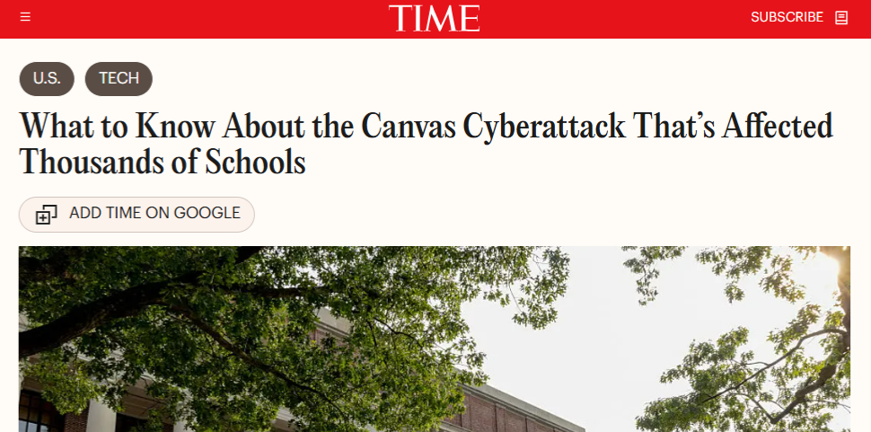
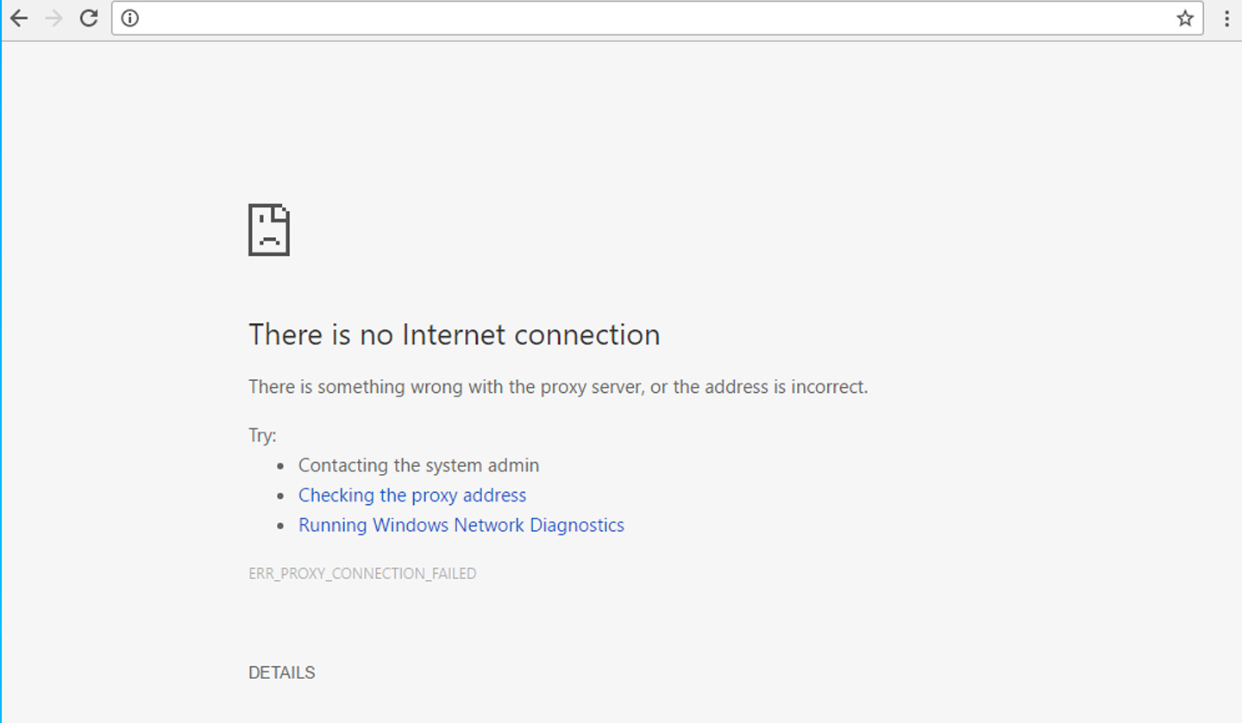
Fall Orientation
Technology can be a challenge
Notes:
One challenge with orientation can be technology. In fall of 2025 the entire campus was without internet for the week that included orientation and the first few days of class.

Slide 19
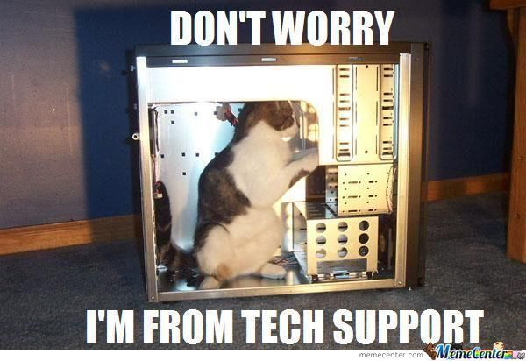
Fall Orientation
Be ready to adapt!
Notes:
We had to make a lot of last-minute adaptations, so staying flexible was key.

Slide 20

Fall Orientation
Past orientations:
Longer
All content for all students
Little coordination with managers ahead of time
Notes:
Previously, orientation was longer- about 10 hours of time and everyone was all together. A common complaint from some returners was that they were bored. Not all content was relevant for all students. Managers helped with orientation, but they often led a station “on the fly” without a lot of planning and coordination and important information was sometimes missed.

Slide 21

Fall Orientation
Online orientation:
Not ideal
Lacking in team-building
Useful tool
Notes:
In 2020, we pivoted to a completely online orientation, because circumstances dictated it. It wasn’t ideal and we really missed out on the team-building aspects of orientation especially. However, it was still useful and a good learning experience for supervisors. We now better understand some of the opportunities and limitations of online meetings, which are a good tool to have in the toolbox.

Slide 22

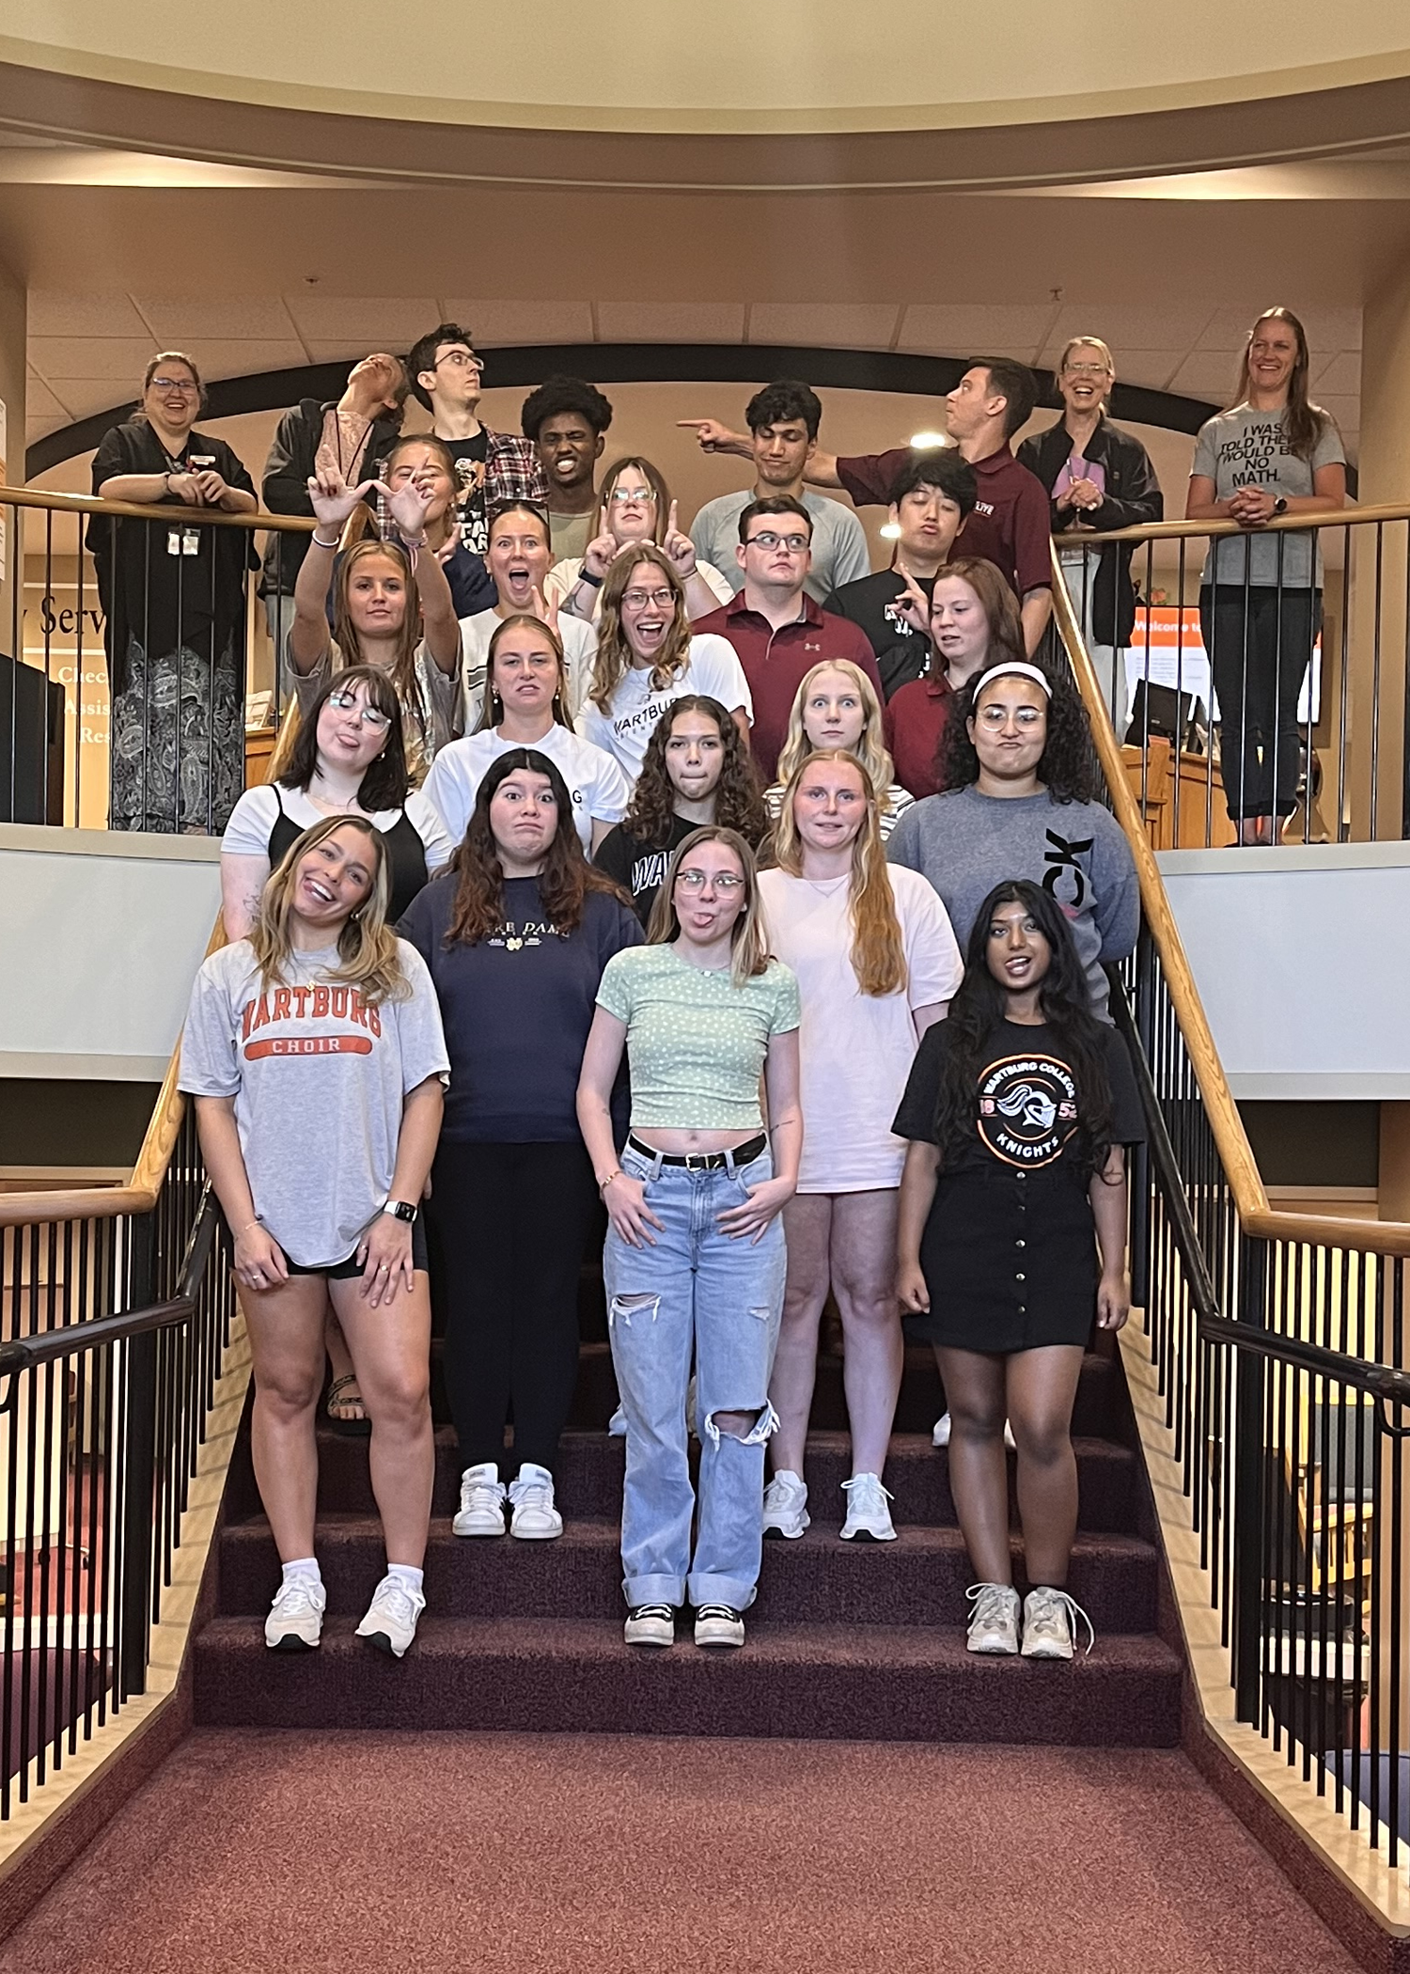
Fall Orientation
Future plans:
Maintain some face-to-face time
Keep evolving
Notes:
In the future we hope to maintain some face-to-face time with the whole team, and will keep evolving to make the best use of that time.

Slide 23
Mentoring
Notes:
Another important component of onboarding is mentoring. A few years ago we started having student managers serve as mentors to new team members.

Slide 24
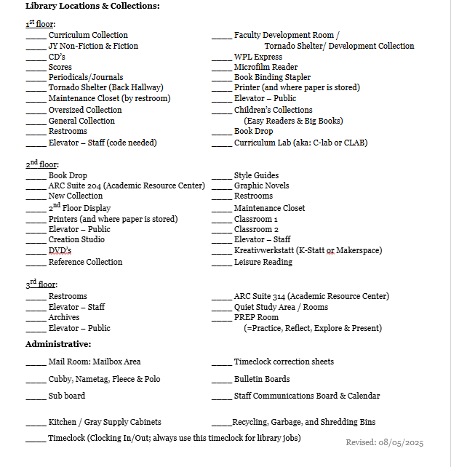
Mentors
First joint activity:
Tour of the library space
Notes:
One of the first activities a mentor does with their mentee (ideally before orientation begins) is a tour of the library space. This checklist helps guide them around the library on all 3 floors. The list may look a little overwhelming, but in practice, it makes for a slow and comfortable introduction to the library space with a peer.

Slide 25
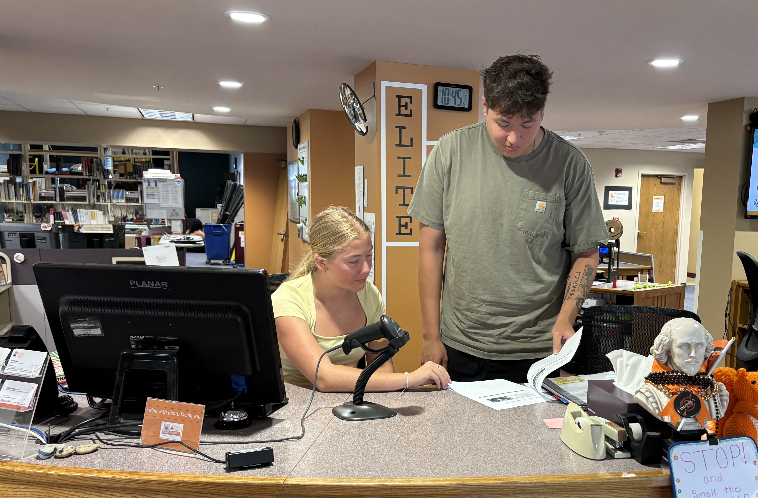
Mentors
Later activities:
Manager-led student meeting
3-part checklist
Notes:
This year managers led a meeting on the 2nd day of classes to do more team-building and to offer an opportunity for students to ask questions without supervisors being present. Onboarding continues on the job where new team members are scheduled to work with their mentors on at least one shift. Together they work through two more checklists, over a few weeks time. A 3-part checklist helps ensure students are exposed to locations of items, basic procedures, etc. which will be reinforced as the semester goes on.
Managers have always been encouraged to help new students and they certainly have, but in the past there wasn’t a lot of structure put in place. Mentors were not scheduled to work with their mentees, and at times, struggled to find common time to get together to work on checklists. We had one giant checklist which students just worked through (sometimes on their own) and at whatever pace they chose, which oftentimes was all at once.

Slide 26
Online Training
Notes:
A final component of onboarding is online training. We ask new team members to complete a free online training “Shelving with Dewey” from WebJunction before their first shift or on it. This helps them start with a baseline knowledge of how our collection is organized. There are a lot of great free trainings out there that we have taken advantage of, there’s no need to reinvent the wheel. This has been a part of onboarding for a long time, and likely will continue to be, though we’ll keep our eyes open for new resources. This wraps up onboarding, Julie will now continue with on-going training.

Slide 27
On-going Training
Notes:
Our onboarding process prepares our team members with many of the initial tasks they need to know. However, we have many additional tasks that our teams need to be familiar with. New tasks and procedures are also developed as our collections and services change. We also know that “refreshers” on common tasks can be helpful. These are some of the reasons that training needs to continue throughout the academic year.

Slide 28
On-going Training
Weekly Meetings
Interactive Training
Online Training Course
Notes:
So, we continue our training through weekly meetings with a focus on interactive, hands-on training. And last fall we began developing a training course in our campus' learning management system, Canvas.

Slide 29
Weekly Meetings

Slide 30
Weekly Meetings
Past
Present
Face-to-face time for team members
Opportunities for sharing
60 minutes every 2 weeks
Circulation and ELITE teams together
Face-to-face time for team members
Opportunities for sharing
30 minutes once a week
Everyone meets each week; either ACE (All Circ & ELITE) or team meetings
Notes:
There are two main reasons for having in-person meetings with our team members. First, face-to-face meetings help build relationships between team members who do not regularly see each other. Second, during the meetings we take time to share common questions heard at the desk and how to respond to them – an impromptu form of peer-to-peer training that leads to better customer service.
Our meetings used to be held with all team members every other week for an hour. Some of the training applied to one team, but not the other. This became more apparent after we evaluated and re-defined the ELITE team's responsibilities.
We also asked team members for their feedback about the meetings and ideas for improvements. Based on the feedback, and considering the importance of on-going training, we decided to move to a weekly, 30-minute format where some weeks we have separate circulation and ELITE team meetings so we can focus on team-specific sharing and training, and other weeks we have ACE (All Circulation and ELITE) meetings where we cover topics of interest for both teams.

Slide 31

Weekly Meetings
Best timing?
Notes:
Our biggest challenge with our weekly meetings is an increased number of attendance conflicts. We currently use one of the two, weekly community time hours embedded in our campus schedule. However, more organizations and faculty are taking advantage of community time to schedule advising meetings, weight training, music rehearsals, group meetings, and the list goes on. It isn’t an issue when someone occasionally misses a weekly meeting, but some conflicting events are scheduled every week so some team members miss meetings regularly.
We have batted around various options, such as meeting once a month at a time convenient to the majority of team members or holding the same meeting twice a week giving an additional time option; but both of these options would limit time for relationship building. [[My being the evening supervisor, I suggested a 9:30 PM meeting time; but that didn’t fly with Meredith or Renée.]]
We’ll continue to wrestle with this question, but a potential bright spot is that Wartburg is planning to move to a new schedule in the 2027-28 academic year which will include additional community times. In the interim . . .

Slide 32
Interactive Training
Notes:
. . . the training we provide at our weekly meetings takes us to our next topic – Interactive Training.

Slide 33
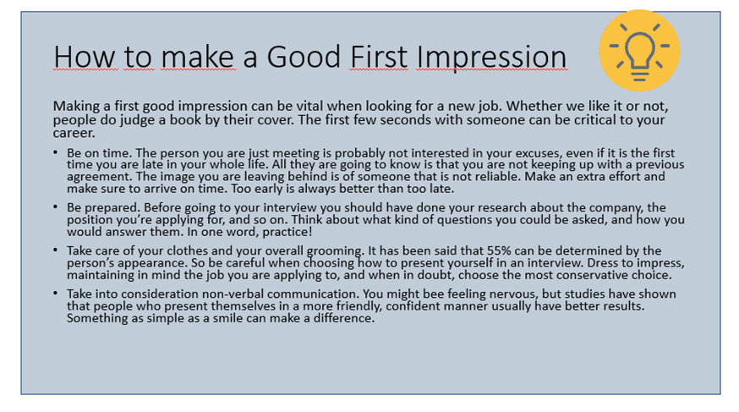
Interactive Training
Lectures!
Zzzzz…
Notes:
Much of our training at our weekly meetings used to be lecture-style, complete with Power Point slides like what you see here! Well, ok, not that bad. However, when using lectures to train our teams we weren’t always making a good connection, and the information wasn’t “sticking.” It’s also challenging to present an important, but common, topic to team members who have worked in the library for 2 or more years. Our challenge, then, is to keep our training fresh and engaging.

Slide 34
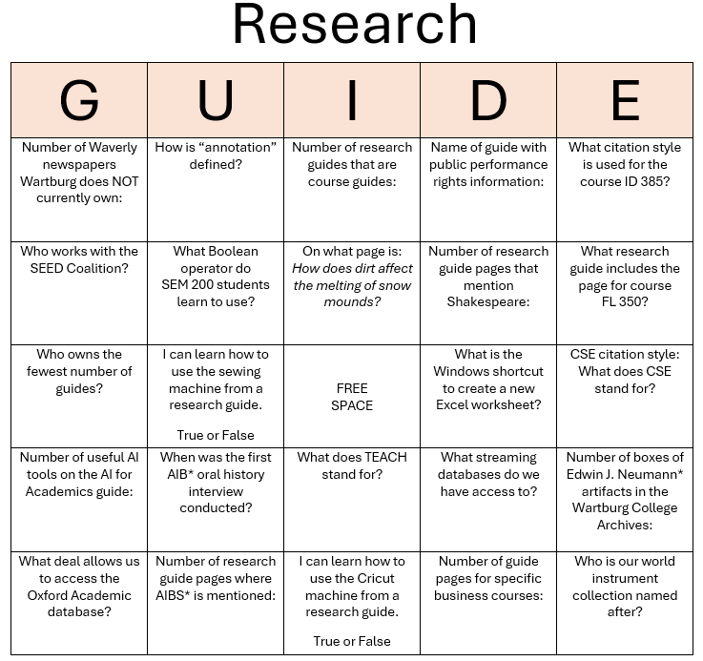
Interactive Training
Finding new ways to present “old” ideas:
Gamification
Notes:
Today – and into the future – we look for creative ways to provide training, especially on topics we need to cover on an annual basis. We haven’t thrown out the lectures completely, but we have put time and effort into making our face-to-face training more interactive. Gamification is one way of doing this and has included . . .
A matching game to help team members learn the difference between adapters, cables, input devices, power cords and data devices available for checkout.
One of our student managers created a relay activity to help their peers become familiar with items available in our makerspace.
Team members like scavenger hunts, and “Research Guide Bingo” was created with questions that can be answered with information in our LibGuides.
Many of these games are simple, yet effective.

Slide 35

Interactive Training
Finding new ways to present “old” ideas:
Gamification
Guest Speakers
Image by macrovector on Magnific
Notes:
And instead of always having to listen to one of us, we have invited guest speakers to come and share about their work. For example:
The head of security came to speak about how we can assist them in an emergency situation.
And the director of the Academic Resource Center, which is located in the library, spoke about the tutoring and academic support services they provide. This was very helpful because our teams often field questions from students about where ARC staff offices are located.

Slide 36

Interactive Training
Finding new ways to present “old” ideas:
Gamification
Guest Speakers
Team building
Our cartonera book, inspired by the Relindial Cartonera Project: https://www.ifla.org/g/relindial/the-relindial-cartonera-project/
Notes:
Team members have shared with us that they want to get to know each other better, so we devoted a few of our weekly meetings to team building. We started the term with some basic activities, like “This or That” and “4 Corners.”
Later in the year we took it up a notch and created a cartonera book. In a nutshell, we began with some training on how one has a dialogue with someone who has views differing from your own. We then asked everyone to create a book page that represents their personal values. Finally, in dialogue, everyone shared their page with two other peers.
Our goal is to continue to find new ways to present “old” ideas, to keep things interesting and engaging for our teams.

Slide 37
Online Training Course
Notes:
Speaking of new ways, our newest format for providing on-going training is development of an online training course.

Slide 38


Online Training Course
Notes:
Audio is of “Night crickets near the swamp” - https://mixkit.co/free-sound-effects/crickets/
We really don’t have a “past” to talk about [PAUSE to hear crickets] because we started to develop our course last August. We recognized that our time for onboarding and on-going training has been dwindling, so an additional method to try would be setting up an on-line course.

Slide 39
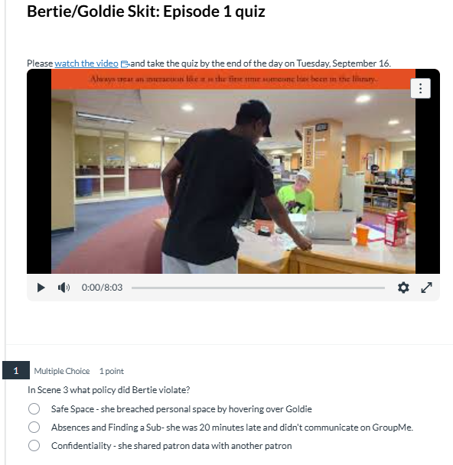
Online Training Course
Evolving as we speak:
Know how assignments will be scored
Have a schedule for assignments
Not all training fits this platform
Notes:
We have learned a lot this past year. A few key lessons are:
Know how assignments will be scored. When we set up our first quiz we did not assign point values to the questions. We were able to see who completed a quiz, but not how many questions were answered correctly because everyone had a score of zero. We now give a point value to each question to gauge team members’ understanding.
Providing assignments on a consistent basis is helpful. During fall term we were “sporadic” in how often we would post an assignment. As a result, not all assignments were completed in a timely manner. During winter term we made it a priority to provide a training assignment each week that opened after our weekly meeting. We also emphasized that we wanted team members to do the assignments during their shifts. This made a significant difference on the completion rate of the assignments.
Not all training fits this platform. Having guest speakers and team building, for example, do not work very well. And some topics, like policies and procedures, are best presented when there is time for questions and discussion. As we review each training topic, we consider if it is best delivered in person or can be added to the online course.

Slide 40

Online Training Course
Continue to build our repertoire
Explore additional tools & features
100% scores on quizzes
Incomplete assignments?
Image by brgfx on Magnific
Notes:
Despite a few “wrong notes”, our online training has gone very well. And in the future . . .
we plan to continue building our repertoire of resources to use in our online training.
we will be exploring other tools and features in the LMS system, such as grading tools to help us know which questions to keep, tweak or replace.
during May Term, while training new ELITE, we experimented with requiring team members to retake quizzes until they answered all questions correctly. This worked really well! The team members came to Renée to ask about the questions they missed, which increased their understanding of the material.
one area we still need to address is what to do when assignments are not completed on time or, occasionally, not at all. Do we send reminder(s)? Does the late or incomplete quiz become a disciplinary issue? That will be one of our topics of discussion this summer.
On-going training is important; in-person and on-line. As we continue to develop training materials we look at the needs of team members. That’s where good communication comes into play, so I’ll now turn it over to Renée to cover that topic.

Slide 41
Communication Methods
Notes:
Hello! In this section I'll talk about the communication methods we use in correlation with our trainings.
A robust communication system, including both synchronous and asynchronous methods, is needed to ensure all team members have the information and updates they need to fulfill their duties.

Slide 42
Communication Methods
Email
Video Calls
Canvas Discussions
One on One Meetings
A Circulation Wiki & Blog
Asana
Surveys
Notes:
Some of the communication methods we use are:
Email
Video Calls
Canvas Discussions
One on One Meetings
A Circulation Wiki & Blog
Asana
Surveys

Slide 43
Planning Discussions
Notes:
Before each academic year, we need to plan which trainings we will do and how.
As previously mentioned, our student managers are involved in planning orientation trainings and mentoring new team members each term.
Over the summer, we communicate with them via various methods.

Slide 44
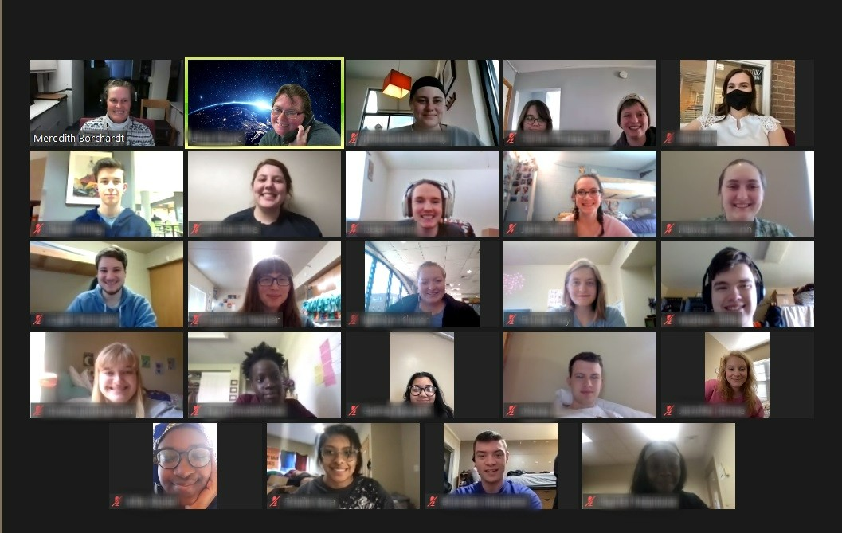
Methods
Email
Canvas Discussions
Video Calls
Notes:
The first method we use to connect with our student managers in the summer is email. We use email to set up a video call and to enroll them in Canvas for the following term.
We then assign discussions in Canvas to begin thinking about trainings and mentoring activities.
Our final planning meeting takes place in August, over a video call. This allows us to consider their Canvas discussions and present an orientation plan to the student manager team. They can give us feedback and select which portions of orientation they'd like to lead.
We also use this time to give any advice we have about presenting the information.
Student managers are highly experienced team members, so they are very familiar with the procedures and topics, but it can be helpful for them to know how each training is informed by and then informs other trainings in the sequence.

Slide 45
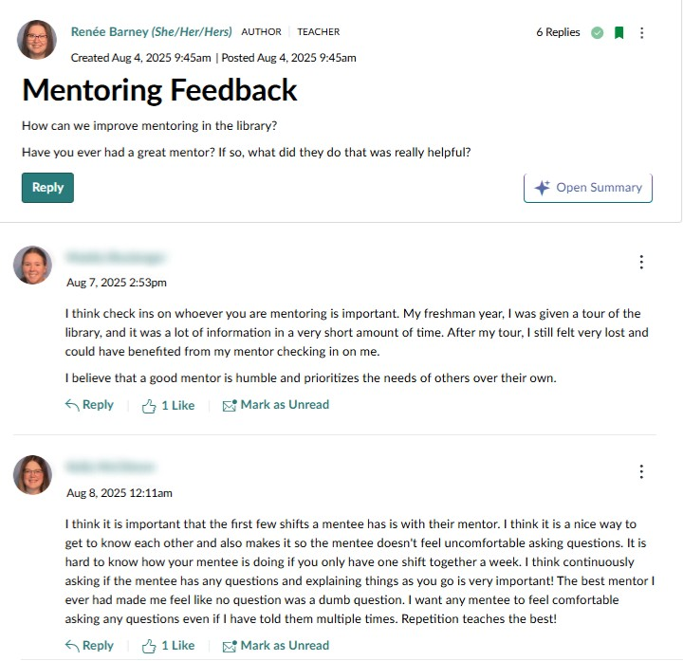
Exploring New Methods
New in summer 2025
Some hiccups, but a decent first run
Needs review
Notes:
Looking ahead, we've gathered feedback from student managers about the effectiveness of Canvas discussions and video calls. (Just last week, actually!)
They had some suggestions:
They would prefer the video call happens first, followed by the discussions.
They would prefer the discussions are released in Canvas one by one. Previously, we have just opened them up (4 or 5 of them) all at once.
We'll certainly take this information into consideration as we plan for the upcoming academic year.

Slide 46
One-on-One Meetings
Notes:
In 2023, we were inspired by the Iowa GROW program at the University of Iowa ("Guided Reflection on Work") to
begin doing one-on-one meetings with all team members.
Previously we only met with new team members for a check-in.

Slide 47

Intentional Reflection
Intentional reflection and conversation
Time to assess training
Relationship building
We were inspired by the Iowa GROW program at the University of Iowa.
https://studentlife.uiowa.edu/initiatives/iowa-grow
Notes:
In these meetings, we ask questions midway through each term to encourage feedback on our training, so we can continually improve. These meetings last about 15-30 minutes.
These conversations also help build our relationships with our team members.

Slide 48
Back to the Basics
Where we are:
Continued to add new questions each term and didn't remove old questions
Has become more like an interview and less like a reflective conversation
Where we want to be:
Will return to 2-3 questions only
Find balance between
  Minimizing the number of questions
  Asking the right questions
  Keeping it fresh
Notes:
Each term, we like to add new questions relevant to the current team and happenings around the library and campus. While doing this, we weren't always great about removing the previous questions. It's hard to let go!
But, it became more like an interview and less like a conversation.
So, we plan on returning to only asking 2-3 questions and allowing the conversations to be organic.
The trick is to find the balance between asking only a few questions, asking the right questions, and avoiding repetition each term for students who have "been there, done that" multiple terms.

Slide 49
Circulation Wiki & Blog
Notes:
Our LibGuide based Circulation Wiki and Blog are internal hubs of information for our team members to utilize while doing their jobs and doing trainings.
It's important to note that these tools, while online, are set to private. Only library staff and student team members have access. There is confidential information shared through these tools.
Each term we change the passwords for LibApps in order to keep this data secure.

Slide 50
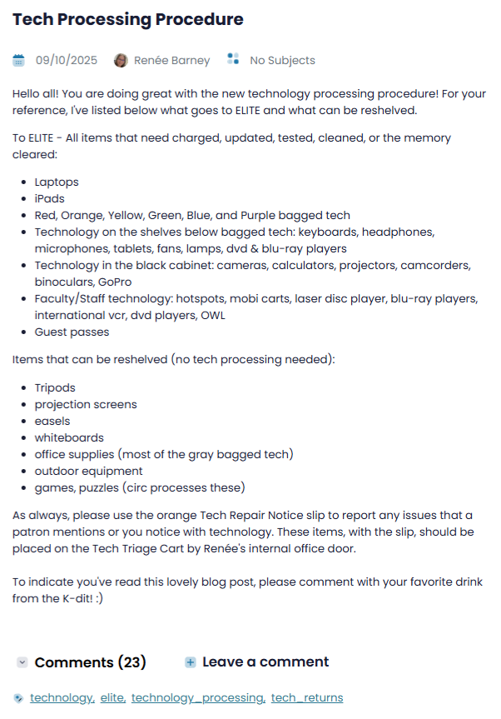
Blog
Notes:
The blog is used for posting longer explanations of procedures or special topics.
An example is the one shown here - a new procedure for technology processing, including detailed instructions of what goes where. This was a follow-up to in-person training during orientation.
You'll also notice that we added an action item at the end of the blog to encourage commenting, which informed us that they read the blog.

Slide 51
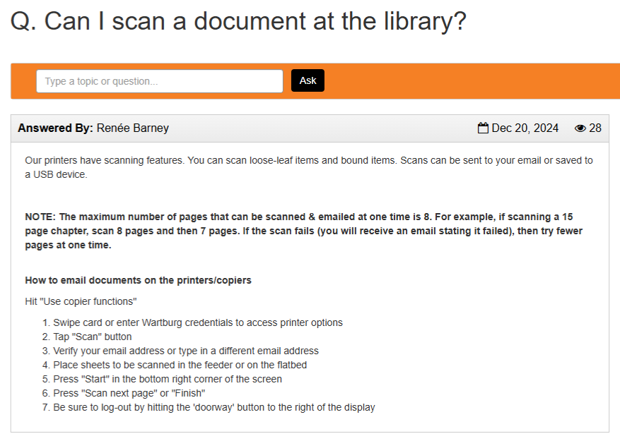
Helpful Resources
Links to helpful resources
Feature a FAQ of the Week
Encourage reading of knowledge bases on shifts
Notes:
We also link to helpful resources on the wiki, such as our knowledge bases, and feature a different FAQ article each week, like the one shown here.
We encourage team members to read the knowledge bases during their shifts, so they are aware of what information is there.

Slide 52
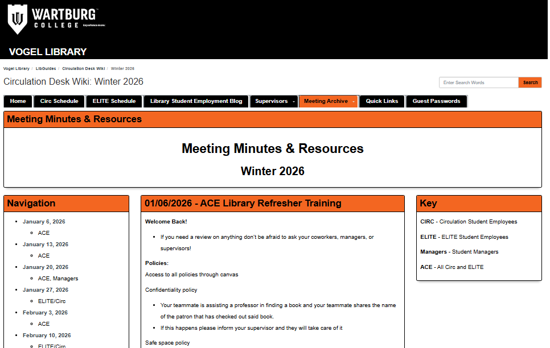
Training Resources
Notes from in-person trainings
Links to resources (in Canvas)
Notes:
Finally, meeting minutes and resources shared in the meetings are also posted on the Wiki.
This allows team members to revisit trainings we did in-person to refresh their memory, and it also allows those who missed a meeting to get caught up.

Slide 53
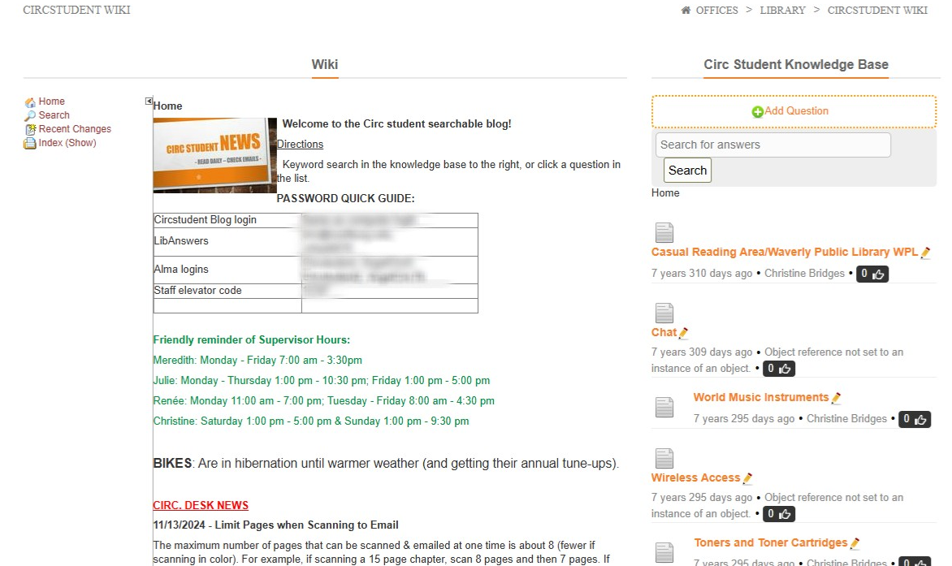
Old Campus Intranet Wiki
Notes:
Our old Wiki was on the old campus intranet and consisted of a scrolling list of announcements and a knowledge base.
It was clunky, difficult to update, and not easily searchable.
We also had no way to efficiently share in-person meeting resources. We printed our meeting notes and posted them on bulletin boards, but it wasn't terribly effective.
So, we moved to our current Wiki, which was created in LibGuides (open wiki)

Slide 54
Asana
Notes:
Asana is a project management tool and it is exclusively used by the ELITE Team, since they are a project-based, educational team.
The team completes both individual and group projects, so it's important to have a central location to keep each other updated on the status of projects.
We started using Asana for projects, but quickly realized it would be a useful tool to communicate about 3D printing orders and open tech issues and tickets.
The team likes it so much, they just requested a fourth zone in Asana – a place to post ideas for future research projects, workshops, and displays.

Slide 55
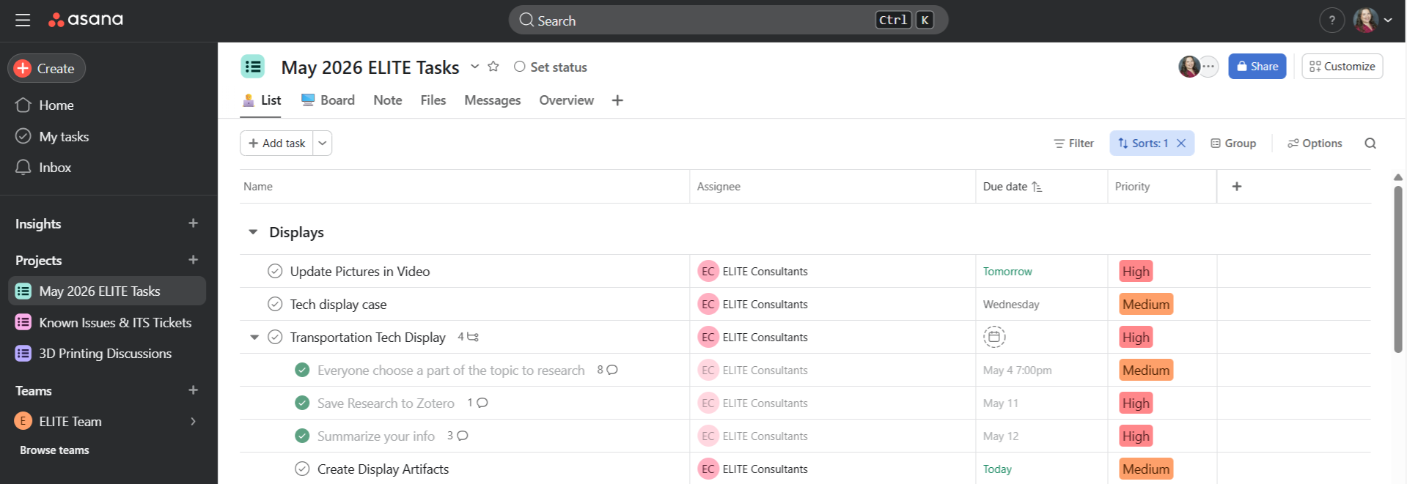
Asana
Used for:
  Project management
  3D printing updates
  Current tech issues/tickets
Free version – limited features
Learning curve
Notes:
In addition to assigning projects, as you see in the screenshot, I can leave feedback on the progress of projects.
ELITE projects aren't just work. They are meant to allow team members to learn something new as they create educational tools for our patrons.
For instance, in May Term, I assigned a project where the eight ELITE each selected a different subtopic relating to technology used in transportation. Because summer...people travel. :)
I had 5 new ELITE that were training during May Term, so it provided a way for them to see how group projects worked and how I liked to have things presented and communicated.
In addition to being a good communication and training tool for projects, Asana also requires some training.
There is a bit of a learning curve and since we use the free version, I had to get creative with how I set it up.
So, be sure to have extensive training documentation and to cover it heavily in a training session, if you decide to use it.

Slide 56
Previous Attempts
Summaries of work done to Technology Librarian every shift
Team Word doc to post updates on projects
LibAnswers form
GroupMe groups
Whiteboard at ELITE desk
Notes:
Some previous, unsuccessful attempts at communicating about projects were:
Summaries of work done to Technology Librarian every shift
Team Word doc to post updates on projects
LibAnswers form
GroupMe groups
Whiteboard at ELITE desk
Just know, it might take time to find the best way to approach a task or training.

Slide 57
Always Improving
Continue to navigate limitations in the free version of Asana
Continue to organize the SharePoint library
Notes:
Going forward,
We seem to have figured out the best way to organize Asana, but I'll continue to look into the limitations of the free version and how we can navigate those.
My team has grown from 5 to 9, so that pushed us right up against the limit of team members, for instance.
We also need to do more work to better organize our corresponding SharePoint library. (obviously, we're librarians!)
Having organized files leads to better communication and understanding.

Slide 58
Surveys
Notes:
Finally, adjacent to training is a LibWizard survey I give to ELITE team members to collect their current skill sets.
Since the ELITE team is an education-based team, it is helpful to patrons and team members to know which team members have which skills.
I encourage ELITE students to learn new skills on-the-job.
For instance, in May Term this year, I had one team member learning Python, another learning REST API, and another researching Quantum Computing (for a future R.I.C.E. Day presentation).

Slide 59
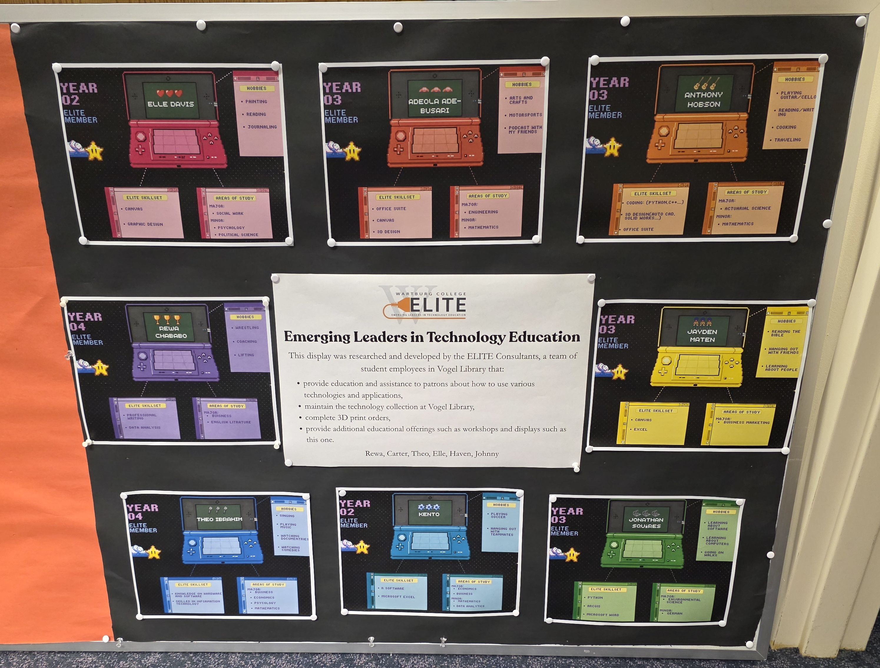
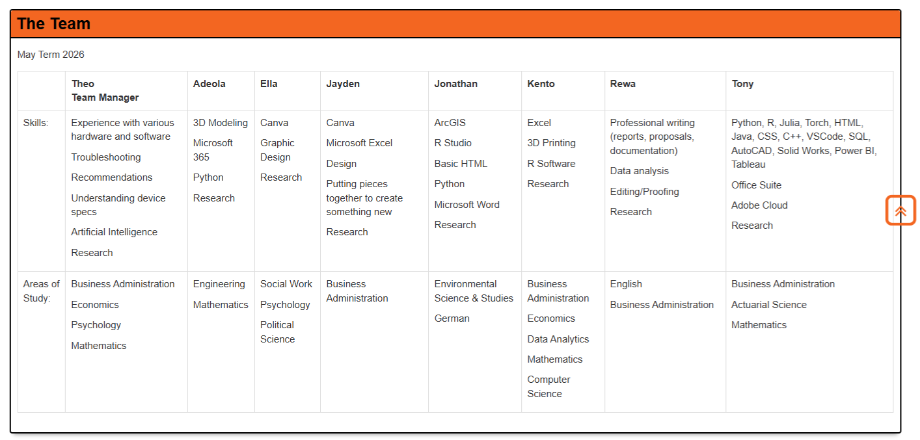
ELITE Profile Survey
Notes:
The skills gathered through this survey are posted on the ELITE display board in front of their workstation and on the ELITE webpage.
This survey is administered every term, so ELITE team members can update their list of skills as they learn new ones.

Slide 60





Encourage Learning
Notes:
In the past, I've tried using a badging system to encourage and reward ELITE for learning skills.
This was very time consuming for me and my former team didn't seem to be very concerned with them. So, I didn't do them this past year.
So of course, my current team asked where the badges went, so I'll be looking into other ways I can do this more efficiently in the future.

Slide 61
Lessons Learned
&
Time to Share
Notes:
Now, we are going to move into hearing about your experiences and answering some questions.
But first...our lessons learned.

Slide 62
Lessons Learned
Stay flexible
Keep trying new things
Peer-to-peer learning works well
Virtual/electronic isn't best for everything
Don't be afraid to alter existing ideas
Do lots of team building!
Communication is KEY
Notes:
Stay flexible
Keep trying new things
Peer-to-peer learning works well
Virtual/electronic isn't best for everything
Don't be afraid to alter existing ideas
Do lots of team building! A strong team is essential.
Communication is KEY!

Slide 63
Time to Share
What questions do you have?
What are your challenges or successes?
What ideas do you have?
Notes:
Now it's your turn!
What questions do you have?
What are your challenges or successes?
What ideas do you have?

Slide 64
Our Contact Info
Renée Barney: Renee.Barney@Wartburg.edu
Information Literacy & Technology Librarian
Meredith Borchardt: Meredith.Borchardt@Wartburg.edu
Student Employment & Circulation Services Supervisor
Julie Fedeler: Julie.Fedeler@Wartburg.edu
Interlibrary Loan & Evening Supervisor

Slide 65
Thank You

