Slide 1
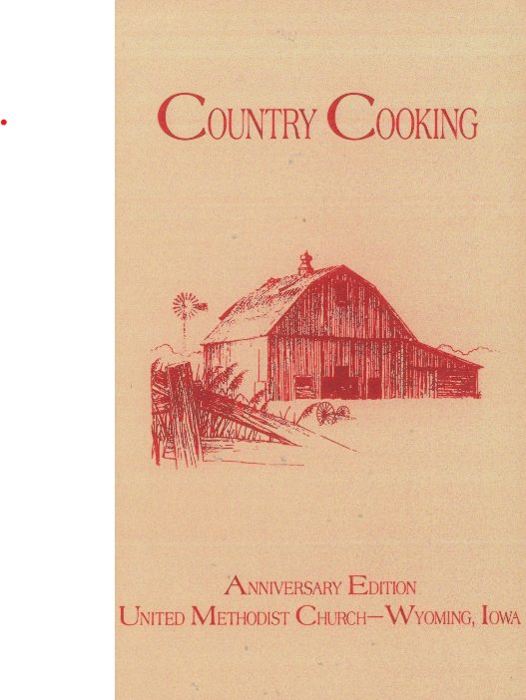
Digital Humanities with a Side of Jello:
The
Computers Reading Cookbooks
Hackathon
Kris Stacy-Bates
Iowa State University Library

Slide 2
Start with a corpus – a body of text
Campus publications
Oral histories
Institutional repository
Iowa Publications Online
Library of Congress
Project Gutenberg
Many others

Slide 3
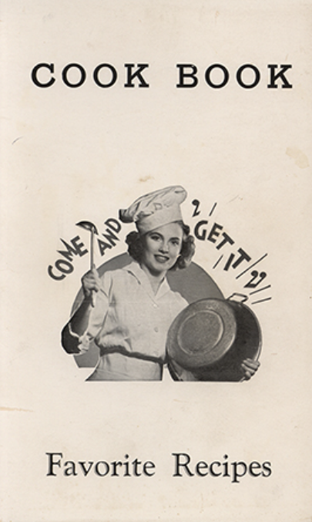
The Iowa Cookbook Collection
Community cookbooks from around Iowa
First acquired for ISU in 1992 by Diana Shonrock
Publication dates from 1884 to the 2000s
201 cookbooks digitized by ISU Digital Collections
Converted to text format with OCR

Slide 4
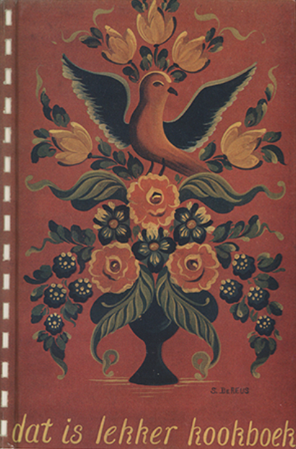
Computers Reading Cookbooks Hackathon
Organized by Digital Scholarship Librarian Erin Ridnour
January 26 – 30, 2026
Started with 2 ½ hour training session covering key tools
Participants experimented and shared results
Celebratory potluck

Slide 5

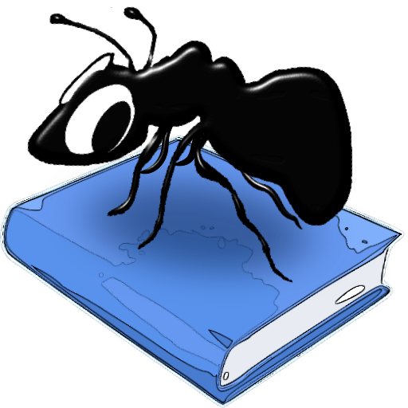
Our Text Analysis Tools
  Voyant Tools
  AntConc
  Excel for data tables,
  Python Notebook for power coding,
  ArcGIS for mapping

Slide 6
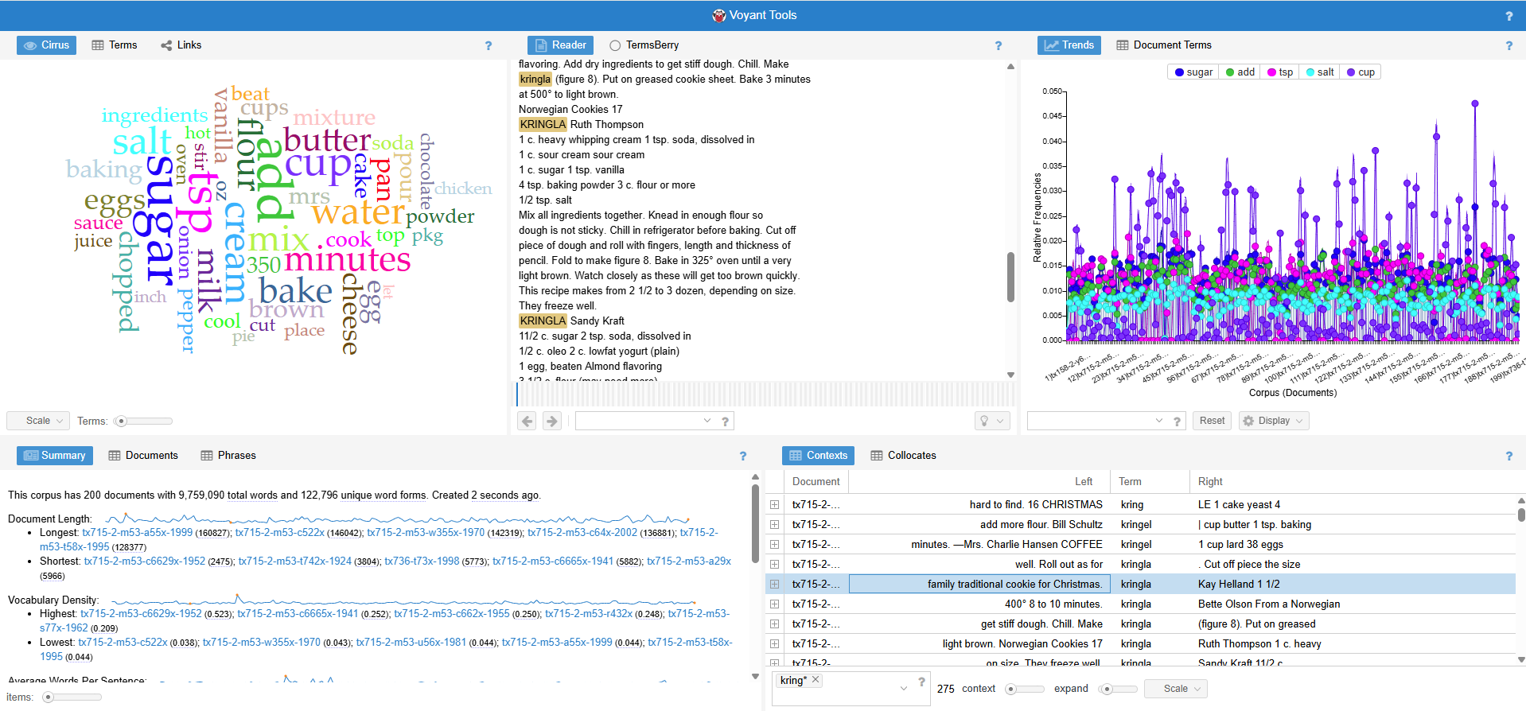
Voyant Tools

Slide 7
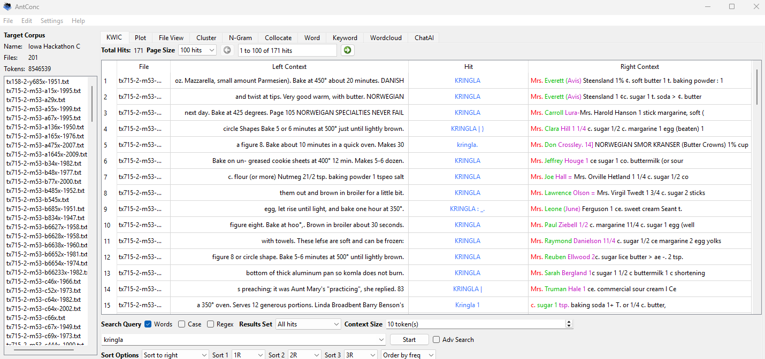
AntConc

Slide 8
Process
Use Voyant Tools or AntConc to locate terms of interest
Download occurrences data to spreadsheet
Review results for false hits
  Human-checked for smaller sets of results
  Excel, Google Sheets, or Python for larger sets
Tally results
Create data visualizations

Slide 9
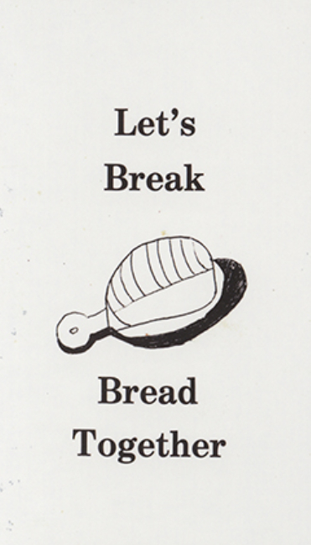
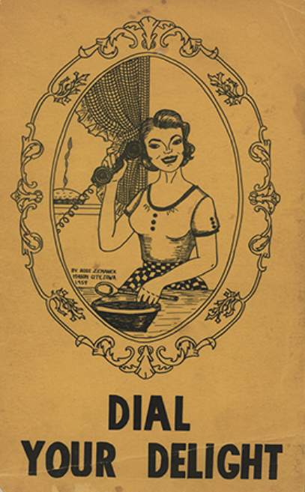
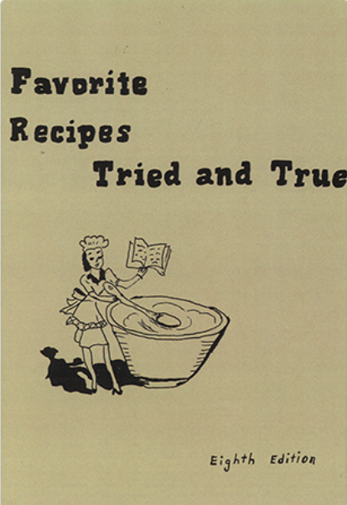
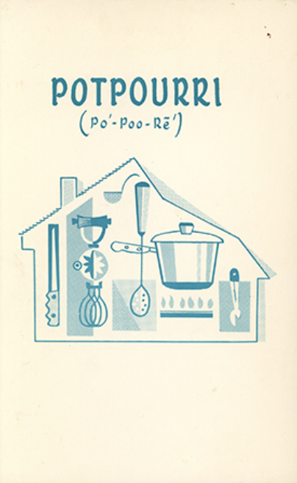
Challenges
Ads were scanned along with recipes
OCR had some errors, text not human-edited
Multiple meanings of words
  Ex. Grease
Multiple words for same meaning
  Ex. Jell-O or Jello or Knox or gelatin
Initial metadata lacked location coordinates
Single cookbooks could skew results

Slide 10
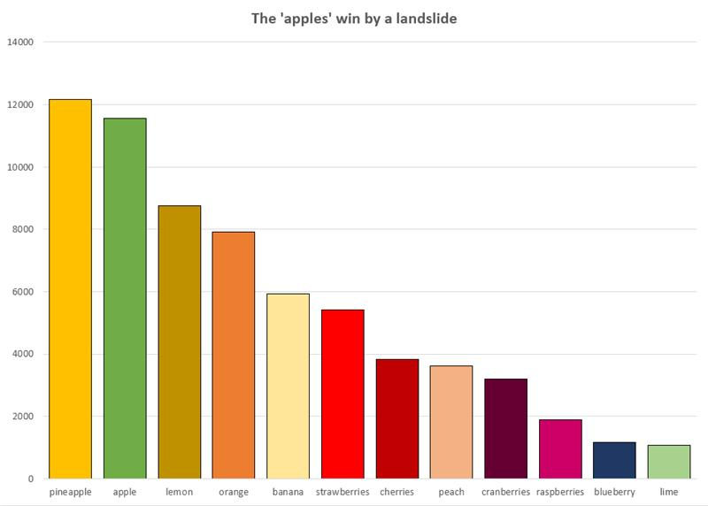
The ‘apples’ win by a landslide
Most frequently mentioned fruits

Slide 11
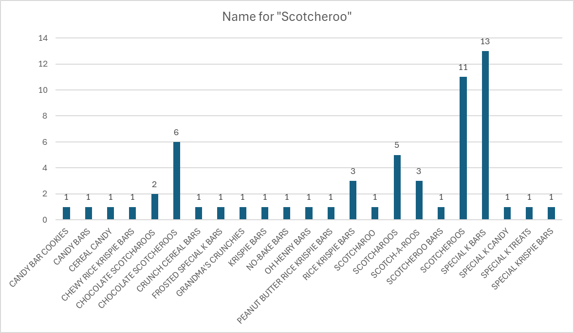
Names for “Scotcheroo”

Slide 12
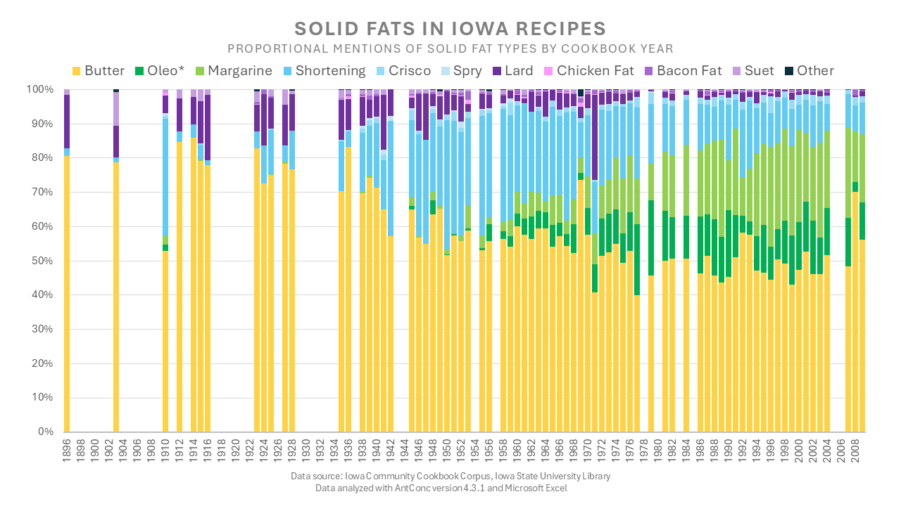

Slide 13
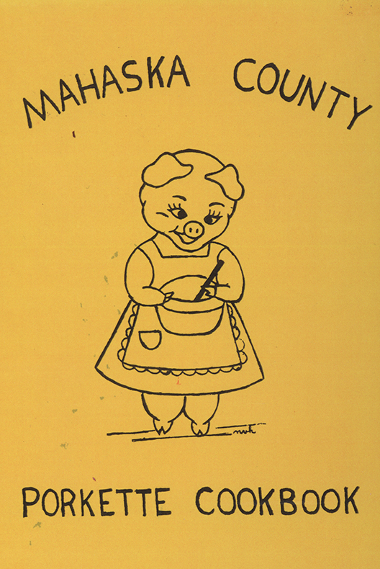

Slide 14
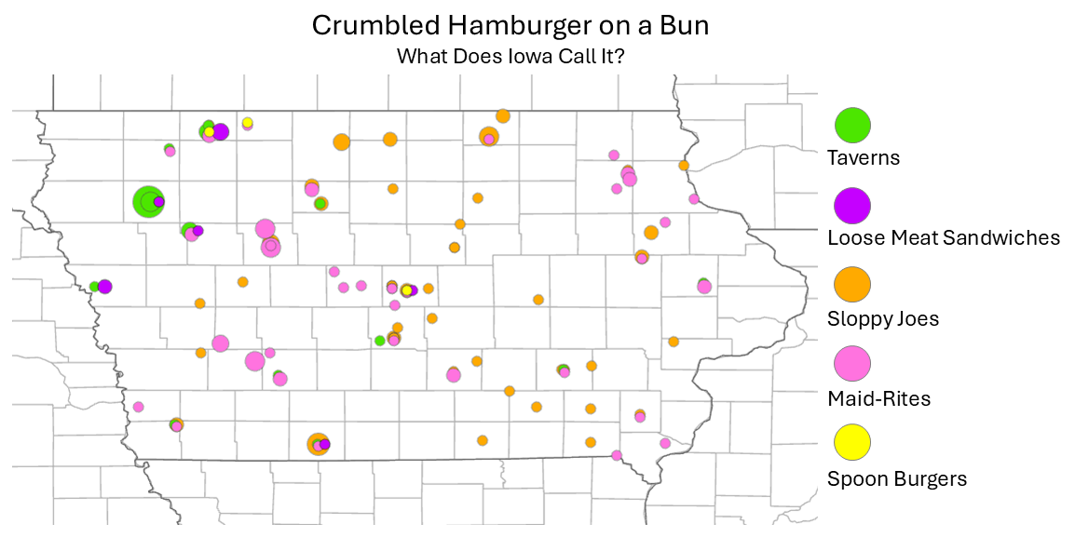

Slide 15
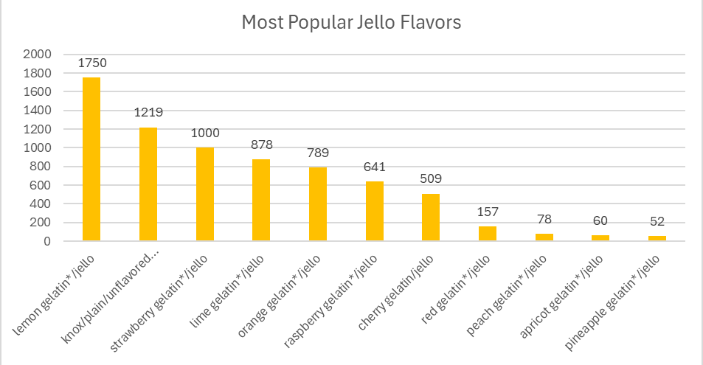
Notes:
Lesser-known gelatin flavors – celery and mixed vegetable!

Slide 16
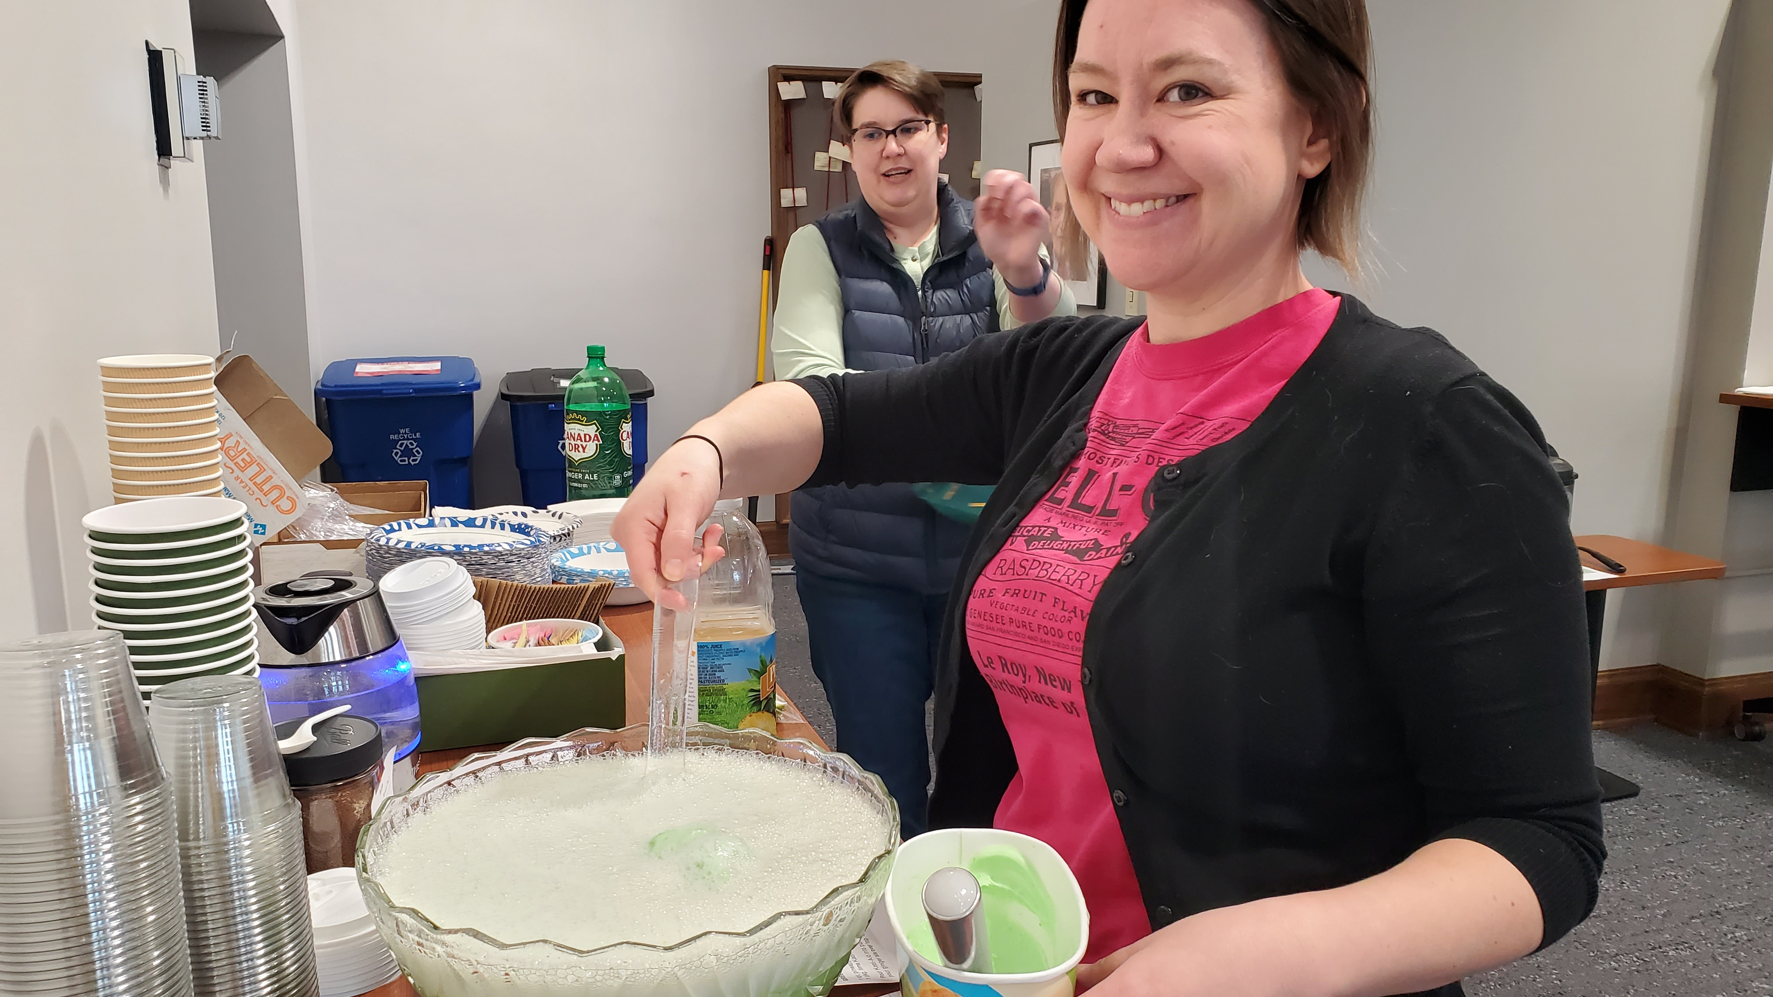
Computers Reading Cookbooks - Outcomes
Staff development and networking
Charts and graphics to promote collections
Improved training materials for digital humanities workshops
Delicious potluck food!

