Slide 1

SAY YES WHEN IT’S RIGHT, AND NO WHEN IT’S WRONG:
MAKING CAREER MOVES AS A FEMALE LEADER
ACSA Women in School Leadership Symposium
Friday, September 25, 2026
9:30 - 10:45 am
Hillery Dixon & Jennifer Handy

Slide 2
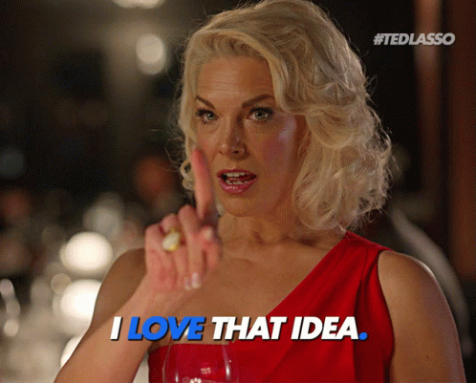
Strong women stand up for themselves. And stronger women stand up for others.

Slide 3

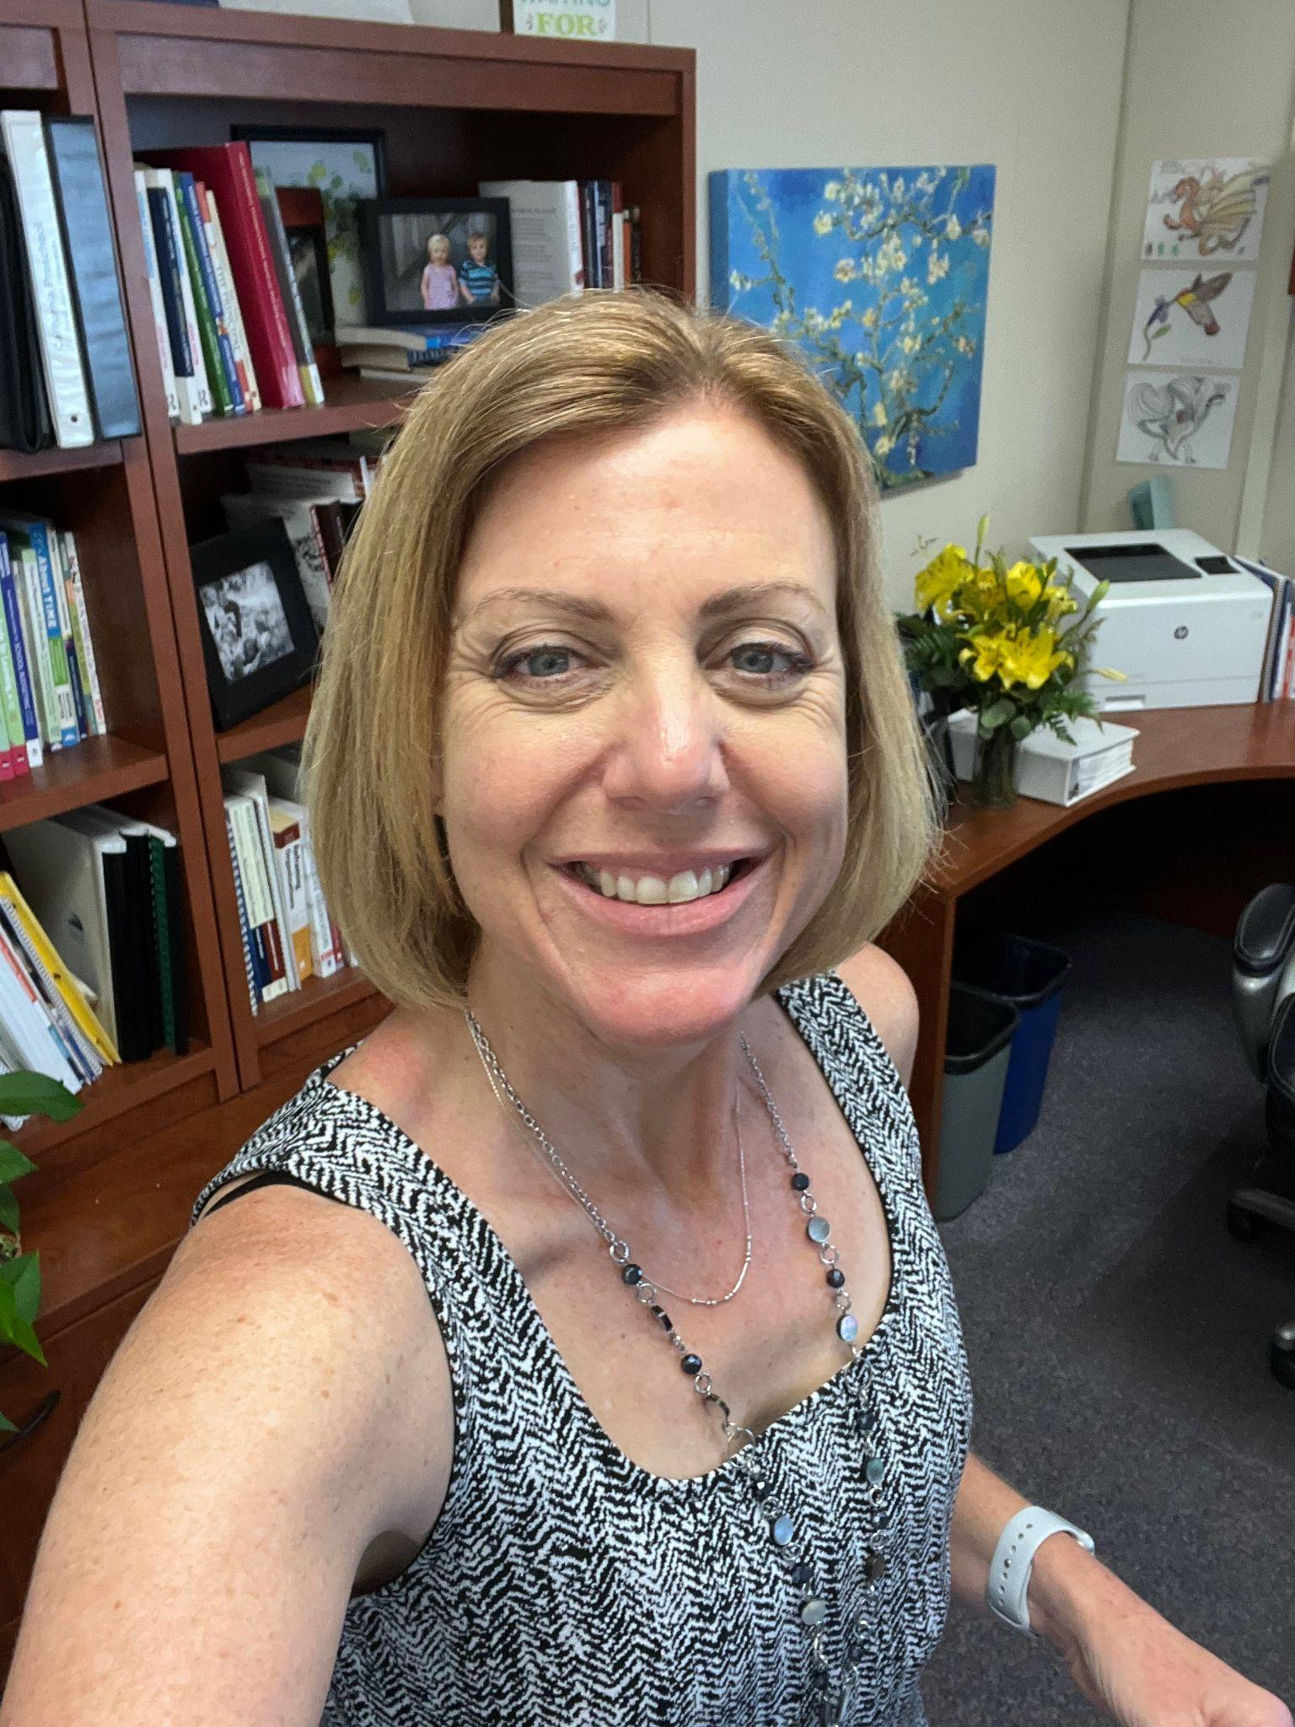
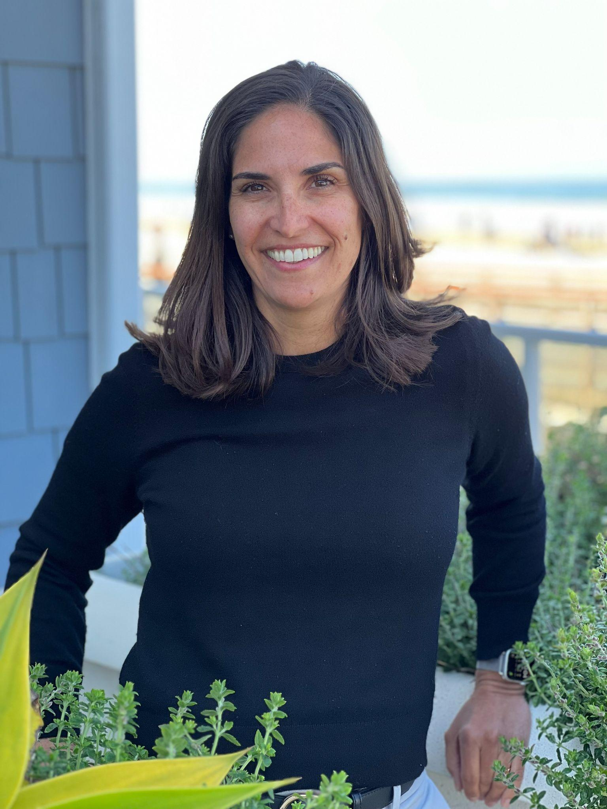
MEET
HILLERY AND JENN
Contact us!
hillery.dixon@lmusd.org
jennifer.handy@lmusd.org
HILLERY DIXON
JENN HANDY
Assistant Superintendent, Curriculum & Instruction
Assistant Superintendent, Human Resources
High school English teacher
Site/District TOSA
Coordinator of Assessment
Secondary Curriculum Director
Elementary Principal (K-6)
Assistant Superintendent
High school English teacher
Counselor
Assistant Principal (7-8)
Elementary Principal (Pre-8)
Director of Special Programs
Director of Special Education
Assistant Superintendent
Notes:
Professional journey to date

Slide 4
UNSTOPPABLE INFLUENCE:
Power, Voice, & Visibility
How do you feel about your Leadership Voice right now?
1
I am finding my voice.
Stand up, and find your people!
2
I am building my confidence.
3
I am ready for my next opportunity.
4
I am looking to expand my influence.
5
I want to help others rise.
Notes:
Talking Points
Welcome participants and acknowledge the unique journey of women in educational leadership.
Emphasize that influence is not positional—it is relational.
State that every participant already has the capacity to lead powerfully.
Interactive Component - who’s in the room
Digital 1-5 vote
respond in chat using one word that describes how they want to feel as a leader.

Slide 5
KNOW WHAT YOU
BRING TO THE TABLE
Identify three strengths you consistently bring to your work by asking yourself:
1
2
3
CONSISTENT HELP
What do people consistently seek your help with?
PEAK EFFECTIVENESS
When do you feel most effective?
RESILIENCE
What challenges do you navigate particularly well?
Confidence grows when leaders understand and articulate their value.
Notes:
Mentally prepare - how would H/J respond to this? Is there a way to share our strength through story.
Frame “Making Career MOves as a Female Leader” what we bring through experience
Hill - from within district
As rising leader - decided to lead when voluntold to write WASC
C&I is something I’m passionate about
Build people’s confidence in my ability (teacher to admin)
NOW - everything C&I
Jenn - from out of district
As a new-to-the district leader - had to lean on what worked previously
Confidence and work ethic
Assuredness →consistent help
Effecitveness - others feel confident
Prompts:
What do people consistently seek your help with?
When do you feel most effective?
What challenges do you navigate particularly well?
Pair Share / Chat Prompt
"Which of your strengths has had the greatest impact on others?"
Facilitator Connection
Link strengths to executive presence: confidence grows when leaders understand and articulate their value.

Slide 6
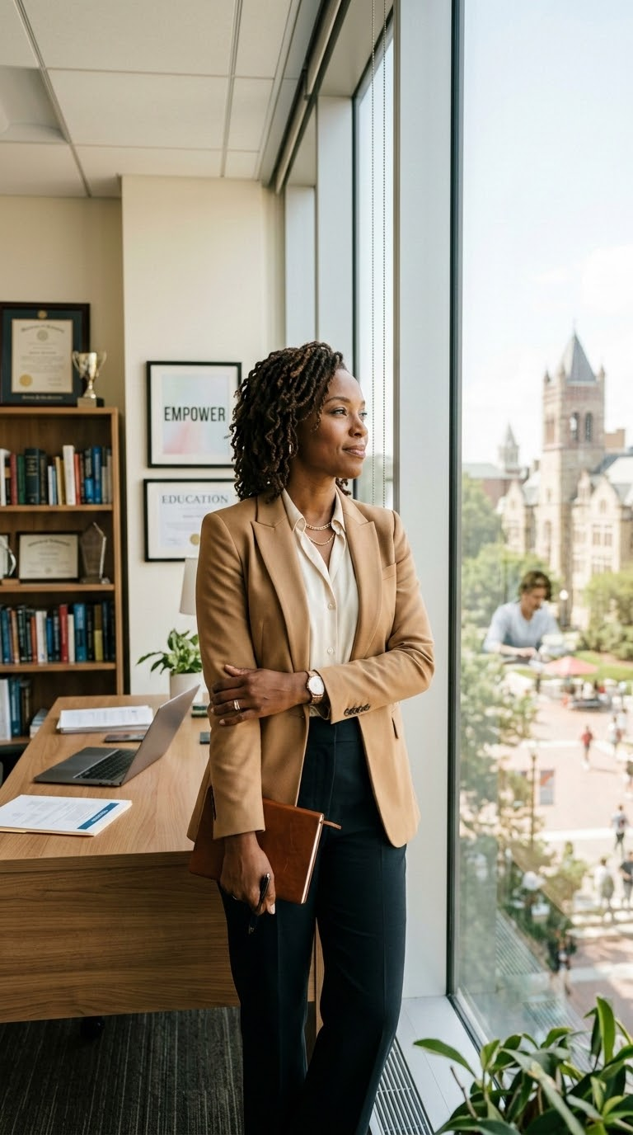
If There Isn't a Seat,
Bring Your Own Chair
Leadership opportunities do not always arrive as formal invitations. Women leaders often need to create visibility and position themselves strategically.
Overcome common barriers by reframing limiting thoughts:
Instead of: "I'm not ready yet"
Think: "I am ready to learn in the role."
Instead of: "No one asked me"
Think: "I can express interest directly."
Instead of: "I don’t know the right people"
Think: "Relationships can be built intentionally"
Notes:
Hillery Reflection Guidance
What level in the organization that you’re looking into
Who’s sitting at the table already?...is there space for you?
Is the door open
Hill’s Tiers
Female super; 2 male asst. Supers → then illness adn the only woman in the room
Analaysis of what’s next, always space, but if ther’es not a chair…
Move to slide 7
Bringing your own chair means claiming your expertise, making your aspirations known, and stepping into influence with confidence.
Common Barriers Women Leaders Experience
Waiting until they feel 100% ready.
Assuming strong work will speak for itself.
Underestimating the value of their perspective.
Hesitating to self-advocate.
Navigating spaces where representation is limited.
Instead of I don't’ want to seem ambitious, THINK ambition in service of students is leadership.
Instead of there isn’t room for me, THINK my perspective adds value to the conversation.

Slide 7
BRING
Believe in Your Value: Know the strengths and results that make your perspective essential.
B
Raise Your Hand: Volunteer for stretch assignments and visible leadership opportunities.
R
FRAMEWORK
for Self-Advocacy
Use these core principles to articulate your value, build key relationships, and advance your professional journey.
Inform Decision-Makers: Share your aspirations with supervisors and mentors.
I
Network with Intention: Build authentic relationships across professional organizations.
N
Generate Evidence: Document impact and measurable outcomes.
G
Notes:
Mini-Workshop Activity: Bring Your Own Chair Map
The table I want to sit at is ______________________________.
The value I bring is ____________________________________.
The barrier I need to overcome is ________________________.
The person who can help me is __________________________.
My next courageous step is ____________________________.

Slide 8
PRACTICAL SCRIPTS FOR SELF-ADVOCACY
Expressing Interest
"I am interested in contributing in this area and would welcome the opportunity to take on a larger role."
Requesting a
Stretch Opportunity
"I'd like to grow in this area. Are there projects where I could lead or support the work?"
Seeking Sponsorship
"I value your perspective and would appreciate your advice on positioning myself for future leadership opportunities."
8
Notes:
Discussion Prompt
What opportunity have you been waiting to be invited to pursue?
Key Takeaway
Do not wait for perfect conditions or formal permission. Influence grows when you step forward and create space for your voice.

Slide 9
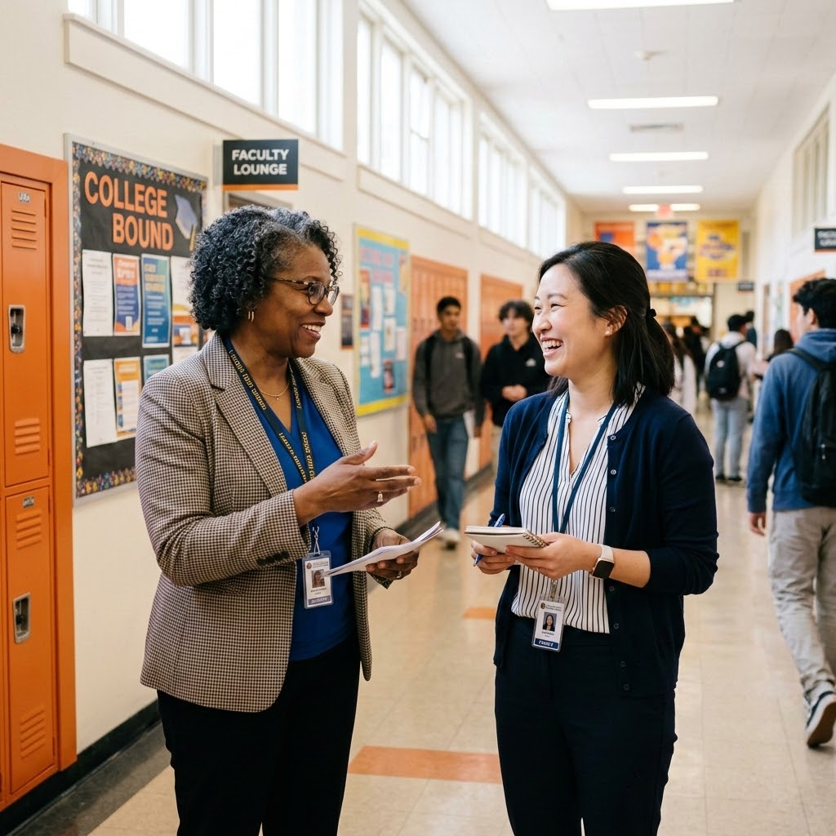
Leadership Is Powerful,
But It Shouldn't Be Lonely
Mentor
Sponsor
Offers advice and perspective.
Helps you grow.
Supports reflection.
Advocates for you in decision-making spaces.
Helps you advance.
Opens doors.
💡 Seek out trusted female leaders who offer honest feedback, confidentiality, and strategic insight.
Notes:
H & J Relevant Journey
Our first meeting→ crazy jobs → COVID
Superintendent transition
9 years of working together → relationships evolve
Some are left behind: reestablishing self in a similar role (or new) with new poeple
Some are deeper long lasting: restablishing self in different role in same diatrixt
HD was supervisor
Depth of confidential trust; at super
Confidentiality can limit the “buddy” system
Reflection Prompts
Who has championed your growth?
What qualities do you value in a trusted female leader?
Where do you need more support right now?
Characteristics Participants Often Seek
Honest and direct feedback
Confidentiality
Encouragement
Strategic insight
Willingness to advocate
Values alignment
Networking Prompt
"What is one quality you bring as a mentor or sponsor to others?"

Slide 10

Tell Your Story
Before Others
Tell It for You
Women often underestimate their accomplishments or wait to be recognized.
Executive presence includes the ability to clearly communicate your results, values, and aspirations.
You must define how you want to be known and articulate your value in professional conversations.
Notes:
Jenn - coming to your confident space not just in prep, in action, but also in preparation
Interview strategy - be the last voice in the room
Framework: Present–Past–Future Narrative
Present: What are you doing now?
Past: What experiences prepared you?
Future: What impact do you want to make?
Interview Prompt Practice
"Tell us about yourself and why you're interested in this role."
Participant Activity
Draft a 60-second response highlighting:
One key strength
One measurable accomplishment
One leadership aspiration
Optional Practice Questions
What leadership challenge are you most proud of navigating?
How do you build trust with diverse stakeholders?
What unique perspective would you bring to this role?

Slide 11
PLAN YOUR NEXT BOLD MOVE!
1
My greatest leadership strength is...
2
The story I want to tell about my leadership is...
3
One opportunity I will pursue is...
4
The person I need in my corner is someone who...
5
This week, I will...
Notes:
Invite participants to exchange contact information with a peer to check in within 30 days.

Slide 12
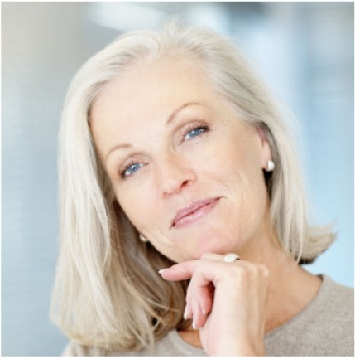
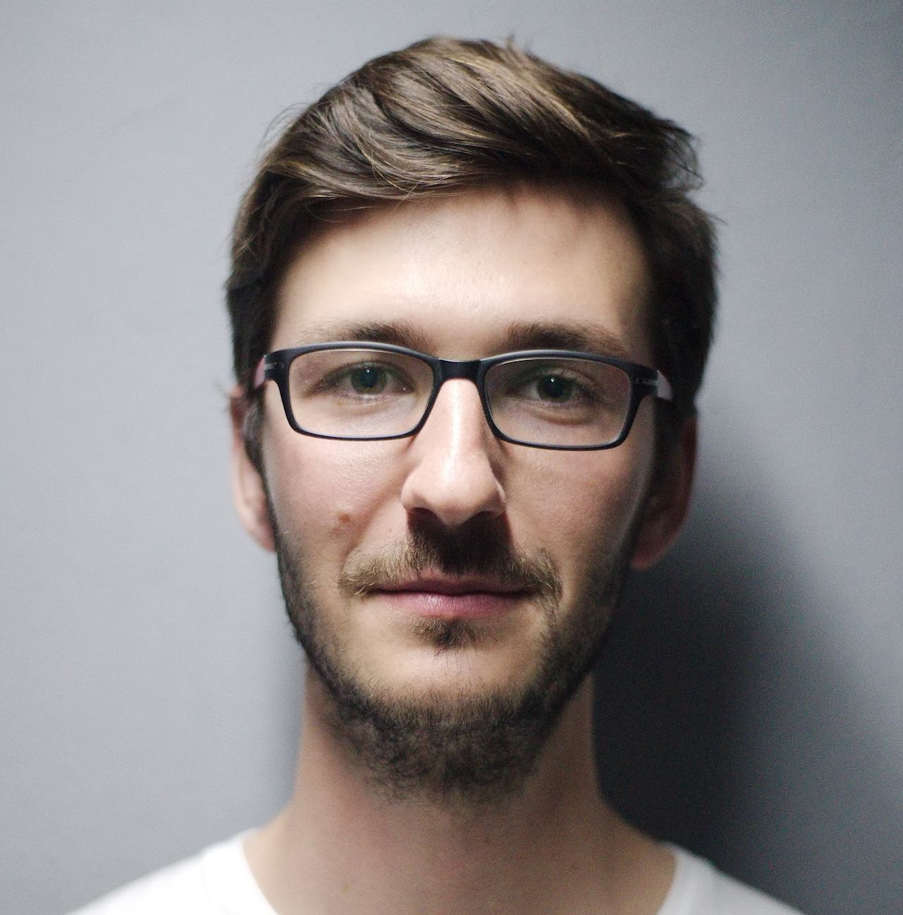
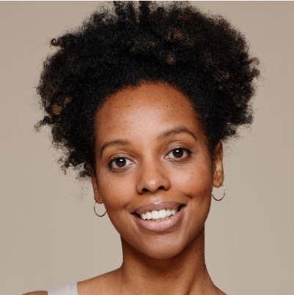
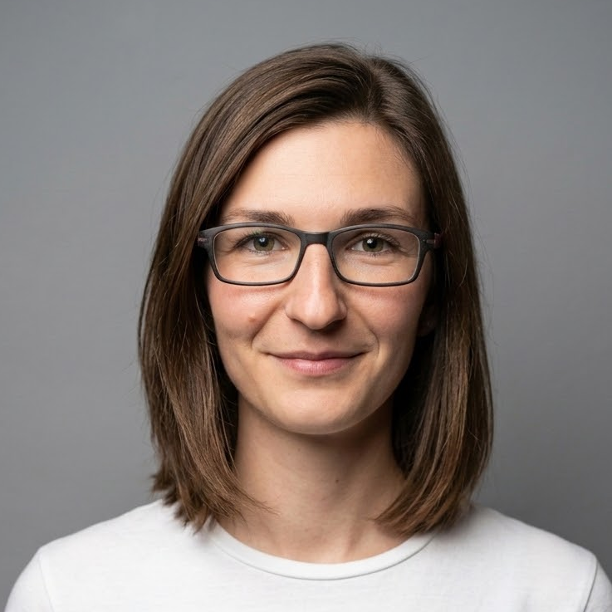
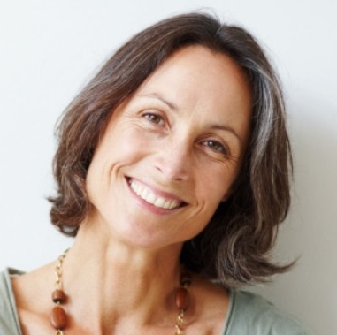
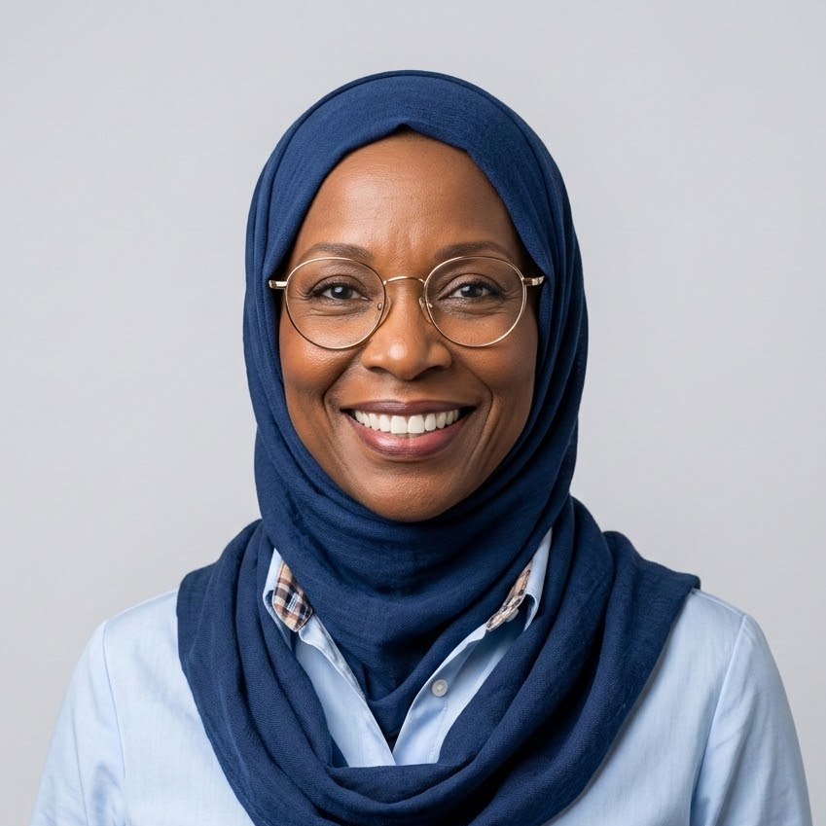
OUR HOPE
FOR THE WOMEN
IN THIS ROOM:
KNOW YOUR STRENGTHS
TELL YOUR STORY
CLAIM YOUR SEAT
FIND YOUR PEOPLE
LIFT OTHERS AS YOU RISE

Slide 13


YOUR VOICE BELONGS IN EVERY ROOM
WHERE DECISIONS ARE MADE
Notes:
Final Message
Your influence is already shaping your school community. Own your strengths, tell your story with confidence, and seek out the women who will help you rise. Then, become that person for someone else.

Slide 14
THANK
YOU!
Contact us!
hillery.dixon@lmusd.org
jennifer.handy@lmusd.org

