Slide 1
Growing Our Own:
Building Teaching Capacity
Through Substitutes,
Student Teachers, and Interns
Cynthia Rapaido, Ed.D.,
Susan Shih, LCSW
ACSA Region 6 Annual Conference
“Empowered to Lead, Inspired by Heart,
United for Impact”
June 11, 2026
Pleasanton, CA
Notes:
30 secs
CYNTHIA
Have them sit with others in their similar position currently are in:
Site leader
District leader
Site teacher
Guest teachers
[Cynthia]: Good afternoon, everyone. We are thrilled to be here with you today at the ACSA Region 6 Annual Conference, grounded in this year's beautiful theme: “Empowered to Lead, Inspired by Heart, United for Impact”. Our session is on: “Growing Our Own: Building Teaching Capacity Trough Substitutes, Student Teachers, and Interns”, with the focus on looking closely at a vital—yet often overlooked—segment of our school ecosystems: our guest teachers and upcoming educators.

Slide 2
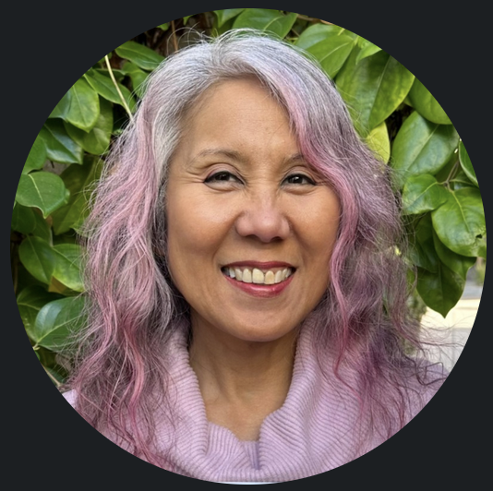
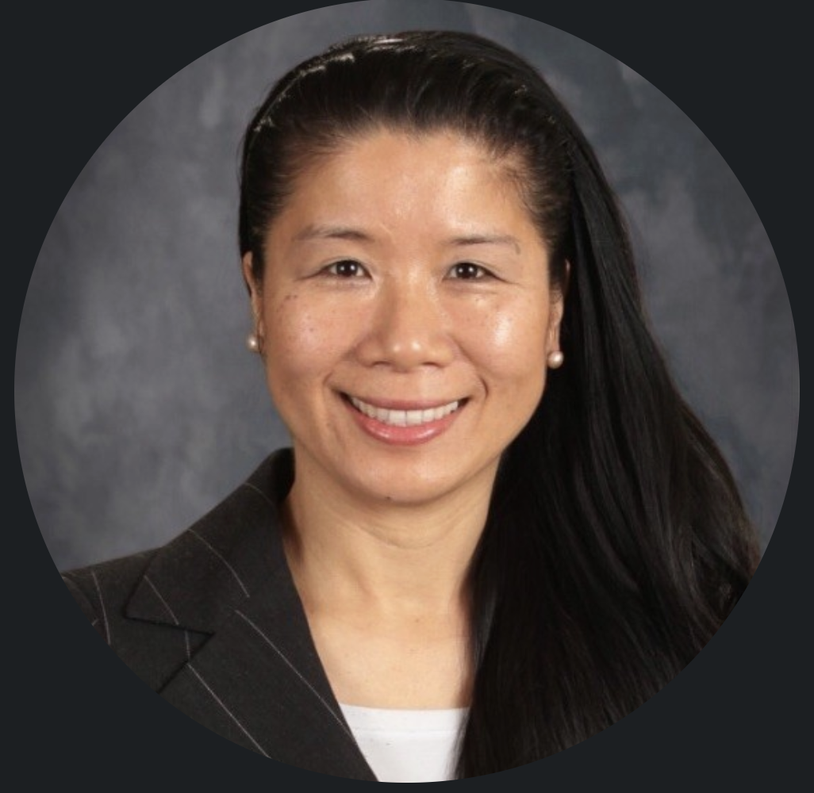
Introduction
Cynthia Rapaido, Ed.D.
Susan Shih, LCSW
Notes:
1 MINUTE (30 seconds each)
CYNTHIA:
Introduce ourselves
[Cynthia] Hi, my name is Cynthia Rapaido…Over 30 years of experience in education as a high school science teacher, assistant principal, principal, school board trustee, educational leadership coach and mentor, university field supervisor, placement coordinator and co-director of Teacher Education and Masters Program, and author of Step Up Your School Leadership Game.
[Susan]: My name is Susan Shih...
We are educators and leadership practitioners, and our presentation focuses on how leaders build systems that actually support people—not just on paper, but in practice.
Our talk is about a leadership blind spot that most of us don’t even realize we have.

Slide 3
Goals and Objectives:
Discuss and Identify:
Invisible
Guest Teachers: Substitute Teachers, Student Teachers/
Interns
3) Ways to
Build Teaching Capacity and Professional Capital
2) Challenges
4) Ways to
Recruit and Retain
Guest Teachers
Notes:
20 seconds
CYNTHIA
(who is present in the room?)
[Cynthia]: In our time together today, our goals are simple but profound. We want to collectively discuss and identify four main elements:
who are our “invisible guest teachers”;
a clear-eyed look at the real challenges faced by substitutes, student teachers, and interns across our districts;
system-wide methods to build teaching capacity and professional capital; and
finally, actionable ways to recruit and retain guest teachers.
Discuss and Identify:
Guest Teachers: Substitute Teachers, Student Teachers, Interns
Challenges: Guest Teachers’, Classroom Teachers’, Site Leaders’, Districts’
Ways to Build Teaching Capacity and Professional Capital: Guest Teachers’, Classroom Teachers’, Site Leaders’, Districts’
Ways to Recruit and Retain Guest Teachers

Slide 4
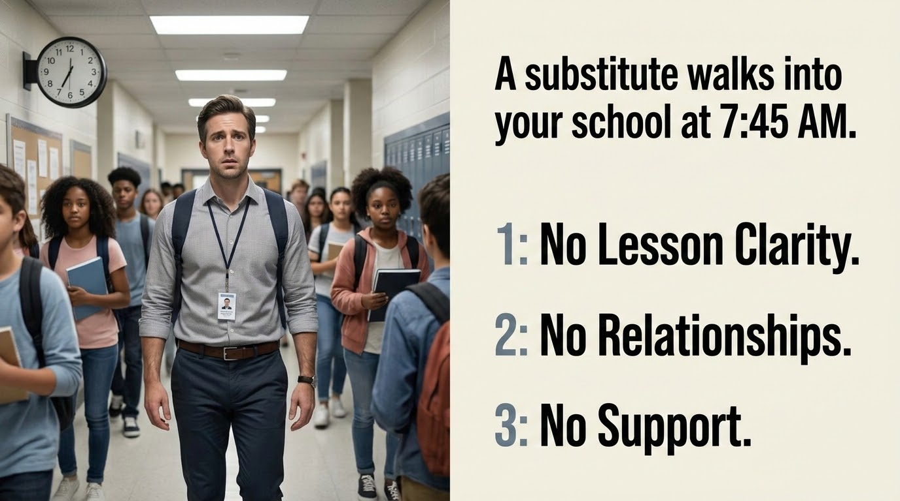
Notes:
15 seconds
SUSAN
[Susan]: Let's paint a familiar picture. A substitute teacher walks into your school building at 7:45 AM. What do they often encounter? Number one: no lesson clarity. Number two: no established relationships. And number three: no immediate support.
In schools, we see it clearly through substitute teachers.
A substitute teacher walks into a school at 7:45 in the morning.
They’ve never met the students.
They don’t know the routines.
Sometimes, they barely know what they’re supposed to teach.
And within minutes, they’re expected to manage behavior, deliver instruction, and maintain order.
Now here’s the question:
When things go wrong…
who do we blame?

Slide 5
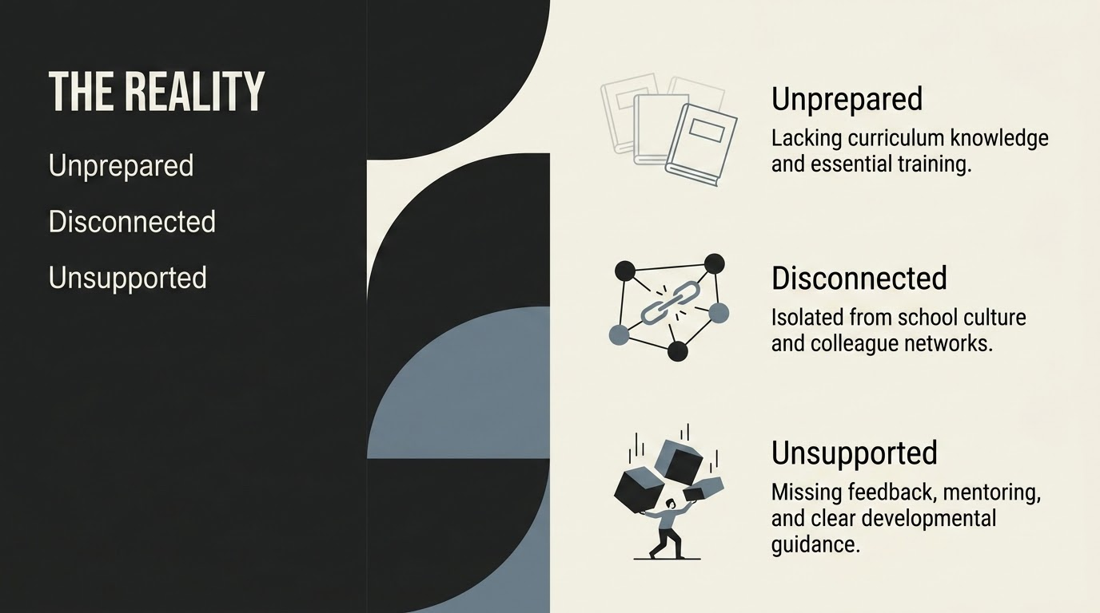
Notes:
15 seconds
SUSAN
[Susan] This brings us directly to the harsh reality of how our guest educators experience their days. They are Unprepared, lacking necessary curriculum knowledge and essential training. They are Disconnected, completely isolated from the school culture and our peer colleague networks. And they are Unsupported, entirely missing targeted feedback, mentoring, or clear developmental guidance.
In most cases, we blame the substitute.
We say they weren’t prepared.
They couldn’t manage the classroom.
They weren’t effective.
But what if we’re asking the wrong question?
What if the real issue isn’t the person…
but the system they walked into?

Slide 6
The Problem:
We don’t treat
substitute teachers,
student teacher, and interns,
as part of the system.
Notes:
15 seconds
SUSAN
[Susan]: Here lies our central problem: as school systems, we don’t treat substitute teachers, student teachers, and interns as true parts of the system.
Because this doesn’t just happen in schools.
It happens every day in organizations, in companies, in communities—anywhere there are people who exist on the margins of a system but still carry responsibility within it.
The new employee expected to perform without onboarding.
The contractor brought in without context.
The team member left out of key conversations but still held accountable.
People are expected to succeed inside systems that were never designed to support them.

Slide 7
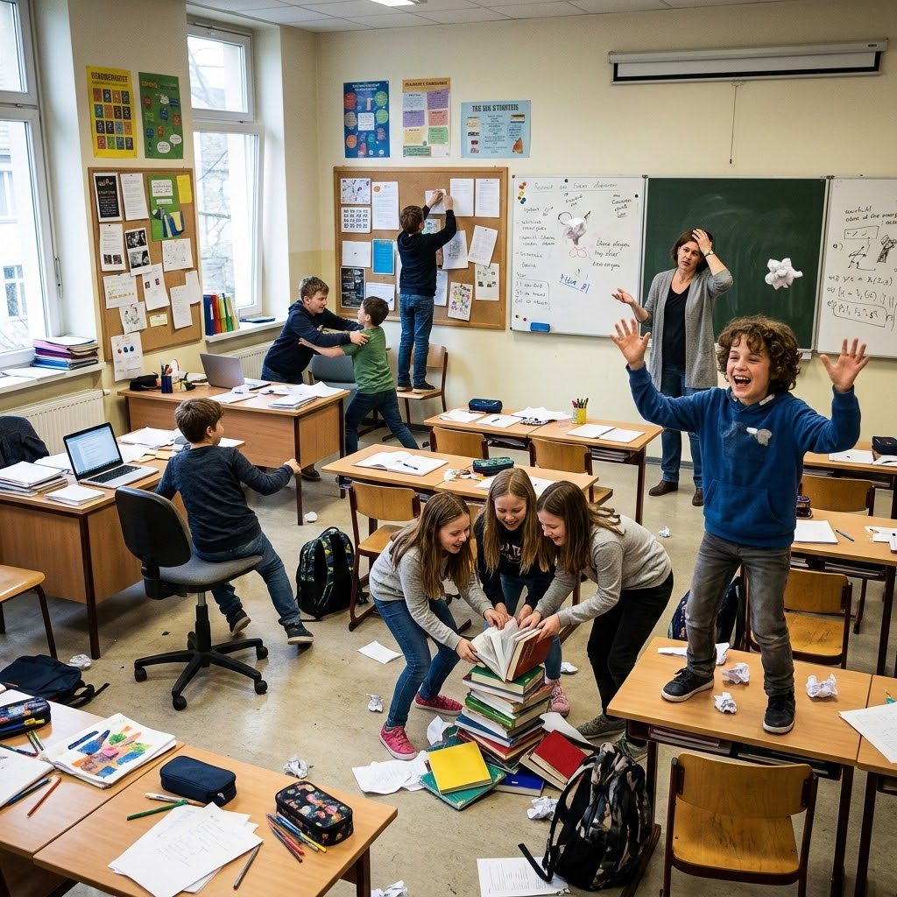
And students feel it immediately.
Lost instructional time
Behavior escalations
Broken continuity
Notes:
15 seconds
SUSAN
[Susan]: Here lies our central problem: as school systems, we don’t treat substitute teachers, student teachers, and interns as true parts of the system. And please make no mistake—our students feel this neglect immediately. When a guest teacher enters a classroom unsupported, it instantly translates to lost instructional time, spikes in behavior escalations, and a completely broken continuity of learning.

Slide 8
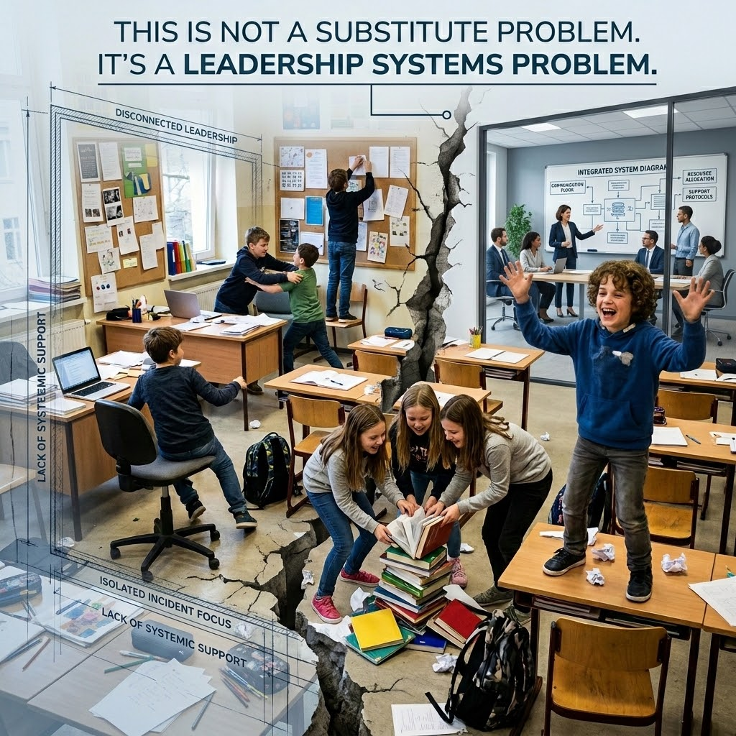
Notes:
15 seconds
SUSAN
Because of this, we need a complete mindset shift. This is not a substitute problem. It’s a leadership systems problem. As leaders, the classroom environment we see when an educator is out is a direct reflection of the systemic support we have—or haven't—provided to the adult stepping in.

Slide 9
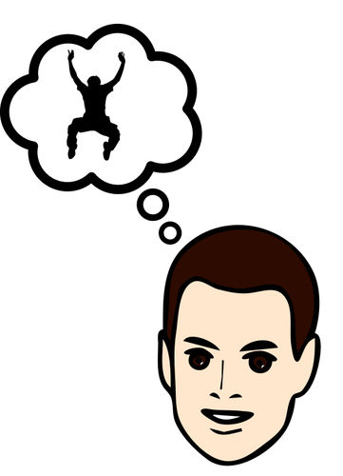
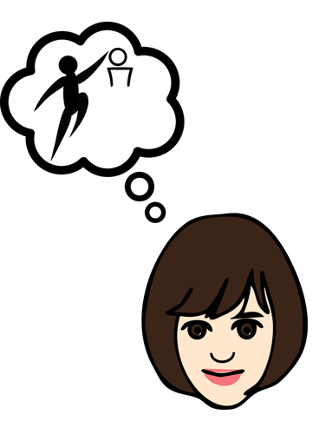

Reflection Question:
What if we saw substitutes,
student teachers, and interns
Differently? What might change?
Notes:
20 seconds
SUSAN
[Susan]: So we want to pause and pose a fundamental reflection question to this room: What if we saw substitutes, student teachers, and interns differently? What might change?

Slide 10
Schools improve when
leaders build
teaching capacity and
professional capital
Notes:
15 seconds
CYNTHIA
[Cynthia]: Educational research shows that schools improve significantly when leaders deliberately build teaching capacity and professional capital.
And here’s what we have come to understand:
Leaders don’t fail because they lack intelligence.
They fail because they overlook the people their systems quietly exclude.
And those “invisible” people?
They shape outcomes more than we realize.

Slide 11
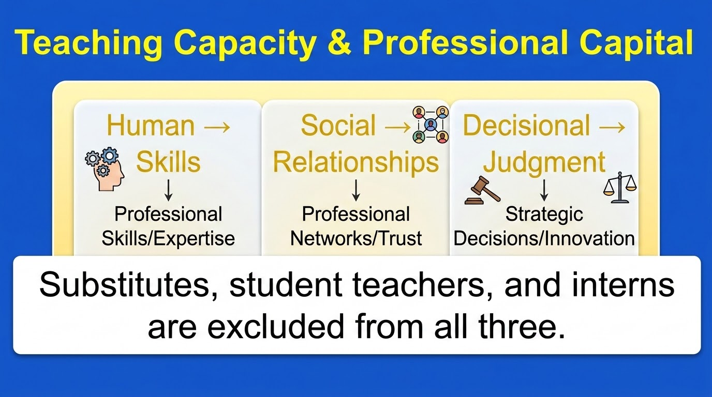
Notes:
20 seconds
CYNTHIA
[Cynthia]: Professional capital relies on three pillars: Human Capital (the skills), Social Capital (the relationships), and Decisional Capital (the judgment).
Yet, traditionally, substitutes, student teachers, and interns are structurally excluded from all three.
In education, we call this building teaching capacity and professional capital.
But the idea applies everywhere.

Slide 12
So what should leaders do to build professional capital?
CONNECT them!
(who to go to, visibility, belonging)
PREPARE them! (expectations, materials,
what success looks like)
SUPORT them! (feedback, guidance, someone stepping in)
Notes:
20 seconds
CYNTHIA
So, what should leaders do instead? The answer is a threefold call to action: We must Prepare them, Connect them, and Support them.Culturally, they are often perceived as a mere “warm body” or a moderately paid babysitter.
It comes down to three things:
Preparation. Clear expectations. Clear materials. Clear understanding of what success looks like.
Connection. Knowing who to go to. Feeling seen. Understanding that you’re part of something—not just passing through it.
Support. Feedback. Guidance. Someone stepping in when things get difficult.
In our talk, we introduce a simple but powerful shift: when leaders intentionally build what’s called teaching capacity and professional capital—through preparation, connection, and support—they don’t just improve performance. They transform the experience for everyone in the system.
This idea matters because every one of us has been that invisible person at some point—expected to succeed without being set up to do so.
And when leaders begin to see and design for those individuals, everything changes.

Slide 13
Goals and Objectives:
Discuss and Identify:
Invisible
Guest Teachers
3) Ways to
Build Teaching Capacity and Professional Capital
2) Challenges
4) Ways to
Recruit and Retain
Guest Teachers
Notes:
15 seconds
CYNTHIA
Discuss and Identify:
Guest Teachers: Substitute Teachers, Student Teachers, Interns
Challenges: Guest Teachers’, Classroom Teachers’, Site Leaders’, Districts’
Ways to Build Teaching Capacity and Professional Capital: Guest Teachers’, Classroom Teachers’, Site Leaders’, Districts’
Ways to Recruit and Retain Guest Teachers

Slide 14

Challenges & Perspectives
Substitutes
Classroom Teachers
Site Leaders
Called with little time to familiarize with lesson plans
Unfamiliar with school site
Perceived as "warm body/babysitter"
Lesson plans with ed jargon (IEP, 504's)
Isolated (physically and socially)
Lack of union representation
Not trained in curriculum, technology, or classroom management
Perception that they do not follow lesson plans
Assumption of lack of content knowledge or teaching experience
Not knowing the substitute or their teaching ability
Not enough substitutes - High demand for effective teachers
Lower test results due to substitute lesson plans are watered down when teachers are out for PD
Liability issues if not trained with ed codes or compliance with SpEd
High attrition rate of substitute teachers due to student behavior
Notes:
30 seconds
CYNTHIA (who is present in the room and prior experience in those guest teacher positions)
To fix the system, we must first deeply understand the specific roadblocks. When it comes to substitute teachers, the challenges across substitutes, classroom teachers, and site leaders are numerous. Subs face a complete lack of union representation. They are handed lesson plans saturated with complex educational jargon like IEPs and 504s without context.
On the flip side, classroom teachers worry that subs won't follow their lesson plans, or assume they lack content knowledge. Subs are frequently called with precious little time to familiarize themselves with plans, leaving them physically and socially isolated, untrained in site curriculum, technology, or classroom management, and entirely unfamiliar with the layout of the school site. Compounding this is the high demand and severe shortage of effective substitute teachers, alongside major liability issues if they are not thoroughly trained in educational codes or Special Education compliance.
Substitute Teacher challenges:
•Classroom management (Byer, 2008)
•Lack of union representation
•Lesson Plans contain educational jargons which substitutes are unfamiliar (IEP, EL, SpEd, 504, AVID) or lesson plans are too vague for substitute to follow
•Perceived by others as “high-priced babysitter” or a “warm-body” (Washington, Jr. ,1972) or “placeholder” (Glatfelter, 2006, p. 93) Feeling unwelcome by permanent employees
•Working in isolation and being isolated in faculty/staff lounges
•Highly interested in expanding their capacities and becoming trained in classroom management, curriculum, and instructional methods.
•Called the morning of with little time to familiarize self with lesson plans (Washington, Jr., 1972)
•Unfamiliar with school site
Classroom Teacher’s Challenges:
•Assumption or expectations that substitutes do not know content or have teaching pedagogy
•No knowing who is the substitute or their teaching ability
•Substitute Teachers don’t follow lesson plans (and not understanding why they did not)
Site Leader Challenges:
•Classroom Teacher absenteeism due to maternity leave, medical leave, illness, professional development, bereavement of family members living abroad
•Average teacher misses between 6-18 days of school per year (Zubrzycki, 2012)which results in lower test results than peers whose teachers were less absent (Kronholz, 2013)
•District expectations: Graduation rates, test scores, school climate, technology, current education practices (Common Core State Standards and 21st Century Skills)
•Need for school improvement based on various data (i.e. Test Scores, school climate data)
•Classroom Teacher Shortages statewide
•Classroom Teachers needing Professional Development
•Classroom Teachers needing release time for Professional Development
•Requires Substitute Teachers coverage(which also drains the substitute pool) (Wheeler-Ayres, 2002)
•High demand of highly effective Substitute Teachers
•Legal liability issues (subs not trained with Ed Codes or Special Education)
•Staying in compliance with IEP and 504s
•High attrition rate of Substitute Teachers due to student behavior (Glatfelter, 2006, p 16)
•Hiring effective Substitute Teachers to make sure students are experiencing high-quality teaching (Zubrzycki, 2012)

Slide 15

Challenges of Substitute Teachers:
What are other perceived CHALLENGES of Substitute Teachers, from the lens of the following individuals…
1) Substitute Teachers?
2) Classroom Teachers?
3) Site leaders?
4) District Leaders?
Turn, Talk and Share Out: Challenges
Notes:
4 MINUTES
CYNTHIA
[Cynthia]: Let’s activate the expertise in this room. We want you to turn to a neighbor for a brief share-out. Look at these challenges through the distinct lenses of the substitute, the classroom teacher, the site leader, and your district leaders. What else are you seeing in your contexts?
Substitute Teacher challenges:
•Classroom management (Byer, 2008)
•Lack of union representation
•Lesson Plans contain educational jargons which substitutes are unfamiliar (IEP, EL, SpEd, 504, AVID) or lesson plans are too vague for substitute to follow
•Perceived by others as “high-priced babysitter” or a “warm-body” (Washington, Jr. ,1972) or “placeholder” (Glatfelter, 2006, p. 93) Feeling unwelcome by permanent employees
•Working in isolation and being isolated in faculty/staff lounges
•Highly interested in expanding their capacities and becoming trained in classroom management, curriculum, and instructional methods.
•Called the morning of with little time to familiarize self with lesson plans (Washington, Jr., 1972)
•Unfamiliar with school site
Classroom Teacher’s Challenges:
•Assumption or expectations that substitutes do not know content or have teaching pedagogy
•No knowing who is the substitute or their teaching ability
•Substitute Teachers don’t follow lesson plans (and not understanding why they did not)
Site Leader Challenges:
•Classroom Teacher absenteeism due to maternity leave, medical leave, illness, professional development, bereavement of family members living abroad
•Average teacher misses between 6-18 days of school per year (Zubrzycki, 2012)which results in lower test results than peers whose teachers were less absent (Kronholz, 2013)
•District expectations: Graduation rates, test scores, school climate, technology, current education practices (Common Core State Standards and 21st Century Skills)
•Need for school improvement based on various data (i.e. Test Scores, school climate data)
•Classroom Teacher Shortages statewide
•Classroom Teachers needing Professional Development
•Classroom Teachers needing release time for Professional Development
•Requires Substitute Teachers coverage(which also drains the substitute pool) (Wheeler-Ayres, 2002)
•High demand of highly effective Substitute Teachers
•Legal liability issues (subs not trained with Ed Codes or Special Education)
•Staying in compliance with IEP and 504s
•High attrition rate of Substitute Teachers due to student behavior (Glatfelter, 2006, p 16)
•Hiring effective Substitute Teachers to make sure students are experiencing high-quality teaching (Zubrzycki, 2012)

Slide 16
Goals and Objectives:
Discuss and Identify:
Invisible
Guest Teachers: Student Teachers/Interns
3) Ways to
Build Teaching Capacity and Professional Capital
2) Challenges
4) Ways to
Recruit and Retain
Guest Teachers
Notes:
20 seconds
CYNTHIA
Discuss and Identify:
Guest Teachers: Substitute Teachers, Student Teachers, Interns
Challenges: Guest Teachers’, Classroom Teachers’, Site Leaders’, Districts’
Ways to Build Teaching Capacity and Professional Capital: Guest Teachers’, Classroom Teachers’, Site Leaders’, Districts’
Ways to Recruit and Retain Guest Teachers

Slide 17
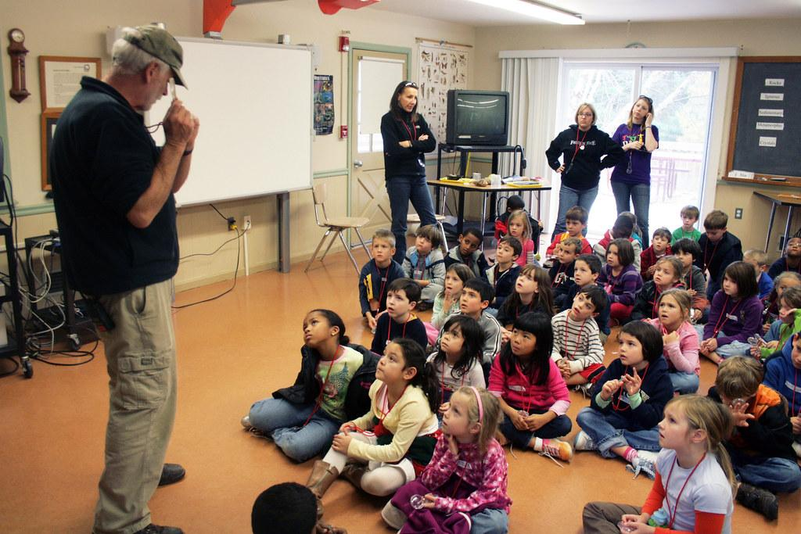
What are some ways the following individuals can PREPARE
Substitute Teachers to build teaching capacity and professional capital?
Turn, Talk and Share Out: “PREPARE”
Clarity reduces chaos.
17
District Leaders?
Site leaders?
Classroom Teachers?
Substitute Teachers?
Notes:
4 MINUTES (in pairs, 2 minutes per person)
SUSAN
PART 1: PREPARATION
[Susan]: Now let's move into solutions using our framework. We firmly believe that Clarity reduces chaos. For our next turn and talk, discuss how district leaders, site leaders, classroom teachers, and the subs themselves can proactively PREPARE guest teachers to build capacity.
Preparation means clarity.
Clear expectations.
Clear materials.
Clear understanding of what success looks like.
Because when people lack clarity, they don’t rise to the occasion—they default to survival.
Site Leaders:
•Welcome substitute and create school climate where they feel they are part of the team and feel valued (Glatfelter, 2006, p 34) (O’Connor, K.; 2009)
•Create a SubPack or Resource Kit (Longhurst, et. al., 2000, p 6)
•Include them in faculty and staff meetings (New Teacher meetings)
•Provide an orientation to acquaint substitutes to the district, Ed Code laws, appropriate/inappropriate behavior with students (Glatfelter, 2006, p 85)
•Provide general assistance) (maps, facilities, resources, policies, handbooks, norms, history, information binder, dates and tasks) (Parnem & Gordon, 2016);
•Encourage ways to develop Student-Substitute Teacher relationship. (Parnem, & Gordon, 2016)
• Be friendly but remain professional (New York City Department of Education, 2011)
•Provide pay to those who attend training
•Provide training (Glatfelter, 2006, p 19); (Wheeler-Ayres, 2002)
–Effective disciplinary techniques (Balance between rewards and punishment)
–Effective teaching strategies (Actively engage students in discussions and critical thinking, differentiating instruction) and pedagogical support (Parnam & Gordon, 2016)
–Teacher-Student relationship
–Allow them to participate in in-service training, walk-throughs or class observations with classroom teachers (Glatfelter, 2006, p 83)
•Provide feedback, ongoing development, encouragement, and support (Glatfelter, 2006, p. 37) (O’Connor, 2009)
•Provide structured support (mentor, support teams, support networks) (Parnam & Gordon, 2016)
•Assign a permanent teacher to be a resource or a master teacher or a mentor
•Role play discipline and provide feedback
•Survey Substitute Teachers
–Find out substitute teachers’ academic strengths
–Offer pre-post learning
–Find out technology skills and teach them how to use
•Provide access to school technology systems (g-apps, emails)
•Provide training on technology equipment (doc cameras, SMART boards, copy machine, Scantron machine)
•Access to curriculum and instruction (what books are students and teachers using)
•Visit Substitute Teachers’ classes, support them with any discipline issues, and provide feedback (Washington, 1972)
•Suggest videos on classroom management (Glatfelter, 2006, p 84)
•Inform staff daily to reach out to Substitutes Teachers in their building and welcome them ( O’Connor, K.; 2009)
•Establish expectations of teachers to provide Substitute Folders and monitor regularly for authentic assignments (Swetnam & Land, 2001)
-Create a Substitute Teaching webpage on the website (True, et. Al., 2011)
Classroom Teachers:
•Provide explicit lesson plans that keeps the continuity (videos can present difficulties) (Glatfelter, 2006 p 69)
•Create ideal lesson plans that are detailed with bulleted information,
•Place all materials needed in one location
•Provide explicit discipline plan (post on walls, provide to substitute teacher)
•Provide visual seating chart (photos, color code identified students who may need additional support)
•Encourage Communication (feedback or questions)
•Make copies of textbook with highlights of what you want the substitute to focus on (Glatfelter, 2006, p 82)
•Build rapport with Substitute Teacher (Glatfelter, 2006, p 54)
•Build trust with Substitute Teacher so Permanent Teacher is more willing to leave lesson plans that the substitute can teach and manage classroom behavior (Glatfelter, 2006, p 55)
•Request to place the best-matched Substitute Teacher in the classroom by identifying his/her top three subject areas
•Provide feedback to Substitute Teacher; Receive feedback from Substitute Teacher
Substitute Teachers:
•Let school site know your top three content areas of strength (English, Math, Science, P.E., Languages, Special Education, CTE, Visual and Performing Arts, etc.)
•Learn district-adopted curriculum especially in English/Reading and Math (Glatfelter, 2006, p. 81)
•Effective strategies:
–Provide student recognition
–Provide visuals, pictures, graphic organizers to promote visualization strategies
–Ask higher level questions to deepen understanding of the subject matter
•Get resources from Internet; network with others
•Provide feedback to Permanent Teacher regarding lesson plans; receive feedback from Permanent Teacher too
•Network and introduce themself to teachers in the surrounding classrooms ( (New York City Department of Education, 2011, p 15)
•Request to be included in staff development, professional learning communities, meetings (True, et. al., 2011)
•Generate your own substitute folder (Johnson, 2013)
•Get to know the students (Johnson, 2013)
•Reverse roles (allow students to teach peers, present) (Johnson, 2013)
•Arrive early to familiarize self on campus, set high behavioral expectations, manage with confidence prepare for the unexpected ( Byer, 2008)
•Stay current with journals, articles, books (Byer, 2008)
•Continuous reflection on day on ways to improve classroom management and instructional skills (Byer, 2008)

Slide 18
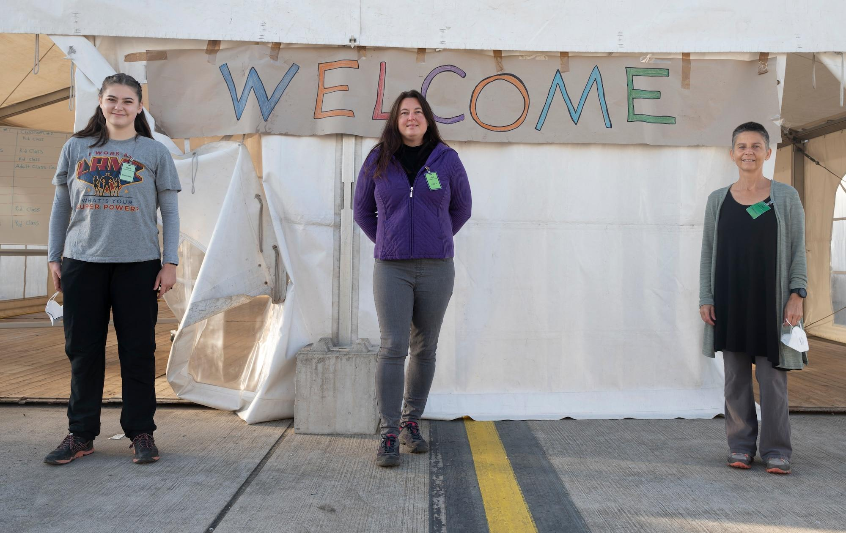
What are some ways the following individuals can CONNECT Substitute Teachers to build teaching capacity and professional capital?
Turn, Talk and Share Out: “Connect”
People perform better when they belong.
18
1) District Leaders?
2) Site leaders?
3) Classroom Teachers?
4) Substitute Teachers?
Notes:
4 MINUTES
CYNTHIA
PART 2: CONNECTION
[Cynthia]: Next, remember that People perform better when they belong. Take a few minutes to talk about how your systems can intentionally CONNECT substitute teachers to the broader school culture.
Connection means belonging.
Knowing who to go to.
Feeling seen.
Understanding that you’re part of something—not just passing through it.
Because people perform differently when they feel like they matter.
Site Leaders:
•Welcome substitute and create school climate where they feel they are part of the team and feel valued (Glatfelter, 2006, p 34) (O’Connor, K.; 2009)
•Include them in faculty and staff meetings (New Teacher meetings)
•Provide pay to those who attend training
–Teacher-Student relationship
•Assign a permanent teacher to be a resource or a master teacher or a mentor
–Find out substitute teachers’ academic strengths
–Offer pre-post learning
–Find out technology skills and teach them how to use
•Inform staff daily to reach out to Substitutes Teachers in their building and welcome them ( O’Connor, K.; 2009)
-Invite guest teachers to observe best teaching strategies
Classroom Teachers:
•Encourage ways to develop Student-Substitute Teacher relationship. (Parnem, & Gordon, 2016)
•Inform staff daily to reach out to Substitutes Teachers in their building and welcome them ( O’Connor, K.; 2009)
-Invite guest teachers to observe best teaching strategies
District:
•Provide pay to those who attend training

Slide 19

What are some ways the following individuals can SUPPORT
Substitute Teachers to build teaching capacity and professional capital?
Turn, Talk, and Share out: “Support”
Support turns survival into success.
19
1) District Leaders?
2) Site leaders?
3) Classroom Teachers?
4) Substitute Teachers?
Notes:
4 MINUTES
SUSAN
PART 3: SUPPORT
[Susan]: Finally, Support turns survival into success. Discuss how your teams can structurally SUPPORT substitute teachers so they move from surviving a single day to thriving instructionally.
Support means consistency.
-Feedback.
-Guidance.
-Someone stepping in when things get difficult.
Because without support, even capable people struggle.
• Be friendly but remain professional (New York City Department of Education, 2011)
•Provide pay to those who attend training
-Allow them to participate in in-service training, walk-throughs or class observations with classroom teachers (Glatfelter, 2006, p 83)
•Provide feedback, ongoing development, encouragement, and support (Glatfelter, 2006, p. 37) (O’Connor, 2009)
•Provide structured support (mentor, support teams, support networks) (Parnam & Gordon, 2016)
•Role play discipline and provide feedback
•Visit Substitute Teachers’ classes, support them with any discipline issues, and provide feedback (Washington, 1972)
•Suggest videos on classroom management (Glatfelter, 2006, p 84)
Encourage faculty to invite guest teachers to observe them teach
Classroom Teacher:
•Provide feedback to Substitute Teacher; Receive feedback from Substitute Teacher
-Invite them to come observe you teach

Slide 20







Student Teachers and Intern Candidates
Notes:
20 seconds
CYNTHIA
[Cynthia]: Let's pivot from substitute teachers-> to our student teachers and intern candidates. These educators are coming to us from regional partners like CSU East Bay, the University of San Francisco, San Francisco State University, Notre Dame de Namur University, Stanford Graduate School of Education, Alameda County Office of Education (PATH program Profesional Advancement & Training Hub) and UC Berkeley. They have their own set of challenges. Many similar to student teachers, but because they are at the school site for the entire school year, their challenges and opportunities are a little more different.
Grow Your Own Teachers (Staff->faculty)

Slide 21
Challenges for Student Teachers
Site Leaders
Student Teachers/Interns
Cooperating Teachers/Mentors
Still learning how to put theory into practice
Struggle with classroom management,
Isolated from peer community
Juggling university work (CalTPA/EdTPA, CSET, etc.)
Unfamiliar with school site
Not seen as a "real teacher"
Designing Lesson Plans & learning SpEd/EL
Liability issues if not trained with ed codes
Ensuring compliance with SpEd regulations
Matching effective CTs with Interns/STs
Last minute matching
Not knowing much about the candidate
Providing critical feedback and guidance
Relationship between ST and CT may not be a good match
Struggle with discipline & student relationships
Classroom management transition
Notes:
20 seconds
CYNTHIA
Just like substitutes, our student teachers and interns navigate distinct hurdles alongside their cooperating teachers, mentors, and site leaders. They are actively struggling with classroom management, mastering discipline, and forming professional relationships with students. They are still learning how to put university theory into real practice, design responsive lesson plans, and understand the practical compliance steps for Special Education and English Learners.
Emotionally and socially, they often report not feeling seen as a “real teacher,” feeling intensely isolated, and feeling completely overwhelmed as they try to juggle intense university coursework, CalTPA/EdTPA portfolios, and CSET exams. Furthermore, cooperating teachers struggle with knowing how to provide critical feedback and guidance, matching candidate-mentor relationships effectively, and protecting against district liability if candidates aren't adequately trained in educational codes.
1) District Leaders?
School calendars not aligned- start student teaching/interning after the school year
Clearing candidates with onboarding process
2) Site leaders?
Last minute matching
Not knowing much about the candidate
3) Classroom Cooperating Teachers?
r Providing critical feedback and guidance
group_off Relationship between ST and CT may not be a good match
psychology Struggle with discipline & student relationships
settings_suggest Classroom management transition
4) Student Teacher/Intern?
Still learning how to put theory into practice
person_off Isolated from peer community
school Juggling university work (CalTPA/EdTPA, CSET, etc.)
map Unfamiliar with school site
visibility_off Not seen as a "real teacher"
edit_note Designing Lesson Plans & learning SpEd/EL

Slide 22


What can the following individuals do to PREPARE Interns and Student Teachers to build teaching capacity and professional capital?
Turn, Talk and Share Out: “PREPARE”
Clarity reduces chaos.
22
1) District Leaders?
2) Site leaders?
3) Cooperating Teachers/District Mentors?
4) Student Teacher/Intern candidate?
Notes:
4 MINUTES
SUSAN
PART 1: PREPARATION
Preparation means clarity.
-Clear expectations.
- Clear materials.
-Clear understanding of what success looks like.
Because when people lack clarity, they don’t rise to the occasion—they default to survival.
Site Leaders:
•Welcome substitute and create school climate where they feel they are part of the team and feel valued (Glatfelter, 2006, p 34) (O’Connor, K.; 2009)
•Create a SubPack or Resource Kit (Longhurst, et. al., 2000, p 6)
•Include them in faculty and staff meetings (New Teacher meetings)
•Provide an orientation to acquaint substitutes to the district, Ed Code laws, appropriate/inappropriate behavior with students (Glatfelter, 2006, p 85)
•Provide general assistance) (maps, facilities, resources, policies, handbooks, norms, history, information binder, dates and tasks) (Parnem & Gordon, 2016);
•Encourage ways to develop Student-Substitute Teacher relationship. (Parnem, & Gordon, 2016)
• Be friendly but remain professional (New York City Department of Education, 2011)
•Provide pay to those who attend training
•Provide training (Glatfelter, 2006, p 19); (Wheeler-Ayres, 2002)
–Effective disciplinary techniques (Balance between rewards and punishment)
–Effective teaching strategies (Actively engage students in discussions and critical thinking, differentiating instruction) and pedagogical support (Parnam & Gordon, 2016)
–Teacher-Student relationship
–Allow them to participate in in-service training, walk-throughs or class observations with classroom teachers (Glatfelter, 2006, p 83)
•Provide feedback, ongoing development, encouragement, and support (Glatfelter, 2006, p. 37) (O’Connor, 2009)
•Provide structured support (mentor, support teams, support networks) (Parnam & Gordon, 2016)
•Assign a permanent teacher to be a resource or a master teacher or a mentor
•Role play discipline and provide feedback
•Survey Substitute Teachers
–Find out substitute teachers’ academic strengths
–Offer pre-post learning
–Find out technology skills and teach them how to use
•Provide access to school technology systems (g-apps, emails)
•Provide training on technology equipment (doc cameras, SMART boards, copy machine, Scantron machine)
•Access to curriculum and instruction (what books are students and teachers using)
•Visit Substitute Teachers’ classes, support them with any discipline issues, and provide feedback (Washington, 1972)
•Suggest videos on classroom management (Glatfelter, 2006, p 84)
•Inform staff daily to reach out to Substitutes Teachers in their building and welcome them ( O’Connor, K.; 2009)
•Establish expectations of teachers to provide Substitute Folders and monitor regularly for authentic assignments (Swetnam & Land, 2001)
Create a Substitute Teaching webpage on the website (True, et. Al., 2011)
Classroom Teachers:
•Provide explicit lesson plans that keeps the continuity (videos can present difficulties) (Glatfelter, 2006 p 69)
•Create ideal lesson plans that are detailed with bulleted information,
•Place all materials needed in one location
•Provide explicit discipline plan (post on walls, provide to substitute teacher)
•Provide visual seating chart (photos, color code identified students who may need additional support)
•Encourage Communication (feedback or questions)
•Make copies of textbook with highlights of what you want the substitute to focus on (Glatfelter, 2006, p 82)
•Build rapport with Substitute Teacher (Glatfelter, 2006, p 54)
•Build trust with Substitute Teacher so Permanent Teacher is more willing to leave lesson plans that the substitute can teach and manage classroom behavior (Glatfelter, 2006, p 55)
•Request to place the best-matched Substitute Teacher in the classroom by identifying his/her top three subject areas
•Provide feedback to Substitute Teacher; Receive feedback from Substitute Teacher
Substitute Teachers:
•Let school site know your top three content areas of strength (English, Math, Science, P.E., Languages, Special Education, CTE, Visual and Performing Arts, etc.)
•Learn district-adopted curriculum especially in English/Reading and Math (Glatfelter, 2006, p. 81)
•Effective strategies:
–Provide student recognition
–Provide visuals, pictures, graphic organizers to promote visualization strategies
–Ask higher level questions to deepen understanding of the subject matter
•Get resources from Internet; network with others
•Provide feedback to Permanent Teacher regarding lesson plans; receive feedback from Permanent Teacher too
•Network and introduce themself to teachers in the surrounding classrooms ( (New York City Department of Education, 2011, p 15)
•Request to be included in staff development, professional learning communities, meetings (True, et. al., 2011)
•Generate your own substitute folder (Johnson, 2013)
•Get to know the students (Johnson, 2013)
•Reverse roles (allow students to teach peers, present) (Johnson, 2013)
•Arrive early to familiarize self on campus, set high behavioral expectations, manage with confidence prepare for the unexpected ( Byer, 2008)
•Stay current with journals, articles, books (Byer, 2008)
•Continuous reflection on day on ways to improve classroom management and instructional skills (Byer, 2008)

Slide 23


What can the following individuals do to CONNECT Interns and Student Teachers to build teaching capacity and professional capital?
1) District Leaders?
2) Site leaders?
3) Cooperating Teachers/District Mentors?
4) Student Teacher/Intern candidate?
Turn, Talk and Share Out: “CONNECT”
People perform better when they belong.
Notes:
4 MINUTES
CYNTHIA
PART 2: CONNECTION
[Cynthia]: How can we CONNECT them so that they experience a genuine sense of belonging within our staff?
Connection means belonging.
-Knowing who to go to.
-Feeling seen.
-Understanding that you’re part of something—not just passing through it.
Because people perform differently when they feel like they matter.
Site Leaders:
•Welcome substitute and create school climate where they feel they are part of the team and feel valued (Glatfelter, 2006, p 34) (O’Connor, K.; 2009)
•Include them in faculty and staff meetings (New Teacher meetings)
•Provide pay to those who attend training
–Teacher-Student relationship
•Assign a permanent teacher to be a resource or a master teacher or a mentor
–Find out substitute teachers’ academic strengths
–Offer pre-post learning
–Find out technology skills and teach them how to use
•Inform staff daily to reach out to Substitutes Teachers in their building and welcome them ( O’Connor, K.; 2009)
Classroom Teachers:
•Encourage ways to develop Student-Substitute Teacher relationship. (Parnem, & Gordon, 2016)
•Inform staff daily to reach out to Substitutes Teachers in their building and welcome them ( O’Connor, K.; 2009)
District:
•Provide pay to those who attend training

Slide 24


What can the following individuals do to SUPPORT Interns and Student Teachers to build teaching capacity and professional capital?
Turn, Talk, and Share out: “SUPPORT”
Support turns survival into success.
24
1) District Leaders?
2) Site leaders?
3) Cooperating Teachers/District Mentors?
4) Student Teacher/Intern candidate?
Notes:
4 MINUTES
SUSAN
PART 3: SUPPORT
[Susan]: And what concrete actions can we take to SUPPORT them to turn their survival into a true instructional success?
Support means consistency.
-Feedback.
-Guidance.
-Someone stepping in when things get difficult.
Because without support, even capable people struggle.
Site administrator:
• Be friendly but remain professional (New York City Department of Education, 2011)
•Provide pay to those who attend training
–Allow them to participate in in-service training, walk-throughs or class observations with classroom teachers (Glatfelter, 2006, p 83)
•Provide feedback, ongoing development, encouragement, and support (Glatfelter, 2006, p. 37) (O’Connor, 2009)
•Provide structured support (mentor, support teams, support networks) (Parnam & Gordon, 2016)
•Role play discipline and provide feedback
•Visit Substitute Teachers’ classes, support them with any discipline issues, and provide feedback (Washington, 1972)
•Suggest videos on classroom management (Glatfelter, 2006, p 84)
Classroom Teacher:
•Provide feedback to Substitute Teacher; Receive feedback from Substitute Teacher

Slide 25


IMPACT of Preparing, Connecting, and Supporting Guest Teachers
Stronger instruction
Better behavior
Consistent culture
Notes:
20 seconds
SUSAN
IMPACT
[Susan]: When we get these systems right, the systemic IMPACT is undeniable. We see demonstrably stronger instruction across all classrooms, drastically better student behavior, and a seamless, consistent school culture that does not fall apart when a permanent teacher is out.
When leaders build these three things, something shifts.
Performance improves.
Outcomes become more consistent.
Culture stabilizes.
Not because people changed…but because the system finally supported them.

Slide 26
Reflection Question:
Who are the invisible guest teachers in your system?
If guest teachers struggle, what systems need to be suggested to address these shortcomings?
What outcomes are they quietly shaping?
Notes:
20 seconds
CYNTHIA
REFLECTION
[Cynthia]: As we close our core content, we want to leave you with these heavy reflection questions to take back to your administrative teams teams:
Who are the invisible guest teachers currently operating in your system?
What outcomes are they quietly shaping every day?
If your guest teachers are struggling, what specific leadership systems need to be suggested or re-engineered to address these shortcomings?

Slide 27



Remember: We all have experienced being in these systems.
Make the change: Build Teaching Capacity and Professional Capital
Prepare them!
Support them!
Connect them!
Notes:
15 seconds
CYNTHIA
[Cynthia]: Remember this truth: We have all experienced being in these exact systems at some point in our careers. It is our responsibility as leaders to make the change. Build teaching capacity. Build professional capital. Prepare them, connect them, and support them.

Slide 28


Every adult shapes student experience.
Even the ones there for a day.
Notes:
15 seconds
CYNTHIA
Remember this truth: Every single adult on your campus shapes the student experience—even the ones who are only there for a single day.
Because every system has them.
And every one of us has been one of them.
Expected to succeed…without being set up to do so.
But when leaders begin to see those individuals—and design for them— everything changes.

Slide 29
Goals and Objectives:
Discuss and Identify:
Invisible
Guest Teachers
3) Ways to
Build Teaching Capacity and Professional Capital
2) Challenges
4) Ways to
Recruit and Retain
Guest Teachers
Notes:
20 seconds
CYNTHIA
Discuss and Identify:
Guest Teachers: Substitute Teachers, Student Teachers, Interns
Challenges: Guest Teachers’, Classroom Teachers’, Site Leaders’, Districts’
Ways to Build Teaching Capacity and Professional Capital: Guest Teachers’, Classroom Teachers’, Site Leaders’, Districts’
Ways to Recruit and Retain Guest Teachers

Slide 30
Recruiting Guest Teachers
District Level
Site Level
Job Fair
Accelerated hiring timeline
In-House Source Pathway
Formalized University Partnership
Intentional Talent Scouting
Streamline Application Process
Notes:
2 MINUTES
SUSAN
Intentional Talent Scouting: Paraprofessionals ->teaching
School Branding (using social media to get positive news out to community)
Content exams (additional CSETs)

Slide 31
Retaining Guest Teachers
District Level
Site Level
Tiered Consistency Incentives
Systemic Access & Professional Capital
Centralized Automated Dispatch
Preferred Guest Teacher Protocol
Relational On-Site Integration
Notes:
2 MINUTES
SUSAN

Slide 32

Reflection Questions:
What did you GAIN from today’s workshop?
How will you lead differently next year?
“ In today’s workshop,
I gained…”
““I plan to lead differently next year by…..”
Notes:
2 MINUTES
SUSAN

Slide 33
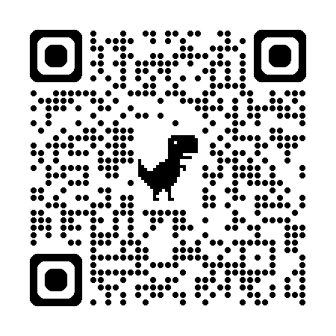
QR Code
Notes:
2 MINUTES
SUSAN

Slide 34
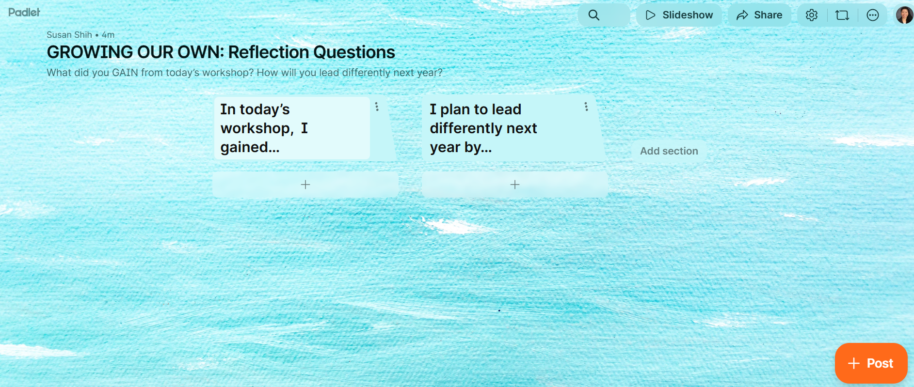
Growing Our Own Padlet
Notes:
2 MINUTES
SUSAN

Slide 35


Questions? Comments? Concerns?
Notes:
30 seconds
CYNTHIA

Slide 36
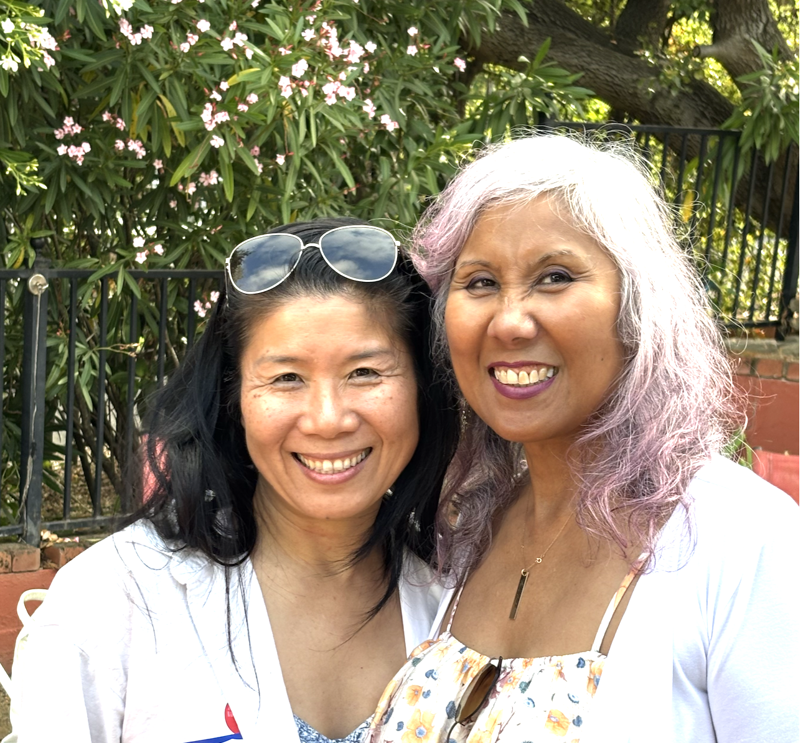
Thank you!
Susan Shih,
LCSW
sshih@cv.k12.ca.us
LINKEDIN:
linkedin.com/in/msusanshih
Cynthia Rapaido,
Ed.D.
crapaido@gmail.com
LINKEDIN:
linkedin.com/in/cynthia-rapaido-ed-d
Notes:
Last slide to leave up
CYNTHIA
Total minutes =45.723 minutes

Slide 37
RESOURCES
•http://www.supersubstituteteachers.com/
–(tips for substitute teachers)
•STEDI.org
–(a substitute training institute website with resources for administrators and substitute teachers)
–https://stedi.org/category/administrator-new/
–https://stedi.org/category/subs/
•http://www.nstasubs.org/
–National Substitute Teachers’ Alliance (has conferences every other year)

Slide 38
REFERENCES
Byer, J. L. (2008). A Sequential and Comprehensive Method for Effective Substitute Teaching. Online Submission.
Glatfelter, G. A. (2006). Substitute Teachers as Effective Classroom Instructors. (Doctoral dissertation). Retrieved from https://eric.ed.gov/?q=substitute+teachers+as+effective+classroom+instructors&id=ED494940
Hargreaves, A. & Fullan, M. (2012). Professional Capital: Transforming Teaching in Every School. New York: Teachers College Press
Hernandez, O. (2015). How to: Become a Substitute Teacher in California. Retrieved on Nov 26, 2016 from http://www.twigghowto.com/how-to-become-a-substitute-teacher-in-california/
Hernandez, O. (2016). How to: Become a Teacher in California. Retrieved on November 26, 2016 from http://www.twigghowto.com/become-teacher-california/
Kronholz, J. (Spring 2013). No Substitute for a Teacher. Education Next. 13(2), 17-21.
Longhurst, M.l.; Smith,, G. G.; Sorenson, B. L. (2000). Enhance One Year of Education. Retrieved from http://files.eric.ed.gov/fulltext/ED438282.pdf
Johnson, M. L. (2013). Contingency Plans for Substitute Teachers. Journal of Modern Education Review 3(1). 8-13.
New York City Department of Education Substitute Teachers Handbook. (2011) . Retrieved from http://www.nctq.org/docs/NYC_SUBTEACHERONLYHANDBOOKFINAL.pdf
Parham, J. N. Gordon, S. P. (2016). Military Veterans Bring Many Positives – and Some Needs – into Teaching. Kappan Magazine 97)(7). 43-47.
O’Connor, K. (2009). No Substitute Teacher Left Behind. Principal 89(1). 32-36.
Sweetnam., L. A. & Lane, R (2001). Supporting substitute success saves time. Subjournal 2 (2), 58-63.
True, C.; Butler, K.; Sefton, R. (2011). Substitute Teachers: Making Lost Days Count. The International Journal of Educational Leadership Preparation, (6)1. Retrieved from http://files.eric.ed.gov/fulltext/EJ972877.pdf
Washington, R., Jr. (1972). Substitute Teachers Need Supervisory Help. Educational Leadership. 153-156.
Wheeler-Ayres, S.A. (2002) A Substitute Teacher Preservice Staff Development Program: A Case Study of the Los Angeles County Office of Education. (Doctoral dissertation). Retrieved from http://digitallibrary.usc.edu/cdm/ref/collection/p15799coll16/id/265742
Zubrzycki, J. (2012). Educators Take Another Look at Substitutes. Education Week 31(36), 1, 16.

