Slide 1
CTE LEADERSHIP SYSTEMS
you can implement Monday morning
TOM SAXTON
MANATEE TECHNICAL COLLEGE
TONIA SHOOK
FRED K. MARCHMAN TECHNICAL COLLEGE
Notes:
.​

Slide 2
By the end of this session, you will be able to
session
OUTCOMES
implement daily rounds
create walkthrough systems
track trends
utilize coaching conversations
lead strategic planning

Slide 3

Research shows that effective leaders:
Instructional leadership is strongly linked to student achievement. (Robinson, Lloyd & Rowe, 2008)
WHY
Spend time in classrooms and learning environments
Build relational trust through frequent interactions
Participate in teacher learning and instructional improvement
Frequent, visible leadership increases communication and organizational effectivemess
this matters
Relational trust is a critical factor in school improvement. (Bryk & Schneider, 2002)

Slide 4

TURN
and talk
What percentage of your day is spent interacting directly with instructors and students? What prevents you from increasing that time?

Slide 5
OUR LEADERSHIP
philosophy
Notes:
​

Slide 6
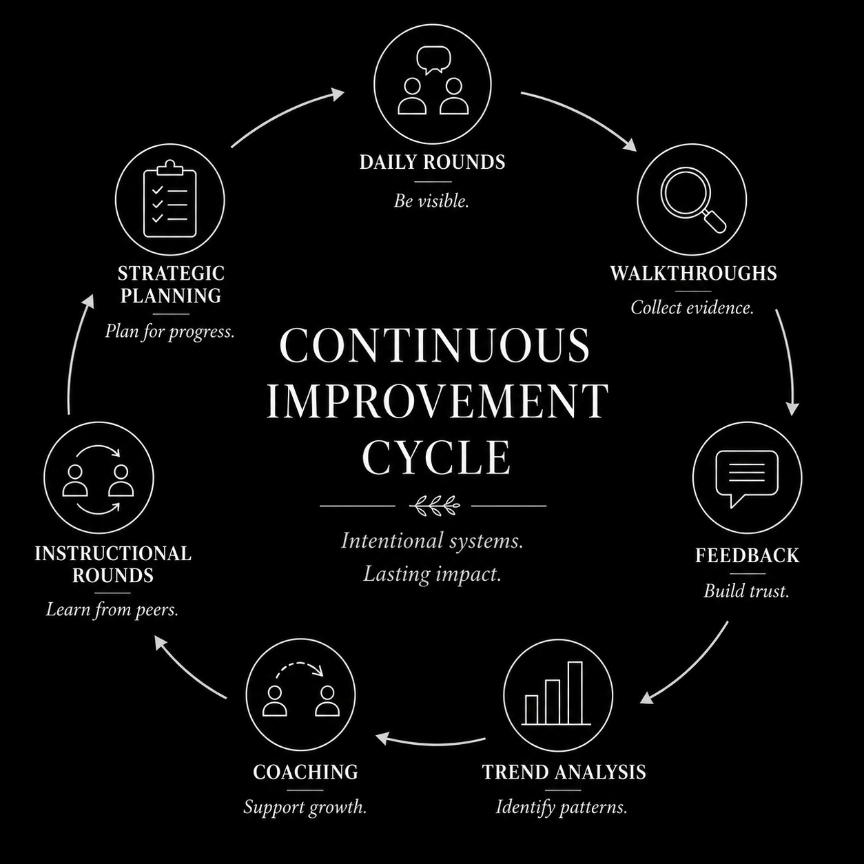

Slide 7
DAILY
daily visits to every classroom and program
relationship-based check-ins
rounds
instructional and operational awareness

Slide 8
reduced
emails
improved trust
IMPACTS
of daily rounds
faster
communication
greater visibility

Slide 9

MONDAY
Morning Move
Block 30 minutes on your calendar every day for uninterrupted campus rounds before opening your email.

Slide 10
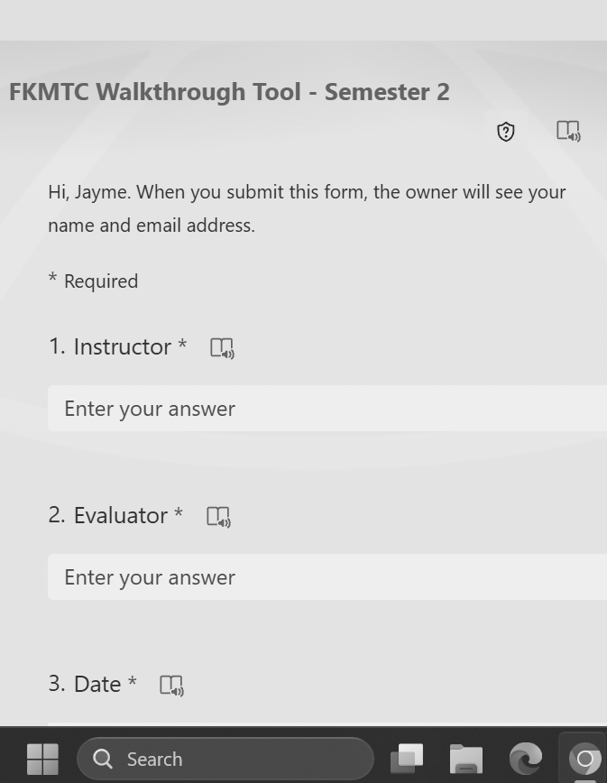
WALKTHROUGH
systems

Slide 11
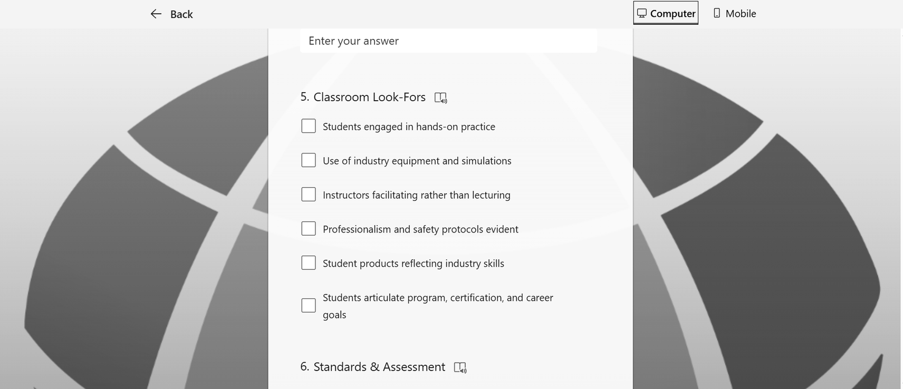
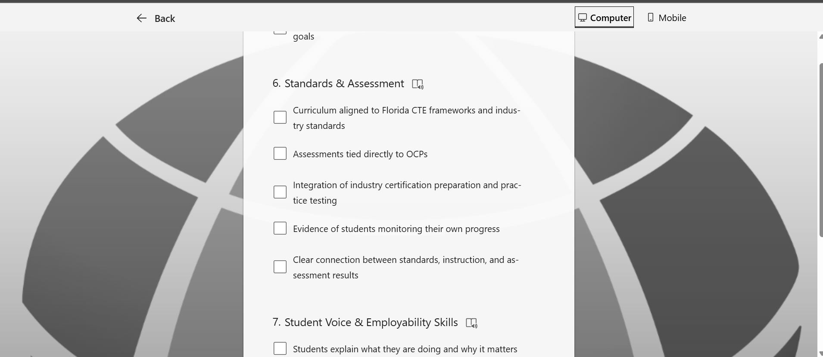
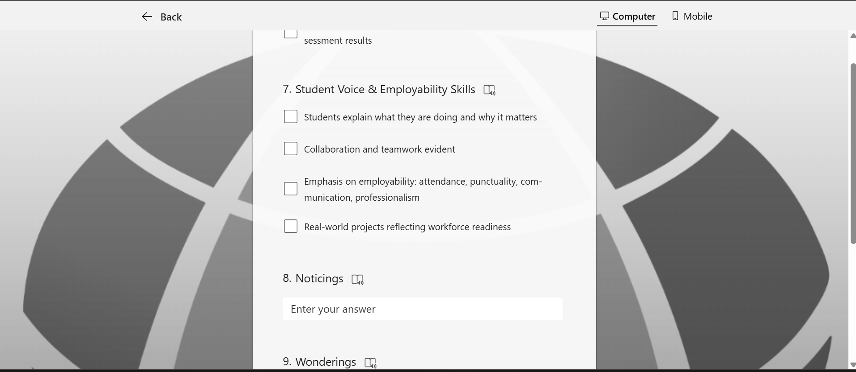
Classroom Look-Fors
Standards & Assessment
Student Voice & Employability

Slide 12
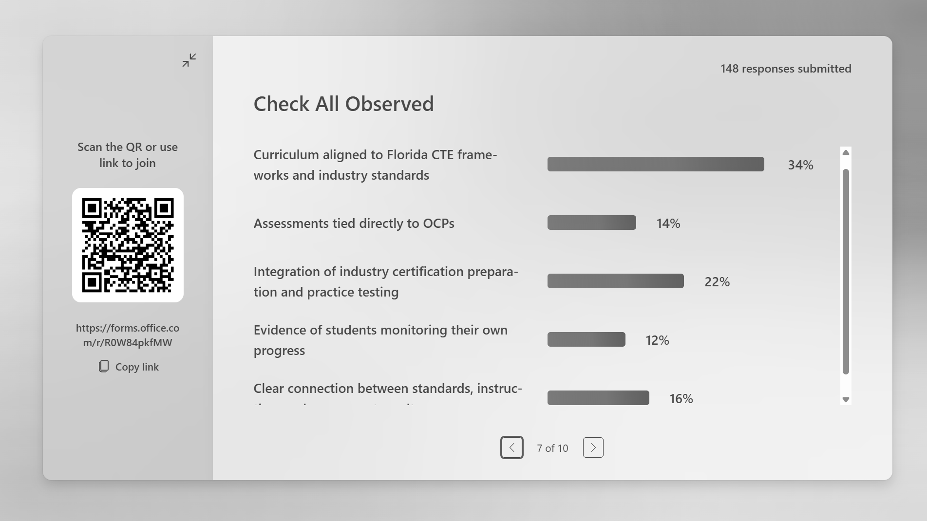
WALKTHROUGH
trends
identify strengths
identify coaching needs
identify leadership priorities

Slide 13
MONDAY
Morning Move
Create a simple walkthrough form with no more than 5 instructional look-fors.
Notes:
Tonia

Slide 14

FEEDBACK
that builds culture
Positive written feedback builds morale and trust.

Slide 15
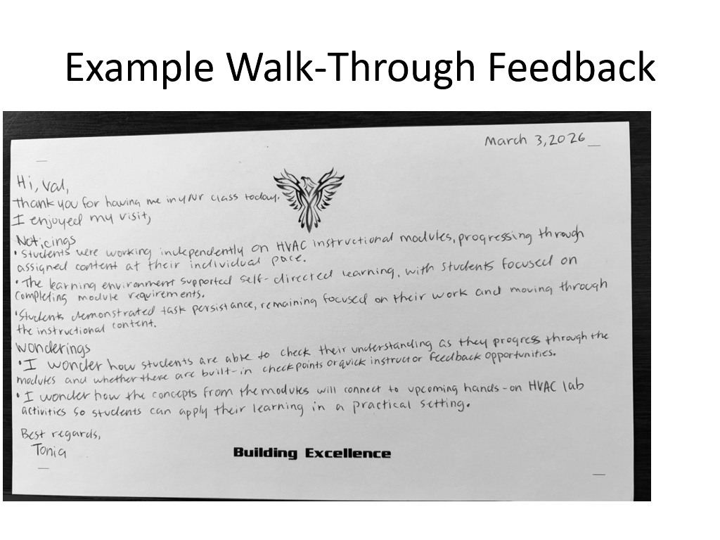
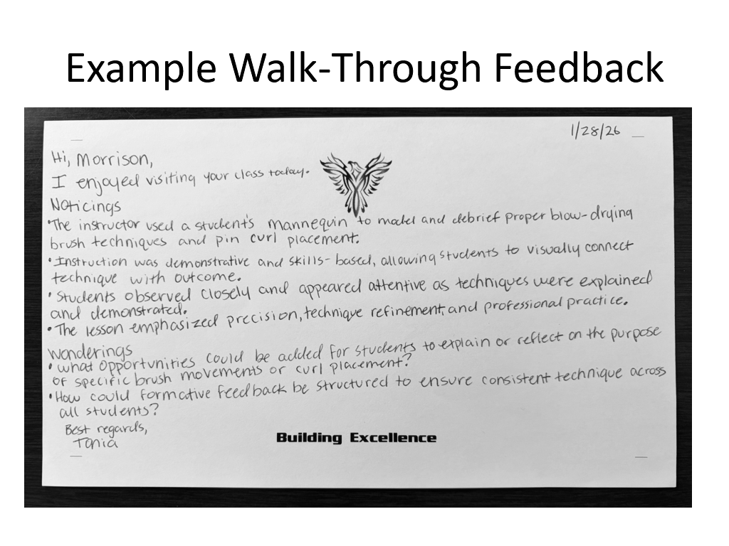
WALKTHROUGH
feedback

Slide 16
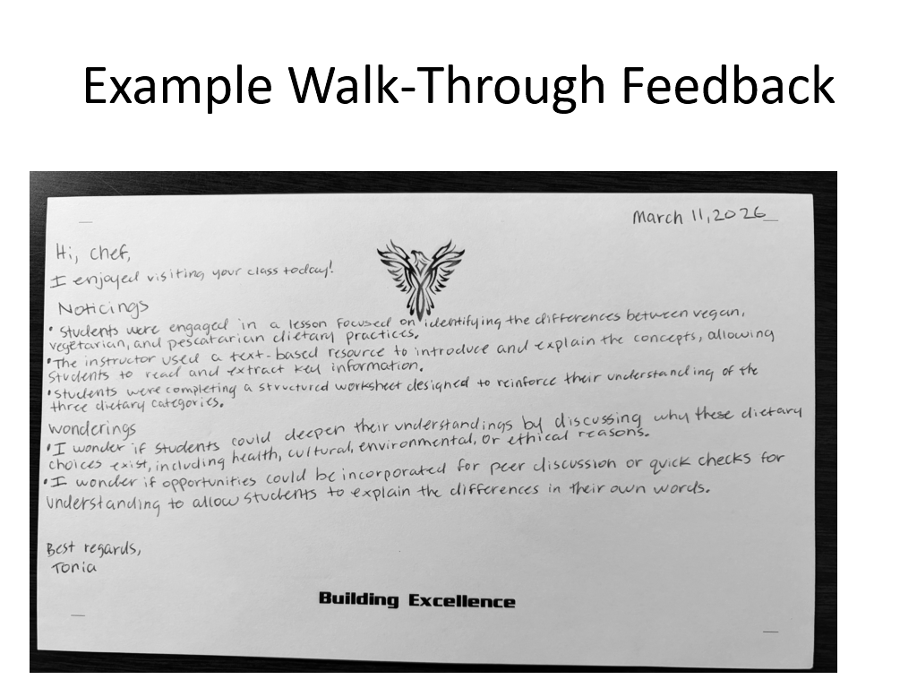
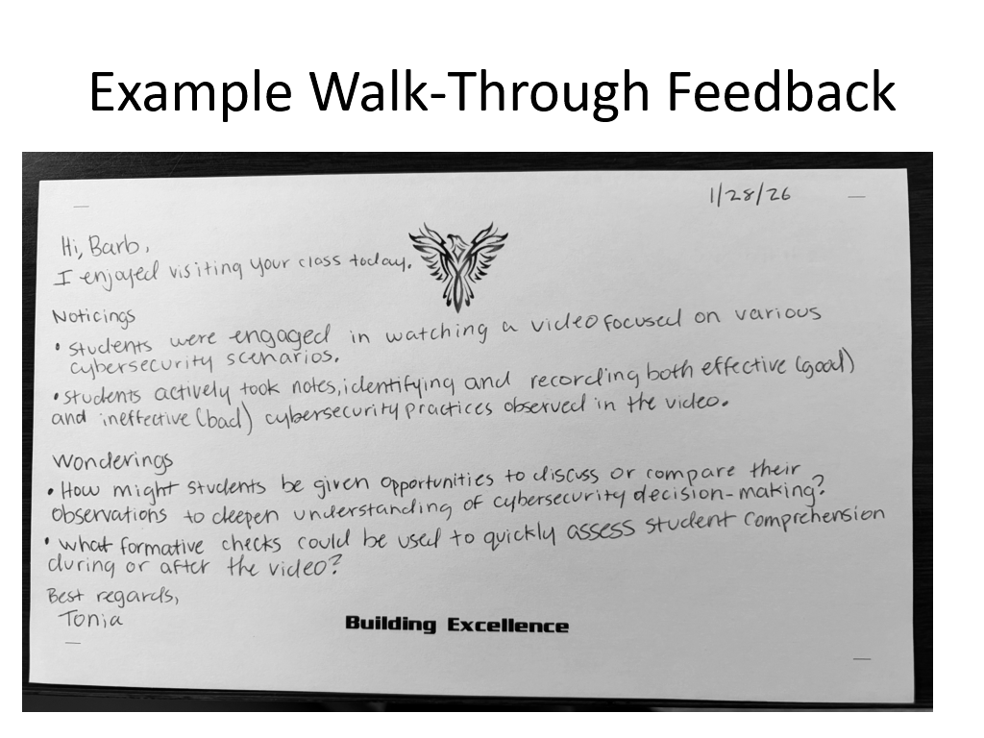
WALKTHROUGH
feedback

Slide 17
MONDAY
Morning Move
Send one handwritten “Noticing & Wondering” note to an instructor this week.

Slide 18
WALKTHROUGH
trends
identify strengths
identify coaching needs
identify leadership priorities

Slide 19
Based on walkthrough data, we offered PD on:
WALKTHROUGH
note-taking
content review
trends
test-taking strategies
classroom management
student-led discussion

Slide 20
MONDAY
Morning Move
Review one month of walkthrough data and identify your top three instructional trends.

Slide 21

from feedback to
COACHING
classroom trends
concerns persist
immediate improvement needed

Slide 22
relay
COACHING
01
determine focus area
02
identify one high-leverage, actionable teaching skill
03
practice/model the strategy
04
set follow-up expectations
05
check implementation

Slide 23
COACHING
conversation
Scenarios:
A - Students are watching videos without notes or an assignment.
B - Students are in the shop wearing Crocs and no safety equipment.
C - Students have 45 minutes left in class but no assigned tasks.

Slide 24
MONDAY
Morning Move
Schedule one coaching conversation focused on a single, actionable improvement goal.

Slide 25
01
identify classroom structures through walkthroughs/rounds
02
INSTRUCTIONAL
secure host classrooms with instructor
03
build and communicate schedule
rounds
04
develop note catching strategy
05
frontload before - set expectations and provide specific look-fors
06
debrief after - What did you see that you’d like to adapt for your class? What support do you need to make that happen? Act on it!

Slide 26
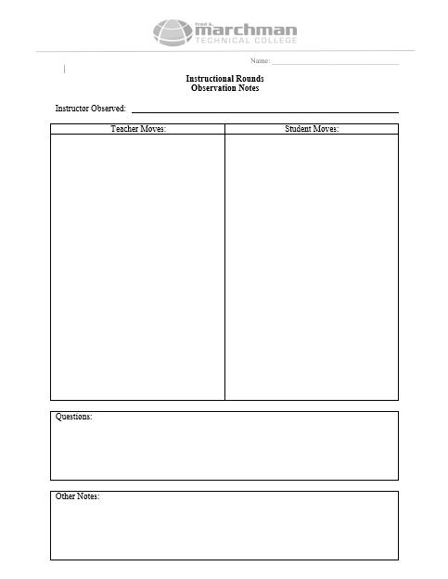
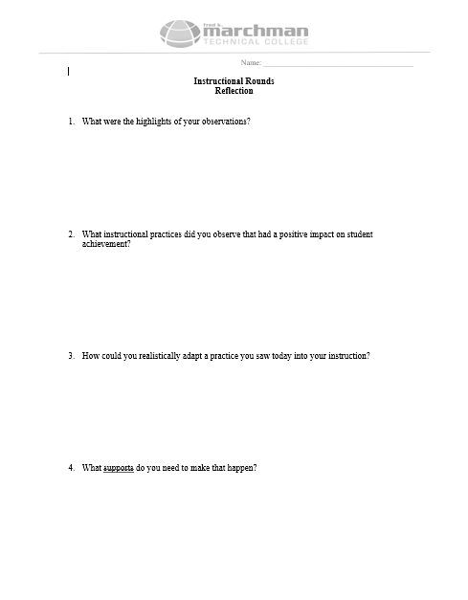
FOCUSED
deliverables

Slide 27
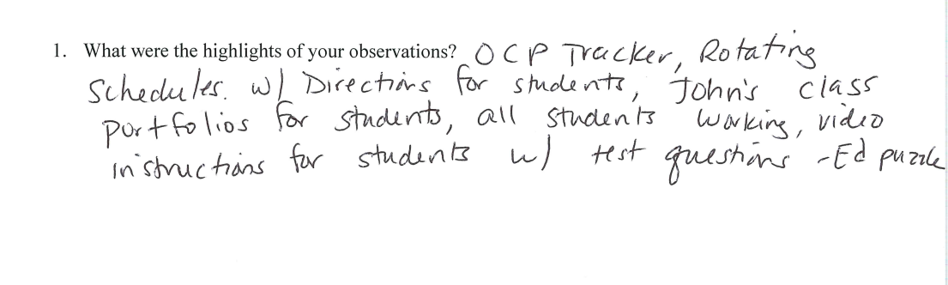
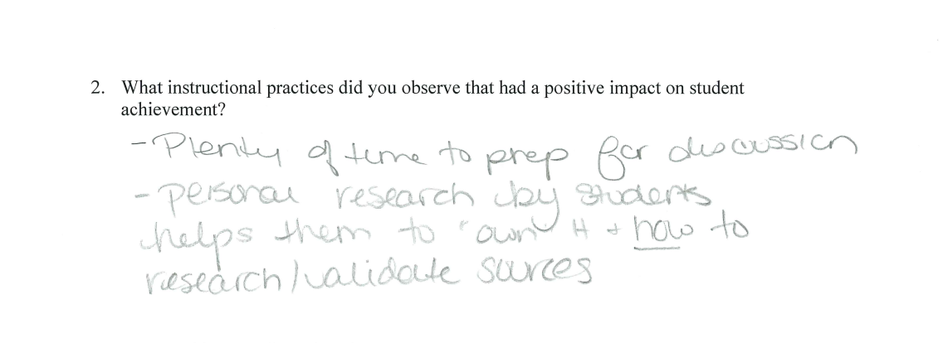
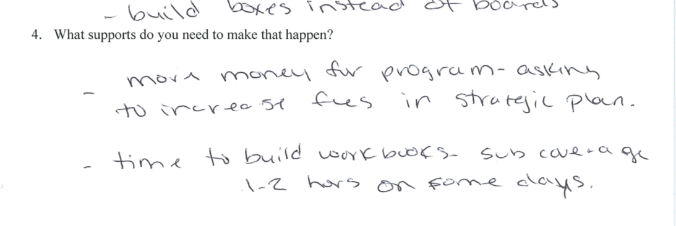
INSTRUCTOR
reflections

Slide 28
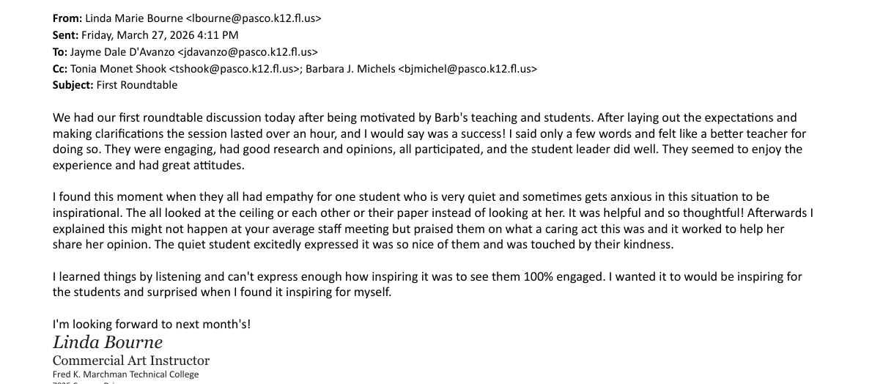


Slide 29
MONDAY
Morning Move
Identify strengths of three instructors that would benefit others to observe.

Slide 30
annual half-day meetings between admin and instructors
STRATEGIC
provided with preparation checklist months in advance
topics: instructional materials, fees, certifications, program needs, document review, program planning
planning
agenda aligned with prep sheet to keep meeting on track
collaboratively make meaningful decisions about the program

Slide 31

why
INSTRUCTOR-LED
planning works
increased commitment
stronger reflection
realistic forward planning
implement advisory feedback

Slide 33
MONDAY
Morning Move
Before you leave today, write down one move you’ll implement next week. Small consistent actions create lasting change.

Slide 34
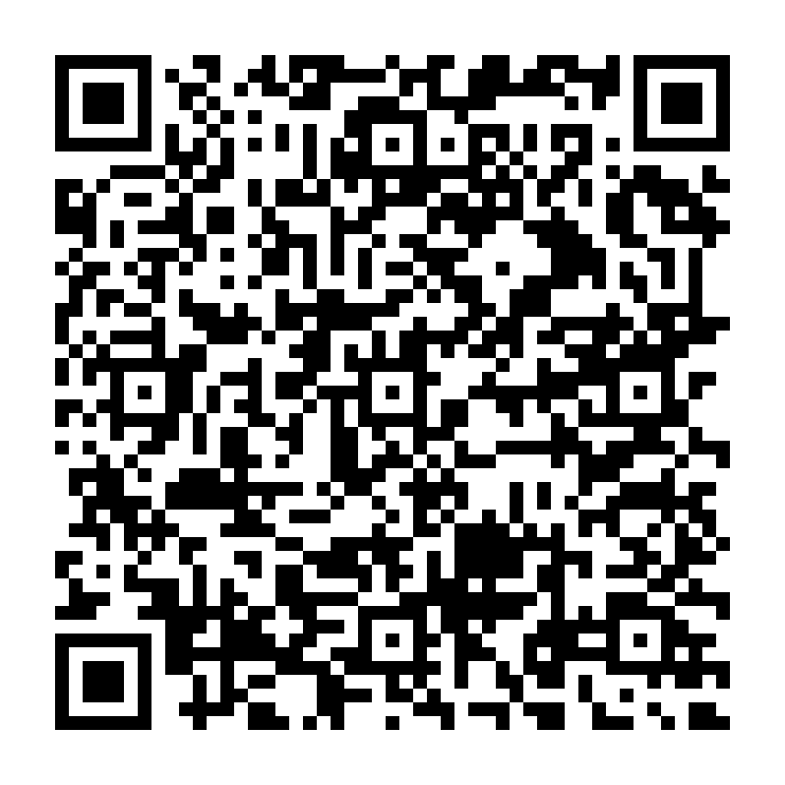
RESOURCES

Slide 35
Presenters
Tom Saxton
Manatee Technical College
saxtont@manateeschools.net
Tonia Shook
Marchman Technical College
tshook@pasco.k12.fl.us

Slide 36
THANK YOU

