Slide 1

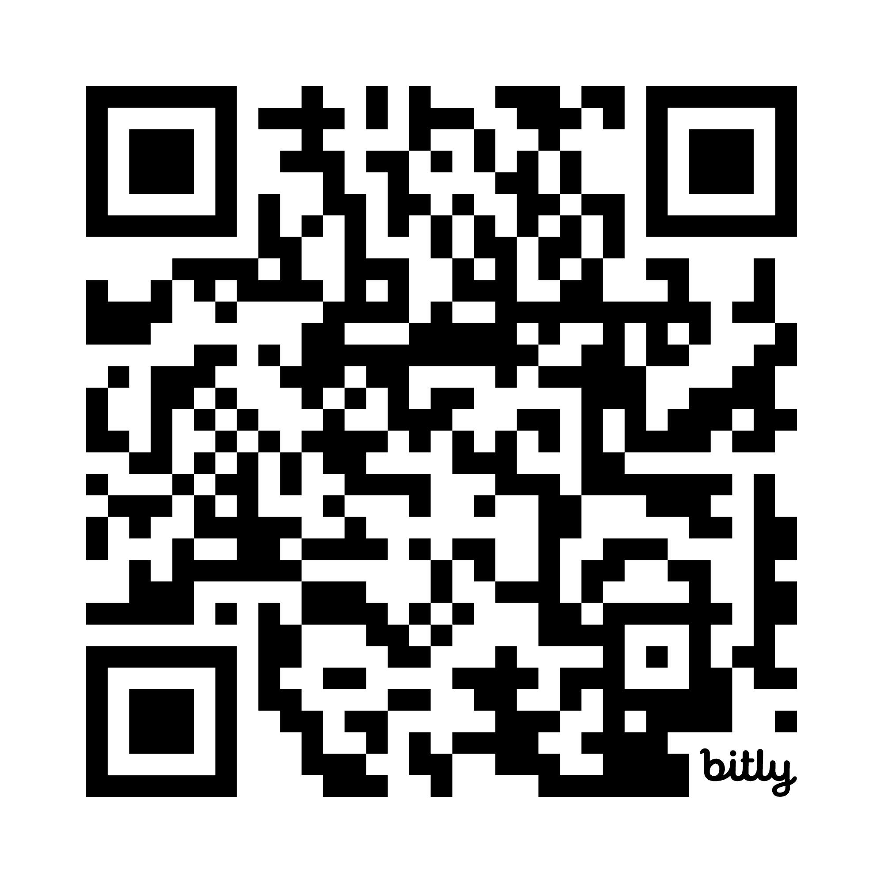
Understanding & Meeting the Professional Development Needs of Post-Secondary CTE Educators
Home Base:
https://bit.ly/4cKk058

Slide 2
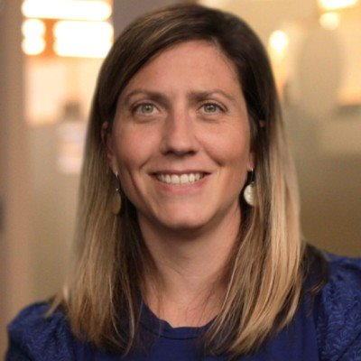
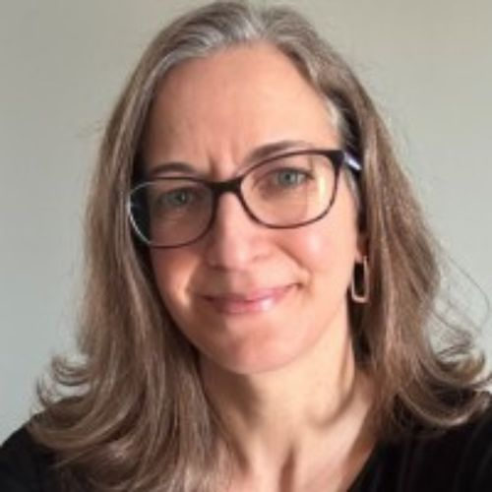
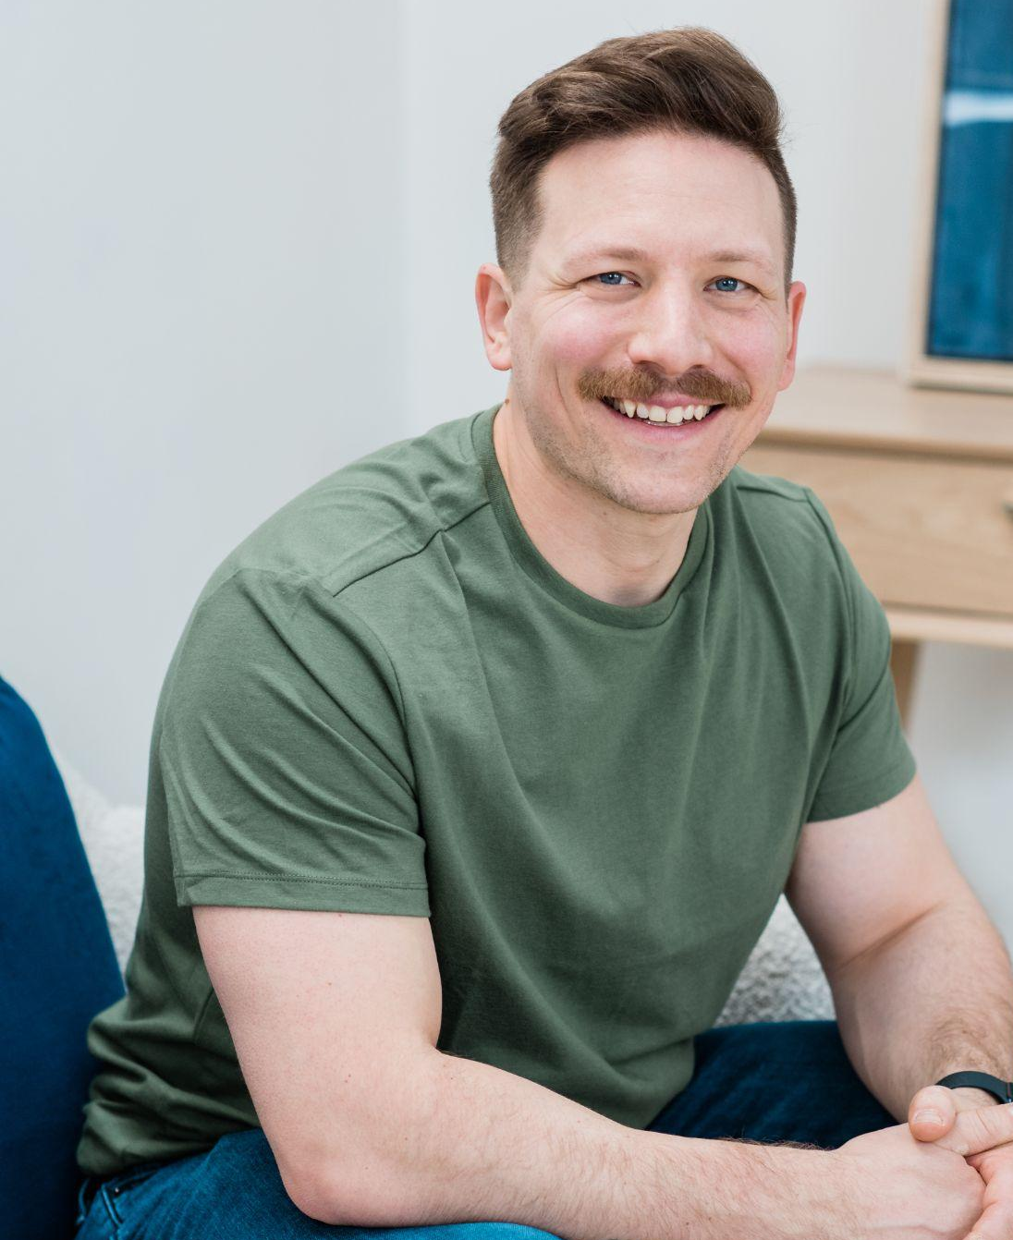
Introductions
Amanda Bastoni
CAST Director Career Technical & Adult Education
Virginia Zimmerman
Michigan Department of Labor and Economic Opportunity
Nolan Lienhart
Michigan Department of Labor and Economic Opportunity

Slide 3
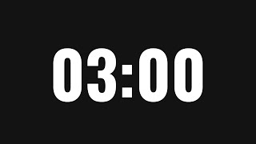
Which quote resonates most with you?
Introduce yourself to someone sitting next to you and share…
I’m concerned because I see a lot of CTE administrators with little CTE experience or CTE pedagogy hiring and evaluating CTE educators.
I really enjoy teaching, and I feel comfortable with my subject, but I wasn’t prepared for the variety of needs my students would have.
There is not a specific training or certification for CTE administrators in my region and having a general principal certification is really not enough to be an effective CTE administrator.
CTE teachers often feel like they are working in silos. They might be, for instance, the only automotive, cosmetology, or culinary teacher in the entire district.
Notes:
Introduce yourself to someone sitting next to you and share…
I’m concerned because I see a lot of CTE administrators with little CTE experience or CTE pedagogy hiring and evaluating CTE educators.
I really enjoy teaching, and I feel comfortable with my subject, but I wasn’t prepared for the variety of needs my students would have.
There is not a specific training or certification for CTE administrators in my region and having a general principal certification is really not enough to be an effective CTE administrator.
CTE teachers often feel like they are working in silos. They might be, for instance, the only automotive, cosmetology, or culinary teacher in the entire district.

Slide 4
Background Research
There is a shortage of CTE educators and leaders
No national standards currently exist for CTE educators or administrators
Most CTE administrators wear multiple hats
The majority of CTE educators are career changers
More teachers from non-CTE programs transition to become CTE leaders
Career and Technical Education Leadership Series: Landscape of CTE Leaders
Staffing Outside the Box: Strategies for Addressing CTE Teacher Shortages (August 2024)
CTE Educator Pipeline Toolkit
Bridging the Gap: Aligning CTE PD with teacher needs
Notes:
There is a shortage of CTE leaders
No national standards currently exist specifically for CTE administrators
Most CTE administrators wear multiple hats
There is no such thing as a typical CTE administrator or CTE administrator preparation
More teachers from non-CTE programs transition to become CTE leaders

Slide 5
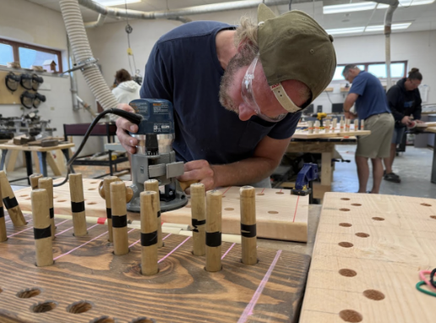
Goals Drive Learning and Clarify Expectations
You leave this session with a better understanding of the professional development needs of postsecondary CTE educators.
Learn about an innovative approach MI is using to improve and increase access to PD for postsecondary educators and CTE administrators.
Notes:
You leave this session with a better understanding of the professional development resources available to CTE educators in MI.
Learn about an innovative approach MI is using to improve and increase access to PD for postsecondary educators and ways they are working to support deans and CTE administrators.

Slide 6
Who We Are…

Slide 7

CAST & LEO-WD
CAST is a national nonprofit education and learning science organization.
CAST leads, inspires and convenes a global community to design equitable, inclusive learning experiences
The Michigan Department of Labor and Economic Opportunity (LEO) connects education, workforce development, and economic development to prepare Michigan residents for high-demand careers while supporting employers and strengthening communities.
Notes:
Research, Professional Development, and Technology Design

Slide 8
UDL is already in Federal Legislation
HEOA2008
First federal legislation to define and endorse UDL
pre-service and in-service teacher preparation
postsecondary instruction
ESSA 2015
LEAs required to use funds for UDL designed technology
UDL as mechanism for equitable consideration of all students in State plans for assessment
UDL used for comprehensive literacy instruction
NETP 2016
inform educational research to improve classroom teaching
Be used to design more equitable assessments and make better learning tools and products
Perkins V 2018
UDL as an allowable use of state and local funds for training for CTE instructors working with English Learners (ELs) and individuals with disabilities.
Notes:
https://www.cast.org/impact/udl-public-policy
UDL was also required in the DOL TAACCCT grant - a $1.9 billion investment in community and technical colleges
CAST has a long history of funding by the National Science Foundation as part of its broadening participation in STEM mandate
The National Ed Tech Plan of 2010, 2016, 2016 NETP Higher Ed supplement and the current one under development all include UDL throughout.
Perkins V Special Populations Provisions, WIOA Youth Policy especially for Out of school youth and Pre-employment for SWDs is well served by UDL
In the apprenticeship realm, federal regulations around affirmative action and non-discrimination in training and employment, are driving trainers and employers towards UDL.

Slide 9
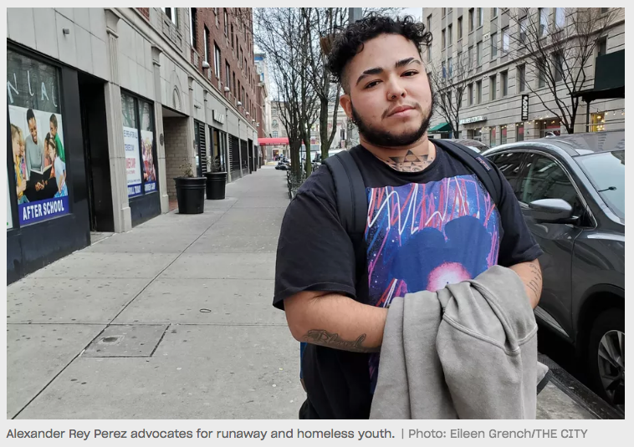


Special Populations
Individuals with disabilities
Individuals from economically disadvantaged families
Individuals preparing for non-traditional fields
Single parents, including single pregnant women
Out-of-workforce individuals
English learners
Homeless individuals
Youth who are in, or have aged out of the foster care system
Youth with a parent who: is a member of the armed forces, is on active duty

Slide 10
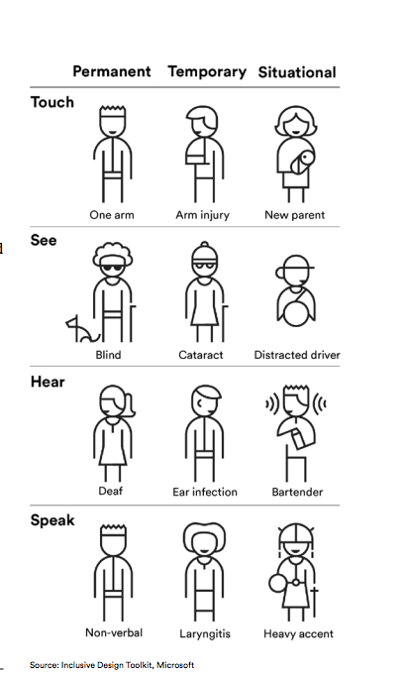
You Can’t Always See the Variability
28% of people in the US have a disability
80% of people globally have non-apparent disabilities
  Dyslexia
  Autism
  ADHD
  Medical
Microsoft illustrates this concept using three persons to describe different types of disabilities and difficulties experienced by everyone

Slide 11
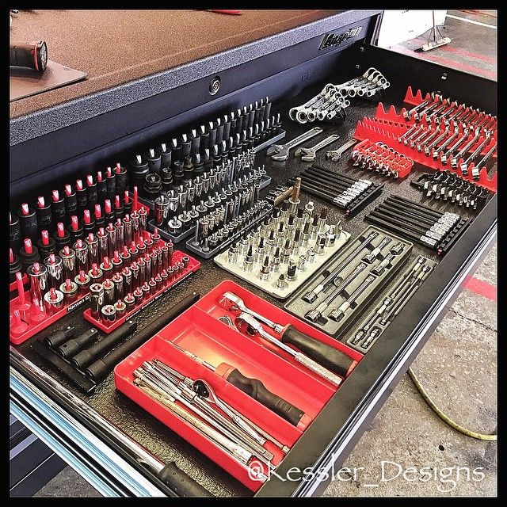
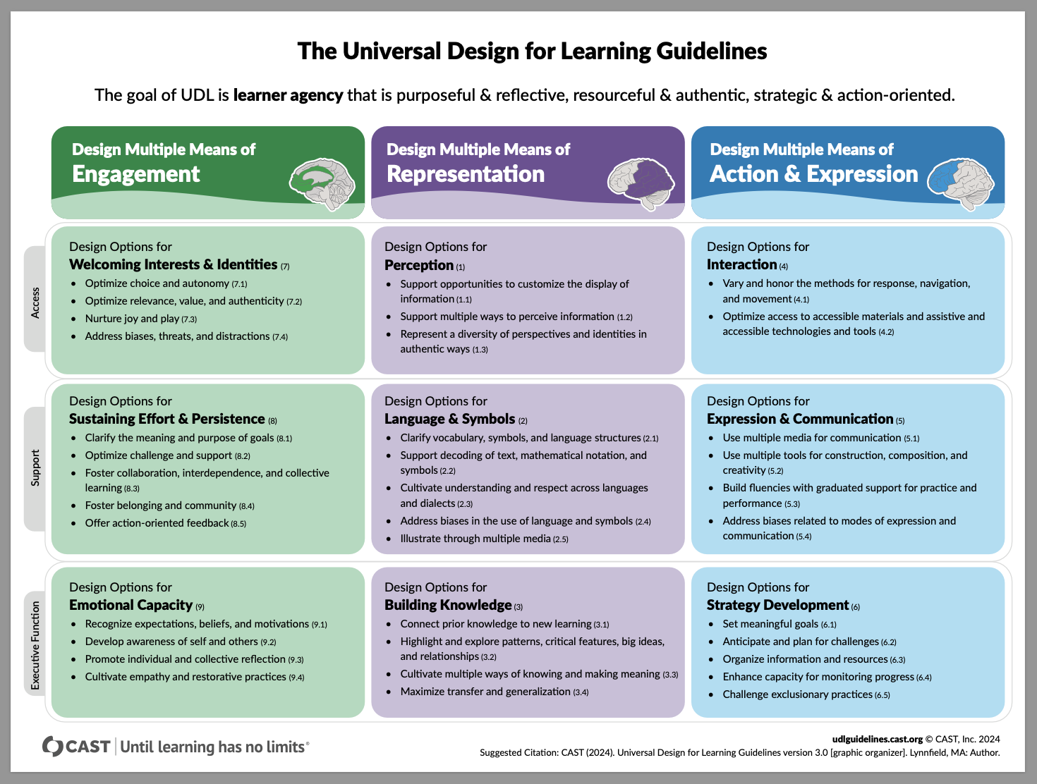
UDL Guidelines: Toolbox for Educators, Instructors, Trainers
Notes:
Udlguidelines.cast.org
Toolbox
Strategically towards a specific goal
Proactively to anticipate barriers
Proactively to design for expert learning
Reactively to identify and reduce barriers
Start (and stay!) small!

Slide 12
UDL Research
Using UDL for Inclusive Apprenticeships
The Evidence for UDL
UDL & Internships
CTE & UDL
Research, references, and articles that highlight the use and benefits of UDL in CTE, adult education, and career connected learning/workforce development.

Slide 13
The Project

Slide 14
Project Background & Goals
Nolan & Virginia
Project objectives, goals, and hopes
What did you hope to learn through this project?
Why was it important for you to better understand the PD needs of post-secondary CTE educators?
14,000+ - Michigan students participated in CTE in the most recent academic year.
55,431 - students completed CTE programs in 2024–25—a record, and more than double the 27,014 completers a decade earlier.
520,000+ -professional trades jobs are projected to be part of Michigan's economy by 2030.
Notes:
https://bridgemi.com/talent-education/more-michigan-students-pursue-trades-but-access-disparities-persist/

Slide 15
Started with a Gap Analysis: Comments
"…nothing is within driving distance..." (referring to networking)
"...they don't know what they don't know..." (referring to instructor training)
"...classroom approach, how to develop a quality test...the inner workings of how to be a good teacher..."
“…not everyone agrees with terminology…”
“…data people don’t understand what directors need…”
“…new directors training”

Slide 16
Professional development for CTE faculty is sorely needed and often under-prioritized. As technology continues to advance the problem becomes more acute.
Don Hutchinson, Macomb CC

Slide 17
Findings From the Literature
Most CTE educators report little or no on- boarding and do not truly understand their responsibilities
(Thierer, 2021).
“... my first year of teaching was so overwhelming [,] like drinking out of a fire hose” CTE faculty moving from industry to the classroom.
Training on disability is limited and disability training designed for CTE educators specifically is nearly non-existent (Carballo et al., 2021; Moriña & Carballo, 2017).

Slide 18
CTE Educators Need PD Designed for CTE
A 2026 study: Bridging the Gap: Aligning CTE PD with teacher needs
Work-Based Learning
Business & Industry Engagement
Advisory Boards
Virtual Hands-On Learning
The areas where CTE teachers reported the greatest gaps between their need for professional development and its availability.
Notes:
CTE educators need support that reflects the unique demands of their work.

Slide 19
What Does This Mean for the Design of CTE Professional Learning?
Design principle | What it means
CTE-Specific | Contextualized to CTE programs, content areas, and responsibilities
Practical | Immediately usable strategies, models, examples, and resources
Flexible | Multiple ways to access learning that reduce time, scheduling, and geographic barriers
Connected | Opportunities to learn from peers, industry, mentors, and other CTE practitioners

Slide 20
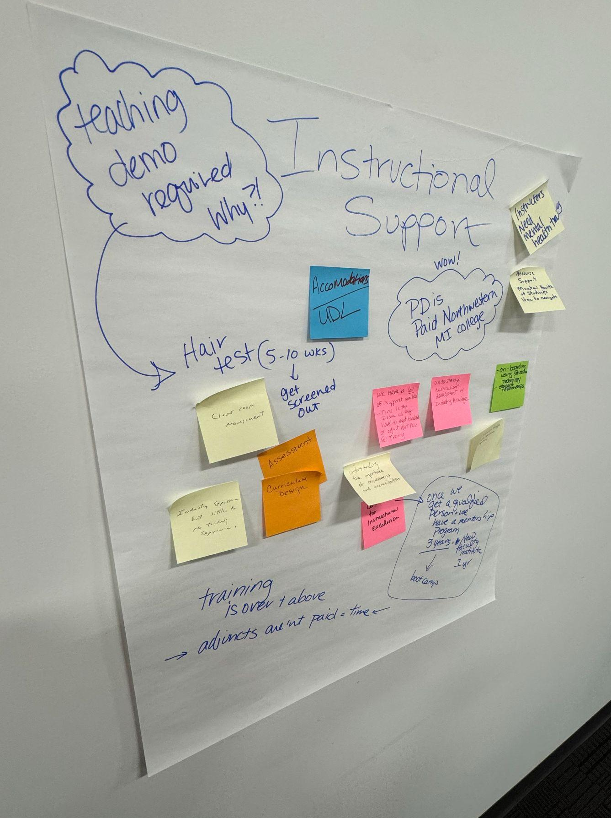
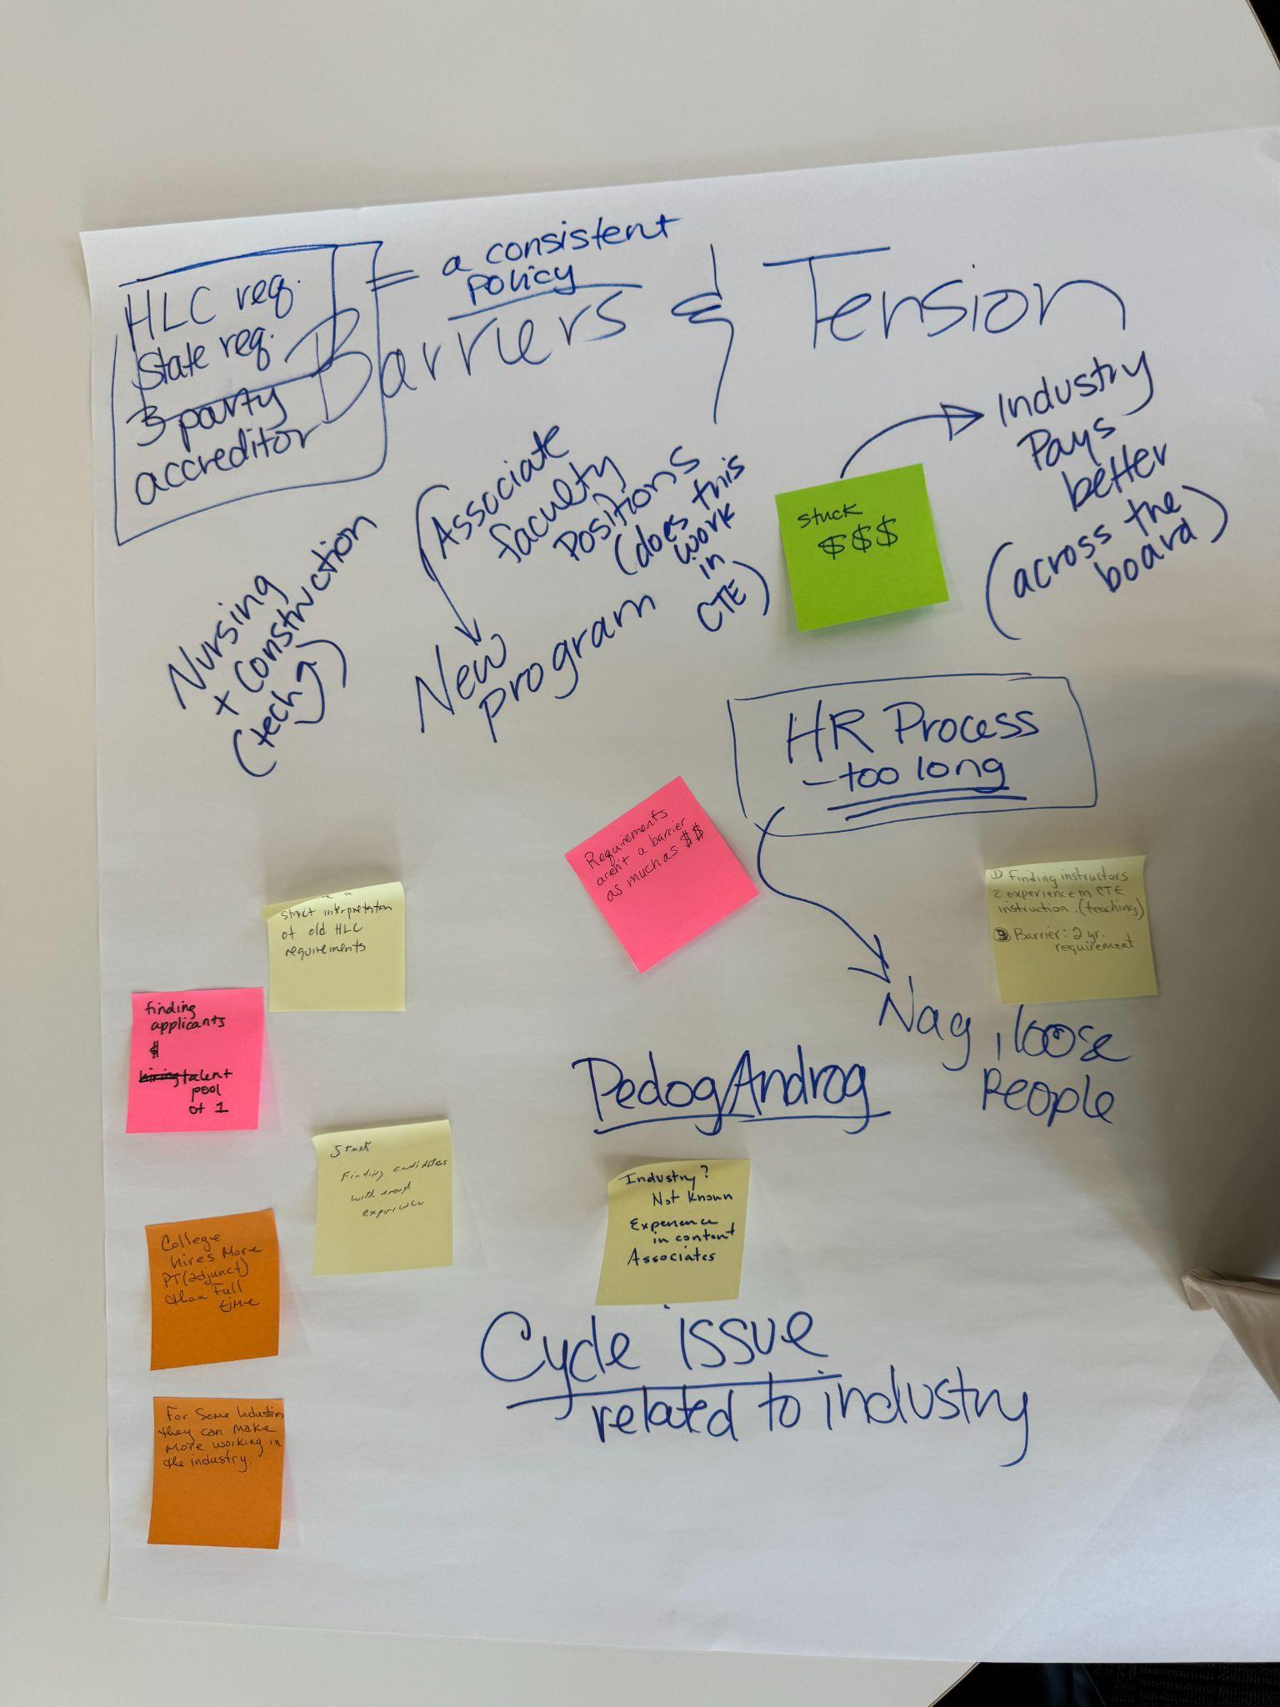
But what about CTE administrators?
Surveyed Institutions & Individuals
Years overseeing the Perkins Grant: 62.5% have 3 years or less
Biggest barriers to PD: Time and scheduling
Strong representation across institutions
https://bit.ly/4cKk058

Slide 21
Professional Development Needs
Needs:
The strongest demand is for practical, immediately usable resources
Leadership support is as critical as technical support
Eager to hear/learn what others are doing
From the survey:
Regular ongoing meetings for CTE Administrators and LEO staff
Coaching & Mentoring
A comprehensive administrative toolkit…
Keep up the good work (Nolan, Virginia, and Neco)

Slide 22

Reflection
Pair & Share
This makes me wonder…
This makes me think…
This makes me feel…

Slide 23
Our Solution

Slide 24
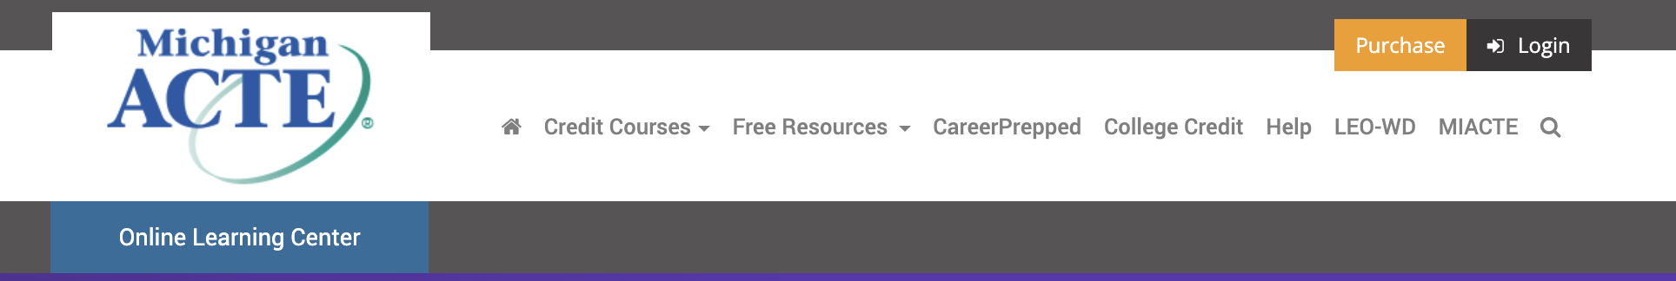
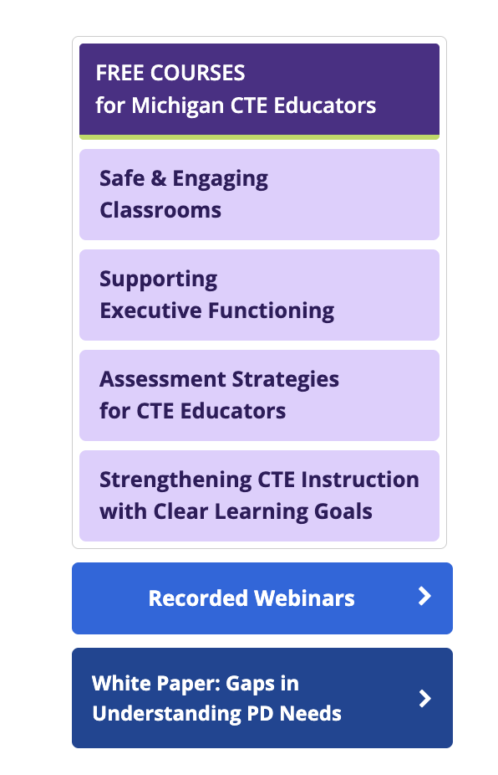
MI CTELearn Portal
This Michigan specific professional development offering of online asynchronous courses is designed to support both new and seasoned CTE programs. The information in each course was developed based on research from the field, interviews with CTE instructors and administrators from across Michigan, and the support of a state-wide selected advisory board.
Free courses!

Slide 25
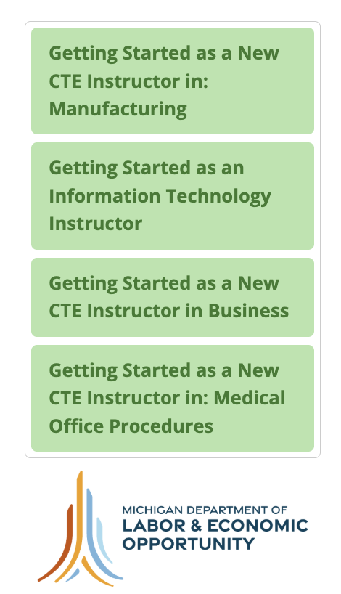
New CTELearn Courses
We determined that onboarding modules for new instructors would be incredibly useful. Paid: Writer & Reviewer
https://mi.ctelearn.org/leo/
Postcard with details for sharing
One-page information for sharing

Slide 26

For CTE Administrators
Generate a New Dean Toolkit
Facilitated Conversation Series
  Anyone can attend (Not just new Deans and Administrators)
Open Office Hours: Technical Assistance
Support the development of coaching/mentoring through MODAC

Slide 27
What CTE Educators & Leaders Need | Michigan’s Response
Flexible, accessible professional learning | FREE CTELearn Asynchronous Modules. Flexible online learning created by Michigan CTE educators for CTE educators. Module topics are generated by needs identified by the field and grounded in CTE contexts. Upcoming example: Advisory Board Development & Management.
Practical answers and technical support | LEO Office Hours. Open access to timely answers, guidance, and technical assistance not a formal presentation.
Opportunities to learn from other CTE leaders | Facilitated Conversation Series. Structured opportunities to connect, share practices, and problem-solve with CTE administrators across Michigan.
Support for people entering CTE leadership | New Dean Resources: Practical guidance, tools, and resources for new CTE deans and administrators.
Ongoing relationships and peer learning | Role-Specific Supports. Administrators: Coaching and mentoring through MODAC. Teachers: Collaborative module development with Michigan CTE educators, with an emphasis on supporting new teachers.

Slide 28
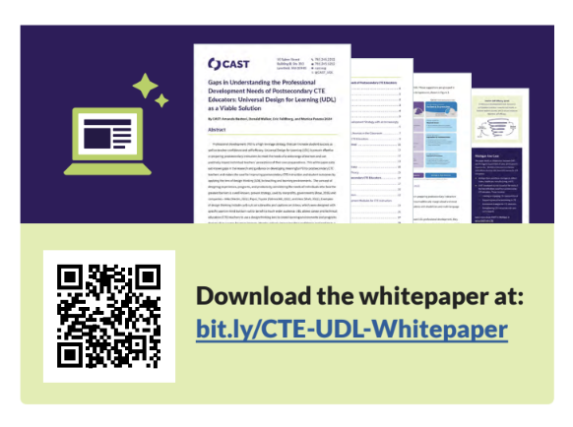
Next Steps
As you think about the educators in your programs…
Where do your educators need greater instructional support or professional learning today?
What types of professional learning would be most useful—and most realistic—for your educators to access?
How well equipped are educators to support special populations, and do they know how to connect with the people, resources, and services available to their students?
Based on what you heard today, what is one area of professional learning or support you would prioritize?
Gaps in Understanding the Professional Development Needs of Postsecondary CTE Educators: Universal Design for Learning (UDL) as a Viable Solution

