Slide 1
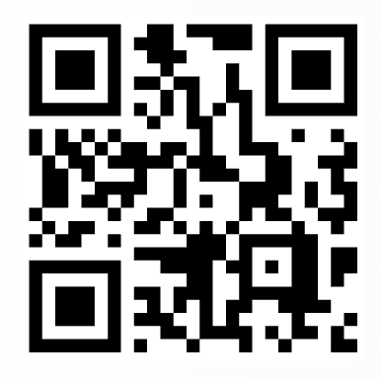
Identifying Skills and Naming Support
Drives Student Success
A roundtable conversation about making skills visible and supporting students to completion
ACTE PostSecondary Summit 2026

Slide 2
The gap: students have the skills. They do not always have the language.
FACULTY
ADMINISTRATORS
INDUSTRY
Students learn real skills, but program learning outcomes often use academic language that does not match job postings.
Students face real barriers to completion. Even capable students can slip through without a way to articulate what they can do.
Creating additional student supports so students can focus on the classroom experience and skill mastery.
Employers want our graduates, but students may not recognize themselves in the language of the job posting.
The challenge is not necessarily a skills gap. It is often a translation gap.
2

Slide 3
Two problems have to be solved together
1 THE LANGUAGE GAP
2 THE COMPLETION GAP
We teach what employers want. We do not always name those skills in employer-facing language.
Example:
“Demonstrate the ability to assess behavioral health needs” → “Behavioral health needs assessment”
Students face barriers that can interrupt progress. The intake survey gives the institution a way to see those barriers and connect students with support.
Solving for the barriers allows students to focus on skill development, and the ability to connect those skills to the workforce and articulate that.
“She had the skills. She had the drive. But if she did not graduate, the skills did not matter.”
3
Notes:
A student facing divorce and financial concerns was afraid she would not have enough aid to finish. The point is not the individual story alone; it is why skill identification and support must be connected.

Slide 4
How to start this work
Translating Program Learning Outcomes
Validate with
1
2
Refine
3
4
Faculty
Identify Core
Language
Add Industry
Confirm accuracy
Skills
Adjust for credential
Terms
with department
level and clarity
chairs
Extract specific skills
Incorporate relevant
from PLOs
certifications and
standards

Slide 5
What changed: students can see what they are learning
BEFORE
TRANSLATION
AFTER
Course and program language
“I learned this, but what do I call it?”
PLO → specific skill → employer term
Validated with faculty and connected to job postings.
Students recognize the skill
“I see this in a job posting. I am building this. Where and how do I practice it?”
5
Notes:
The key point: this is not about creating a common language across the college. It is about speaking the language industry already uses so students can recognize themselves in job postings.

Slide 6
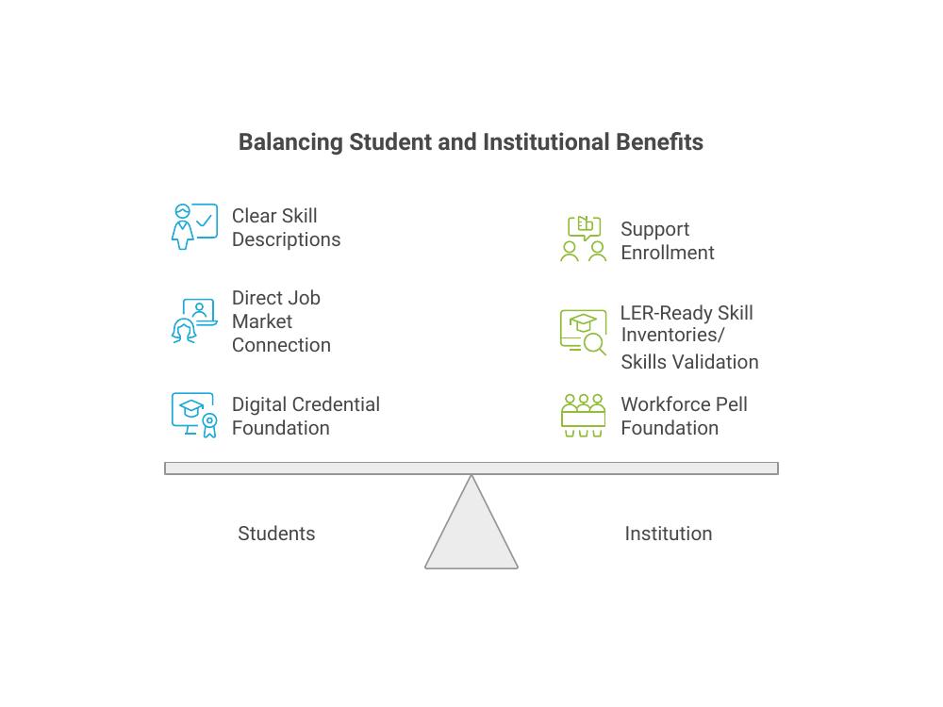

Slide 7
Our Survey found that naming skills is only half the work
~70
>50%
>⅓
1 STUDENT INTAKE
students responded
named financial concerns
asked for advisor follow-up
Employment goals + credential confidence + barriers
2 ROUTING
Responses go to a program coordinator for follow-up
The goal is visibility + response.
A student can only benefit from skills if they stay enrolled long enough to use.
3 CONNECTION
Coordinator connects the student with appropriate support
7
Notes:
The survey responses go directly to a program coordinator who connects students with support.

Slide 8
From CCA practice to a Colorado-scale opportunity
CCA HAS SHOWN A PRACTICAL MODEL
WHAT THIS POSITIONS US TO BUILD
• Evaluated approved program learning outcomes
• Translate them using employer-facing language
• Validate with faculty
• Put the skills in students’ hands through assignments, and program mapping
• Identify barriers and route support
• Colorado Skills Forward pilot participation
• Learning and Employment Records (LERs)
• Skill evidence in the Colorado Talent Marketplace
• Stronger connections between education, employers, and students
• A clearer way for students to tell their story
The future opportunity: close the gap between what students know and what they can prove they know.
8

Slide 9
A repeatable process: translate what you already have
1
Review approved PLOs
2
Extract the skill
3
Check credential level
Use existing program review or accreditation documents.
Strip academic framing. Use noun and verb phrases.
Certificate = entry-level; AAS = applied scope; BAS = leadership, evaluation, or advanced judgment.
4
Add industry terms
5
Validate with faculty
Use certification, regulatory, or employer language where it exists.
(Advisory boards, job postings for actual job seekers)
Use a working document and track-changes feedback.
Translation, not standardization: use industry language so students can recognize themselves in the work.
9

Slide 10
Identifying skills
+
naming support
=
student success
Questions: How might this fit your context?
10

Slide 11
Misty G. Hull
Dean of Academic Success for Allied Health
Community College of Aurora
Misty.Hull@ccaurora.edu

