Slide 1
ACTE’s Postsecondary CTE Summit 2026
Powering Possibility: Advancing Postsecondary CTE Impact Sept. 16 - 18 I Arlington, VA
Beyond Instruction
Building Staff Capacity and Scaling Cybersecurity Work-Based Learning
STAFF
CAPACITY
ACTE Interactive Workshop • 45 minutes • Case-study format
RW2 Career and Technical Education • Cyber Conversations
LEARNER
CAPACITY
Dr. Joy Vann-Newton, Founder & CEO
WBL
OPPORTUNITIES
Notes:
0:00–0:01 | Welcome. Frame the workshop as a capacity-building story at two levels: staff and learners.

Slide 2
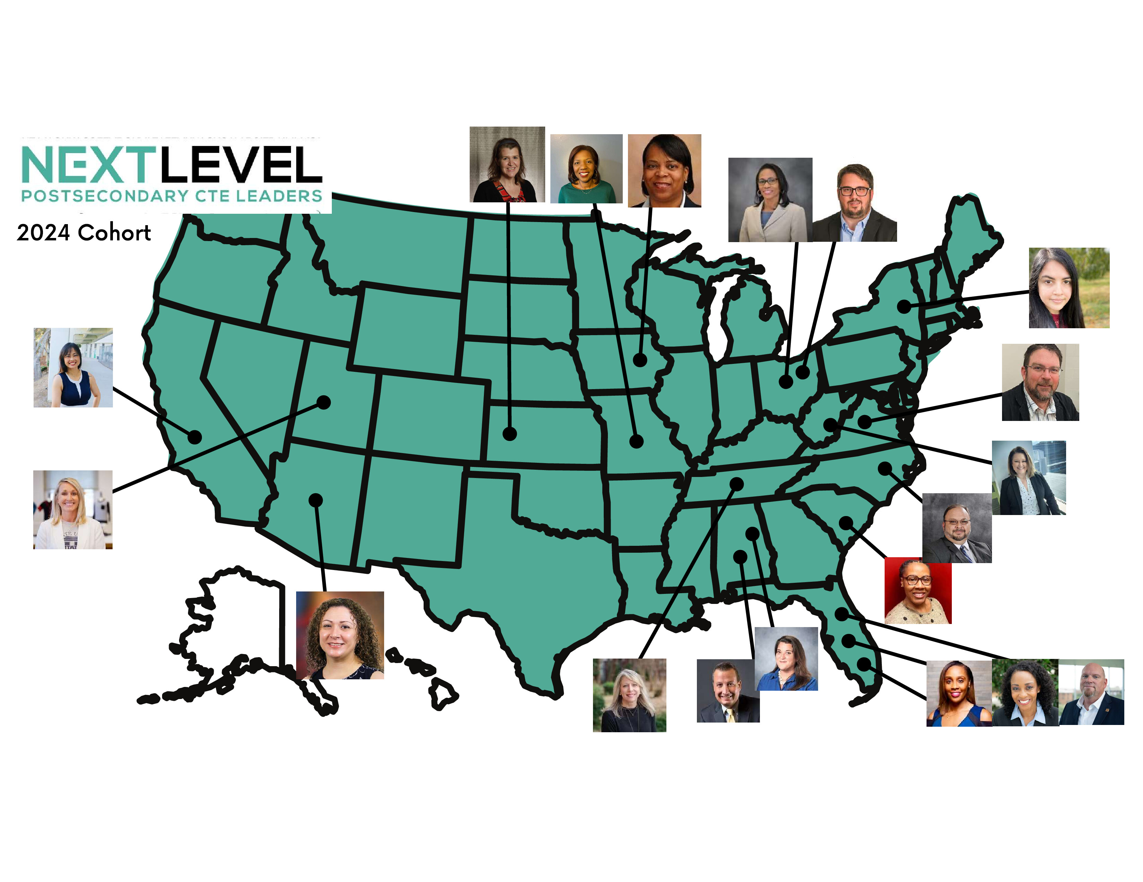


RW2 Career and Technical Education Overview
Mission: Changing the FACE; Closing the Gap in the nation’s
technically skilled workforce.
14–24-week programs – CADD, Revit/BIM, Cybersecurity, (Data Center Tech, pending)
The nation’s first African-American and woman-founded career and technical school
Certified by the Missouri Department of Higher Education and Workforce Development (MDHEWD)
Certified as an Eligible Training Provider by the MDHEWD
Articulation Agreement - Avila University
Values - ARISE: A = Above and beyond is our norm. R = Resiliency in life and work. I = Integrity in all we do. S = Structure for stability and change. E = Equity in education and the workplace.

Slide 3
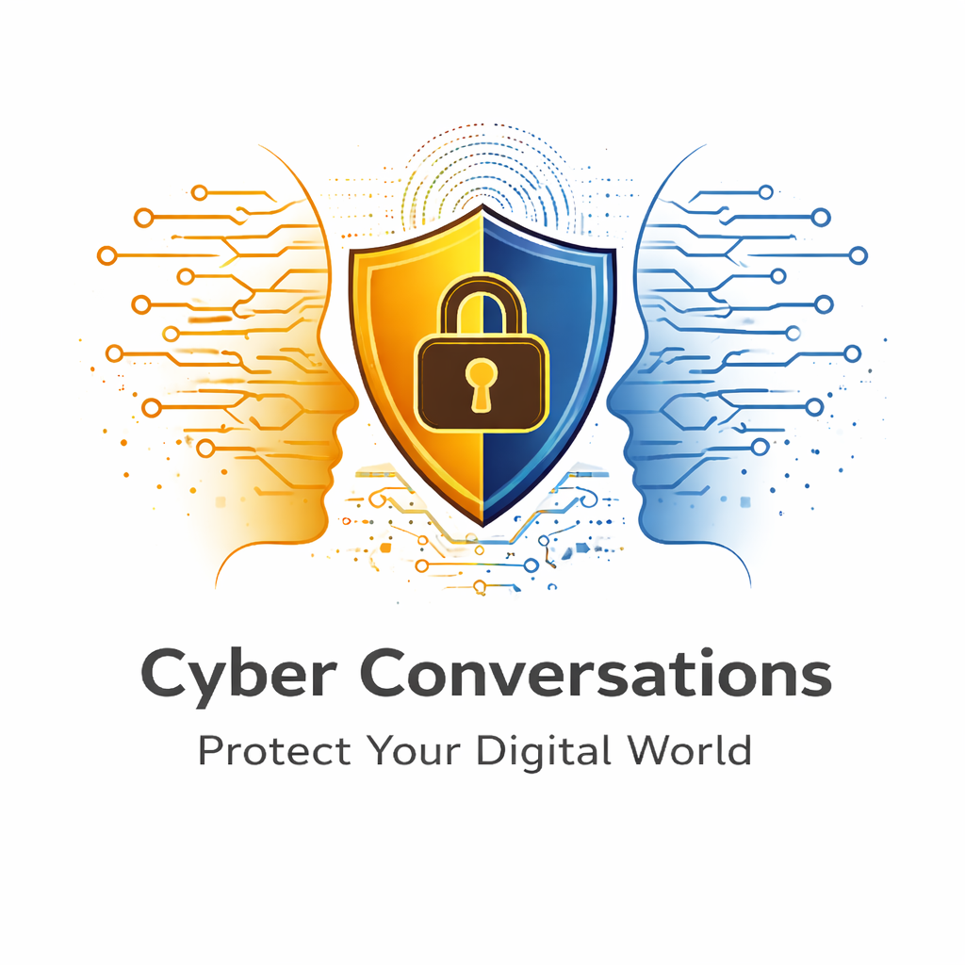
Beyond Instruction: Building Staff Capacity and Scaling Cybersecurity Work-Based Learning
Overview of Cyber Conversations – RW2’s Cybersecurity WBL initiative
An EMERGING WBL model builds staff and learner capacity to create and extend opportunities.
  Staff Capacity, Adult Learner Capacity, WBL Opportunities
Case Study Approach and Activities
    The Opportunities – Global Soccer Event, State of Missouri Sponsored Training
    Case Round 1: Staff Capacity
    Case Round 2: From Learner to Cyber Liaison
    Translating Training into a Client-Facing Framework
    Cyber Liaison Application and Outcomes
ACTE Transfer Activity: Build Your Version
Closing Takeaway – Three Investments for WBL – Build Staff and Learner Capacity and Authentic Work

Slide 4

WBL VIDEO

Slide 5
The Premise: Capacity Expands WBL Opportunities
An emerging WBL model builds staff and learner capacity to create and extend authentic opportunities.
“Work-based learning expands when institutions build staff who can operate as both educators and industry-connected professionals—people who translate workplace needs into learning, prepare learners for authentic work, maintain quality and boundaries, and build partnerships and systems that create more WBL opportunities over time.”
RW2 CURRICULUM FOUNDATION • Company X Capstone • Simulated consulting engagement • NIST CSF 2.0 & Other Cybersecurity Frameworks
BUILD STAFF CAPACITY
BUILD LEARNER CAPACITY
EXPAND WBL OPPORTUNITIES
Educator + industry-connected professional
Develop • coach • validate • supervise • support • enable WBL
Technical application + professional judgment
Understand • communicate • apply • document • escalate • grow
Repeatable preparation
More prepared facilitators
More authentic experiences
Additional pathways over time
Research synthesis used in this workshop: OECD (2021, 2022); Zhou, Tigelaar & Admiraal (2022); CCRC/WestEd; RAND (2026).
Notes:
0:01–0:03 | State the central premise. Add the RW2-specific starting point: the WBL opportunity did not begin with a blank slate; it grew from an existing cybersecurity capstone that already taught a NIST CSF 2.0-based consulting process. Then move to staff capacity, learner capacity, and WBL opportunities.

Slide 6
Opening Poll: What Does It Take to Expand WBL?
Audience engagement • 2–3 minutes
You have a strong cybersecurity instructor and capable students.
Is that enough to create meaningful, repeatable work-based learning opportunities?
A
Yes
B
Almost
C
No
D
It depends on how their roles are structured
Follow-up: What needs to exist between classroom instruction and responsibly placing learners in authentic work with real clients?
Notes:
0:03–0:05 | Poll by show of hands or live poll. Ask 2–3 people what has to exist between classroom learning and real client work. Listen for expertise, scope, coaching, quality, partnerships, and repeatable preparation.

Slide 7
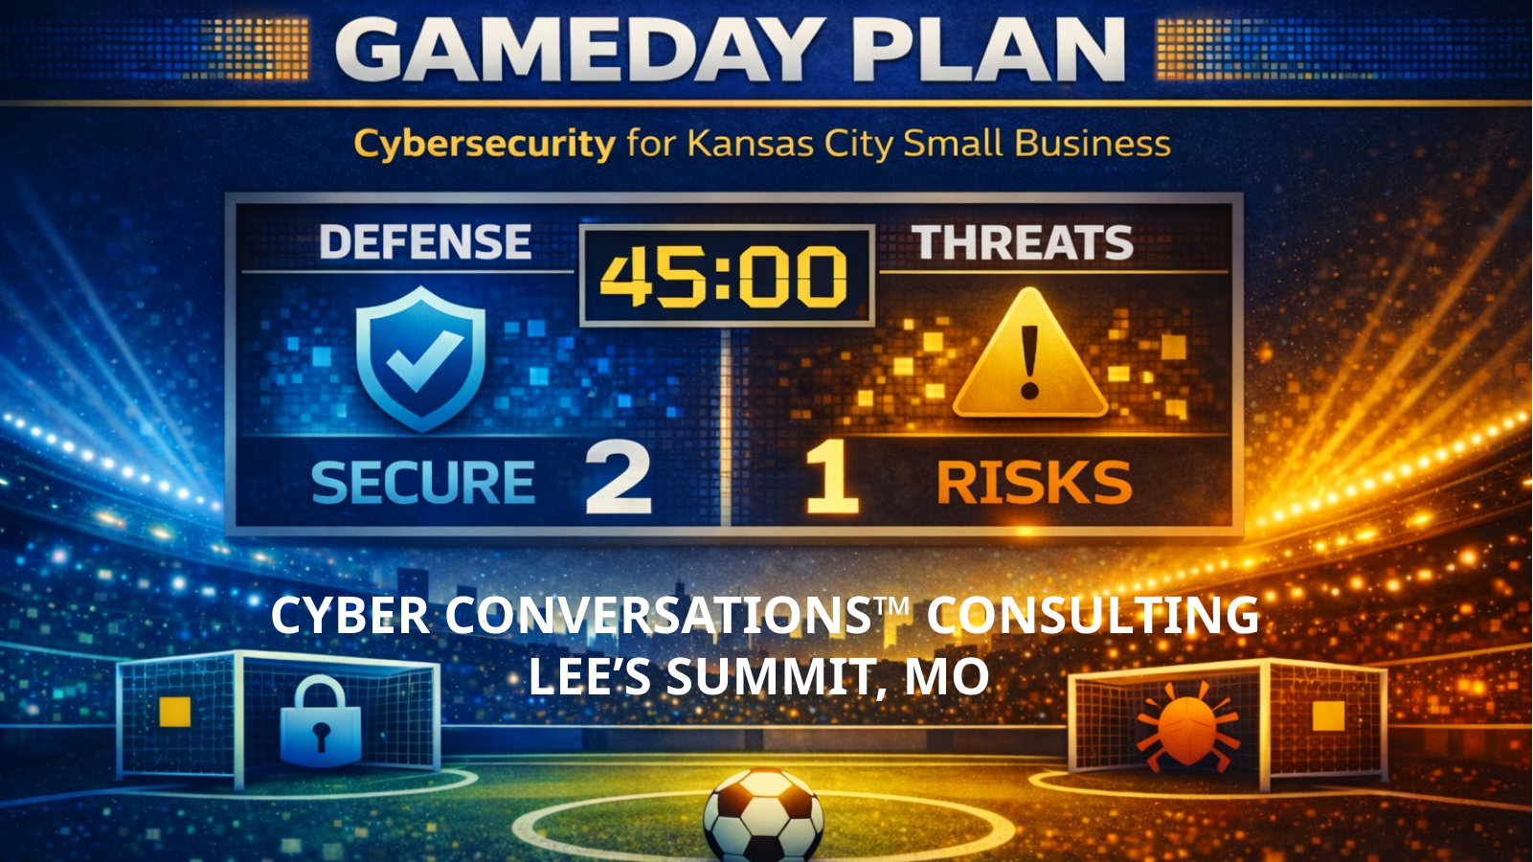
Case Study: The Opportunity
Global Soccer Event Small Business Readiness
PROJECT SNAPSHOT
THE CASE CHALLENGE
Audience
Retail • Hospitality • Lodging • Entertainment
Context
Small businesses preparing for increased cyber risk around a major international event
Delivery
In-person workshop — March 2026
Virtual workshop — April 2026
Your organization has been asked to help small businesses prepare for increased cybersecurity risks.
You have:
a cybersecurity instructor
adult cybersecurity learners / graduates
a real external audience
How would you build the staff and learner capacity needed to support this authentic WBL opportunity responsibly?
INSTRUCTIONAL FOUNDATION: RW2’s cybersecurity capstone uses a simulated consulting engagement with simulated cybersecurity consulting scenarios and NIST CSF 2.0 to assess organizational cybersecurity posture.
Case source: RW2 Cyber Liaison Case Study — World Cup Small Business Readiness (2026).
Notes:
0:05–0:08 | Introduce the opportunity, then make the curricular throughline explicit. Learners were not starting from zero: The hypothetical company scenarios already placed them in simulated consulting engagements, using NIST CSF 2.0 as the analytical lens. The WBL design challenge was how to move that consulting practice into a responsible external role.

Slide 8
Case Round 1: Build Staff Capacity for WBL
Table activity • 4 minutes
If you want to create and extend authentic WBL opportunities, what additional roles or capabilities should staff develop?
Identify 3–5 functions
Develop training materials
Validate technical content
Coach student facilitators
Define role boundaries
Provide technical backup
Ensure quality & consistency
Constraint: The goal is to build staff capabilities and supports that make high-quality,
authentic learner opportunities possible.
Notes:
0:08–0:13 | Groups identify 3–5 staff roles or capabilities needed to support authentic WBL opportunities. Ask 2–3 tables to share one. Do not reveal Dr. Horn’s actual expanded role until the next slide.

Slide 9
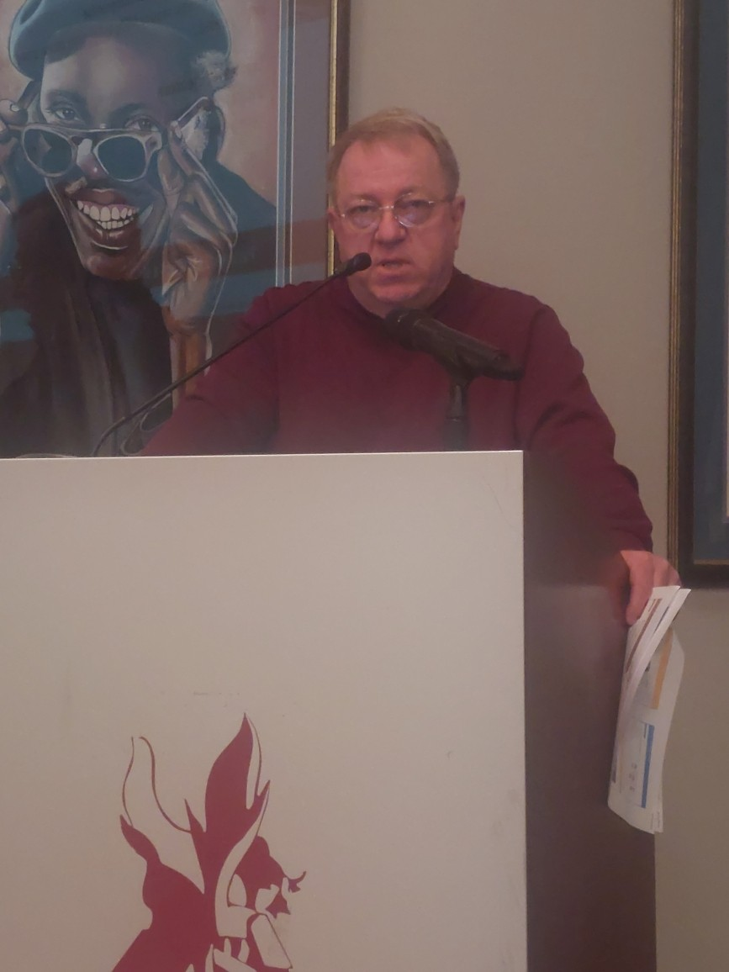
What the Research Says About Staff Capacity
The evidence base points to a broader role for CTE/VET instructors in authentic, industry-connected learning.
Dual professionalism
Workplace-connected learning
CTE instructors need both pedagogical competence and current occupational / industry expertise.
Professional learning is strengthened by collaboration, industry engagement, and workplace-linked activities.
Infrastructure matters
Adult learners need coordination
Cross-sector pathways and WBL opportunities are easier to create, sustain, and expand when institutions build coordinating roles, partnerships, and repeatable processes.
Organization–program partnerships for working adults depend on direct coordination and staff capacity—not only curriculum.
Research implication: staff capacity is both pedagogical and occupational — and organizational support helps institutions create and expand high-quality WBL opportunities.
Sources: OECD (2021; 2022); Zhou, Tigelaar & Admiraal (2022); CCRC/WestEd; RAND (2026).
Notes:
0:13–0:16 | Brief research grounding. Use “dual professionalism” as the key term. Note that the adult-learner evidence base is smaller, but it consistently highlights coordination and organizational partnerships.

Slide 10
Case Reveal #1: Staff Capacity Expanded Beyond Instruction
Dr. John Horn and Dr. Joy Vann-Newton brought complementary technical, training, and program leadership to the WBL effort.
DR. JOHN HORN
JOY VANN-NEWTON
Cybersecurity Instructor →
Senior Cybersecurity Consultant
Program Leadership &
Cyber Liaison Preparation
Trainer-of-Trainers
Content / Review
Technical Quality
Presentation Skills
Logistics
Administrator Engagement
• Developed train-the-trainer materials for Cyber Liaisons
• Created/reviewed World Cup and MOSOC cybersecurity content
• Connected content to RW2’s capstone and NIST-aligned risk thinking
• Provided technical quality review, backup, and scope protection
• Coached presentation skills, delivery, and confidence
• Coordinated workshop logistics and learner participation
• Engaged KC 2026 and MOSOC administrators
• Helped translate technical preparation into effective external engagement
Complementary staff capacity helped translate an existing instructional foundation into a structured, learner-led WBL opportunity—with technical quality, presentation readiness, logistics, scope, and partner alignment in place.
Notes:
0:16–0:19 | Introduce Dr. John Horn and Joy Vann-Newton as complementary capacity builders. Emphasize that Dr. Horn protected the technical throughline from RW2’s capstone/NIST-based preparation into World Cup and MOSOC content, while Joy built presentation readiness, logistics, and partner alignment. Ask: Which staff functions are essential when a classroom capstone becomes an external WBL experience?

Slide 11
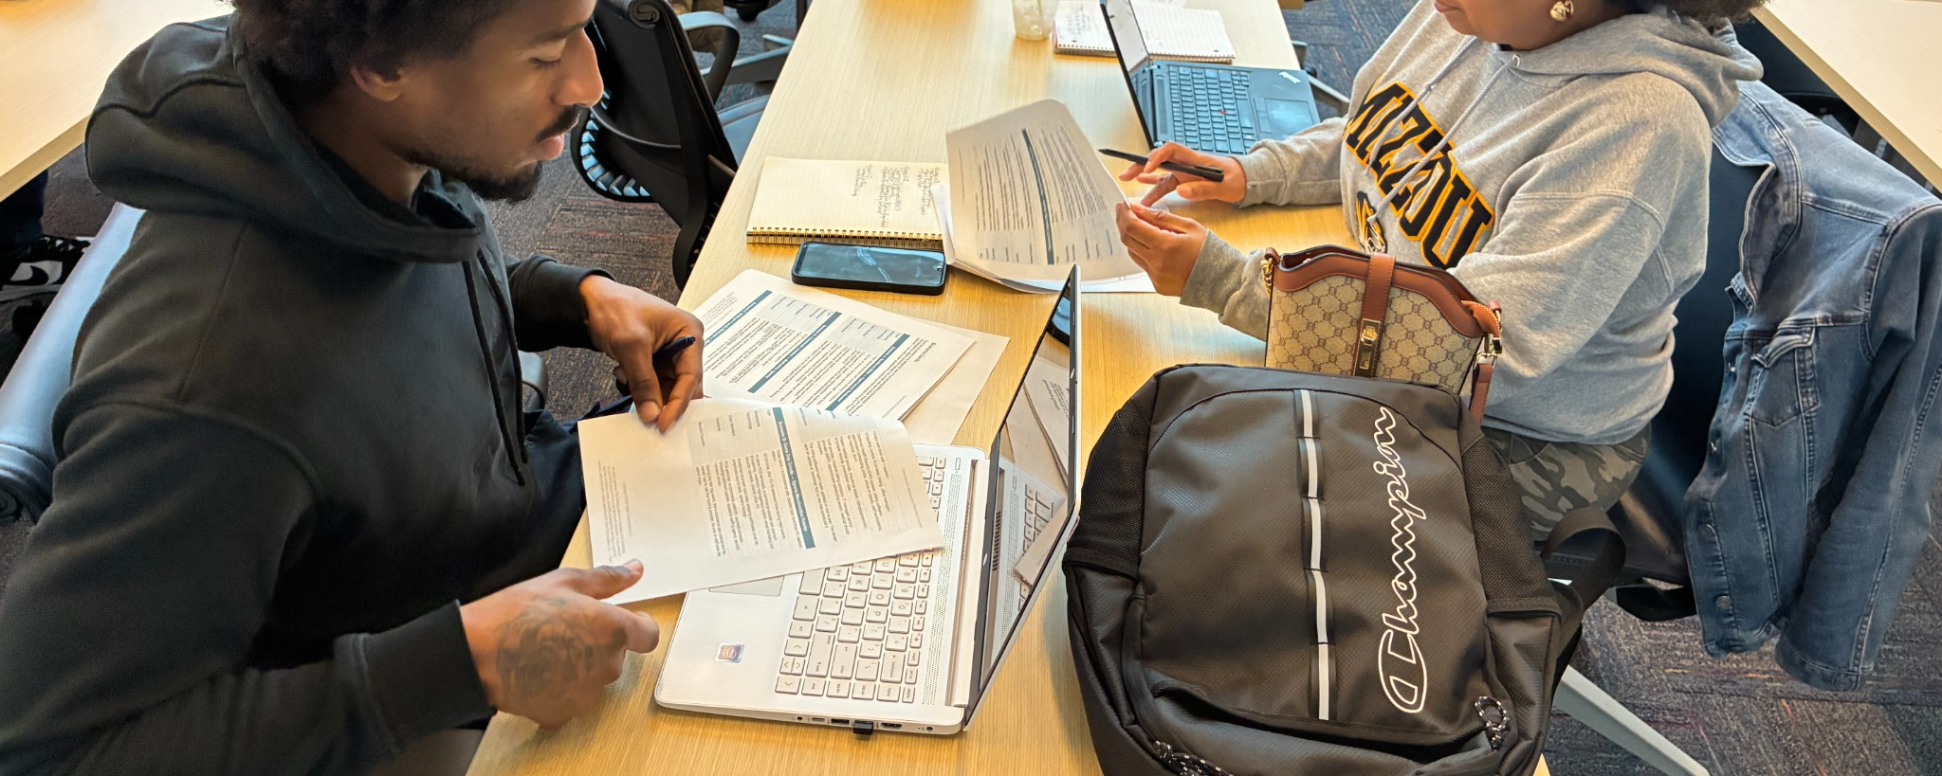
Case Round 2: Move From Learner to Cyber Liaison
Table design challenge • 5 minutes
Simulated consulting scenarios gave learners a simulated consulting process. Before they represent RW2 / Cyber Conversations with real organizations, what additional selection, preparation, and safeguards should be in place?
SELECT
ORIENT
PRACTICE
SUPPORT
How will learners qualify and be selected for the role?
What scope, conduct, and communication expectations must be explicit?
How will they rehearse the assessment process and hard conversations?
What expert support and escalation path must remain available?
Constraint: Move from simulated consulting to authentic WBL without turning learners into technical consultants, compliance advisors, or unsupervised practitioners.
Notes:
0:19–0:24 | Groups make four design decisions: selection, orientation, practice, and support. Remind participants that the learners already know a simulated consulting process from the capstone. The question is what must be added before they can represent the organization with real external audiences. Ask 2–3 groups to report one choice.

Slide 12
Case Reveal #2: How Cyber Liaisons Were Selected & Prepared
The transition from training simulations to work-based learning was structured—not informal.
FOUNDATION • Capstone, Simulated Consulting Scenarios • NIST Cybersecurity Framework (CSF) 2.0
1
APPLY + SELECT
2
SCOPE + CONDUCT
3
ASSESSMENT PRACTICE
4
REHEARSE + DELIVER
Cyber Liaisons applied for the role based on a job description.
The role had expectations, responsibilities, and boundaries before the learner entered the WBL experience.
Liaison Handbook + Code of Conduct
Field Guide with approved language, hard stops, confidentiality expectations, and out-of-scope responses.
Rule: Pause • Document • Escalate.
Cybersecurity Assessment Form + hands-on, team-based activity.
Learners experienced the assessment from three angles:
• business facing decisions
• consultant asking questions
• owner discovering gaps
Virtual + in-person prep
Paired planning
Workshop Q&A practice
Individual presentation
Live expert support available
FROM SIMULATED CONSULTING → SUPERVISED, AUTHENTIC AWARENESS-LEVEL FACILITATION
Case materials: Cyber Conversations Liaison Handbook • Liaison Field Guide • Training Outcomes/WBL Competencies/NIST alignment.
Notes:
0:24–0:27 | Reveal the actual transition architecture. First, Cyber Liaisons applied for the role based on a job description. Then explain the role-definition materials: handbook, code of conduct, field guide, approved scripts, hard stops, and escalation language. Highlight the Cybersecurity Assessment Form and the three-angle team exercise—business, consultant, owner—as a deliberate bridge from the simulated consulting scenarios into external readiness. Close with paired planning, individual delivery, and live expert support. Video can play after this slide.

Slide 13
Translating Training into a Client-Facing Framework
Cyber Conversations translated cybersecurity training and NIST-aligned risk thinking into four practical moves for organizational engagement.
AWARENESS
ASSESSMENT
ACTION
RESILIENCY
How systems, devices, and information are accessed and used – protective habits, potential threats.
Structured questions to identify gaps or risks . . .
POS system practices
Weak passwords
Shared accounts
Third-party/vendor access
No technical diagnosis
Practical, right-sized safeguards . . .
Staff training,
Passwords/MFA
Limiting access
Review vendor access
Prepared response . . .
Who to contact
How to report an incident
How to maintain or restore operations
When to escalate to technical support.
NIST CSF 2.0 LENS: GOVERN • IDENTIFY • PROTECT • DETECT • RESPOND • RECOVER
Plain-language coaching + right-sized controls + vendor/third-party review + managed support services
The framework helped Cyber Liaisons translate technical learning into practical conversations while staying within an awareness-level/readiness-support role.
Notes:
0:27–0:29 | Before asking participants to act as Cyber Liaisons, introduce the four-part client-facing framework: Awareness, Assessment, Action, and Resiliency. Emphasize that the framework translates deeper cybersecurity and NIST-aligned thinking into practical organizational conversations; it does not make the liaisons technical consultants. Use this slide to equip the audience for the next case activity.

Slide 14
Now Be the Cyber Liaison
Apply the framework—and know your role.
THE BUSINESS
“We’re a small food truck. Most of our business is face-to-face, and we take card payments. What should we be doing to better protect the business?”
Food truck owner preparing for increased activity around a major international event.
YOUR TASK
• only a few people
• mostly face-to-face
customers
• a few outside vendors
• POS technology
Using Awareness → Assessment → Action → Resiliency, identify three practical, awareness-level recommendations the Cyber Liaison could make.
NOW TEST THE BOUNDARY
The owner asks: “Can you look at our network and tell me whether we’re secure?”
A
Inspect the network and determine whether the controls are sufficient.
B
Perform a basic vulnerability assessment.
C
Continue the conversation, document observations, and escalate concerns appropriately.
D
Recommend a specific cybersecurity product.
Vote first. Explain why.
Notes:
0:29–0:33 | Put participants in the Cyber Liaison role. First, have them use Awareness → Assessment → Action → Resiliency to identify practical, awareness-level recommendations for the food-truck owner. Then introduce the boundary question: “Can you look at our network and tell me whether we’re secure?” Ask participants to vote before discussing. The goal is to test both application and professional judgment.

Slide 15
The Right Answer Is C — and That Was Trained
Cyber Conversations prepared learners to contribute responsibly within a clearly defined scope.
Continue the conversation. Document observations. Escalate concerns appropriately.
ENGAGEMENT
ASSESSMENT / RISK AWARENESS
Conduct structured, professional awareness conversations
Use structured intake; identify common threats and visible red flags
PROTECTION
DOCUMENTATION
Explain practical safeguards in plain language
Record observations clearly and consistently
ESCALATION
WORKFORCE SKILLS
Follow defined protocols and role boundaries
Build confidence, communication, professionalism, and experience
FIELD GUIDE RULE: Pause • Document • Escalate. | Discussion: Is knowing when NOT to act independently also a workforce competency?
Notes:
0:33–0:37 | Reveal C. Emphasize that the correct response was trained—not left to improvisation. Connect the answer to the field guide, code of conduct, assessment practice, and escalation process. Reinforce: professional judgment includes knowing what not to do. Use the phrase “Pause • Document • Escalate,” then ask: Is knowing when NOT to act independently also a workforce competency?

Slide 16
Expanding the Opportunity: The Same Foundation Carried Forward
Cyber Liaison preparation translated for World Cup small-business engagement and later MOSOC training.
STAFF CAPACITY + CONTINUITY
LEARNER / WBL PROGRESSION
Cybersecurity Instructor + Program Leadership
Cybersecurity Learner / Graduate
Simulated Consulting Scenarios / NIST-Aligned Content Expertise
Simulated Consulting Scenarios — NIST CSF 2.0
Senior Consultant + Partner Coordination
Applied / Selected as Cyber Liaison
Train-the-Trainer + Liaison Preparation
World Cup Small-Business Facilitation
Content Review + Quality / Scope
Additional Training Responsibility
Support for Emerging WBL Opportunities
Some Liaisons: MOSOC Cybersecurity Facilitator
What made progression possible—the curriculum foundation, staff capacity, structured role preparation, partnerships, or the combination?
Notes:
0:40–0:42 | This is the throughline slide. On the learner side, show the actual progression: learner/graduate → Capstone/Simulated Consulting Scenarios → application/selection → World Cup facilitation → additional responsibility → for some, MOSOC facilitation. On the staff side, emphasize continuity of technical content, NIST alignment, partner coordination, preparation, quality, and scope. Frame MOSOC as an additional WBL/training opportunity, not proof of a fully scaled system.

Slide 17
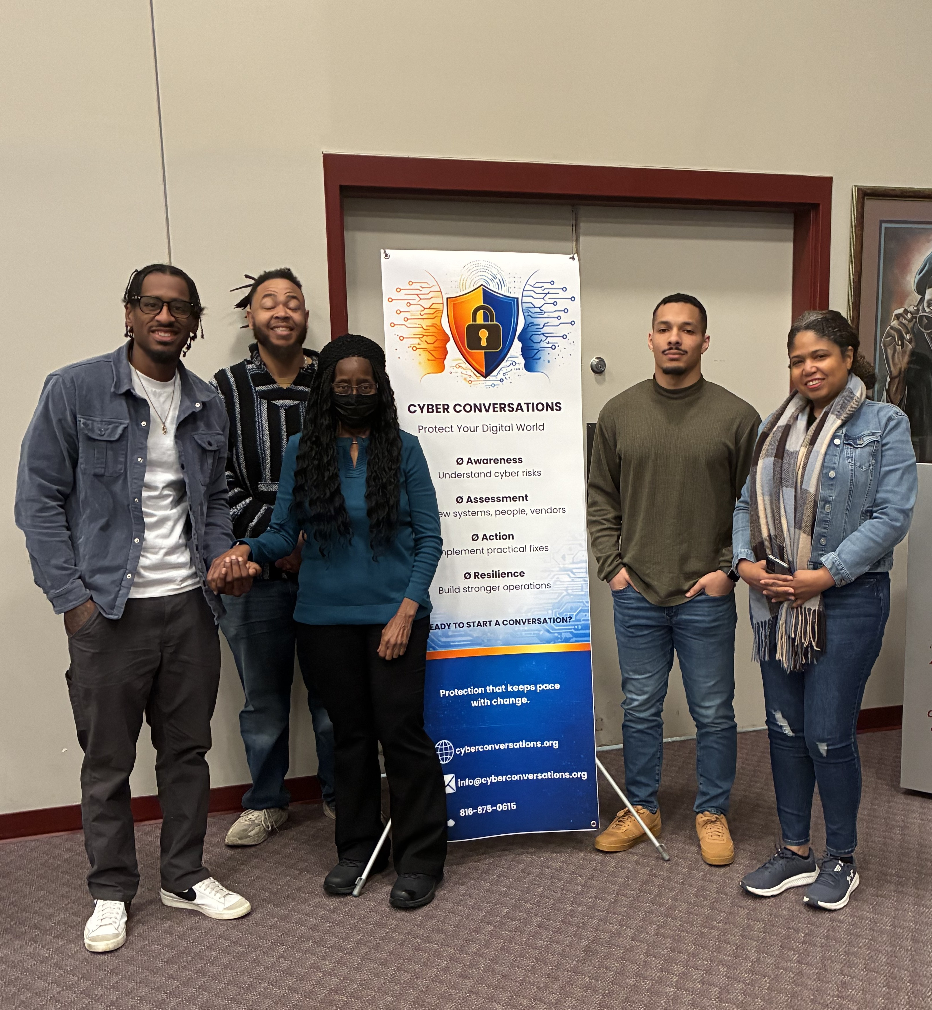
Outcomes: What the Cyber Liaisons Gained
In this case, learner development itself is important evidence of impact.
Public speaking
Technical presentation
Client / stakeholder engagement
Hybrid workshop facilitation
CYBERSECURITY APPLICATION
PROFESSIONAL PRACTICE
AUTHENTIC EXPERIENCE
Risk identification . . .
• Phishing
• MFA & password security
• Vendor / third-party risk
• Incident-response fundamentals
• Structured assessment & action
planning
Real-world workshop experience
• Small-business cybersecurity
awareness
• Physical + cybersecurity awareness
• Working within scope and
escalation protocols
• Documented work experience for
résumés
PAID WORK EXPERIENCE
Stipends supported by Black Community Fund + ECMC Mini-Grant
Evaluation boundary: business assessment completions and follow-up were not collected as success measures for this initiative.
Case source: RW2 Cyber Liaison Case Study — Outcomes: What Liaisons Gained.
Notes:
0:37–0:40 | Ask first what learners gained that would be difficult to reproduce in class. Then reveal the documented outcomes, including structured assessment/action-planning practice and paid work experience. Clarify that business assessment completion and follow-up were not project success measures.

Slide 18
What the Research Suggests—and What Our Case Adds: Three Levels of WBL Capacity
Staff and learner capacity can help institutions create, support, and gradually expand authentic WBL opportunities — especially for working adults.
STAFF CAPACITY
LEARNER CAPACITY
FROM CAPACITY TO
MORE WBL
• Dual professionalism
• Industry currency & organizational engagement
• Curriculum translation
• Coaching, supervision & quality assurance
• Partnership coordination
• Capacity to train others
• Apply technical learning in authentic settings
• Communicate in plain language
• Exercise professional judgment
• Engage organizations professionally
• Recognize boundaries & escalate
• Progress to greater responsibility
CYBER CONVERSATIONS: FINDING + CREATING WBL
FIND WBL
Organizations provide authentic work.
CREATE WBL
Awareness, readiness & consulting work can create supervised learner roles.
supports
can
expand
Research theme: Staff need both instructional and occupational capacity to support authentic WBL.
Adult-learner lens: Strong partnerships and dedicated coordination support persistence and progression.
KEY QUESTION: What work can we responsibly bring into our own organization and structure as supervised WBL?
CAPACITY CAN EXPAND WBL: Build staff → prepare learners → find OR create authentic work
Research base: OECD (2021; 2022); Zhou, Tigelaar & Admiraal (2022); CCRC/WestEd; RAND (2026).
Notes:
0:42–0:43 | Research-to-case synthesis. Connect the two capacity levels to expansion: staff capacity supports learner capacity, and together they can create more WBL opportunities. Then introduce Cyber Conversations as an emerging in-house entrepreneurial platform. Distinguish finding WBL—outside organizations provide authentic work—from creating WBL—bringing appropriate cybersecurity awareness, readiness, or consulting engagements into Cyber Conversations and structuring supervised roles for RW2 students and graduates. End with the question: What work can we responsibly bring into our own organization and structure as supervised WBL?

Slide 19
ACTE Transfer Activity: Build Your Version
Apply the case to your own CTE program—starting with what already exists in the curriculum.
1
My CTE program or discipline
2
An existing capstone, project, simulation, or authentic task that could anchor WBL
3
An organization or audience our learners could responsibly serve
4
Something learners could DO — plus one boundary / safeguard
5
What staff capacity, tools, or partner coordination would be needed to support the opportunity?
Notes:
0:43–0:45 | Give participants 60–90 seconds to write. The new first transfer move is curricular: what capstone, project, simulation, or authentic task already exists that could become the foundation? Then identify an organization/audience, a responsible learner task with a boundary, and the staff/tools/partner coordination needed.

Slide 20
Closing Takeaway: Expanding WBL Requires Three Investments
Start with a strong curricular foundation, build staff and learner capacity, and identify authentic work experiences that move learning into supervised practice.
BUILD STAFF CAPACITY
BUILD LEARNER CAPACITY
IDENTIFY (or CREATE) AUTHENTIC WORK EXPERIENCES
1
2
3
Staff must be prepared to move beyond delivering instruction to:
DEVELOP → COACH → VALIDATE → SUPERVISE → SUPPORT → EXTEND WBL
Learners must be prepared to:
UNDERSTAND → COMMUNICATE → APPLY → DOCUMENT → RECOGNIZE BOUNDARIES → ESCALATE → GROW
Programs must intentionally identify or create authentic work that connects curriculum to real organizational needs.
SIMULATED CONSULTING SCENARIOS → REAL NEED → DEFINED TASK → SUPERVISED WBL
What existing capstone or authentic task could become the foundation for one WBL opportunity in your program?
At RW2, this remains an evolving WBL model: build from the capstone, define the role, prepare and support the learner, test the opportunity, learn, and expand responsibly.
Notes:
Close with the revised reflection question. Emphasize that RW2’s lesson is not “create a brand-new WBL program.” It is: identify the authentic practice already embedded in the curriculum, build the staff capacity and learner safeguards around it, then move it into real work carefully and iteratively.

Slide 21
ACTE’s Postsecondary CTE Summit 2026
Powering Possibility: Advancing Postsecondary CTE Impact Sept. 16 - 18 I Arlington, VA
THANK YOU
Beyond Instruction: Building Staff Capacity and Scaling Cybersecurity Work-Based Learning
STAFF
CAPACITY
ACTE Interactive Workshop • 45 minutes • Case-study format
RW2 Career and Technical Education • Cyber Conversations
LEARNER
CAPACITY
Dr. Joy Vann-Newton
jvh@rw2.education
www.rw2.education
816-875-0111
WBL
OPPORTUNITIES
Notes:
0:00–0:01 | Welcome. Frame the workshop as a capacity-building story at two levels: staff and learners.

Slide 22
Selected Research & Case Sources
Sources supporting the staff-capacity and adult-learner framing used in this workshop.
OECD (2021)
Teachers and Leaders in Vocational Education and Training
https://www.oecd.org/en/publications/teachers-and-leaders-in-vocational-education-and-training_59d4fbb1-en.html
OECD (2022)
Preparing Vocational Teachers and Trainers
https://www.oecd.org/en/publications/preparing-vocational-teachers-and-trainers_c44f2715-en.html
Zhou, Tigelaar & Admiraal (2022)
Vocational teachers’ professional learning: A systematic literature review of the past decade. Teaching and Teacher Education, 119, 103856.
https://doi.org/10.1016/j.tate.2022.103856
CCRC & WestEd
Using Guided Pathways to Build Cross-Sector Pathways Partnerships
https://ccrc.tc.columbia.edu/publications/guided-pathways-cross-sector-partnerships.html
RAND (2026)
Employers as Partners in the Success of Working Adult Learners: Evaluation of Ivy Tech’s Achieve Your Degree Program
https://www.rand.org/pubs/research_reports/RRA3681-1.html
RW2 / Cyber Conversations (2026)
Internal RW2 / Cyber Conversations materials: Cyber Liaison Scenarios; Cyber Awareness Liaison Handbook; Liaison Field Guide; Cyber Workshop Training Outcomes, WBL Competencies & NIST CSF 2.0 Alignment.
Note: Research on adult learners/graduates in short-term client-facing CTE roles is more limited than the broader WBL/VET evidence base. This workshop uses the Cyber Conversations experience as a case study of an emerging model.
Notes:
Reference slide. Internal case materials now include the Liaison Handbook, Field Guide, and Training Outcomes/WBL Competencies/NIST alignment document in addition to the World Cup case study. Keep available for Q&A or leave-behind.

