Slide 1
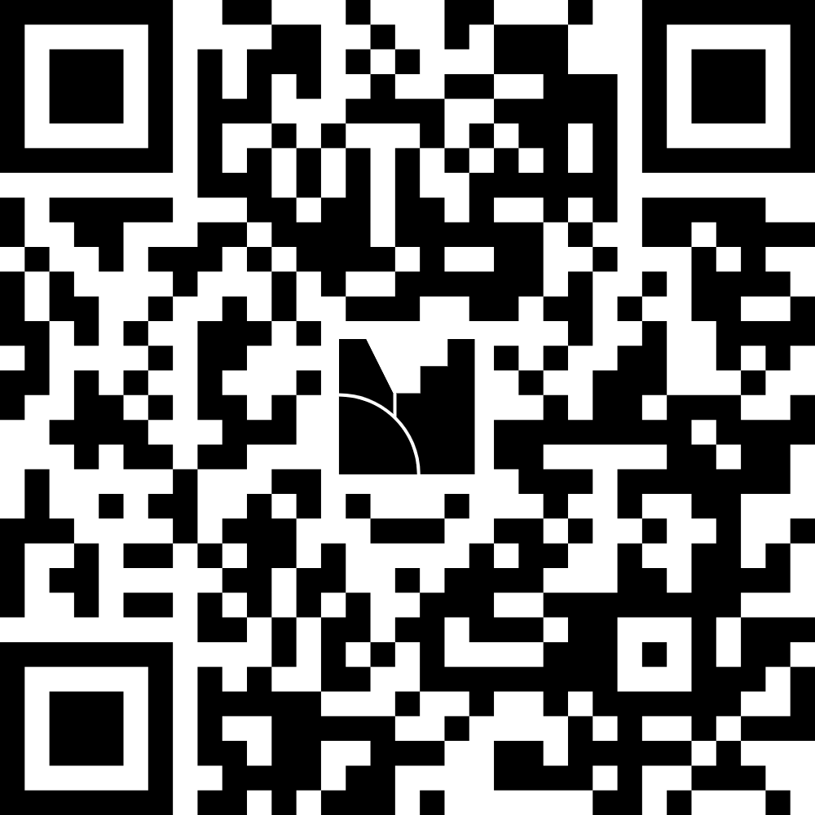
Audience Poll
Join at menti.com | use code
3231 5032

Slide 2
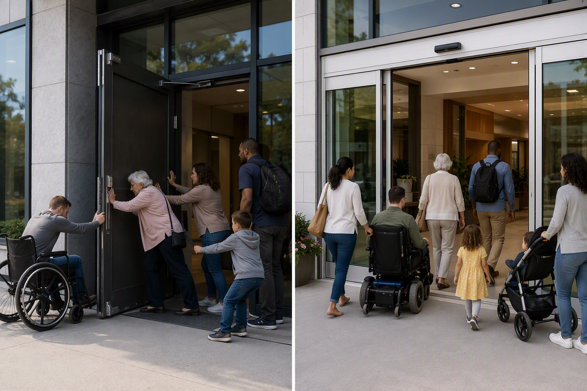
THE CORE IDEA
Equity is not “special treatment.”
It is designing conditions so people can participate fully.
Equality
=
Everyone gets the same door.
Equity
✓
The barrier is removed so each person can enter independently.
The goal is the same: access.
The support may be different.

Slide 3

THE DOOR TEST
Who benefits when the barrier disappears?
Many people, for different reasons and at different moments.
1
Wheelchair user
independence
2
Person using crutches
less physical effort
3
Parent with a stroller
easier movement
4
Person carrying boxes
hands-free access
5
Older adult
greater stability
6
Anyone with a temporary injury
continued participation

Slide 4
FROM DOOR TO DECISION
Use an equity lens in any process or service.
Start with the barrier, not with assumptions about the person.
1
2
3
4
5
NOTICE
LISTEN
DESIGN
EXPAND
CHECK
Where do people get stuck?
Who experiences the barrier?
What change supports participation?
Who else benefits?
Can people use it with dignity?
Equity question: “What would make full participation possible?”

Slide 5




My Role & Perspective
Bridging Academic and Workforce​
​
Efficient Operations Focus​
Legal Perspective in Education​
Adapting to CTE Complexity​
Joy Pak​​
​
​
Operations Manager, Academic DivisioN ​​
Business and Social Science​​​
​​
2026 NextLevel Fellow - Cohort 8​​

Slide 6
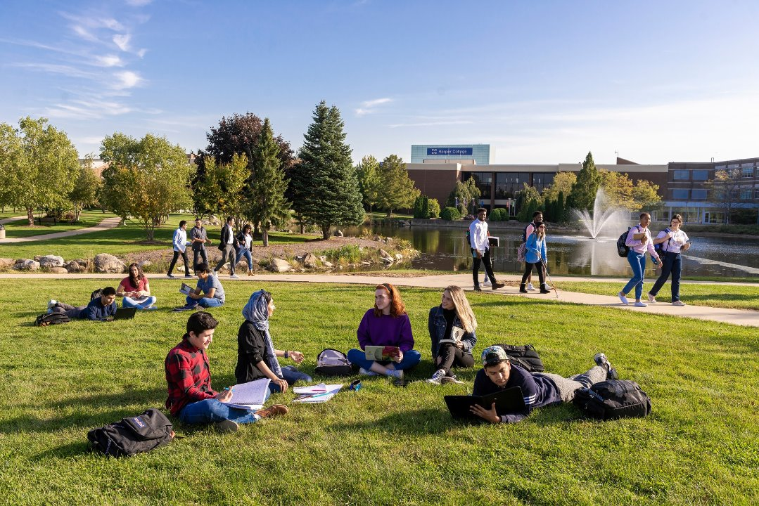

Harper College At A Glance
26,000+ diverse learners served annually (22,900 credit students| 3,800 community education)
10 academic program of study
6 transfer degrees
40+ career degrees
90+ certificate programs
12 registered apprenticeships
4 university partnerships – on campus

Slide 7
Stackable Credentials Pathways
Multiple Entry Points. Multiple Opportunities to Advance.
🚀
📜
🎓
💼
COMPLETE
ADVANCE
START
BUILD
Short-Term Certificate
Career Certificate
Associate Degree
Transfer or Employment
ENTER QUICKLY
EARN WHILE YOU LEARN
KEEP ADVANCING
Students can begin building skills without waiting years.
Flexible pathways support work and family goals.
Credentials stack without starting over.
Students can enter, build skills, earn credentials, and continue advancing without starting over.

Slide 8
Session Description
Description
Adult and multilingual learners bring caregiving experience, motivation, and community strengths, but the pathway into Early Childhood Education can be hard to see and harder to navigate. This Make It Better Plan creates a clearer, more equitable pathway by making ECE credentials, costs, wages, financial supports, language supports, and next steps transparent before students commit time and money. The plan uses warm handoffs, student voice, and term-based equity data to reduce barriers and improve informed choice, persistence, belonging, and advancement. ECE is the pilot pathway, with a model that can later scale to other workforce credentials.
Issue
Equity Response
Outcome
Unclear systems create unequal burdens.
Design the pathway so students do not have to figure it out alone.
Students make confident, supported choices that lead to mobility.
Make It Better Plan | Equity-Centered Early Childhood Education Pathway
2

Slide 9
Pathways That Connect
An Equity-Centered Make It Better Plan for Early Childhood Education
Helping adult learners see their options, understand tradeoffs, access support, and advance without navigating the system alone.
DISCOVER
DECIDE
ENTER
PERSIST
ADVANCE
Make It Better Plan | Equity-Centered Early Childhood Education Pathway
1

Slide 10
Assess the Current Situation
What conditions justify the need for change?
Referrals can depend on students knowing whom to contact and when to follow up.
Students may not see credential options, sequence, transfer, or next steps early enough.
ECE wages can be modest, so students need honest cost, aid, wage, and advancement information.
Plain language, translations, and Career English support are not always built into the pathway.
Adult learners, multilingual learners, ECE programs, childcare centers, families, and the community.
Information gaps
Financial risk
Language access
Complex handoffs
Who is affected
Equity challenge: Unequal burdens appear when students must navigate disconnected information and offices on their own.
Make It Better Plan | Equity-Centered Early Childhood Education Pathway
3

Slide 11
What “Better” Looks Like
Equity-based outcome statement.
Students can see the pathway, understand the tradeoffs, access support, and make informed choices without navigating the system alone.
1
2
3
4
5
See
Understand
Enter
Belong
Advance
One visual source of truth for ECE credentials, costs, wages, supports, and next steps.
Plain-language advising supports informed decisions about time, money, and career goals.
Warm handoffs connect students to named people and scheduled next steps.
Language, culture, caregiving, and work experience are treated as assets.
Students connect completion to employment, stacking, transfer, and long-term mobility.
Make It Better Plan | Equity-Centered Early Childhood Education Pathway
4

Slide 12
1
Where do students get stuck?
4
Who else would benefit?
2
Who experiences the barrier?
5
Can students participate with dignity?
3
What change would help?
The Door Test: Questions to Take Back
Make It Better Plan | Equity-Centered Early Childhood Education Pathway
12

Slide 13

What is one barrier students should not have to navigate alone?
Cost
$$$$
Join at menti.com | use code
3231 5032
Advising
Transportation

