Slide 1

Selling the Strategy
Dr. John A. Vasquez
Assistant Vice Provost for Student Success
Senior Director Comprehensive Studies
Notes:
“Good morning, everyone. I’m John Vasquez, and I spend a lot of my work thinking about student success, institutional systems, and, increasingly, how we actually get good ideas to move inside complicated organizations.
And one of the things I’ve learned over the years is that having a good idea is often the easy part.
Many of you probably have ideas right now that you know would make a difference for students. Maybe it’s expanding an apprenticeship program. Maybe it’s work-based learning.
Maybe it’s a new credential, an employer partnership, better advising, equipment, staffing—whatever it might be.
And you’ve probably had the experience of thinking, This makes so much sense. Why wouldn’t they support this?
Then you take it to someone—a dean, vice president, president, foundation, donor—and you don’t get a no, exactly.
You get:
‘That’s interesting.’
‘Send me some more information.’
‘We should keep talking about that.’
And six months later, nothing has happened.
So that’s what I want to spend our time on today.”
“I want to start with one idea that is going to carry us through the next 45 minutes.”

Slide 2
Ideas don’t get funded. Priorities get funded.
Notes:
“I don’t mean that cynically.
I mean that the person sitting across from you isn’t evaluating your idea in isolation.
Your president isn’t sitting there asking, Is John’s idea good?
They’re asking: Is this more important than the other ten things sitting on my desk?
A vice president may be thinking about enrollment.
The CFO may be thinking about sustainability.
A donor may be asking what difference their investment could make.
An employer may be thinking about whether this actually helps solve a workforce problem.
Same idea.
Different decision environment.
So our job isn’t simply to explain the idea better. Our job is to understand the environment in which someone has to make a decision about it.”

Slide 3
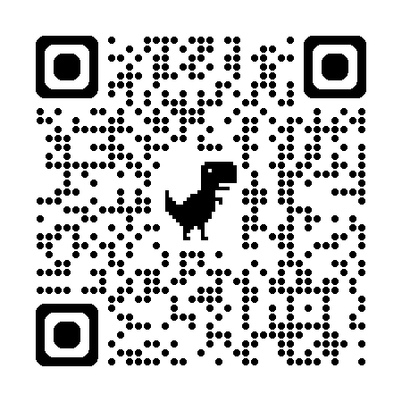

Selling the Strategy
Notes:
“So rather than spend 45 minutes talking at you about this, I want you to actually work on something.
Use these qr codes to download a workbook either via google docs or drop box. Which ever you prefer.
And my hope is that you use a real idea today.
Something you’re trying to start. Something you’re trying to grow. Something you need funded. Something you’ve been trying to get someone to pay attention to.
And then I want you to identify the actual person or audience whose support you need.
Don’t write ‘senior leadership.’
Who?
Your president? Your provost? Your dean? Your board? A foundation? A donor? An employer?
Because the more specific we can make this, the more useful the next 40 minutes will be.”
Give them about 30–45 seconds to write.
Then:
“Keep that idea and that person in mind. We’re going to come back to both of them.”

Slide 4


Riverbend Community College
Notes:
“But first, I want to give you somebody else’s problem to solve.
Some of you who were in the pre-conference have already met Riverbend Community College. For everybody else, Riverbend is completely fictional—which means nobody from Riverbend can email me afterward and tell me I got their organizational chart wrong.”
Small laugh.
“Riverbend has an advanced manufacturing apprenticeship initiative.
Employers are interested. Students need more opportunities to earn while they’re completing their credentials. The college believes there’s an opportunity to expand.
The program director wants additional resources to do it.
And they finally get the meeting they’ve been waiting for:
Three minutes with the president.”
“So imagine you’re the president.
The program director sits down across from you and says:
‘Our apprenticeship program has been very successful, and we would like to hire two additional staff members and expand the program.’
That’s it.
Now you’re the president.”
Pause.
“What’s missing?”
Let them call things out.
You can repeat responses:
“Outcomes. Yes.”
“Cost.”
“Why now?”
“Employer demand.”
“How many students?”
“Sustainability.”
“Connection to the strategic plan.”
“Exactly.”
6:30–8:00 | Let them diagnose it
“Go to the Riverbend page in your workbook.
Take about a minute with the person next to you—or at your table—and answer this question:
What does the president still need to know before deciding whether this belongs on Riverbend’s priority list?
Don’t fix the pitch yet.
Just diagnose what’s missing.”
Give them 60–90 seconds.
As they talk, circulate rather than standing at the front.
Then bring them back.
“Okay. Give me two or three things you heard.”
Take a few responses.
8:00–9:30 | Debrief the lesson
“Here’s what I want you to notice.
Nothing the program director said was necessarily wrong.
They may absolutely need two people.
The apprenticeship program may be fantastic.
The problem is that they answered the question from their perspective.
They’re thinking:
Here’s what my program needs.
The president has a different question:
Why does the institution need this?
And that’s a really important distinction.
We do this all the time in higher education.
We walk into an executive meeting and start explaining the program.
We tell them what we do.
We tell them how many students we serve.
We tell them what we need.
And sometimes we give them fifteen minutes of history before we ever explain why any of this matters to the decision they’re being asked to make.”
Then pause.
“That’s not really a communication problem.
It’s a framing problem.”
9:30–10:00 | Transition into the next section
“So here’s the shift I want us to make today.”
A good idea answers:
Would this help?
A strategic proposal answers:
Why should we do this—now?
“And to answer that second question, before we ever start writing our pitch, we have to understand something else:
What is the person across the table actually responsible for?
That’s where we’re going next.”
Then move directly into Read the Decision Environment: Strategy, Impact, Resources, Risk, and Sustainability.

