Slide 1


From Proposal to Award: Navigating the Grants Process
Notes:
This is an alternate cover page.

Slide 2

Today's Roadmap
Where to start: applying to grants
Review essential questions and processes
Example: CSN's Internal Grant Process
Questions and Best Practices
Notes:
Edit this slide and make additional copies if more of same type of slide is desired (right click on slide in left column > Duplicate Slide).

Slide 3
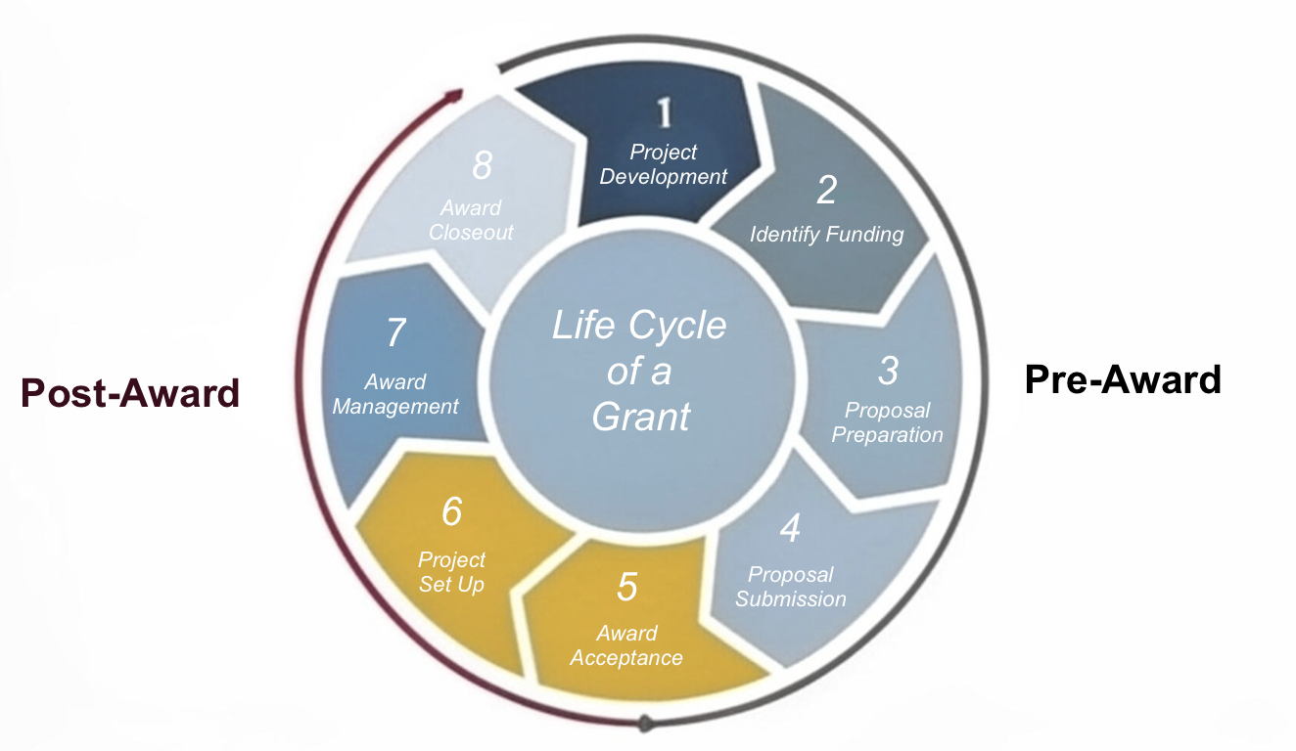
Grant Life Cycle
Notes:
Award Acceptance and Set up

Slide 4
CTE Grant Roadmap: From Idea to Application
📊 1. Identify the Need
🎯 2. Align with CTE Priorities
🤝 3. Build Partnerships
🛠️ 4. Design the Solution
📝 5. Develop & Submit Proposal
Notes:
Edit this slide and make additional copies if more of same type of slide is desired (right click on slide in left column > Duplicate Slide).

Slide 5
Grant Prospecting: Where Do I Start?
Define your project: what do you intend to do, who do you intend to impact?
  Review Perkin's goals and your CLNA
  Identify how your idea supports career pathways, workforce needs, and student outcomes
Compile a list of related agencies, programs, and institutes
Examine the types of projects each agency funds and the size of grants previously awarded
Notes:
Edit this slide and make additional copies if more of same type of slide is desired (right click on slide in left column > Duplicate Slide).

Slide 6
Is my project grant worthy?
Does your project fit within the sponsor's goals and objectives?
How familiar your organization with this sponsor?
Does the project meet sponsor’s eligibility criteria?
How competitive is this funding opportunity?
Strong proposals begin with a clearly defined need
backed by data.
Notes:
Edit this slide and make additional copies if more of same type of slide is desired (right click on slide in left column > Duplicate Slide).

Slide 7
What Makes a Strong CTE Proposal?
Clear alignment with labor market data and regional workforce needs
Integration of industry-recognized credentials
Strong employer or industry partnerships
Defined student outcomes (completion, placement, wage gain)
Inclusion of work-based learning (internships, apprenticeships, clinicals)
Support for special populations (e.g., adult learners, first-gen, economically disadvantaged students)
Notes:
Edit this slide and make additional copies if more of same type of slide is desired (right click on slide in left column > Duplicate Slide).

Slide 8

Example Time!
College of Southern Nevada's Process
Notes:
Edit this slide and make additional copies if more of same type of slide is desired (right click on slide in left column > Duplicate Slide).

Slide 9
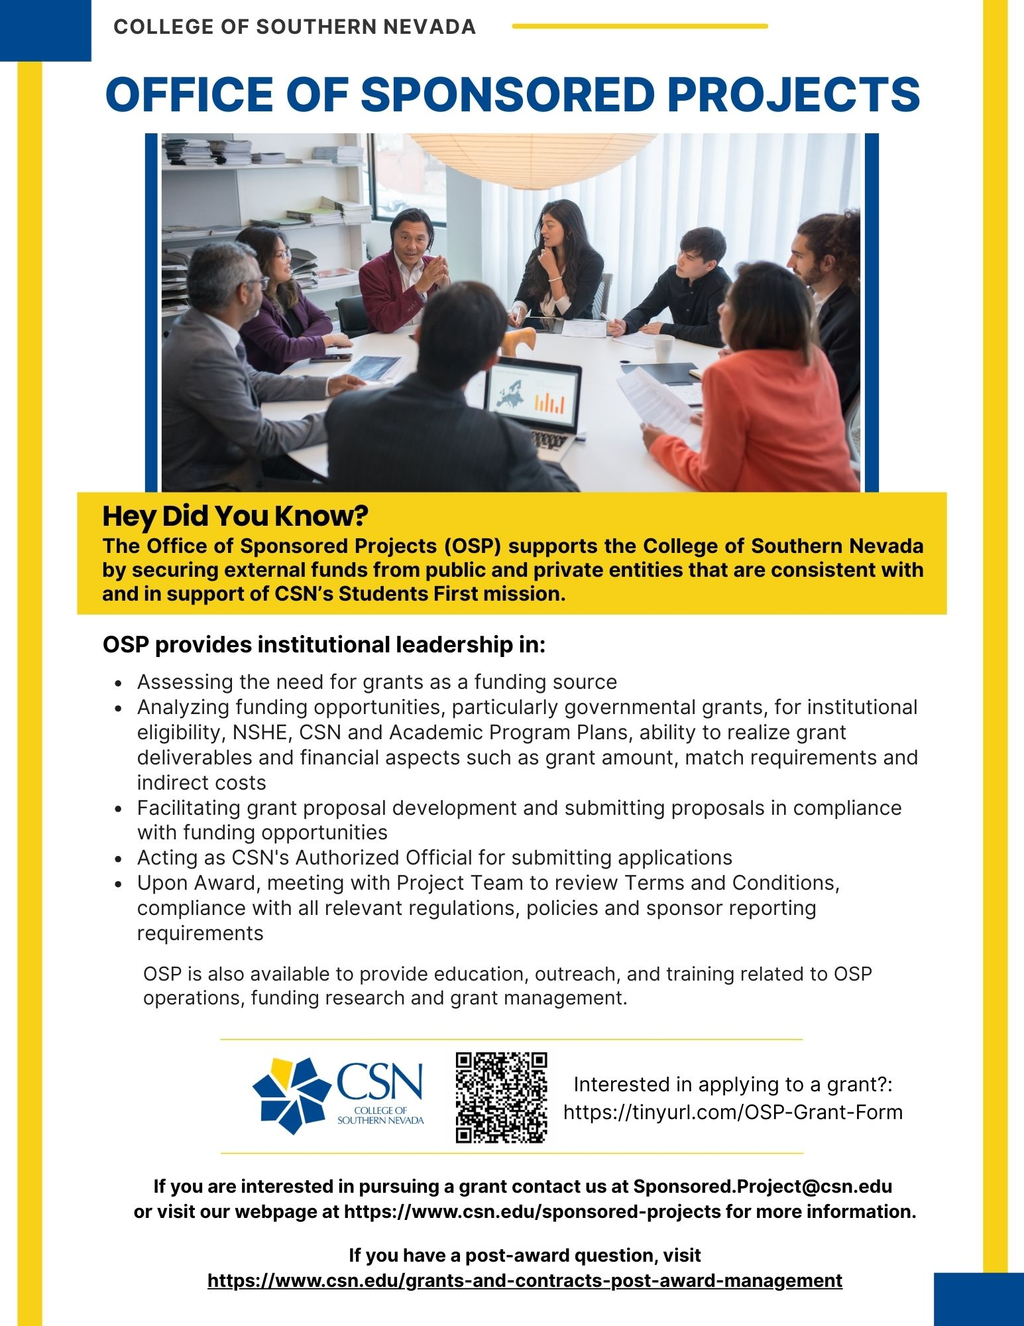
OSP Institutional Leadership
Dr. Clarissa Cota, VP External Relations and Campus Operations
Dr. Janna Bernstein Rogers, Director
Dr. Ruth Pe Palileo, Grants Manager
Dr. Debra Morton, Grants Manager
Rudolph Chavez, Perkins/CTE Coordinator
Cassandra Aguirre, Administrative Assistant
Notes:
Edit this slide and make additional copies if more of same type of slide is desired (right click on slide in left column > Duplicate Slide).

Slide 10
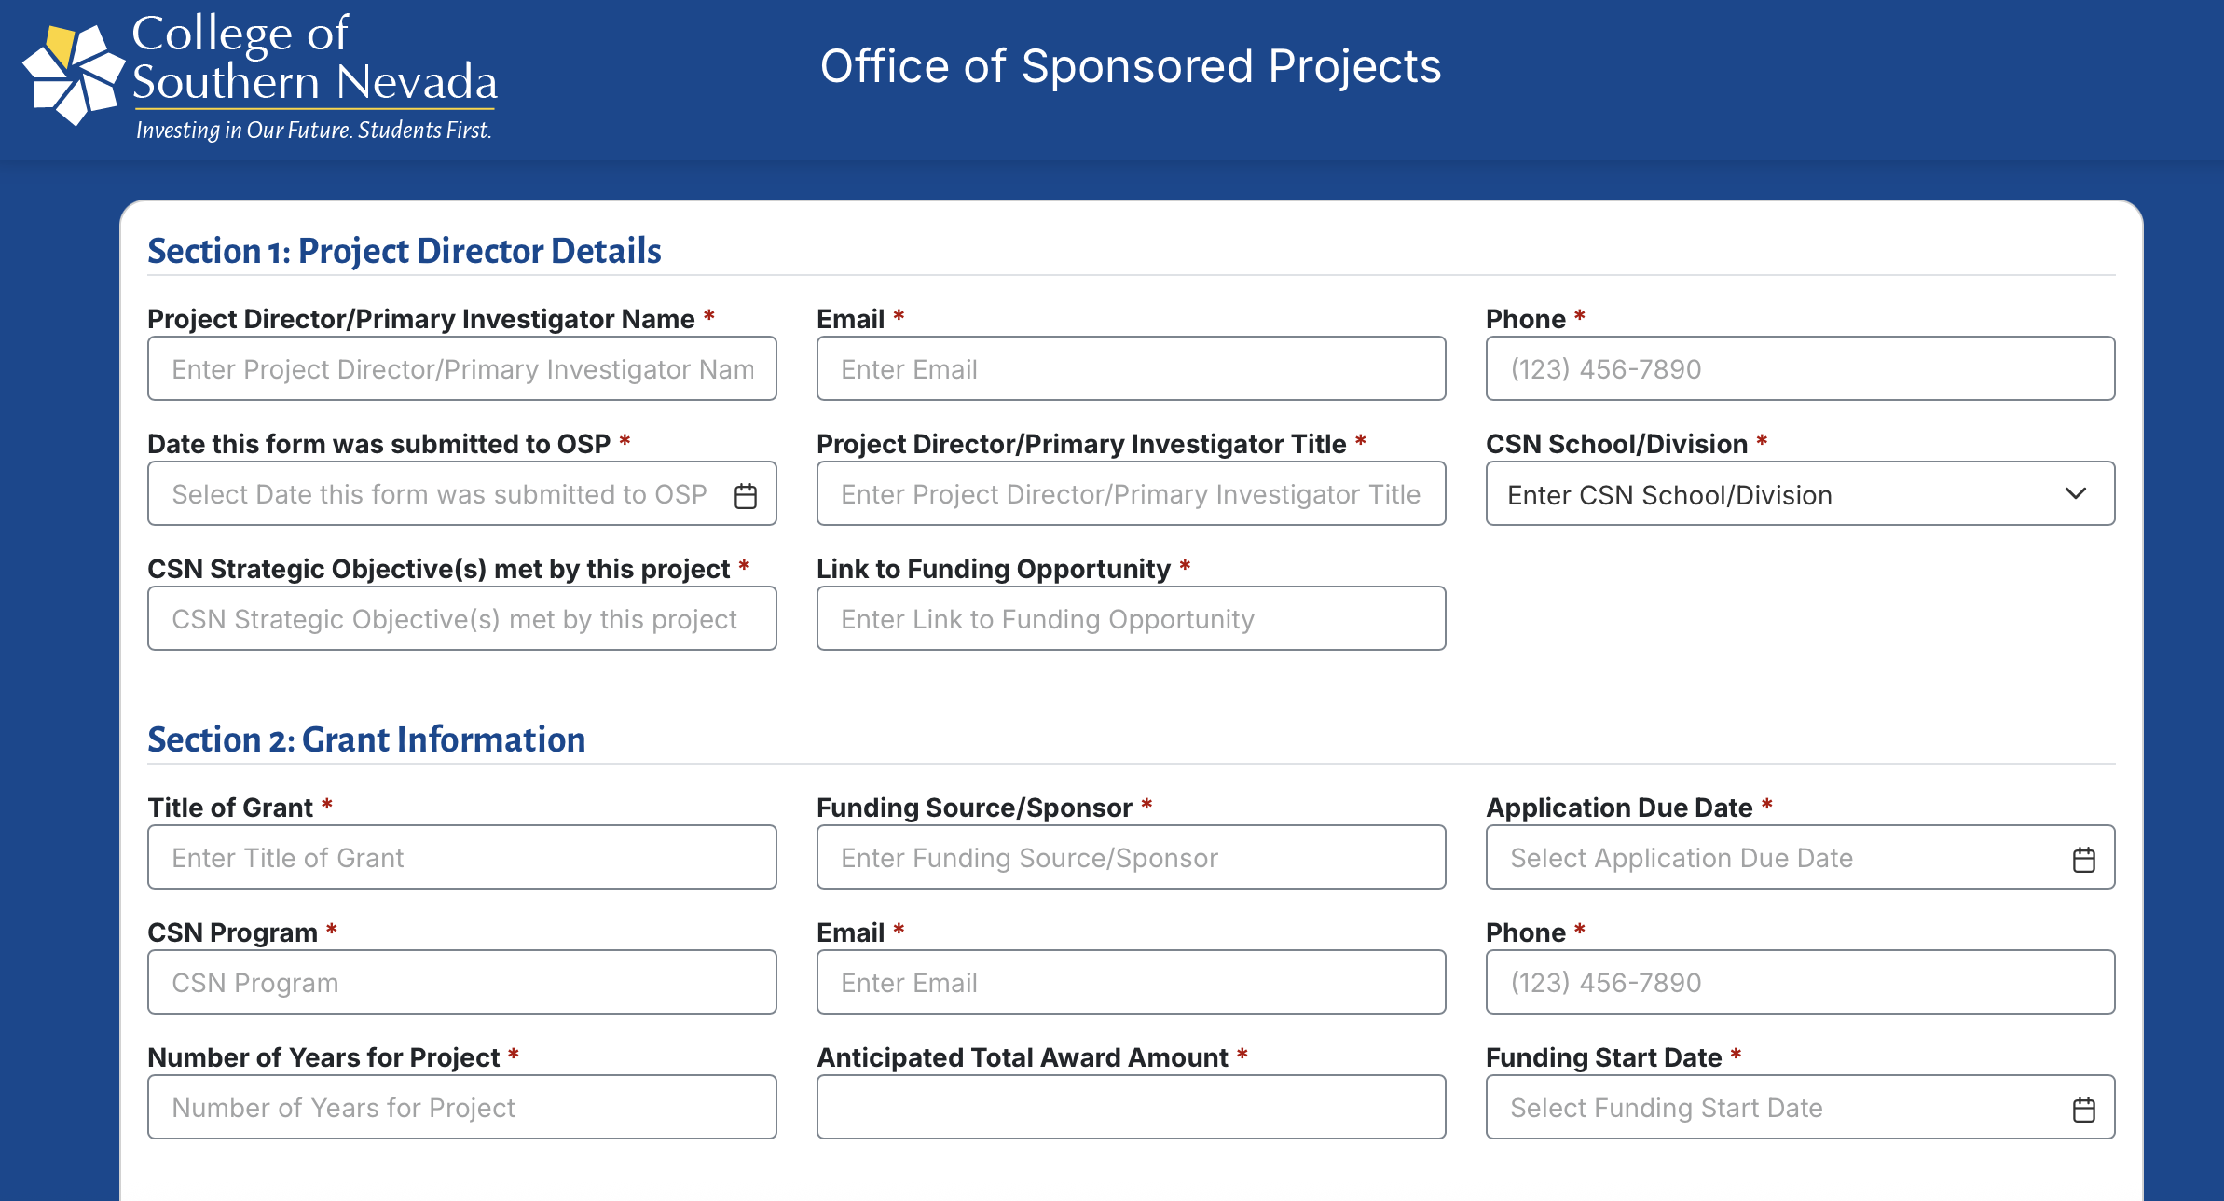
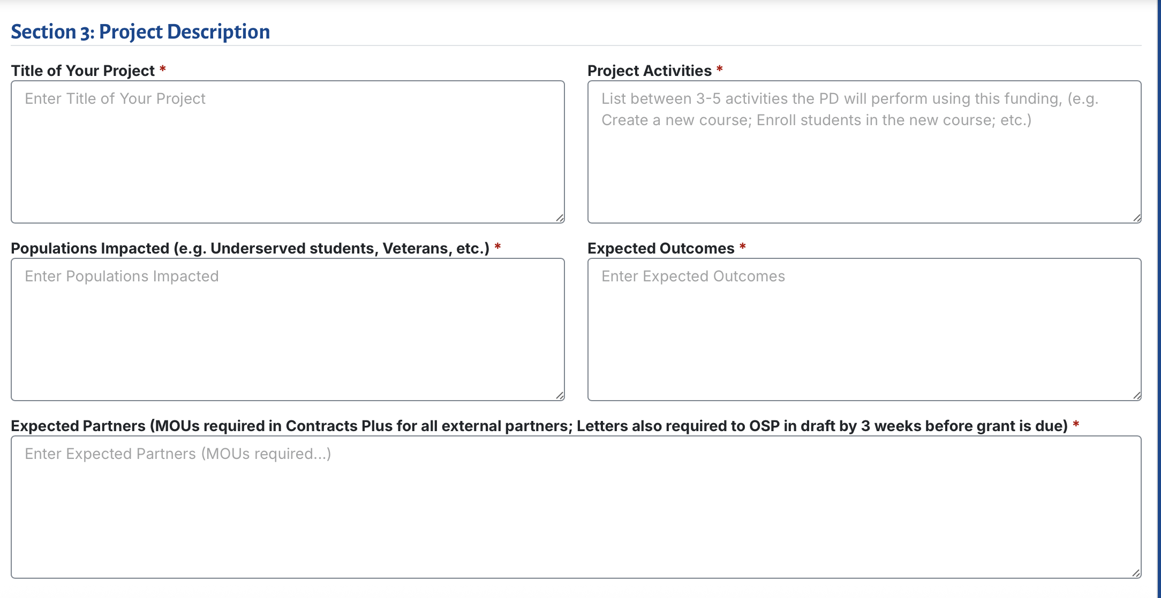
CSN OSP Intake Form
Every time a grant is submitted, we are signing on behalf of institution
  Never submit on behalf of yourself
  OSP needs to be aware of ALL submitted grants
All new, continuing and renewable grants submit for compliance
Multiple approvals are needed upon submission before grant is approved
Notes:
Edit this slide and make additional copies if more of same type of slide is desired (right click on slide in left column > Duplicate Slide).

Slide 11
CSN Perkins Intake Form
NEW this year!
Technical Review webinar provided to Deans and Faculty prior to application opening
Multiple approvals needed upon submission- work closely with Academic Affairs partners
All submissions reviewed and "Thunderdome" occurs
Notes:
Edit this slide and make additional copies if more of same type of slide is desired (right click on slide in left column > Duplicate Slide).

Slide 12
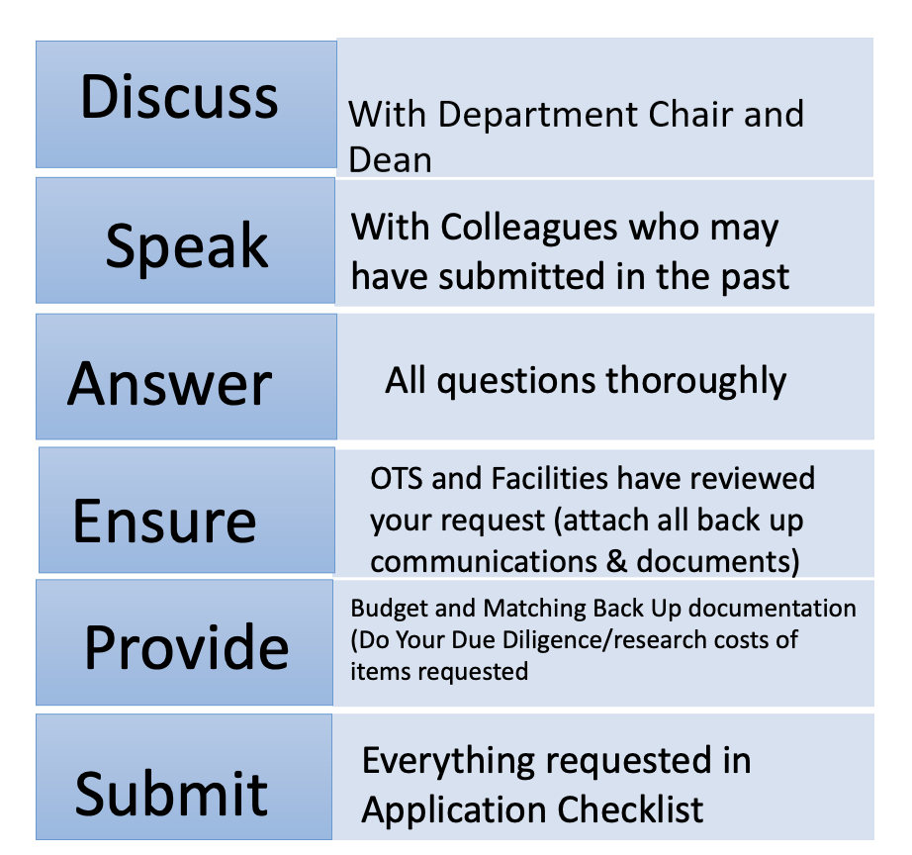
Tips for a Successful Application Submission
Notes:
Edit this slide and make additional copies if more of same type of slide is desired (right click on slide in left column > Duplicate Slide).

Slide 13
What happens once grant is approved?
When the Intake form has been approved, a Pre-Award team member is assigned as the main point of contact:
PI/PD Responsibilities:
  Carefully review application directions
  Write the narrative
  Approve final budget (in collaboration with OSP)
  Be Available until submission
OSP Responsibilities:
  Standard submission forms and requirements
  Obtain Letters of Commitment and Support
  Budget Narrative Development (in collaboration with Post-Award)
  Grant Submission
Notes:
Edit this slide and make additional copies if more of same type of slide is desired (right click on slide in left column > Duplicate Slide).

Slide 14


Grant Award Notification
CSN Grant Acceptance*
*Terms and Conditions
Notes:
Award Acceptance and Set up

Slide 15
Grant Life Cycle
Notes:
Award Acceptance and Set up

Slide 16
What happens once a grant has been awarded?
Account Set Up & Modifications
Invoice Sponsors
Financial Reporting
Track Budgets
Effort Certifications
Notes:
Edit this slide and make additional copies if more of same type of slide is desired (right click on slide in left column > Duplicate Slide).

Slide 17
CSN's Post-Award Management
Award expenditures are routed through Workday inbox for approval.
The Post-Award point of contact emails monthly invoices to review for accuracy.
Post-Award runs regular effort certifications
For any grant reporting by the PI/PD, the report is reviewed by supervisor/team member before submitted to the sponsor.
  Copies of the report, and backup for any data reported, is saved in our OSP Repository
Notes:
Edit this slide and make additional copies if more of same type of slide is desired (right click on slide in left column > Duplicate Slide).

Slide 18
Best Practices for
Sponsored Projects Success
Proposal Compliance – All proposals must be routed for accuracy & to obtain approvals
Clear Award Terms – Review and communicate key conditions before acceptance.
Financial Stewardship – Monitor allowable costs, effort reporting, and timely invoicing.
Regulatory Compliance – Ensure training, disclosures, and subrecipient monitoring.
Continuous Improvement – Document SOPs, leverage technology, and invest in staff training.
Notes:
Edit this slide and make additional copies if more of same type of slide is desired (right click on slide in left column > Duplicate Slide).

Slide 19
Best Practices for
Sponsored Projects Success
Meet your deadlines/reports- don’t miss the date, if an issues, communicate!
Send your funders updates, especially when things are positive- take photos!
  Share your newsletters and successes
Notes:
Edit this slide and make additional copies if more of same type of slide is desired (right click on slide in left column > Duplicate Slide).

Slide 20
Questions?
Notes:
This is an alternate closing slide.

Slide 21

Contact Us!
Director
Dr. Janna Bernstein Rogers
Janna.bernstein@csn.edu
CTE Perkins Coordinator
Rudolph Chavez
Rudolph.chavez@csn.edu

