Slide 1


Future Teacher Opportunities at Northern Arizona University

Slide 2
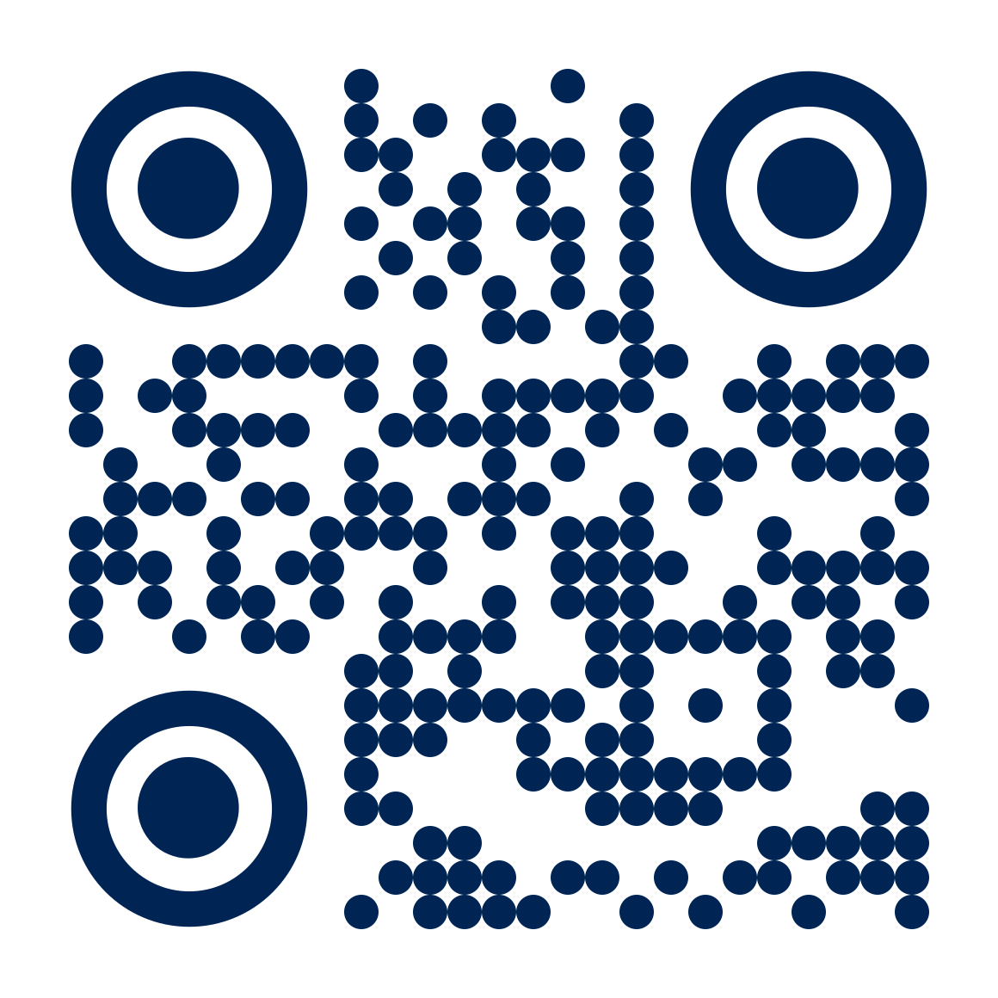
Arizona Teachers Academy (ATA) Scholarship
The ATA is a state-sponsored scholarship for teacher education students that covers all tuition and mandatory fees.
In exchange, recipients commit to teach in an Arizona publicly-funded school.
All teacher education students can apply, and are awarded on a first-come, first-served basis.
The ATA is not need-based, merit-based, or competitive.
We award funds until we spend all the money provided by the state each year.
Last year, we awarded $8.16 million to 1,299 students.
For more information, scan the QR code!

Slide 3
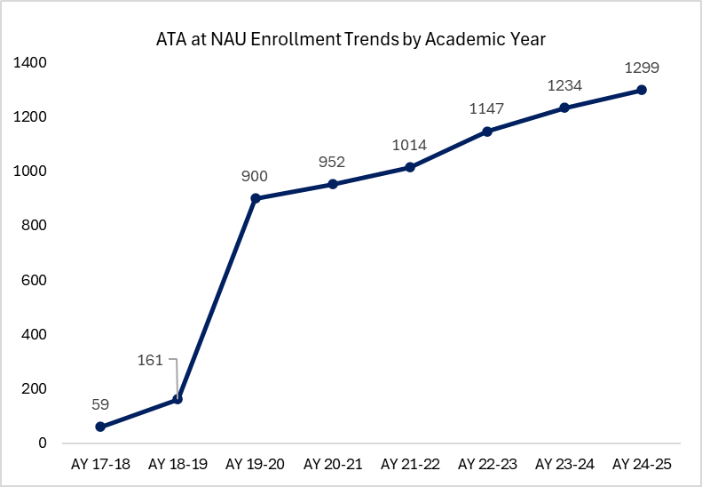
A Snapshot of ATA Enrollments at NAU
This past year, a record 1,299 NAU students used ATA scholarships and licensure fee waivers!

Slide 4

Additional Funding Opportunities
In addition to the ATA scholarship, the College of Education offers close to 1/2 million dollars in scholarships each year.

Slide 5

Student Teach Anywhere!
Students can complete their student teaching
Anywhere in the state
Out of state
Abroad in another country

Slide 6
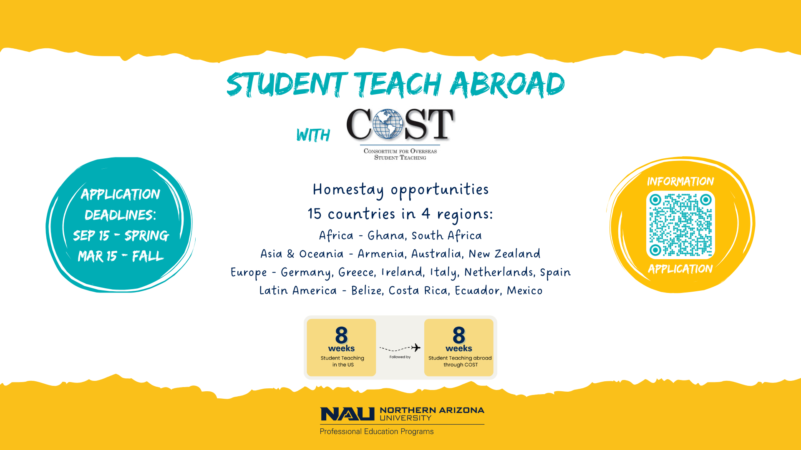

Slide 7

Access2Excellence
Beginning fall 2023, the Access2Excellence (A2E) program at Northern Arizona University will guarantee tuition coverage for every undergraduate Arizona resident with a household income up to $65,000, and for all eligible members of Arizona’s 22 recognized Tribes, regardless of income.
Highlights: In-person programs only
•Available to first-year & transfer students
•For students attending Flagstaff or a statewide campus
•FAFSA completion required; no other application needed

Slide 8
Thank You
FOR MORE INFORMATION
928-523-7246 | PEPAdmin@NAU.edu

