Slide 1


Welcome Future Teachers!
Your Journey Starts Here:
Become a Teacher Through NAU

Slide 2


Slide 3


Slide 4
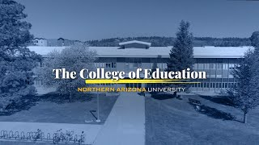

Slide 5

The Joys of Being a Teacher
Making a real difference in students’ lives
Inspiring curiosity, confidence, and creativity
Becoming a role model in your community
Every day is meaningful — and never the same
Teaching is a career with purpose, impact, and heart

Slide 6
Inspiring the next generation begins with YOU!

Slide 7

Why Choose Northern Arizona University?
A university built for future educators
Programs available statewide, online, and the Flagstaff mountain campus
A proud community of Lumberjacks committed to service and leadership
Over 120 years of preparing Arizona’s teachers

Slide 8
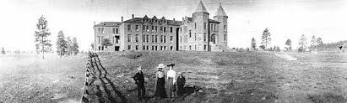

Slide 9
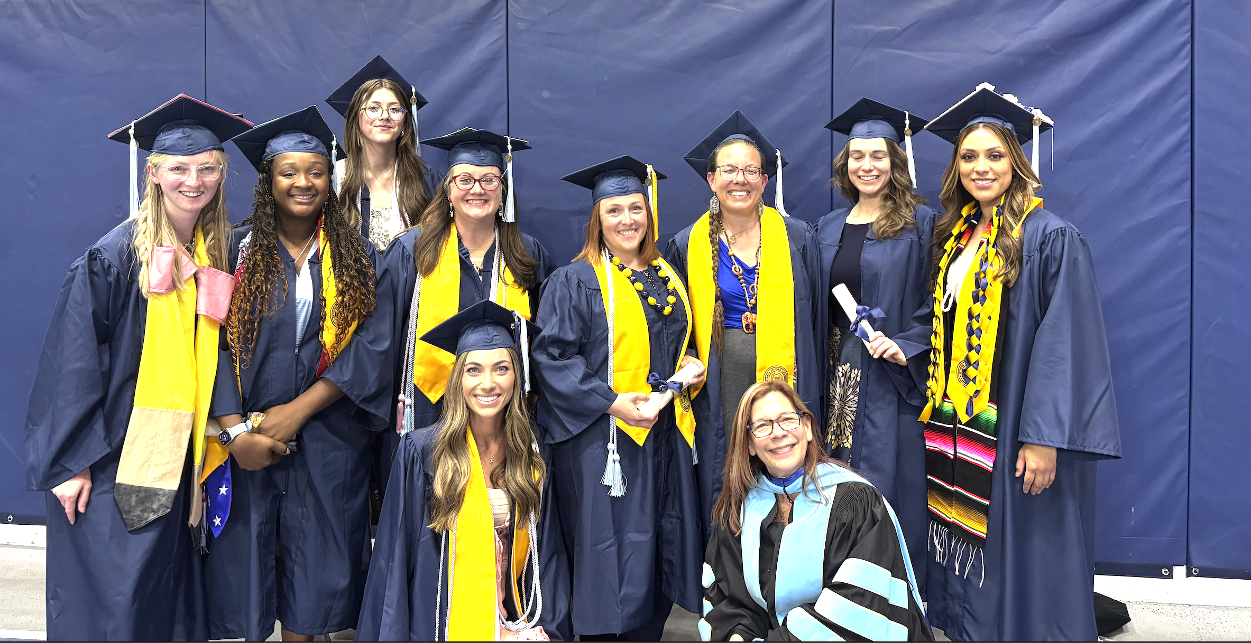
What Makes NAU’s Teacher Prep Exceptional
Largest Teacher Preparation Program in AZ
Early and frequent classroom placements
Partnerships with Arizona school districts
Professors with real‑world teaching experience
Programs shaped around Arizona’s workforce needs
High job placement rates for graduates

Slide 10
Undergraduate Pathways to Becoming a Teacher at NAU
Elementary & Early Childhood
B.S.Ed. in Elementary Education
B.S.Ed. w/Special Education (Dual Certification)
B.S. Early Childhood Education
B.S. Early Childhood w/Special Education

Slide 11
Undergraduate Pathways to Becoming a Teacher at NAU
Secondary Education (Subject‑Specific)
B.S.Ed. in Secondary Education – English
B.S.Ed. in Secondary Education – Mathematics
B.S.Ed. in Secondary Education – Science (various tracks)
B.S.Ed. in Secondary Education – History/Social Studies

Slide 12
Specialty Areas
B.S.Ed. in Career and Technical Education
B.S.Ed. in Special Education (Early Childhood and K-12)
B.S.Ed. in Physical Education
B.A./B.S. in Music Education
B.A. in Art Education
Teaching in Indigenous Communities (TIIC) certificate

Slide 13
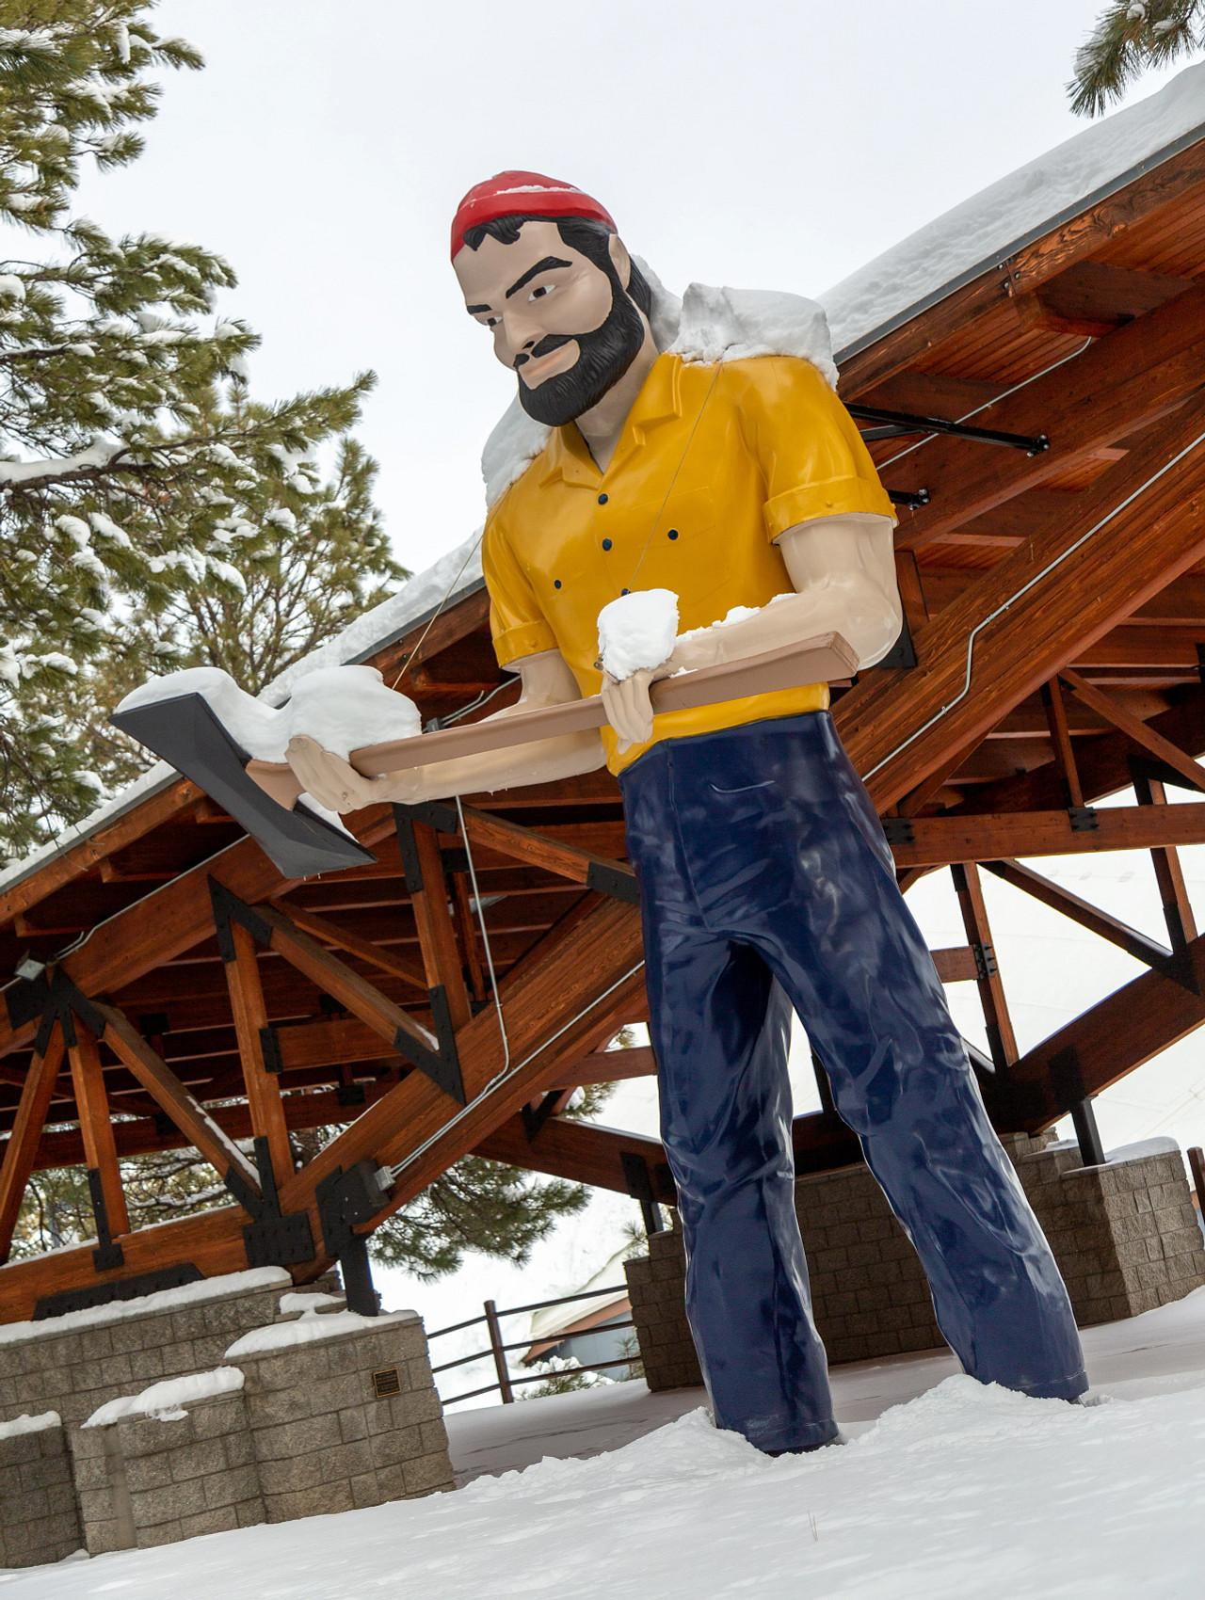

Multiple Pathways:
Choose What Fits Your Life
Flagstaff Mountain Campus
Traditional college experience
Hands‑on learning in local schools
Vibrant student life and campus community

Slide 14

Multiple Pathways:
Choose What Fits Your Life
NAU Statewide Campuses- In Person
Locations across Arizona
NAU North Valley (Freshman-Senior)
Yavapai/Prescott, Chandler/Mesa, Mohave, Yuma
Designed for students who want to stay close to home
Flexible scheduling for work‑school balance

Slide 15

Multiple Pathways:
Choose What Fits Your Life
NAU Online
Fully online degree options
Ideal for students needing maximum flexibility
Same NAU faculty, same quality, same degree

Slide 16
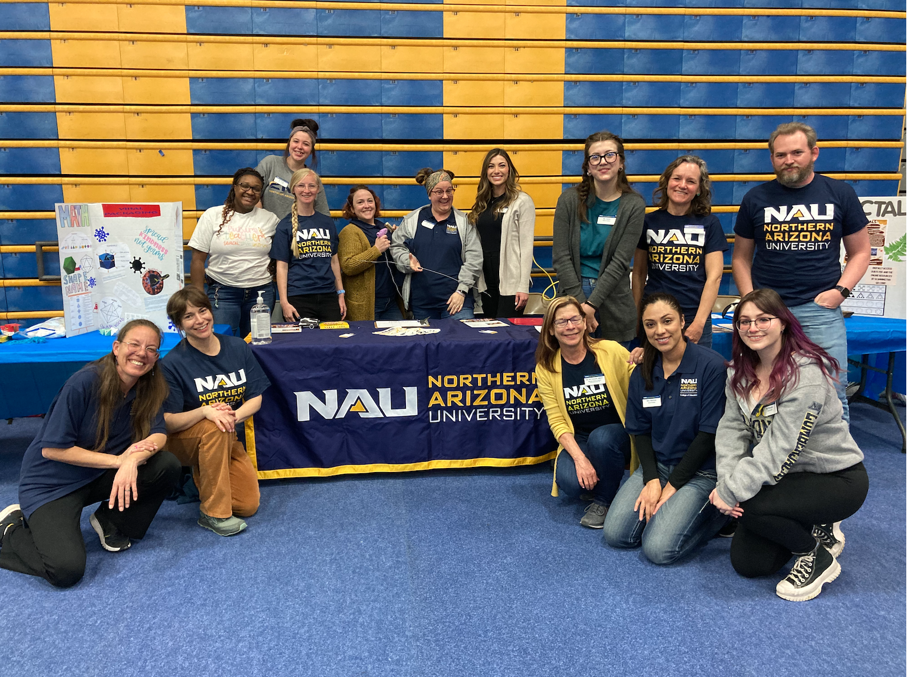
Benefits of Becoming a Lumberjack
Strong sense of community and belonging
Supportive faculty who know your name
Access to scholarships and financial aid (more information this afternoon)
Career‑ready preparation with real classroom experience
A network of educators across Arizona

Slide 17

Access to Scholarships and Financial Aid
(more information this afternoon)
Arizona Teacher’s Academy (ATA)
Access2Excellence
Scholarship Opportunities

Slide 18

Resume Builders
Dual Enroll- English Courses
CPR
Find a position working with children
Apply for your Fingerprint Clearance Card (18 years)
Ask questions

Slide 19

Your Next Steps to Becoming a Teacher
Choose your degree pathway
Apply to NAU
Start coursework + field experiences
Complete student teaching
Graduate and become certified to teach in Arizona

Slide 20

Teaching changes lives — including your own.
NAU gives you the pathway, the support, and the community to make it happen.
Become a Lumberjack. Become a teacher. Shape the future.

Slide 21
Contact Us!
Dr. Ali Conant
Teaching and Learning
Associate Teaching Professor
Alison.conant@nau.edu
239-281-3699
Maureen Fray
Director | University Advising
Maureen.Fray@nau.edu
928-523-8143
Notes:
@

Slide 22

Today’s Schedule for TARIAT

Slide 23
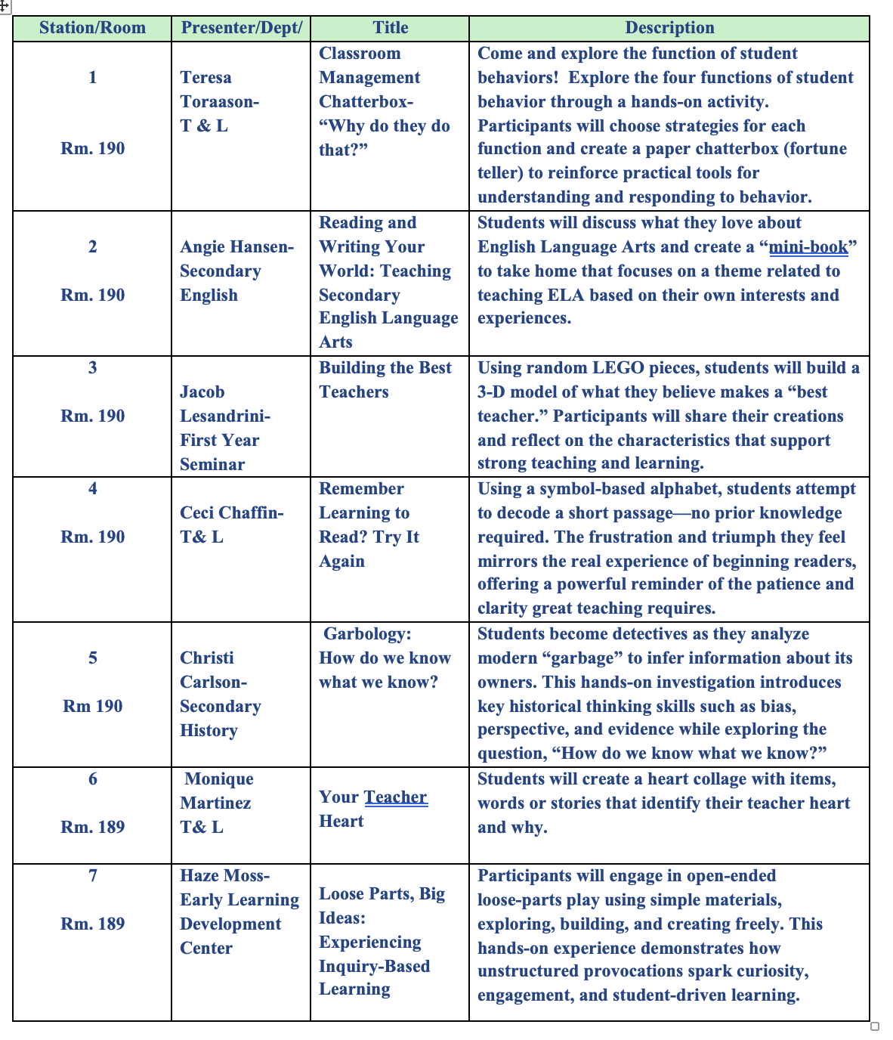
Exciting Center Activities Ahead!
Choose 3
25 minute rotations
Meet in 190
Special Note: Station 8- is in Room 190
Home Away From Home
This presentation will focus on the transition from high school to college and the importance of belonging in this new environment.

