Slide 1


Meeting Students Where They Are: Outreach Strategies That Strengthen Rural Cybersecurity Pathways
ACTE Postsecondary CTE Summit 2026
Marion Technical College | NSF-ATE Project #2350280

Slide 2
Who are we?
Christy Culver, Professor/Assistant Program Administrator for Business and Information Technologies @ MTC, PI NSF ATE Cybersecurity Grant
Ks Ku, Assistant Professor, Information Technologies @ MTC, Co-PI NSF ATE Cybersecurity Grant
Tola Francis-Sanusi, CPSN Coordinator @ MTC,
Career Pathway Support Networks - Central Region
Notes:
The opinions, findings, conclusions, and recommendations expressed in this material are those of the author and do not reflect the position or policies of the National Science Foundation.

Slide 3
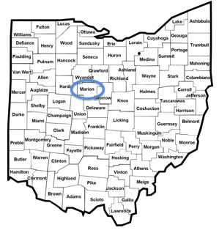
Brief History
Marion Technical College, Marion, Ohio
Founded in 1970 as Marion County Technical Institute
1972 - Name change to Marion Technical College
One of 22 public two-year colleges in Ohio
180 acre campus co-located with The Ohio State University at Marion

Slide 4

Classroom
Degrees
Cost
Financial Aid
24
32
$225
90%
Average class size
Associate degree programs
per credit hour
receive and use aid
17
6
$2,700
FAFSA
GRANTS
SCHOLARSHIPS
LOANS
Average lab size
Academic departments
12 credit hours
4100
21
$2,925
Students
Certificates
13-18 credit hours

Slide 5
Who Is in the Room?
Surface shared challenges before introducing solutions — a live poll sets the tone for peer-driven dialogue.
Live Poll
Select all that apply:
My institution serves rural or geographically isolated students.
We struggle to reach students before they make post-secondary decisions.
We lack dedicated outreach or recruitment staff.
We want to expand cybersecurity or STEM pathways but aren't sure where to start.
NSF-ATE Project #2350280 | Marion Technical College
2

Slide 6





The Rural Access Gap
Rural students face compounding barriers that make outreach not just helpful — but essential for equitable access.
Marion, Morrow, Delaware, and Union Counties, Ohio
Socioeconomic Barriers
First-Generation Awareness Gap
Geographic Distance
Limited college awareness and readiness due to financial constraints.
Inequities in school funding reduce access to high-quality CTE programs.
First-generation students often unaware of cybersecurity and emerging career fields due to limited local exposure and fewer adult role models in the field.
Physical separation from campus resources creates a compounding disadvantage — out of sight often means out of mind when it comes to post-secondary planning.
Result: Students make enrollment decisions — or don't — without ever seeing what post-secondary looks like.
NSF-ATE Project #2350280 | Marion Technical College
3

Slide 7

About This Project
MTC's NSF-ATE funded work provides a concrete, field-tested model — and today's session shares what was learned.
Institution
Marion Technical College (MTC), Marion, Ohio
NSF
Project Title
National Science Foundation
Expanding Cybersecurity Education at a Rural Community College
Advanced Technological Education
Funder
Grant #2350280
National Science Foundation — Advanced Technological Education (ATE) Program, Grant #2350280
$533,404
Award & Timeline
Three-Year Award
$533,404 | Three-year performance period | Year Two Evaluation: July 2026
Year Two Evaluation
July 2026
External Evaluator
Dr. Blake Urbach, Preferred Program Evaluations
Core Question
How do we make cybersecurity pathways visible, relevant, and attainable for rural students before they ever step on campus?
Any opinions, findings, conclusions, or recommendations expressed are those of the authors and do not necessarily reflect the views of the National Science Foundation.
NSF-ATE Project #2350280 | Marion Technical College
4

Slide 8





Three Strategies, One Framework
Three distinct outreach strategies work together — each targeting a different moment in the student awareness-to-enrollment journey.
1
Strategy One
2
Strategy Two
3
Strategy Three
Mobile Training Lab
Summer Cybersecurity Camps
Structured Campus Visit Days
Bring college-level cybersecurity to students in familiar settings
Immersive experiences that spark career awareness and interest
Connect outreach directly to enrollment through on-campus experiences
Together:
Build Awareness → Build Confidence → Build Pathways
Today's Objectives
Identify and describe all three outreach strategies
Apply a transferable framework to your institution
Use evaluation findings to inform your outreach decisions
NSF-ATE Project #2350280 | Marion Technical College
5

Slide 9
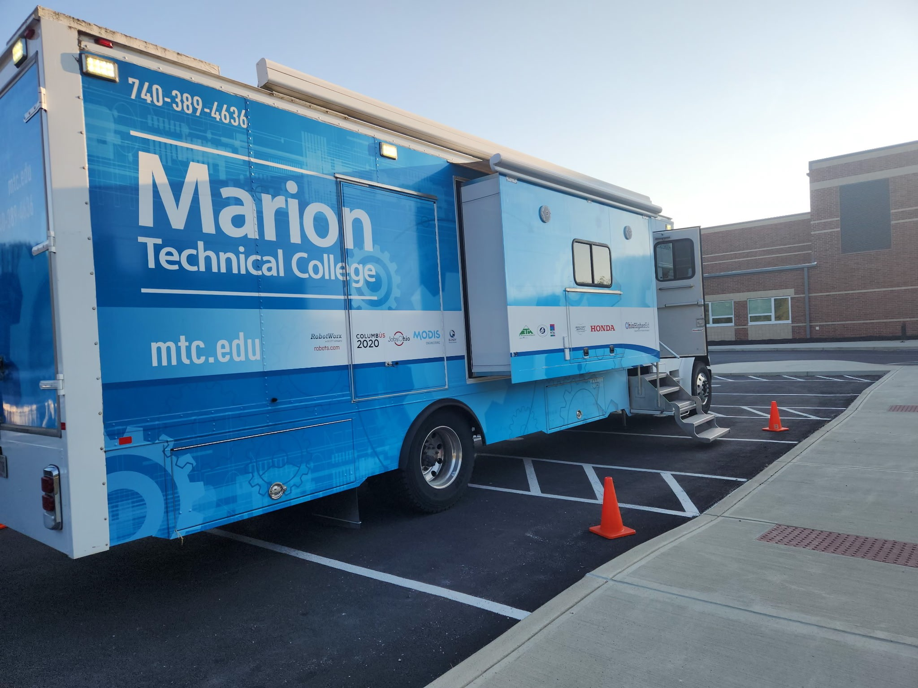
Strategy 1 of 3
Mobile Training Lab
When students cannot come to the college, the college comes to them — breaking down geographic and financial barriers in one move.
The Lab: A 40-foot, self-contained, handicap-accessible mobile classroom delivering college-level cybersecurity instruction
Activities: Cybersecurity awareness, brute force passwords, encryption, Internet safety, and coding
Year 2 Reach: Nearly a dozen middle and high schools visited (Fall 2025 & Spring 2026)
Multiple partner faculty have already requested follow-up visits
K-12 educator toolkit: worksheets, Caesar Cipher Wheel, and e-resource website (also available on USB)
Grades 5–12 | Self-contained | Handicap-accessible | No campus visit required
NSF-ATE Project #2350280 | Marion Technical College

Slide 10
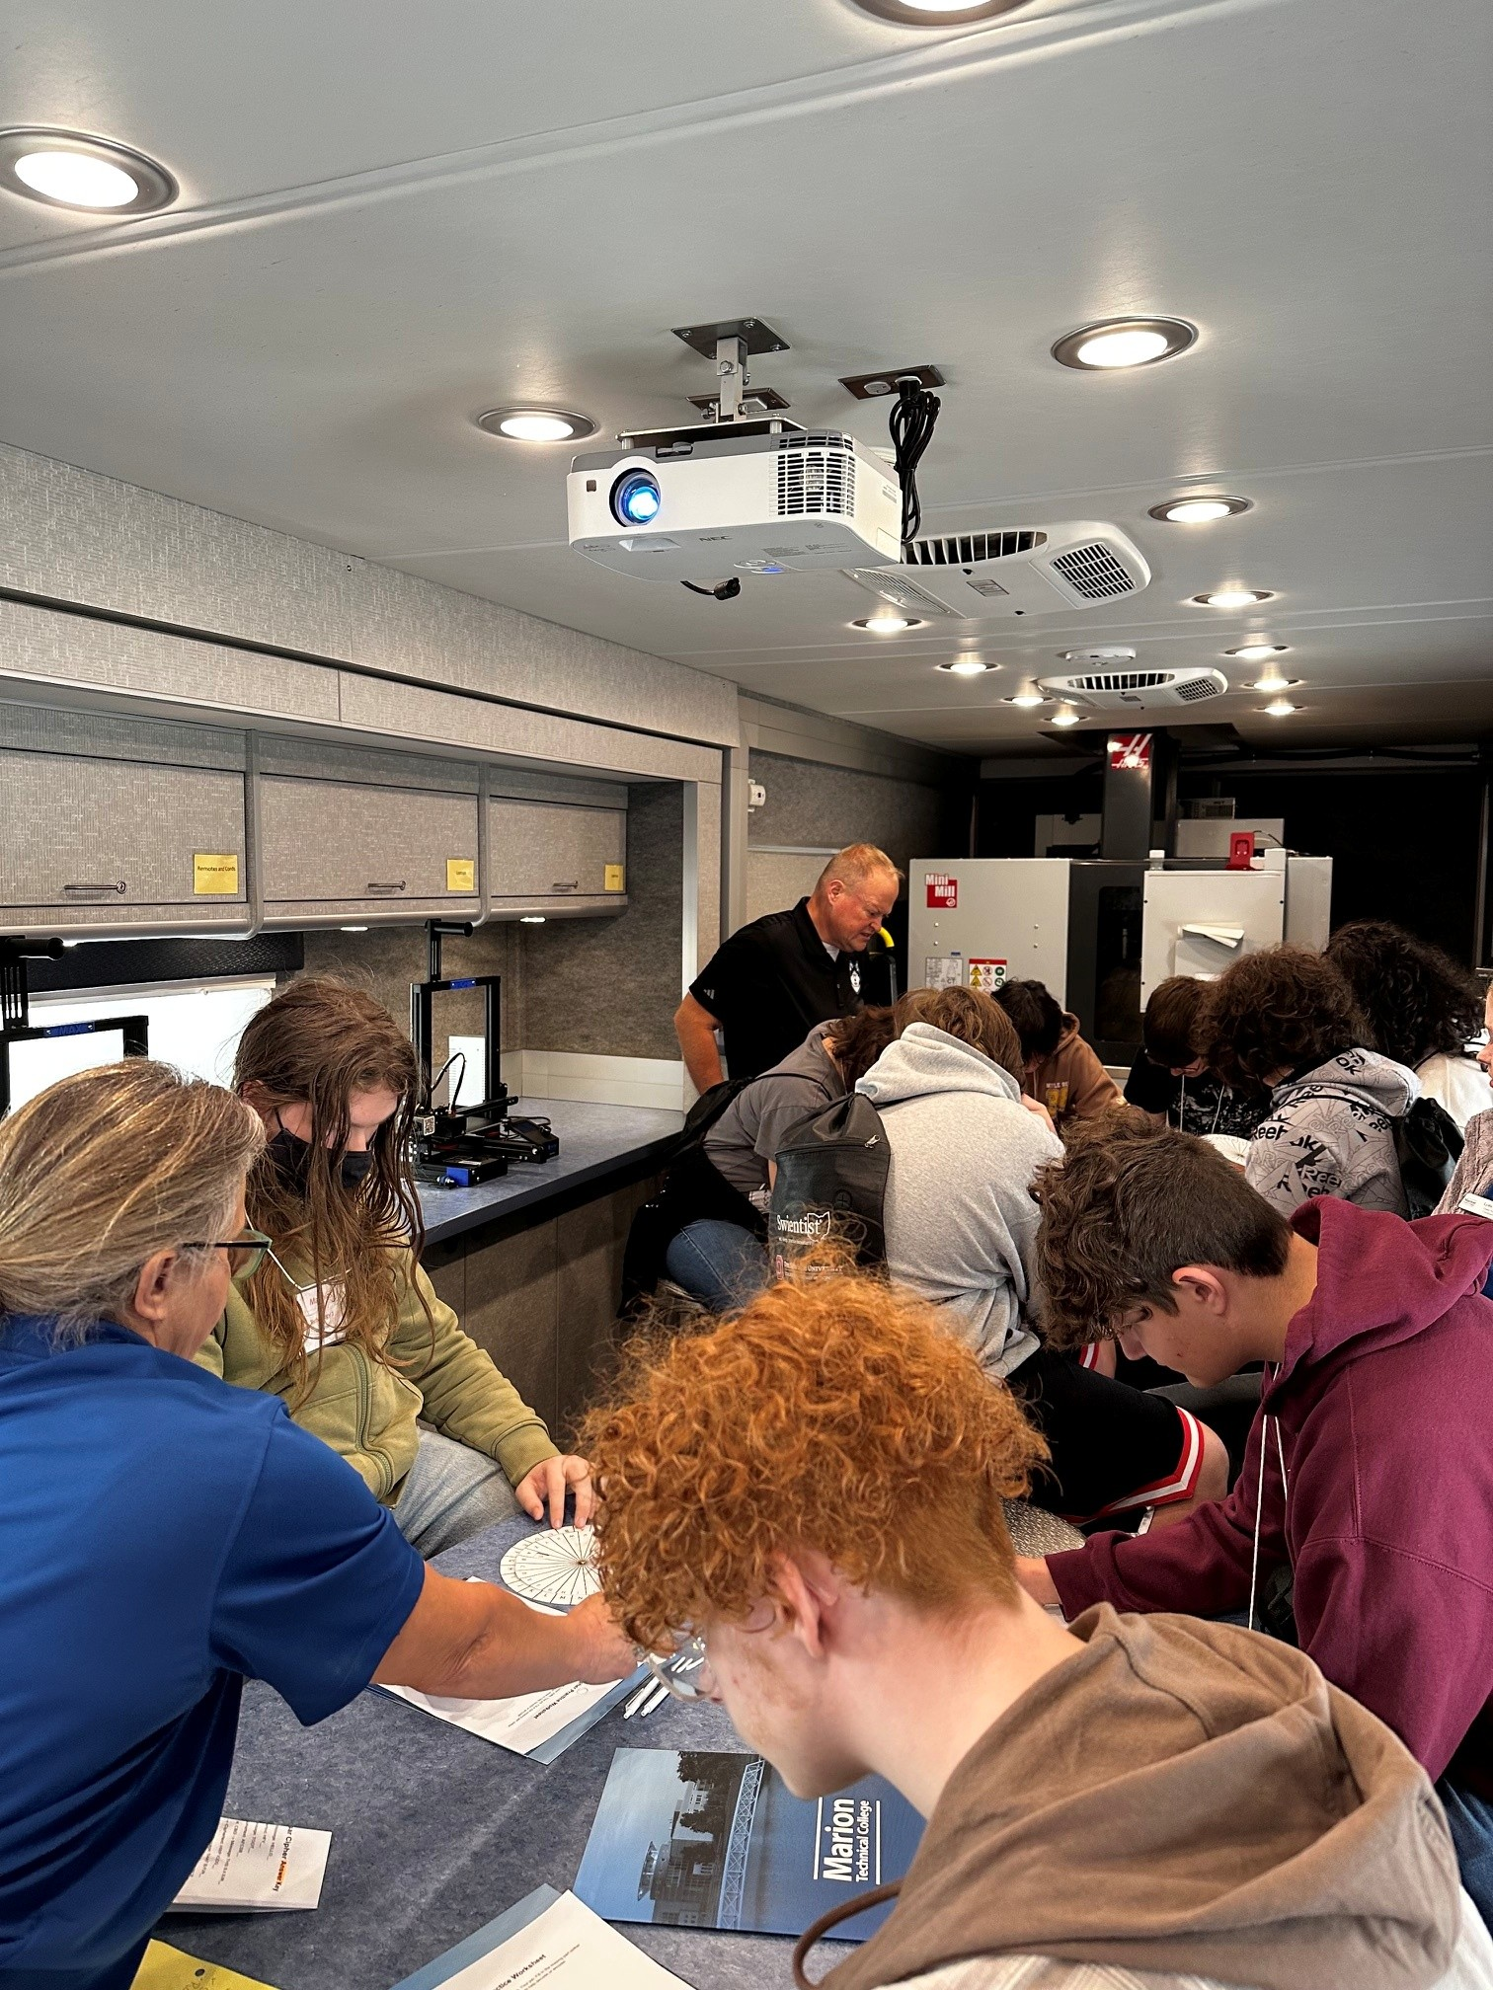
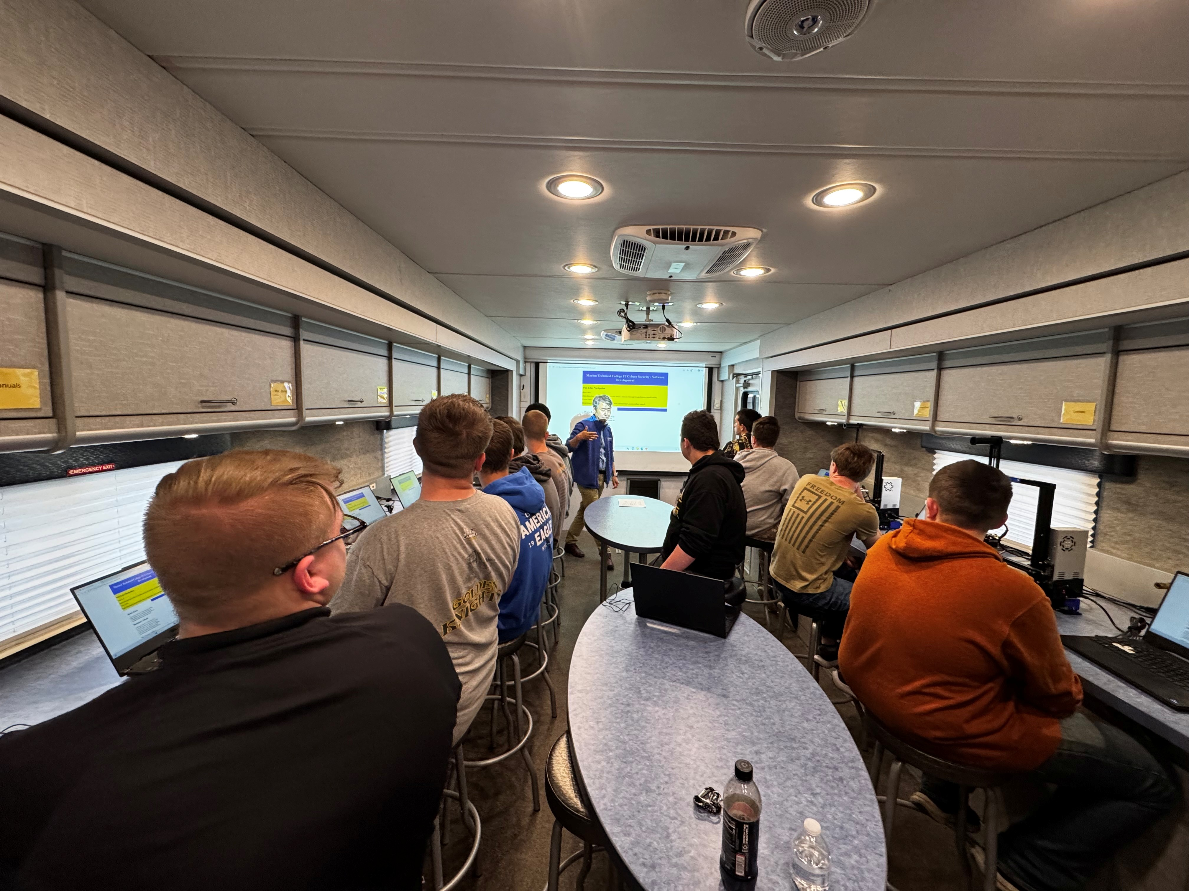
Strategy 1 of 3
Mobile Training Lab
NSF-ATE Project #2350280 | Marion Technical College

Slide 11



Strategy 1 — Reflection Activity
Mobile Lab in Action — Think-Pair-Share
Pause to connect MTC's mobile model to your own context before moving to the next strategy.
Think
Pair
Share
1 minute — individually
2 minutes — with a neighbor
2 minutes — whole group
Reflect on your context: What barriers prevent your students from engaging with post-secondary programs before enrollment?
Discuss together: What resources or partnerships could a mobile model leverage at your institution?
Brief report-out: Each pair shares one key insight with the full room.
NSF-ATE Project #2350280 | Marion Technical College
7

Slide 12

Strategy 2
Summer Cybersecurity Camps
Short-term immersive experiences create the "I can do this" moment that transforms student interest into intent.
24
100%
4-Day
Total Camp
Participants Y1+Y2
2025 respondents strengthened
STEM interest at MTC
Immersive format
co-facilitated by faculty
2025
IT Summer Camp — Rising 9th–12th Graders (July 28–31): 5 students
100% of survey completers: participation strengthened interest in studying STEM at MTC
2026
Cybersecurity Summer Camps — Expanded to include middle school track: 19 students
Beginner (rising 6th–8th graders): 75% increased IT interest at MTC; 100% would recommend to peers
Intermediate (rising 9th–12th graders): 100% would recommend to peers
"I found that I like computers and cybersecurity more than I thought I did before the program."
— Camp Participant
NSF-ATE Project #2350280 | Marion Technical College
8

Slide 13
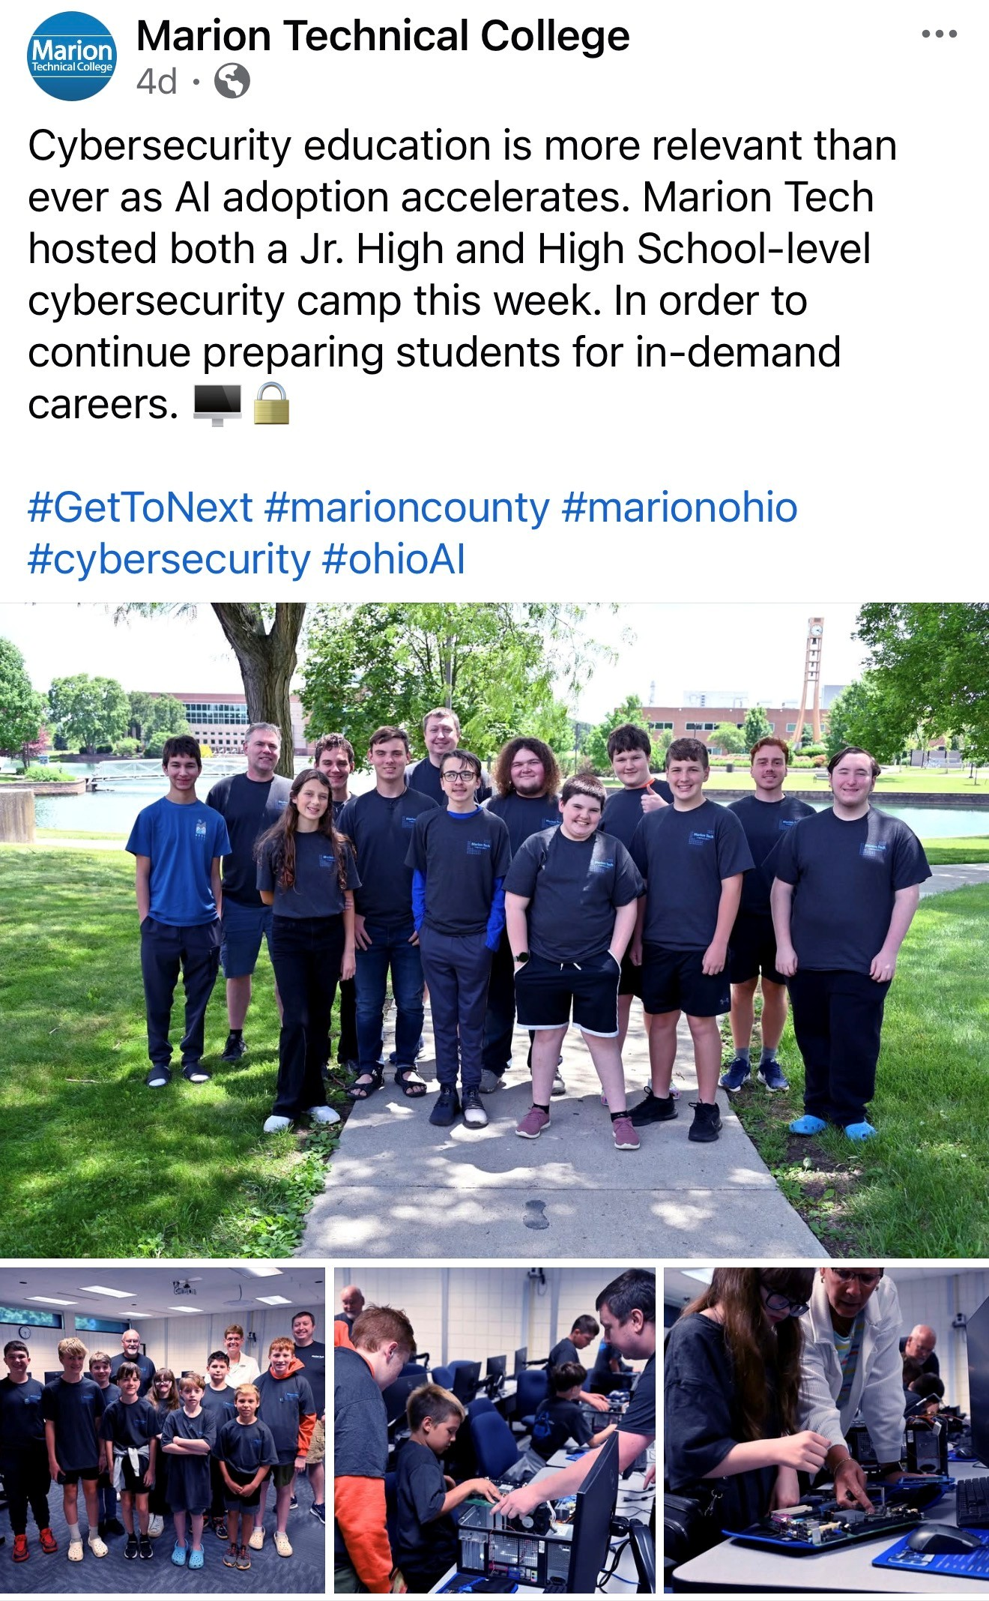
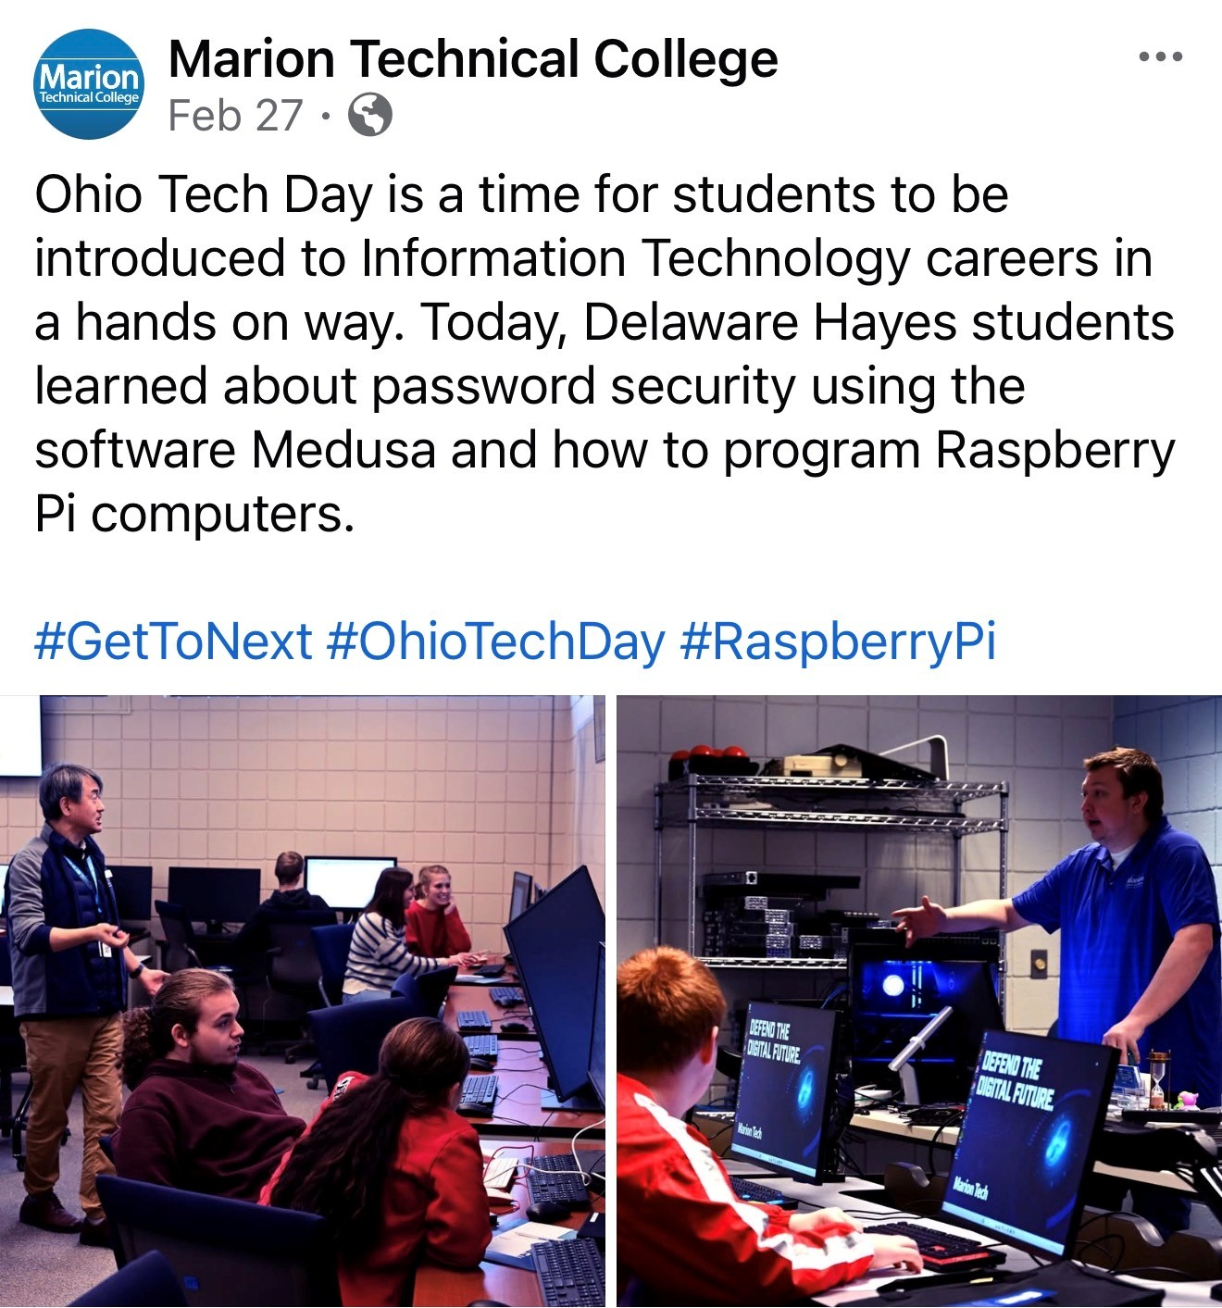
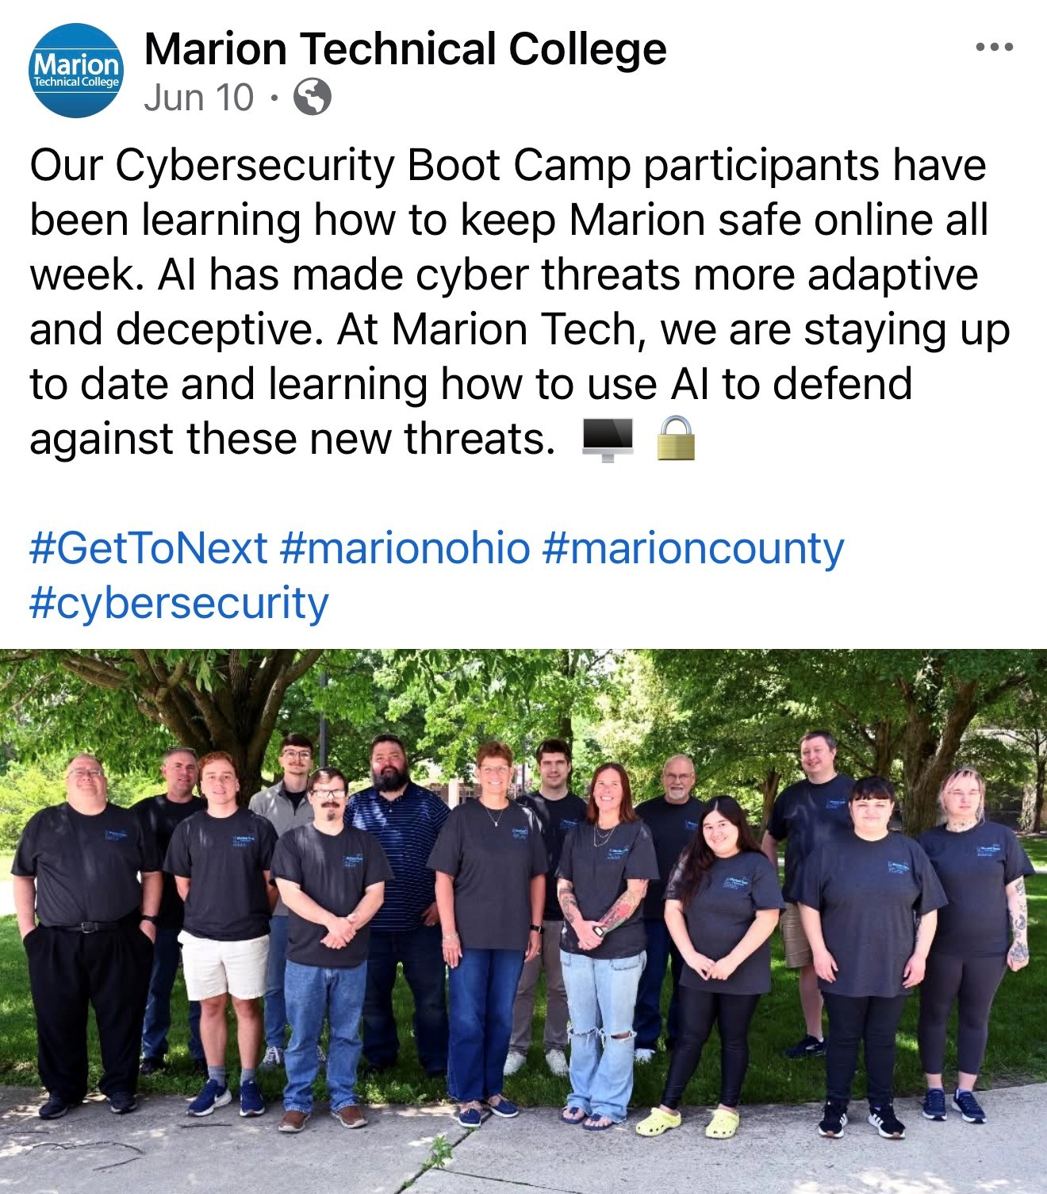
Hidden Strategy
Social Media

Slide 14






Strategy 3 of 3
Structured Campus Visit Days
A campus visit day is not a tour — it is a deliberate transition event that converts outreach into enrollment opportunity.
Element 1
Element 2
Element 3
Element 4
Hands-On Lab Experiences
Faculty & Student Interaction
Stackable Credentials & Career Pathways
Enrollment Connection
Students engage directly with campus cybersecurity facilities — learning by doing in a real college environment.
Direct conversations with faculty and current students build belonging and answer the question: "Is this place for me?"
Clear explanation of how cybersecurity credentials stack — connecting coursework to careers students can actually see themselves in.
Every visit element links intentionally to next enrollment steps — the visit ends with a clear, supported path forward.
Design principle: Every element of the visit answers a student's unspoken question — "Is this for someone like me?"
NSF-ATE Project #2350280 | Marion Technical College
9

Slide 15






What the Evaluation Found
Evidence from MTC's Year Two external evaluation confirms these strategies are working — and the data points toward what to do next.
Key Findings — Year Two Evaluation
Mobile Training Lab
Nearly a dozen schools visited in Y2; well received grades 5–12; multiple partner faculty requested follow-up visits
~12
24
Summer Cybersecurity Camps
Schools Visited
Total Camp Participants
24 total participants Y1+Y2; 75% of 2026 Beginner respondents increased IT interest; 100% of both cohorts would recommend to peers
Mobile Lab, Year 2
Year 1 + Year 2 combined
Enrollment Impact
Female cybersecurity enrollment +67% (fall 2024 → fall 2025); Pioneer Career Center students enrolled — attributed to outreach
All stakeholder interviewees confirmed: the grant has potential to build a pipeline of superior cybersecurity graduates.
+67%
+1
Female Enrollment
New Service Region
6 → 10 students (Fall 2024–2025)
Pioneer Career Center
enrolled
100%
2025 camp respondents: strengthened STEM interest at MTC
NSF-ATE Project #2350280 | Marion Technical College

Slide 16



Activity — Small Group
Small Group Case Study
Now apply the framework — use MTC's model to design an outreach strategy for a scenario drawn from your own practice.
Group Task — Using MTC's Three-Strategy Framework, identify:
Your Scenario
Strategy First
1
Which outreach strategy would you launch first and why?
A rural community college wants to reach first-generation high school juniors and seniors who have never considered cybersecurity. You have limited staff and a modest budget.
2
Partnerships
Small groups of 3–4 people | 8 minutes
What partnerships would you need to make it happen?
3
Measuring Success
How would you measure success — and what data would you collect?
Report-out: 1 spokesperson per group shares one key decision (5 min)
NSF-ATE Project #2350280 | Marion Technical College

Slide 17

A Transferable Outreach Framework
The MTC model is not a blueprint to copy — it is a framework to adapt, using your institution's context, partnerships, and resources.
1
Identify
Who are your underserved students? What barriers block their pathway?
EVALUATE
IDENTIFY
2
Design
OUTREACH
Which strategy fits your context — mobile delivery, immersive experience, or structured visit?
FRAMEWORK
Continuous Cycle
3
Deliver
Partner with secondary schools, community organizations, and industry to extend reach.
DELIVER
DESIGN
4
Evaluate
Use student feedback and enrollment data to refine — and make the case for continued investment.
MTC Lesson in Action
Middle school camp track added based on mobile lab evaluation findings — evidence directly informing design. Outreach must be intentional, connected to credentials, and centered on the student's perspective.
NSF-ATE Project #2350280 | Marion Technical College
12

Slide 18

Embedded, Stackable Certifications
Integrate industry-recognized certifications directly into applicable courses.
Allow students to earn a credential as part of their course experience.
Connect course learning outcomes to certification competencies and exam preparation.
Provide students with a clear pathway from course completion → certification → career readiness.
Student Benefit
“Know what you have. Know what it counts toward.
Know what comes next.”
A poster can be displayed in advising areas, classrooms, career centers, and online to make certification pathways easy to understand and navigate.
NSF-ATE Project #2350280 | Marion Technical College

Slide 19



Your Next Steps
Leave today with a concrete first action — not just inspiration.
This Week
This Month
This Semester
Identify a Gap in Your Outreach
Map Your Partnerships
Draft One Outreach Event
Identify one student population your current outreach does not reach — first-generation students, rural learners, or those unaware of cybersecurity careers.
Map existing partnerships that could support a mobile lab, camp, or campus visit-day model. Who are the secondary schools, community organizations, and industry contacts already in your network?
Draft one outreach event tied directly to a credential pathway and a measurable outcome. Connect every element of the event to a student's next enrollment step.
Contact: Marion Technical College | NSF-ATE Grant #2350280
Q&A — Open Discussion (5 min)

