Slide 1
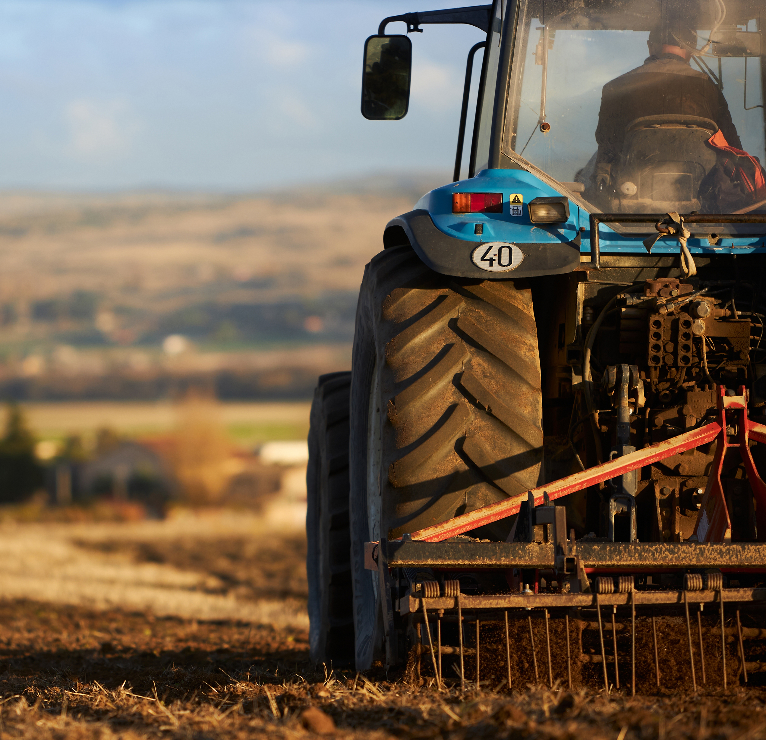
Maximizing WBL Resources in a Rural Setting
Suzanne Mitchell and Lori Sexton

Slide 2
Objectives
Understand the unique challenges and opportunities for WBL in rural Tennessee
Identify key stakeholders and partners for building sustainable WBL programs
Gain tools and resources to enhance rural WBL programs
Explore successful models of WBL implementation in rural areas

Slide 3

District Snapshot
Bedford County Schools
Three High Schools 9-12
Two K-8 Schools
Three Middle Schools
Seven Elementary Schools
Total student population: ~9,000

Slide 4
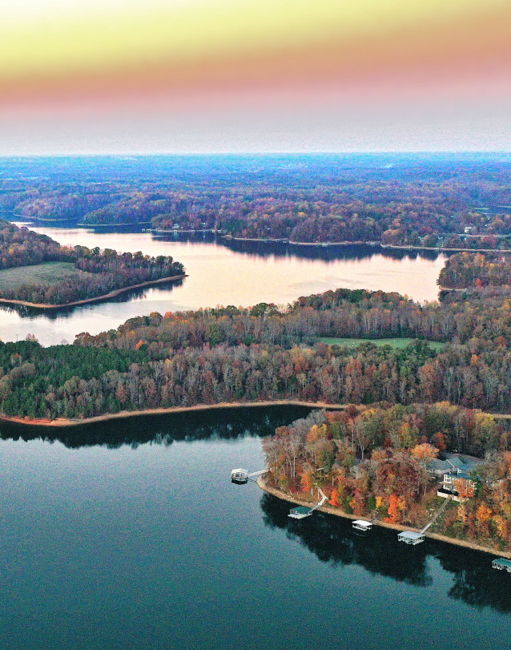
District Snapshot
Franklin County Schools
One High School 9-12
One K-12 School
Two Middle Schools
Eight Elementary Schools
Total student population: ~4,000

Slide 5
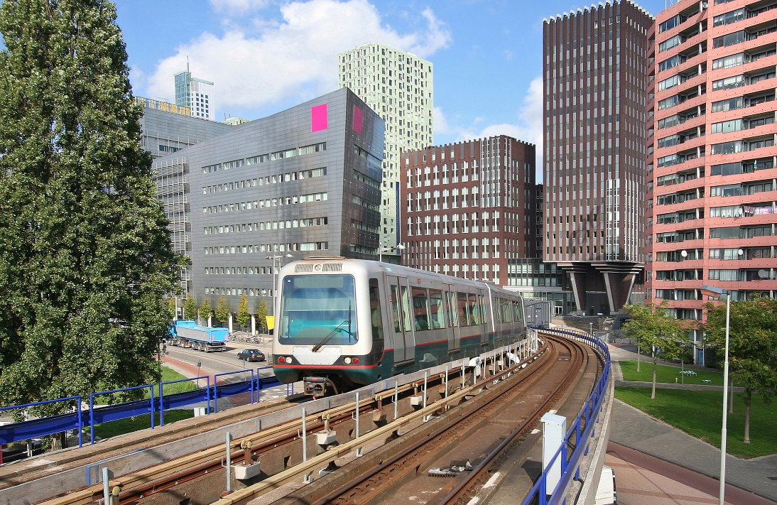

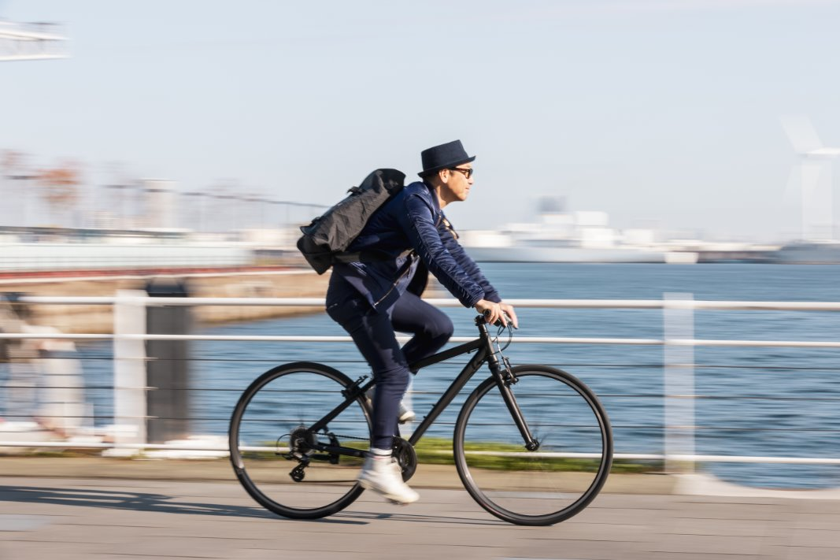
Challenges Vs. Opportunities
Challenges
Opportunities
Transportation
Employer Reluctance
Stigma
Academic Schedules
Funding Disparities
Limited Employer Participation
Grants
Practicums
SBEs
American Job Center
WIOA
YEP

Slide 6
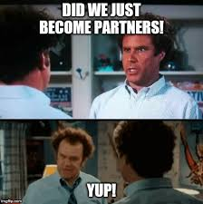
Who are your people?

Slide 7
Stakeholders
Local Business and employers
Chamber of Commerce
Community Colleges
Parents/Guardians
School Counselors
CTE Teachers
District Administrators
Workforce Development Boards
Non-Profits and Community Organizations
Students
Potential Roles
Provide mentorship, job shadowing opportunities, internships
Connect schools with local employers, organize networking events
Offer dual enrollment, career pathway programs, technical training
Share professional insights, support student career exploration
Coordinate programs, manage student placements, track outcome
Embed work-based learning into curriculum, maintain employer relationships
Allocate funding, create policies, remove barriers
Provide grants, labor market data, connect to training programs
Offer internships, mentorship, support underserved students
Actively participate, provide feedback, drive demand for opportunities

Slide 8

Let's Talk
Discussion Questions
Which 3 stakeholders are most critical for your school to engage first?
Who are you already connected with? Who is missing?
What barriers might prevent certain stakeholders from participating?
How can you build sustainable relationships with these groups?

Slide 9
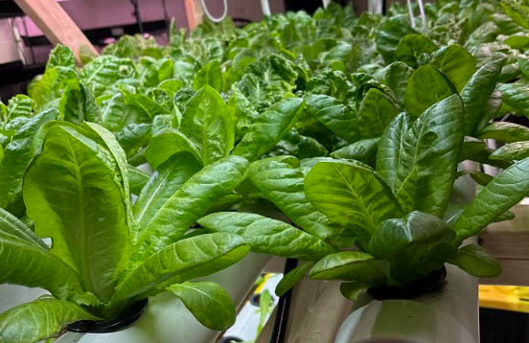
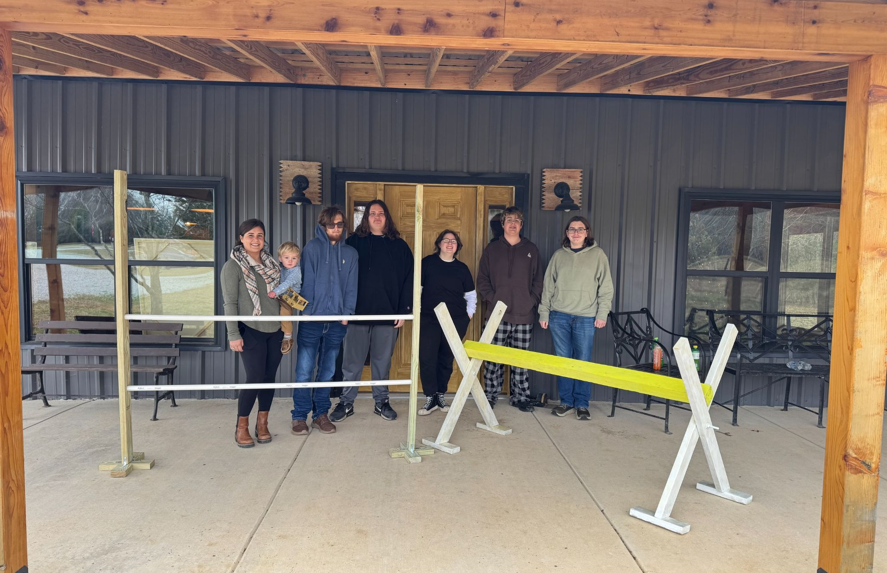
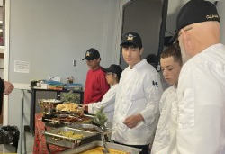
Successful Models of WBL: Inside and Outside of the Box Approach
Virtual and Hybrid Models
ICON
District C-Teamship
Community Driven Projects
Sleep in Heavenly Peace
Bits and Peaces
SBEs
Champion's Table
Hornet Microgreens

Slide 10
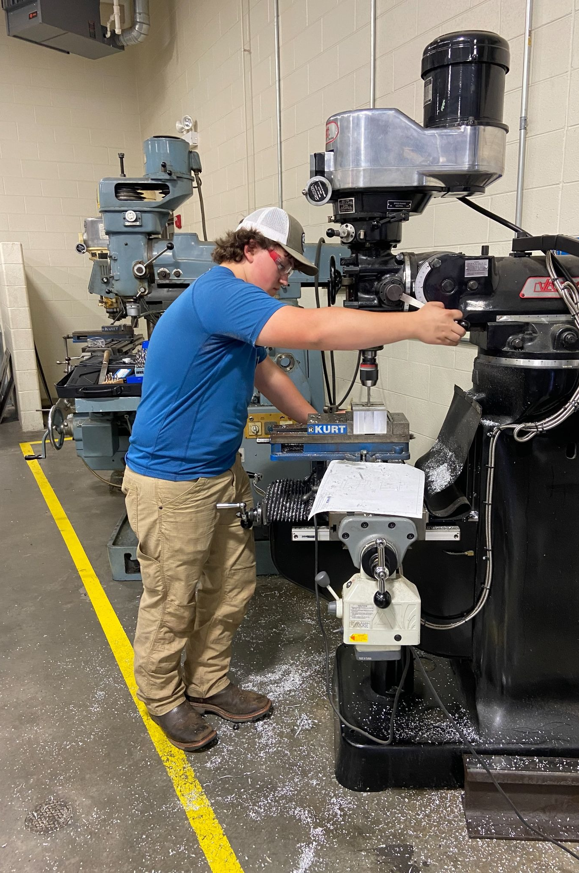
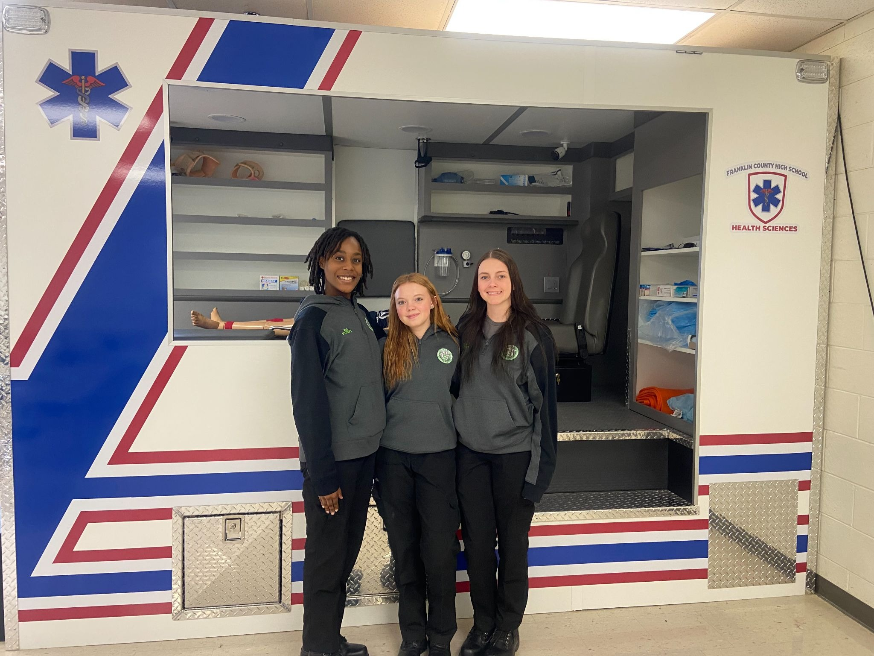
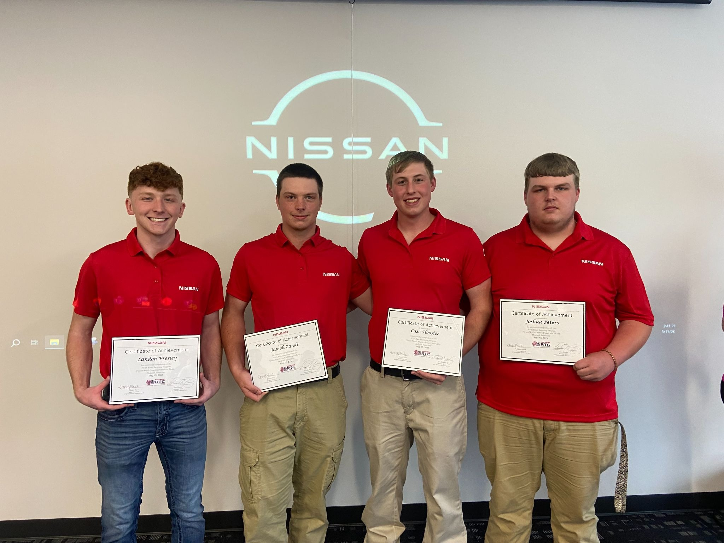
Innovative Partnerships at Work
TN Legislative Support
Innovative School Model Grant
TN Course Substitutions
TN Course Codes for WBL
State Partnerships
THEC, TBR, TN SCORE
Regional Partnerships
Jobs for the Future (JFF)
Regional Advisory Council
Post Secondary Partnerships
Early Career Preparation
High School and Beyond Plan
Middle School Expectations

Slide 11

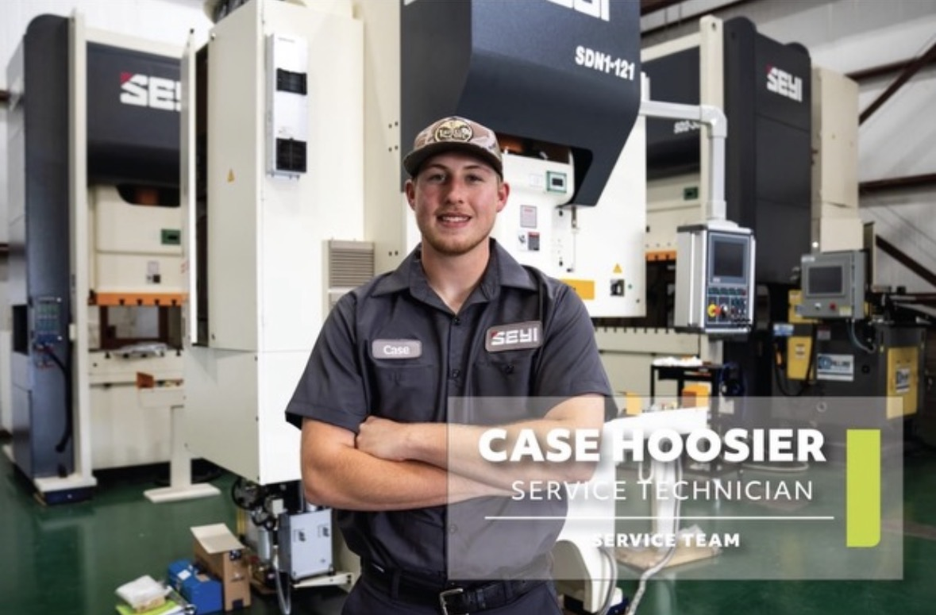
Future Ready Tennessee Official Home Page
Additional Resources
Outreach Letter Template
WBL Planning Template

Slide 12
Questions?
Lori Sexton
Bedford County Schools
Shelbyville, TN
Sextonl@bedfordk12tn.net
Suzanne Mitchell
Franklin County Schools
Winchester, TN
suzanne.mitchell@fcstn.net

