Slide 1

From Findings to Action: Engaging Employers and CTE Educators for High-Quality WBL
Presented by: Dr. Cindy L. Miller & Ms. Gabriella Garcia
Texas Tech University
Notes:
Good morning and thank you for being here. Today I’m sharing insights from a completed mixed‑methods research project called Bridging the Gap: Enhancing Workforce Readiness in High School Students Through Employer-Education Partnerships. The goal of the project was to better understand how work‑based learning is actually functioning across systems and how employer–education partnerships can be strengthened. This session focuses on translating research findings into practical decisions that districts, educators, and workforce partners can implement.

Slide 2
Why This Research Matters
WBL widely promoted as a workforce readiness strategy
Implementation often inconsistent
Access varies widely across schools and communities
Employer engagement frequently depends on individual relationships
Notes:
Across the country, work‑based learning is recognized as one of the most powerful ways to prepare students for careers. However, the way WBL is implemented often varies widely depending on resources, networks, and coordination.

Slide 3

Research Purpose
The Study Examined:
  Employer expectations for workforce readiness
  How educators implement WBL
  Barriers affecting WBL participation
  The role of intermediary coordination
Notes:
The purpose was not to evaluate one specific program, but to understand how the system works and where friction occurs between education and employers.

Slide 4


Convergent Mixed-Methods Design
Data Sources Included:
  Quantitative Stream: Employer survey (n=71)
  Qualitative Stream: Interviews with CTE teachers and district leaders & employer focus group
  Contextual Stream: Intermediary case studies in Texas
Notes:
We wanted to understand the problem from both sides of the partnership.

Slide 5
What the Research Did (and Did Not) Examine
The study examined:
The study did not:
Employer expectations for workforce readiness
How educators implement WBL
Barriers affecting WBL participation
The role of intermediary coordination
Evaluate one specific WBL program
Measure long-term student outcomes
Prescribe a single national model
Assume employers or educators are the problem
Notes:
This research focused on understanding how systems function rather than evaluating individual programs.

Slide 6
Key Finding #1:
Communication Skills
Problem-solving
Reliability
Professionalism
Initiative
Adaptability
What Employers Value Most:
Notes:
Employers consistently emphasized that technical skills can be taught, but employability skills must already be developing. Employability skills are the primary currency of employer trust.

Slide 7
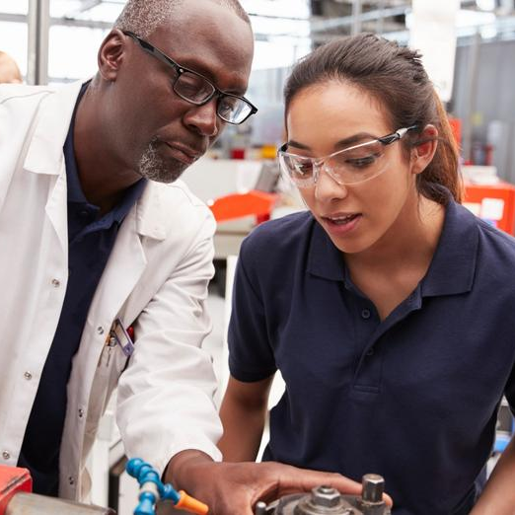
Key Finding #2:
Employers prefer:
  Clear expectations
  Single points of contact
  Manageable time commitments
Notes:
Employer engagement is limited by coordination challenges.

Slide 8
Key Finding 3:
Barriers Employers Identified
Transportation
Scheduling conflicts
Student age restrictions
Liability concerns
Lack of coordination with schools
Notes:
The barrier is rarely the employer’s willingness.

Slide 9
Key Finding #4
What Educators Told Us
Difficulty finding employer contacts
Time required to coordinate experiences
Uncertainty about employer expectations
Lack of standardized agreements or processes
Notes:
WBL is often relationship-dependent rather than system-supported.

Slide 10
Key Finding 5:
Without Coordination
Employers disengage
Partnerships dissolve
Students lose access to WBL experiences

Slide 11
What This Means
Without coordination
Some students receive excellent experiences and others receive none
The challenge:
How do we move from isolated partnerships to system-level coordination?
Notes:
The barrier is system capacity and coordination.

Slide 12
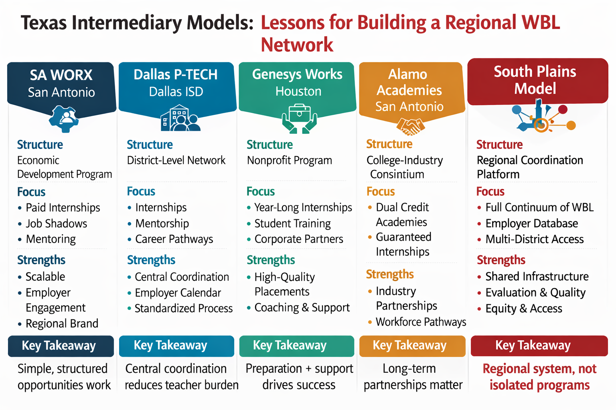

Slide 13
Lessons from Texas Models
Successful intermediary systems include:
A single point of contact for employers
Clear expectations for partners
Standardized processes
Strong cross-sector collaboration
Notes:
Development of a regional employer–education database platform

Slide 14

Our Regional Intermediary Approach
Centralized employer database
Structured placement requests
Standardized agreements
Evaluation systems
Regional coordination partners

Slide 15
Community Workforce Partnership (CWP) Model
CWP
Employers
Economic Development
Workforce Board
Schools
Community College
Students
University
WBL Providers
Industry Alignment
Regional Coordination
Student Preparation
Pathway Continuation
Career Development
Research & Evaluation
Notes:
What distinguishes this model from many intermediary structures is that it is not housed within a single organization. Instead, the Community Workforce Partnership Committee serves as a shared coordinating body that brings together employers, educators, workforce organizations, and economic development partners. Each stakeholder plays a specific role, but responsibility for coordination is shared across the network. This structure allows for more sustainable and scalable work-based learning opportunities, particularly in regions that do not have large urban infrastructure.” The research showed that the challenge isn’t a lack of employer interest or educator commitment. The challenge is coordination. The Community Workforce Partnership serves as the intermediary that connects schools, employers, workforce organizations, and students through a shared system that makes participation easier for everyone.

Slide 16
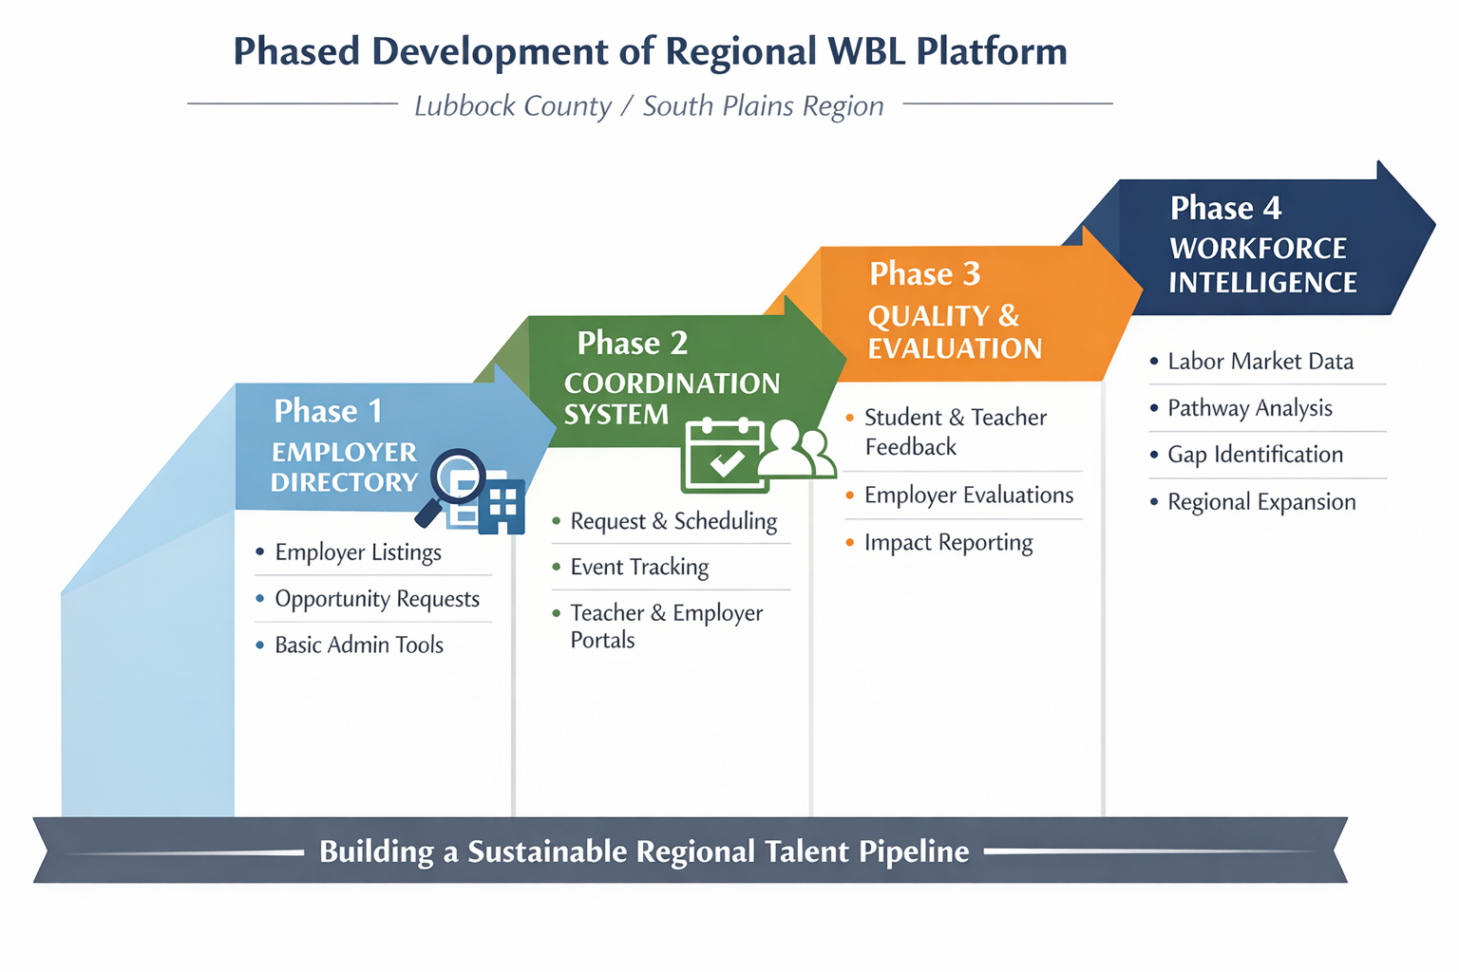

Slide 17

Group Discussion Activity
Discuss with someone near you:
  What challenges exist in your local or regional WBL system?
  Who currently coordinates employer engagement?
  What intermediary structure might strengthen your partnerships?

Slide 18
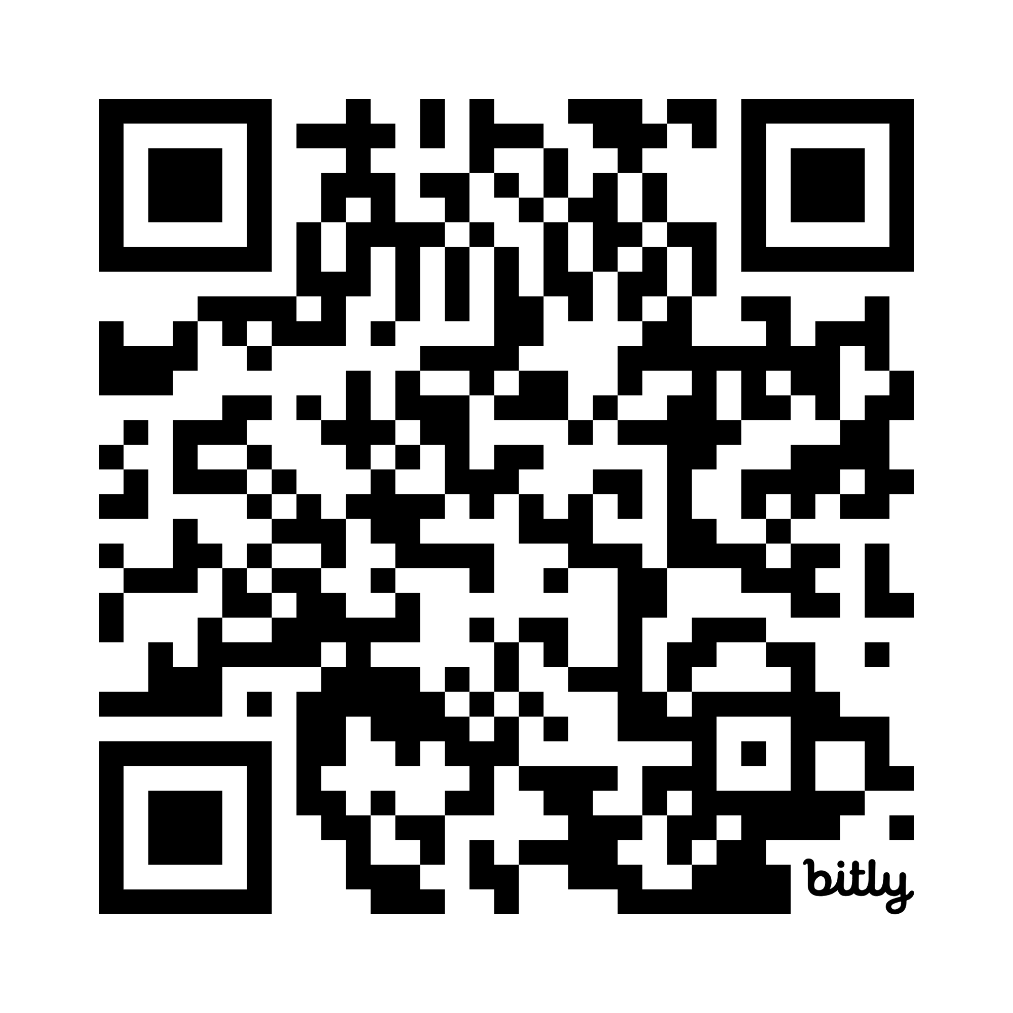
Intermediary WBL Toolkit
Bridging the Gap: Actionable Recommendations for Strengthening WBL in Lubbock County
How the South Plains Intermediary Model Builds on Proven Texas Models
Phased Development of Regional WBL Platform
What Regional WBL Platform Should Accomplish
Regional WBL Impact Dashboard Framework
One-Page Quality Standards for Employer Partners
Employer Feedback on WBL Experience
Student WBL Experience Survey
Teacher Feedback on WBL Experience
https://bit.ly/4lt5Qbq

Slide 19

Final Thought
Strengthening employer–education partnerships requires systems, not just programs.

Slide 20

Questions
Email: Cynthia.L.Miller@ttu.edu
LinkedIn: https://www.linkedin.com/in/cindyallenmiller/

