Slide 1

Navigating together: Schools and industry aligned for student impact

Slide 2
Where are you in the process of building your internship program?
Brainstorming
Launching
Scaling

Slide 3
Presenter introductions
Breona Ward Director, College and Career Success DeLaSalle High School
Sean Stalling Executive Director DeLaSalle High School
April Fleming Career Navigator Liberty Public Schools
Dr. Sara Wickham Director, Real World Learning Liberty Public Schools
Crystal Everett Real World Learning Officer Kauffman Foundation

Slide 4
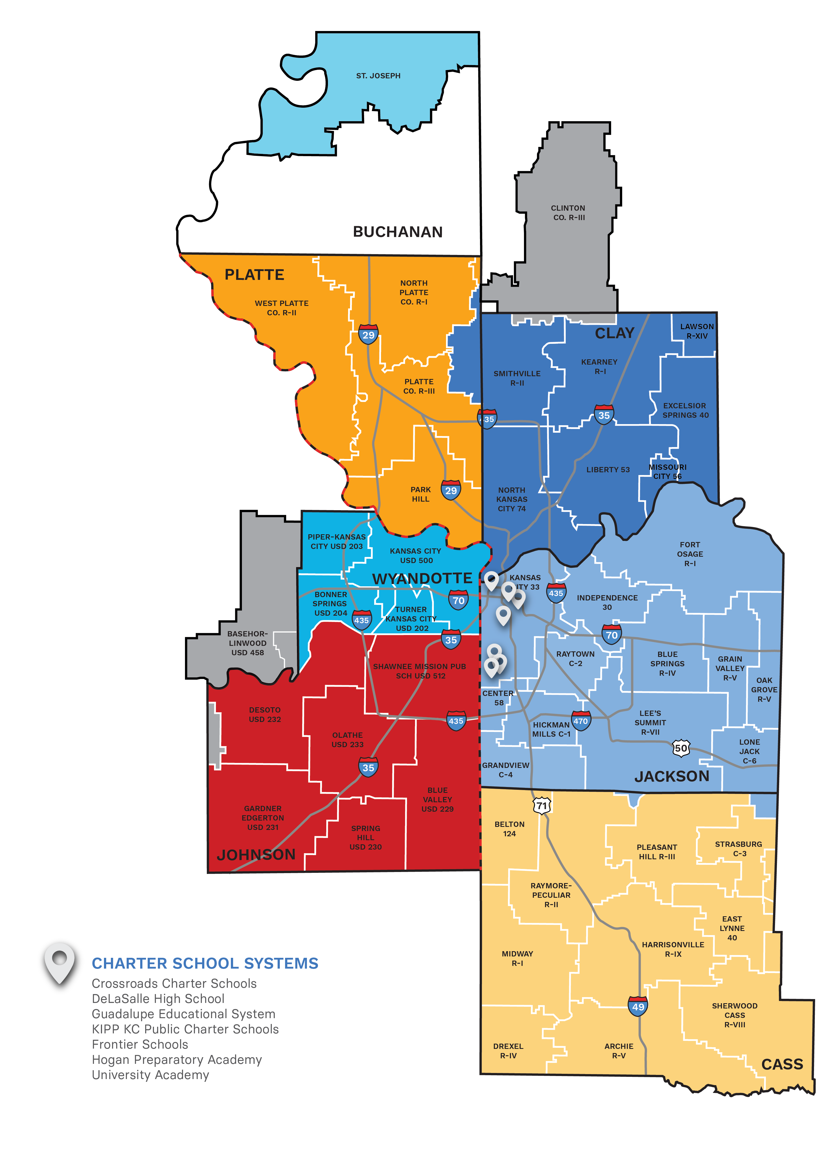
RWL School Districts
Six-county Kansas City metro
Missouri and Kansas
Cass
Clay
Jackson
Johnson
Platte
Wyandotte
Engaged districts
34 grant-funded school districts and charters
14 non-funded school districts and charters
87 high schools
~100,000 high school students
*RWL activity not limited to 6-county footprint
Notes:
12 non-funded high schools - includes 10 districts + Kauffman School and Notre Dame De Sion
75 highschool + 12

Slide 5




By 2030
Updated August 2023*
Work Experiences
Internships or Client Connected Projects
All high school students across our regional graduate with market value assets and a diploma, preparing them for future work and learning.
Entrepreneurial Experiences
Students identify a compelling social or market problem and mobilize resources to research and solve it.
Industry Recognized Credentials (IRCs)
Regionally vetted by employers & state departments
College Credit
Nine (9) or more hours of college-level credits, in which the student completes coursework progressing towards a college degree.
*Updates are intended to provide clarity and were developed in collaboration with RWL Network Superintendents & MDRC

Slide 6
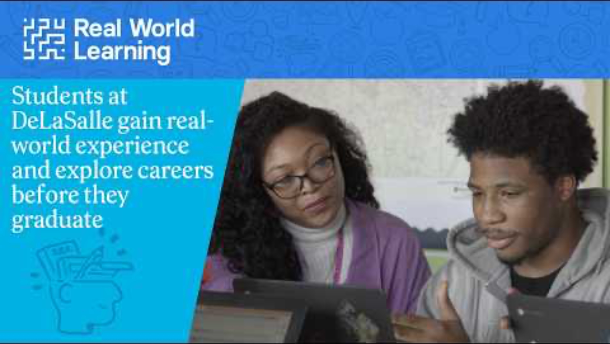

Slide 7



Brainstorming: Origin of the DeLaSalle Daytime Internship and Block37 programs
Notes:
History of both programs:
DDI – Relationship/experience with an org that connects students to internship opportunities – led to gatekeeping and was not a good partnership experience. We rerouted and developed our own daytime internship cohort – the DeLaSalle Daytime Internship aka Young Professionals. This internship experience operates on a guided 8-week model which allows students to participate at multiple internship sites during the academic year. These experiences are curated based on student’s interest and aptitudes which are assessed via the YouScience assessment. Students not only attain internship hours and mentorship through this program, but they are also involved in client connected projects, entrepreneurial experiences, and can earn entry level credentials. Students work on softskills in class when not at their internship site.
Block37, is DeLaSalle's premier Internship Experience program and gives students the protective factors they need to mitigate risky behaviors (e.g., violence, drug/alcohol use, cyber/bullying, etc.) and strengthens their engagement in school. Through internships provided on-site at DeLaSalle High School and off campus at partner organization locations, teens gain real work experience and learn new skills while earning an hourly stipend. During this unique opportunity, students also have the chance to earn market value assets such as internship hours, entrepreneurial experiences, industry recognized credentials, and participation in client connected projects.
Focus areas are Science, Technology, Engineering, Arts, and Math (STEAM); Sports; Life Skills; Communication; Trades, Education and Entrepreneurship. Students gain a stronger sense of belonging, positive community interactions, a sense of purpose, and increased school attachment that leads to improved academic performance and preparedness for higher education or employment.

Slide 8
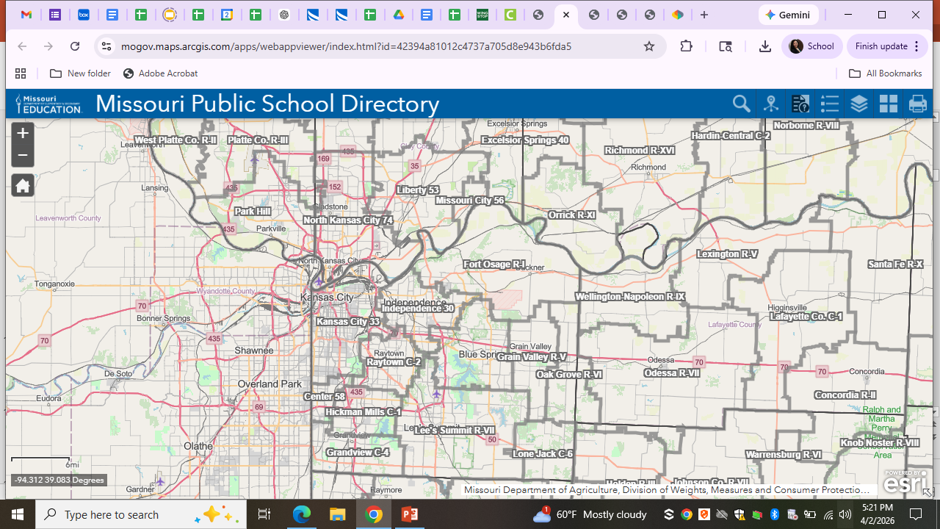
DeLaSalle at-a-glance
👩‍🎓 240 students
Governed by the Missouri Charter Public School Commission (MCPSC)
3 academies serving students from the Kansas City Missouri Public School District and surrounding districts
DeLaSalle High School (traditional 9th-12th)
- Freshman Academy
Flipside Academy (Missouri options)
Kintsugi Academy (justice-involved students 6th-12th)
100% of students qualify for Free and Reduced Lunch
98% receive transportation services
Notes:
Demographics:
87% Black/African American
6% Hispanic/Latino
3% White
4% Multi-racial
15% Receive Special Education Services

Slide 9
DeLaSalle Daytime Internship Program structure
Year-long immersive experience (2 class periods each day)
Built-in flexibility for Real World Learning
Transportation provided
Detailed interest and aptitude review
Intensive career exploration
Onboarding and internship placement
Weekly soft skills training + individual coaching
Course credit and Market Value Asset attainment
Capstone presentation: Showcasing learning and impact

Slide 10
Block37 internship program structure
Four 8-week sessions throughout the calendar year
3-4 internship days per week | 3 hours per day
Stipend ≤ $828.00 per session
Built-in flexibility for Real World Learning
Transportation provided
Meal provided
Application, interview, and selection process
Onboarding and internship placement
Individual coaching
Course credit and Market Value Asset attainment
Capstone presentation: Showcasing learning and impact

Slide 11
Community partnerships
Finding opportunities | Onboarding and preparation | Monitoring and feedback
Local entrepreneurs and business owners Networking events Student, staff, and personal contacts | Internship fair and interview participation Background checks Safety guidelines Internship checklist and walkthrough | Site visits Surveys

Slide 12

How we market our program
Recruitment tool and artifacts
Community events
Word of mouth – student and partner
Social media platforms

Slide 13
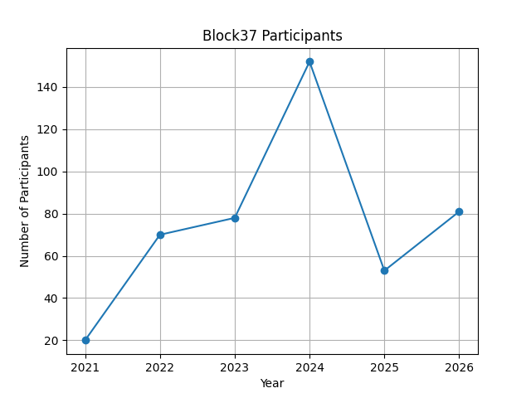
Program growth
In 2024:
5,296 Internship hours earned
9th: 969 Internship hours earned
10th: 1,634 Internship hours earned
11th: 1,240 Internship hours earned
12th: 1,453 Internship hours earned
83 total Market Value Assets earned
44 Internship hours (120+ hours)
21 Client-Connected Projects
18 Industry-Recognized Credentials
Notes:
Block37 is funded by the Jackson County Combat Grand for Violence and Drug Prevention
2021 – First Year of Program (20)
2022 – Upward trend in participation (70)
2023 – Upward trend in participation (78)
2024 – Spike in participation – COMBAT + UNI Funding (152)
2025 – Decrease in participation – Legislation (53)
2026 – Have facilitated 81 internships to date (51)

Slide 14

Program considerations and challenges
Selecting the right partners for the program
Growing student interest and sustainability
Hiring and onboarding program staff
Coordinating and conducting site visits
Developing professional skills and financial literacy
Transportation logistics

Slide 15
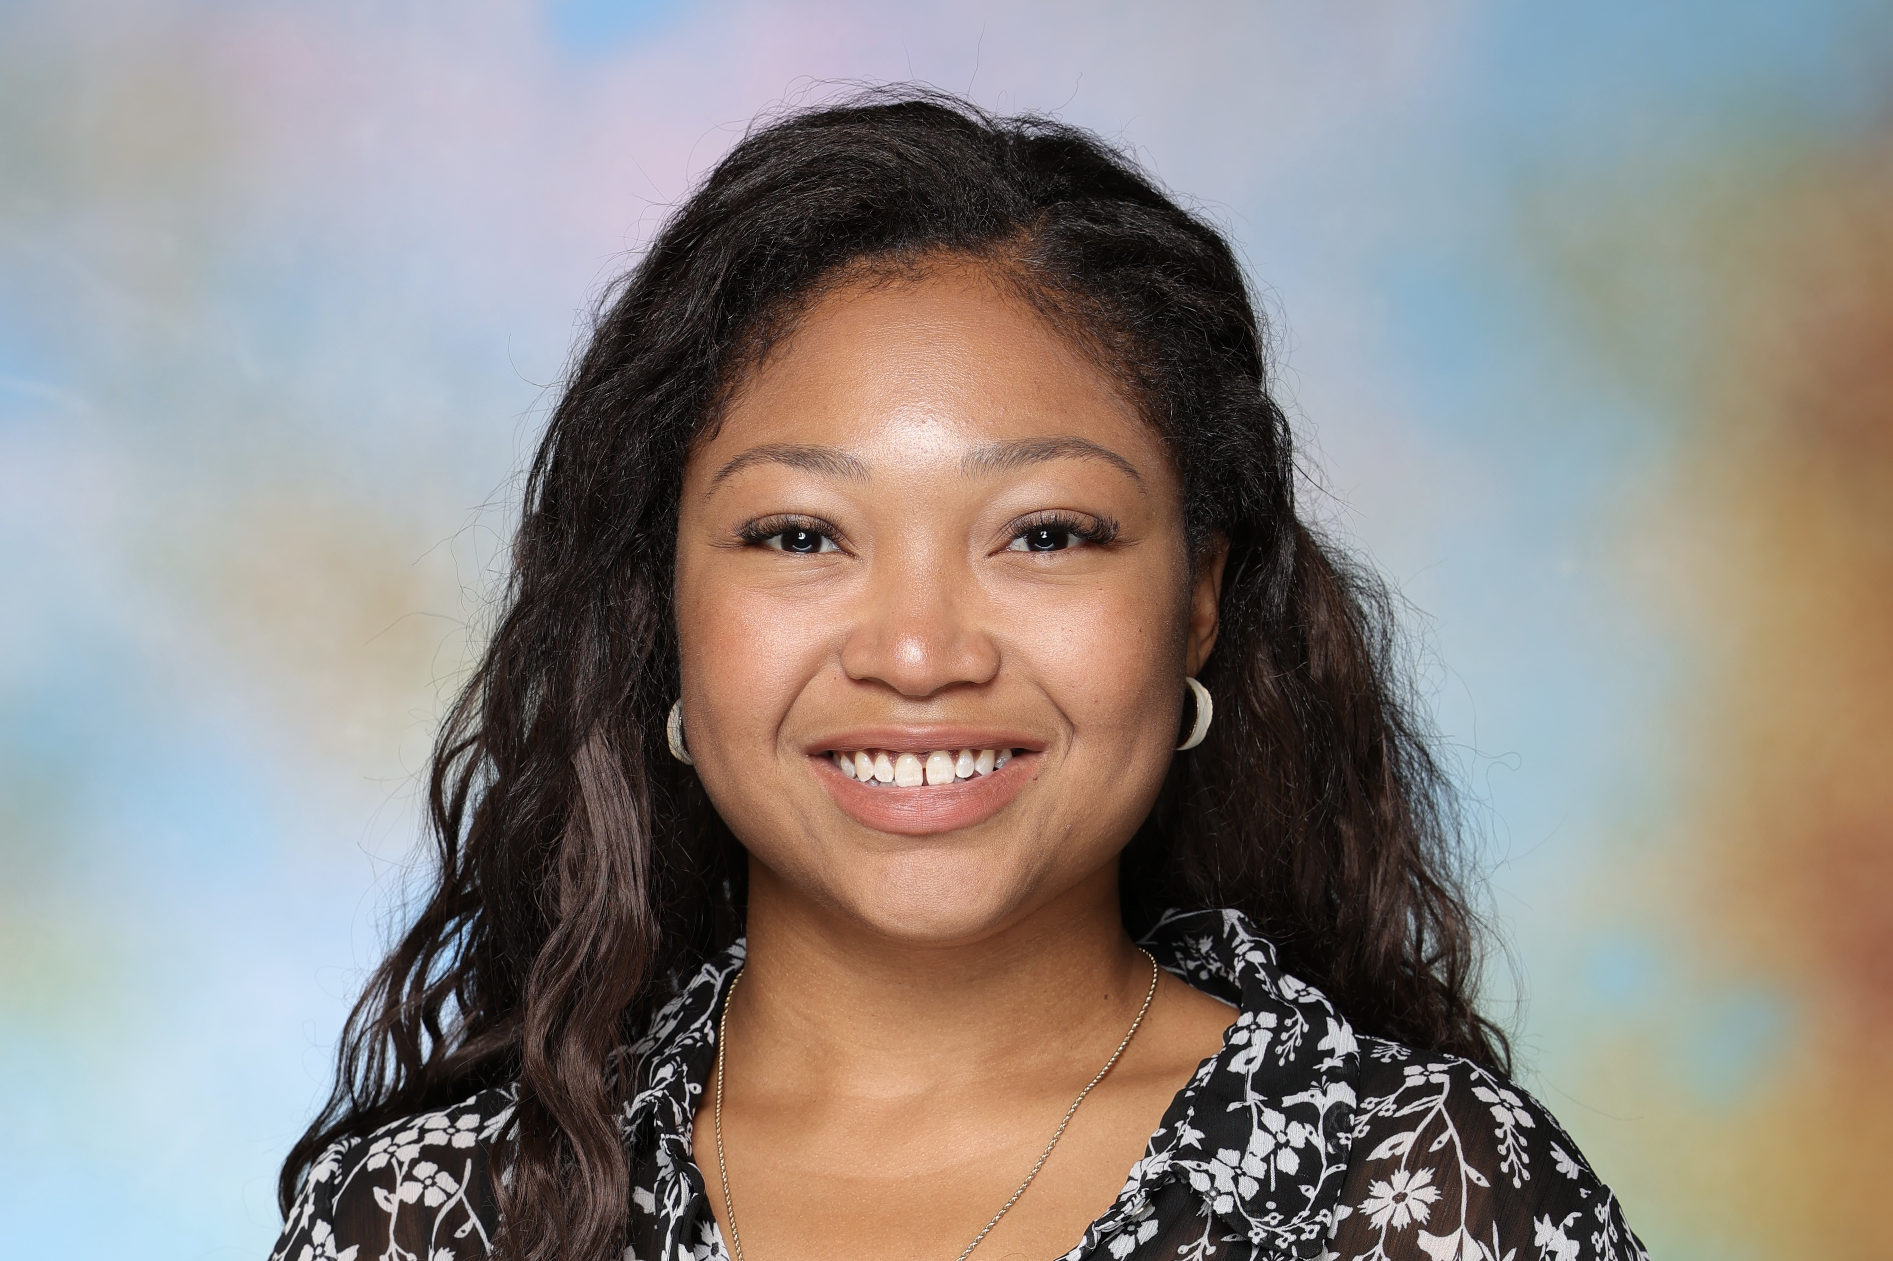
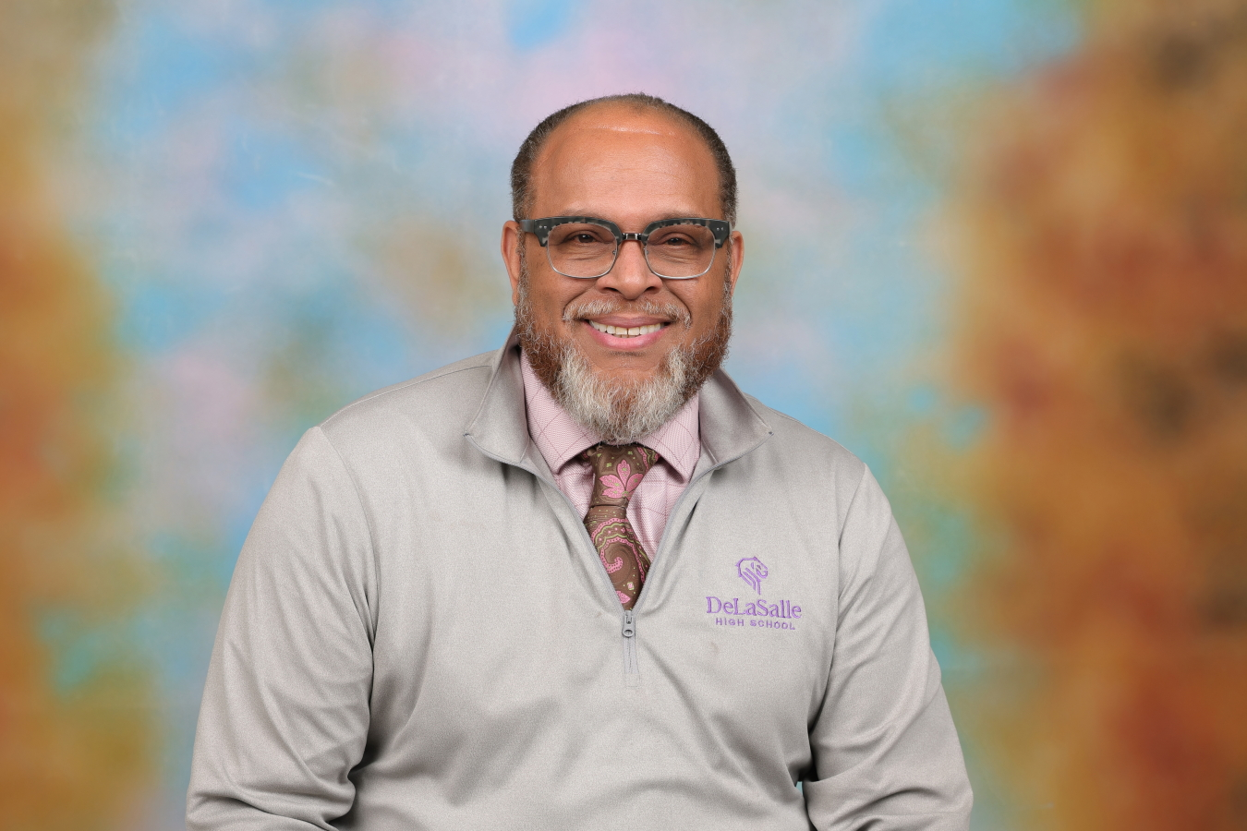
Resources and contact info
Access resources at delasallekc.org
Breona Ward
Director of College and Career Progression
DeLaSalle Education Center
wardb@delasallekc.org
Sean Stalling
Executive Director
DeLaSalle Education Center
stallings@delasallekc.org

Slide 16
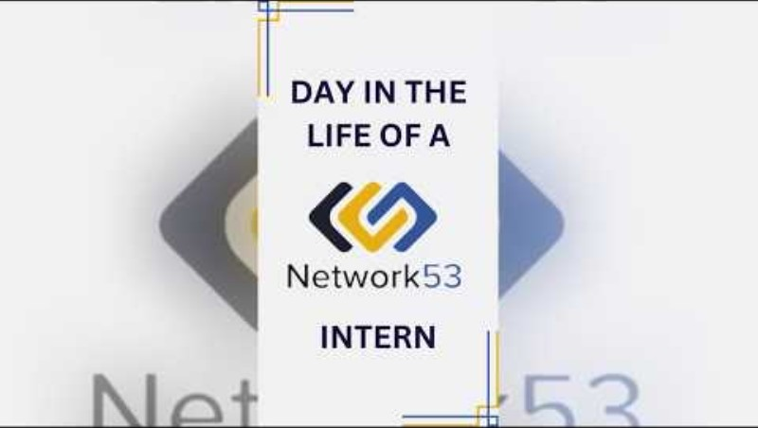

Slide 17
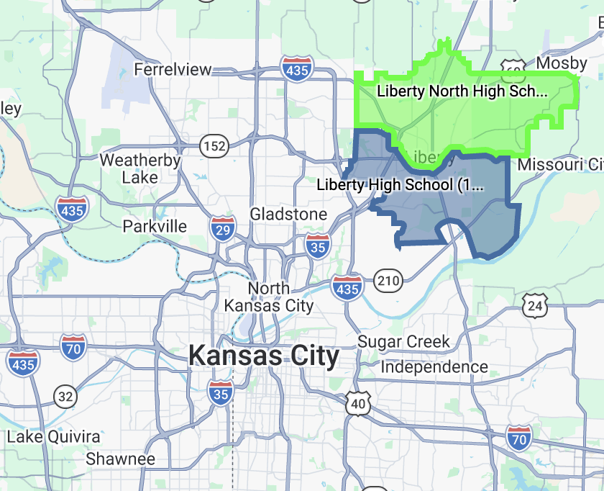
Liberty Public Schools at-a-glance
👩‍🎓 11,903 students (PreK–12)
🏫 2 high schools 🔁 1 alternative high school 🎒 4 middle schools 🍎 11 elementary schools 🧸 1 early childhood center
🍽️ 22% of students qualify for Free and Reduced Lunch
🎓 96.3% graduation rate
📚 69% of graduates attend a 2- or 4-year college
🌍 55 languages represented
Notes:
55% of students reside in Kansas City
43% of students reside in Liberty
1.5% of students reside in Kearney
.03% of students reside in Glenaire
.08% of students reside in Other

Slide 18
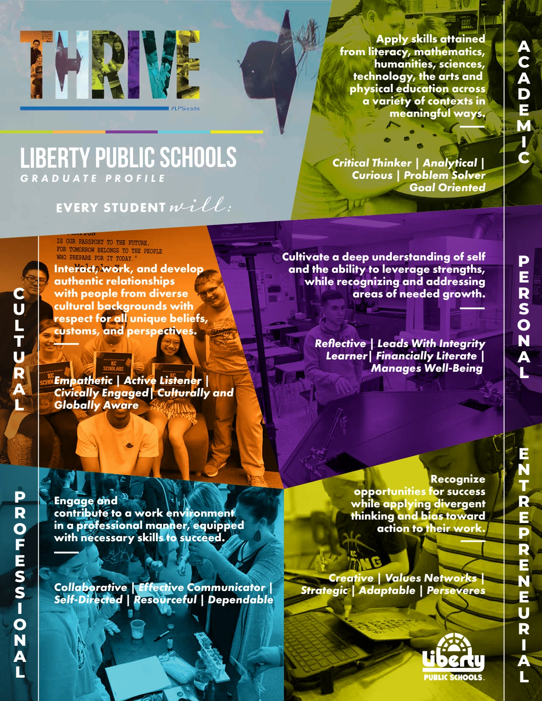
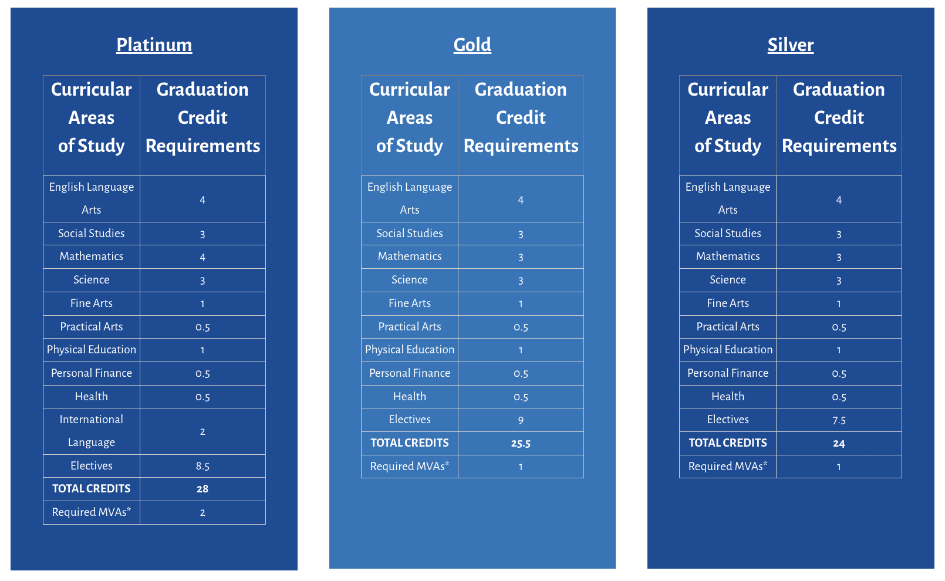
Brainstorming:
Origin of Network53 internship program
Notes:
High School Study Team
Graduation Requirements
Portrait of a Graduate
LPS Network 53

Slide 19

What is a career navigator
🧭 Career Navigator job description 📅 Extended contract (20 additional days) 🔄 Seasonal workflow 🗓️ A typical week in action

Slide 20

Network53 internship program structure
🚀 Year-long immersive experience (two class periods)
🕒 Flexibility: 4-6 hours per week
📝 Application, interview, and placement
🤝 Onboarding
📅 Weekly seminar & hour logs
📝 Monthly communication
🎤 Capstone presentation: Showcasing learning and impact
🎓 MVA, Dual Credit, and A+ hours

Slide 21
Community partnerships
Finding opportunities | Onboarding and preparation | Monitoring and feedback
Chamber of commerce Networking events Student/personal contacts | Background checks Liability coverage Safety guidelines Internship checklist | Site visits Surveys

Slide 22
How we market our program
💬 Word of mouth and personal connections
🎓 Elective fair and course exploration
🏫 Off-campus opportunities night
📱 RWL Instagram page
🌐 RWL website and resources

Slide 23
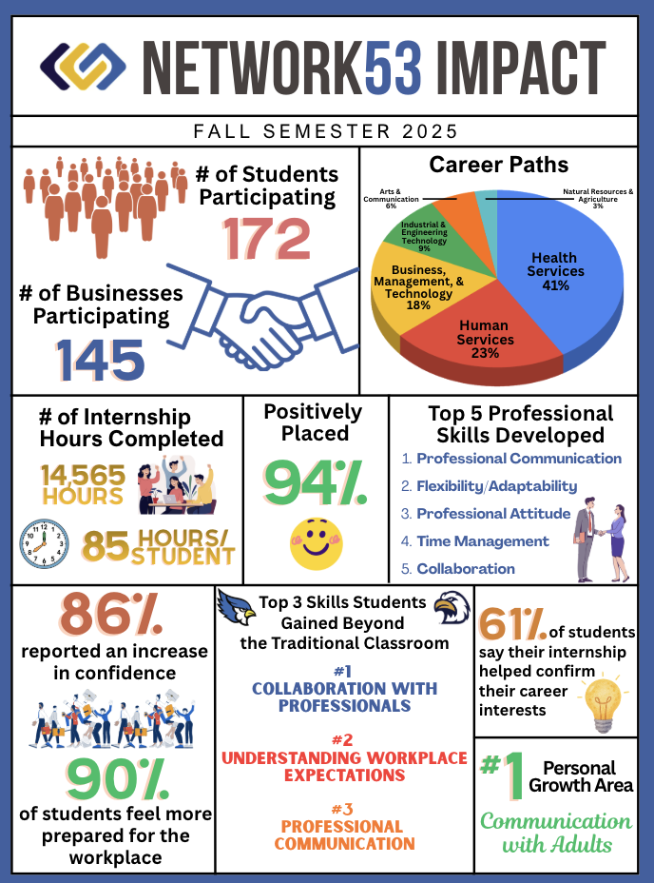
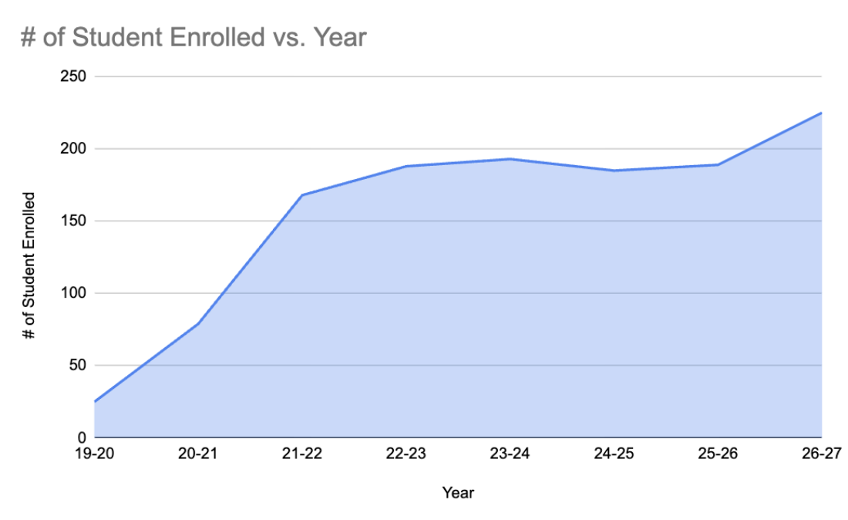
Program growth
3rd Career Navigator
2nd Career Navigator

Slide 24
Program considerations and challenges
⏰ Limited time (two-hour class block constraints)
🤝 Balancing employer needs with flexibility and creativity
🔄 Navigating pivots when placements don’t work out
📈 Growing student interest vs. Limited business capacity
👀 Coordinating and conducting site visits
💬 Developing professional skills
🚗 Transportation logistics and access

Slide 25

Worth it!
Dear Mrs. Winn,
I just wanted to take a moment to thank you for the impact you’ve had on me through the Network53 program. I’m now two and a half weeks into college, and in my core class one of the first things we completed was a CliftonStrengths assessment. One of my top five strengths was Connectedness, something I don’t think would have shown up for me a year ago without the growth I experienced through this program.
Network53 really helped me build confidence, especially when it came to speaking out and connecting with others. My interview skills also grew so much, which gave me the confidence to interview successfully this summer. Because of that, I’m now serving on the Youth Advisory Board for Suicide Prevention with MSPN and the Missouri Department of Education, while also continuing to run my nonprofit in partnership with the Jason Foundation.
On top of that, through my connections at Jewell, I got to work at Fringe this summer, a paid opportunity where I learned so much and met some amazing people.
I’m so grateful for the way you lift up students and cheer us on through Network53. Your kindness and encouragement make such a difference, and I really appreciate all you’ve done to help me grow.
With gratitude,
Elizabeth S.

Slide 26
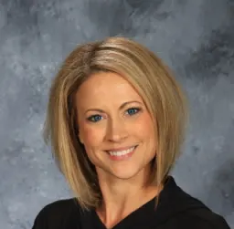
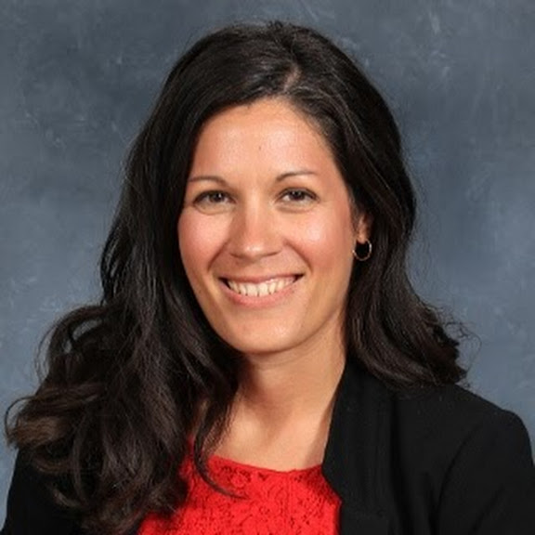
Resources and contact info
Access resources at tinyurl.com/LibertyInternshipInfo
April Fleming
Career Navigator
Liberty Public Schools
april.fleming@lps53.org
Dr. Sara Wickham
Director of Real World Learning
Liberty Public Schools
sara.wickham@lps53.org

Slide 27
Questions?

Slide 28
Navigating together: Schools and industry aligned for student impact

