Slide 1


Exploring, Equipping, and Experiencing
A K-12 Framework for WBL
Notes:
Sue
From Kindergarten to Career, this work is really about one thing. Making learning meaningful and connected to what comes next.
Work-Based Learning is not a single program or event. It’s a system. A continuum that intentionally connects classroom instruction to real-world careers over time.
Today, we’re going to walk through how that continuum works. Explore, Equip, and Experience.
As we do that, we want you to think about your role in this work. Educators, how this fits into what you’re already doing. Business and workforce partners, where your engagement has the most impact. And policy makers, how systems and alignment make all of this possible.
By the end, our goal is simple. You leave with ideas you can actually use

Slide 2

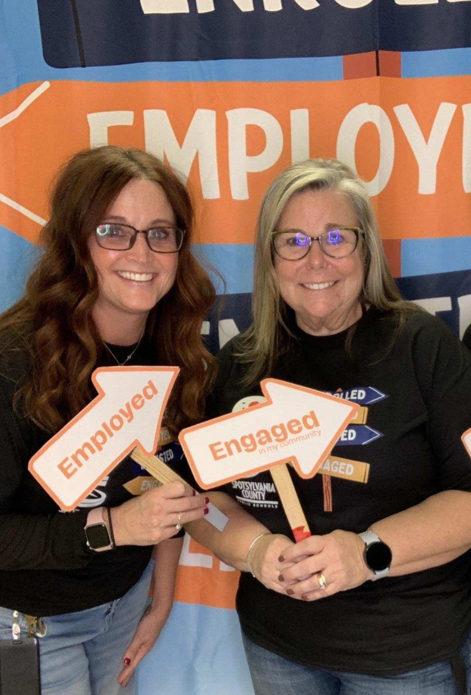
Emily Hall
Sue Venable-Shelton
Work-Based Learning Coordinator
Director of Career and Technical Education
Notes:
Both: Introduce ourselves
Emily: My name is Emily Hall, and I serve as the Work-Based Learning Coordinator for Spotsylvania County Public Schools. I work to connect students with local businesses where they can gain real-world experience and begin discovering meaningful career paths. This is year 25 for me. The first 17 years were spent as a School Counselor, and about 8 years ago, I made the move to CTE where my role has continued to evolve. Best decision ever!

Slide 3


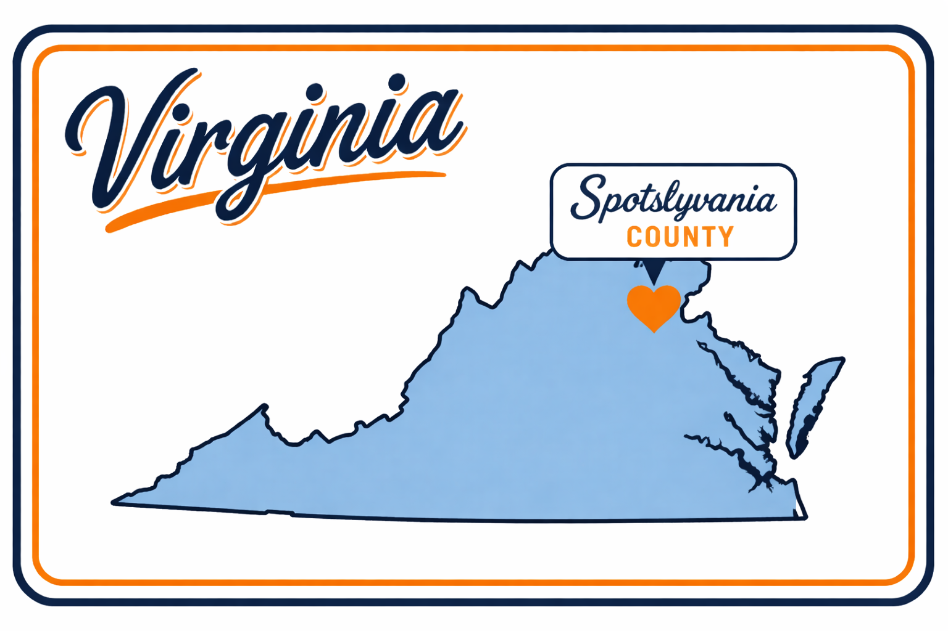
Notes:
Sue - Spotsy Facts
Emily
Before we dive in, we’d love to know how your state defines WBL.

Slide 4

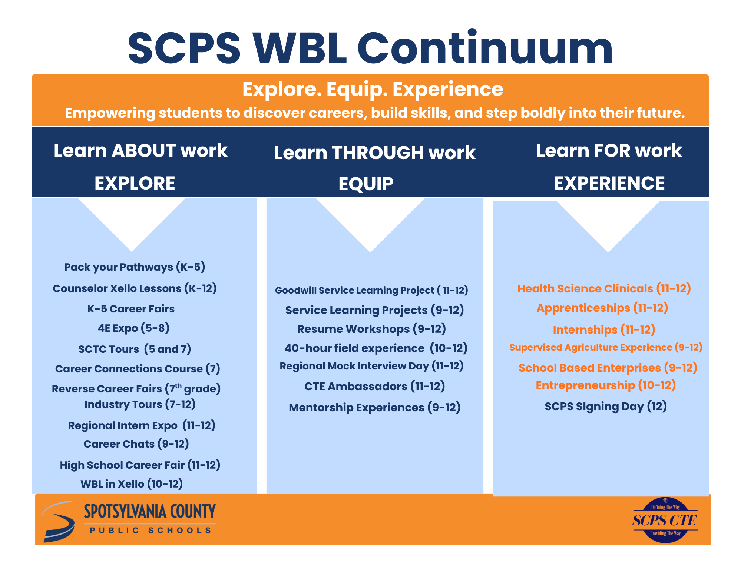

Notes:
Emily: I used to think of WBL as only the types in Orange under our experience column, but with the state changing their definition, it really helped me to understand that WBL needs to be continuum. Work-Based Learning is a Career Development Journey, so why not call it all WBL?
Sue
One of the biggest shifts we’ve made is thinking about Work-Based Learning as a continuum, not a checklist.
Students don’t just jump into internships or apprenticeships. They build toward them.
We start with exploration. Helping students understand what’s out there. Then we move into equipping. Building skills and confidence. And finally, we get to experience. Where students are actually doing the work.
This structure is now required, and it’s tied to school performance. But more importantly, it just makes sense.
It ensures every student has access to meaningful experiences, not just the ones who happen to find their way into them.

Slide 5

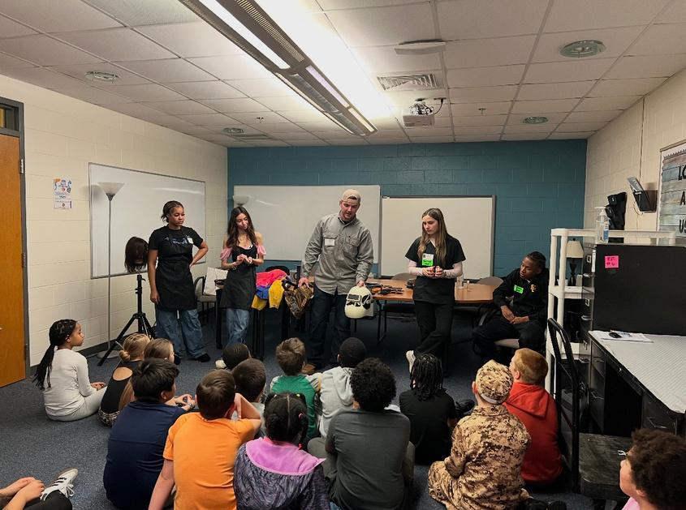
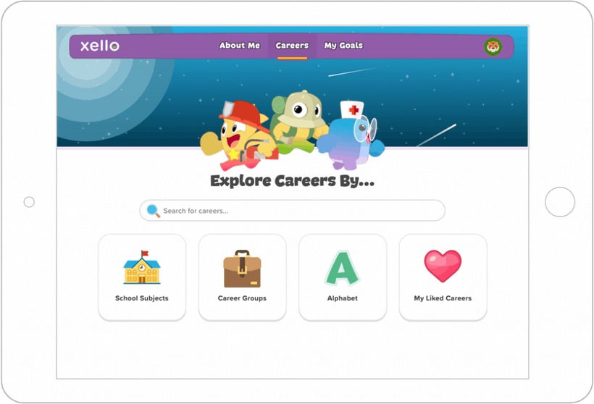
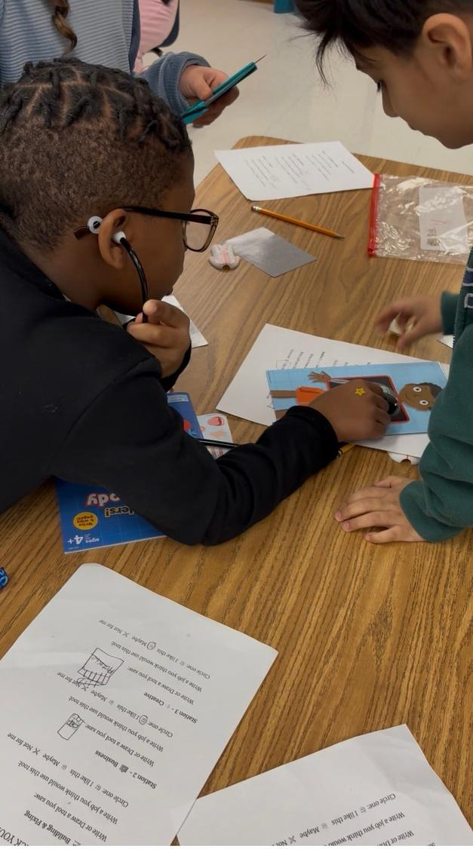
EXPLORE
Kindergarten - Fifth Grade
Elementary
Career Fairs
Elementary
Career Fairs
Counselor
Xello Lessons
Pack your Path
Notes:
Emily:
This is what EXPLORE looks like at the Elementary Level. This work starts much earlier than people expect.
At the elementary level, we’re focused on exposure and curiosity.
With 17 different elementary schools, we have to be a little creative so we aren’t taxing our business partners. So for our Elementary Career Fairs: We add a little twist. We use CTE high school students as presenters/vendors instead of tapping into our business partners.
Counselor Xello Lessons - Xello is our Career and College Readiness platform, we chose Xello to be able offer a K-12 platform, plus when sampled, our students preferred it over the other platforms. Our counselors are required to provide at least one lesson to each grade level. We are also beginning to have our teachers use it in different lessons that they are doing. This can be a huge resource for the Career Research projects.
Pack Your Path —an engaging, hands-on career exploration experience
Students rotated through six interactive stations, exploring tools and activities connected to different career clusters. From building and creating to health science and helping roles, students were able to play, experiment, and imagine their futures in meaningful ways.
Through career fairs, hands-on experiences like Pack Your Path, and tools like Xello, students begin to explore what’s possible.
And one of our favorite strategies is using our own high school CTE students as presenters. That near-peer model is powerful. Younger students see someone they relate to, and older students build leadership skills.
This isn’t something extra for our educators. It’s about making connections within what they’re already teaching.
This means are business partners don’t have to show up everywhere. We’re being strategic with their time.
This is where equity begins. Every student, early on, gets access to career awareness

Slide 6

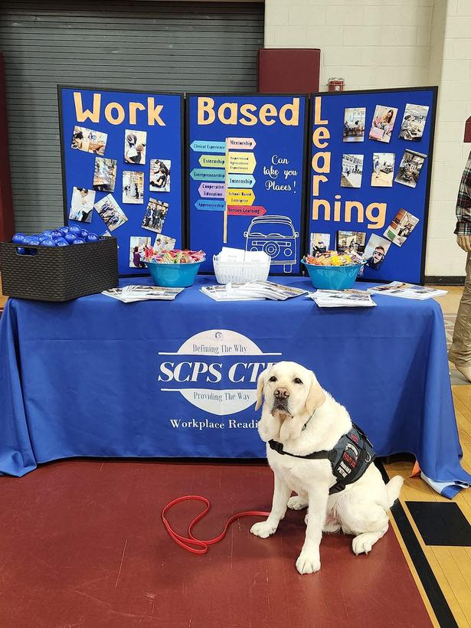
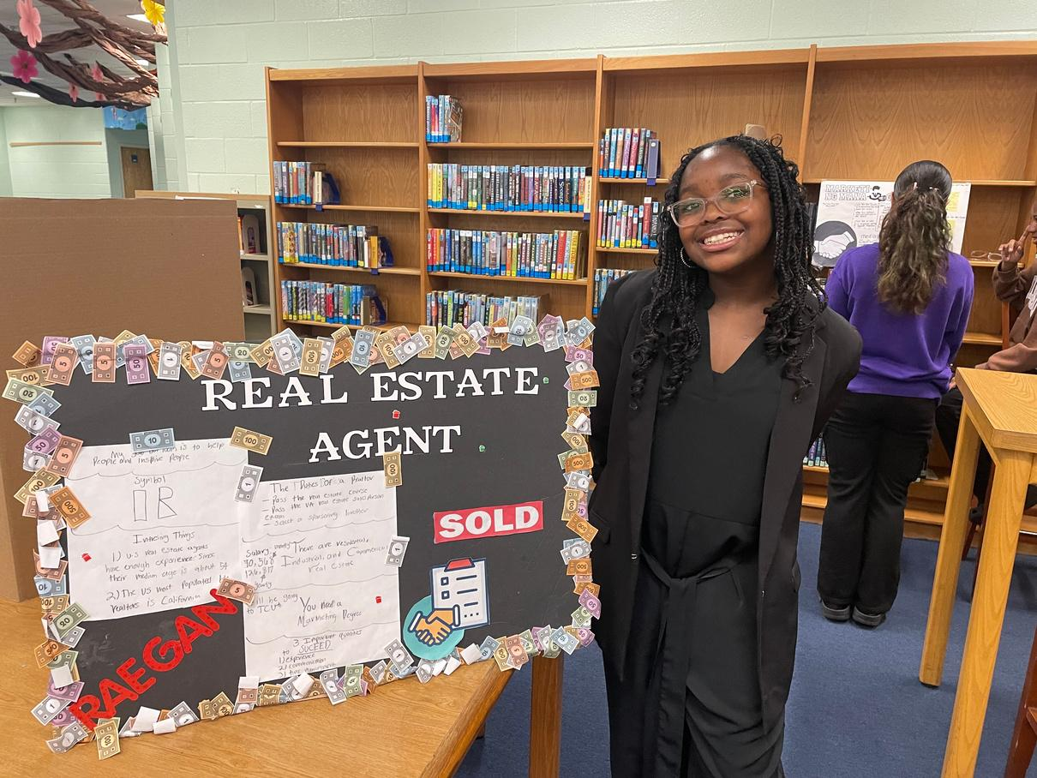
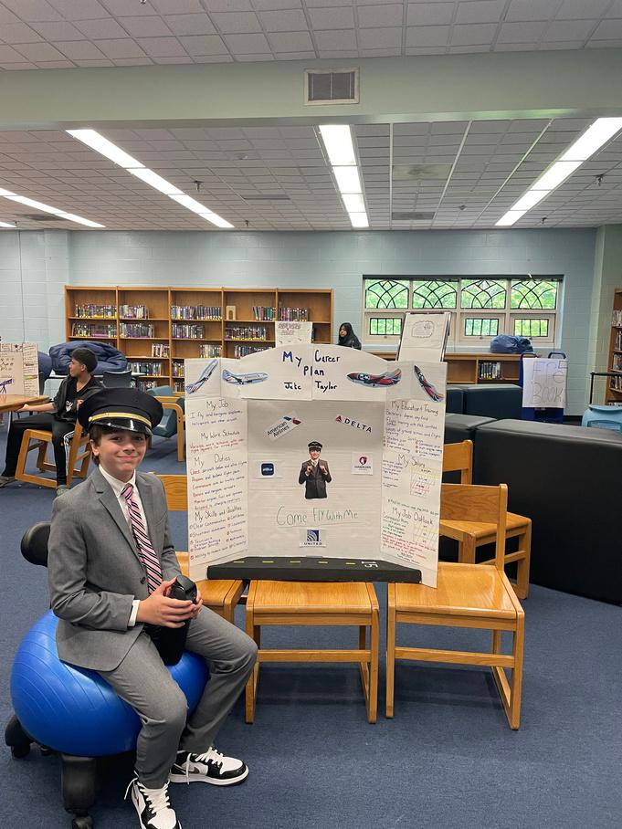
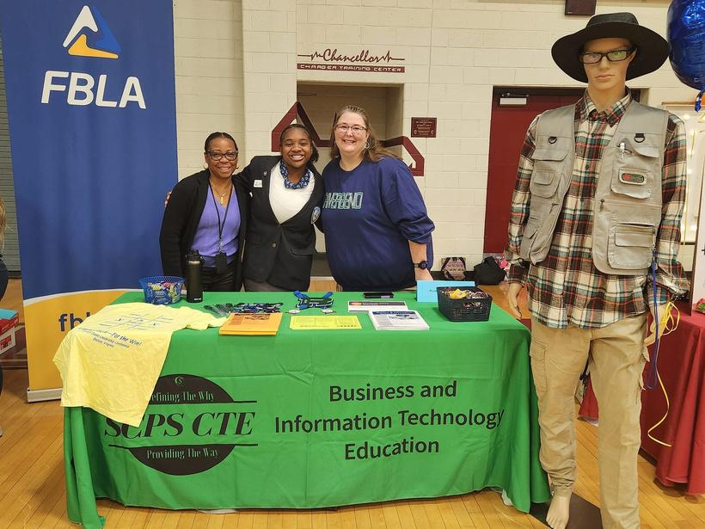
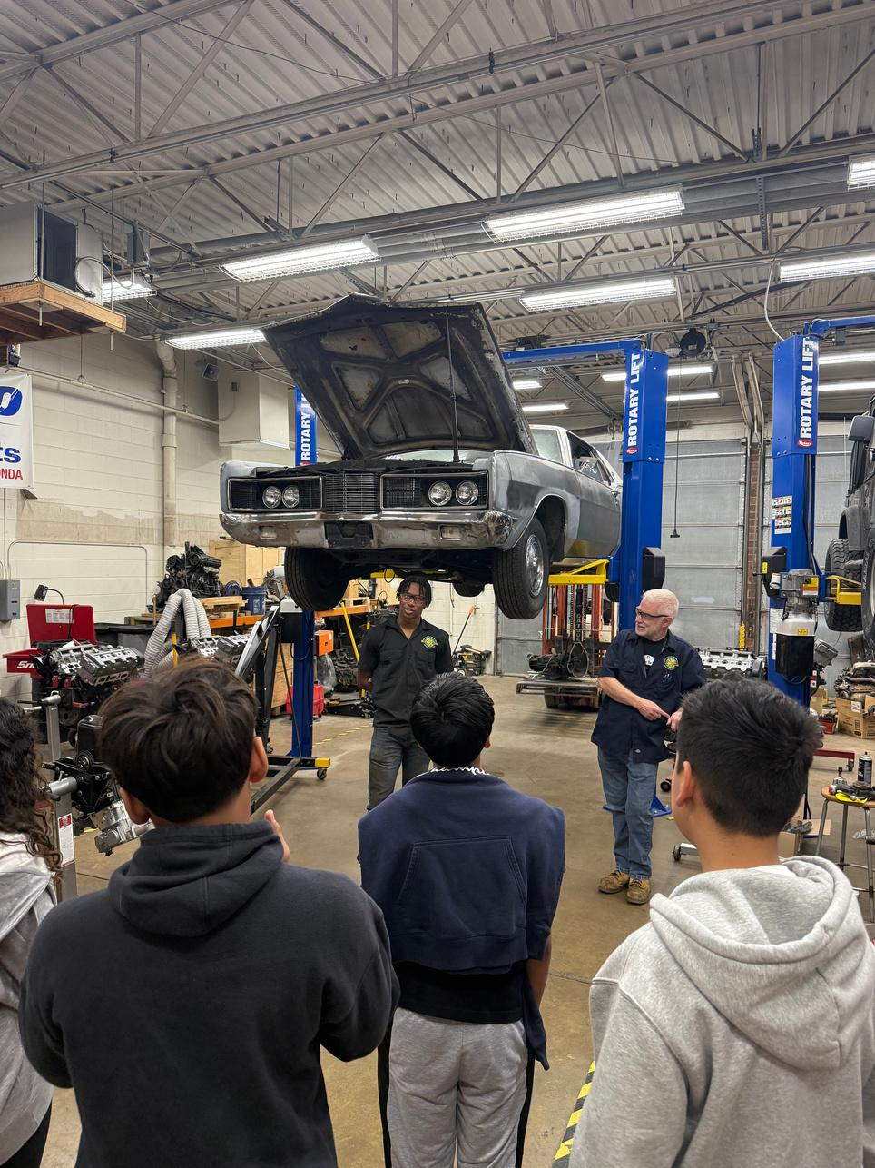
EXPLORE
6th-8th grade
Reverse
4E
Career
EXPO
Fairs
Fairs
Career Connections Course
Notes:
Emily:
This is what EXPLORE looks like at the middle school Level.
Reverse Career Fairs are a great example. Students research a career and then teach it to younger students. And we all know, when you teach something, that’s when it really sticks.
The 4E Expo expands their perspective even further. This is a showcase designed for our 5th–8th grade students to introduce them to the wide range of opportunities available as they begin to explore their “E” in middle and high school.
While Virginia has adopted the 3E model—Employed, Enlisted, and Enrolled—Spotsylvania expanded this framework by adding a fourth E: Engaged in the community. This addition reflects our commitment to inclusivity, recognizing that some students may choose a gap year or have unique needs that make traditional pathways less accessible. We want to make sure all students see themselves in the continuum.
At the 4E Expo, students can explore a variety of options, including CTE programs, IB, AP, and Dual Enrollment courses, World Languages, as well as connections to military branches and local community organizations. These partners help students see the full spectrum of possibilities available to them beyond high school.
The goal is to spark curiosity, build awareness, and get students excited and confident about their next steps.
And Career Connections in 7th grade brings consistency. Every student now has a structured opportunity to explore careers, build skills, and begin a plan for their future. A statewide requirement is to provide Career Connections in 7th grade. In the past, we attempted to integrate this content into core classes, but found that students were not receiving the same level of information or intentional experience across the board.
This past year, we transitioned Career Connections into a standalone course that is now required for every 7th grader in our division. This shift ensures consistency and allows for a more focused approach to career exploration and skill development.
In this course, students identify and build the workplace skills that employers value most. Using Xello, they assess their strengths, explore career clusters and pathways, and begin developing an Academic and Career Plan aligned to their interests and goals.
The course also incorporates meaningful work-based learning experiences, such as tours of our Career and Technical Center, helping students connect classroom learning to real-world opportunities.
As students move into middle school, we shift from awareness to understanding. This is where we start to see direction forming. Not final decisions, but informed thinking.
This is about creating meaningful learning experiences where students actively engage, reflect, and begin connecting their interests to real-world pathways without adding new content.
This stage helps students build early awareness and direction, giving our employers future talent that already has a foundational understanding of careers and where they might fit.
Our intentional design ensures consistency, inclusivity, and equitable access so every student begins developing direction and a plan for their future.

Slide 7
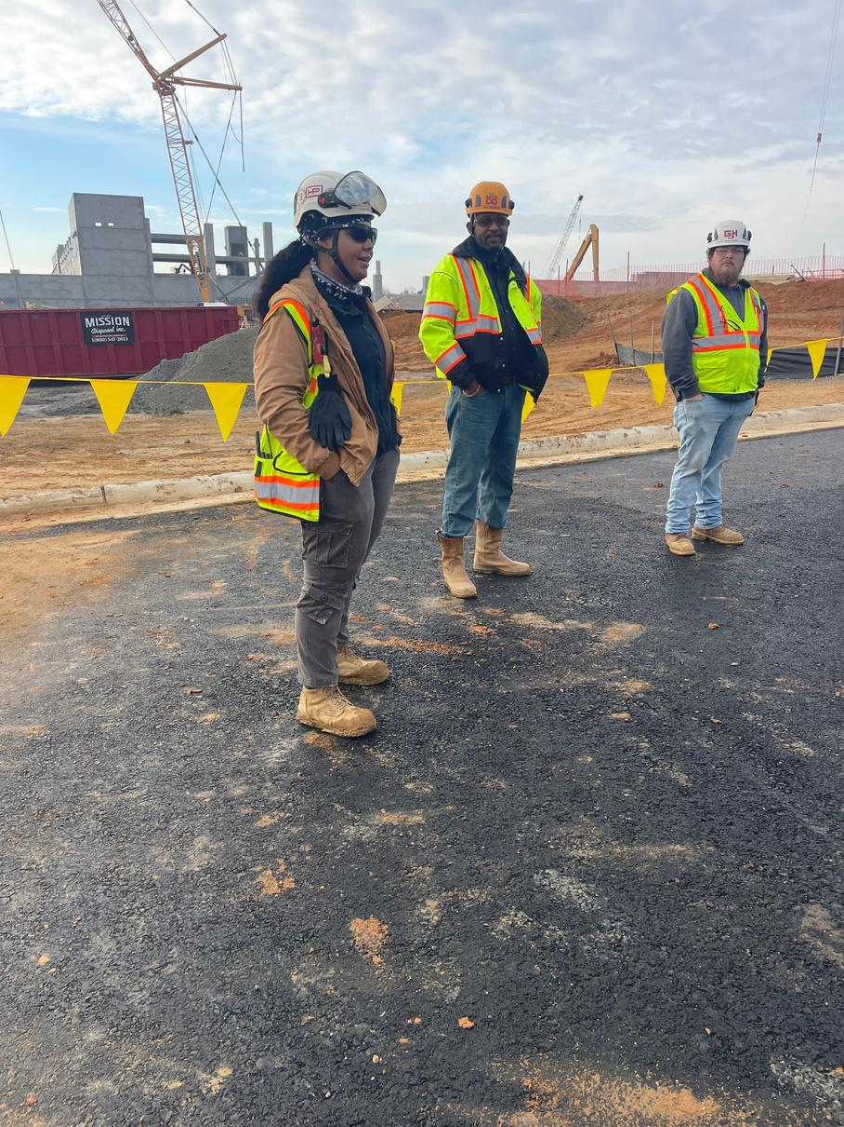
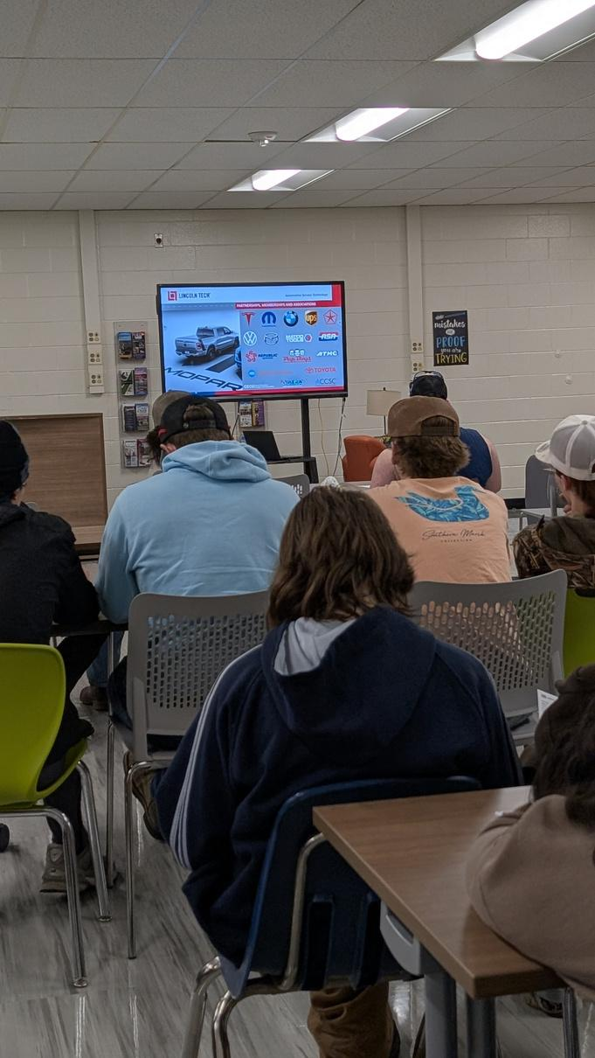
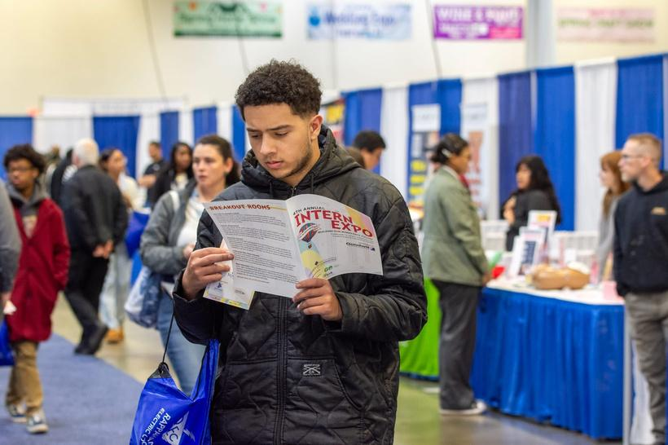
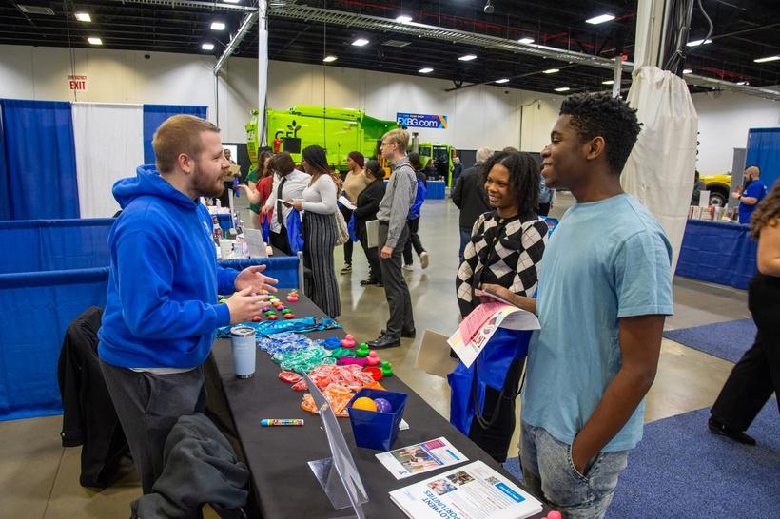
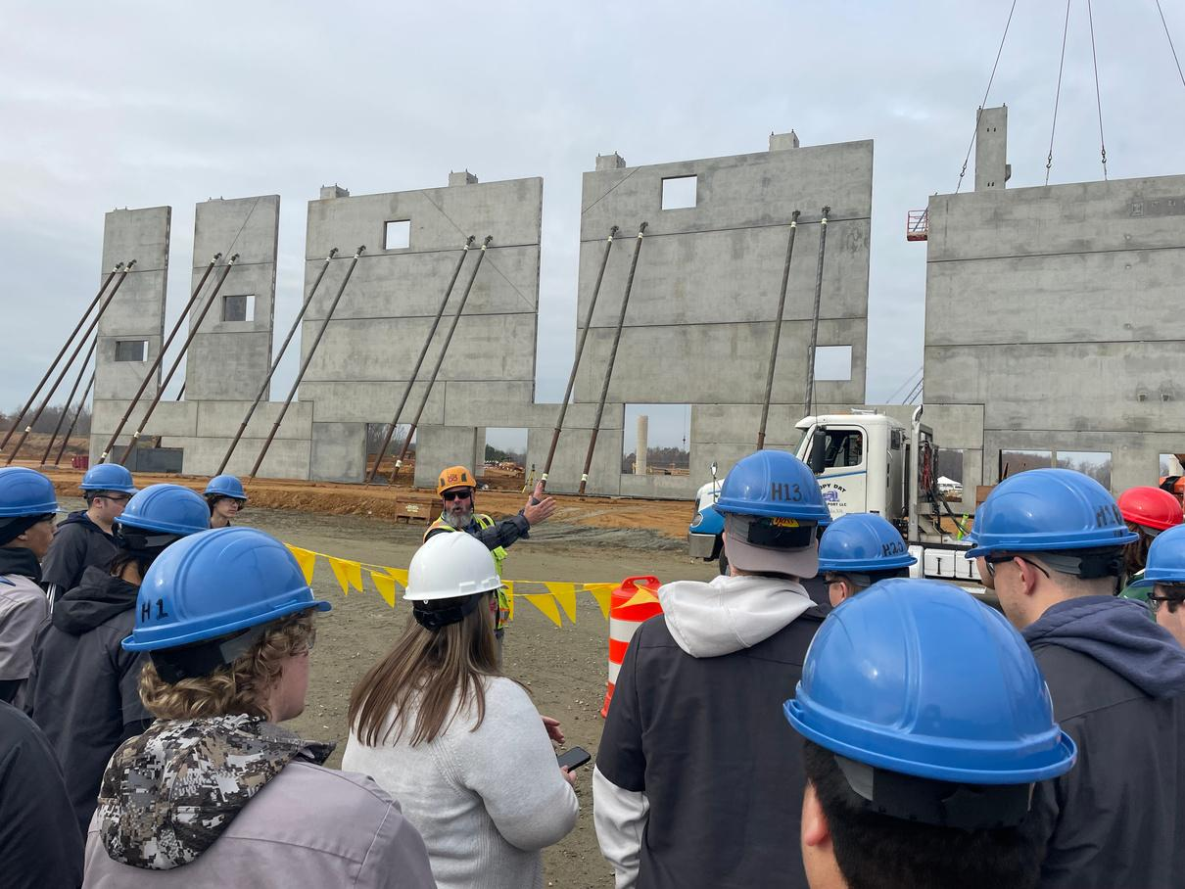
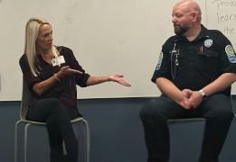
EXPLORE
9th-12th grade
Regional
Intern
Industry
Career
Expo
Tours
Chats
Notes:
Emily:
Now, we will look at Explore at the High School Level. By high school, exploration becomes more intentional and connected to real opportunities.
Regional Intern Expo: This Expo hosted by the Fredericksburg Regional Chamber of Commerce offers a unique opportunity for businesses to connect with potential interns while allowing students to explore diverse career paths across various sectors. This event is particularly valuable for companies looking to attract interns in fields not typically associated with their industry, broadening their talent pool and fostering new opportunities for growth.
Industry Tours: Provide students with the opportunity to visit local businesses and experience different industries in real time, helping them connect classroom learning to real-world applications.
Career Chats: Industry professionals share their career journeys and pathways with students. Sessions are hosted at one high school and live-streamed to others during flex time, allowing us to expand access and ensure more students can engage with a variety of career perspectives.
These experiences help students answer a critical question. Not just ‘What jobs exist?’ but ‘Where do I fit?’
This increases engagement because students can finally see the ‘why.’
This is our business partners early entry point. Low commitment, high impact.
This is scalable access. We’re reaching more students without increasing complexity.
What are some other outside of the box ideas you are doing in your districts in the EXPLORE category?

Slide 8

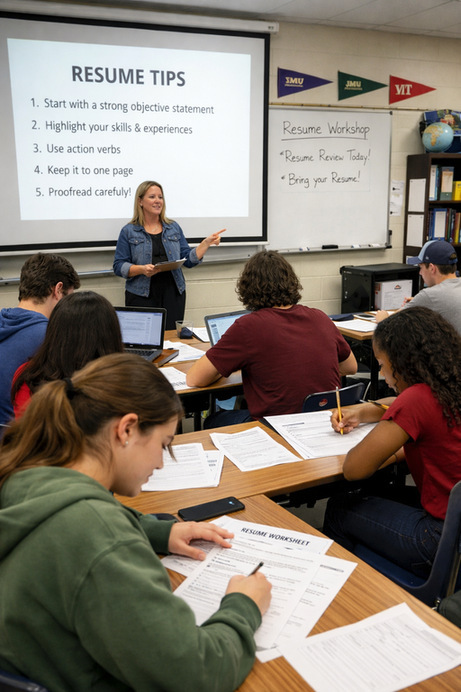
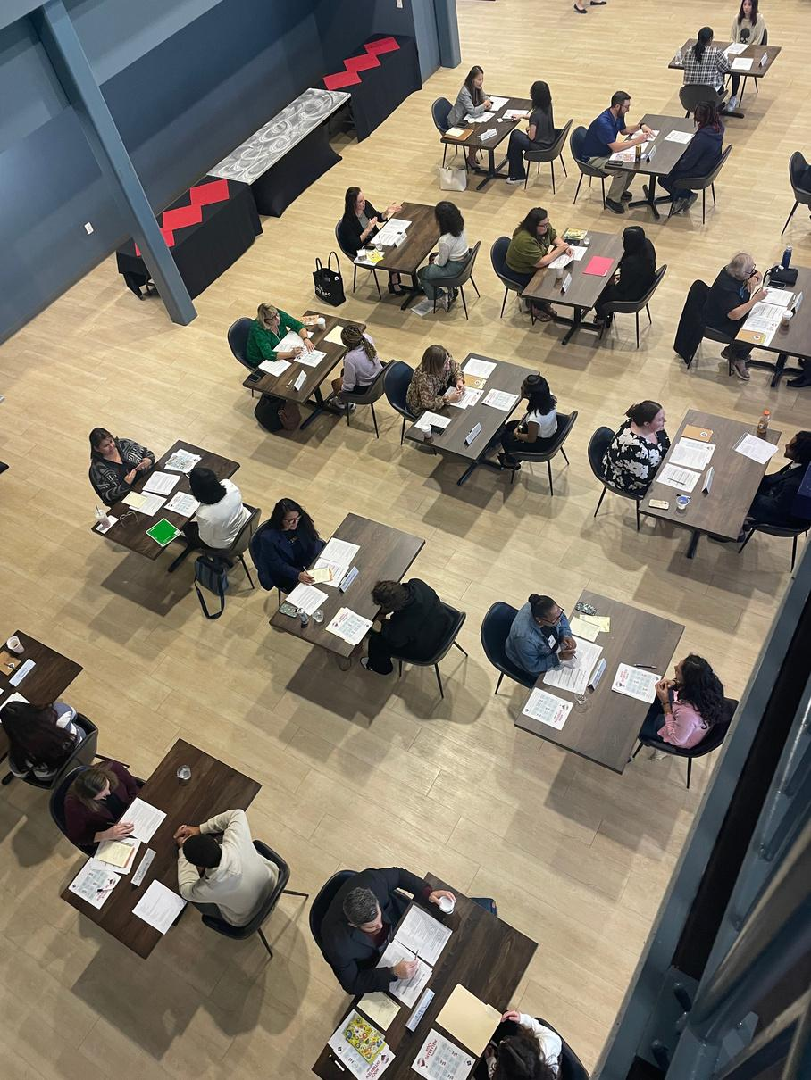
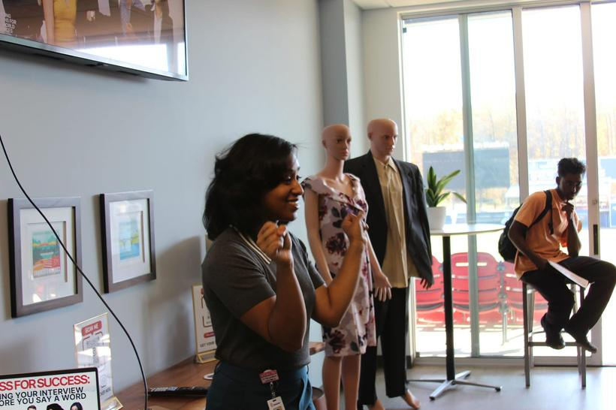
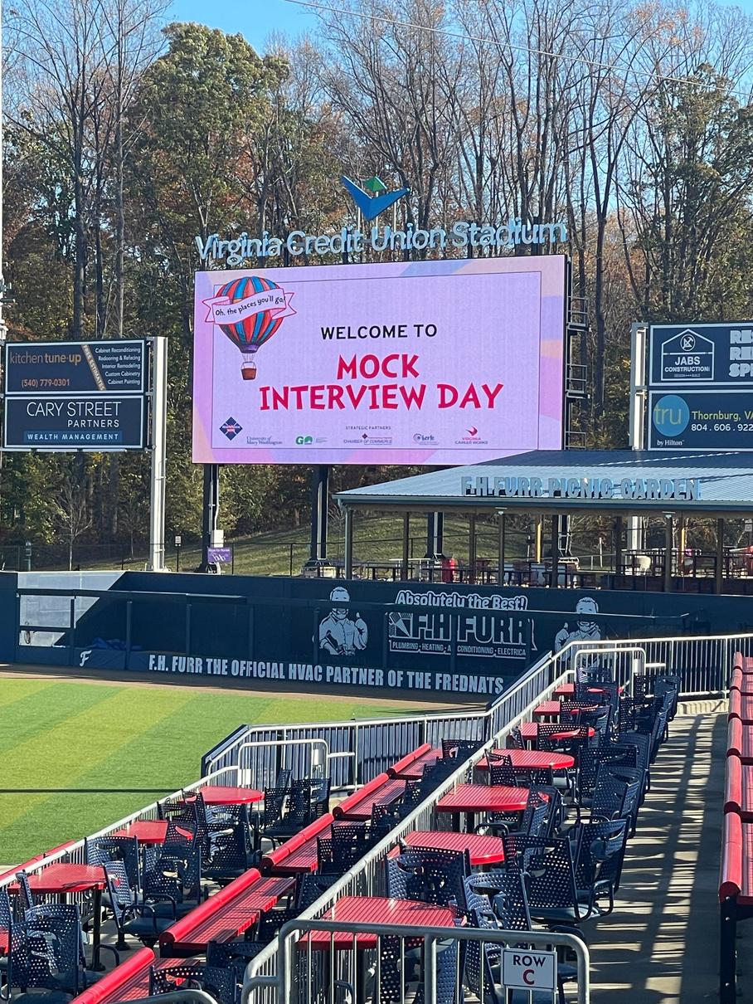
EQUIP
Regional
Resume Workshops
Mock
Interview Day
Dress for Success Workshops
Notes:
Sue:
Now we move into equipping students with the skills they need to be successful. This is where preparation becomes real.
Regional Mock Interview Day: The Fredericksburg Regional Chamber of Commerce hosts this interview day. It is designed to interview and provide feedback to high school and college students in attendance. Students will participate in real-world interviews, providing them with the chance to practice their skills and receive personalized advice on how to improve. Interviewers, who are leaders in various industries, volunteer their time to mentor and guide students through the process, helping to prepare them for future job interviews.
Resume Workshops: A resume workshop is an interactive, hands-on learning experience designed to help students develop and refine their resumes for real-world opportunities. During the session, students learn the key components of an effective resume, including how to highlight their skills, experiences, and accomplishments in a clear and professional way. This year, we had a local staffing office come in and train our team on resume building so they could best help our students. Train the trainer, if you will.
Dress for Success Workshops:A Dress for Success workshop is a practical, confidence-building experience that helps students understand how to present themselves professionally in a variety of settings. During the session, students learn about appropriate attire for interviews, internships, and workplace environments, including how expectations may vary across industries.
The workshop often includes interactive elements such as outfit examples, do’s and don’ts, and discussions around grooming, body language, and first impressions. Students may also have the opportunity to practice selecting professional outfits or receive feedback on their choices.
Beyond clothing, the focus is on helping students feel prepared and confident. They gain a clearer understanding of how professional appearance connects to personal branding and workplace success. By the end of the workshop, students are better equipped to make informed decisions about how they present themselves and to walk into professional settings with confidence.
Mock Interview Day gives students authentic practice with real feedback. Resume Workshops build their ability to tell their story. And Dress for Success helps them understand how to present themselves professionally.
We’ve also built capacity internally through a train-the-trainer model, so this support is sustainable.
At this stage, students aren’t just learning about work. They’re preparing to step into it.
This is where students build real-world skills like communication, professionalism, and self-advocacy through experiences that reinforce and extend your classroom instruction without adding extra burden.
This stage ensures students are better prepared to engage with our workforce partners by developing the confidence, communication skills, and professional behaviors needed to succeed, while also creating an early touchpoints for them to meet and begin building relationships with future talent.
This phase demonstrates how intentional, scalable systems can equip students with essential employability skills, creating a more prepared workforce while maximizing sustainability through models like train-the-trainer.
.

Slide 9

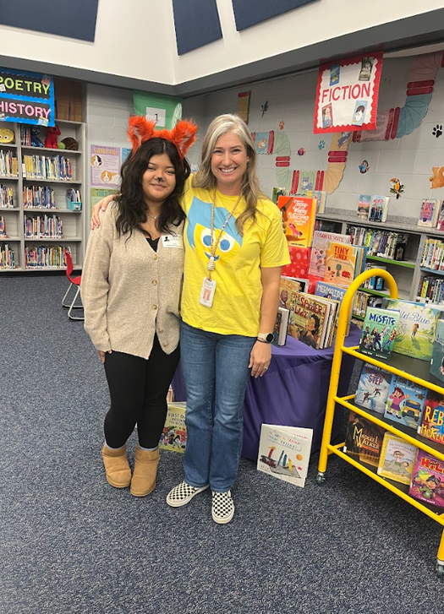
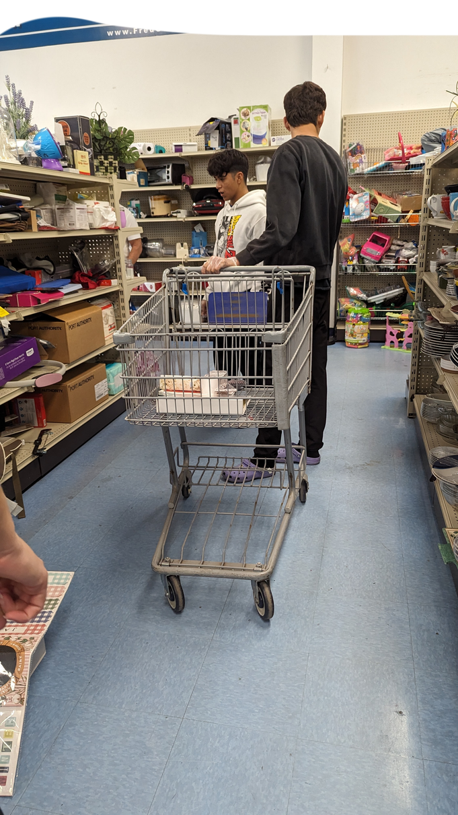
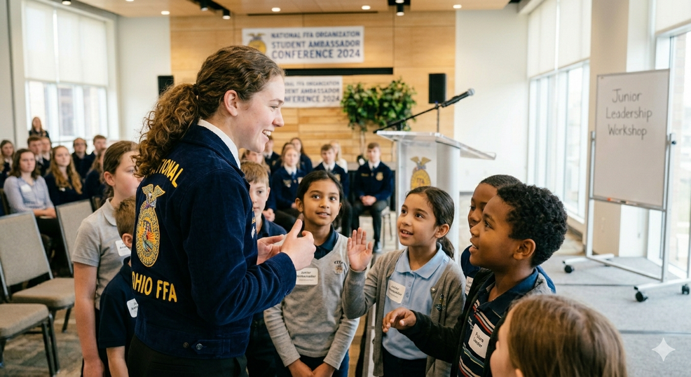
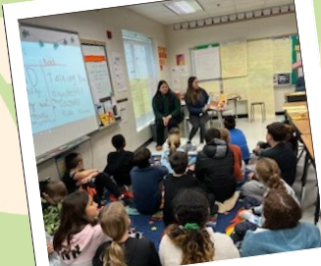
EQUIP
Mentorships
Goodwill Service Learning
Classroom Service Learning Projects
CTE Ambassadors
Notes:
Sue
This is where students begin learning through work.
Goodwill Service Learning: Rappahannock Goodwill Industries partners with the community to support individuals facing barriers to employment by providing job opportunities and resources. Two of the key populations they serve include individuals with special needs and English language learners.
Each year, we identify students who may benefit from learning more about these supports and connect them to this experience. As part of the program, participating students organize and contribute to a clothing drive, reinforcing the service-learning component.
On the day of the visit, Goodwill staff begin by providing an overview of their mission and services. Students then travel to a local Goodwill location, where they follow the full lifecycle of donations, from items being received at the door to sorting, pricing, and placing them on the sales floor.
Students also participate in hands-on activities, gaining real-world experience in these processes. This experience not only raises awareness of Goodwill’s services, but has also proven to be an effective recruitment pathway for future employment opportunities.
In the past, these experiences have counted for graduation, but they no longer help students meet that requirement. BUT that doesn’t take away from their value. We have continued to offer these trips this school year and hope to continue to do so in future years.
Service Learning projects are also being done in many classrooms and I hope that continues.
The example shown is an English 12 Service Learning Project.
English 12 students studied tragic and epic heroes in British Lit.
Shifted focus to modern/everyday heroes through a research project.
Connected their “hero” research with Just Help! by Sonia Sotomayor.
Students prepared to be “heroes” by designing lessons for younger students:
Read the picture book
Explored character traits
Led discussions on citizenship and heroism
High schoolers presented their lessons at feeder elementary schools, reinforcing K–3 citizenship SOLs.
Mentorships - Mentorship opportunities are taking place within our own school buildings, most commonly through Teacher’s Aide positions. In this role, students work alongside educators, supporting classroom activities such as lesson preparation, assisting with instruction, and helping with lab setup and organization.
These experiences go beyond simply helping in a classroom. Students gain firsthand insight into the field of education while developing important workplace skills like communication, responsibility, and professionalism.
Just as important, these mentorships create meaningful relationships between students and staff. Over time, those connections build social capital, giving students trusted adults who can offer guidance, encouragement, and future opportunities.
For many students, this is not just an introduction to a career pathway. It is the beginning of a lasting professional relationship that supports their growth well beyond the classroom.
CTE Ambassadors: CTE Ambassadors are student leaders who represent Career and Technical Education programs by sharing their experiences with peers, younger students, and the community. They help promote opportunities within CTE, support events, and serve as role models by showcasing the skills, knowledge, and pathways available through these programs.
This is where students begin learning through work.
Service learning connects academics to community impact. Mentorships build relationships and professional habits. The Goodwill partnership adds a powerful layer of equity and access. And CTE Ambassadors step into leadership roles, sharing their experiences with others.
What’s happening here is bigger than skill-building. Students are developing confidence, identity, and connection.
And those are the things that truly prepare them for what comes next.

Slide 10

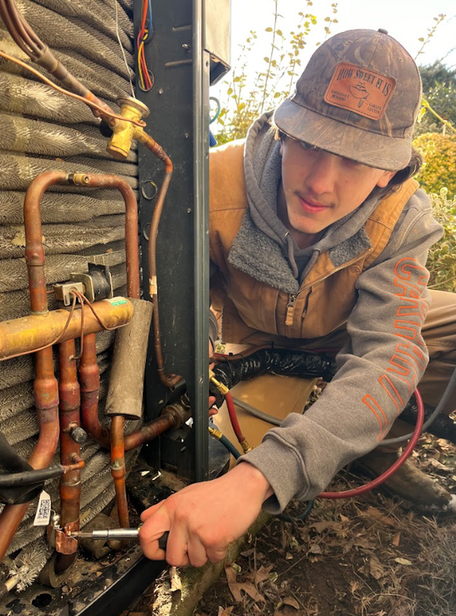
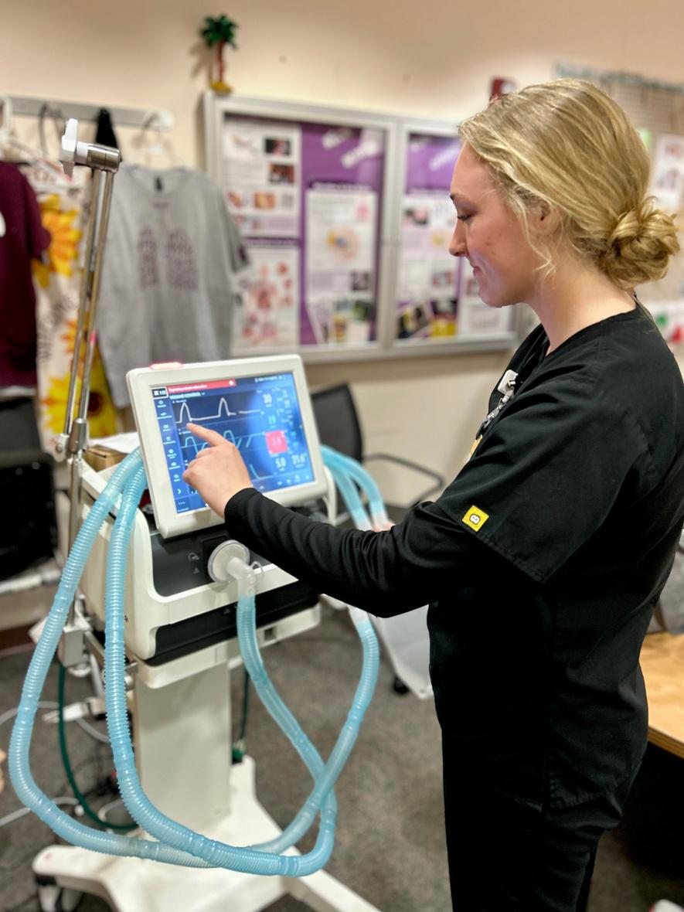
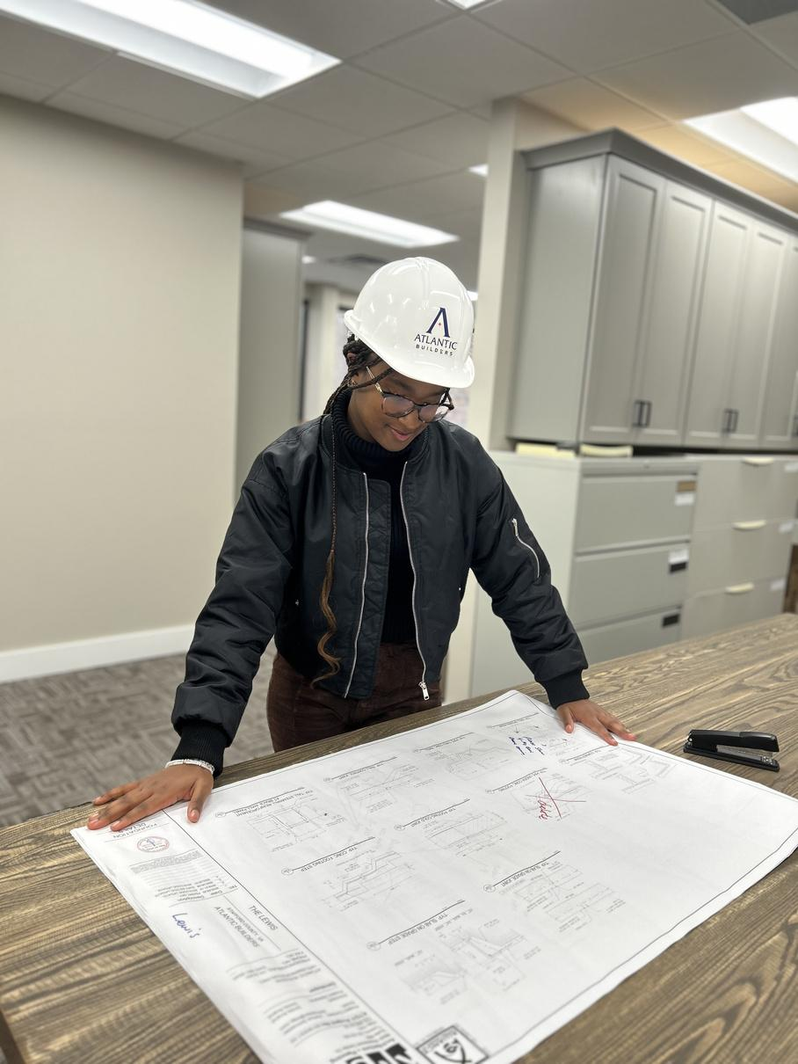
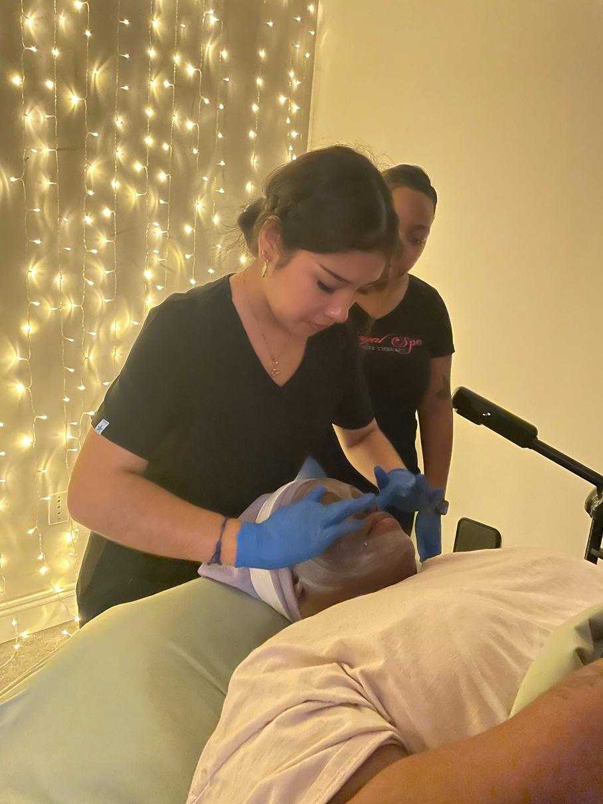
EQUIP
40-hour
Field Experiences
Notes:
Sue
The 40-hour field experience is our signature event where everything comes together. Students spend a full week in a workplace, applying what they’ve learned and building real connections.
Completing an application
Meeting with a career readiness para to discuss career interests
Submitting a resume
Participating in a meet-and-greet with their host to practice interview skills
Reporting to the host site for 40 hours (typically Monday–Friday, business hours) to shadow professionals
Students are placed in a wide range of careers—from Architecture to X-Ray Technology. Depending on the business partner, some students take part in hands-on activities while others primarily observe. Most hosts provide opportunities for meaningful engagement, even if it’s simply practicing skills with their mentor. Students also have the opportunity to demonstrate their workplace readiness skills throughout the week.
It’s structured, intentional, and supported from application to reflection. This is often where pathways become real.
For students, it’s eye-opening. For educators, it reinforces learning. For employers, it’s essentially a working interview. We have also added the spirit of competition. At our business partner appreciation breakfast, each partner was recognized for their partnership levels to celebrate the impact they’ve made.
Our Bronze Sponsors have hosted 0–4 students
Our Silver Sponsors have hosted 5–10 students.
Our Gold Sponsors have hosted 11–16 students.
And our Platinum Sponsors have hosted 17 or more students
And for policy makers, it represents the foundation of economic development, as students begin to see viable pathways to live, work, and contribute within their own communities.
Do you have any outside of the box ideas that you would like to share with the group?

Slide 11

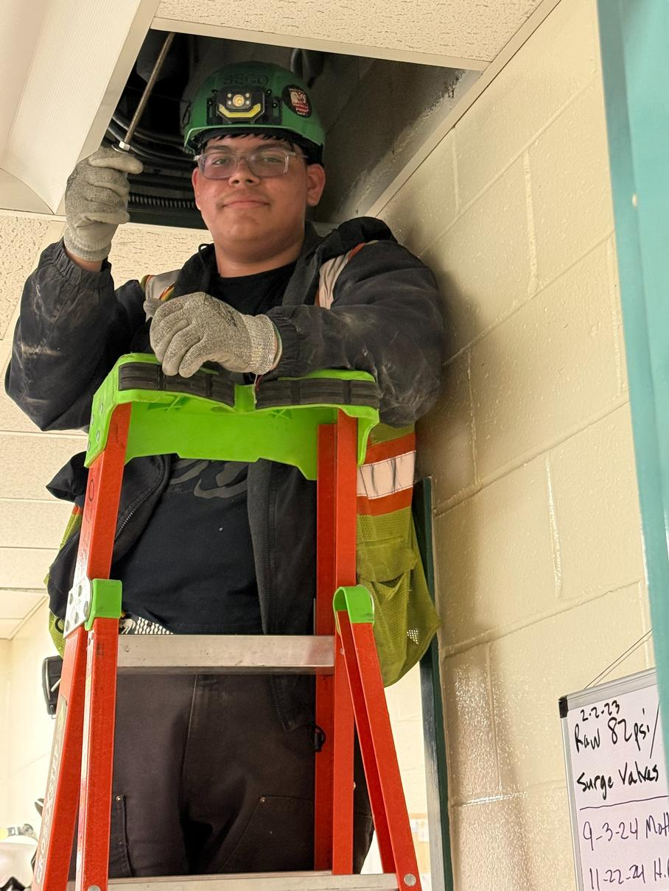
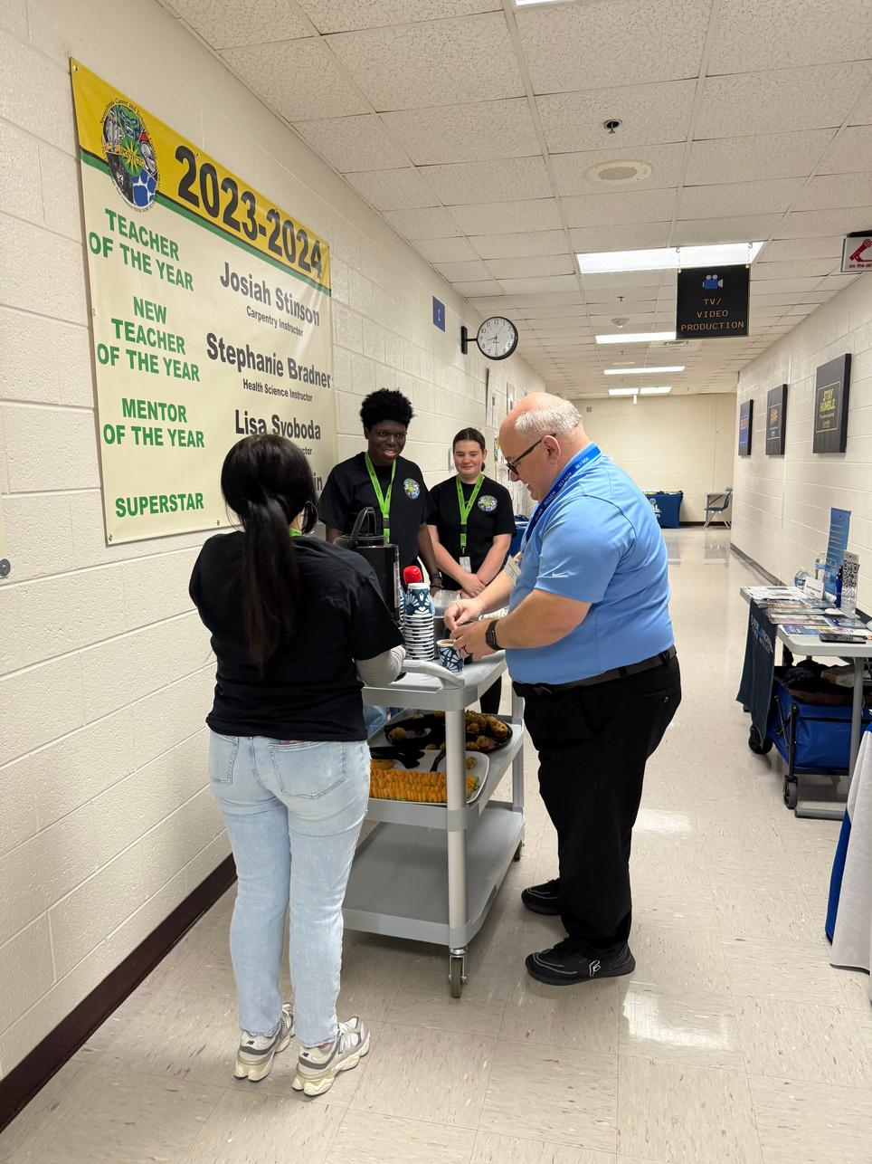
Experience
WHAT IS APPRENTICESHIP
WHAT IS INTERNSHIP
WHAT IS CLINICAL
WHAT IS SAE
WHAT IS ENTREPRENEURSHIP
WHAT IS SCHOOL-BASED ENTERPRISE
Notes:
Emily:
This is the highest level of the continuum. Learning for work.
These are the experiences that count towards a graduation requirement and the 3E Readiness Framework which is used for Virginia’s school performance report. In Virginia, these are known as High Quality WBL.
Each of these must meet specific criteria. High-demand fields. 90 hours. CTE alignment. Credential opportunity. And a structured mentorship with a business partner.
And they take multiple forms. Internships, apprenticeships, clinicals, entrepreneurship, school-based enterprises, and supervised agriculture experiences.
This is where students are not just preparing for the workforce. They are actively participating in it.
Apprenticeship: A career preparation WBL method that blends CTE curriculum with On-the-Job Training, giving students the chance to build both employability and occupational skills. This is a true collaboration among VA Works, employers, and the school system. All apprenticeships are paid experiences.
Clinical: Allows Health and Medical Science students to integrate knowledge acquired in the classroom with clinical practice.
Entrepreneurship: The student plans, implements, operates, and assumes financial risks in a business that produces goods or delivers services. The student owns the business assets and keeps financial records to determine return on investment.
Internship: An experience that places the student in a real workplace environment to develop and practice career-related knowledge and skills for specific career field related to the student's career interests, abilities, and goals. The student in the top picture was in an internship with Singleton Electric helping with a water treatment facility. His experience was a paid experience, but internships can be non-paid.
Supervised Agriculture Experience: a student-led, instructor supervised, work-based learning experience that results in measurable outcomes within a predefined, agreed upon set of Agriculture, Food and Natural Resources(AFNR) Technical Standards and Career Ready Practices aligned to a career plan of study. This can be a mix of Research, Internship, Entrepreneurship, and School-Based Enterprises in our Agriculture classes. Some examples are the plant sales done by our Horticulture classes and research projects of small animals and then learning how to care for the classroom pets, and raising chickens and selling their eggs to the school community.
School-Based Enterprise: an ongoing, student-managed, entrepreneurial operation within the school setting. It provides goods or services that meet the needs of the school’s target markets (i.e., students, teachers, administrators, parents/guardians, community members, community organizations/businesses). In the picture, students in our hospitality program had a coffee cart for all of the vendors at the SCTC Career Fair last year. Other examples are School Stores collaboration between Film Club and Family and Consumer Science classes to offer concessions during their film viewings, and one of our engineering programs is making gadgets for our assistive technology staff to use with students needing adaptations.
This is where learning becomes application, as students engage in rigorous, hands-on experiences that align directly with your CTE programs and bring classroom content to life.
This is an opportunity for our workforce partners to directly shape and evaluate future employees through meaningful, sustained experiences where students contribute, learn the industry, and build job-ready skills.
This level ensures accountability and impact by aligning high-quality, credential-driven experiences with workforce demands, creating a measurable return on investment in student readiness and economic growth.
Is this how your state defines WBL? Is there anything that Virginia has missed?

Slide 12
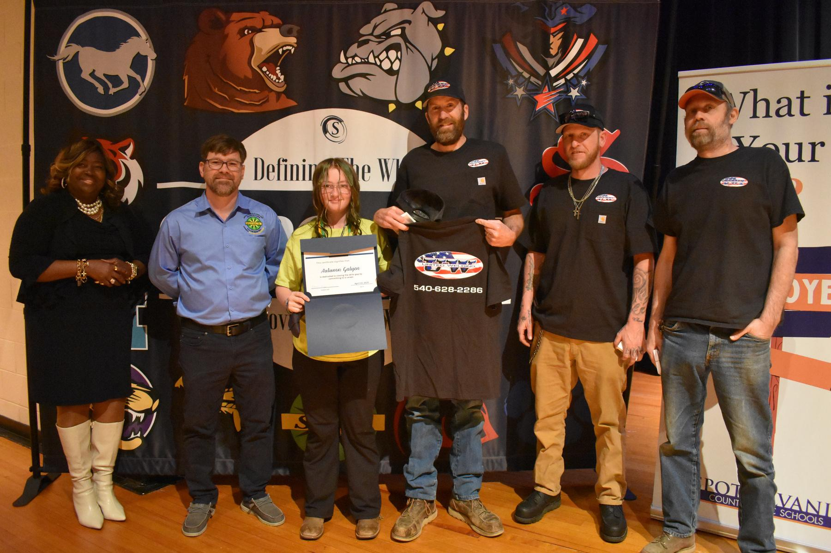
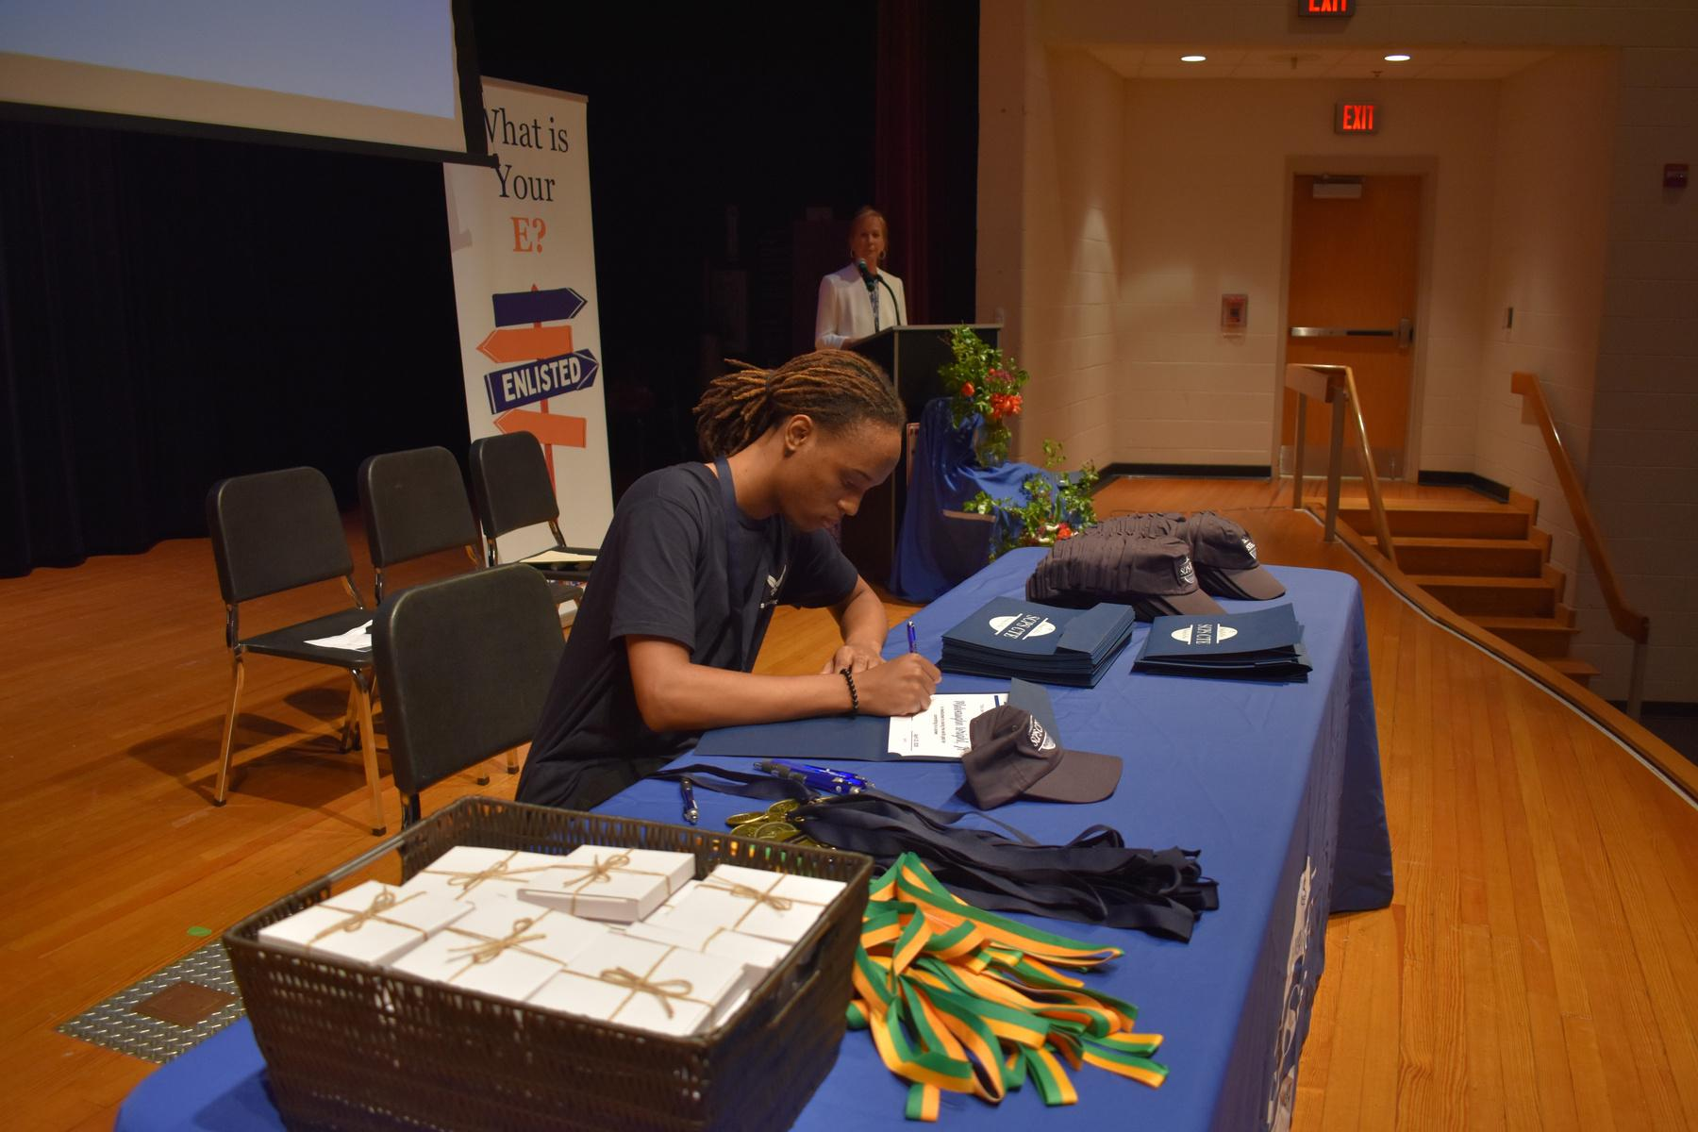
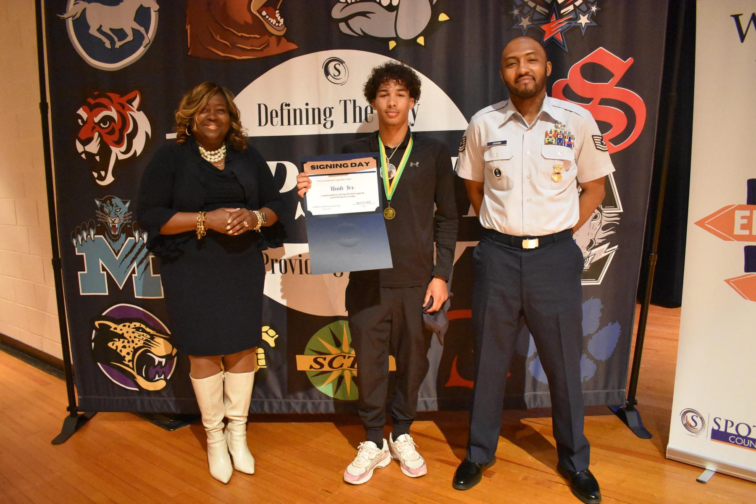
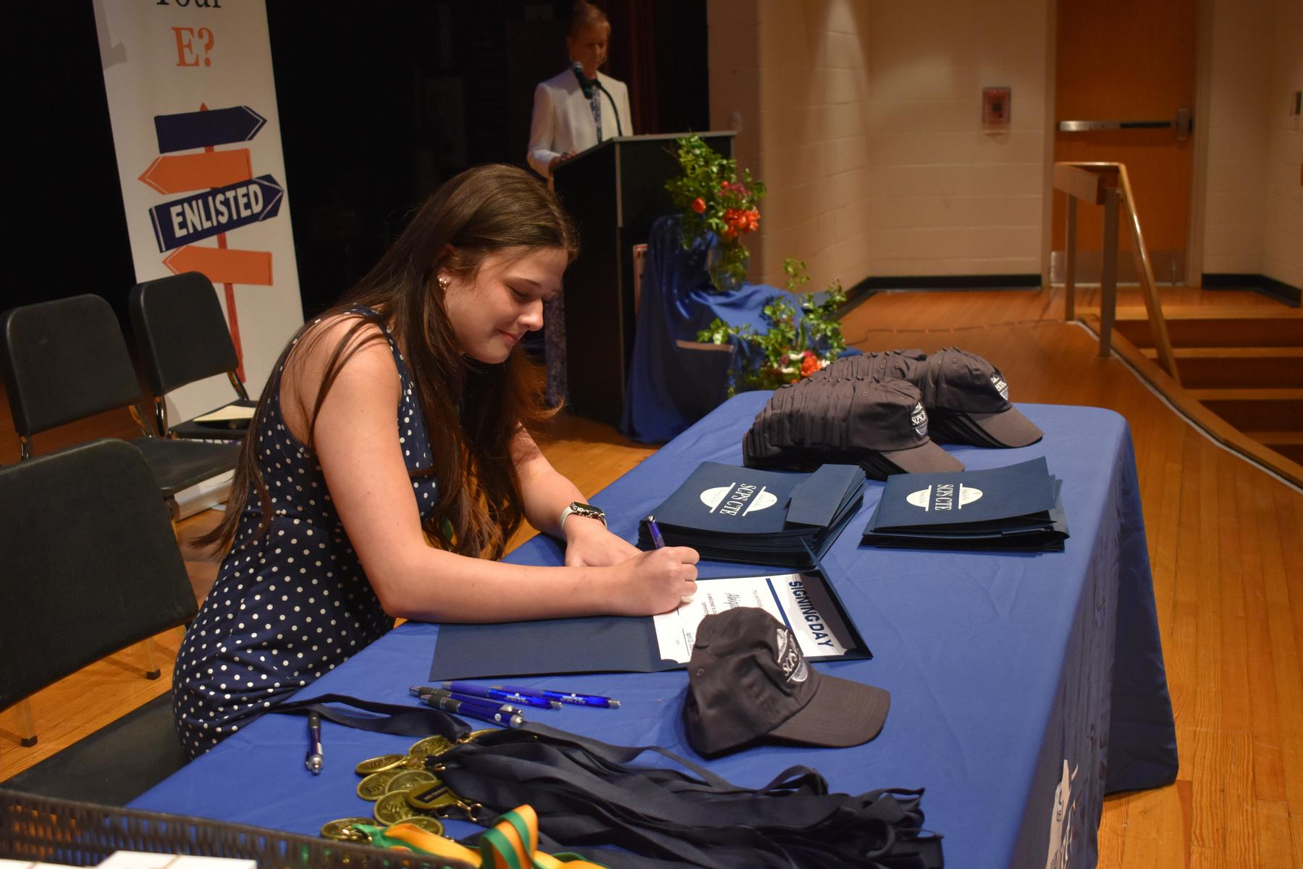
Signing Day
Notes:
Emily
And this is how we celebrate it.
At the end of the journey, we recognize students who are entering the workforce or enlisting.
Much like a college signing day, they take the stage with their employer and teacher and make that commitment public.
It’s powerful. Not just for the student, but for families, educators, and partners.
Because it sends a clear message. All pathways matter. And all pathways deserve to be celebrated.
This is a powerful, full-circle moment for our educators where they see their impact as students confidently take the stage to commit to their next step in the workforce or military, validating the skills, direction, and growth developed in your classroom.
This is where the Employer’s investment comes full circle as they celebrate students publicly committing to the workforce or military, recognizing not just a hire, but the role you played in developing and mentoring that student along the way
This highlights the strength of our partnerships and the alignment between education and workforce development. Moments like this not only celebrate student success, but also shift the narrative, showing that there are multiple meaningful and respected paths to a successful future.

Slide 13
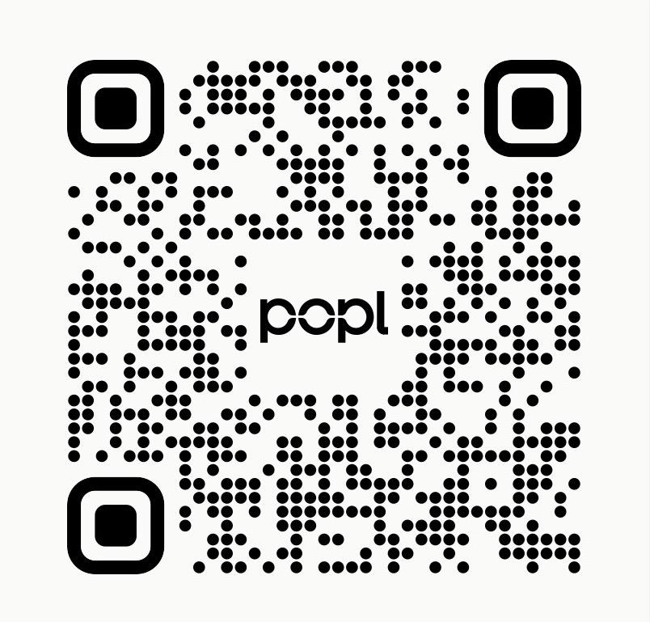
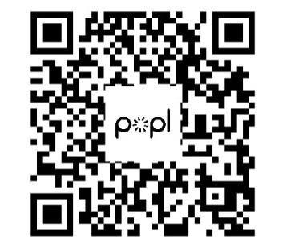
THANK YOU
Emily Hall
Sue Venable-Shelton
Notes:
Both:
So as you think about your role in this work, here’s the takeaway.
This doesn’t happen in isolation. It takes alignment. It takes partnership. And it takes intentional design.
But when it works, it builds something incredibly powerful. A system where students don’t just graduate. They launch.
And that’s the goal.
_________________________________________________________________________________________________
If time allows...
We’d love to continue the conversation and hear how this connects to the work you’re doing

