Slide 1
Dr. Jacqueline (Jackie) Tiermini
ACTE WBL Conference | April 30, 2026

Slide 2

Biggest Barrier?

Slide 3

Turn & Talk

Slide 4

Powerful…but limited
ACCESS | LOGISTICS | SCALE | EQUITY

Slide 5

Bring The Work In

Slide 6

A Different Model
STUDENTS | COLLEGE | BUSINESSES | PROJECTS

Slide 7

Why Here?
FLEXIBLE | CONNECTED | SHARED | SCALABLE

Slide 8

Not Internships
TEAMS | REAL CLIENTS | REAL DELIVERABLES

Slide 9

Let’s Try It!

Slide 10

Recruit Younger Workers
Healthcare partner needs help

Slide 11

Understand
Who | Needs | Barriers

Slide 12

Brainstorm
No filtering | Build ideas

Slide 13

Create
One idea | Sketch it

Slide 14

What did you come up with?

Slide 15

30-Second Pitch

Slide 16

Partner Up!

Slide 17

What Felt hard?

Slide 18
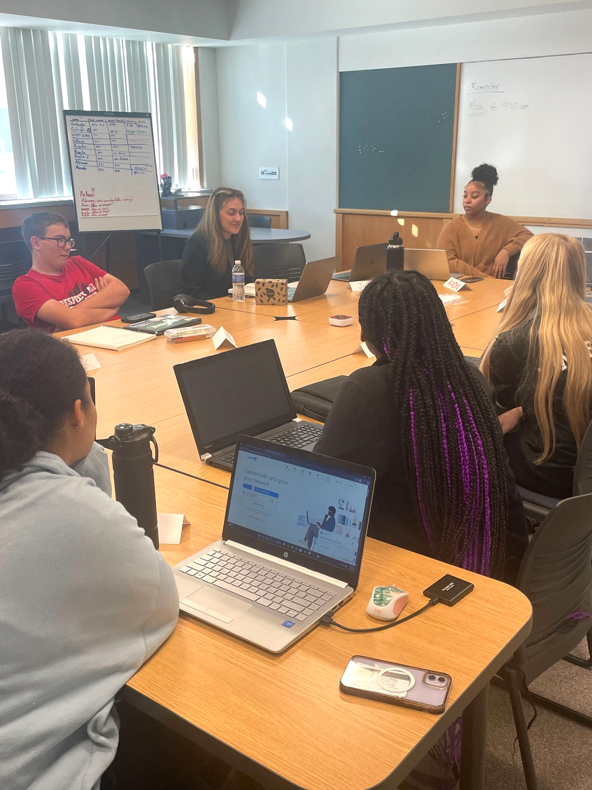
This is MOSAIC

Slide 19

Structure + Authenticity

Slide 20

One Partner | One Project

Slide 21
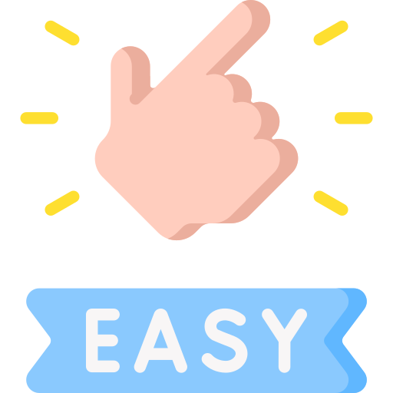
Keep It Simple
Need | Task | Deliverable | Skills

Slide 22

You Can Do This!

Slide 23
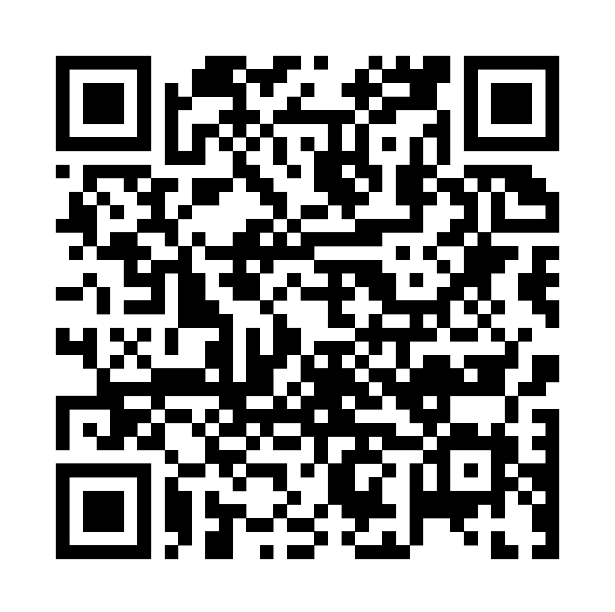
Scan For Tools

Slide 24

Real Work Builds Readiness

Slide 25


Thank You!
I would love to connect:
585.698.6841
www.linkedin.com/in/jacqueline-tiermini-ed-d-0768a0265

