Slide 1
Unlocking Potential, Empowering Communities: Rural Success Stories in Work-Based Learning

Slide 2

Who is Reach Higher Montana
Outreach?

Slide 3

What’s our vision? How do we work towards it?
Montana students achieve personal success in education, career, and life.
RHM helps students strategically pursue educational opportunities.

Slide 4


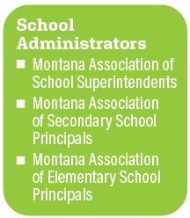
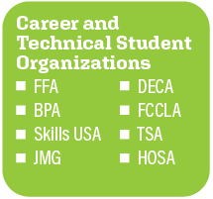
Who are our partners?

Slide 5
How do we carry out our mission?
Student Services
Scholarships
Support for CTE organizations
Information & resources
Pre Apprenticeship-JFF
Youth Apprenticeships-PAYA
Services for Youth in Foster Care
Foster Care Education & Training Vouchers
Summit for Youth in Foster Care
Career Training
Youth Advisory Board
Foster Club All Stars

Slide 6
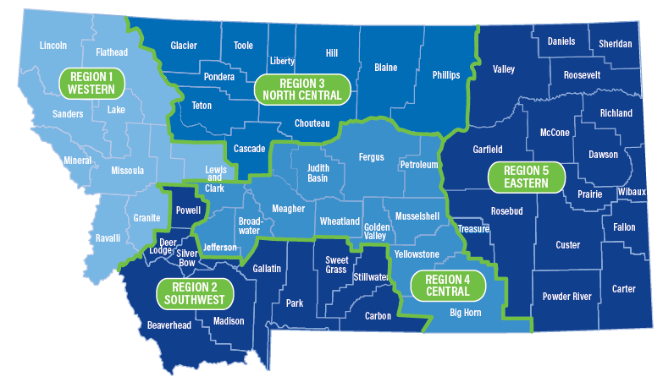
Our Outreach Regions
Outreach
Five advisors
Engagement & support for local efforts
Presentations in schools
One-on-one help for students
Notes:
Define Rural-Stats

Slide 7
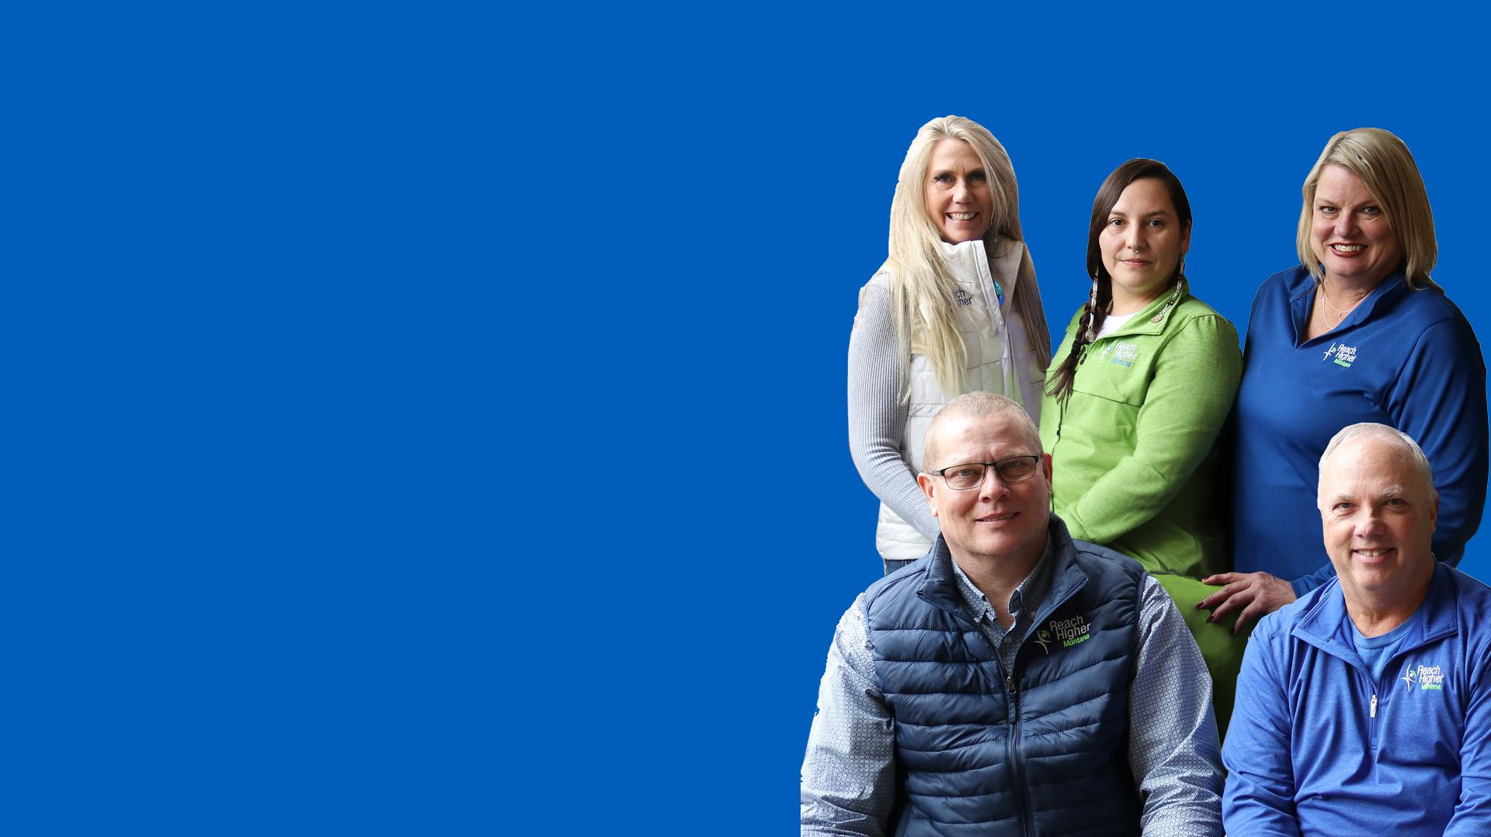
Our Outreach Team
NCDA Certification
Overview of their collective professional experience
Live in/near the communities they serve

Slide 8
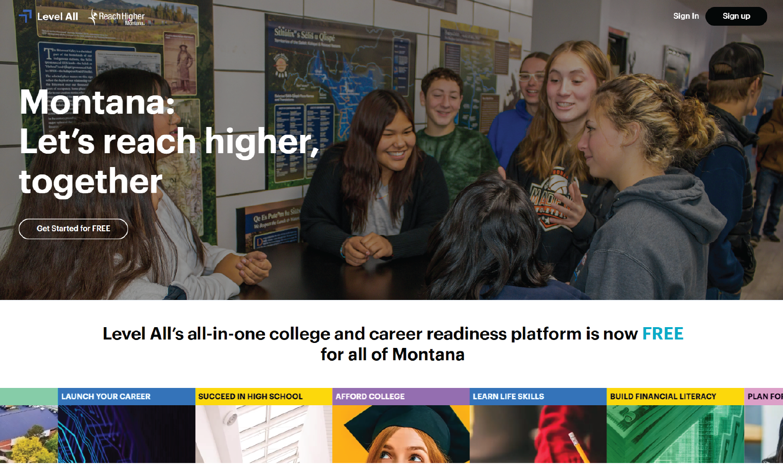
Level All
https://www.levelall.com/montana

Slide 9
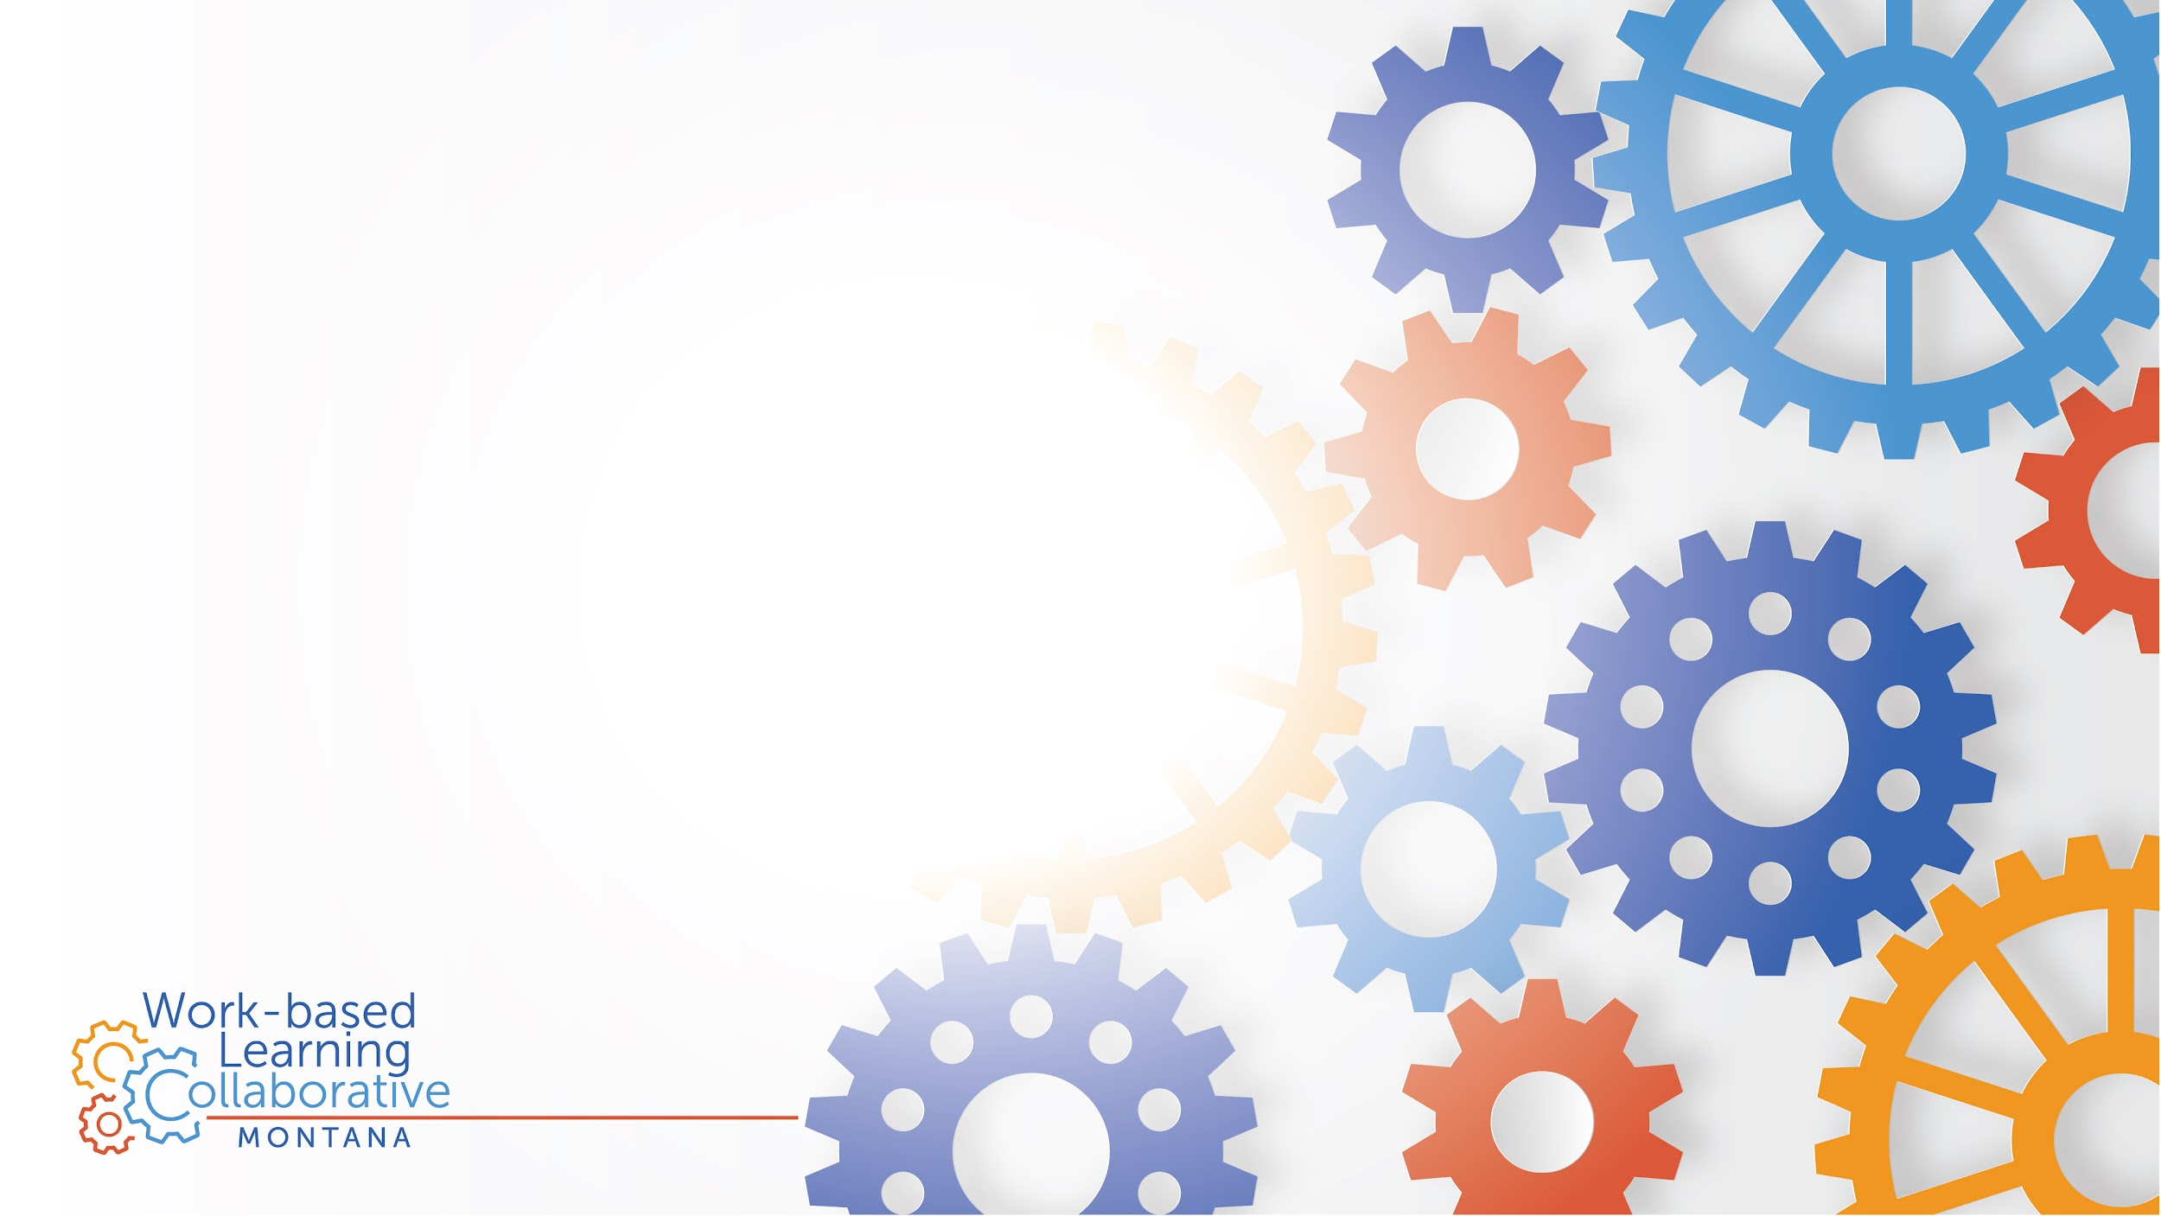
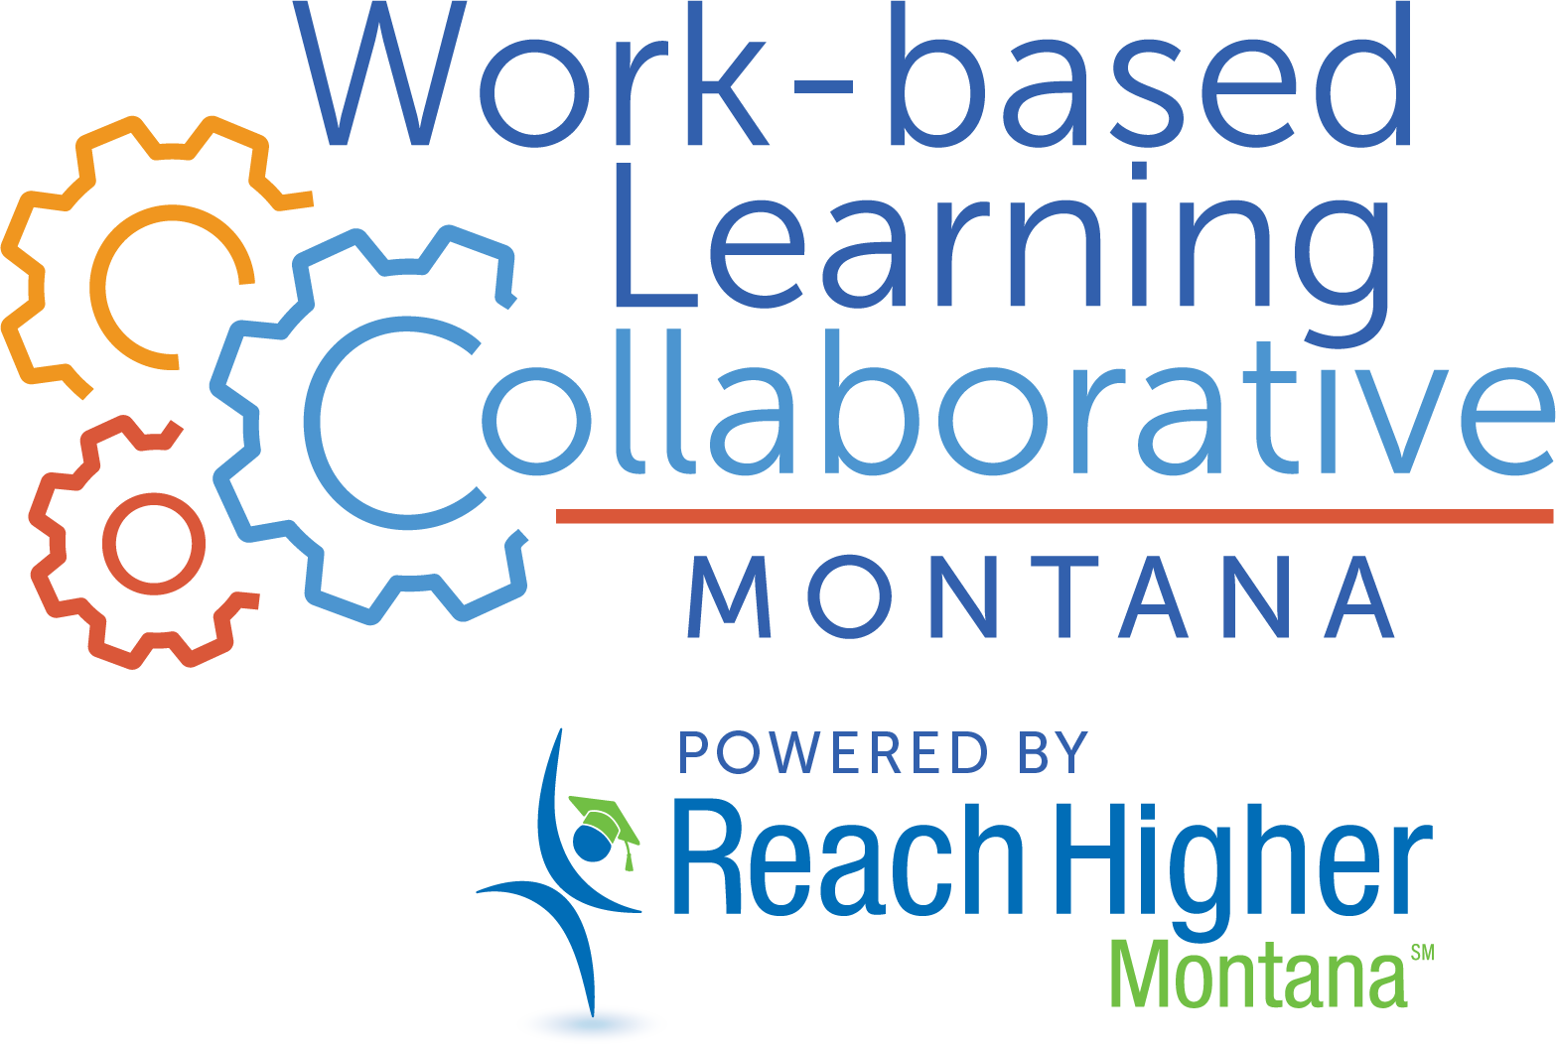

Slide 10
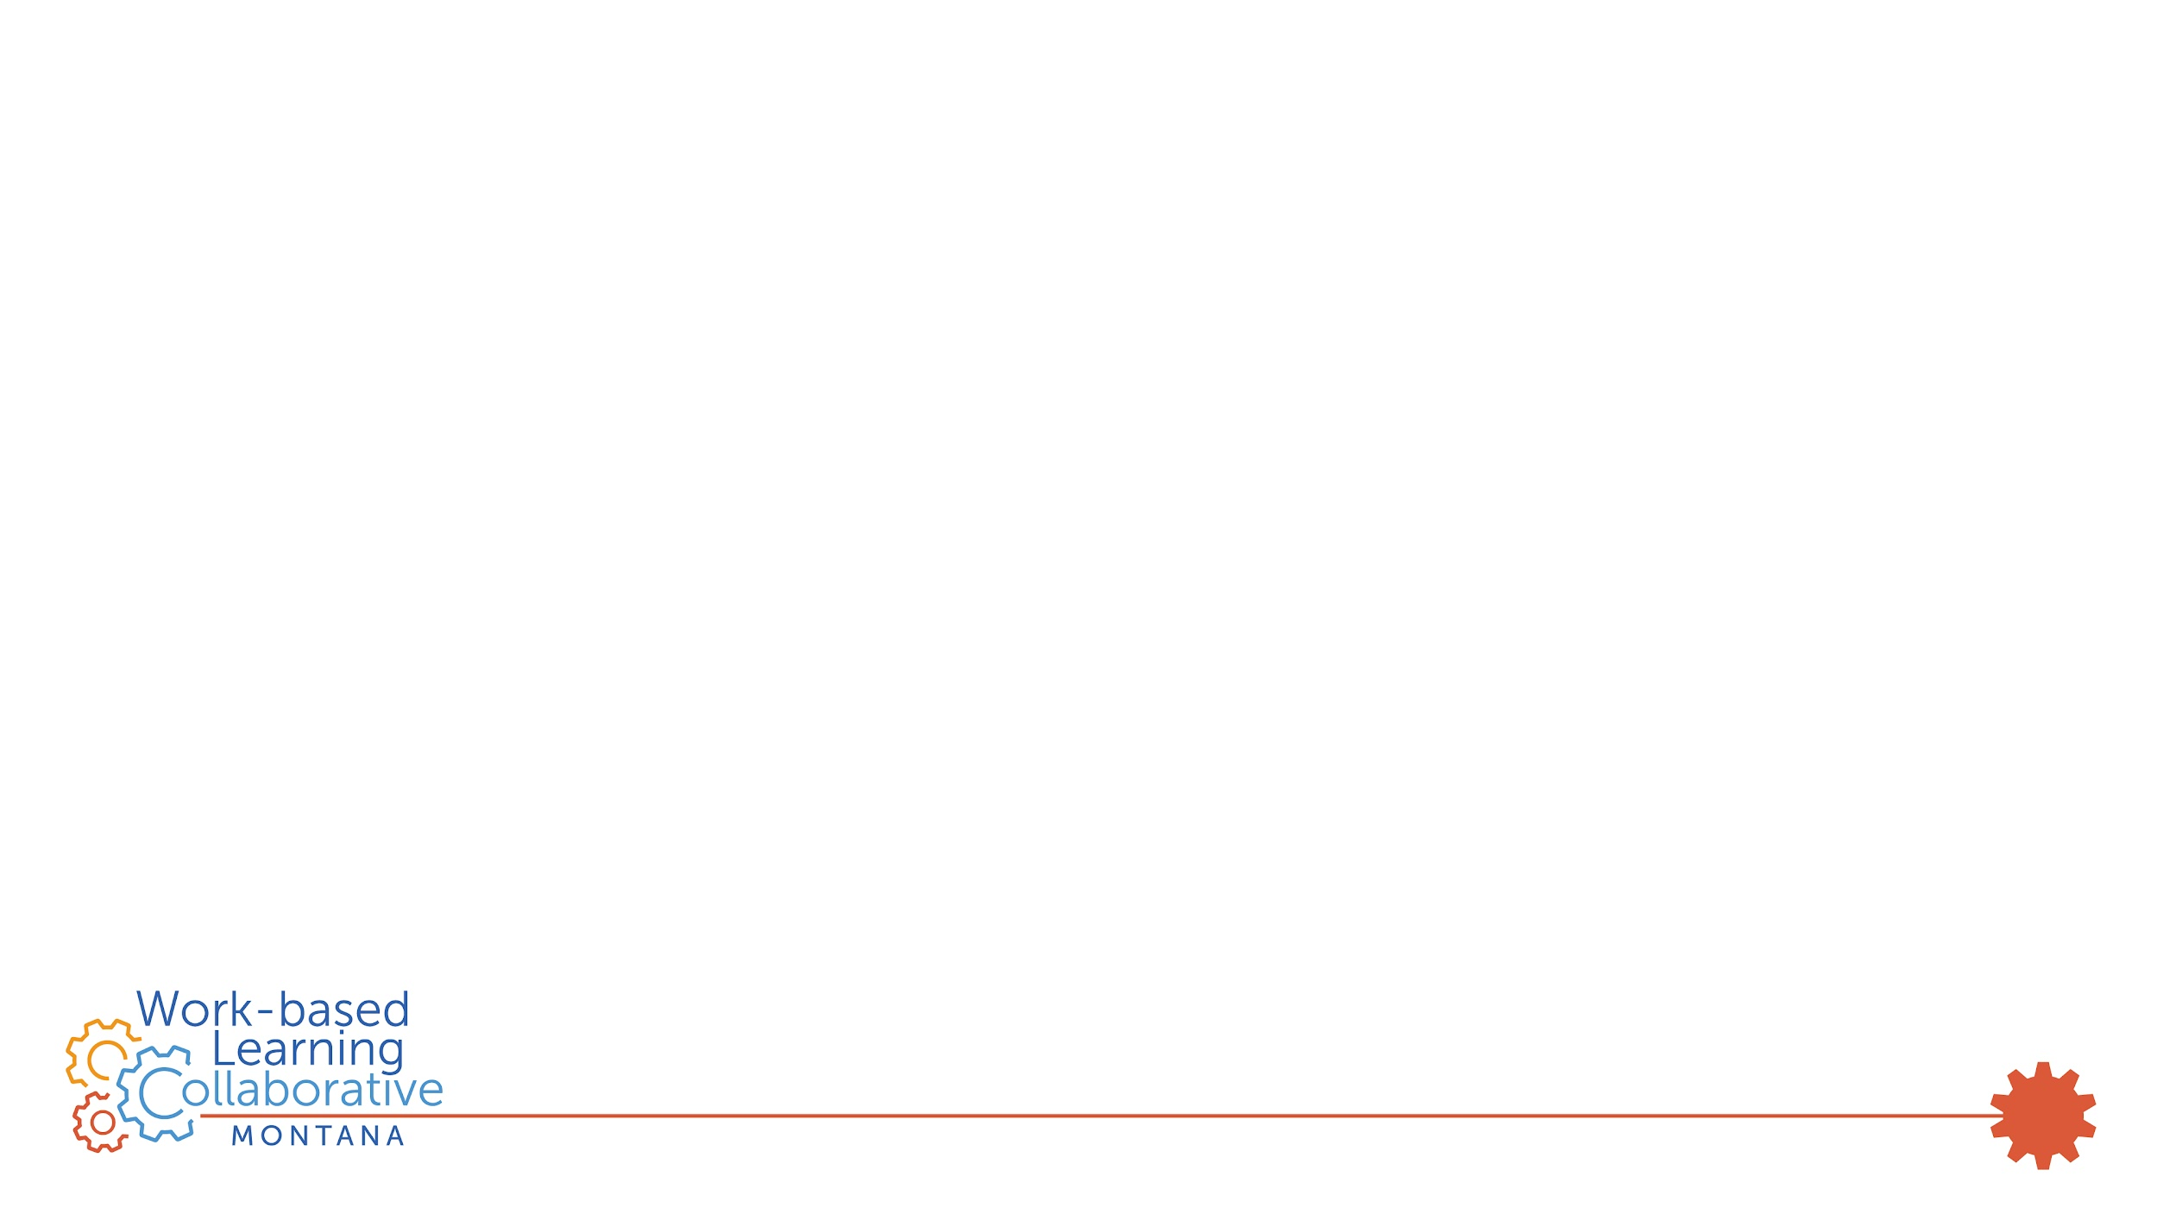
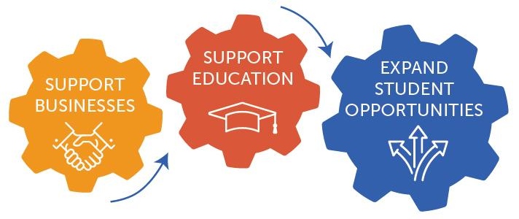
Work-based Learning Collaborative
Vision: Every young adult in Montana will have multiple pathways to economic mobility, supported by a statewide work-based learning system that honors the potential of students and addresses the workforce needs of Montana businesses, today and tomorrow.
Formed: 2021
Members: 30 private, public, or nonprofit organizations
Staff: Director & Data Analyst
2
Notes:
The Work-based Learning Collaborative is a cross-section of public and private sector organizations working together to improve and expand work-based learning opportunities. We want to ensure Montana students, educators, and businesses are supported by high-quality, accessible, relevant, and measurable work-based learning opportunities. We build cross-sector collaboration and support critical partnerships.
We are a capacity-building entity, so we support our members and partners across the state who do the direct programming.

Slide 11
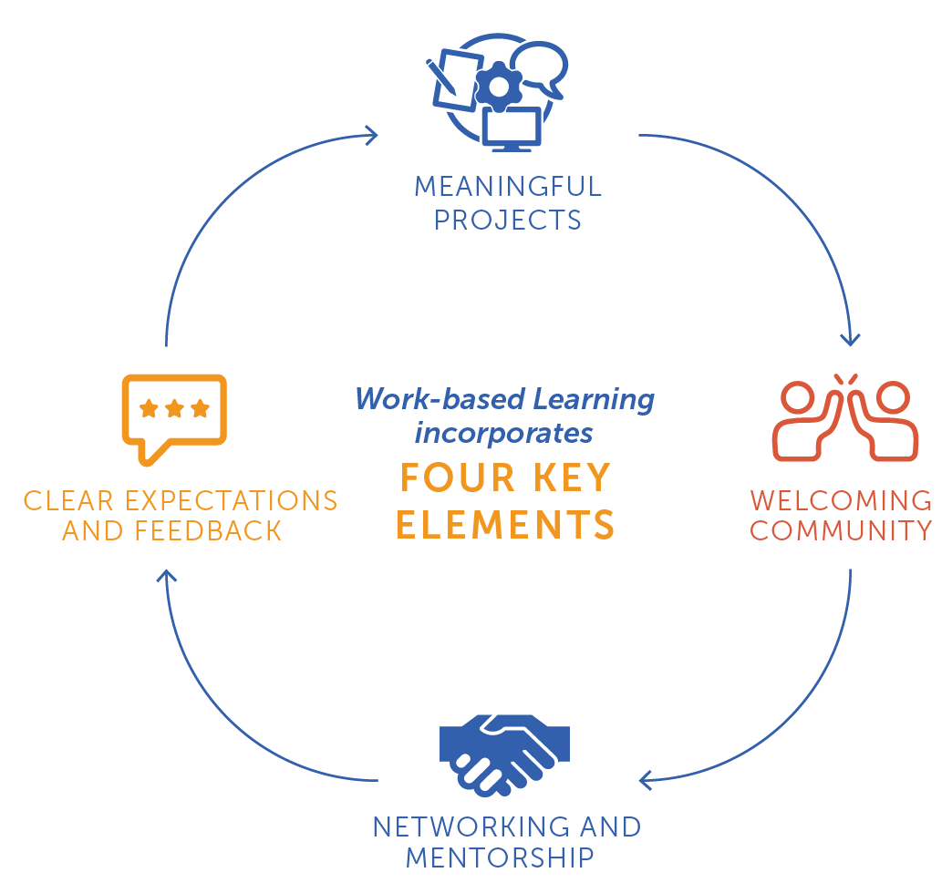
High-quality
REFLECTION,
18
Notes:
These are elements of high quality WBL. This image was created by national experts at the nonprofit Jobs for the Future (JFF.org) through significant research. WBL is experiential education, and you can see that reflected in this cycle with goals, action, reflection - rinse and repeat.
Starting at the top - whether one major project or several smaller projects, employers engage students in meaningful work that is based in a real-life challenge, allows them to problem solve, and leads to a tangible product or outcome. This helps learners feel a true sense of purpose in their WBL experience.
Employers create a welcoming environment and build community among student workers and staff with strong onboarding, points of connection, and celebration. Learners feel a sense of belonging.
Student workers have networking opportunities to explore careers and grow their professional network, as well as a mentor who can help them navigate the workplace, make meaning of their experience, and support their career development.
Student workers are provided clear expectations about performance and workplace standards, are engaged in regular goal setting, and receive frequent, constructive feedback that helps them stay on-track and learn. There is also regular opportunity for reflection, which helps the student make meaning of their experience and deepens their learning.
Then we’re back to goals to help learners tackle the meaningful projects they’re working on.

Slide 12
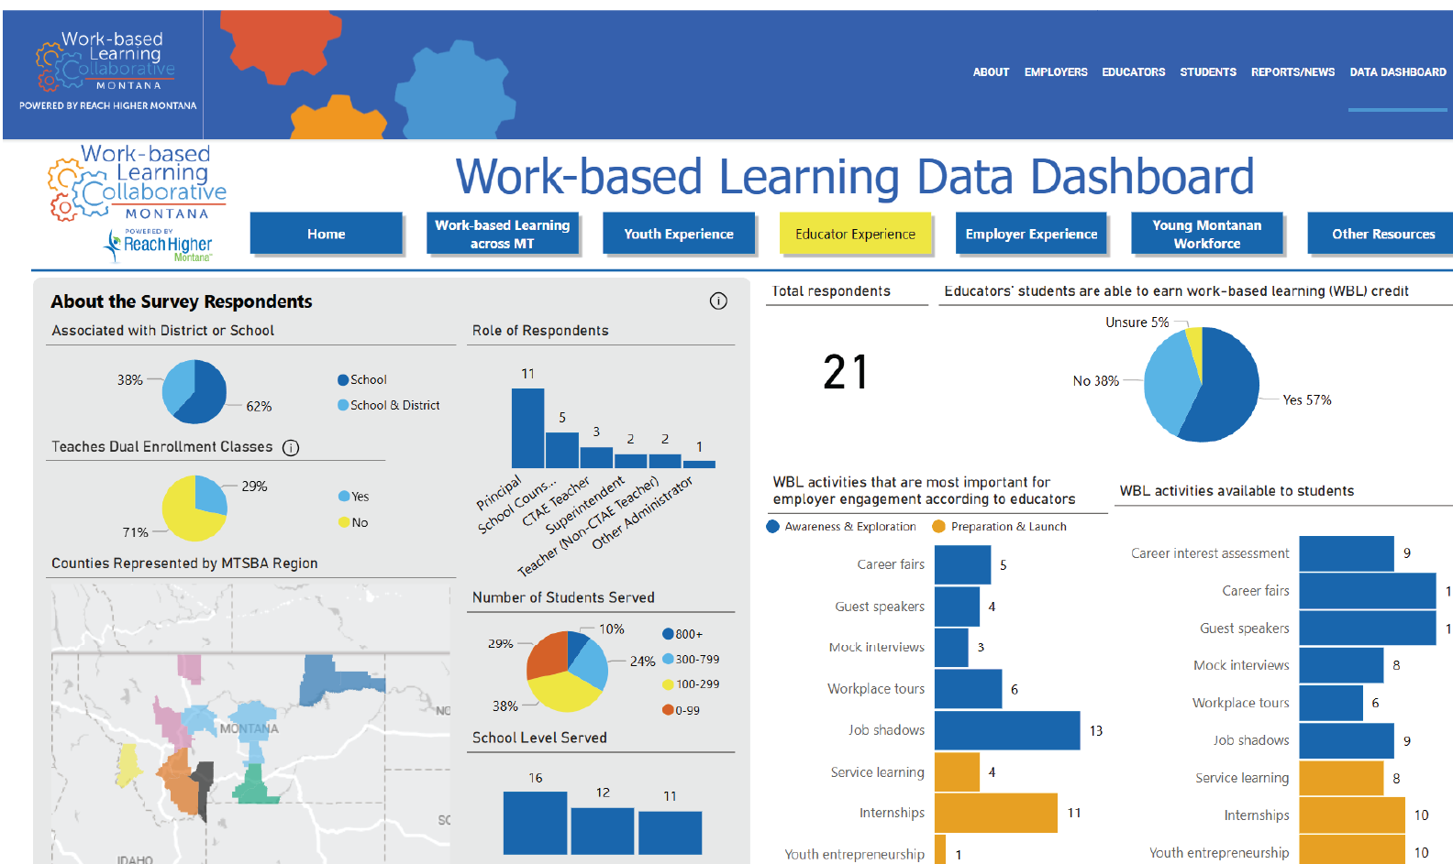
https://wblmt.org/data-dashboard

Slide 13
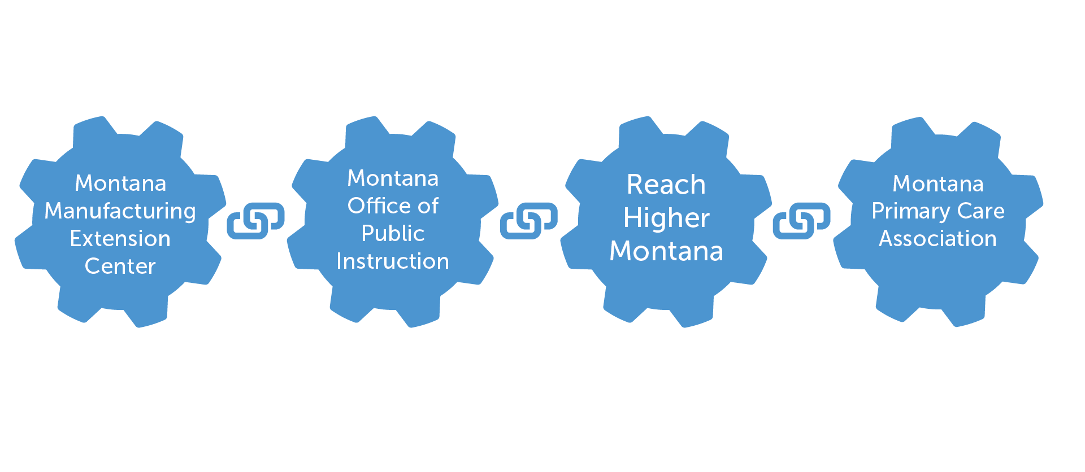
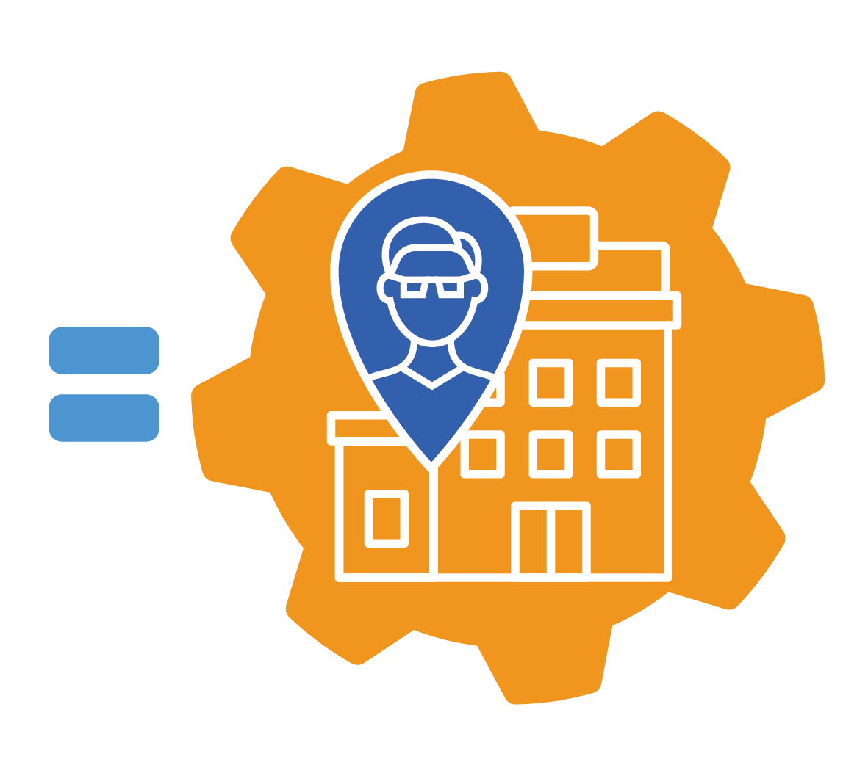
Teacher Externships Partnerships

Slide 14
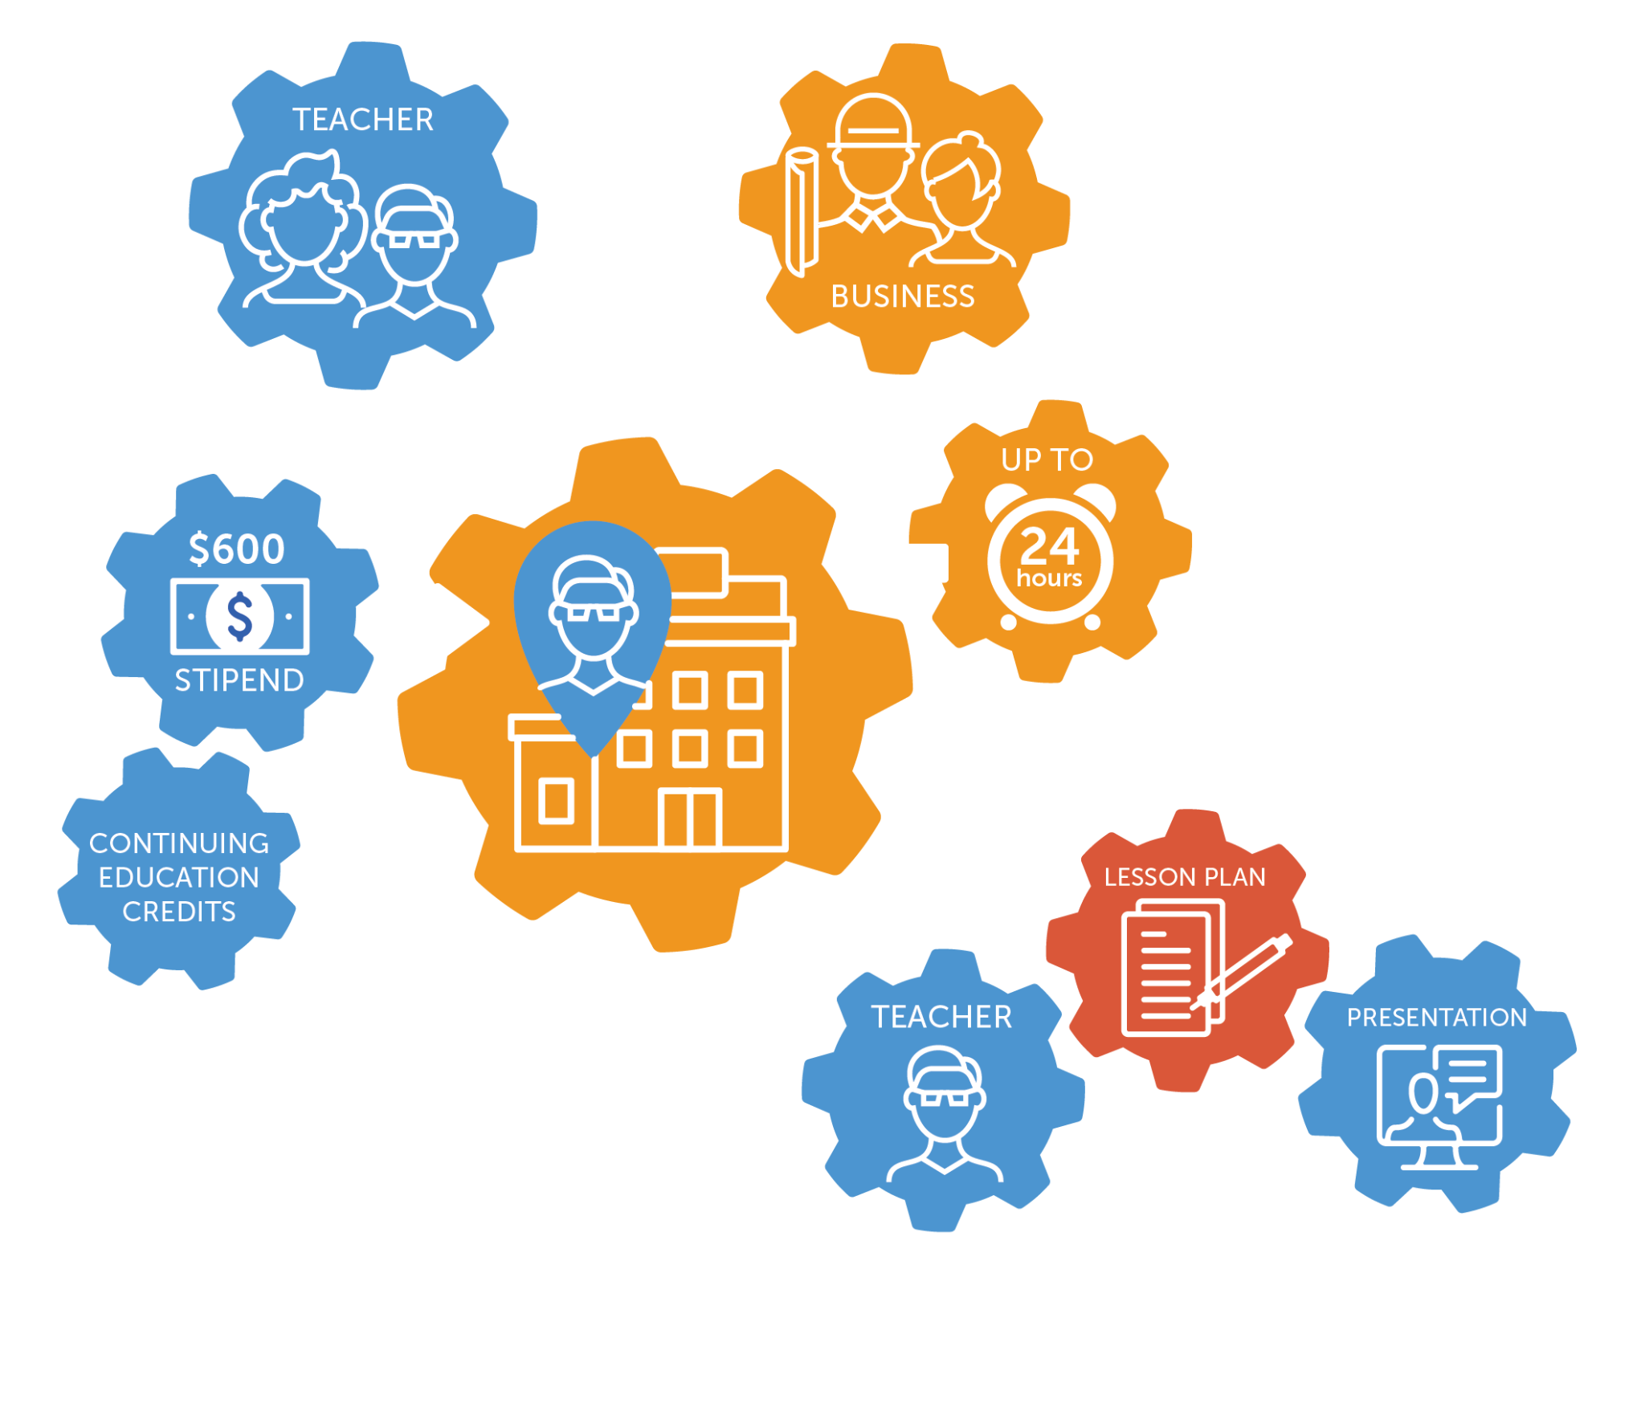
Teacher Externships

Slide 15
Teacher Externship Participation
1889 Coffee
ADF International, Inc.
Applied Materials
Atomic Industries
Big Sky Economic Development
CACI Gimbal Technologies
Deer Lodge Medical
Diversified Plastics
Girl Scouts of Montana/Wyoming
Granite Technologies
HE Parts International
Intermountain Health
Mystery Ranch
Nomad Global Communications
Northern Ag Network
Mission West Community Development
One Health-Hardin
Opportunity Bank
Parkside Financial Credit Union
PureView
Red Oxx Manufacturing, Inc.
Riverstone Health
Spark R&D
Spika Manufacturing
Tongue River Winery
Tuscano Machine
Visit Great Falls
West Paw
Wheat Montana
Wood’s Powr-Grip
Notes:
Update Businesses. Add Intermountain Health, Deer Lodge Medical, PureView, Spark R&D, West Paw, ADF International, Inc,. Wheat Montana. Remove 7 Manufacturing Employers and 7 Teachers

Slide 16
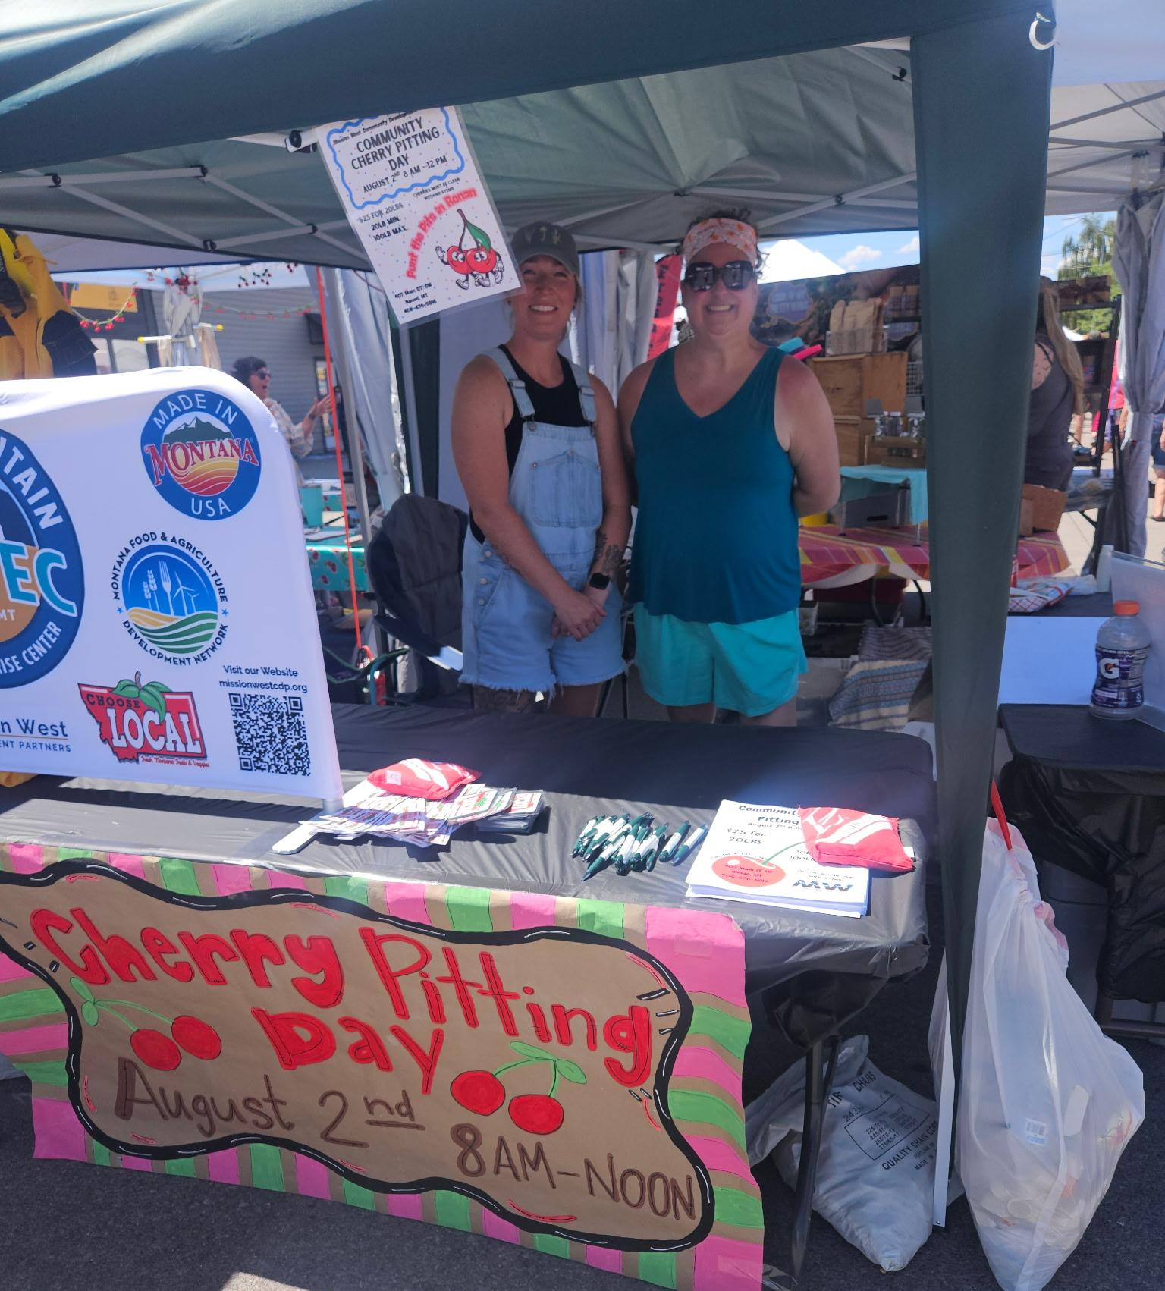
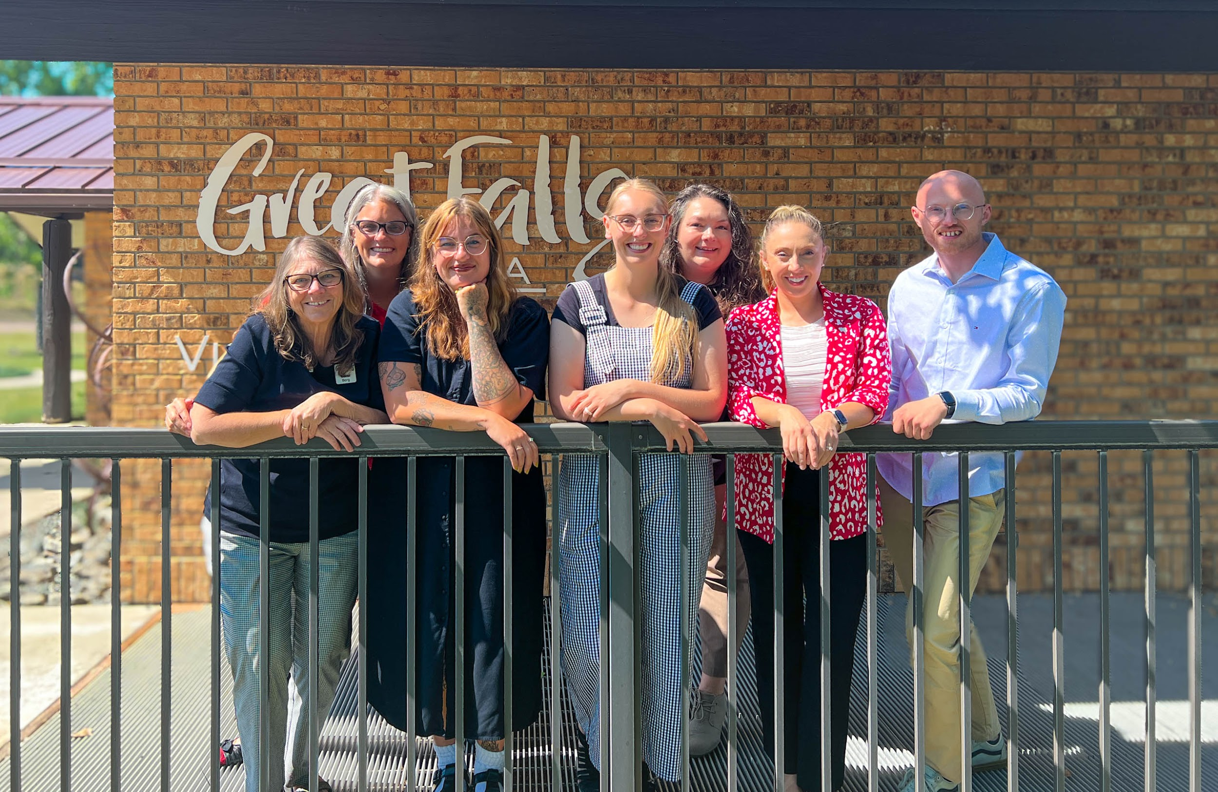
Mission West Community Development Partners in Ronan
Visit Great Falls

Slide 17
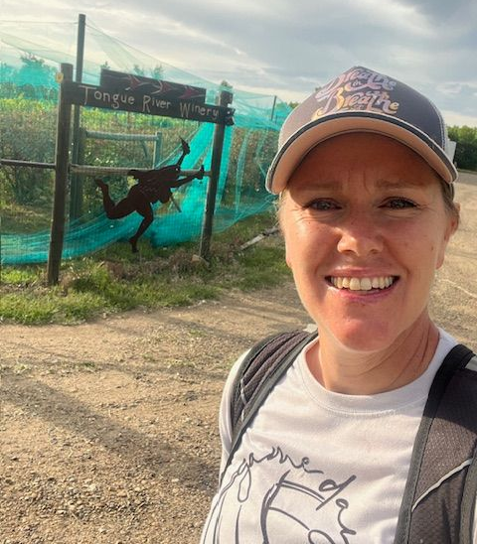
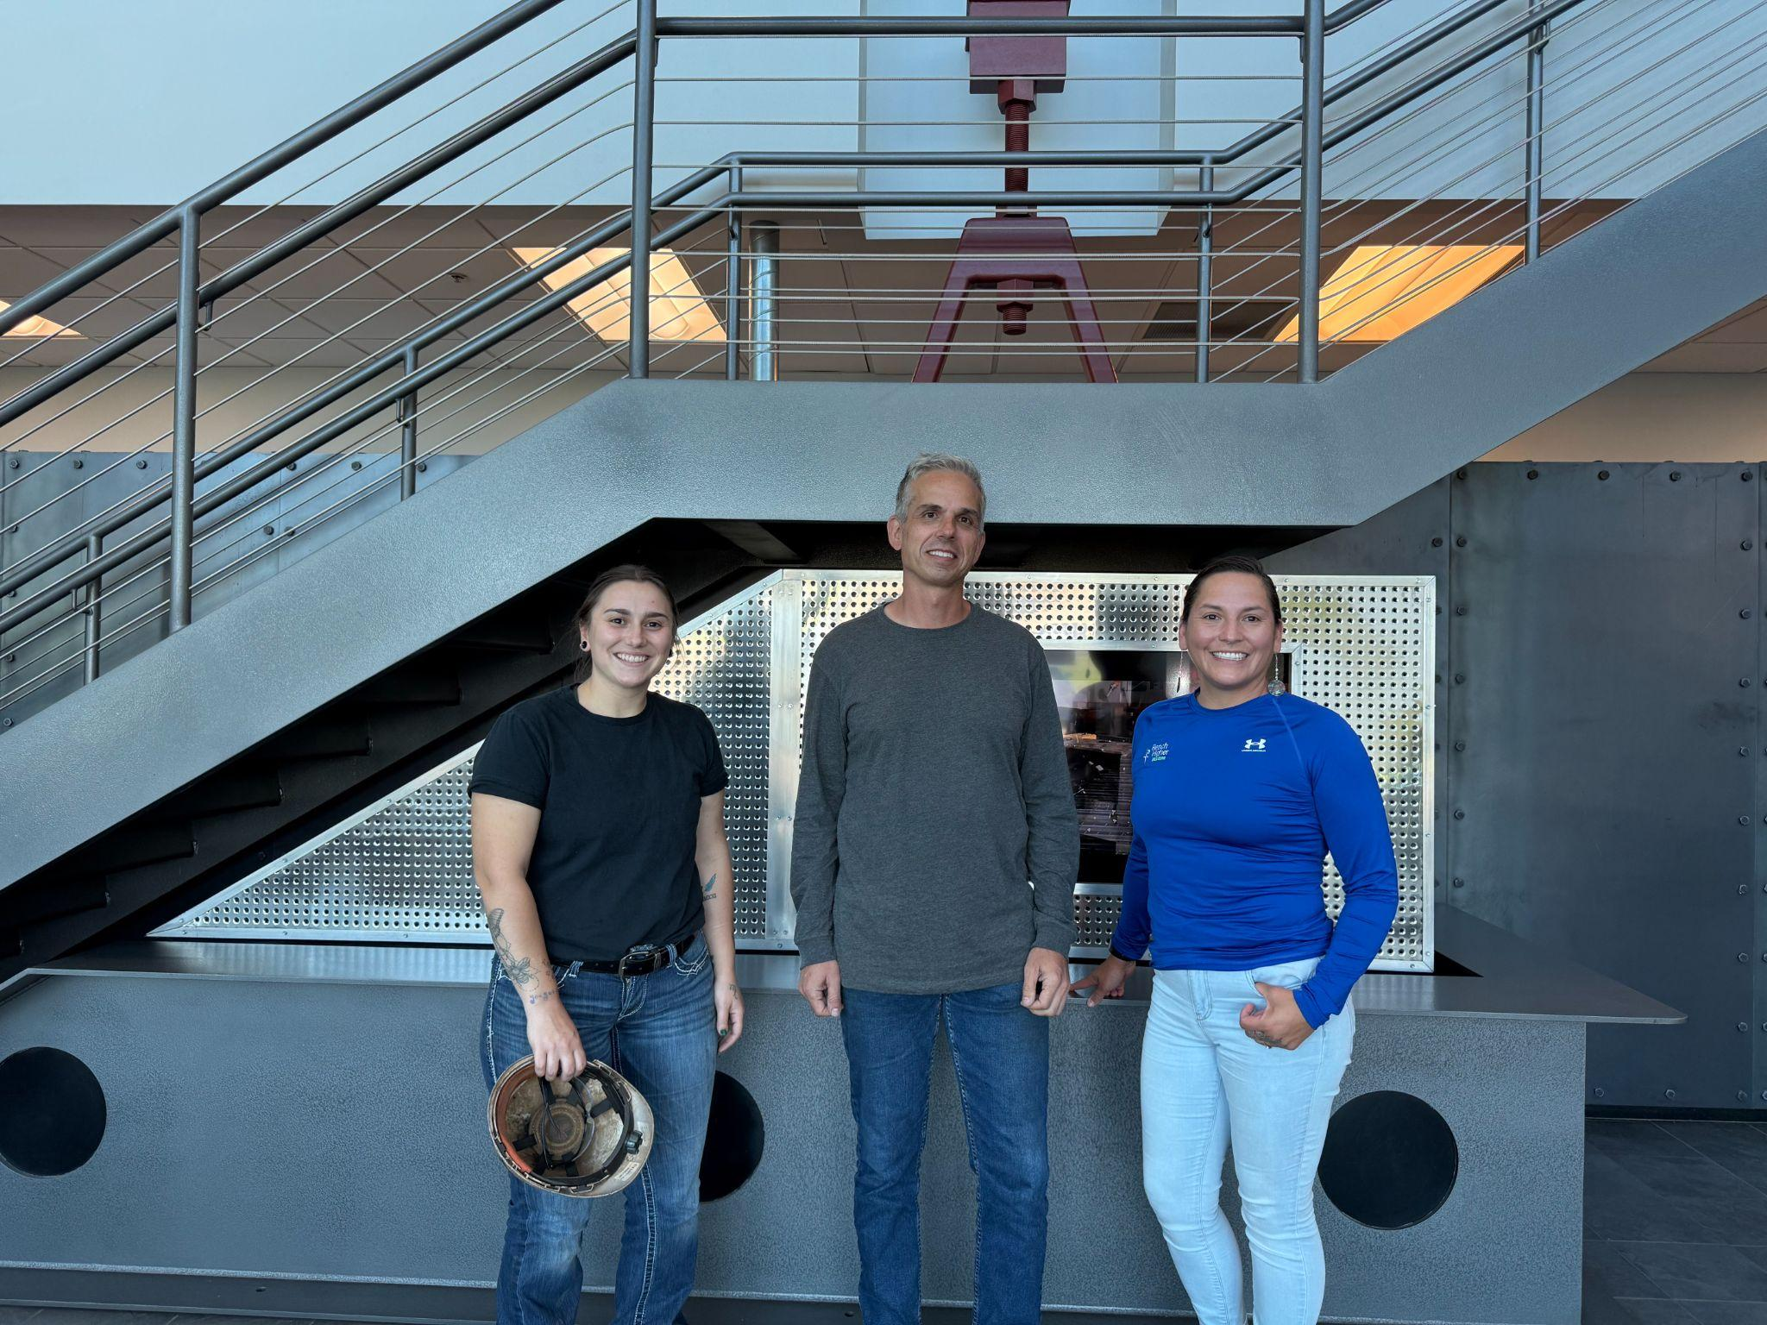
Tongue River Winery in Miles City
ADF International in Great Falls

Slide 18
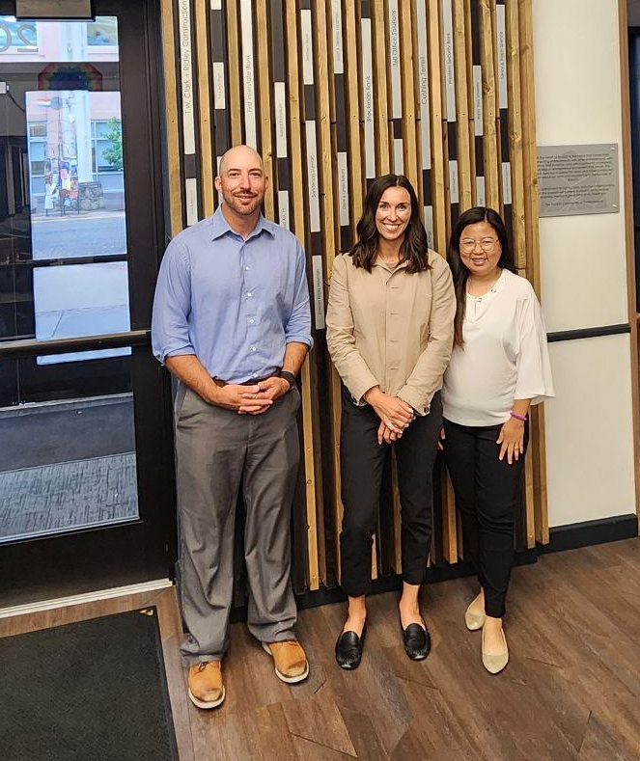
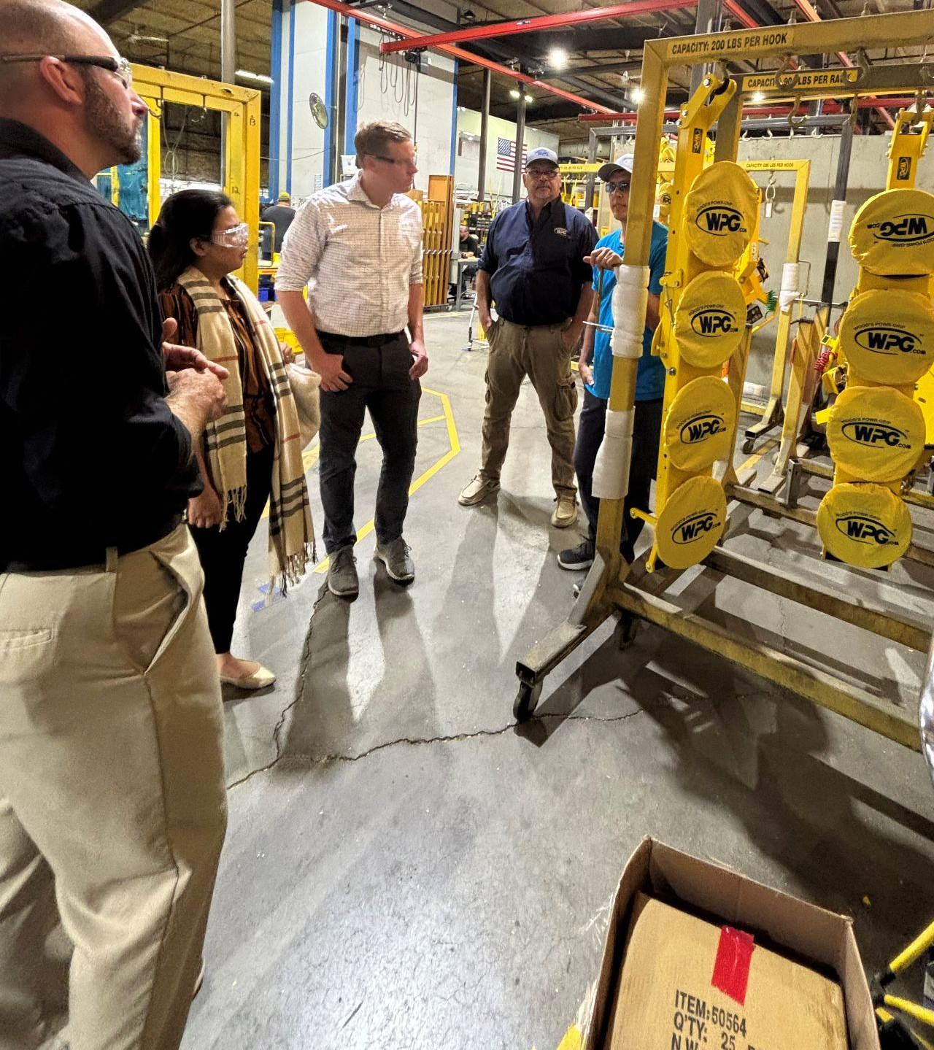
Big Sky Economic Development in Billings
Wood’s Powr-Grip in Laurel

Slide 19
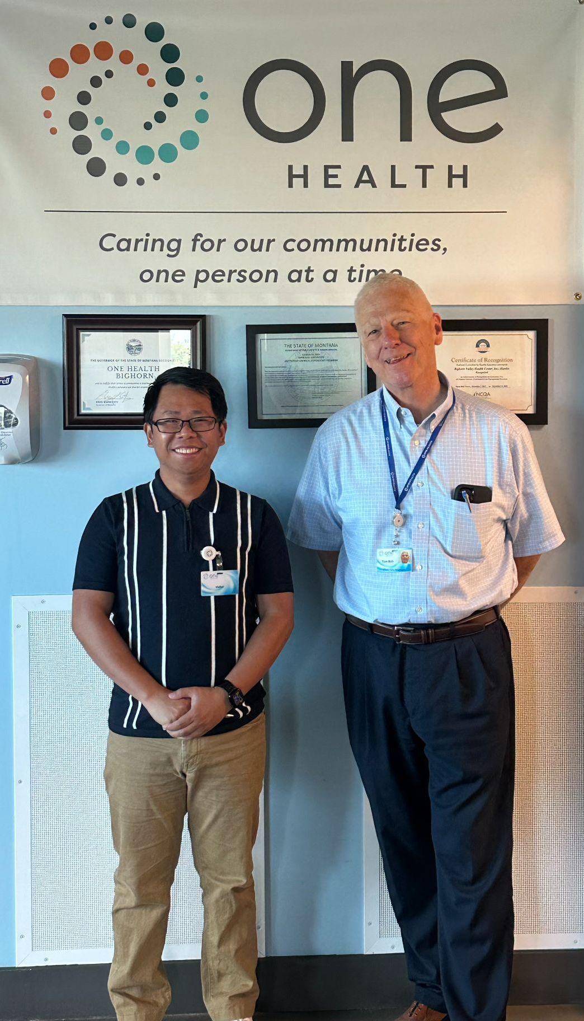
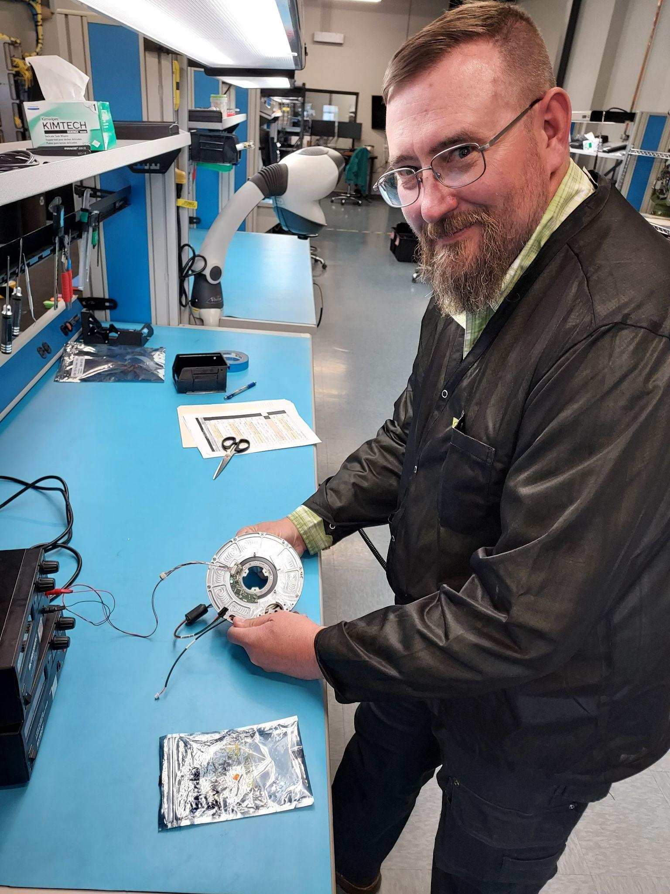
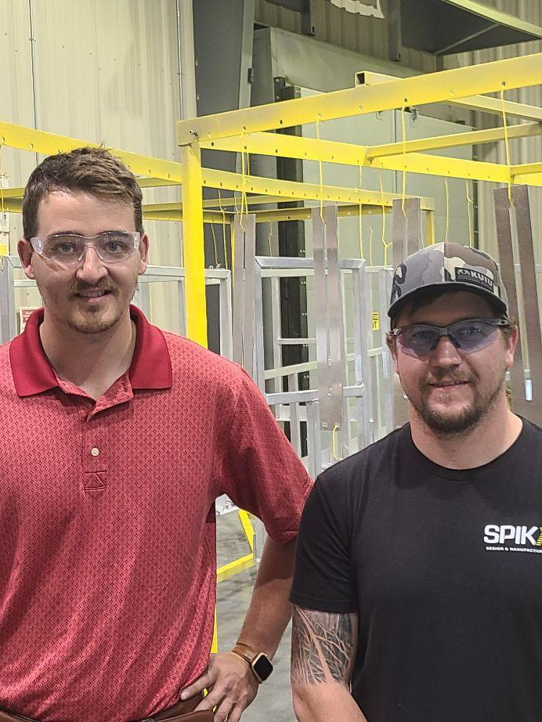
CACI Gimbal Technologies in Bozeman
Spika Manufacturing in Lewistown
One Health in Hardin

Slide 20
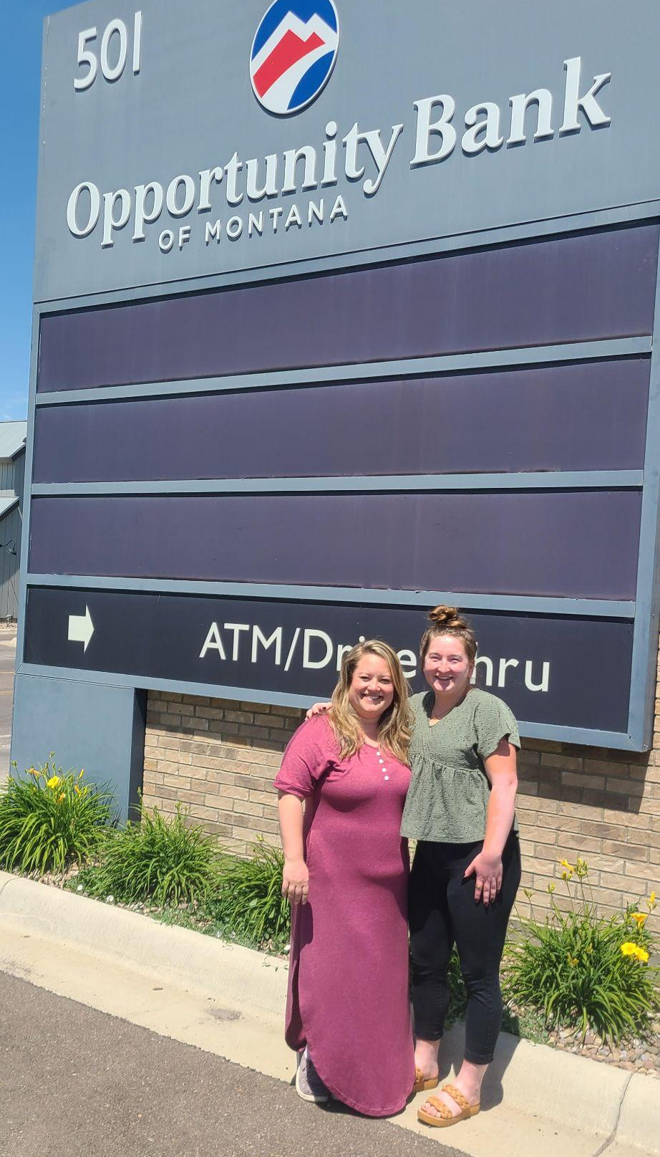
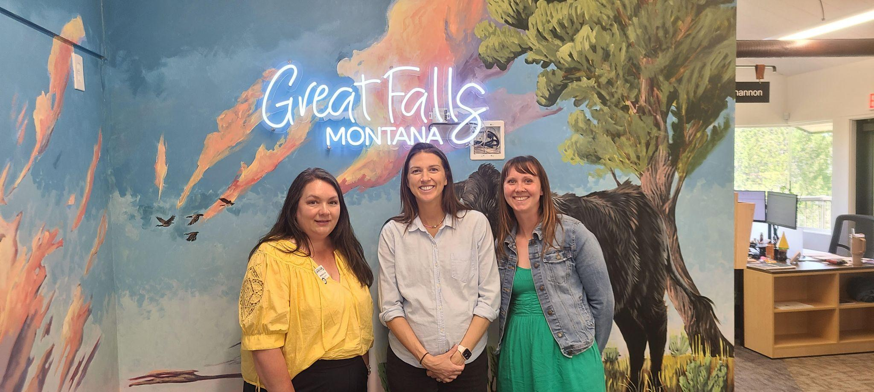
Visit Great Falls
Opportunity Bank in Great Falls

Slide 21
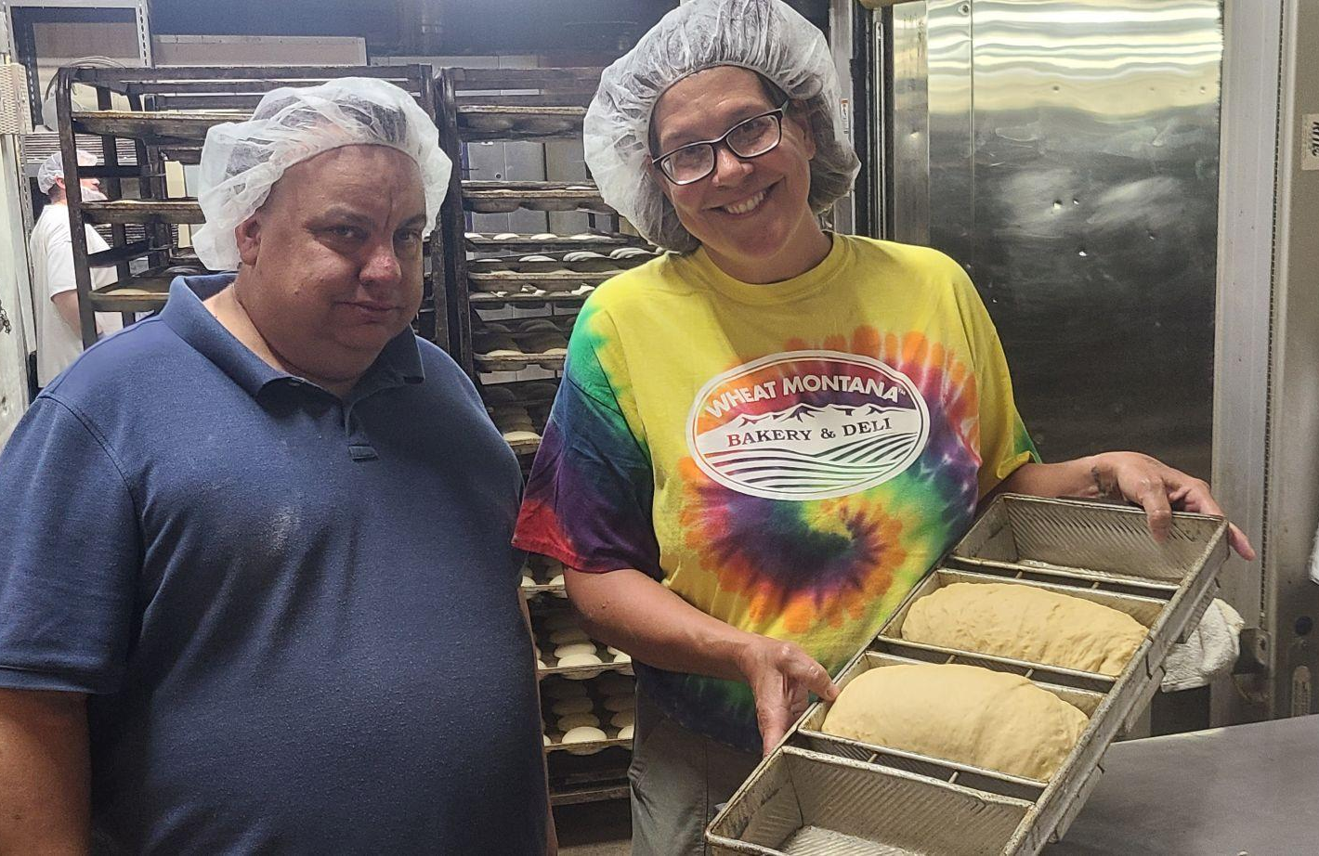
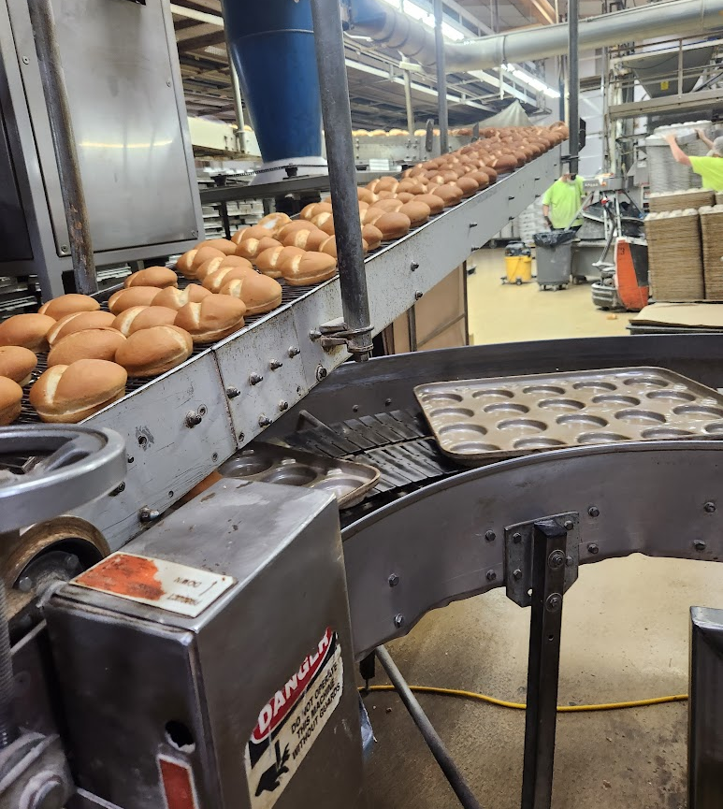
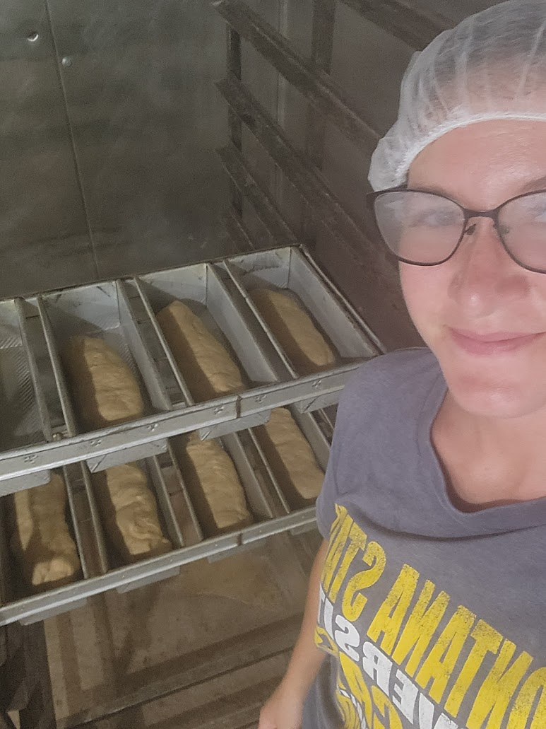
Wheat Montana In Three Forks

Slide 22
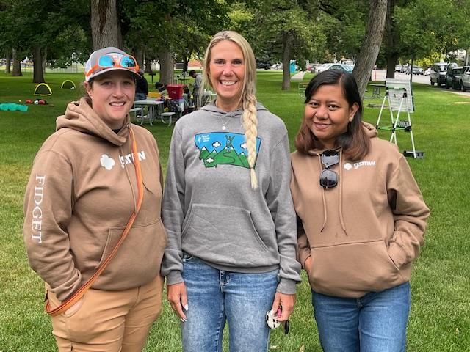
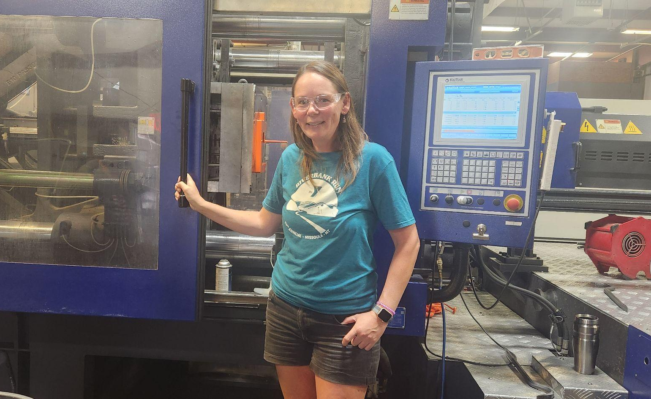
Girls Scouts of Montana and Wyoming
Diversified Plastics in Missoula

Slide 23
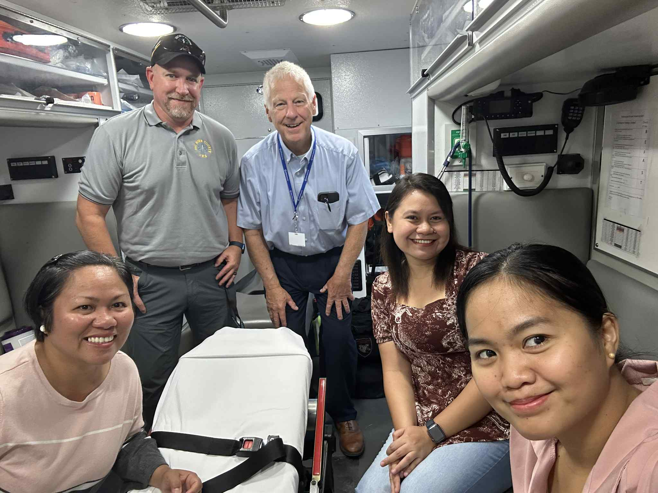
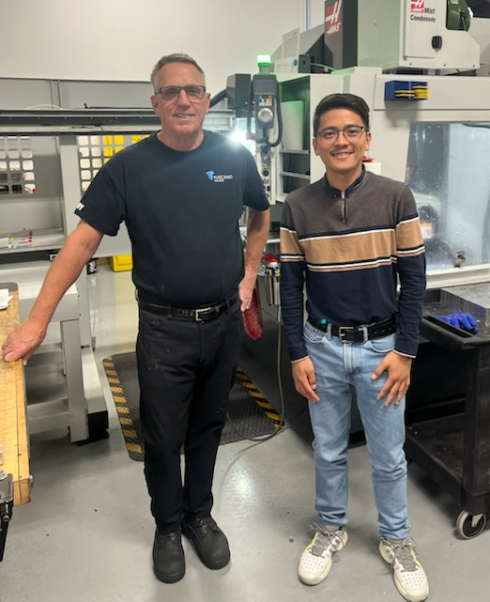
One Health in Hardin
Tuscano Machine in Big Timber

Slide 24
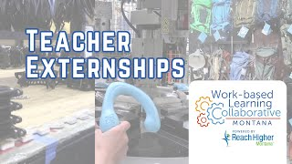
Teacher Externship Videos

Slide 25
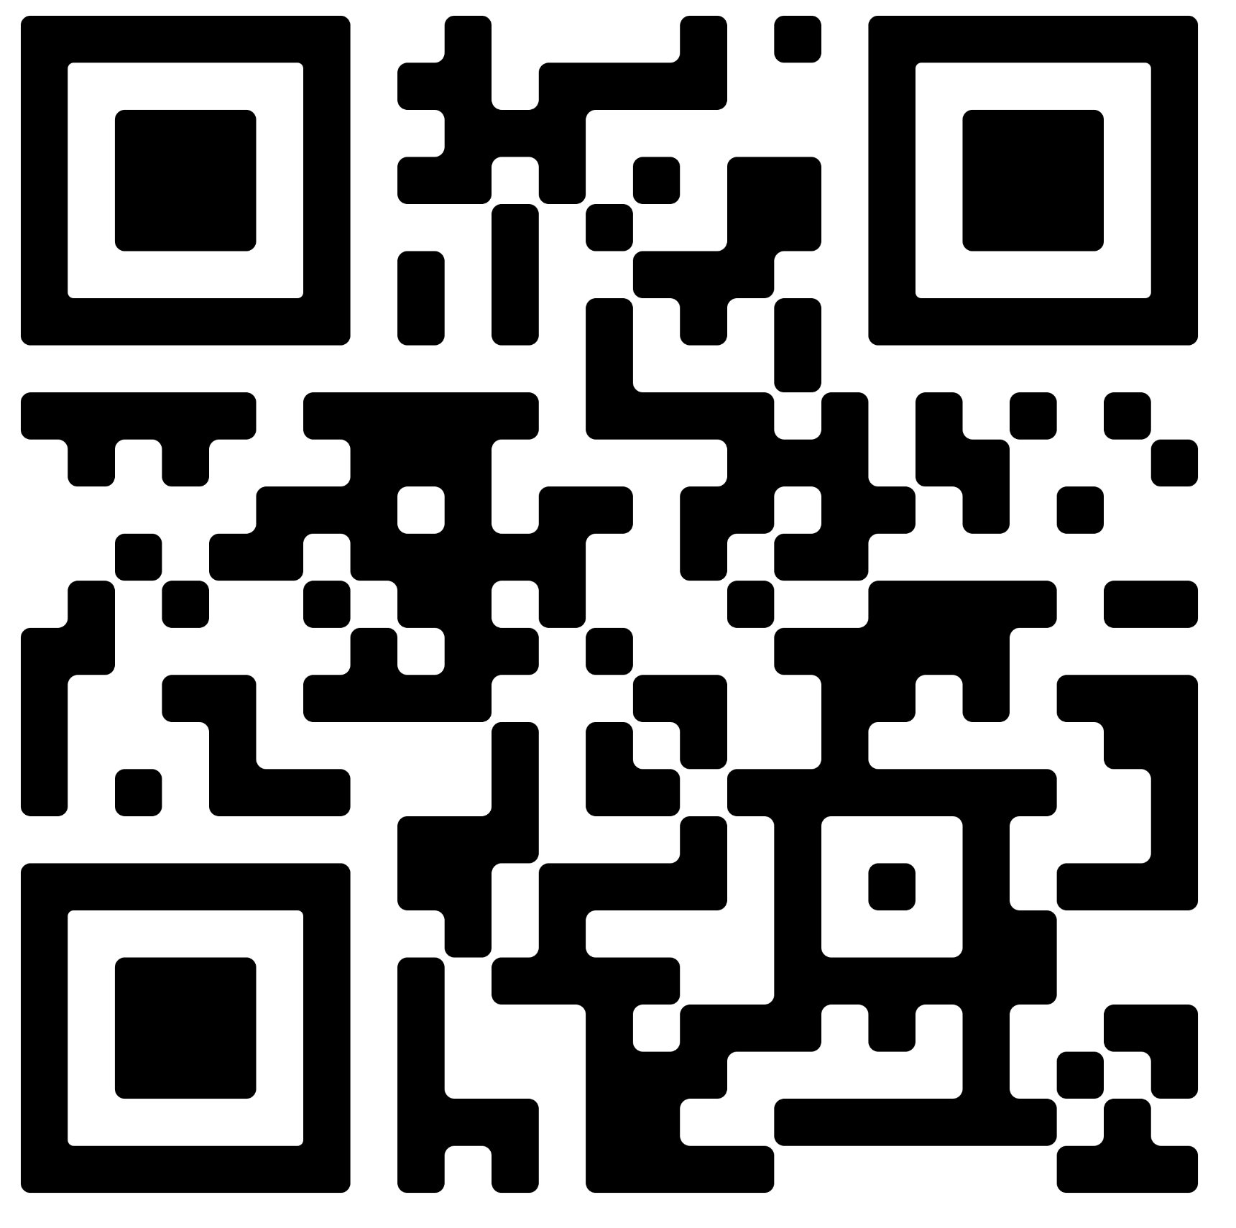
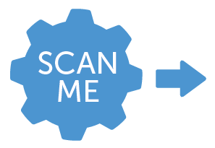
Visit the WBLC website
For more information including:
Employer & Student Toolkit
Teacher Externships
Data Dashboard
Sign up for our monthly newsletter
28

Slide 26
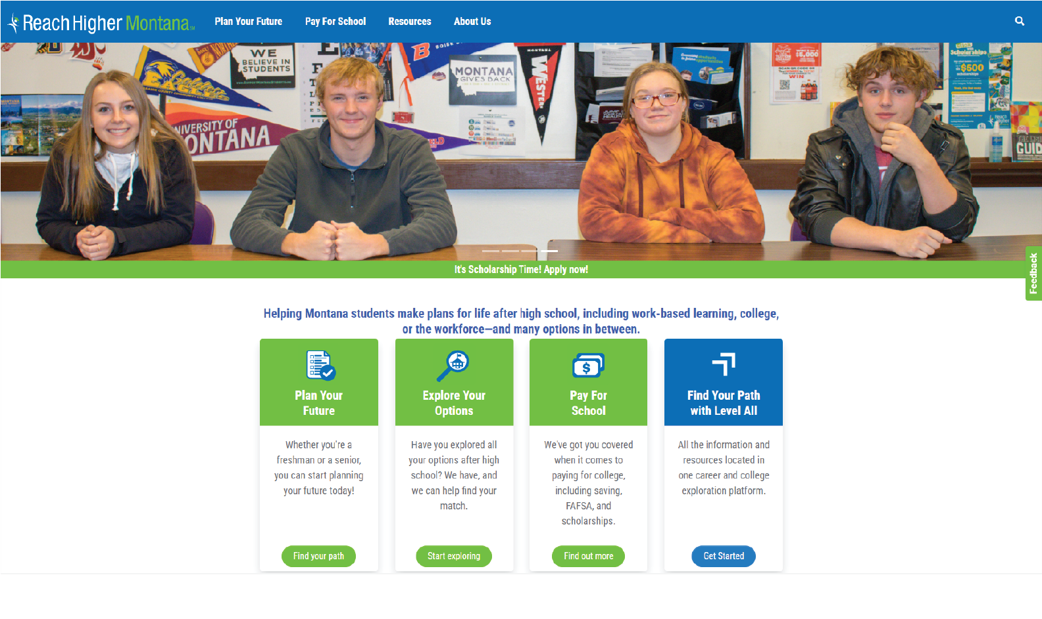
https://reachhighermontana.org/

Slide 27
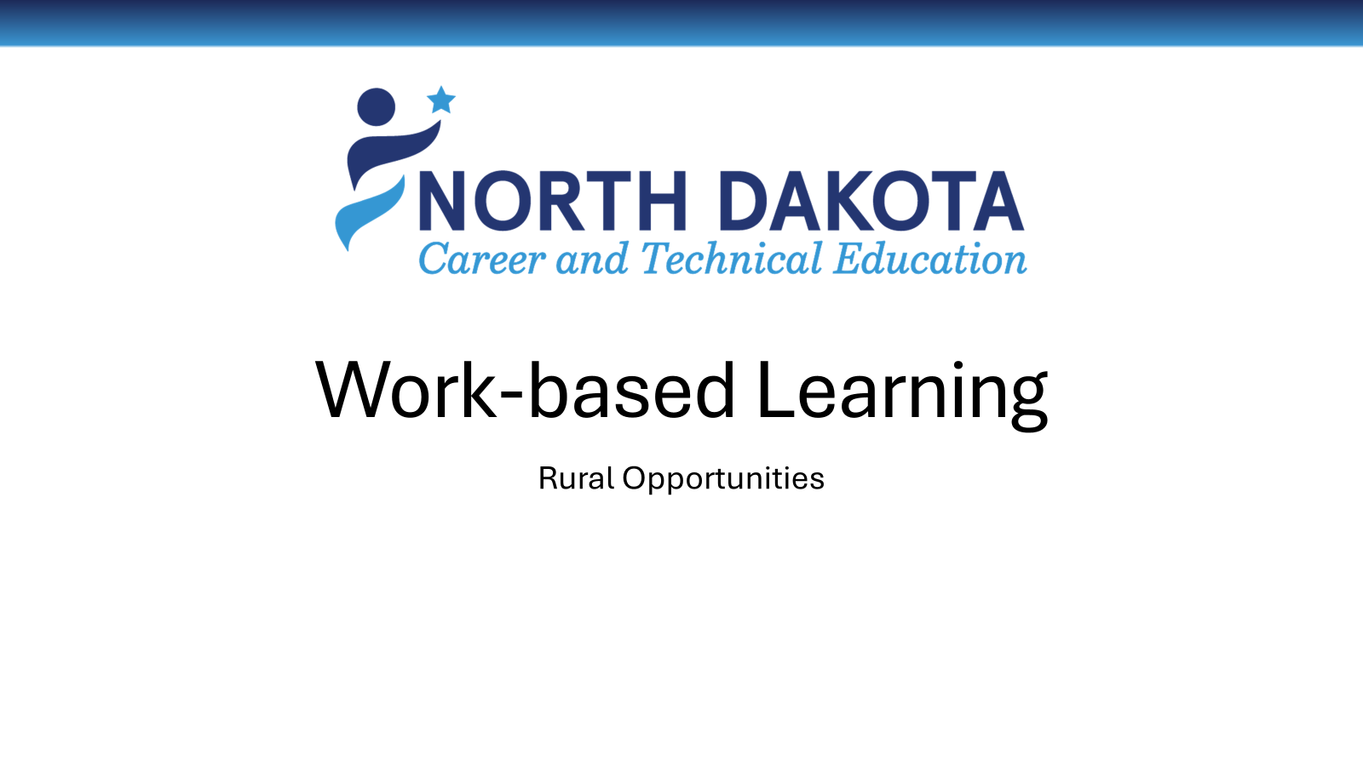

Slide 28
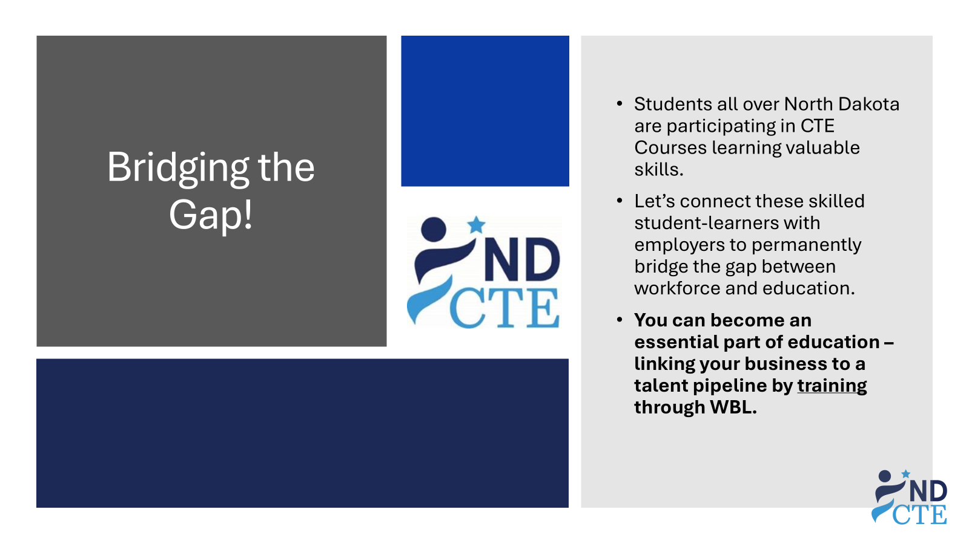

Slide 29
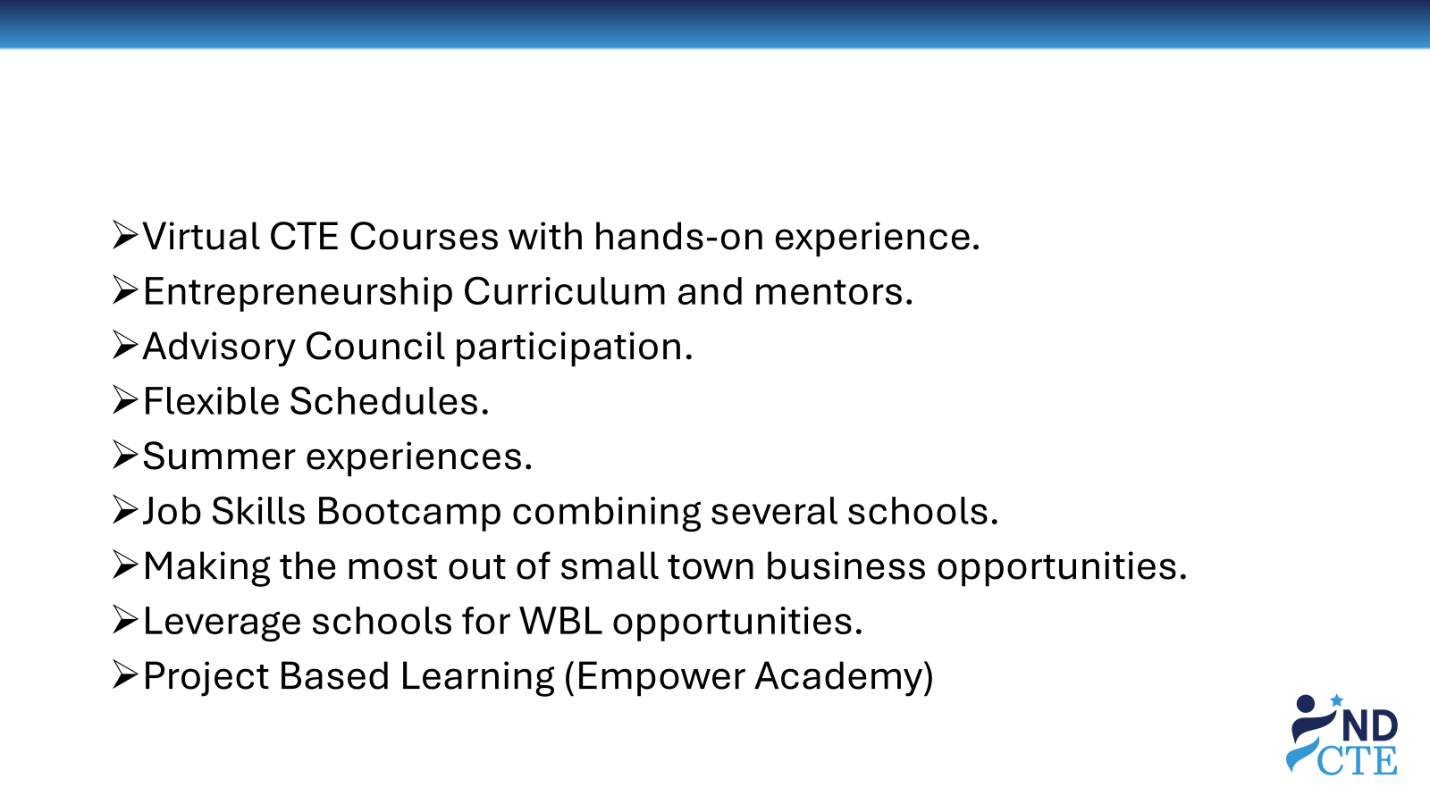

Slide 30
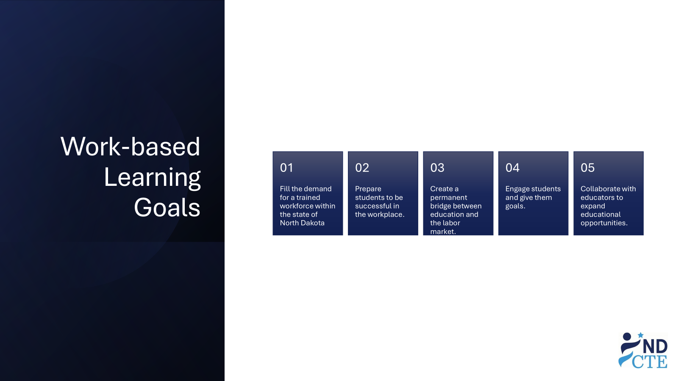

Slide 31
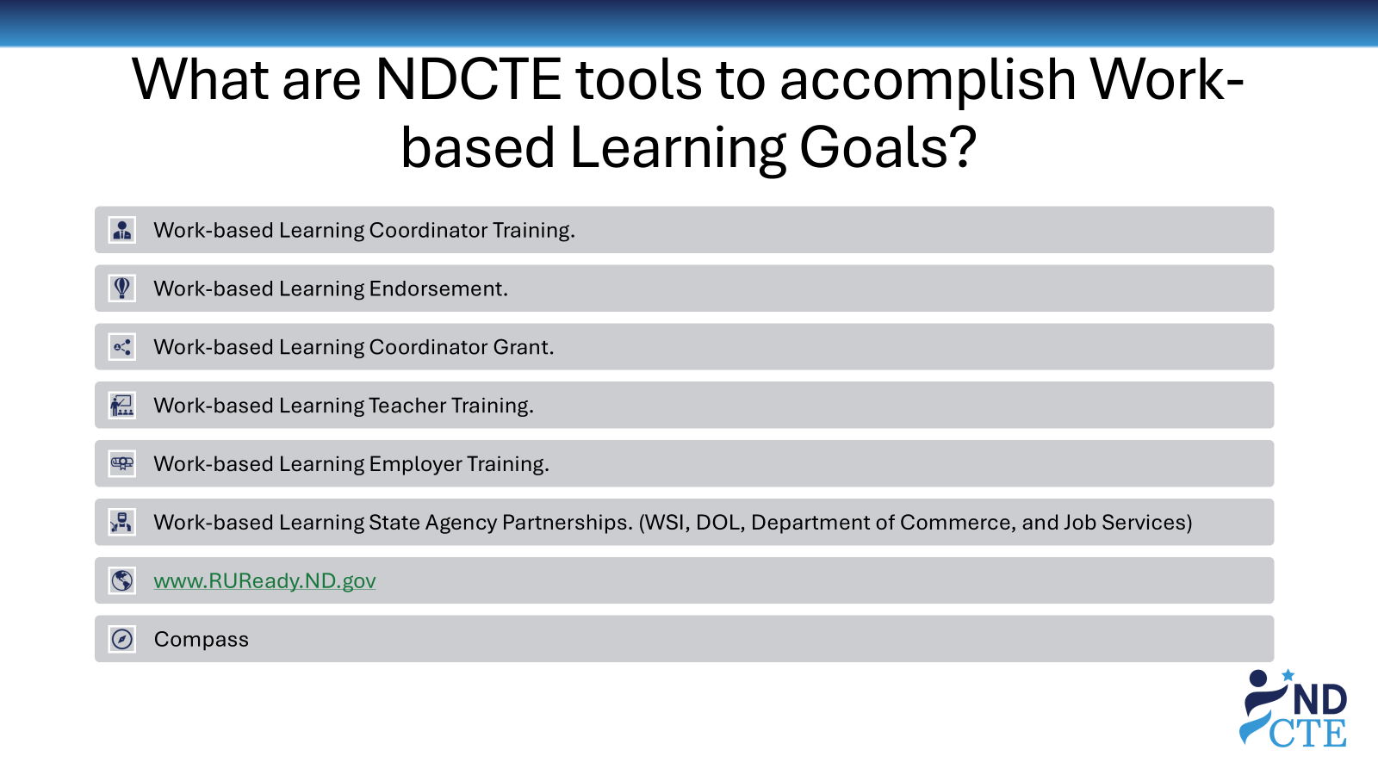

Slide 32
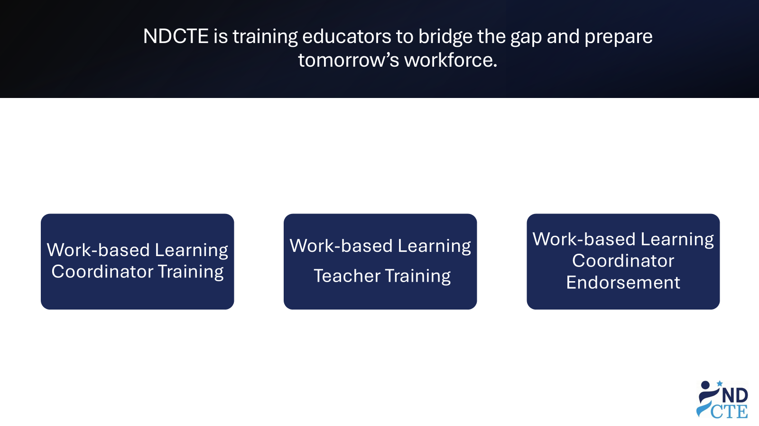

Slide 33
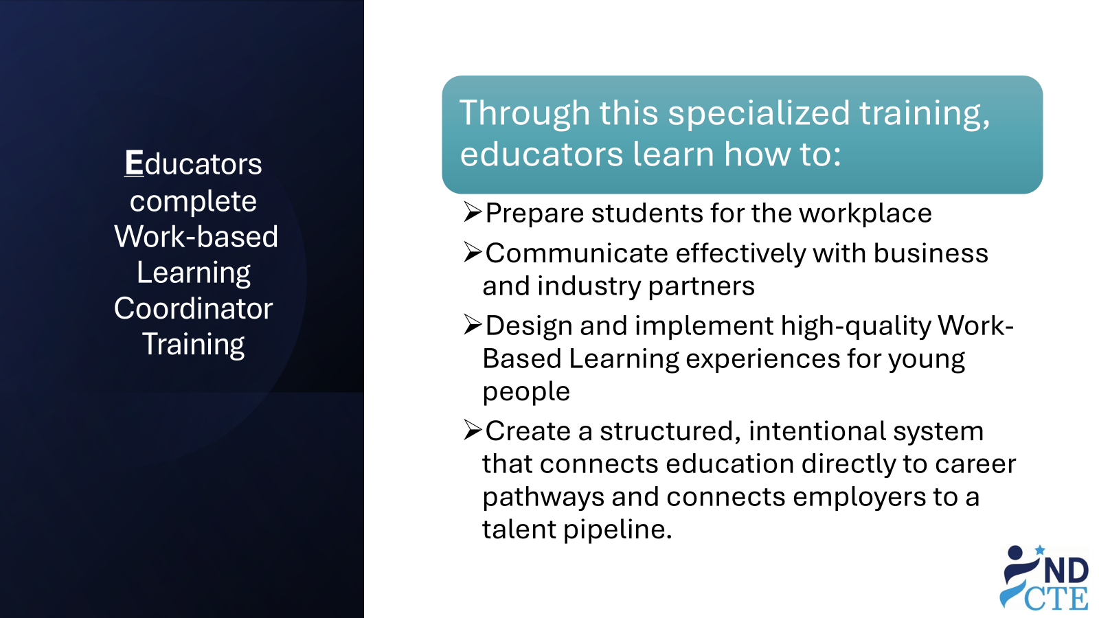

Slide 34
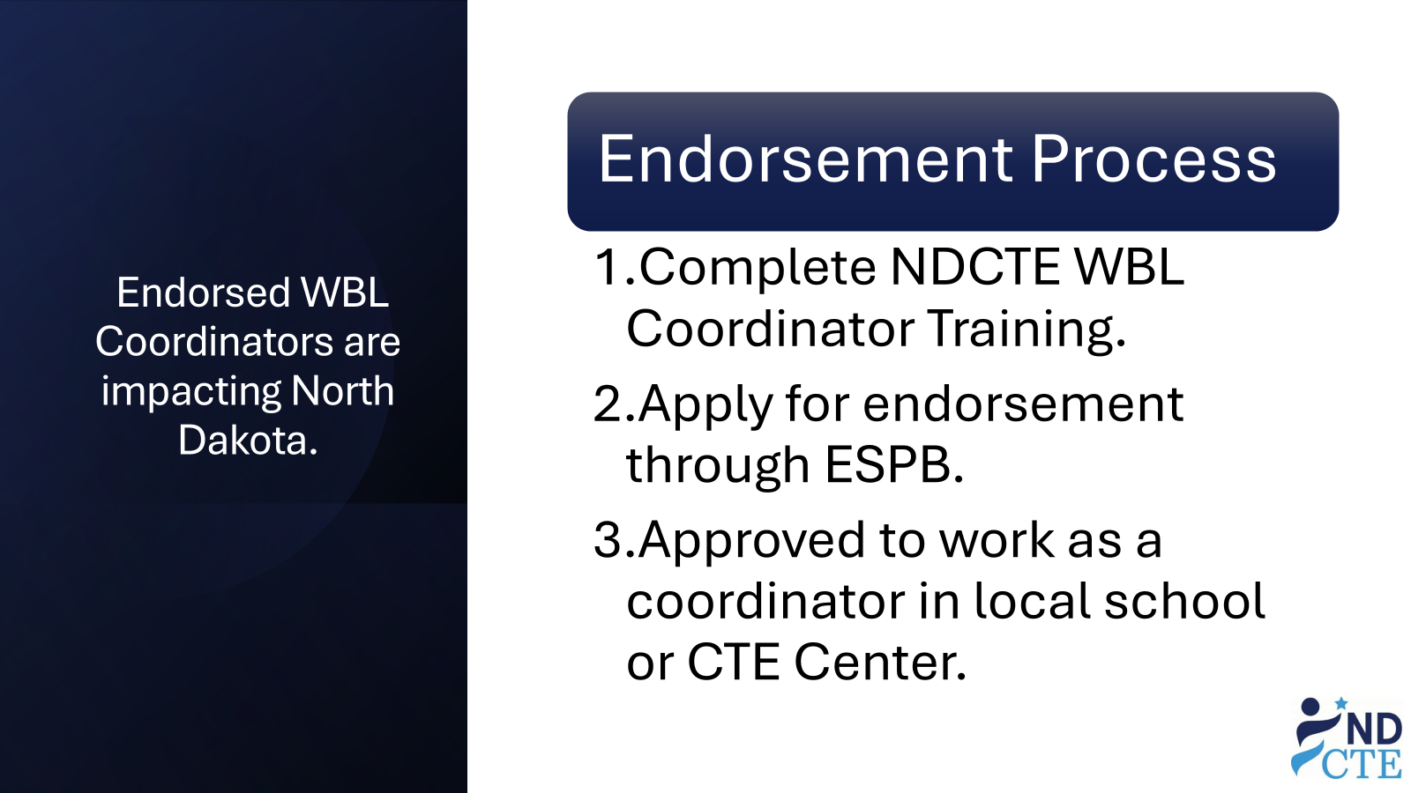

Slide 35
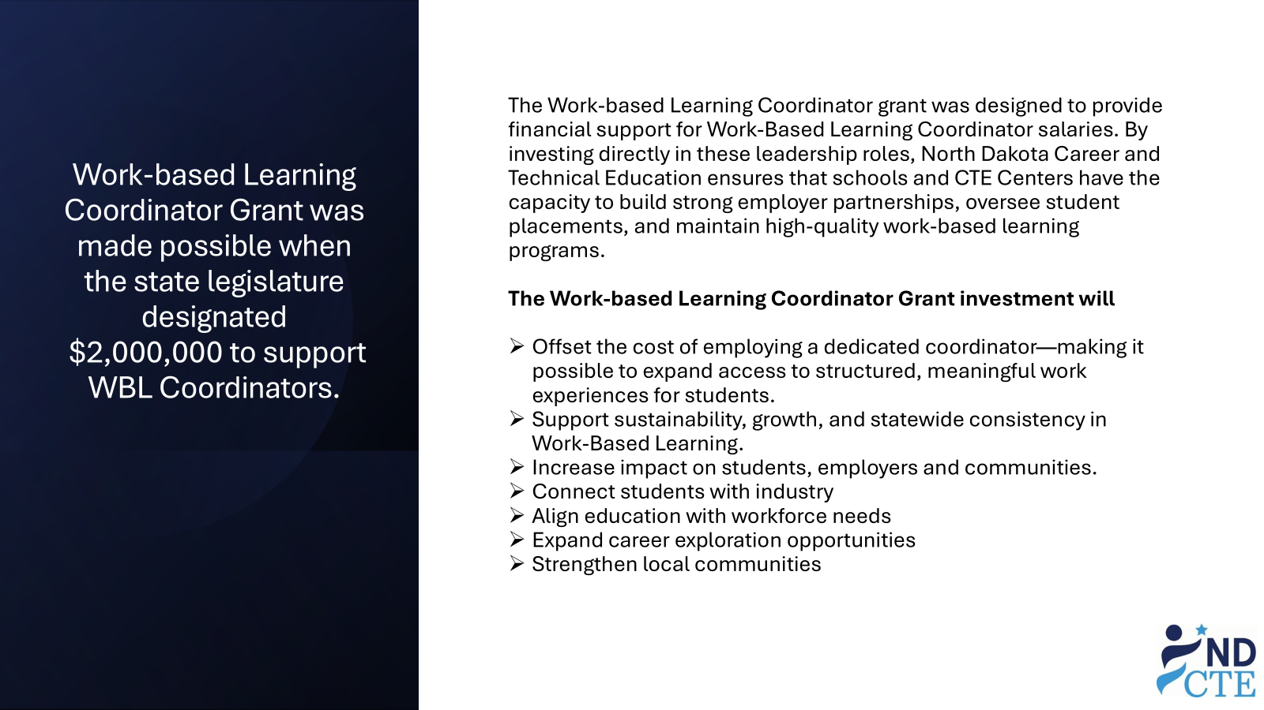

Slide 36
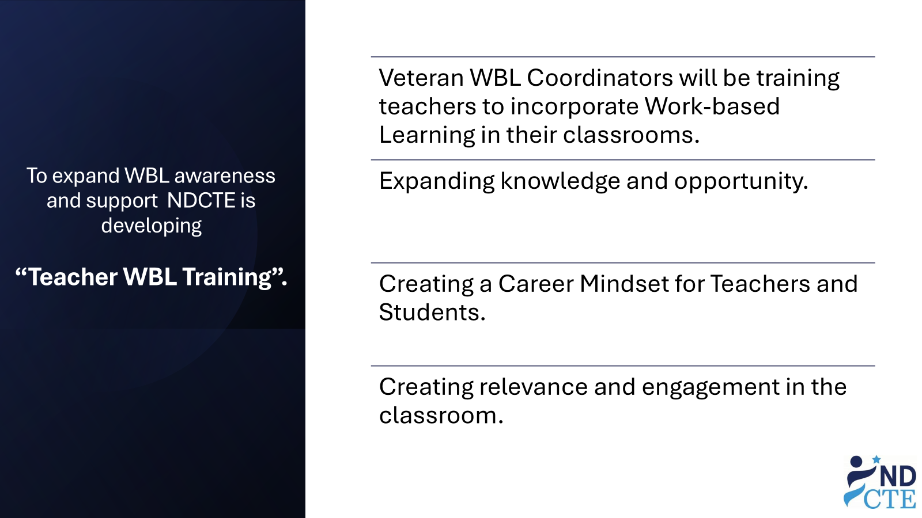

Slide 37
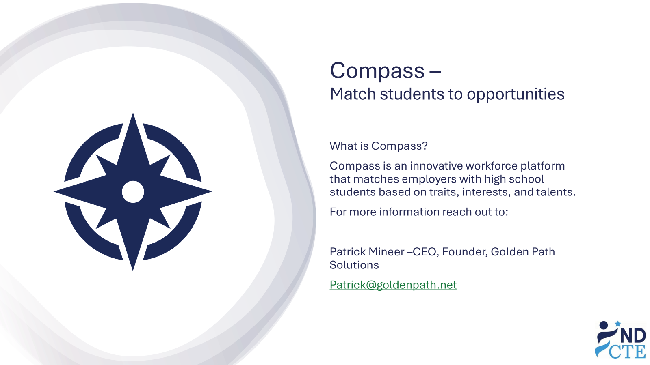

Slide 38
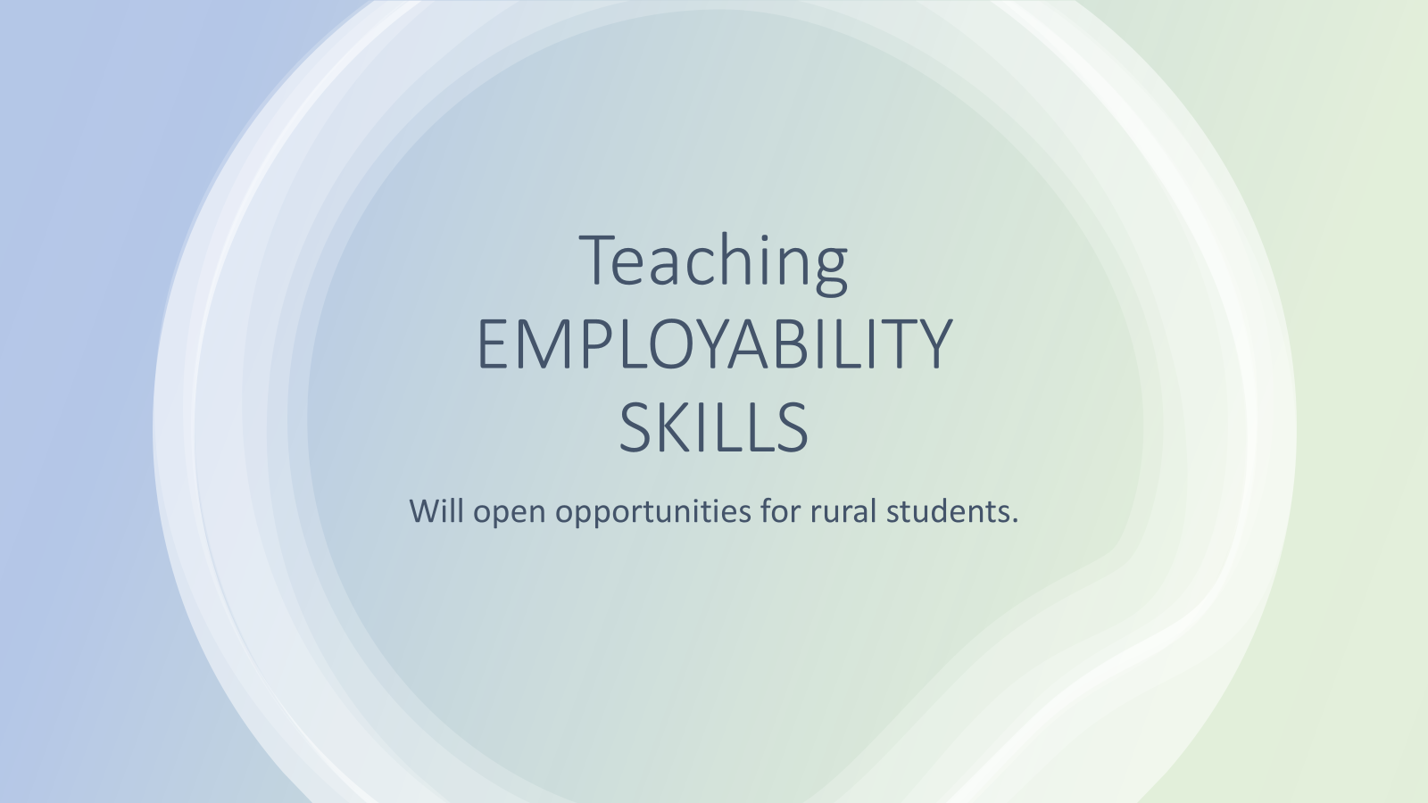

Slide 39
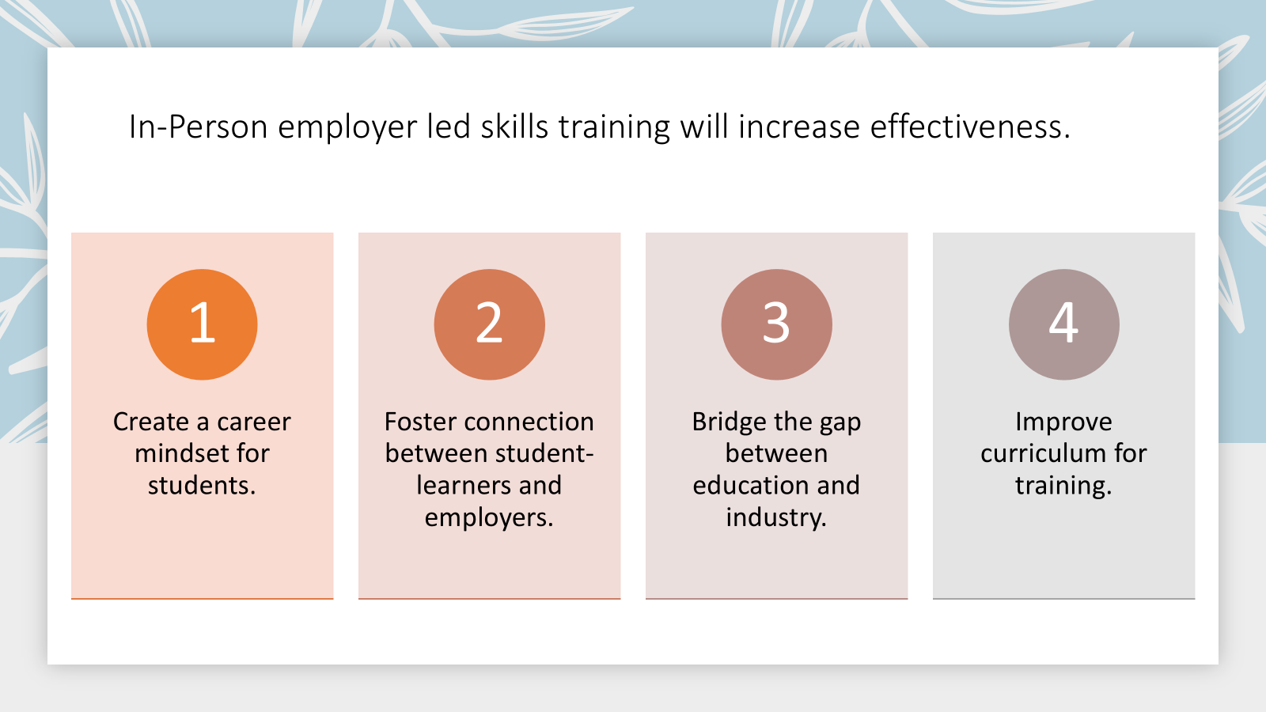

Slide 40
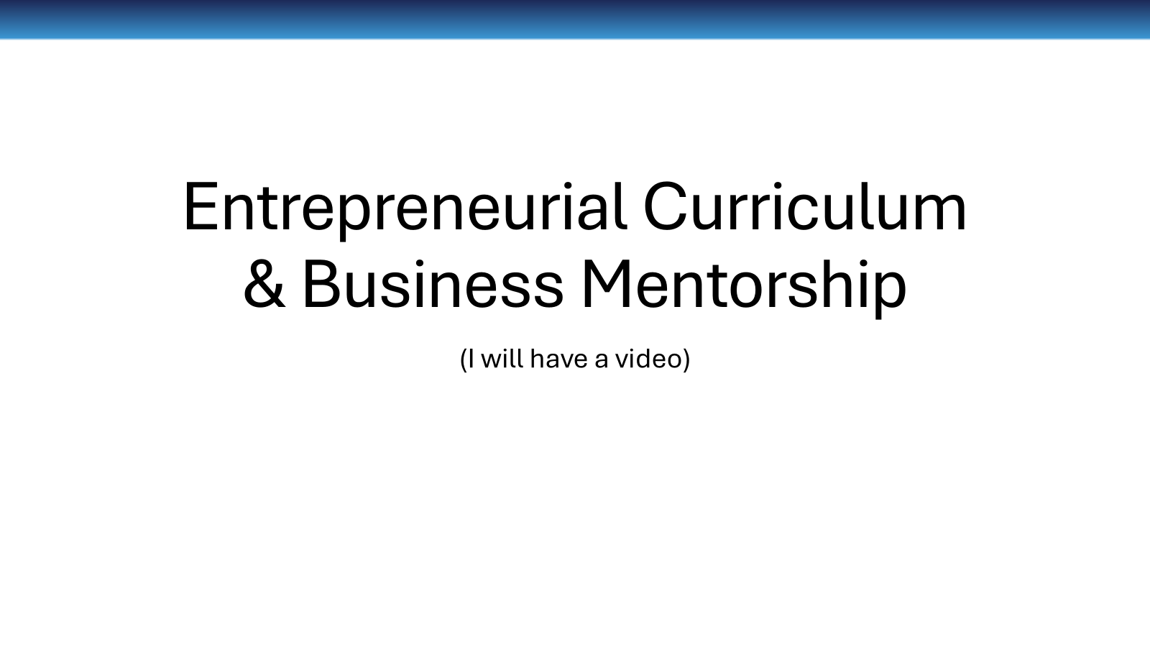

Slide 41


Slide 42


Contact Information
Jason Butcher
Reach Higher Montana
jbutcher@reachhighermontana.org
(406) 366-0777
Dawn Ulmer
NDCTE Strategic Project Manager
dulmer@nd.gov
(701)328-3124

