Slide 1

Stronger Together
Building Regional WBL Programs Through District Collaboration
Notes:
Madi
Today is really about how we move from isolated efforts to true regional impact—how districts can work together to expand access to meaningful work-based learning for students.
We’ll explore what that looks like in practice—from partnerships, to shared resources, to aligning with workforce needs in your region.
Session Description:
A thriving Work-Based Learning (WBL) program depends on a strong network of local employers and meaningful opportunities for students. But building and sustaining that network can be challenging, especially when it’s one of many responsibilities on your plate. What could your WBL program achieve if you partnered more intentionally with neighboring districts and expanded your collective reach?
In this session, Xello and Susan Scott from Thompson School District share how inter-district collaboration can strengthen regional WBL ecosystems and expand opportunities for students, employers, and communities alike. By sharing resources, aligning goals, and coordinating outreach to local businesses and organizations, districts can work together to build a more connected and comprehensive approach to WBL.
Join us to explore practical strategies for collaborating across districts, strengthening employer partnerships, and creating a coordinated approach to expanding WBL opportunities throughout your region.
Learning Outcomes:
Build cross-district partnerships: Learn how to connect and collaborate with neighboring districts to strengthen your regional network and expand access to WBL opportunities for students.
Leverage shared resources and employer connections: Explore strategies for coordinating outreach, sharing industry relationships, and exchanging best practices to support scalable and sustainable WBL programs.
Align programs with regional workforce priorities: Discover how collaborative district efforts can align WBL programs with broader economic and workforce development goals, creating lasting value for students, employers, and communities.
CONFIRMED CO-SPEAKER
Susan Scott, Business Community Co-ordinator
Thompson School District
susan.scott@tsd.org

Slide 2
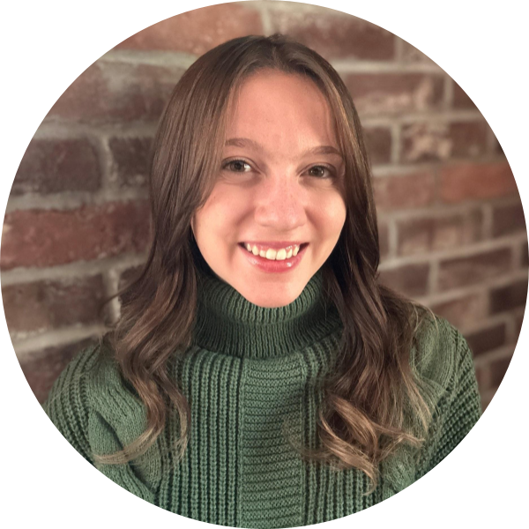
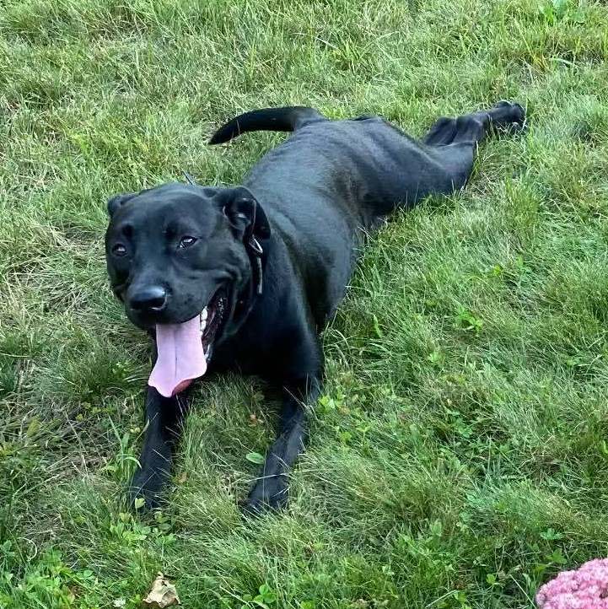
Hi, I’m Madi!
After discovering a passion for workforce development at the Chamber of Commerce in New Hampshire, I joined Xello as a Partnership Manager for Work-Based Learning. I now work to bridge the gap between education and industry by building partnerships that create meaningful, real-world opportunities for students.
When I’m not at work, I love to read. If you haven’t yet, I recommend reading Remarkably Bright Creatures by Shelby Van Pelt!
I have a spunky and wonderful dog named Rita,
who is also the best coworker!
Madison Hendrick
Partnership Manager, WBL
madisonh@xello.world
Notes:
Madi

Slide 3

Who are we at Xello?
Hello, we’re Xello!
Over the last 25 years, our company has been helping students across North America become college, career, and future-ready.
We come from humble beginnings. What started out as a small 3-person company, has grown to a 200+ person team dedicated to supporting thousands of districts and millions of students.
Our program is used to help all K-12 students, regardless of background, ability or pathway, build personalized plans to help them reach their full academic potential and achieve future success.
Notes:
Madi
By a quick raise of hands, how many folks are Xello users or have heard of Xello before? If you haven’t heard of us before, we’re Xello, formerly known as Career Cruising. For more than 25 years, we’ve supported thousands of districts across the country, helping students from kindergarten through high school graduation explore careers, build skills, and plan for their future success. Today, our team of over 200 includes success managers, trainers, and a dedicated user research team, all making sure what we build truly meets the needs of educators, students, and families.
Xello helps K-12 school districts deliver high-quality college and career readiness programming that equips students for the real world. Our comprehensive platform supports students in building self-knowledge, exploring post-secondary options, and evaluating potential pathways through lessons and activities that motivate purposeful and actionable plans for a successful future.

Slide 4





Designed to Support Educators & Students
Connects career exploration, planning, and real-world experiences
Built-in curriculum, 4-year planning, and application tracking
Supports Work-Based Learning and aligned student pathways
Career Exploration
& Planning
4-Year
Course Plans
College Readiness & Applications
FAFSA Tracking & Completion
Work-Based Learning
Notes:
Madi
Xello’s future readiness model connects career exploration, planning, and real-world experiences in one cohesive system for educators and students. With built-in curriculum, 4-year planning, application tracking, and Work-Based Learning, it enables districts to create aligned pathways that prepare students for life after graduation.

Slide 5
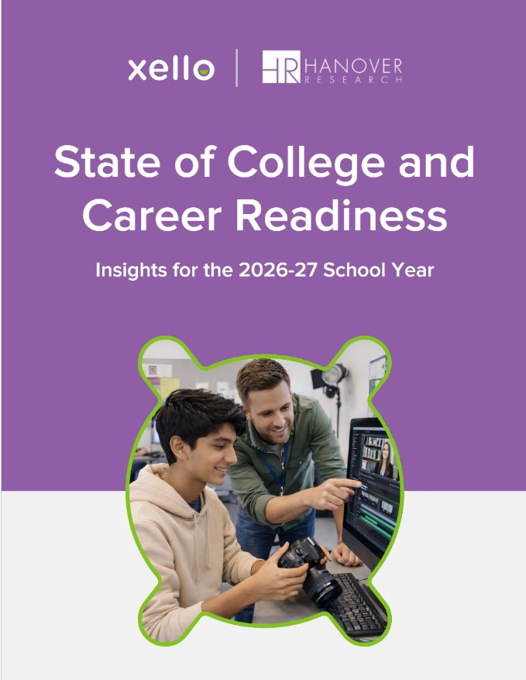
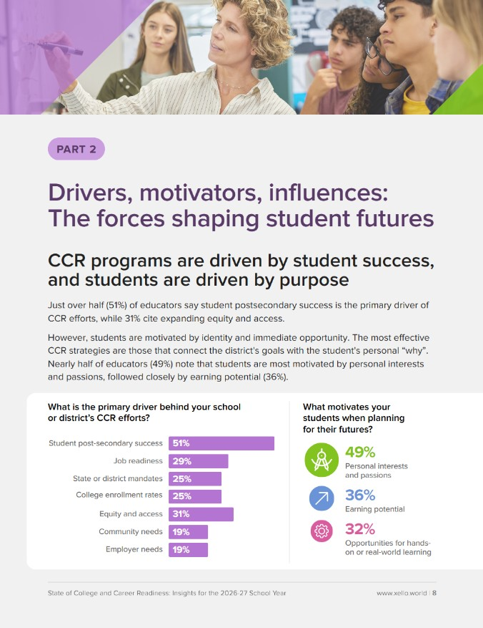
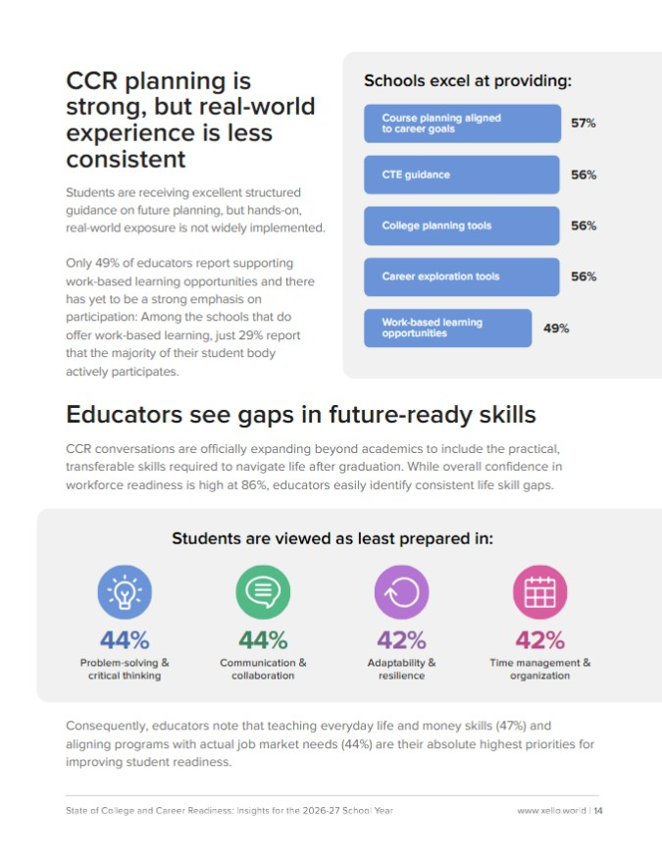
The Current CCR Landscape
94%
Rate their CCR efforts as “Good” or “Excellent”
86%
Are confident students will graduate work-force ready
*Figures are based on a recent study by Xello that surveyed 281 U.S.-based, K–12 educators.
Notes:
Madi
I also wanted to provide some timely data from a recent stud in which we partnered with Hanover Research to uncover new insights from 281 school leaders and educators on what’s working, what’s changing, and what’s next for preparing students for life after graduation for the 2026-2027 school year. We see that confidence has rebounded. A resounding 94% of educators now rate their district's current CCR efforts as “Good” or “Excellent.” And we also see high workforce optimism - with 86% of educators feel at least somewhat confident that their students will graduate workforce-ready.

Slide 6

The WBL Gap
49%
Offer Work-Based Learning opportunities
29%
Of students participate in the opportunities when available
*Figures are based on a recent study by Xello that surveyed 281 U.S.-based, K–12 educators.
Notes:
Madi
When looking at Work-based Learning, only 49% of educators report supporting work-based learning opportunities and there has yet to be a strong emphasis on participation: Among the schools that do offer work-based learning, just 29% report that the majority of their student body actively participates. Students are receiving excellent structured guidance on future planning, but hands-on, real-world exposure is not widely implemented.

Slide 7

What if expanding WBL access wasn’t something districts had to do alone?
Notes:
Madi
When we look at these two realities side by side, something important stands out.
We’ve built strong systems to prepare students—but we haven’t scaled access to the real-world experiences that make that preparation meaningful.
And it’s not for lack of effort. This work is complex—building employer networks, coordinating opportunities, sustaining programs—it takes time and capacity.
So it raises a key question:
What if this isn’t something districts are meant to do alone?
What if the path forward is working across districts—sharing connections, aligning efforts, and building something bigger together?
That’s what we’re going to explore next.

Slide 8
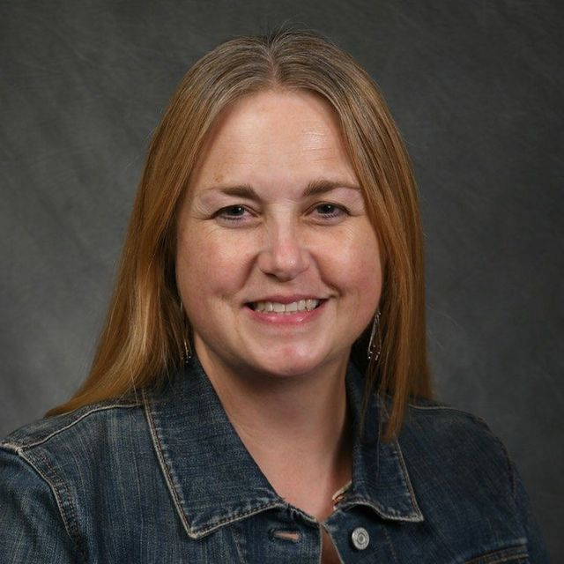
Introducing our guest, Susan!
I’m passionate about connecting students with the Northern Colorado business community through meaningful work-based learning experiences. In Thompson School District, I build partnerships that support CTE and WBL, helping students explore careers while meeting regional workforce needs. I also work with the NoCo K-12 WBL Collaborative to expand opportunities for 19,000 students across Larimer and Weld Counties through a shared, regional approach.
Susan Scott
Business Community Coordinator
Thompson School District
Loveland, CO
susan.scott@tsd.org
I love enjoying all that that Colorado’s great outdoors can offer! Can’t wait for camping and hiking this summer.
I'm a big fan of the band Weezer and am excited to see them for the 8th time this fall!
Notes:
Madi to pass to Susan, Susan to intro herself
I’m excited to introduce Susan Scott, Business Community Coordinator of the Thompson School District in Loveland, CO. Susan, I’ll pass it over to you to share a bit more about yourself.

Slide 9
Can you tell us about your district’s journey with work-based learning—and what problem you were trying to solve?
Notes:
Madi
Let’s start at the beginning. Every strong program comes from trying to solve a real problem. Can you share a bit about your district’s journey with work-based learning—and what challenge or opportunity really sparked this work?
Probe Questions:
A little background on your district/school, geography/demographics
How it got started in your district - was this due to a mandate?
How long it’s been running, your role in its development and delivery to students
What are the goals?
Are there specific requirements/milestones for your students?

Slide 10

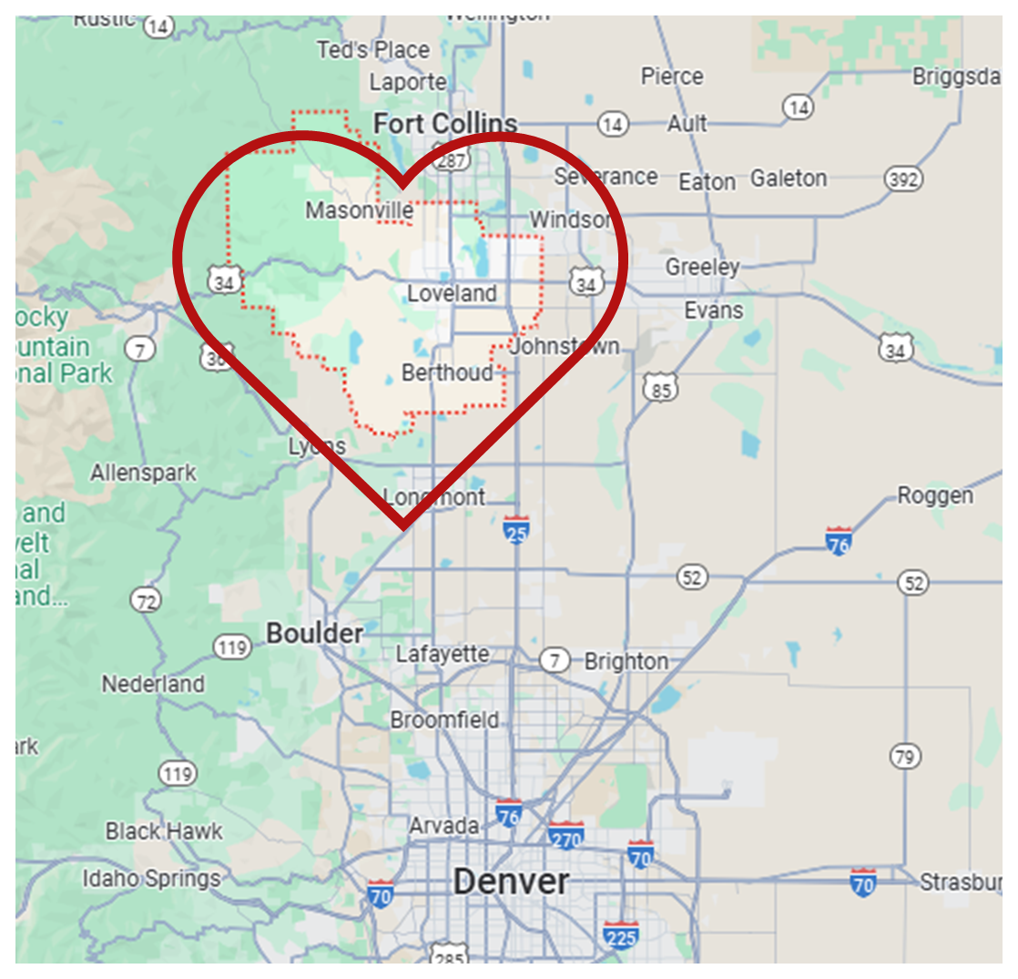
Thompson School District: A Snapshot
We’re in “NoCO” - Northern Colorado
Loveland, Berthoud, Johnstown, Windsor
17th largest district in Colorado
30 Schools:
  5 high schools + Thompson Career Campus
  4 middle schools
  3 PK-8 schools
  16 elementary schools
  2 charter schools
Approximately 14,000 total students
2000 total staff
  1 Business Engagement staff
  2 Work-Based Learning Specialists

Slide 11
What led you to start collaborating with other districts?
Notes:
Madi
At some point, you made the shift from working within your district to thinking more regionally. What prompted that shift? What made collaboration feel necessary or valuable?
Probe Questions:
Was there a gap you couldn’t solve alone?
How did initial conversations start?
What made collaboration feel worth it?
Any early concerns or hesitation?
Had you seen this model elsewhere?

Slide 12
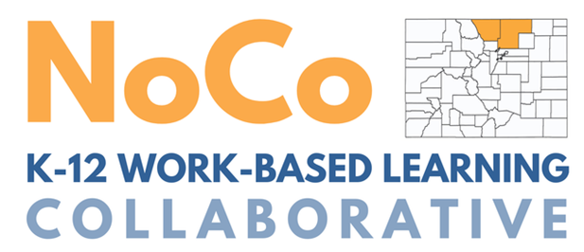









OUR WBL ECOSYSTEM
Shared regional WBL network, powered by Xello
19,000 high school students & educators have access across 2 counties - I-25 corridor
Supported by regional workforce partners and industry sector partnerships

Slide 13
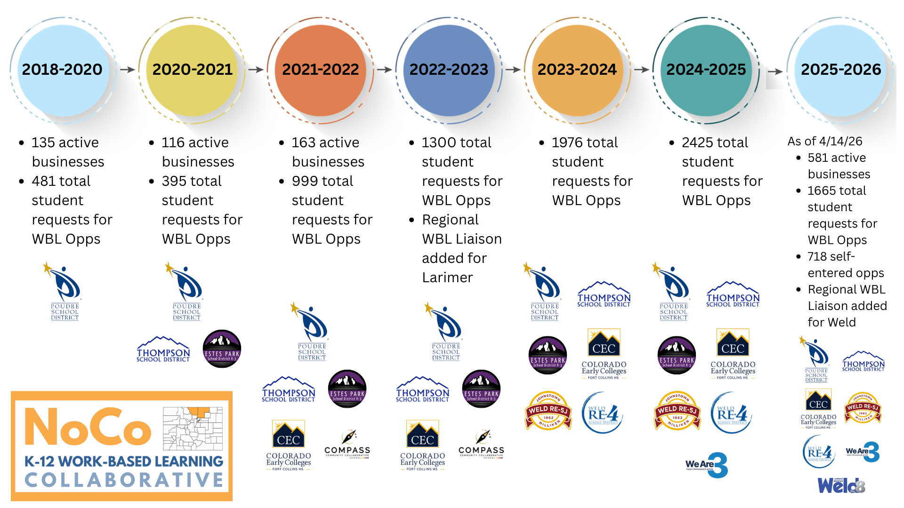
Notes:
Susan

Slide 14
What is the collaboration process like when you partner with multiple districts on a shared WBL network?
Notes:
Madi
Collaboration sounds great in theory, but people are often wondering what it looks like in practice. Can you walk us through how your partnership works day-to-day? How do districts communicate, make decisions, and stay aligned?
Probe Questions:
How do you communicate (cadence, format)?
Who leads vs. contributes?
How are responsibilities shared?
Expectations for participation
What keeps everyone aligned?

Slide 15
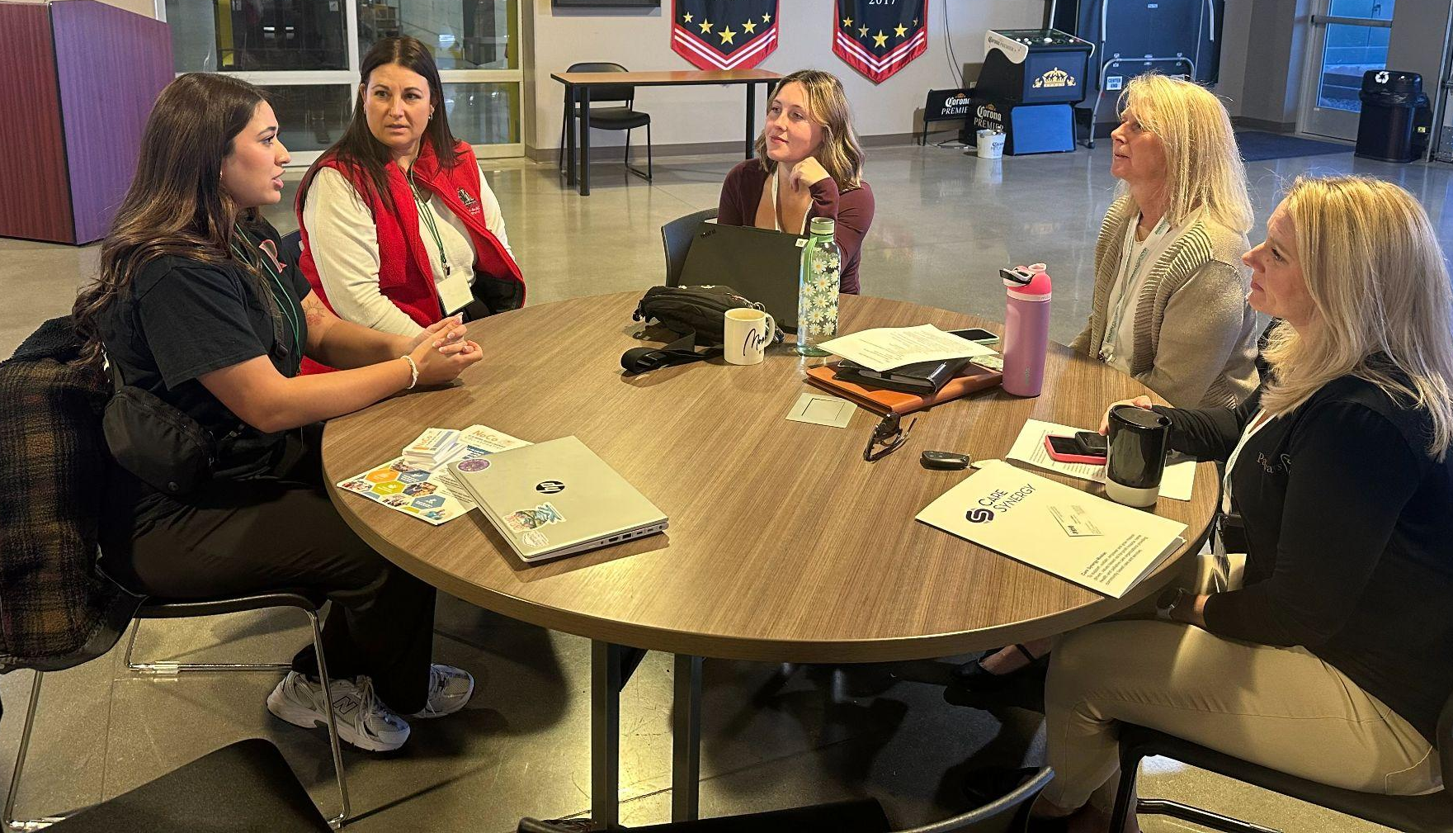

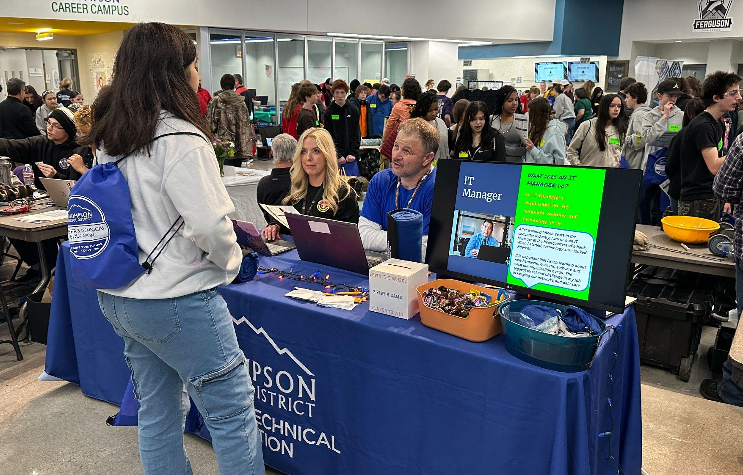
“Farm-to-Table” Work-Based Learning
Hunters/Gatherers | Chefs/Concierges | Servers
Generate community interest. Manage leads. Navigate business partners and opportunities. Regional Business Liaisons Public Partners in the community Collab districts agree to contribute partnerships/ opportunities available to the entire network | Build relationships and Develop opportunities. Help businesses build engaging experiences. Regional Business Liaisons Some Collab districts have this role at some capacity, while others do not | Market opportunities and recruit students. Act as gatekeepers to manage student requests. Provide application support and assign grades for credit-based opportunities. School-based WBL Coordinators Collab districts must have someone in this role, levels of staffing vary between districts
Notes:
Susan
From Career Connection Education Conference
https://docs.google.com/presentation/d/1_DZ69OO8i6QuZ31-7ut6BI-sYwMgt2unjW1BOUXyXD0/edit#slide=id.g152accbaf63_0_17

Slide 16
How do you engage and manage employer partnerships as a region?
Notes:
Madi
One of the biggest challenges districts face is building and maintaining employer relationships. How do you coordinate outreach to employers, avoid duplication, and share those relationships across districts? Are there tools, systems, or norms that help make this work?
Probe Questions:
What types of outreach do you have? Do folks come to you or you always reach out to them?
Who is responsible for finding opportunities?
How are those opportunities managed between the network and businesses?
Do you collect feedback from businesses? What does that look like?
How did you plan and execute?
Any pushback? How did you overcome it?
Can you touch upon your relationship with the Chamber of Commerce or any other business groups?

Slide 17
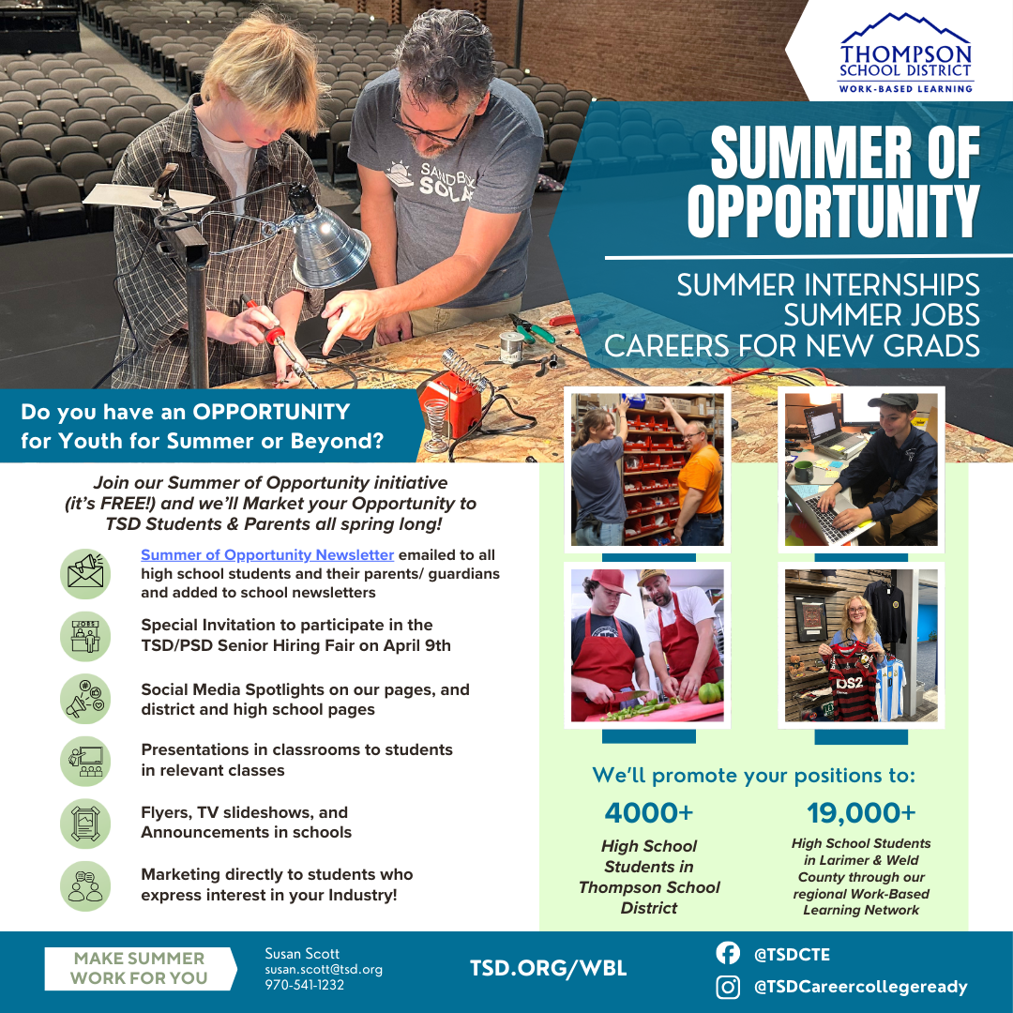

Slide 18
How do you both promote work-based learning (WBL) opportunities to students and support them in choosing experiences that truly fit their goals?
Notes:
Madi
Shifting gears, I’d love to chat about the student experience.
Probe Questions:
What strategies have you found most effective for promoting WBL opportunities and ensuring students across districts are aware of what’s available?
What’s worked well to drive participation? What hasn’t worked?
How do students typically discover and apply for opportunities?
What role do counselors, teachers, or other staff play in this process?
Are there differences in approach by grade level?
How do you support underrepresented students in accessing and engaging with WBL?
Once students are aware of opportunities, how do you help them choose experiences that align with their interests, skills, and future goals—not just what’s available?
How do you prevent students from signing up for opportunities that may not be a good fit?
What tools or resources do you use (e.g., Xello lessons, custom curriculum, videos, external sites)?
What guidance do you give students who have no idea where to start?

Slide 19
Looking back on your experience building a regional WBL network, what are your biggest lessons learned—and what advice would you offer to districts just getting started?
Notes:
Madi
Probe Questions:
What has been your biggest success so far?
What has been your biggest challenge or misstep?
What surprised you along the way?
What would you do differently if you could start over?
What advice would you give your past self at the beginning of this work?
For districts earlier in this journey, what’s one piece of advice you’d emphasize most?
How do you keep school- or district-level staff engaged and organized in this work?
Are there any plans for expansion or next steps you’re excited about?

Slide 20
Questions from the audience?
Notes:
Madi
Back pocket questions:
No questions right now? I have a question from another district that has been asked a few days ago….
When it comes to implementing a WBL program, what do you wish you would have known before you started?
What goals do you have for 2-3 years down the road?
Have you ever said no to a request from a district to join your network? On what grounds?
Do you involve the WBL module into any classroom activities?
What class period/communication form do students find out about opportunities, have a chance to discuss them and apply for them?

Slide 21
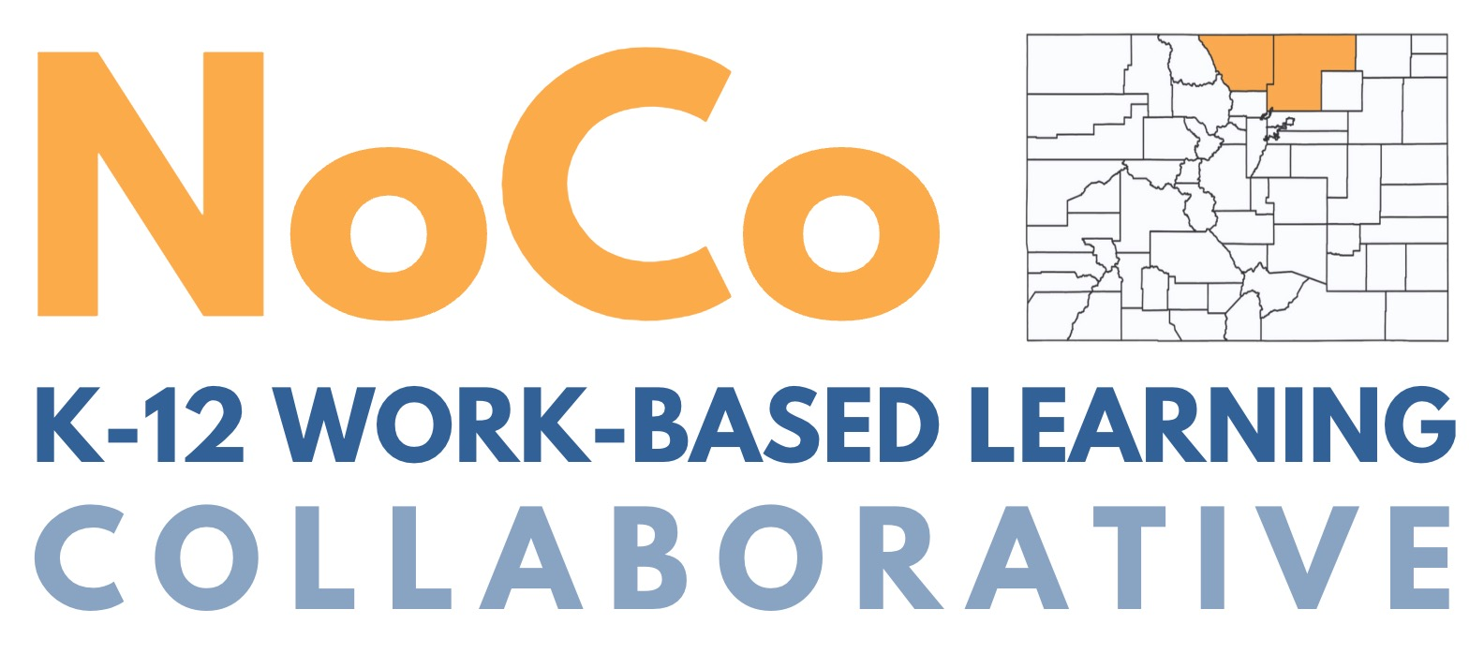
Business-facing website: nocoinspire.org/xello
School district Xello/WBL resource sites:
Thompson School District
Poudre School District
Susan Scott
Business Community Coordinator
Thompson School District
susan.scott@tsd.org

Slide 22





help.xello.world
@xellofuture

