Slide 1

Classroom 2 Career Apprenticeships Enhancing Work-Based Learning Through West Virginia’s Classroom2Career Initiative and Youth Apprenticeship Expansion

Slide 2


Slide 3


Slide 4


Slide 5
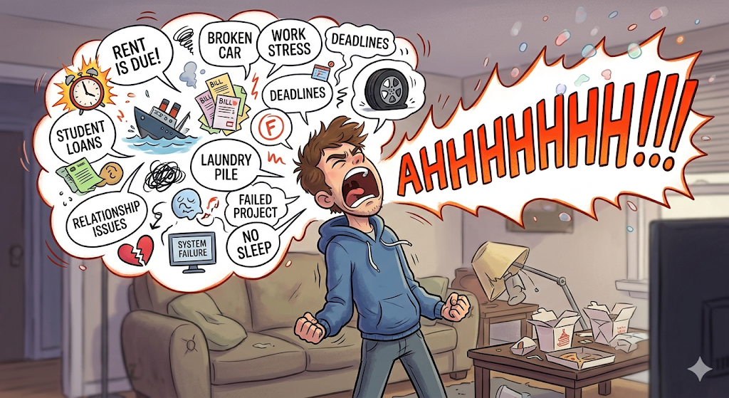
What’s the Problem – Let it Out
01
Partnerships
02
Time Constraints
03
Data
04
Transportation
05
Liability
06
Staffing
07
Inconsistencies
08
Funding

Slide 6

The Business Side of Education
The AIM Approach
The AIM Approach
A
CTION
A
CTION
I
NFRASTRUCTURE
I
NFRASTRUCTURE
M
OTIVATE

Slide 7

Take Action
A

Slide 8
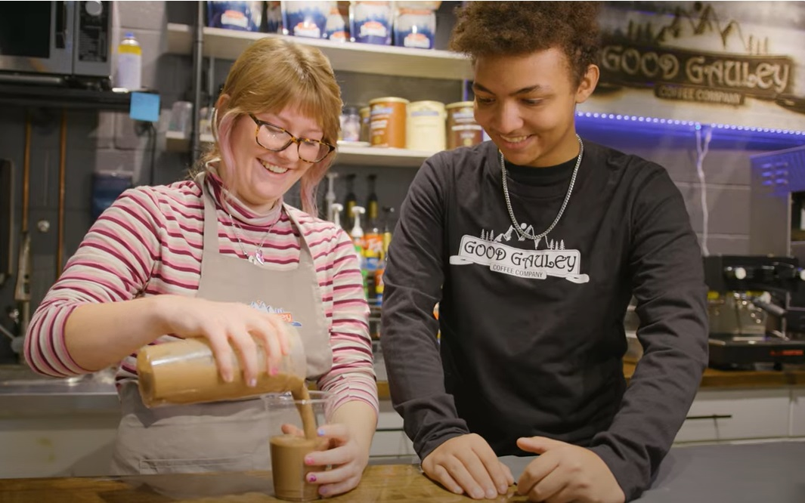
Capitalize on Existing Success
ACTION

Slide 9
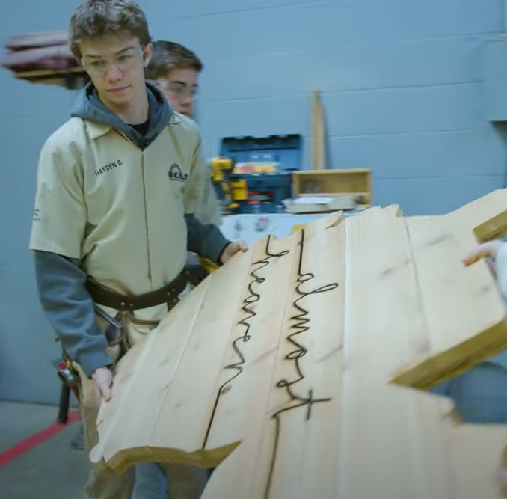
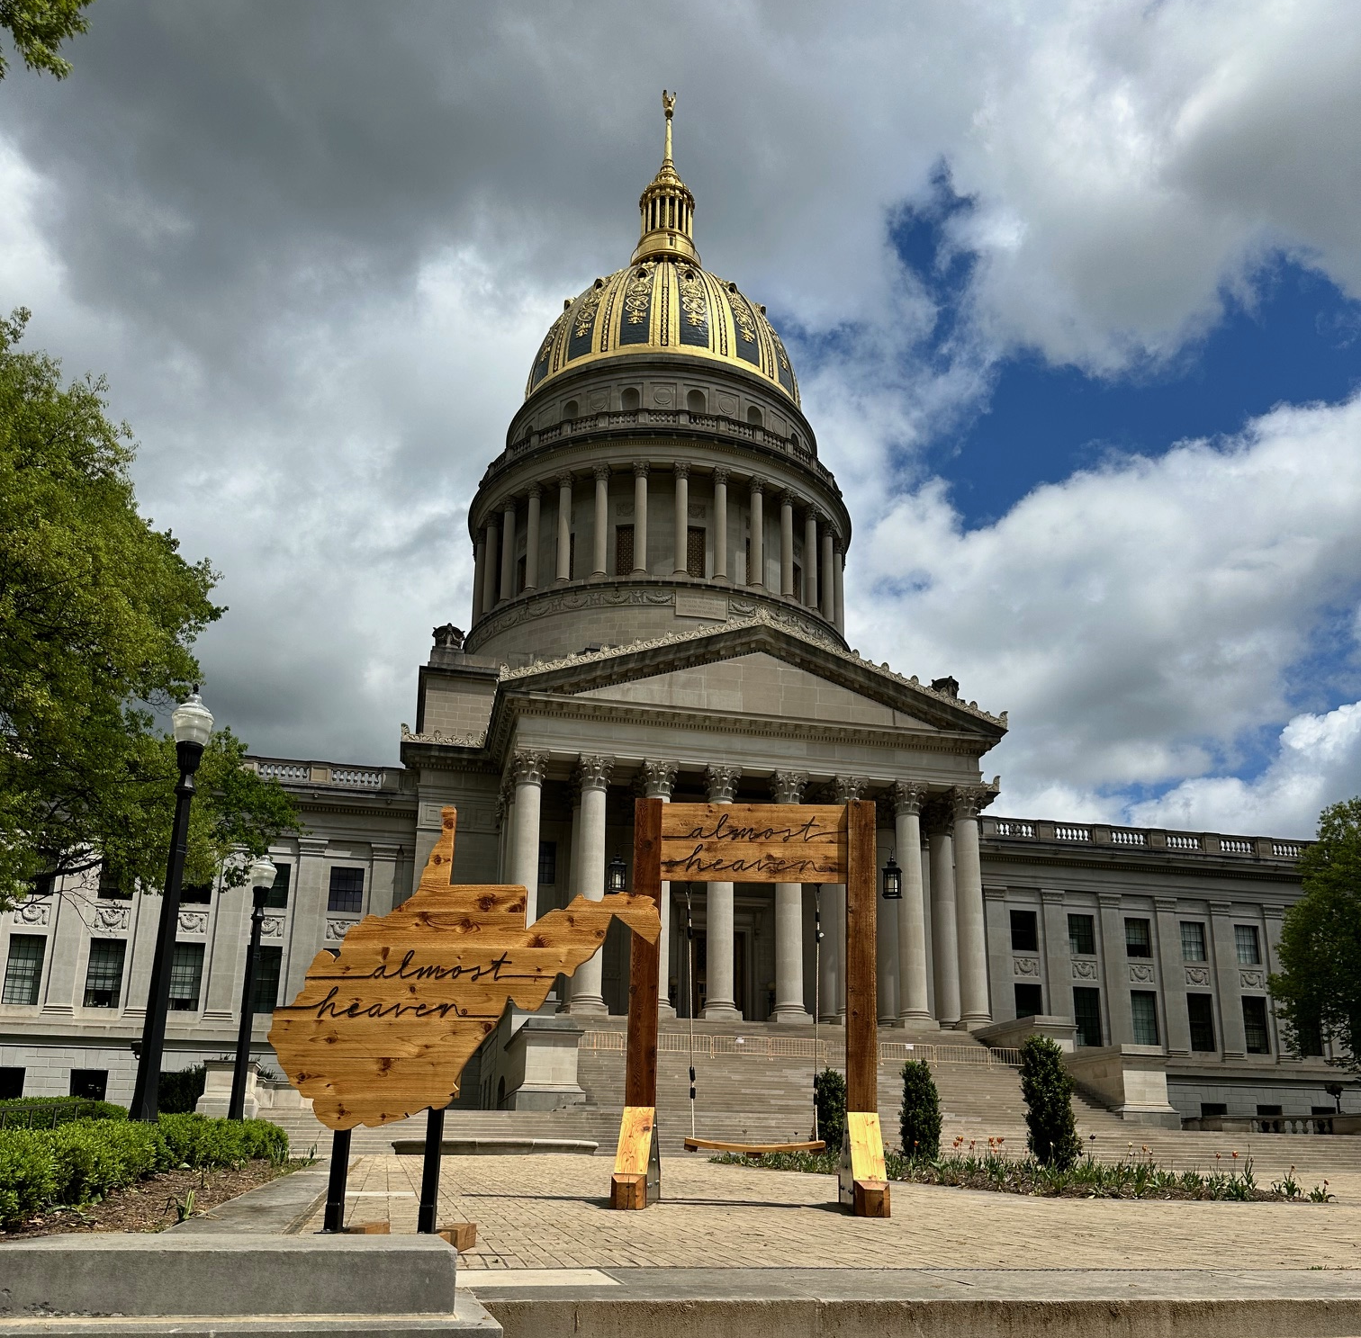
Capitalize on Existing Success
ACTION

Slide 10

Discover Your Niche
ACTION

Slide 11

Find Your Trail Blazers
ACTION

Slide 12
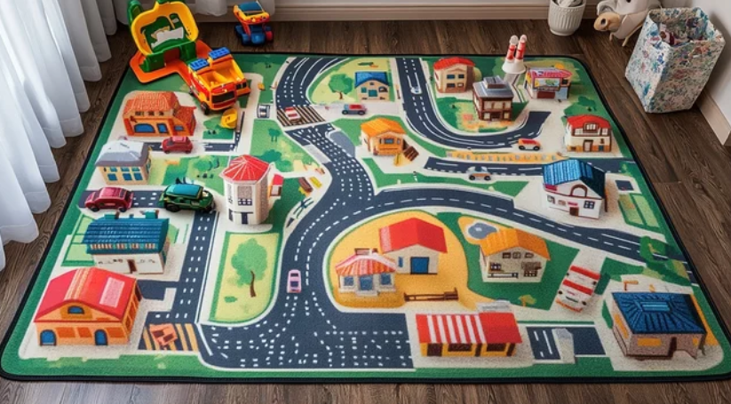
Formalize the Infrastructure
A

Slide 13

Create Your Ecosystem
INFRASTRUCTURE

Slide 14
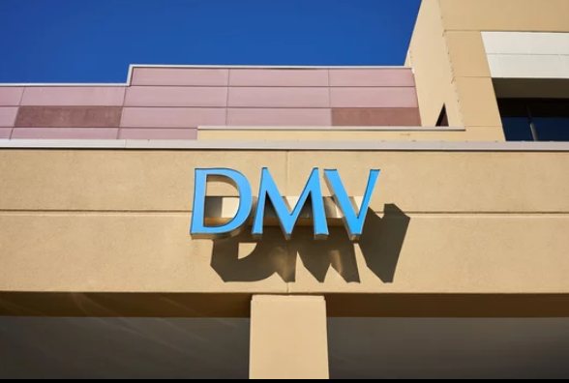
Standardize Processes
INFRASTRUCTURE

Slide 15
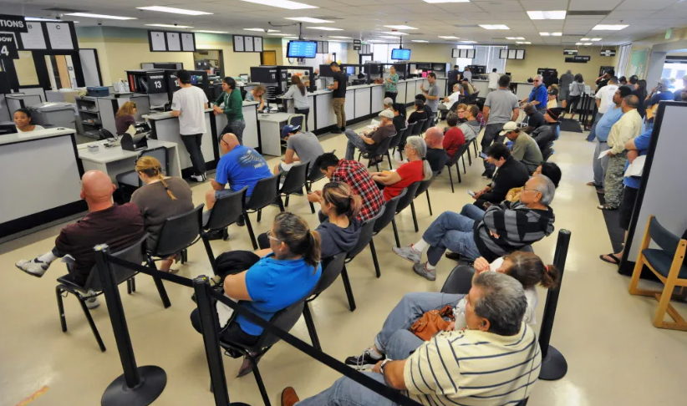
Standardize Processes
INFRASTRUCTURE

Slide 16


Make it Scalable
INFRASTRUCTURE

Slide 17

Motivate the Stakeholders
A

Slide 18

Create the Why
MOTIVATE

Slide 19
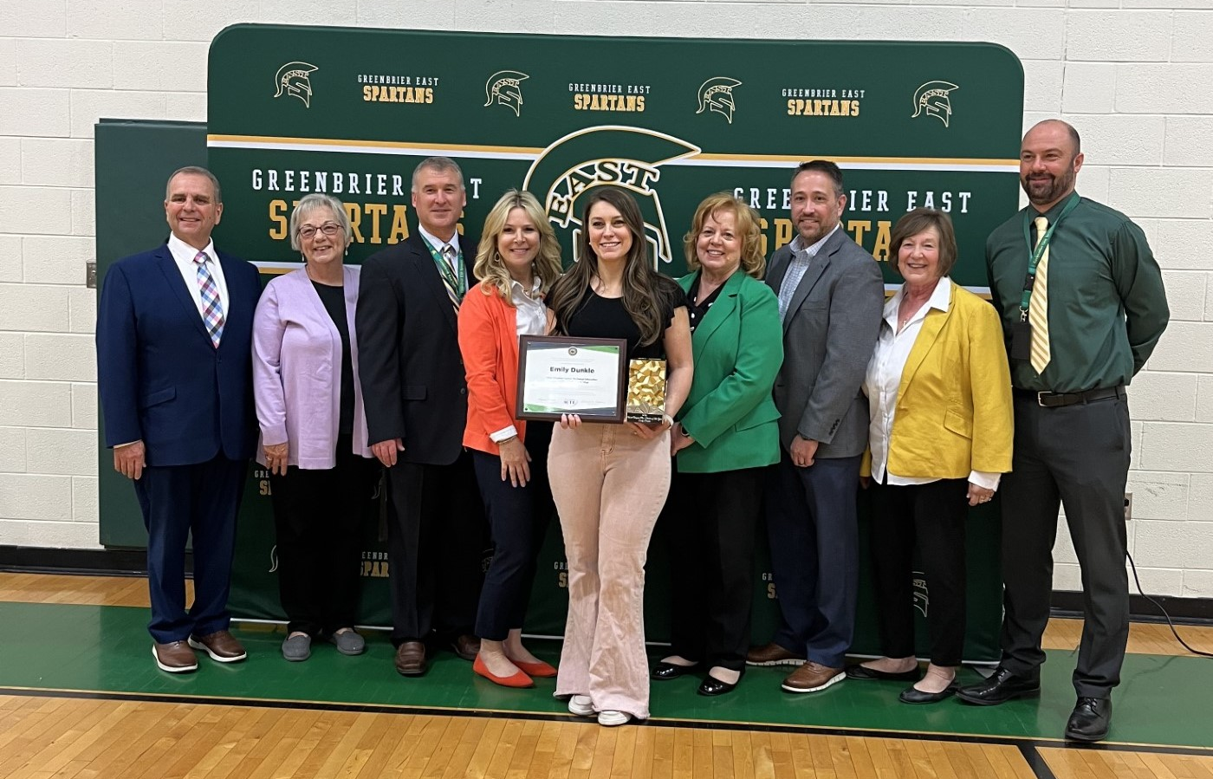
Positive Reinforcement
MOTIVATE

Slide 20
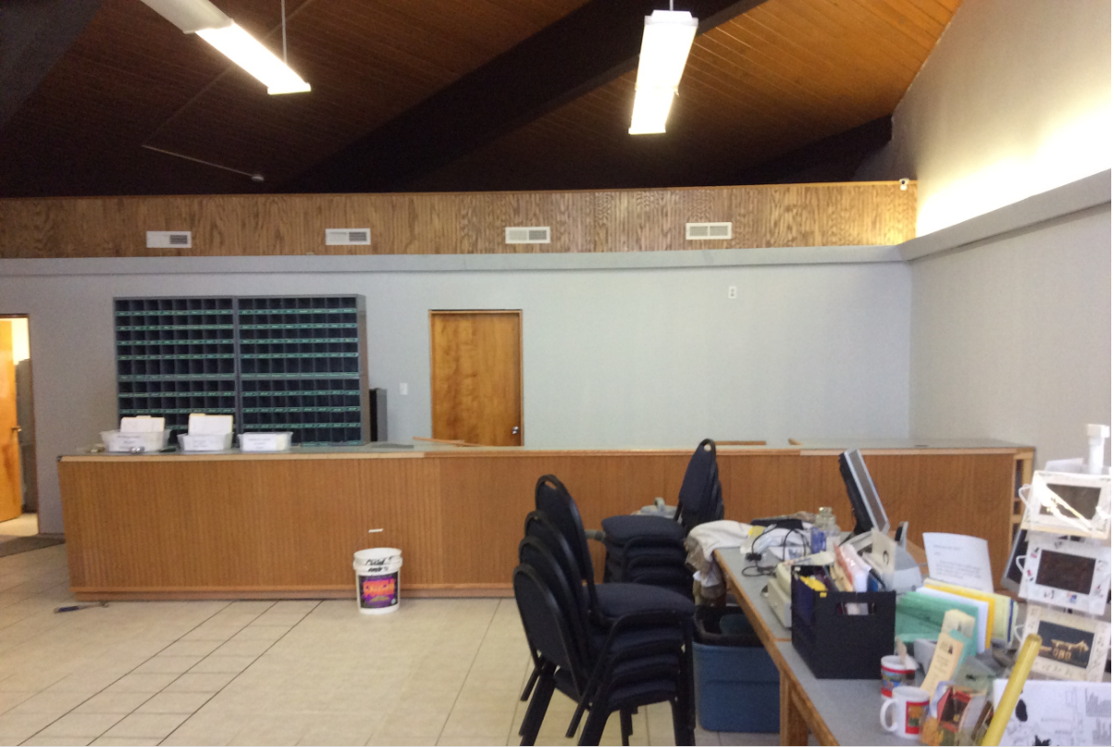
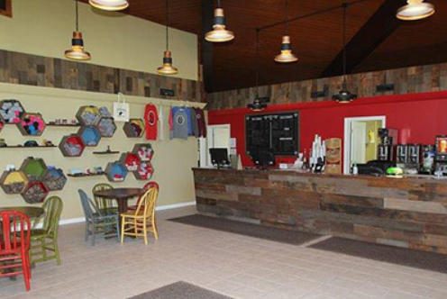
Paint the Perception
MOTIVATE

Slide 21

One
Unified
Vision

Slide 22




2,000
600+
350,000
5,000,000+
Students
Partners
Hours
Dollars

Slide 23


Slide 24
Classroom 2 Career Apprenticeships
Adam Canter
WVDE, Director of CTE
ccanter@k12.wv.us

