Slide 1
Applying the TESS Rubric Across
Multiple Classroom Roles
Andee Ingram
Carol Skiba
Alonzo Terrell
Julie Amstutz
July 14, 2026
10:20 am
ADE Summitt

Slide 2
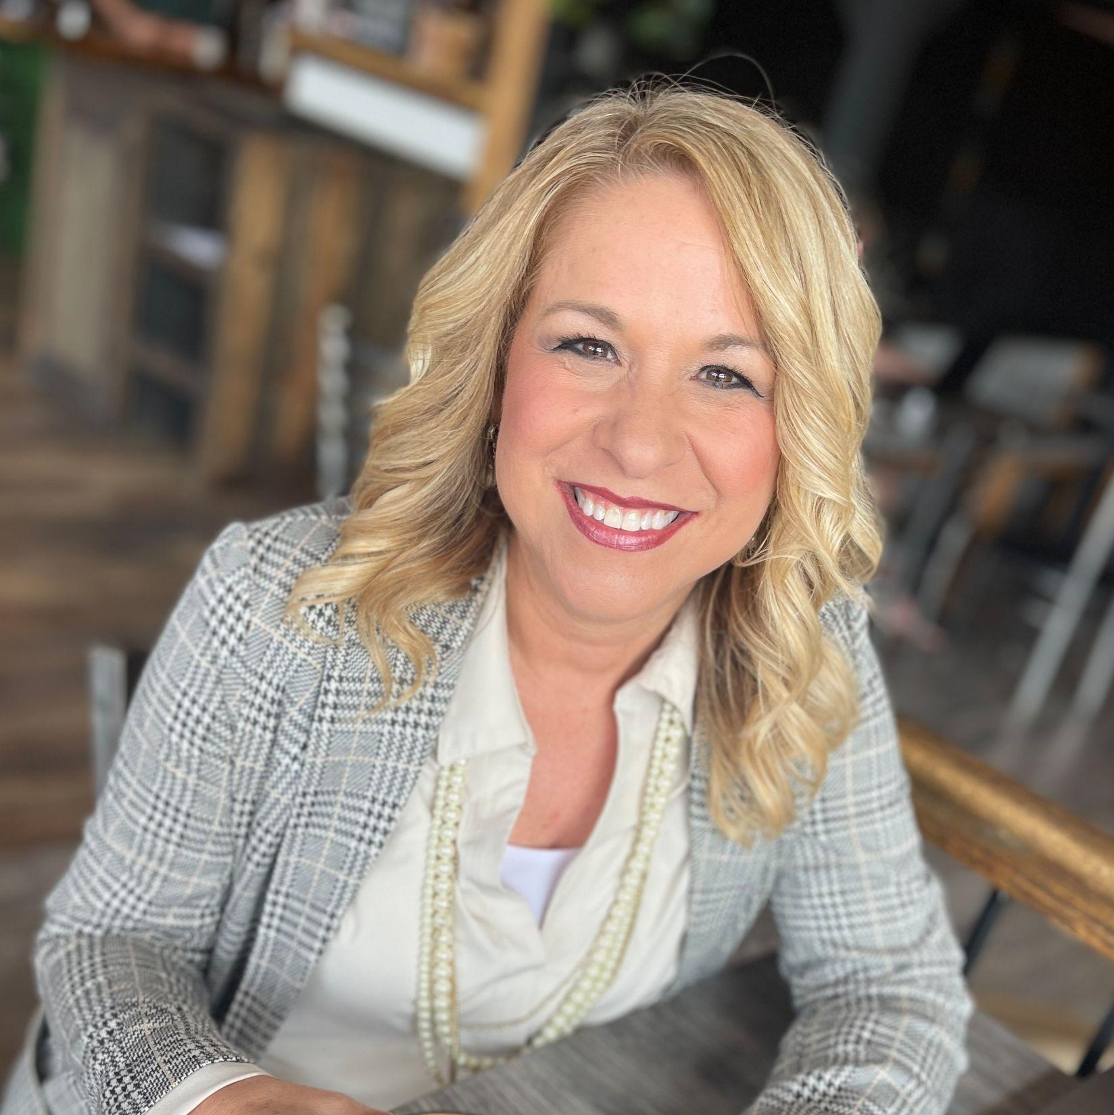
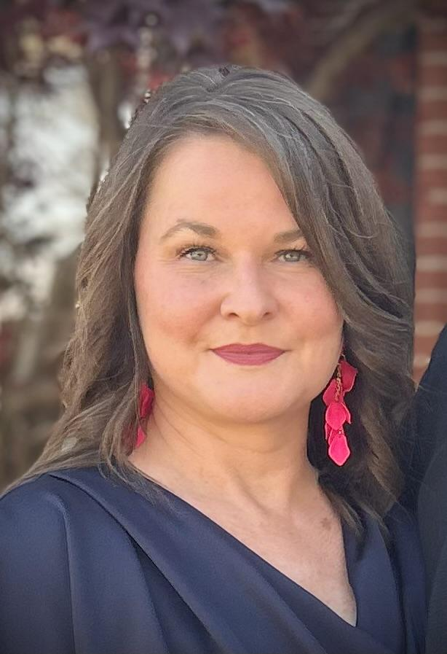
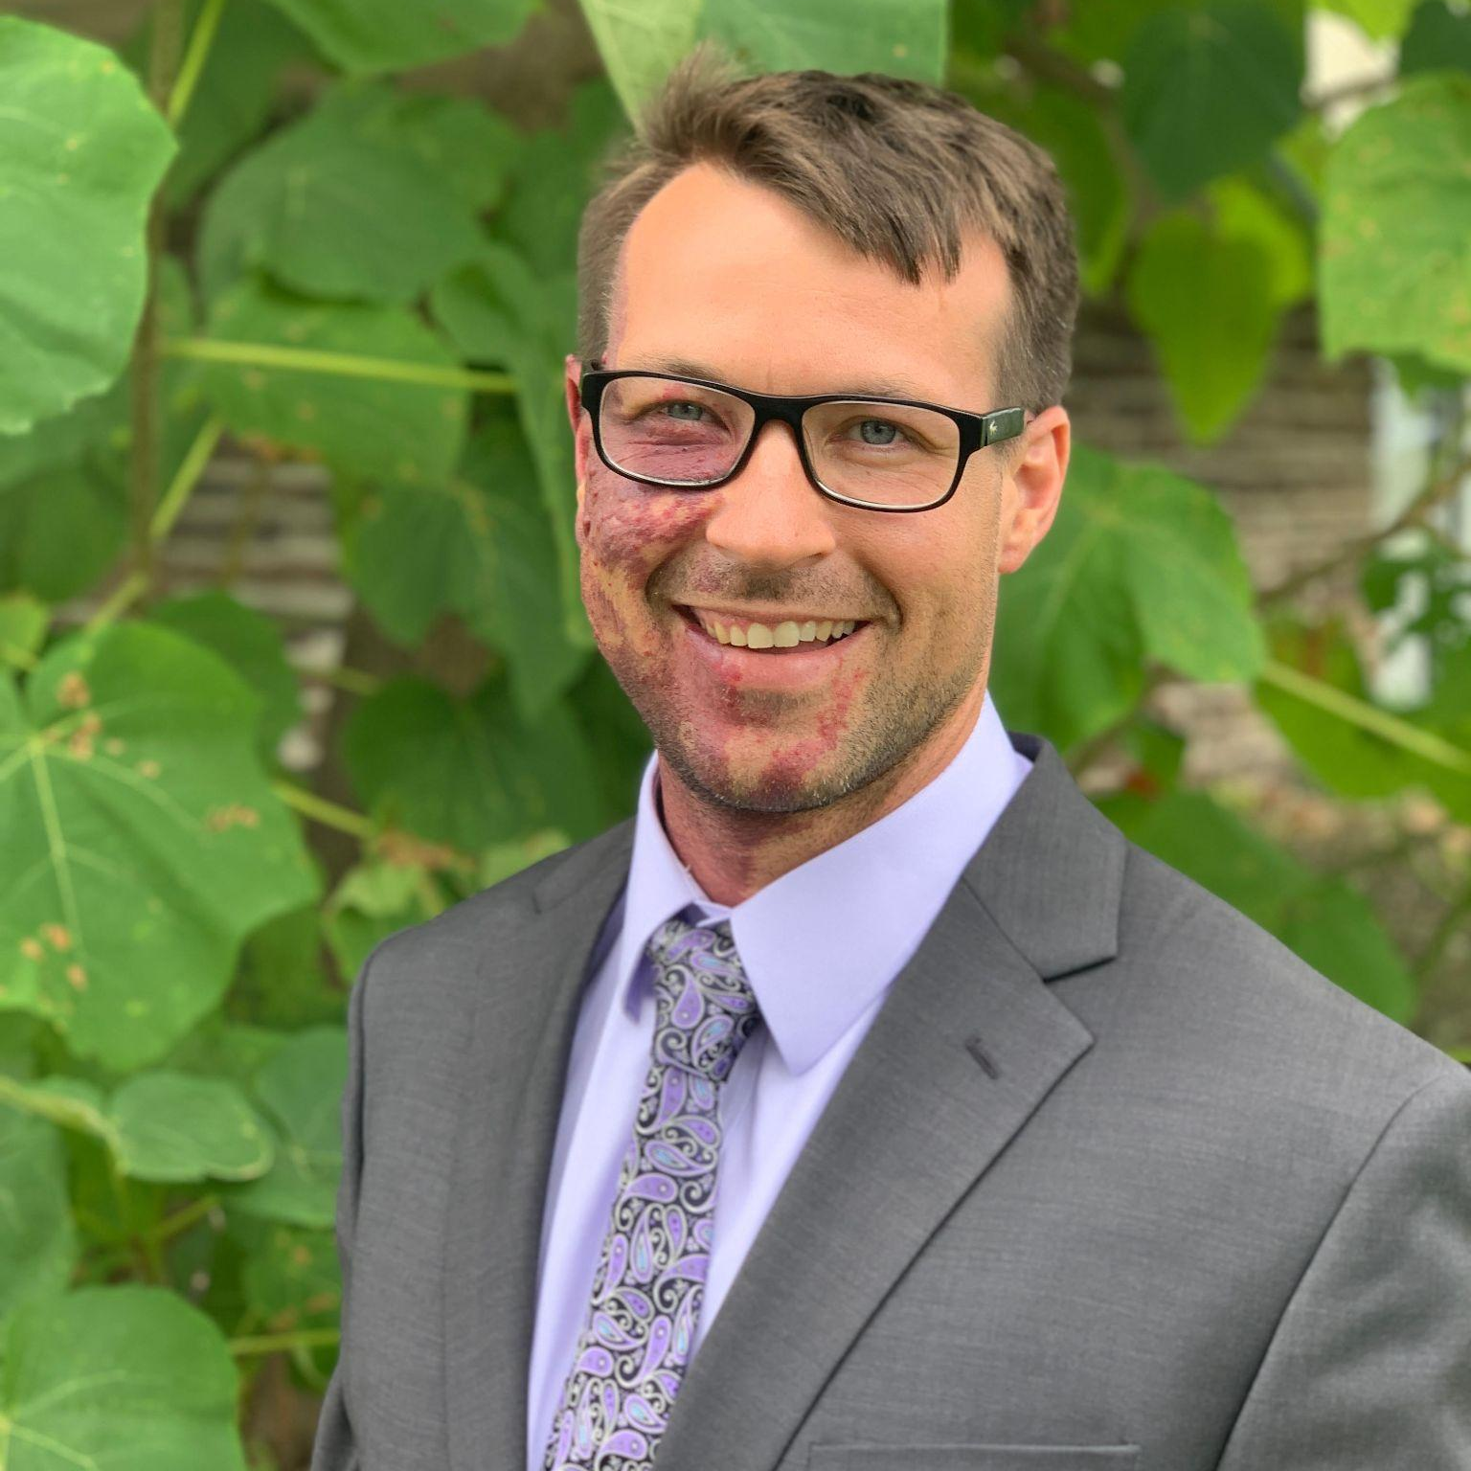
Carol Skiba carol.skiba@lrsd.org
Principal
Little Rock School District
Andee Ingram aingram@sdale.org
Special Education Director-
Springdale Public Schools
Alonzo Terrell aterrell@sdale.org
Assistant Principal
Southwest Junior High
Presenters
Carol has 28 years of experience in education, including 16 years as a classroom teacher and 12 years as an administrator. A National Board Certified Teacher and recently designated Master Principal, Carol is passionate about building high performing schools with a culture of continuous growth in which all students are successful.
Andee has served in special education for 25 years, including 20 years with Springdale Public Schools. She began her career as a Speech-Language Pathologist and has served as a Special Education Supervisor and currently as the Special Education Director. She is passionate about supporting students, staff, and systems that improve outcomes for all learners.
Alonzo has worked in public education for 15 years in both traditional and alternative learning settings. Prior to being a teacher, Alonzo worked in a mental health setting.

Slide 3
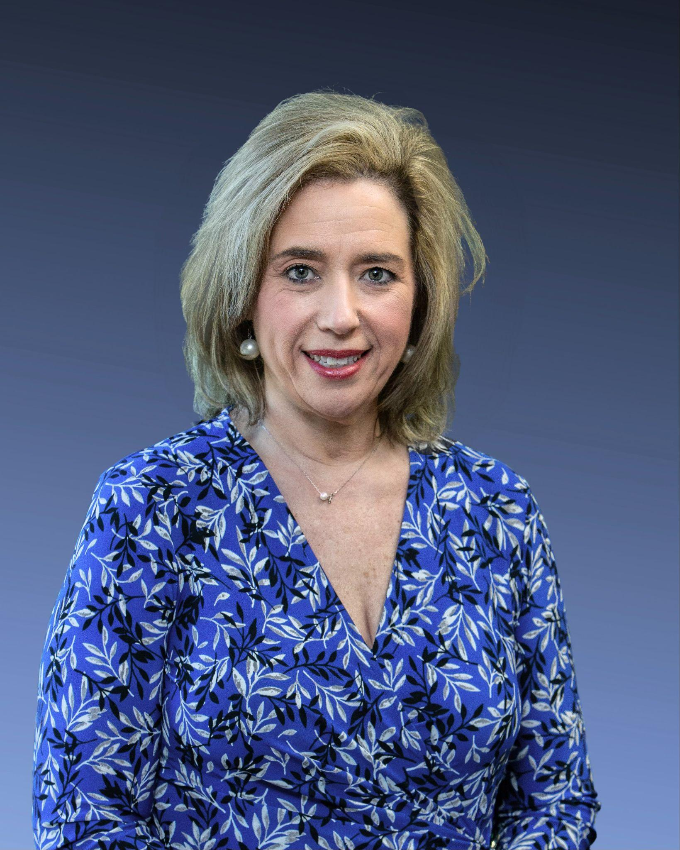

Session Overview
Welcome and Introductions
Pre-Conference
Activity Check-in
Post Conference
Examples of Scenarios
Self Contained Conversations
Overview

Slide 4
Pre-Conference Questions
Strategies in place for achievement of goal
Post-Conference Questions
Lesson Observation
Pre-Conferencing Questions pertaining to review, prior experience, any look fors and what the goal is for the session
Look for modifications in place to accomplish the outcome. Look for practices and arrangements these co-staff have in place as they work together
What went well How do we know the outcomes were achieved Discussion on strategies used Next steps to support

Slide 5
Student Scenarios
The following examples show some possible ways students could be supported. Example IEP documentation is also provided, but there are many additional ways that supports could be provided.

Slide 6

Mr. Golden has twenty-four students in his seventh grade literacy class.

Slide 7
There are eight students with IEPs in Mr. Golden’s class.

Slide 8

Scenario 1
Mr. Golden and Ms. Smiley (special education teacher) co-teach each day in the 50-minute literacy class. They co-plan, co-instruct, and co-assess for the class. They are equal partners in the instruction.
Notes:
Co-Teach

Slide 9

Scenario 2
Ms. Friendly (special education teacher) provides special education services for four students for 20 minutes every day in the general education literacy classroom. They focus on foundational skills, IEP goals, and pre-teaching concepts and vocabulary.

Slide 10
Scenario 3
Ms. Friendly provides extra support for students who need it for 15 minutes every day in the general education literacy classroom. The group is fluid and may change on a daily basis.

Slide 11
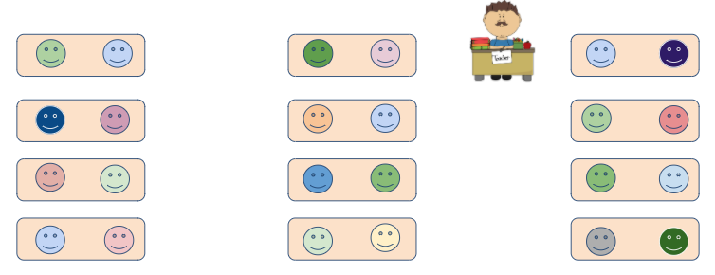
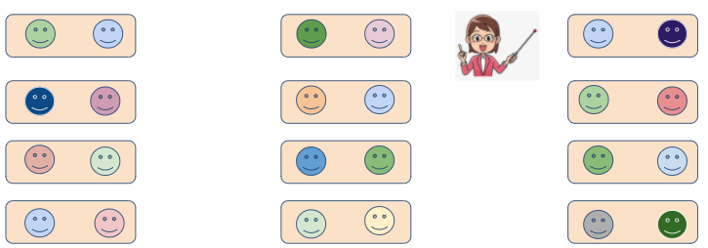
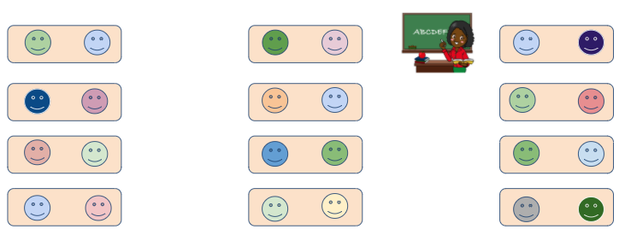
Scenario 4
Ms. Friendly serves four students with IEPs in her classroom three days each week for 25 minutes. They focus on foundational skills, IEP goals, and pre-teaching concepts and vocabulary.

Slide 12

Scenario 5
Mr. Watson is a dually certified teacher. He is licensed in 9-12 Mathematics and has recently added his special education resource certification. This new certification equips him to provide special education in multiple settings, including the general education classroom.

Slide 13

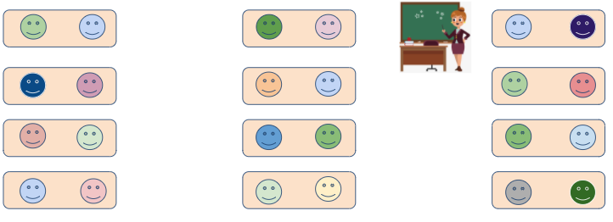
Scenario 6
Mr. Franks (SpEd teacher) floats into classrooms based on student needs.

Slide 14
Scenario 7
Of the twenty-four students in Mr. Golden’s literacy class, eight have IEPs.
Peer-assisted learning strategies are utilized to meet students’ needs.

Slide 15


Scenario 8
In-Classroom
Related Services
Ms. Chatty, the speech-language pathologist goes into general education science classroom 3 times weekly to support a student with generalization of speech articulation and language goals.

Slide 16
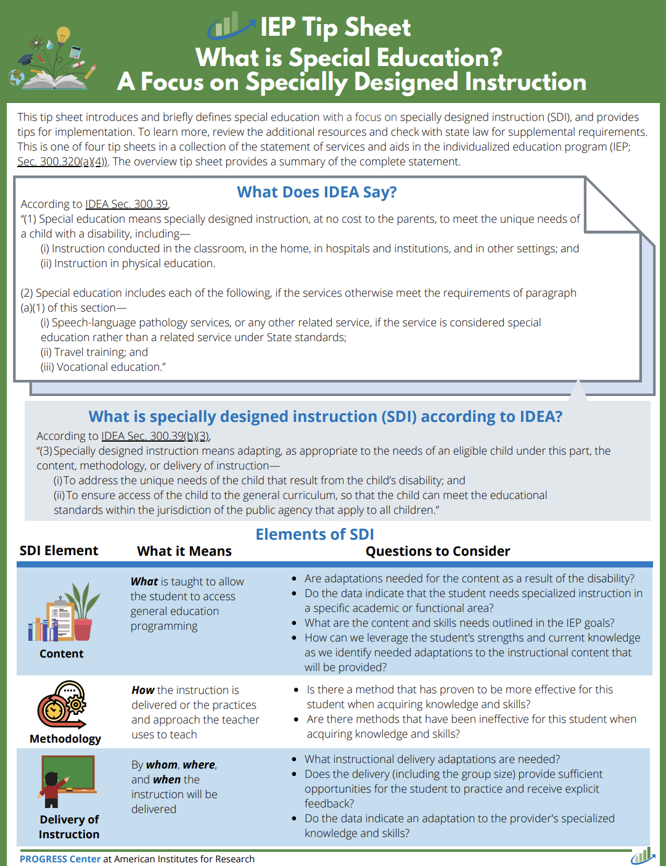
Pre Conference
Pre-observation Conferencing: Eliminating the Subjective
May look different but high quality instruction is same
The PROGRESS Center emphasizes that IEP services should be directly connected to the student's Present Levels of Academic Achievement and Functional Performance (PLAAFP), annual goals, and identified services and supports. Services should be individualized and reasonably calculated to help the student make progress toward annual goals.
  Student learning and growth
  Appropriate implementation of IEPs
  Access to grade-level standards
  Individualized instruction
  Data-based decision making
  Collaboration with staff and families
  Compliance with special education requirements

Slide 17
CHALLENGE: The question is not whether the special education teacher is busy. The question is whether the special education teacher is delivering specialized instruction that students would not otherwise receive.
PARAPROFESSIONAL LIKE SUPPORT
GENERAL CLASSROOM ASSISTANCE
SPECIALLY DESIGNED INSTRUCTION (SDI)
Paraprofessional Like Support
• Redirecting behavior
• Helping complete assignments
• Repeating directions
• Sitting beside the student(s)
Specially Designed Instruction
• Aligned to IEP goals
• Providing accommodations & modifications
• Targeted interventions
• Monitoring IEP goal progress
• Teaching self-advocacy and independence
• Using disability-specific instructional strategies
General Classroom Assistance
• Circulating among students
• Answering questions
• Assisting any student who needs help
• Supporting classroom management

Slide 18
Pre-observation Conferencing = Listen Fors
(1c) What do you want learners to know and be able to do during and after this lesson? Annual Goals (Academic & Behavioral)
NEW: Which specific standards are you focused on when planning the lesson? Modifications & Access
(1a) How is the lesson connected to previous learning? Progression of learning
(1b) In what ways do you become familiar with student backgrounds and interests? Listening for Data/Assessments, transition plan, evaluations, IEP & PLAAFP
(1d) What resources are you utilizing to teach this lesson? Accommodations & Supports
(1e) In what ways will you use resources, groupings, or activities to differentiate instruction for all students to achieve the learning outcomes ? Listening for Collaboration w/ Gen Ed Teacher; planning of modifications
(1f) How will you know if students have mastered the lesson objective? What will be your evidence of mastery? CFA data, progress monitoring, accommodation use, self-monitoring, etc.
(3d) How might students monitor their own progress toward the learning objective?

Slide 19
Pre-observation Conferencing = CLARITY
(1c) What do you want learners to know and be able to do during and after this lesson?
  NEW: Which specific standards are you focused on when planning the lesson?
  What specially designed instruction (SDI) will you provide during this lesson? And how is this instruction different from what the general education teacher is providing? (Determines if providing access only)
(1d) What resources are you utilizing to teach this lesson?
  What accommodations should I expect to see implemented during this lesson? (extended time?, graphic organizers, guided notes, chunking, assisted technology, etc.)
  Which accommodations are required by student IEPs?
  How will you ensure those accommodations are provided consistently?
(3d) How might students monitor their own progress toward the learning objective?
  How are you promoting student independence rather than dependence on adult support? (self-monitoring, self-advocacy, use of accommodations independently, fading prompting)

Slide 20

Key Takeaways About Pre-observation Conferencing
What looks simple is often highly specialized.
The quality of the observation depends heavily on the quality of the pre-observation conversation.
Evaluate expertise and impact, not movement and activity
Accurate evaluations do more than produce ratings—they build confidence, trust, and teacher retention.

Slide 21
Providing high quality special education services in the general education setting is some of the most complex instructional work in a school. To be effective and provide relevant feedback, an administrator needs to look beyond what is easiest to see and seek to understand how the teacher’s specialized expertise is being used to support some of our most exceptional students access, meaningfully participate in, and make progress alongside their general education peers.

Slide 22
Post Conferencing
Post Conference
Purpose: To create a reflective, growth-focused conversation that will result in teacher confidence and improve student outcomes.
Establish a positive tone
Let the teacher know how long the conference will last
Let the teacher know the purpose of the conference is to reflect on the lesson and focus on best practices
Reflect on an area of Reinforcement and identify an area of Refinement to strengthen student learning
Post-Cct on the observed lesson and focus on best practices
Reflect on Area of Reinforcement and identify Area of Refinement to strengthen
student learning

Slide 23
Post Conference
Analyze the Lesson Through Student Evidence
Ask reflection question: Based on student work samples, how do you think the lesson went?
Analyze student work samples with the teacher
Identify evidence of student learning in the samples
Discuss evidence of student misconceptions
Determine strengths demonstrated through the lesson

Slide 24

Reinforcement Plan: Celebrating Effective Practice
Reflect on: What part of the lesson was successful?
Name instructional strategies that supported the learning
Evidence: Student work, responses, mastery
Evidence: Teacher moves, questioning, modeling, differentiation

Slide 25

Refinement Plan: Growing Instructional Practice
Ask refinement question: Based on student work, what would you change about the lesson?
Determine a specific refinement objective
Identify a recommended action to improve student outcomes
Guided practice: Teacher walks through what this could look like in future lessons
Discuss supports and success criteria

Slide 26
Closing the Conference and Follow-Up
Reflection: What was something positive you heard about teaching and learning?
Restate areas of reinforcement and refinement
Share observation ratings and evidence
Follow up through classroom walkthroughs and teacher check-ins
Continue the cycle of reflection

Slide 27

Self Contained Teachers
Evaluating Self-Contained Teachers:
How To Make The Teacher Rubric Work For Self-Contained
Common Questions:
“How do I evaluate student engagement and instruction when students cannot demonstrate learning through typical verbal discussion, written work, or independent tasks?”
Shift the lens:
Instead of asking “Are students talking?” ask “Are students accessing, responding to, and benefiting from instruction?”

Slide 28
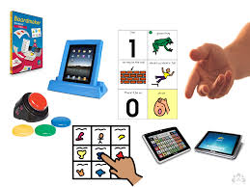
First Think Through Students’ Access Needs
What are the students' communication methods? (AAC, eye gaze, switches, gestures, vocalizations, behaviors, etc.)
What are the students' medical or physical needs?
What level of support is required for participation?
What does engagement look like for these students?
Example:
For one student, engagement may be answering verbally. For another, it may be activating a switch, maintaining visual attention, reaching toward a choice, or using eye gaze to indicate a response.
Focus of the evaluation should be based on how well the teacher provides access and learning opportunities, not on whether students can perform typical grade-level behaviors independently.

Slide 29
Rethinking “Student Driven” Evidence
Traditional Look-For | Possible Self-Contained Equivalents
Student discussion | AAC responses, eye gaze, switches, gestures, picture exchange
Independent work | Participation with prompts, adapted materials, supported independence
Student choice | Choice-making between activities, symbols, objects, or partners
Collaboration | Turn-taking, peer interaction, shared activities, communication exchanges
Engagement | Visual attention, motor response, communication attempts, participation in routines

Slide 30
Possible Evidence of Effective Practice
Domain 2: Classroom Environment
Look for:
Predictable routines
Visual schedules
Safe and respectful interactions
Behavior supports matched to student needs
Efficient coordination with paraprofessionals and nurses
Domain 3: Instruction
Look fors:
Clear learning targets (academic, functional, communication, social, or self-care)
Adapted materials
Frequent opportunities to respond
Use of AAC and assistive technology
Progress monitoring

Slide 31

Possible Evidence Sources Outside of a Single Observation.
For self-contained teachers, evaluators should review multiple evidence sources
Classroom observation
IEP goals and progress reports
Data collection systems
AAC implementation
Behavior intervention plans
Collaboration notes with therapists, nurses, and families
Student work samples (including adapted responses)
Transition and functional skill instruction
Many high-impact special education practices occur outside a 20-minute observation window.

Slide 32
Questions Evaluators Can Ask Themselves:
Are students being given meaningful opportunities to communicate and participate?
Is the teacher using specialized instructional practices appropriate for these learners?
Are supports enabling access rather than creating dependence?
Is there evidence of growth, progress, or increased access over time?
Is the classroom organized to meet medical, behavioral, communication, and academic needs simultaneously?
If the answer is yes to most of these questions, the teacher is demonstrating strong professional practice even if the evidence looks different from a general education classroom.

Slide 33
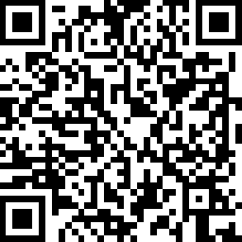

Thank you!

