Slide 1
SPED Finance 101
Josh Hart
Arkansas Department of Education - DESE
Office of Special Education - Finance

Slide 2
AGENDA
Key Terms
Source of Funds (SOF)
Maintenance of Effort
Private School Proportionate Share
CCEIS
High-Cost
Allowability
Key Resources
Contacts

Slide 3
Key Special Education Finance Terms

Slide 4
Key Terms
Source of Fund (SOF): Identifies what fund is being utilized.
  Example: 6702-1220-000-200-00-61110
IDEA Part B Funds: Federal funds utilized to educate students with disabilities, formerly known as VI-B.
  611 – School Age (3-21) SOF: 6702
  619- Early Childhood (3-5) SOF: 6710
Function: second portion of funding coding that describes the activity being performed when a service is provided or a material object is received.
  Example: 6702-1230-000-200-00-61110
Program Code: this code identifies the educational program or specific set-asides within that educational program.
  Example: 200: Special Education, 267: CCEIS Current FY, 269: CCEIS Carryover.
  200 program code is used to capture Maintenance of Effort

Slide 5
Key Terms
Object: this code is used to describe the service of commodity obtained as a result of specific expenditure.
  Example: 61110: Certified Employees, 61120: Classified Employees, 62000: Employee Benefits, 63300: Professional Employee Training and Development Services (PD), 66000: Supplies and Materials, 65910: Services Purchased from another School District or Education Services Agency within the State.
Annual Financial Report (AFR): expenditures shown in eFinance and COGNOS reports.
Allocation: Amount of Federal or State funds that the LEA receives in each source of funds. Allocations are typically distributed two times per fiscal year. Preliminary allocations occur in July/August, and Final allocations occur in March/April.

Slide 6
Key Terms
Carryover: The amount of unspent Federal funds from previous fiscal year's allocation. Federal funds are reimbursement based.
Cash on Hand: Funds that the LEA has revenued for a specific fund that creates a positive balance when revenue exceeds expenditures. Typically shown in board reports.
eFinance: State financial management system.
COGNOS: State report system for eFinance and eSchool. Aggregates data sources.
Fiscal Year: State fiscal year is July 1 to June 30. LEAs can still make budget adjustments and journal entries to expenditures during period 13.
Period 13: July 1 to the end of August in which LEAs can make budget amendments and journal entry expenditures. Overlaps period 1 and 2 of the new fiscal year.

Slide 7
Source of Funds

Slide 8
Source of Funds (SOF)
SOF 6702: IDEA Part B 611 3-21
SOF 6710: IDEA Part B 619 3-5
SOF 2262: State Preschool
SOF 2240: Special Education Supervisor Reimbursement
SOF 2244: Extended School Year Reimbursement
SOF 2265: High-Cost Occurrence

Slide 9
Maintenance of Effort

Slide 10

MOE
IDEA Part B Supplement vs Supplant test.
  Looks at State/Local expenditures towards educating students with disabilities across fiscal years.
  To maintain effort, the LEA must budget and spend at least as much as it spent on educating students with disabilities in the previously established compliance year.
Two standards:
  Budgetary: measured with October 1 budgets pulled from eFinance.
  Compliance (AFR): measured at the close of period 13 in September/October with eFinance data loaded into MySped by the SEA.

Slide 11
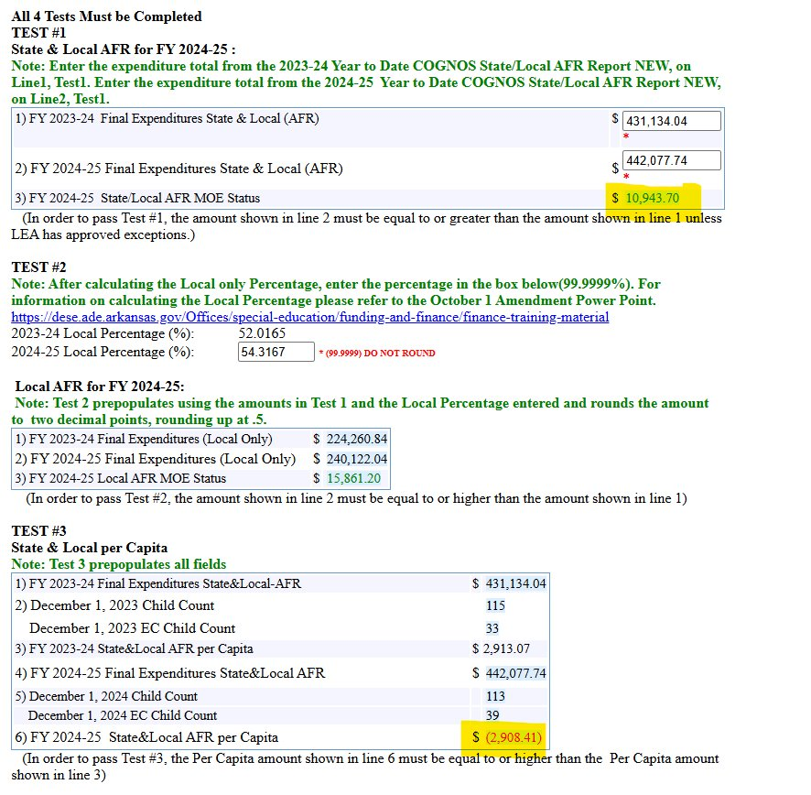
MOE Test
Four Test:
  State & Local Total
  Local Only
  State & Local Per Capita
  Loca Per Capita

Slide 12
MOE
34 CFR 300.204: “an LEA may reduce the level of expenditures by the LEA under Part B of the Act below the level of those expenditures for the preceding fiscal year if the reductions is attributable to any of the following:
A1: Personnel loss/change
A2: Decrease in enrollment of children with disabilities
A3: Loss of an exceptionally costly child
A4: The termination of costly expenditures for long-term purchases

Slide 13
MOE
  For every $1 spent in IDEA Part B funds another $3.24 were spent in State & Local funds to educate students with disabilities (does not include Medicaid & ARMAC)
    Lowest: 13.59% (next lowest 26.74%)
    Highest: 88.58%
    Average: 71.30%

Slide 14
Private School Proportionate
Share

Slide 15
Private School Proportionate Share (PSPS)
Required set-aside for the provision of equitable services for parentally placed private school students with a disability.
  Includes homeschool students.
  Set-aside for both funds 6702 and 6710
  Required set-aside is called the proportionate share
PSPS counts are collected via the PSPS survey completed in December in MySped.
The provision of equitable services is built on the required consultative process with Private School and Homeschool Representatives.
The consultative process is ongoing throughout the year, but begins in the Spring for the next fiscal year as part of the AR App process.

Slide 16
Private School Proportionate Share (PSPS)
The Private School Proportionate Share set-aside is provided by ADE via the Preliminary and Final Allocation Worksheet.
  Current set-aside based on previous year's PSPS Survey
PSPS has a 24-month required period:
  Program Code 266 carryover
  Program Code 268 current
Provision of services is the responsibility of the LEA, funds can not be given to the Private School.
  Can be used for direct IDEA services and supports
  Can be used for indirect/consultative IDEA services and supports
  Allowability is based on IDEA services and supports related to the child's educational disability

Slide 17
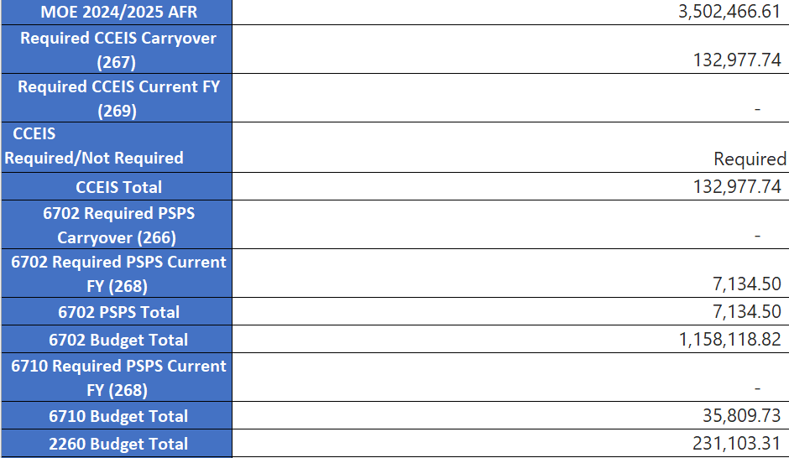
Private School Proportionate Share (PSPS)

Slide 18
Comprehensive Coordinated Early Intervening Services (CCEIS)

Slide 19
CCEIS
REQUIRED due to districts exhibiting 3 consecutive years of significant disproportionality.
The required set-aside is provided in the Preliminary and Final Allocation worksheets.
A required 15% of their preliminary 611 & 619 federal allocations for the development and provision of CCEIS for:
    Children who are not currently identified as needing special education or related services but who need additional academic and behavioral support to succeed in a general education environment (3-21) and
    Children with disabilities (ages 3-21).
An LEA may not limit the provision of CCEIS to children with disabilities.

Slide 20
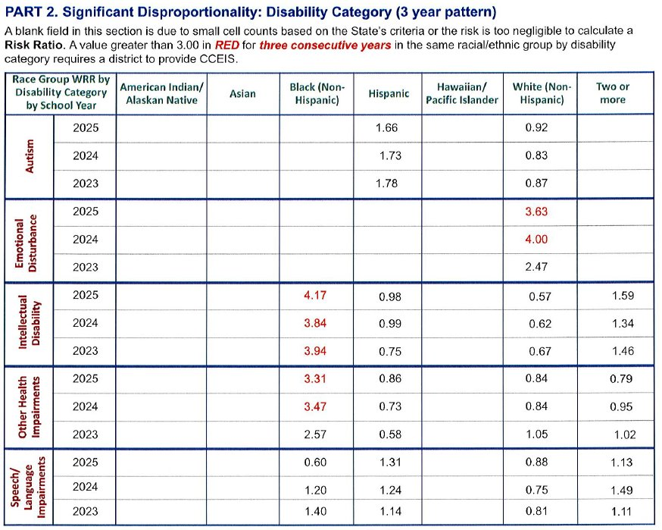
CCEIS

Slide 21
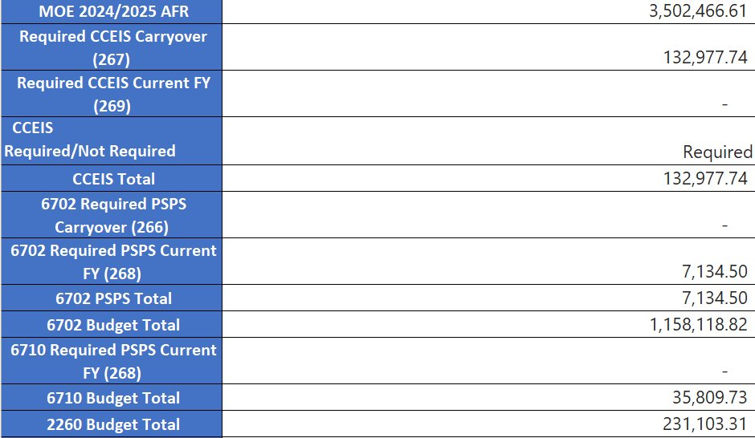
CCEIS
OSEP Memorandum 08-09, dated July 28, 2008:
The funds must be used during the period of their availability for obligation and must be used for CCEIS regardless of whether the significant disproportionality is resolved during the time that funds are available.

Slide 22
High-Cost Occurrence (HCO)

Slide 23
HCO
Individual cases where costs associated with special education and related services required by an IEP are:
  Unduly expensive
  Extraordinary
  Beyond the normal and routine special education and related services
Important Dates:
December the registry opens in MySped for student demographics entry.
January student demographic entry closes and students can no longer be added.
February registry reopens.
March 18th the registry closes. All supporting documents must be submitted in MySped:
  HCO LEA Calculation Sheet
  Required IEPs
  Required Invoices
  Signed Superintendent Certification

Slide 24
HCO
What are typical HCO claim costs:
Special Education Teacher:
  1:15
  1:10
  1:6
Paraprofessional:
  Multi-student
  1:1
Related Services:
  OT
  PT
  Speech
  Interpreter
  Specialized Transportation

Slide 25
HCO
25-26
$75,725,990.82 in approved claims before offsets (first $15,000, Medicaid, Avg. IDEA Part B)
$32,506,002.98 in approved claims after offsets. Claims were then prorated at 55.1713%
Pass through for IDEA Part B 611 & 619: $126,928,403.44
59.66% of IDEA Part B funds support 2350 students with disabilities

Slide 26
Allowability

Slide 27
Allowability
IEP Services/Supports:
Are the services and supports paid for from SOF 6702 outlined in a student’s IEP?
  Summary of Services
  Special Factors
  Transition Plan
  Administration
  Does the expense support the administration of the program?
  Special Education Director
  Special Education Administrative Support Staff
  Materials/Supplies
  Technology

Slide 28
Key Resources

Slide 29
Key Resources
Office of Special Education
OSE-Finance
Three-Month Snapshot
MySped
  MOE
  High-Cost
  Monthly Budget AFR Compliance
CCEIS District Profile
OSEP Guidance for Equitable Services (PSPS)

Slide 30
Questions

Slide 31
Contacts

Slide 32
Mikki Eubank
Mikki.eubank@ade.arkansas.gov
Kim Vogt
Kim.vogt@ade.arkansas.gov
Patricia Siribouth
Patricia.siribouth@ade.arkansas.gov
Heather O'Shields
Heather.oshields@ade.arkansas.gov
Josh Hart
Josh.hart@ade.arkansas.gov

