Slide 1
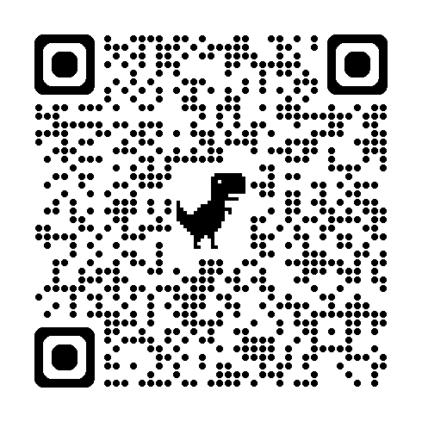
Navigating the State Data Landscape
A Guide to Using the Year in Data: Know It, Use It, Do It!

Slide 2

If data is the compass, improved student achievement is the destination.

Slide 3
Data
A year at a glance
Know It
Use It
Do It
What is this data, and when does it land on your desk?
What is it for — and just as important, what is it NOT for?
Practice the call: given a real sample, what's your Notice, Wonder, and Action?
We'll repeat this cycle for five state data milestones this year — by the fifth time, it should feel automatic.
Navigating the State Data Landscape | 2026 ADE Summit

Slide 4
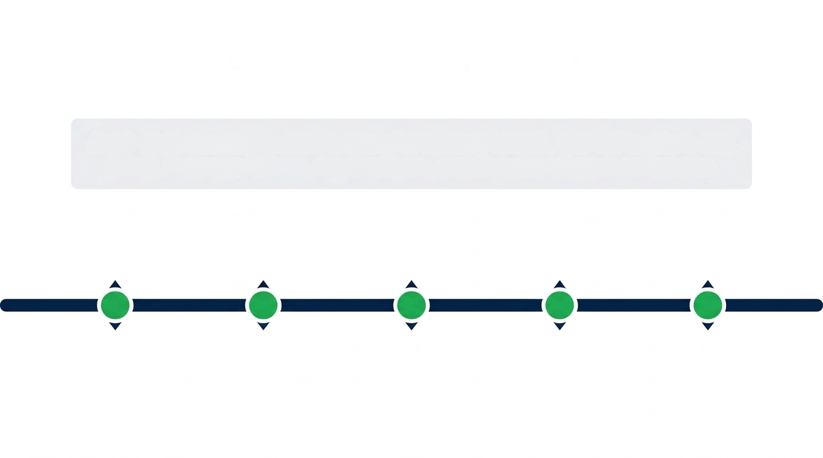
The 2026-2027 Data Timeline
Each milestone below provides a specific system check or process. We will explore the what it is, its purpose, when it lands, how to use it.
July-September
September-
October
Fall/
Winter
April-May
Winter-
June
K-3
Screeners
Ratings &
VAM
Interims
Summative
AR App
Planning

Slide 5
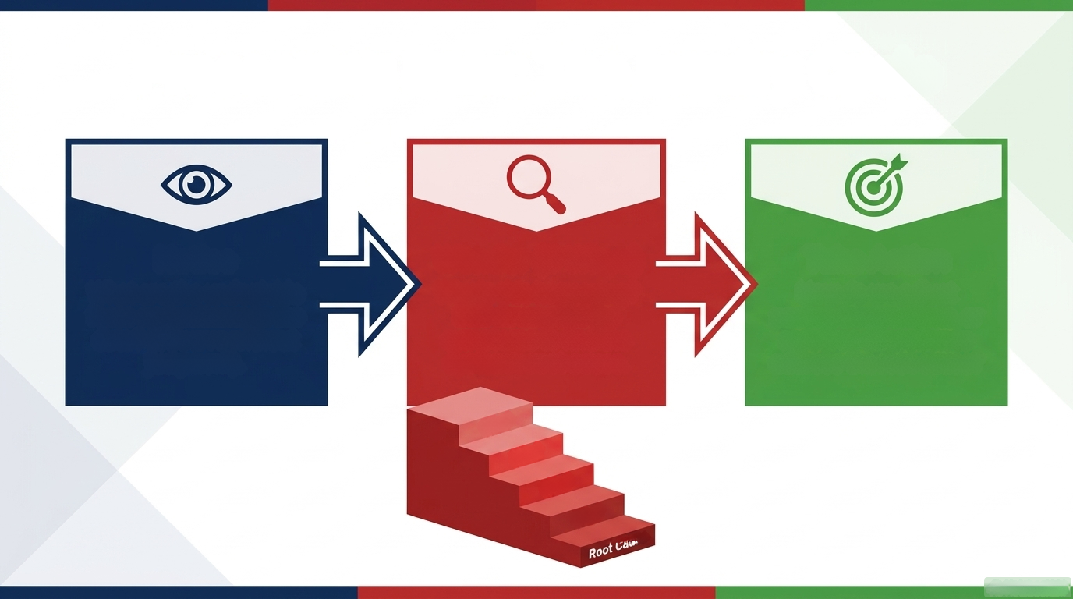
Processing Data: The Inquiry Cycle
Notice
Wonder
Why is this happening?
Drill down past the
symptoms to find the
root cause.
Take Action
How do we adjust
pacing, interventions, or
resource allocation to
address the root cause?
What are the undeniable facts and patterns in the data? (Observe without
judgment).
Why?
Why?
Why?
Why?
Root Cause

Slide 6

5 Whys: From Symptom to Root Cause
1ST WHY
Identify the first cause contributing to the problem.
2ND WHY
Dig deeper by questioning why the first cause occurred.
3RD WHY
Continue drilling down to understand deeper reasons.
4TH WHY
Reveal underlying system or process-related issues.
5TH WHY
Reach the actionable root cause and formulate corrective actions

Slide 7
The Rules of Engagement for 5 Whys Protocol
Key Principles & Mindsets
Be Curious: Approach problems with the relentless curiosity of an inquisitive toddler.
Rely on Facts: Base your answers on actual observations and real data, not assumptions or guesses.
Process Over People: Avoid blaming individuals. Focus on systemic factors and areas within your control.
Stay Flexible: You don't have to stop at exactly five. Stop when you find an actionable root cause, or keep going if you need to drill deeper.

Slide 8
5 Whys Protocol
The symptom:
"My project grade was lower than expected."
  Why? Because I lost points on the citations.
  Why? Because I did not format the bibliography correctly.
  Why? I didn’t know it was required.
  Why? Because I didn't use the formatting rubric while writing.
  Why? Because I didn't understand how to read the rubric.
Root Cause: Lack of familiarity with project rubrics prior to starting

Slide 9
5 Whys Protocol Practice
Meet Abbott Elementary. Here's a few of their data milestones to investigate. Choose one data point and run the 5 whys protocol.
Milestone | Abbott Elementary — Data Snapshot
K-3 Screener (BOY) | 45% of 2nd graders score “POTENTIAL RISK” in reading fluency — up from 11% last year.
Ratings & VAM | School earned “C” rating; Achievement has increased but VAM growth in ELA bottom-quartile is stagnant from prior year.
Fall/Winter Interims | 2nd-grade ELA interim scores flat since BOY screener — no movement despite adoption of new HQIM this year.
Summative (last spring) | 4th-grade reading proficiency dropped 9 points year-over-year; no other grade declined.
Your group's job: 1) State the “symptom”. 2) Run 5 whys protocol. 3) Determine probable root cause.
***Bonus*** Name one action that can be taken before September 30 to positively impact root cause

Slide 10
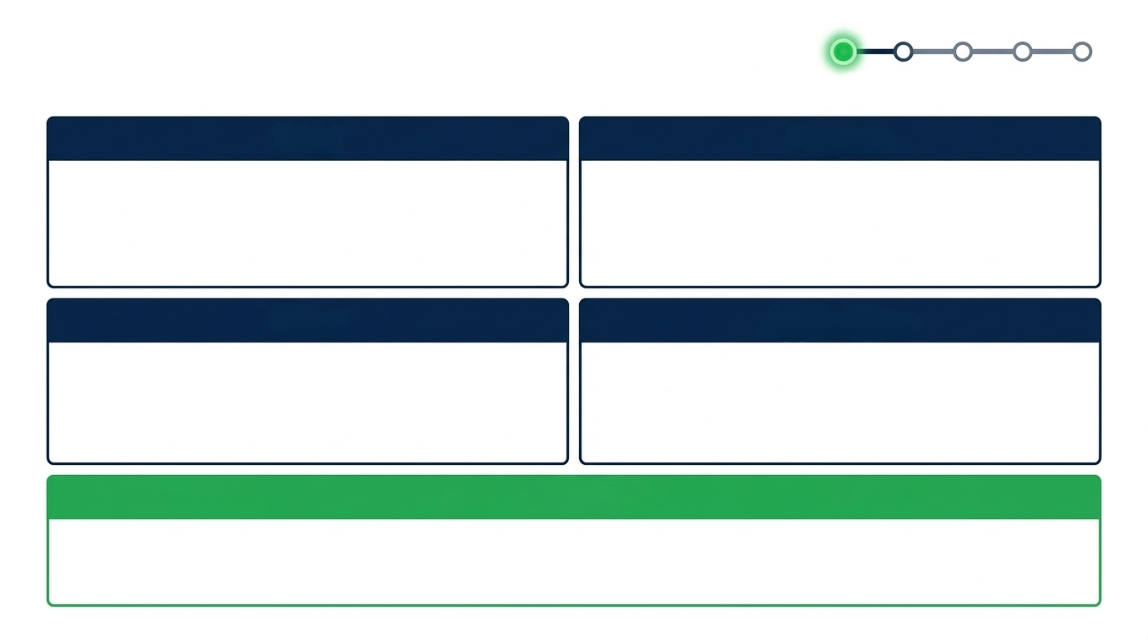
Milestone 1: K-3 Screeners
Know it
Jul-Sept
What
Purpose
Beginning/Middle of Year (BOY/MOY) early foundational check in ELA (K-3) and Math (K-2).
Identify students who are at the highest risk for reading or math difficulties.
When
Applications
BOY: First 30 days of the Fall semester.
MOY: January-April.
Immediate Tier II/Tier III intervention placement; baseline data for the Inquiry Cycle (Notice/Wonder).
Results
Targeted support for vulnerable early learners before achievement gaps widen.

Slide 11
Milestone 1: K-3 Screeners
Screeners
Ratings/VAM
Interims
Summative
AR App
USE IT
USED TO...
NOT USED TO...
✓
Identify students for immediate Tier II/III grouping
✗
Use as the sole data point for a formal SPED referral
✓
Set a baseline to progress-monitor all year
✗
Compare results across schools or districts
✓
Start building-wide Notice/Wonder conversations early
✗
Treat a single screener as a permanent label for a child
Navigating the State Data Landscape | 2026 ADE Summit

Slide 12
Milestone 1: K-3 Screeners
Screeners
Ratings/VAM
Interims
Summative
AR App
Do it
— Table Talk
THE SCENARIO
Your BOY K-2 literacy screener shows 48% of your kindergarten cohort scoring “Potential Risk" on letter naming — more than double last year's rate at this window.
What pattern jumps out, and what would you want to double-check before reacting?
NOTICE
Run the 5 Whys protocol. Can you determine a likely root cause?
WONDER
What is the one thing you do in the first two weeks of school or even to prepare for next year?
ACT
2 minutes at your table · be ready to share one Action out loud

Slide 13
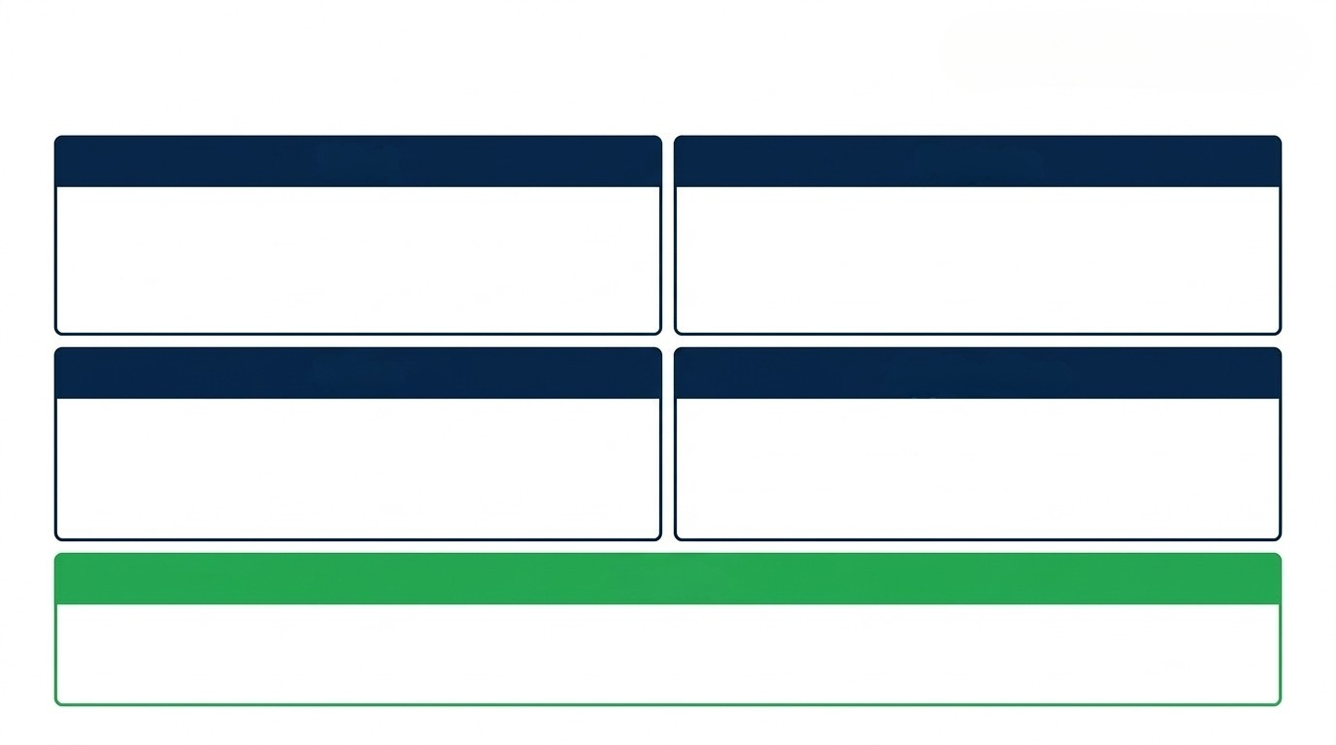

Milestone 2: School Ratings and VAM
Know it
September
What
Purpose
Official A-F school ratings and Value-Added Growth (VAM) data via LEA Insights
Provide public accountability and measure longitudinal cohort growth.
When
Applications
Analyze district, building, or classroom level trends; a data point for placement, targeted professional development, resource allocation.
September/October
Results
Broad structural adjustments to school improvement plans based on validated growth metrics.

Slide 14
Screeners
Ratings/VAM
Interims
Summative
AR App
Milestone 2: School Ratings and VAM
USE IT
USED TO...
NOT USED TO...
✓
Read growth and achievement as two separate stories
✗
Judge one teacher's effectiveness off a single year of VAM
✓
Spot grade/subject teams for targeted professional learning
✗
Assume a low letter grade means low growth (or the reverse)
✓
Use multi-year VAM trends to see systemic patterns
✗
Over-read small-n subgroups — small samples swing widely
Navigating the State Data Landscape | 2026 ADE Summit

Slide 15
Milestone 2: School Ratings and VAM
Screeners
Ratings/VAM
Interims
Summative
AR App
Do it
— Table Talk
THE SCENARIO
Your school earned a "C" rating this year — achievement is in the bottom 20% in the state, but the VAM data shows students are meeting growth expectations.
Two data points seem to conflict. What does each one actually measure?Why might achievement and growth tell different stories for the same grade band?
NOTICE
Run the 5 Whys protocol. Can you determine a likely root cause?
WONDER
What might you plan for summer PD or back to school to begin to address the root cause?
ACT
2 minutes at your table · be ready to share one Action out loud

Slide 16
Milestone 3: Interim Checkpoints
Know it
fall/winter
What
Purpose
Grade-level standards check-points for Grades K-2, 3-10 and EOC (ELA, Math, Science).
A systems check to monitor progress
toward grade-level expectations; evaluate pacing, rigor, and curriculum fidelity.
When
Applications
Identify need for acceleration or intervention mid-flight. Adjust instructional pacing, models, content.
Interim I- August-November
Interim II-December-March
Results
Real-time course correction to maximize student achievement before the spring summative assessment.

Slide 17
Screeners
Ratings/VAM
Interims
Summative
AR App
Milestone 3: Interim Checkpoints
USE IT
USED TO...
NOT USED TO...
✓
Check pacing-guide fidelity against actual standards taught
✗
Treat results as a final grade or high-stakes placement tool
✓
Fuel data reflection conversations with a mid-year checkpoint
✗
Skip reviewing it because "it doesn't count"
✓
Catch a reteach need while there's still time to act
✗
Use it to predict summative scores with precision
Navigating the State Data Landscape | 2026 ADE Summit

Slide 18
Milestone 3: Interim Checkpoints
Screeners
Ratings/VAM
Interims
Summative
AR App
Do it
— Table Talk
THE SCENARIO
Your Fall ATLAS interim shows 7th-grade reading proficiency down 10 percent from where last year's 7th-grade cohort landed at the same checkpoint.
Is this one class, one standard, or building-wide? Pacing guide? New HQIM rollout? A staffing change?
NOTICE
WONDER
Run the 5 Whys protocol. Can you determine a likely root cause?
What's the pacing or PD adjustment you make before the Winter Interim?
ACT
2 minutes at your table · be ready to share one Action out loud

Slide 19
Milestone 4: Summative Assessments
Know it
April/May
What
Purpose
Measure progress toward grade-level standards and support state/federal accountability. The summative provides a “systems check”.
Comprehensive end-of-year assessments aligned to Arkansas Academic Standards and Blueprints.
When
Applications
Review curriculum alignment; evaluate instructional strengths and areas for systemic improvement.
April/May
Results
Final performance levels (1-4) that reset the strategic
baseline for the following academic year.

Slide 20
Screeners
Ratings/VAM
Interims
Summative
AR App
Milestone 4: Summative Assessments
USE IT
As a principal, this data is FOR the following — and NOT for what's on the right.
USED TO...
NOT USED TO...
✓
Review curriculum alignment
✗
Draw conclusions about student growth (that's VAM's job)
✓
Identify PD needs for instructional teams
✗
Use as a sole source for intervention or SPED placement
✓
Evaluate instructional strengths
✗
Punish individual students or teachers
✓
Consider advanced opportunities / acceleration
✗
Check standard-by-standard achievement for individual students
Navigating the State Data Landscape | 2026 ADE Summit

Slide 21
Milestone 4: Summative Assessments
Screeners
Ratings/VAM
Interims
Summative
AR App
Do it
— Table Talk
THE SCENARIO
Summative results show Level 3/4 proficiency up 5 points school-wide — but a 15-point gap between your English Learners subgroup and their peers.
What's true at the building level, and what's hidden inside that average? Think resources, pacing, teacher efficacy, enrollment shifts, etc.
NOTICE
WONDER
Run the 5 Whys protocol. Can you determine a likely root cause?
What's the one structural/system change this data justifies changing next year?
ACT
2 minutes at your table · be ready to share one Action out loud

Slide 22
Milestone 5: AR App
Know it
January/June
What
Purpose
A single, consolidated strategic plan and federal funding application replacing 17 redundant grants and plans.
Systematically align district priorities and financial resources to identified student needs.
When
Applications
Form a cross-functional team to target funding toward Academic Outcomes, Safe & Healthy Schools, and Quality Workforce.
Planning begins in Jan/Feb; Final Submission due June 30, 2026.
Results
A cohesive, fully funded district strategy for the 2026-2027 school year.

Slide 23
Screeners
Ratings/VAM
Interims
Summative
AR App
Milestone 5: AR App
USE IT
As a principal, this data is FOR the following — and NOT for what's on the right.
USED TO...
NOT USED TO...
✓
Fund the root causes the year's Notice/Wonder work surfaced
✗
Treat it as a paperwork exercise finished in isolation
✓
Build one coherent strategy instead of scattered mini-plans
✗
Fund a wishlist unconnected to this year's data
✓
Decide as a cross-functional team, not solo
✗
File it away in June and not revisit it until next spring
Navigating the State Data Landscape | 2026 ADE Summit

Slide 24
Milestone 5: AR App
Screeners
Ratings/VAM
Interims
Summative
AR App
Do it
— Table Talk
THE SCENARIO
ELA scores are low across the district. In the review of your AR App the team recognized weak Tier I HQIM implementation.
Are low scores present across the grades? What HQPL has been provided? What do walk throughs tell you about implementation of HQIM?
NOTICE
Run the 5 Whys protocol. Can you determine a likely root cause?
WONDER
What goal might you write in the AR app around HQIM implementation and how might you monitor progress?
ACT
2 minutes at your table · be ready to share one Action out loud

Slide 25
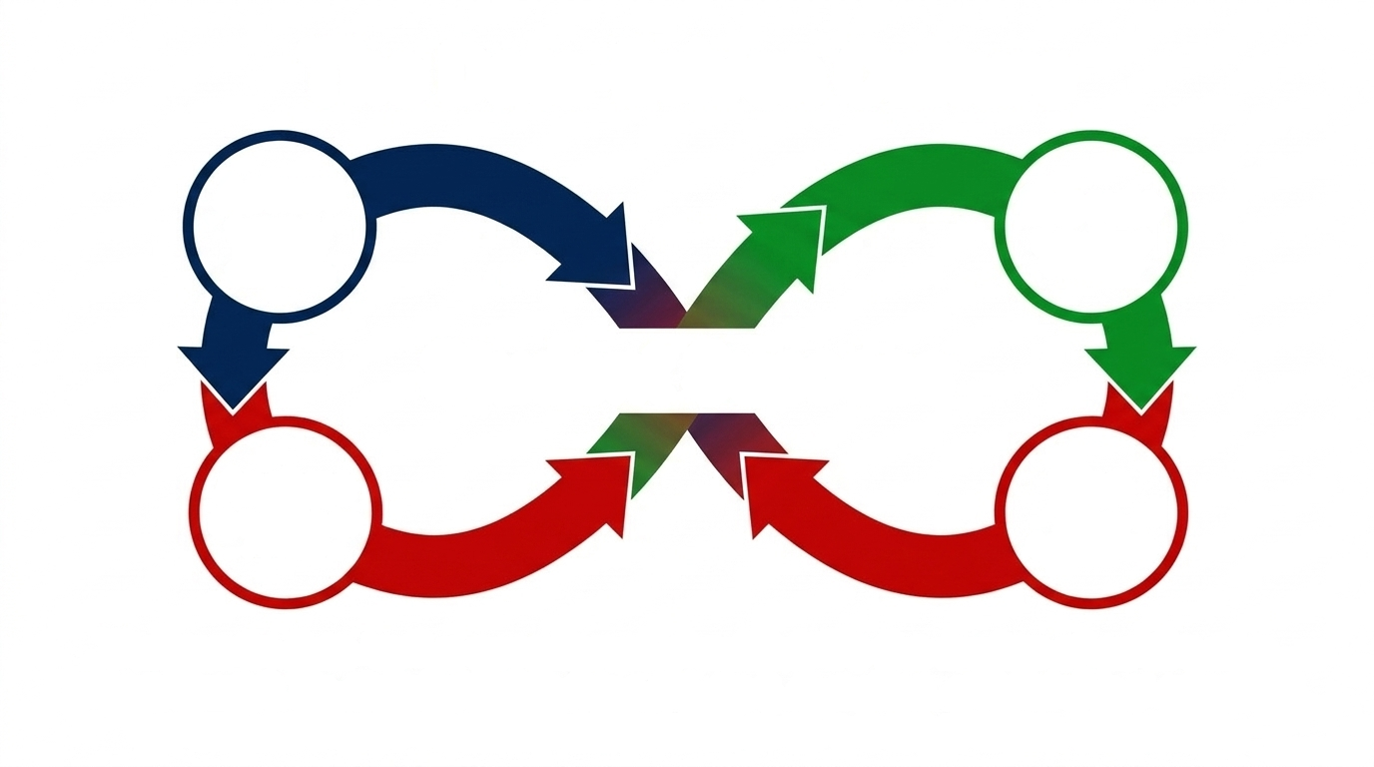

The Data-Driven Culture
Assess
Plan
Student Success
Analyze
Execute
The year in data isn't a compliance checklist; it's the engine of continuous improvement. By standardizing how we utilize data and prioritize resources, we ensure every Arkansas student receives a best-in-class education.

Slide 26
YOUR LEAVE-BEHIND
The Principal's Data Playbook
Milestone | When It Lands | Things to Check | One Conversation to Have
K-3 Screeners | Jul–Sept | Which students need to be prioritized for tier II, tutoring, focused instruction? | Interventionist / K-3 team
Ratings & VAM | Sept–Oct | Growth vs. achievement — what story do they tell? | Grade-level teams, leadership
ATLAS Interims | Fall & Winter | Pacing-guide, fidelity of implementation of curriculum, which standards taught, ALDs and rigor of classroom assessments | Instructional coach / content and/or grade level teams
Summative | Apr–May | Subgroup gaps, grade, content or teacher anomalies, big systems check | Leadership team
AR App | Jan–Jun | Do goals and resource allocation map to a root cause from this year's data? | Cross-functional planning team
By standardizing how we view, question, and fund our priorities, we ensure every Arkansas student receives a best-in-class education.

Slide 27
Additional Resources
Resource | Description | Link
ATLAS 101 Presentation (Summit 2025) | Explanation of the suite of assessments | https://docs.google.com/presentation/d/1jt9ONbx4X8UU0wZ_i7QJ5ZM2HBTCfp3Q/edit?usp=sharing&ouid=114426604802629790998&rtpof=true&sd=true
Final Testing Calendar | Assessments by Chronological Order | https://docs.google.com/document/d/1SF46NA6EPlcrhEnRoNWZnfH3itAKop41ckbBHSHOmnk/edit?usp=sharing
Data Training Series | Bite-sized data training | https://dese.ade.arkansas.gov/Offices/public-school-accountability/data-training-series/atlas-video-series-using-data-to-drive-instruction
Analyzing Achievement Data | Digging into achievement data presentation | https://docs.google.com/presentation/d/1vPV7sCFnG9Zk6esLjVJbaTUV5LyRLCv3Xe_eTesrfMU/edit?usp=sharing

