Slide 1
Equatio: The Math Engine That Refuses to Let Your District Spiral into Numerical Nonsense
Empowering districts with precise and engaging math solutions

Slide 2

Evan Beavers
AEM Coordinator

Slide 3
Introduction and Context

Slide 4

Equatio

Slide 5

Why Math Accessibility Matters
Barriers to Math Access
  Many students face barriers like difficulty typing equations and interpreting symbols, limiting their math learning.
Individual Learning Needs
  Students with disabilities, multilingual learners, and diverse cognitive styles need accessible math content to succeed.
Impact on Outcomes
  Limited access to math content reduces learning opportunities and affects overall student success and confidence.
Rethinking Instruction
  Improving math accessibility is foundational and leads to better educational outcomes for all students.

Slide 6
Understanding the Challenge

Slide 7
Session Goals and Outcomes
Practical Application
  Because great PD should lead to real classroom impact. Participants leave with read-to-use strategies they can confidently implement. No flush, just practical ideas that fit into everyday instruction.
Focus on Accessibility
  Math is for all students, not just the ones who get it before you finish the question. This session leans into real ways to remove barriers, support individual learners, and make math make sense.
Engaged Professional Development
  No sit-and-get. No passive nodding. No “I’ll totally use this someday” energy. Instead, expect thinking, reflecting, maybe even a little discomfort as we take an honest look at what’s working, what’s not, and what we’re actually asking students to do.

Slide 8

The Reality of Inaccessible Math Instruction
Challenges in Traditional Math Instruction
  Traditional math teaching often uses static text and complex symbols that many learners find difficult to access and understand.
Barriers to Expression and Input
  Students face difficulties typing equations and expressing reasoning due to incompatible formats and standard keyboards.
Universal Accessibility Concerns
  Accessibility issues impact not only students with disabilities but also many learners, making access-focused approaches essential.
Need for Instructional Change
  Current gaps between teaching methods and student needs create urgency for new tools and approaches in math education.

Slide 9
Equatio as a Solution

Slide 10
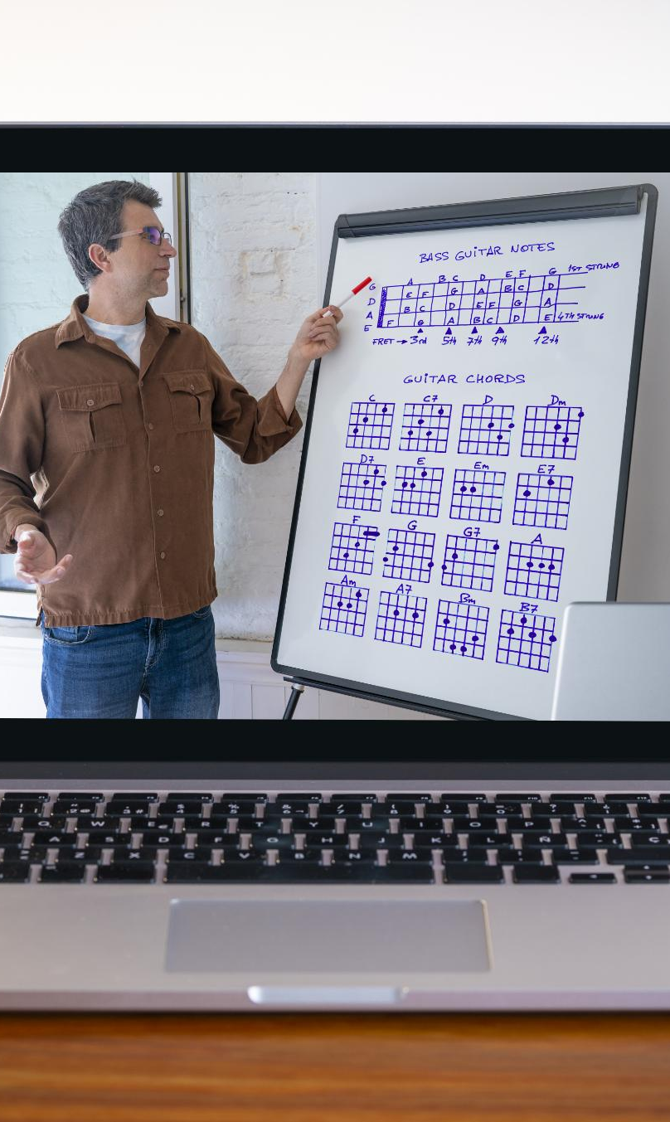
What Is Equatio?
Multiple Input Methods
  Users can enter math expressions by typing, handwriting, or speech, enhancing accessibility for all learners.
Educational Platform Compatibility
  Equatio integrates smoothly with common digital educational platforms, supporting seamless workflow integration.
Supports Students and Teachers
  The tool aids both students and teachers in creating and accessing math content effectively.
Broad Educational Applicability
  Equatio serves all grade levels and subjects, making it a versatile resource for a broad range of educational needs.

Slide 11

Why Equatio Makes a Difference
Removing Access Barriers
  Equatio removes barriers, enabling students to fully participate in math activities and showcase understanding effectively.
Supporting Independent Learning
  Equatio supports independent work by matching tools to individual student needs like speaking, typing, or drawing equations.
Improving Instructional Insight
  Teachers gain better insight into student understanding, enabling targeted support and accurate assessment.
Alignment with UDL Principles
  Equatio aligns with Universal Design for Learning, promoting accessible and adaptable instruction for all learners.

Slide 12
Features and Impact

Slide 13
Key Features of Equatio
Speech-to-Math Functionality
  Users can dictate mathematical equations using speech, enabling hands-free input and faster equation creation.
Handwriting Recognition
  Converts handwritten math expressions into digital text for easy editing and integration into documents.
Screenshot Reading
  Extracts and interprets mathematical content from images, making math accessible from screenshots and pictures.
Predictive Math Tools
  Assists users in creating equations with predictive suggestions, improving speed and accuracy in math input.

Slide 14
Who Benefits from Equatio?
Everyone.

Slide 15
Instructional Transformation

Slide 16
From Compliance to Meaningful Access
Shift from Compliance
The mindset moves beyond merely meeting accessibility regulations to fostering meaningful learning experiences for all students.
Practical Tools Enhance Learning
Tools like Equatio provide practical solutions that help educators create engaging and accessible instructional materials.
Universal Design Goals
Reframing accessibility as an opportunity supports broader educational goals of high-quality instruction, meaningful access, and continuous improvement

Slide 17

Everway + Clever

Slide 18

Buckle up, It’s demo time.

Slide 19
Get In touch
Get in touch!
evan.beavers@ade.arkansas.gov
arkansasaem.org
501-683-0107

Slide 20
DESE end slide

