Slide 1
Turning “Gotcha” Into “I’ve Got You!”
How an Effective P.O.P. Cycle Supports and Grows All

Slide 2
Purpose for Today's Learning
Goals
Explore the P.O.P. Cycle
Discover EES Platform Updates
Feel Confident When Observing and Coaching

Slide 3


Slide 4
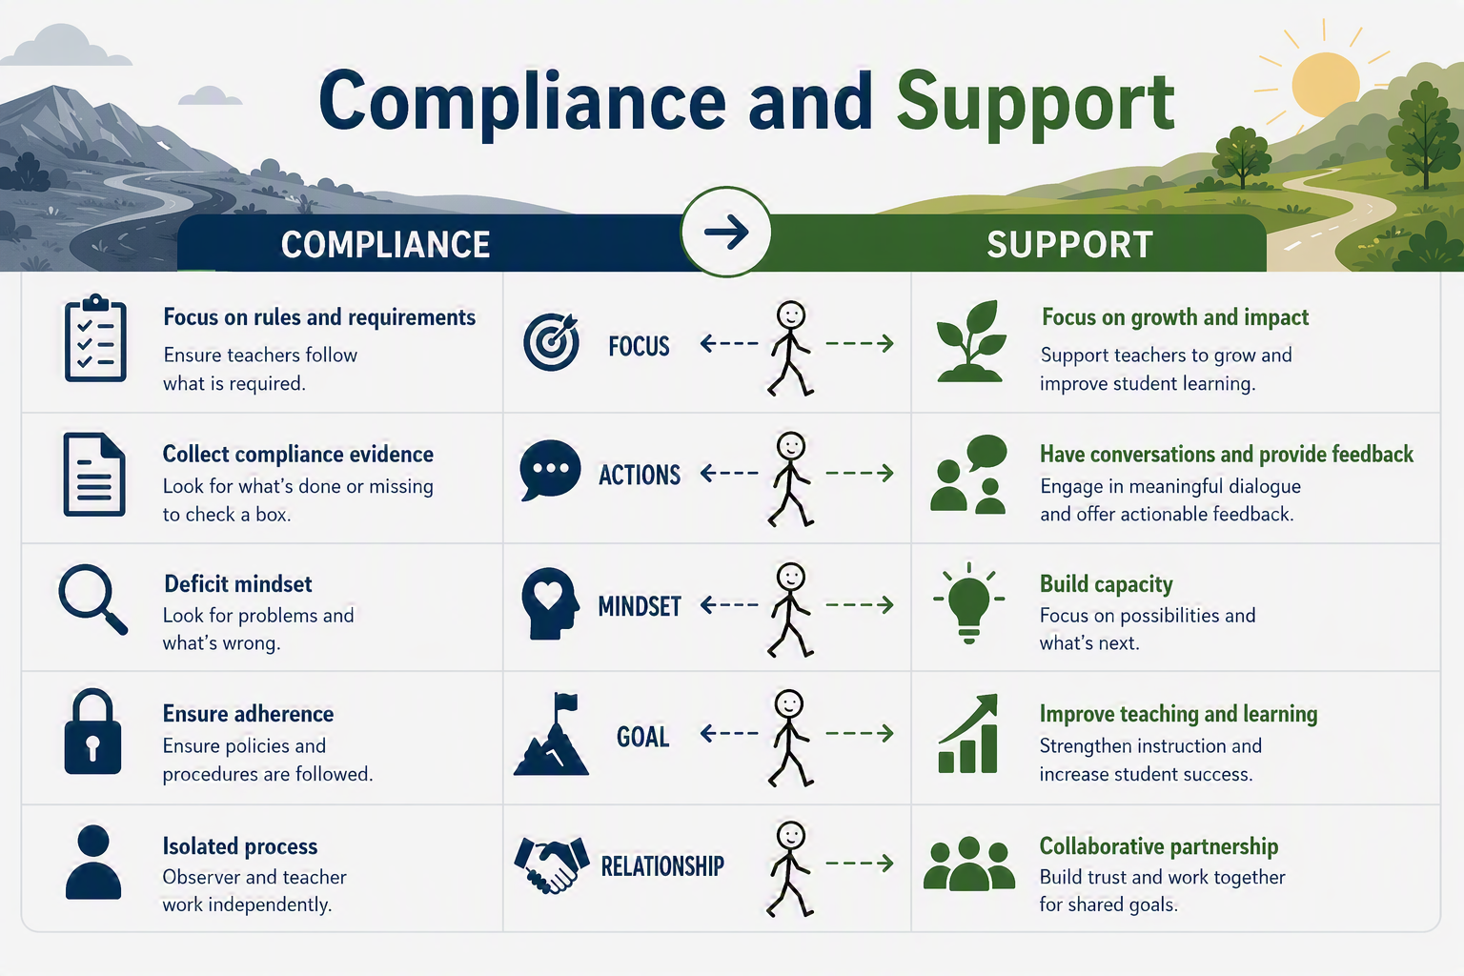

Notes:
Act 808 of 2025 is compliance.

Slide 5
 |  | EES Platform | Pre Observation Conferencing | Collecting Quality Evidence | Post Observation Conferencing | Providing Accurate Ratings | Key Levers Tool | TESS Indicators
Theory
Demonstration
Practice
Coaching
Source: Joyce, B. & Showers, B. (2002). Student Achievement Through Staff Development.
Notes:
Explain each of the four.

Slide 6
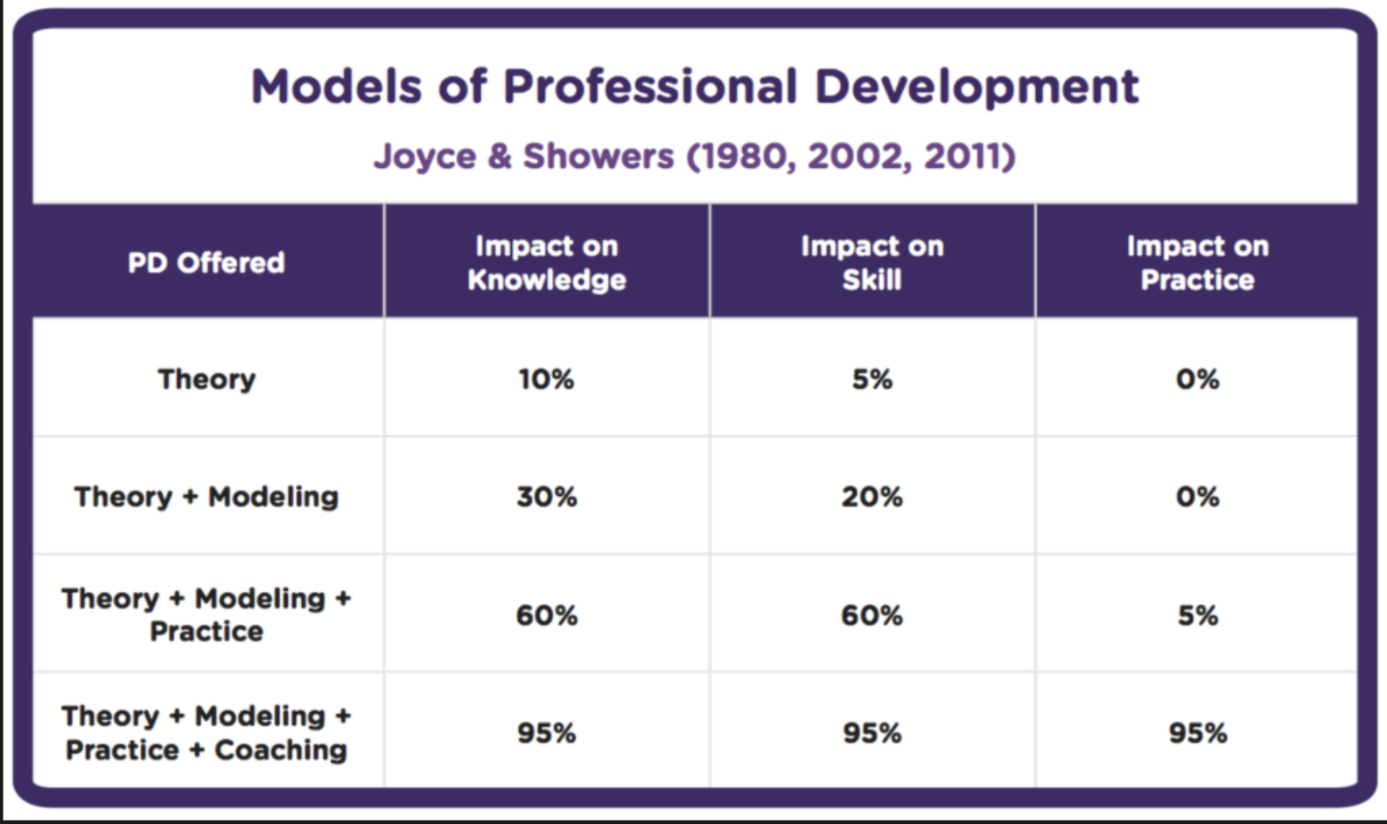
Source: Joyce, B. & Showers, B. (2002). Student Achievement Through Staff Development.

Slide 7
The Observation Cycle
Notes:
I would love to tell that if your culture is strong enough, your teachers won’t be nervous. If I did, that would be a lie. My father says that if you’re not a little nervous, you don’t care enough. Knowing this, how can we use the observation cycle to demonstrate that we are a team.

Slide 8
The Observation Cycle: Three Connected Phases
Connect with the teacher before an announced observation. Gather background on the lesson plan, students, and context; begin coaching.
1. Pre-Conference
Script evidence in real time from both teachers and students to evaluate the impact of instruction on student learning.
2. Observe the Lesson
Guide teacher self-reflection. Identify one area of reinforcement (strength) and one area of refinement (growth), grounded in evidence.
3. Post-Conference
Throughout every phase, — the mission is to develop teachers to improve student learning.

Slide 9
The Platform Supports You
The Educator Effectiveness System (EES) platform mirrors the observation cycle. Each phase you just saw has a matching, guided form in the platform — you focus on the coaching conversation while the platform structures and stores your documentation.
Guided fields for greeting, general questions, lesson overview, and reflection questions.
Type Evidence Notes directly as the teacher talks through the plan.
Save a draft and return before the observation.
In the Platform: Pre-Conference
Script teacher and student evidence in real time in the observation report.
Tag evidence to rubric indicators as you go.
Enter Observer and Self-scores across all three domains.
In the Platform: Observation
Build the Reinforcement and Refinement plans in structured fields.
Attach evidence, record the recommended action, and share ratings.
Route for electronic signatures to close out the cycle.
In the Platform: Post-Conference
Bottom line: the platform does the organizing so leaders can focus on evidence, feedback, and the coaching conversation.

Slide 10
The Preconference

Slide 11
Pre-Conference Planning: Purpose
The pre-conference facilitates a connection between the teacher and observer before an announced observation.
The teacher engages in a coaching conversation; the observer gathers essential background on the lesson plan and students.
The observer asks about the lesson plan, grouping structures, classroom configuration, and specific students.
The teacher shares student composition, lesson context within the unit, assessment, extenuating circumstances, and evidence of planning using the rubric.
Source: Arkansas TESS Teacher Rubric Handbook, Appendix A, p. 56.

Slide 12
The Pre-Conference Process
Component | Key Actions
Purpose | • Provides an opportunity to ask questions and begin collecting evidence for the upcoming lesson. • Allows the observer to begin coaching and address issues that may negatively impact the lesson.
Scheduling | • For announced observations, schedule the pre-conference 2–3 days before the lesson observation. • Gather the lesson plan at least 24 hours before the pre-conference. • The pre-conference usually lasts 10–20 minutes.
Planning | • Analyze the lesson plan and supporting documents, such as handouts, assessments, and visuals. • Complete the pre-conference planning template.
Source: Arkansas TESS Teacher Rubric Handbook, Appendix A, p. 56.

Slide 13
Preparing for the Pre-Conference
General Tips
Review the lesson plan, handouts, and assessments to be used.
Review the unit plan or weekly lesson plans.
Develop questions that lead to explanations of planning decisions and clarity about the lesson.
Review previous observations for areas of reinforcement and refinement.
Pre-Conference Questions (EES)
(1c) What do you want learners to know and be able to do during and after this lesson?
(1c) Which specific standards are you focused on when planning the lesson?
(1a) How is the lesson connected to previous learning?
(1b) In what ways do you become familiar with student backgrounds and interests?
(1d) What resources are you utilizing to teach this lesson?
(1e) In what ways will you use resources, groupings, or activities to differentiate instruction for all students to achieve the learning outcomes ?
(1f) How will you know if students have mastered the lesson objective? What will be your evidence of mastery?
(3d) How might students monitor their own progress toward the learning objective?

Slide 14
Pre-Conference Form in the EES Platform
Conference Introduction / Greeting
Greeting / set the tone; establish the length of the conference; review the process and purpose. "The purpose of this pre-conference is to allow you to discuss your lesson plan, share student data, and provide a general idea of what I can expect to see during the lesson."
Lesson Overview
Ask the teacher to talk through the lesson as planned.
Ask Additional Questions for Teacher Reflection
Which specific descriptors did you focus on when planning this lesson? How does your analysis of student data/work impact planning for this lesson? Where will instruction be differentiated to address varying learning needs? How will you and your students know they have mastered the objective? Evidence Notes:
Next Steps and Closing
"Thank you for taking the time to discuss the lesson with me. I look forward to seeing your lesson on ______."

Slide 15
Observation

Slide 16
Observing the Lesson: Purpose
The primary goal is to gather evidence regarding teaching and learning within the classroom.
When observing in real time, carefully script everything you see and hear from both teachers and students.
This evidence is crucial for evaluating the impact of instruction on student learning of the lesson's objectives.
Ensure all participants feel supported and maintain a growth-focused mindset — the mission is to benefit students and support their growth.
Source: Arkansas TESS Teacher Rubric Handbook, Appendix A, p. 58.

Slide 17
High-Quality Evidence Collection
Focus on Collecting
Student evidence: what students say, do, and produce.
Teacher evidence: what the teacher says and does.
Visual evidence: wording from visuals used.
Task evidence: wording from tasks or assignments.
Impact evidence: what impacted student mastery of the objective.
Capturing Evidence During the Lesson
Time: capture the length of different lesson segments.
Abbreviate: write out abbreviations after the lesson.
Verbatim: capture exact dialogue when possible.
Paraphrase: use parentheses to indicate paraphrasing.
Circulate: move as necessary to collect teacher, student, and student-work evidence.
Source: Arkansas TESS Teacher Rubric Handbook, Appendix A, p. 58.

Slide 18
The Post-Conference

Slide 19
Post-Conference Planning: Purpose
The post-conference enables teachers to self-reflect on their lessons, guided and supported by the observer.
The teacher and observer discuss an area of reinforcement (the relative strength) and an area of refinement (the relative area for improvement).
The observer identifies these based on the lesson's evidence, analysis of student work, and rubric indicators.
The focus is on two indicators — one strength and one growth area — rather than detailed feedback on multiple indicators.
Source: Arkansas TESS Teacher Rubric Handbook, Appendix A, p. 59.

Slide 20
Post-Conference Format
Introduction | Reinforcement | Refinement | Review Ratings
Greeting | Reinforcement Area (Indicator & Descriptor) | Refinement Area (Indicator & Descriptor)
Review Conference Process | Teacher Reflection Questions | Teacher Reflection Questions
Ask a General Impression Question | Share Evidence for the Reinforcement Area, referencing student work | Share Evidence for the Refinement Area, referencing student work | Share Evidence for Ratings
Analyze & Discuss Student Work Samples |  | Share Recommended Actions · Guided Practice
Source: Arkansas TESS Teacher Rubric Handbook, Appendix A, p. 59.

Slide 21
Post-Conference Form in the EES Platform — Part 1
Introduction / Greeting
Greeting / set the tone; establish the length; review the process and purpose. "We will reflect on the strength of the lesson observed (area of reinforcement), then identify an area of refinement to strengthen that could have extended student learning." Ask a general question: "Based on your analysis of student work, how do you think the lesson went?" Analyze student work samples with the teacher to identify areas of strength.
Reinforcement Plan
Reinforcement Objective:
Questions for Teacher Reflection: (Open-ended questions focused on the reinforcement area, sequenced general → specific.) |  | Evidence from the Lesson (at least three examples that support student learning): Student Evidence: Teacher Evidence:

Slide 22
Post-Conference Form in the EES Platform — Part 2
Refinement Plan
Refinement Objective:
Transition to Refinement Question: "Based on the analysis of student work, what would you change about the lesson and why?"
Questions for Teacher Reflection: (Open-ended questions focused on the refinement area, sequenced general → specific.) | Evidence from the Lesson (at least three examples that support student learning): Student Evidence: Teacher Evidence:
Recommended Action:
Closing
What was something positive you heard about teaching and learning? · Restate the areas of refinement and reinforcement. · Share ratings. · Sign documentation. · Closing statement.

Slide 23
Developing the Post-Conference Plan
Introduction / Greeting
Common Threads
Alignment
Scaffolded approach
Impact on student learning
Objective — timeline + observable action; narrow to an indicator & descriptor; include impact on student learning
Reflection Questions — open-ended, sequenced general → specific; connect practice to student learning
Evidence — strongest evidence for the targeted indicator; specific teacher & student evidence
Recommended Action (Refinement) — clear, measurable, highest-leverage, realistic
Guided Practice (Refinement) — teacher brainstorms applying the action in future lessons
Closing
Source: Arkansas TESS Teacher Rubric Handbook — Guidance for Observers, Appendix A, p. 60.

Slide 24
Reinforcement vs. Refinement
The relative strength of the lesson.
Identify the indicator where the teacher is most accomplished.
Use language from the Instruction domain.
Reflection questions prompt the teacher to explain the strength.
Evidence explicitly integrates teacher and student examples showing positive impact on learning.
Reinforcement
The relative area for improvement.
Identify the major area of growth.
State it in unambiguous, explicit language from the Instruction domain.
Add a Recommended Action: clear, measurable, highest-leverage, and manageable.
Add Guided Practice so the teacher can plan applying it in a future lesson.
Refinement
Source: Arkansas TESS Teacher Rubric Handbook — Post-Conference Scoring Rubric, pp. 65–66.

Slide 25
Coaching Skills for the Post-Conference
Coaching Skills to Utilize | Post-Conference Structure
Active listening | Start with the positive.
Reflective questioning | Allow the teacher time to process and reflect.
Body language | Discussion focused on specific evidence from the plan, lesson, and student work.
Paraphrasing | Use strengths to address the area for growth.
Confirming and validating | Focus is narrowed.
Extending thinking | Provide action steps for future lessons with guidance.
Collaborating | One-on-one coaching conversation.
Source: TESS Observation Training Participant Guide — Day 3 Participant Materials, p. 44.

Slide 26
Virtual Training Calendar
EES Monthly Newsletter

