Slide 1



REAL TALK
Q&A WITH ARKANSAS STATE POLICE ICAC
LENORE PALADINO & CASSIE HARRIS

Slide 2

The predator can always tell who is without protection.
-Dr. Gabor Mate

Slide 3
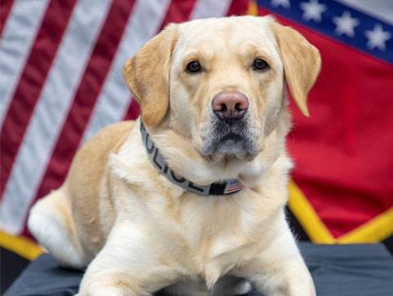

OUR
MISSION
  The Internet Crimes Against Children Task Force Program (ICAC) helps state and local law enforcement agencies develop an effective response to technology-facilitated child sexual exploitation and Internet crimes against children. This support encompasses forensic and investigative components, training and technical assistance, victim services, prevention and community education.

Slide 4


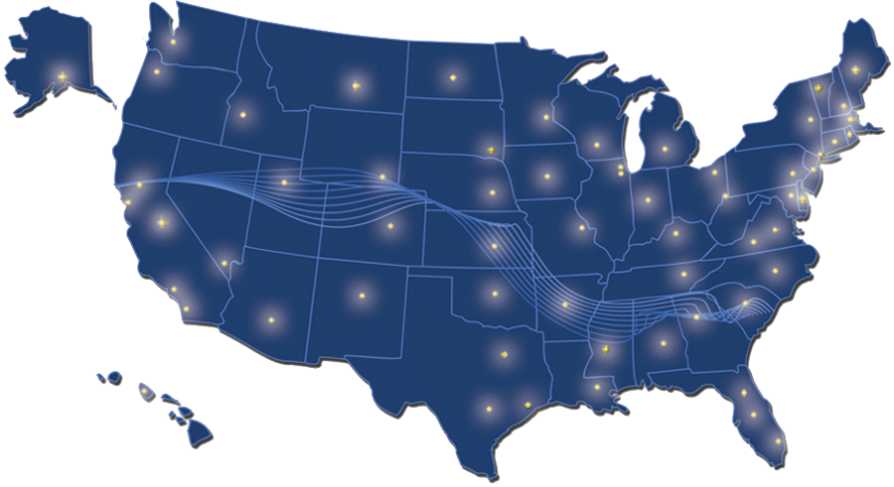
  NATIONAL ICAC TASK FORCE SINCE 2003
  ONE OF THE 61 REGIONAL ICAC TASK FORCES IN THE US
  AFFILIATES; LOCAL AND FEDERAL

Slide 5

National Center for Missing & Exploited Children
  Largest and most influential child protection organization in the country.
  Private, nonprofit 501(c)(3) corporation,
  Work with families, victims, law enforcement, child welfare, private industry and the public to provide free services to help find missing children, stop child sexual exploitation and prevent child victimization

Slide 6
CYBERTIPLINE
  NCMEC’s CyberTipline is designated by Congress as the clearing house for suspected child sexual exploitation. Electronic service providers are required by law to report suspected child sexual abuse material (CSAM), online enticement and child sex trafficking to NCMEC. Members of the public can also report directly. NCMEC makes reports available to domestic and international law enforcement agencies, adding valuable information where possible.

Slide 7

CYBERTIPS
ONLINE ENTICEMENT
— WHERE AN OFFENDER USES THE
INTERNET TO SOLICIT OR COERCE A CHILD FOR
SEXUAL PURPOSES — INCREASED 158%
AI is playing an increasing role in the sexual exploitation of children -182,000 reports
BY THE NUMBERS 2025
21.3 Million reports received in 2025
61.8 Million total files included in reports of suspected child sexual exploitation
19.5 Million reports of child sexual abuse material (CSAM)
113,500+ reports of Child Sex Trafficking

Slide 8
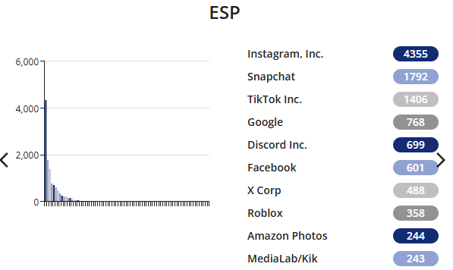
ARKANSAS RECEIVED
12,697 CYBERTIPS IN 2025

Slide 9


Slide 10


Slide 11
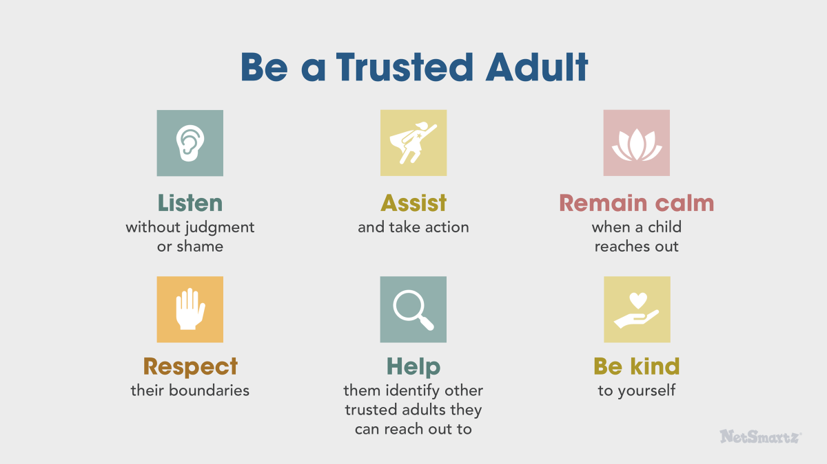

Slide 12
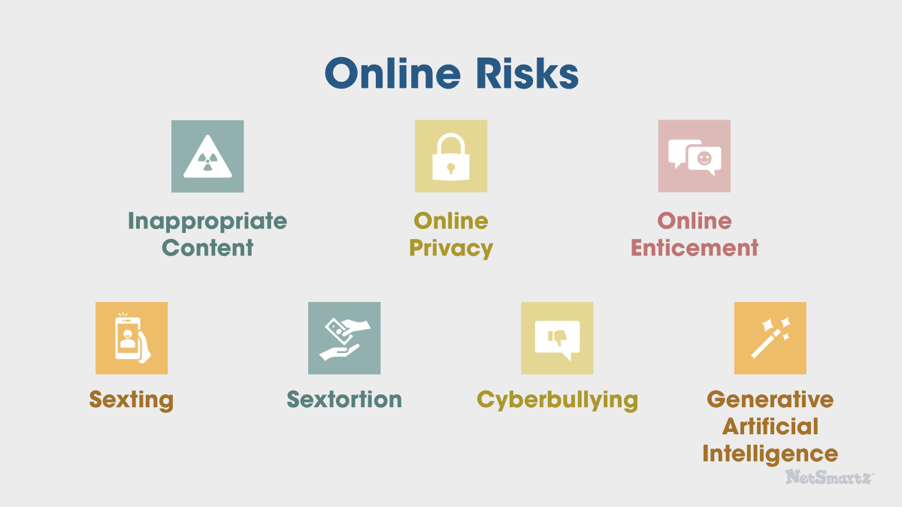

Slide 13

AVAILABLE RESOURCES

Slide 14

THANK YOU
CONTACT US
LENORE PALADINO
CASSIE HARRIS
501-618-8151 OFFICE
501-618-8151 OFFICE
501-297-8607 CELL
501-350-7673 CELL
LENORE.PALADINO@ASP.ARKANSAS.GOV
CASSIE.HARRIS@ASP.ARKANSAS.GOV

