Slide 1

Healthy Students, Higher Achievement: Leveraging School Health Data for Classroom Success
Cheria McDonald, APRN, NCSN, State School Nurse Consultant
Dana Bennett, RN, MITS Asst Director
Taylor James, MPH, CDC Surveillance Coordinator
Notes:
Introduce topic and speakers

Slide 2
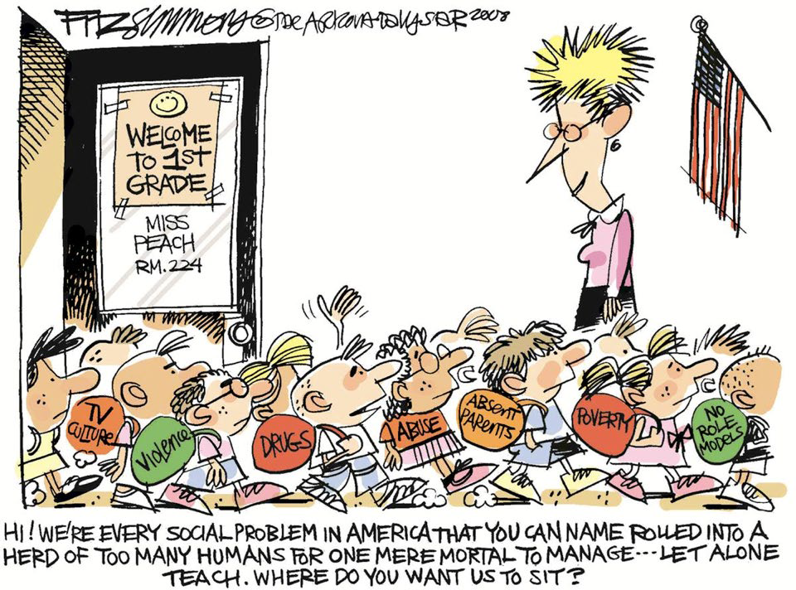
Notes:
This image is meant to be a little light-hearted, but it reflects a very real challenge in our classrooms. Students don’t come to school as blank slates - they bring complex experiences and barriers with them every day. Often, those needs aren’t fully understood or visible. And when we don’t fully understand what students are dealing with, it becomes much harder to reach them, teach them, and support their success. That’s really the foundation of this entire conversation - Students can’t succeed if their needs aren’t understood - and they can’t be supported if we don’t see those needs clearly.

Slide 3
WHY This Data Matters
Understanding the Real Barriers to Learning
Students are coming to school with significant health and behavioral challenges that directly impact learning:
  Obesity & Physical Health
  Anxiety, Depression, and Suicide Risk
  Teen Pregnancy
  Behavioral & Mental Health Needs
These challenges don’t show up in one place - they show up across systems:
  YRBS - Identifies student risk behaviors & experiences on a state-level & national level
  Profiles - Shows school policies, supports, and gaps in Arkansas & the nation
  School Health Survey & MITS - Show real student needs and services being delivered
Notes:
YRBS/Profiles: Explain this data is through CDC Surveillance Grant and reflects data on a state-level/allowing capability to compare data on a national-level, as well.
School Health Survey: shows audience what their local schools are exhibiting.
MITS: Ties in the financial piece, how much we are spending towards these supports, how much is available, etc.

Slide 4
What This Means for Schools
Not isolated issues - system wide, measurable disparities
Without data schools are reacting instead of planning
With data, schools can improve:
  Identify priority needs
  Target interventions and supports
  Align MITS funding and school nursing services
  Improve both health and academic outcomes
If we don’t use this data, these disparities stay hidden - and students continue to struggle.
Notes:
When we look across YRBS, Profiles, and school health data, we start to see consistent patterns - mental health, chronic conditions, and behavioral risks. These are separate issues - they are interconnected barriers to learning that require a coordinated response.”

Slide 5
Where Arkansas Stands Nationally
Arkansas students face greater health challenges - making school support critical
Key Disparities
Teen Birth Rate
  Arkansas ranks 49th in the nation (23.8 per 1,000 vs. 13.1 U.S. average)
Youth Mental Health
  Arkansas ranks 46th for youth mental health outcomes
  Higher rates of depression, suicidal thoughts, & unmet need for services
Overall Health Ranking
  Arkansas ranks 48th-49th overall nationally
  Falls below average on the majority of health indicators
Obesity & Behavioral Health
  Among the bottom tier of states for obesity and mental distress
  Reflects long-term, systemic health challenges
Notes:
Across key student health indicators, Arkansas consistently ranks below the national average.
These rankings aren’t about comparison for the sake of comparison—they help us understand the level of need. When Arkansas ranks near the bottom nationally, it means our schools are carrying a heavier burden—and our systems have to be stronger and more coordinated in response.

Slide 6
Understanding Arkansas Students
YRBS
YRBS gives us direct insight into student experiences on a state-level
Moves us from state rankings - real student behaviors
Helps answer:
  What are students experiencing right now?
  Where are the highest risks?
  What is impacting classrooms daily?
If national data tells us where Arkansas stands, YRBS tells us what our students are actually experiencing.
Notes:
Transition slide into YRBS. Briefly explain how YRBS works. Focus area (7th-12th grades), health disparities on a state-level with capability to compare where Arkansas lies with national-level of YRBS. YRBS is taken during odd-numbered years.

Slide 7
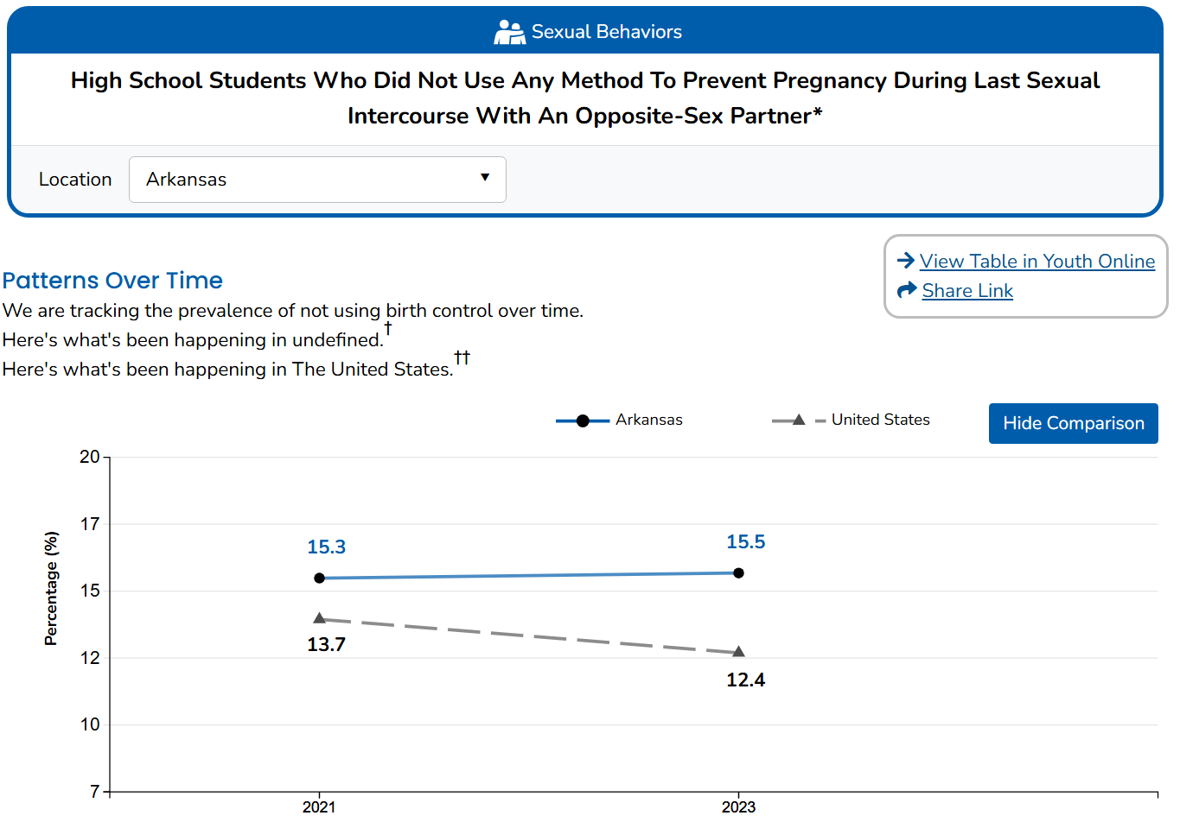

Slide 8
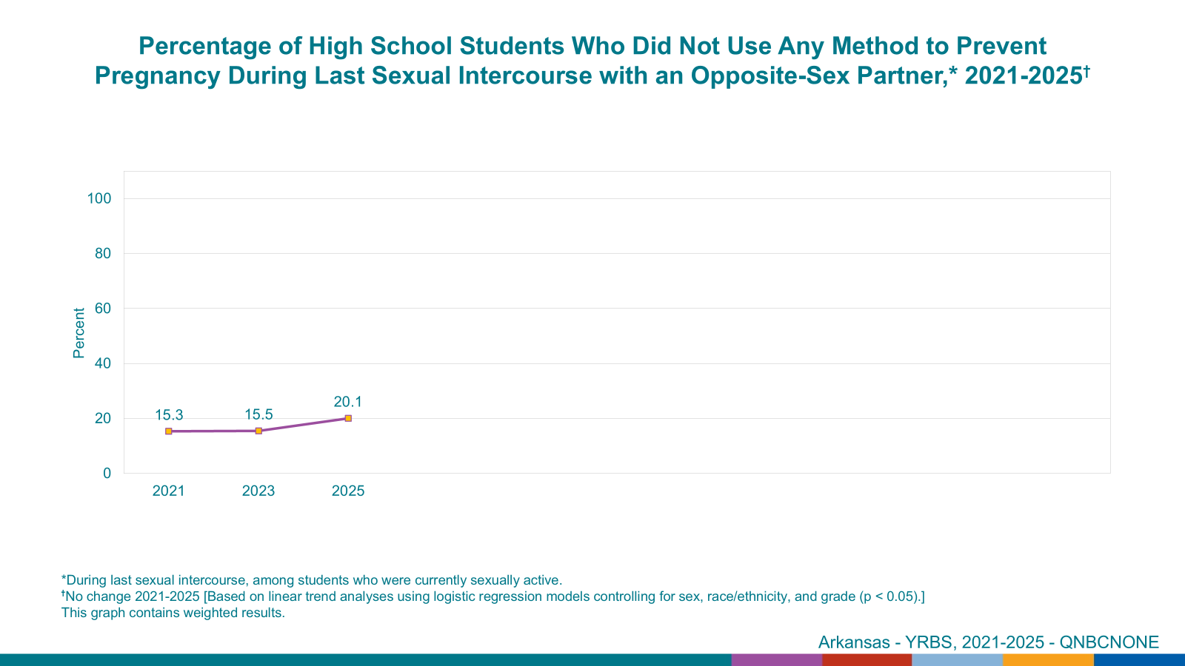
Notes:
Arkansas has risen in this factor.

Slide 9
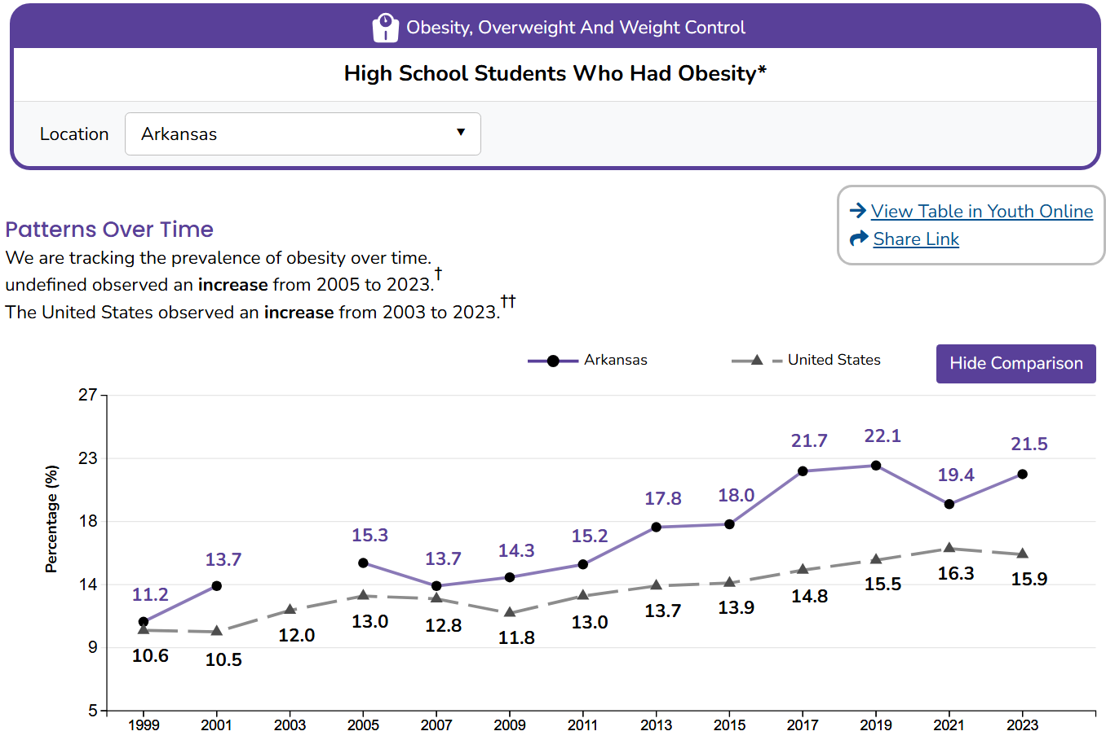

Slide 10
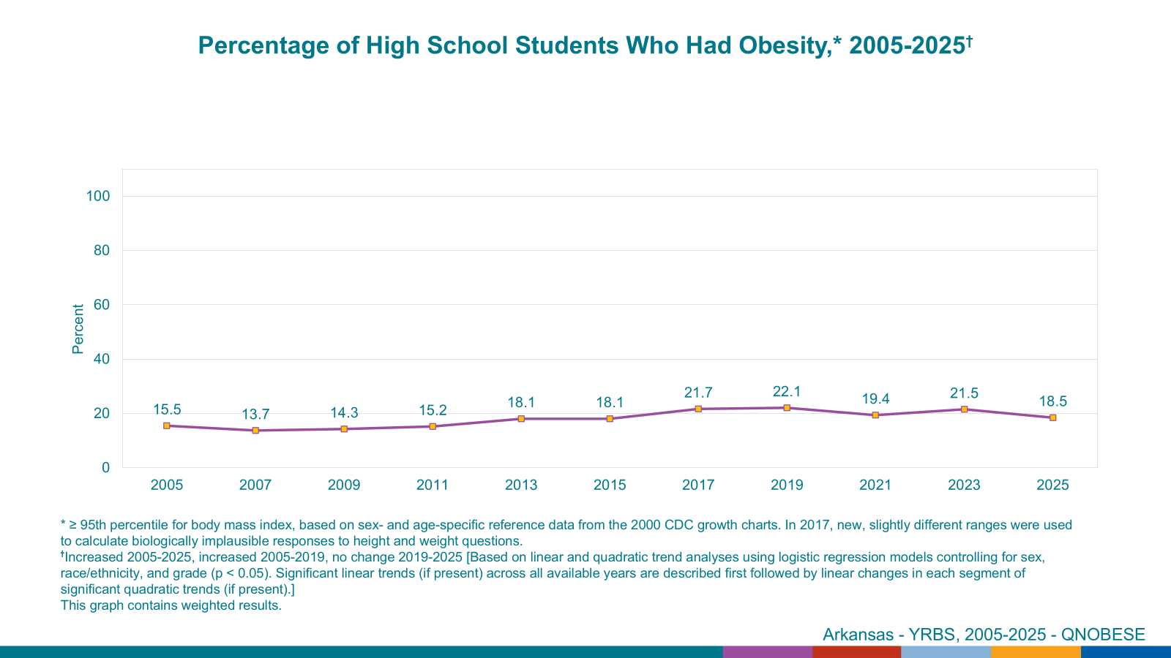
Notes:
2025 The percentage has dropped 3%. May seem small but this is a big drop that we haven’t seen in our state since 2015! 2025 Data is still coming in for the nation, but we were able to receive our State’s data for this factor.

Slide 11
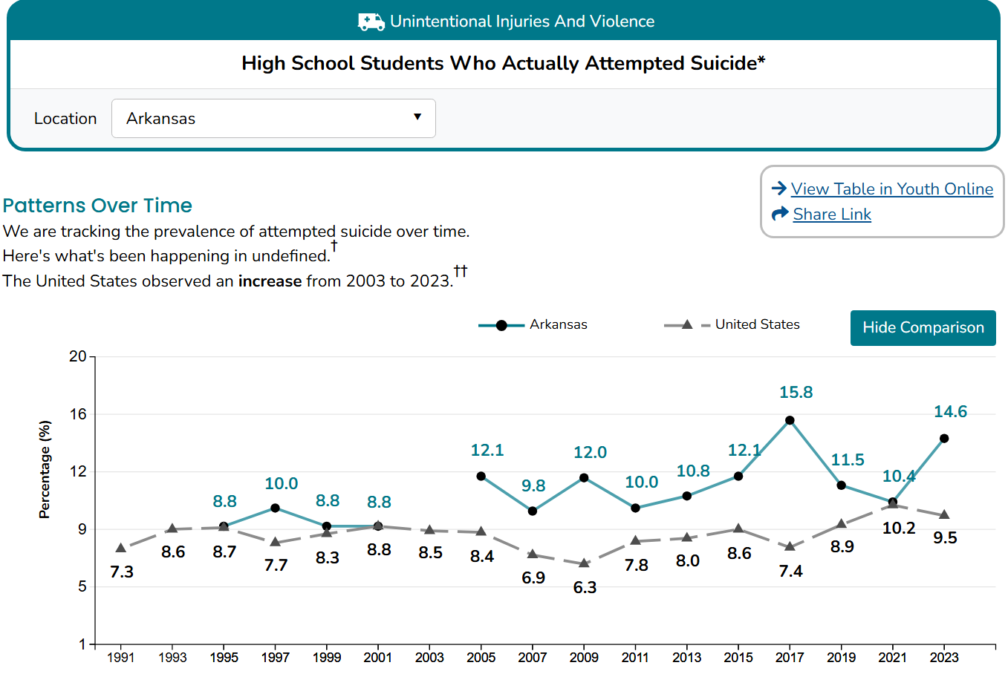

Slide 12
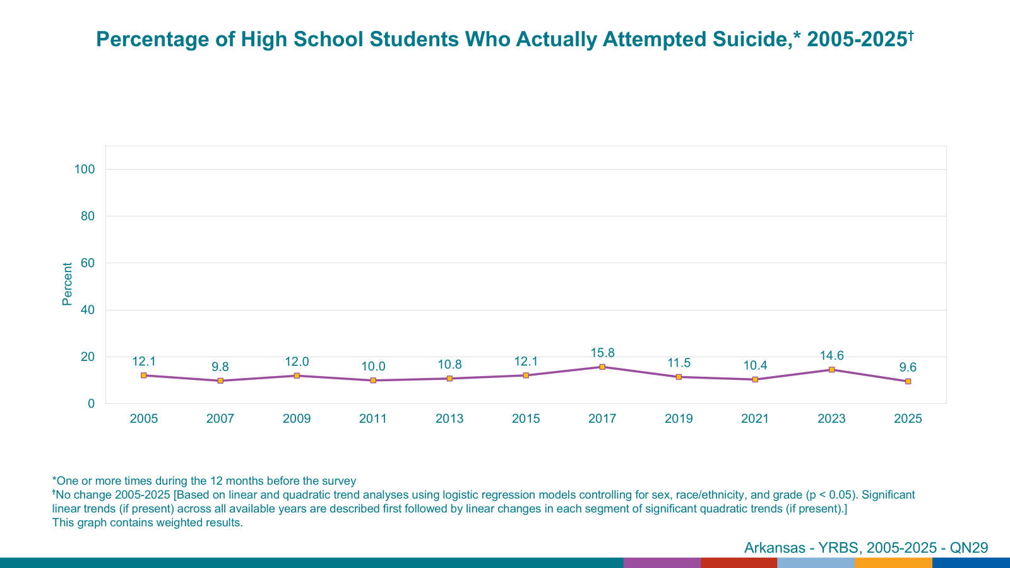
Notes:
Percentage has dropped significantly in 2025. Lowest it has been since 2005.

Slide 13
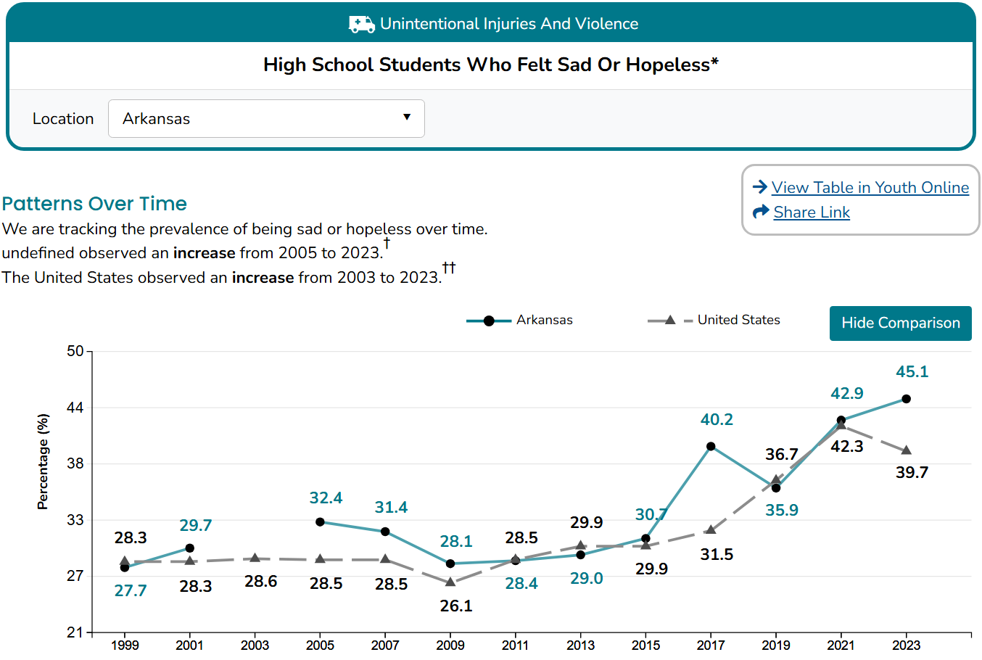

Slide 14
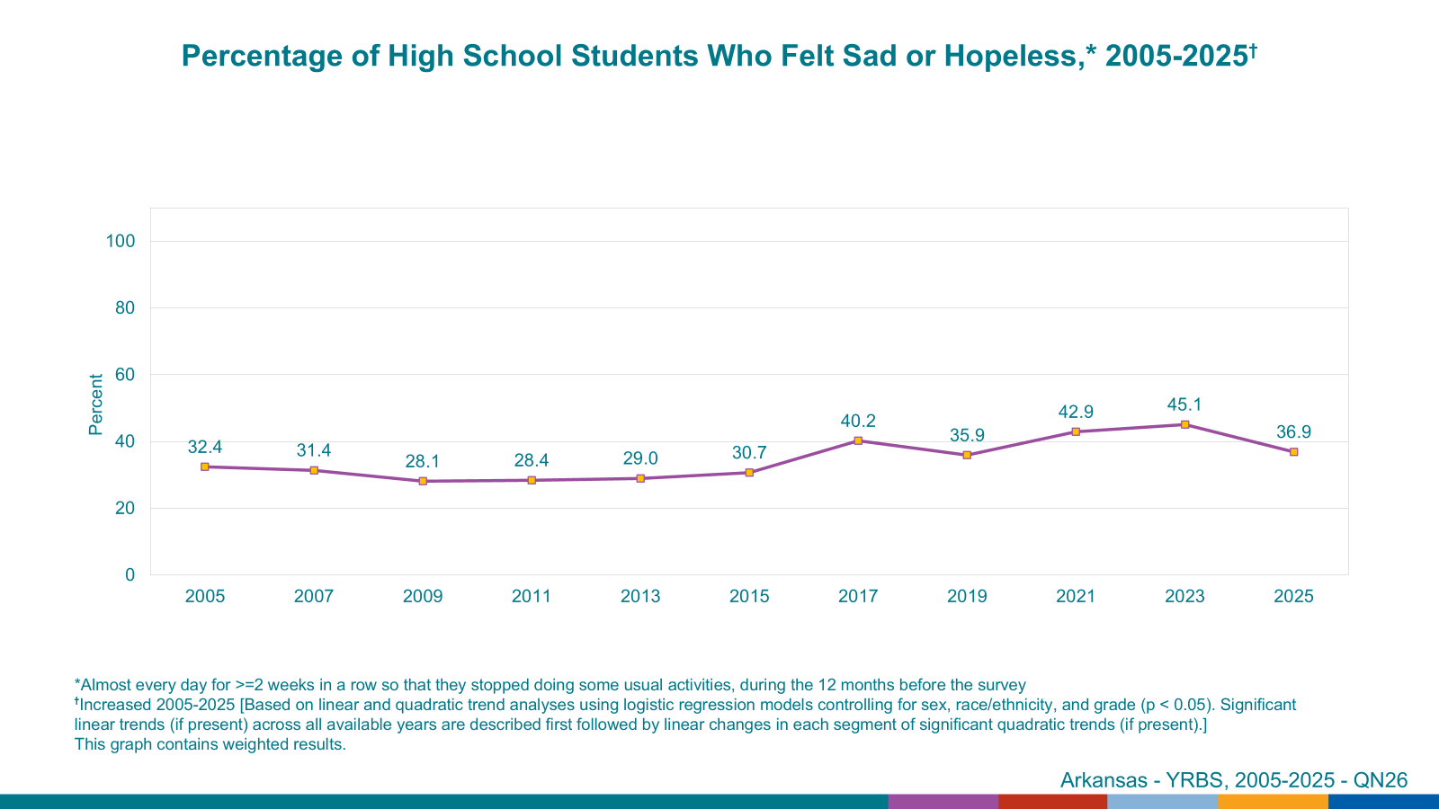
Notes:
Another decrease in percentages. This is contributory to AWARE resources being shared and taught in schools, probably.

Slide 15
YRBS - Why It Matters for Schools
Arkansas YRBS: Turning Student Voice into Actionable Data
Provides the student’s perspective
Allows for direct comparison with other states
Provides representative statewide data on Arkansas high school students (grades 9-12)
Monitors priority risk behaviors impacting attendance, engagement, and graduation outcomes
Identifies trends in mental health, substance use, violence, and physical activity that affect learning
Highlights emerging health challenges affecting Arkansas students across rural and urban districts
Enables ADE and districts to prioritize resources based on real student need - not assumptions
Supports data-driven planning for school health, mental health, and safety initiatives
Provides trend data every two years to evaluate impact and progress over time
Notes:
Second Column: Why it Matters. As we look at these mental health indicators in YRBS—such as persistent sadness, hopelessness, and suicide risk—it’s important to recognize that many of these outcomes are connected to Adverse Childhood Experiences, or ACEs. ACEs include things like exposure to violence, family instability, substance use in the home, and other traumatic experiences. These are the very types of challenges reflected in what students are bringing into classrooms every day. While YRBS does not directly measure all ACEs, it captures many related experiences and outcomes—especially around mental health, safety, and risk behaviors. What this tells us is that schools are not just addressing academic needs—they are responding to the long-term effects of trauma. That’s why coordinated supports—like school nursing, mental health services, and programs funded through MITS—are so critical. They help schools respond not just to behaviors, but to the underlying experiences driving them.

Slide 16
What Does This Look Like in Our Schools
School Health Survey Data Bridges with YRBS Data
State Trends - Real Student Needs
Chronic conditions and obesity
Risk behaviors-substance use
Attendance impact
Teen pregnancies
Anxiety and depression-mental health needs
These trends aren’t theoretical - they are showing up in our schools every day.
Notes:
What we’re seeing in YRBS is showing up in our school health and Medicaid data - these needs are already being managed in schools across Arkansas?

Slide 17
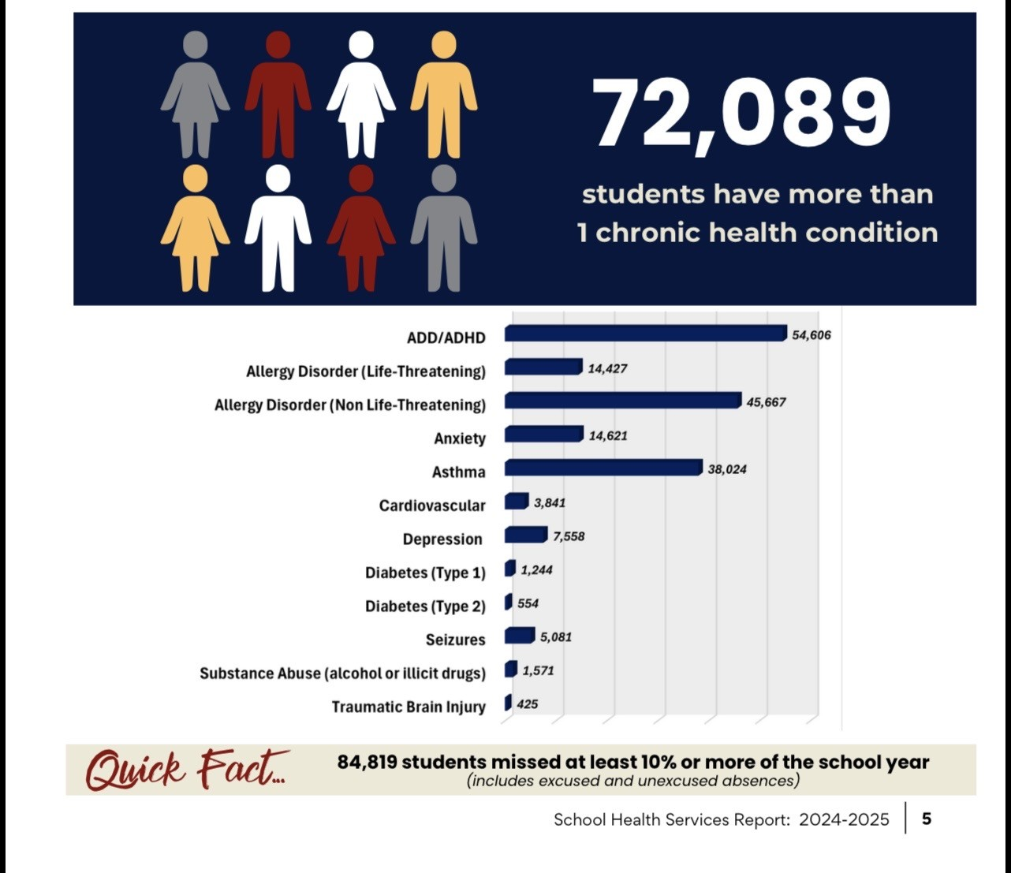
School Health Survey
Chronic Health Conditions

Slide 18
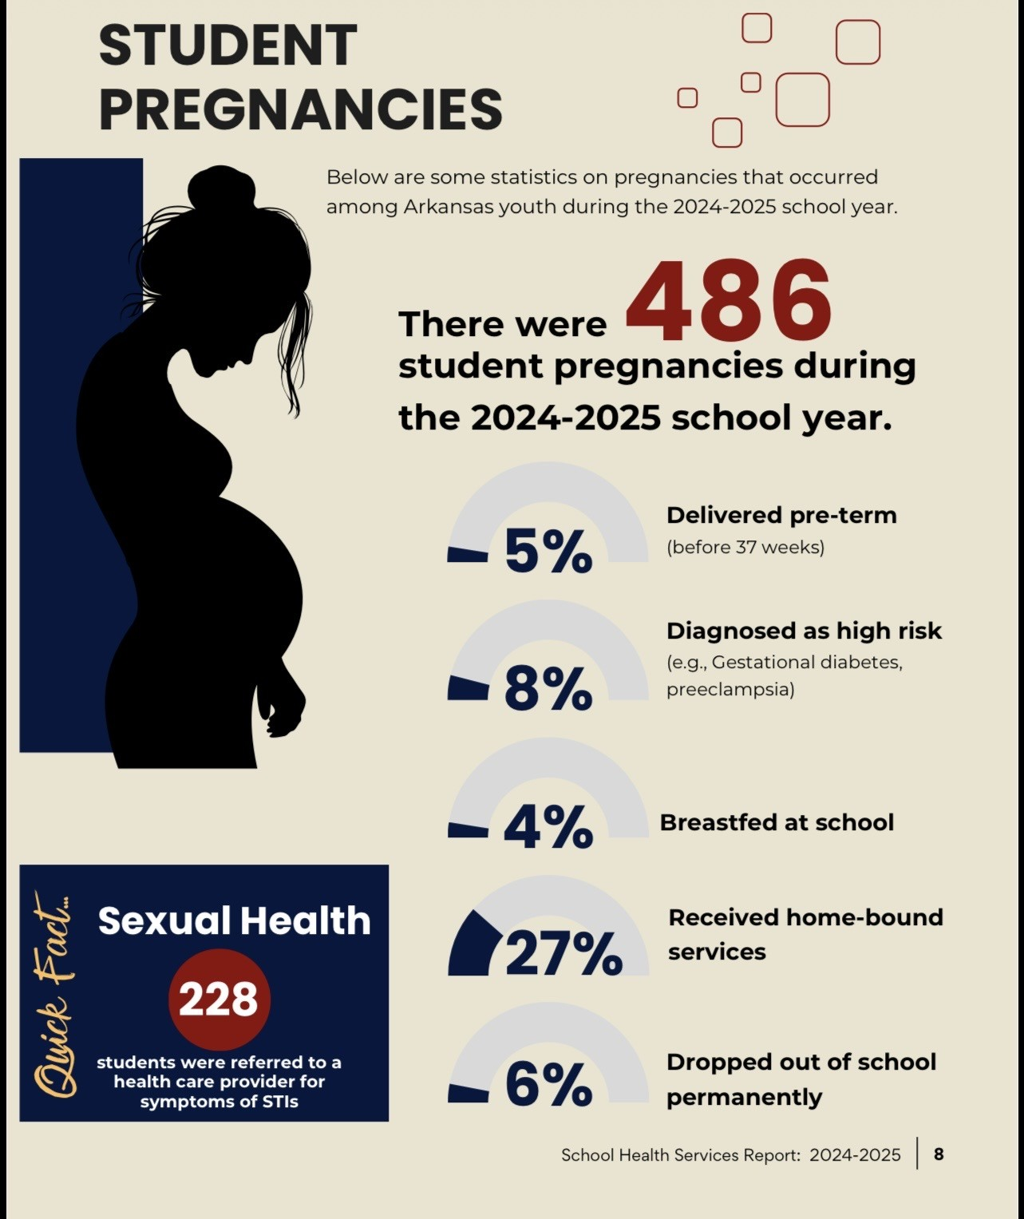
School Health Survey
Teen Pregnancies

Slide 19
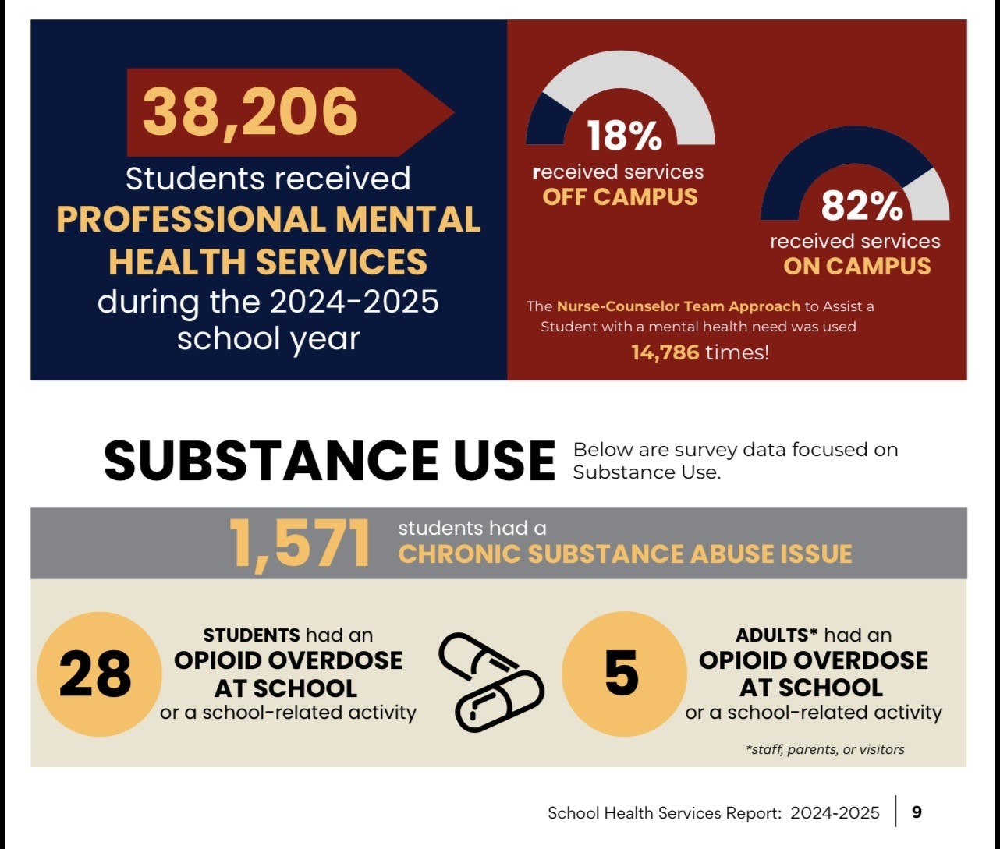
School Health Survey
Mental Health

Slide 20
How Schools Are Responding
School Health Profiles Participation Matters
Profiles depends on Principal and Lead Health Teacher participation
Ensures data reflects real school practices across Arkansas
Without participation:
  Gaps go unseen
  Needs go underrepresented
  Funding and support may not align
Arkansas 2026 Profiles Participation
291 schools selected statewide
226 Principals participated (~80%)
218 Lead Health Teachers participated (~75%)
Highest Response Rate in Arkansas in many years
Notes:
Profiles are collected on even-numbered years. Strong Data Requires Strong Participation. If schools don’t participate, their needs - and their students - may not be reflected.
Participation isn’t just about completing a survey - it’s about making sure your school’s story is part of the data that drives decisions across the state.
Key areas assessed: Health education requirements, Mental health services, Physical activity opportunities, Nutrition policies
Profiles helps us understand whether school systems are aligned to student needs.

Slide 21
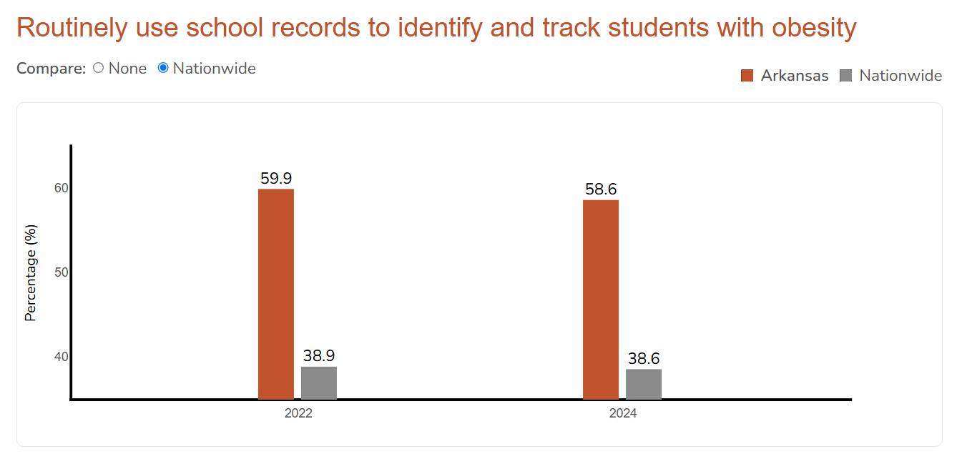

Slide 22
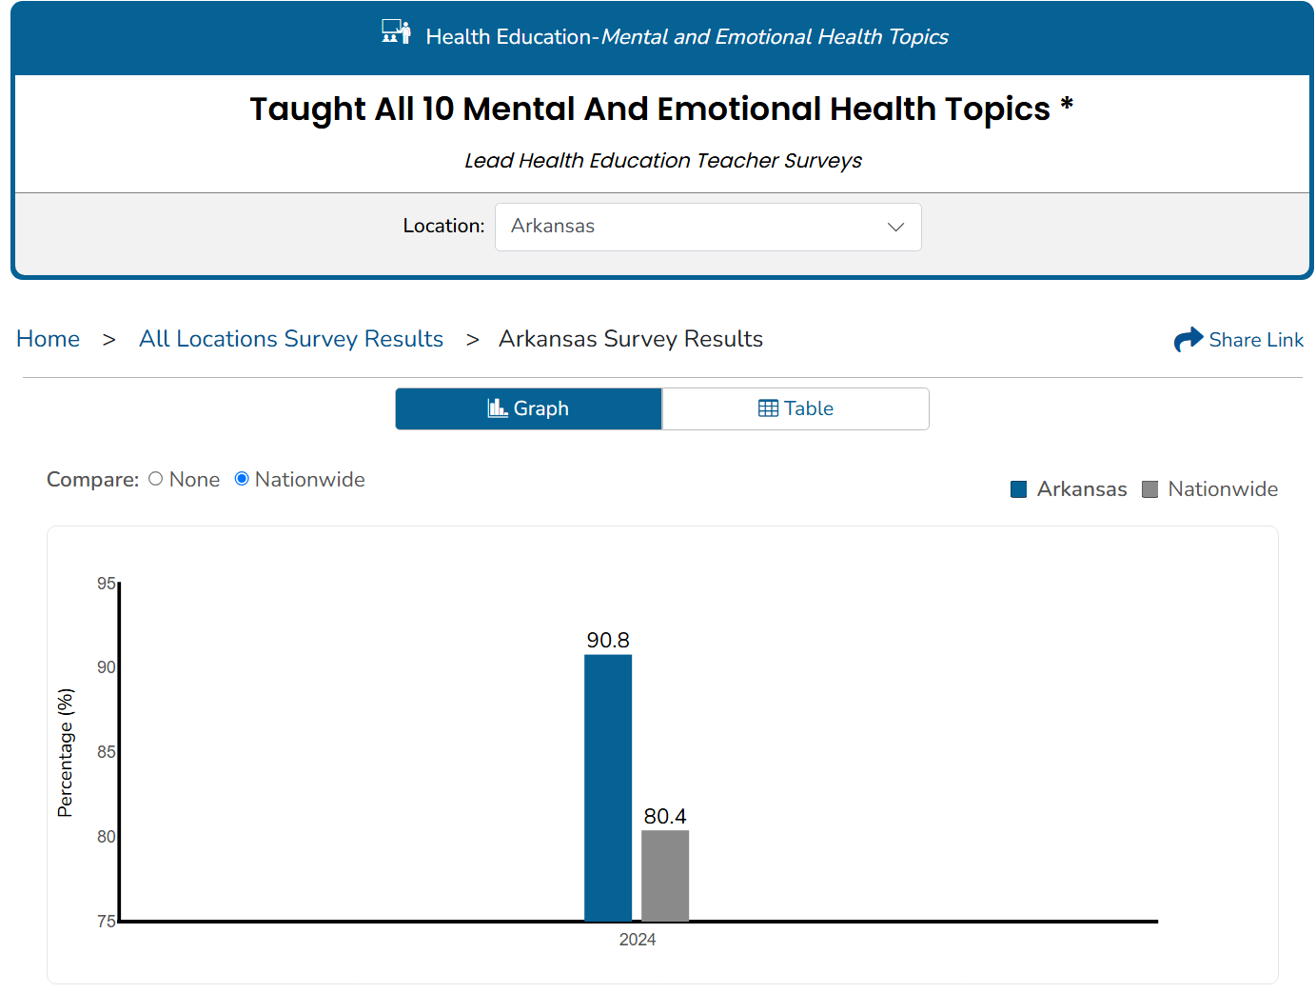
Notes:
Arkansas Health Educators are teaching all ten components and leading the way in the nation in professional development.

Slide 23
10 Mental and Emotional Health Topics
What is Taught in Schools
Identifying Emotions
  Recognizing feelings in self and others
Emotional Regulation
  Managing stress, anger, and strong emotions
Self-Awareness and Self-Esteem
  Understanding personal strengths and identity
Coping Skills
  Healthy ways to deal with stress and challenges
Goal-Setting and Decision-Making
  Making responsible and thoughtful choices
Mental Health Awareness
  Understanding anxiety, depression, and common conditions
Suicide prevention & help-seeking
  Recognizing warning signs and how to get help
Healthy relationships
  Communication, boundaries, and respect
Bullying & violence prevention
  Conflict resolution and safe behaviors
Help-seeking behaviors
  Accessing trusted adults, school staff, and community resources

Slide 24
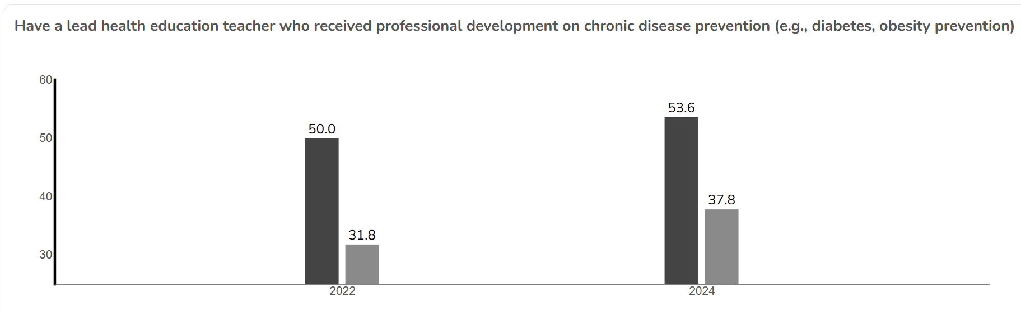
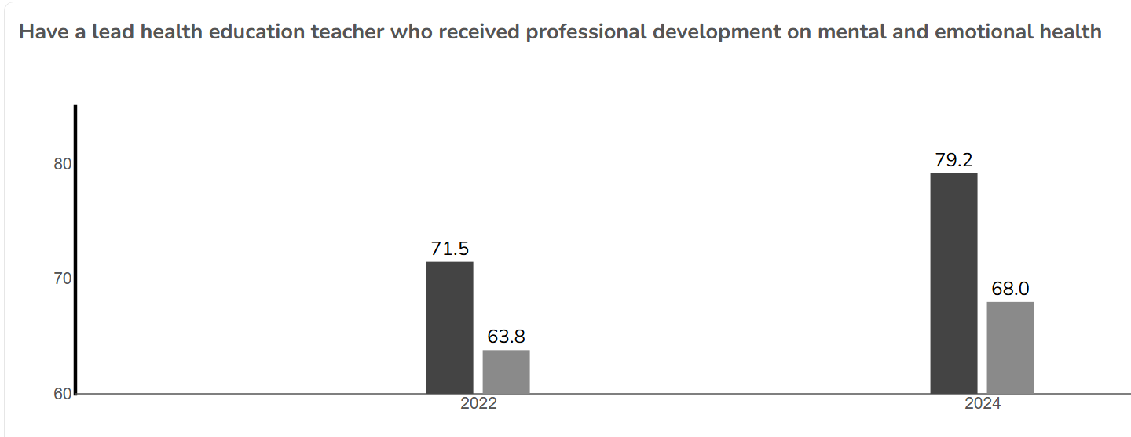
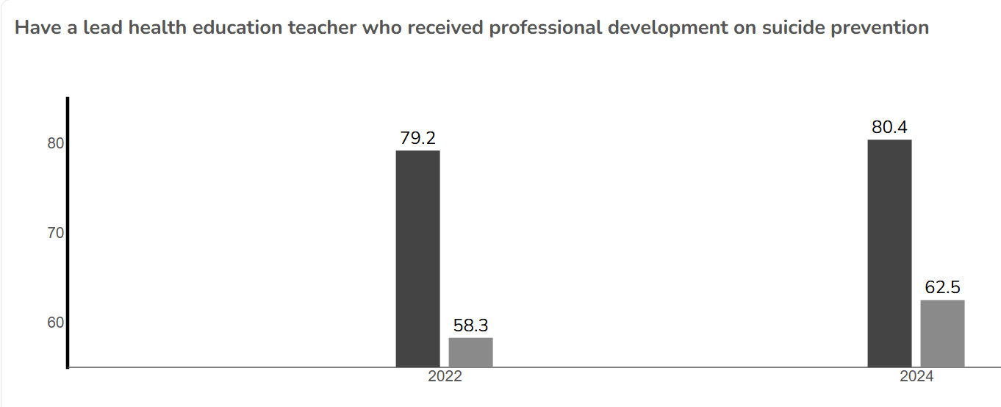
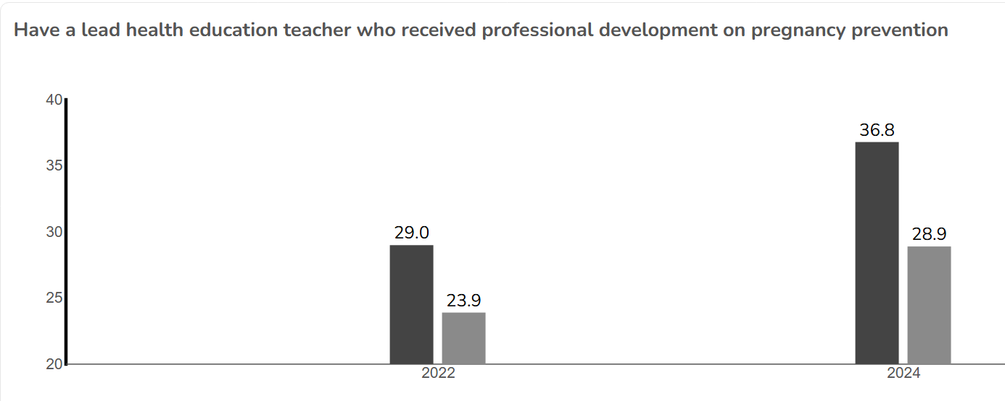
Notes:
We lead the nation in offering the most Professional Development to our educators. Obesity and chronic disease prevention, mental and emotional health development, suicide prevention, pregnancy prevention. We have and offer the training, but how are kids applying it to their own lives? Or are they applying it to their environment?

Slide 25
Why Participation Matters
Strong Data Starts with Strong Participation
Participation ensures accurate, representative Arkansas data
Data drives funding, programs, and policy decisions
Supports district-level planning and resource alignment
Arkansas 2025 YRBS Participation
1,192 students participated
28 of 35 randomly-selected schools participated
73.9% student response rate
Arkansas 2026 School Health Profiles Participation
291 schools selected statewide
230 Principals participated (80%)
218 Lead Health Teachers participated (75%)
Highest Response Rate in Arkansas in many years
Notes:
Delivery: These response rates matter. When participation is strong, we can trust the data to reflect Arkansas students and schools. When participation drops, entire communities can become invisible in the data - and that directly impacts funding, support, and decision-making.
If schools don’t participate, their students’ needs may not be reflected. Participation ensures your district’s voice is included - and your students’ needs are seen.

Slide 26
Why Participation Matters
School Health Survey: Annually-§6-18-709-May 10th through June 10th
463,000+ students represented statewide (93%)
  932 school nurses participated in survey
1,007,000+ encounters for skilled procedure provided for students
15,000+ prescription medications given to students daily in school across Arkansas
2,687,000+ students sent back to class-returning to learn
Health needs are already in our classrooms-data helps us respond effectively!

Slide 27
Emergency Preparedness…..to Readiness
What does this really mean for schools and higher achievement?
Notes:
Audience question

Slide 28
Example: Asthma
Children who are chronically absent between preschool and second grade are much less likely to read at grade level by the the third grade.
(U.S. Department of Education)
38,000+ students

Slide 29
Example: Teen Pregnancy
“Teen motherhood is still associated with educational and lifetime disparities among women who give birth at ages 15-19 and are 15 percent more likely to live in poverty.”
Morris (2023)
In general, 90% of females graduate from high school, compared to 50% of teen mothers who receive a high school diploma by age 22.
(Congressional Research Service, 2025)

Slide 30
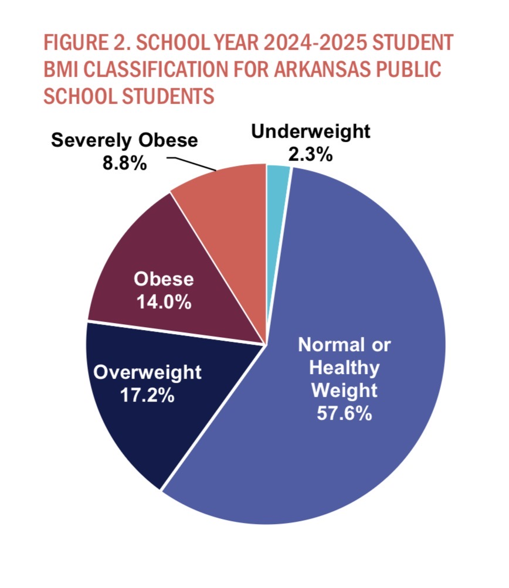
Example: Obesity
In 2025, 40 percent of Arkansas students are identified as overweight, obese, and severely obese
The AR adult obesity rate is projected to increase to 51% by 2030. (Ward, 2019)
Arkansas Center for Health Improvement
Notes:
Currently, AR Adults are at 40%

Slide 31
Connecting the System
YRBS tells us:
  What students are experiencing
Profiles tells us:
  How schools are responding
School Health data tells us:
  What schools are experiencing and their response
Notes:
What this really shows us is that no single data source gives us the full picture—we need all three working together. YRBS tells us directly from students what they’re experiencing—their behaviors, risks, and needs. Profiles helps us understand how schools are responding at the building and district level—what policies, practices, and supports are in place. And the School Health Survey gives us a broader view of what schools are experiencing overall and how they’re addressing those needs. When we connect these together, we move from isolated data points to a more complete system view—what students need, what schools are doing, and where gaps still exist. And that’s exactly where the next piece comes in. MITS helps us take all of this information and turn it into coordinated action—so we’re not just collecting data, but actually using it to improve outcomes.

Slide 32
Medicaid In The Schools (MITS)
Overview
Medicaid in the Schools program provides guidance, leadership, and technical assistance to support schools in operating effective Medicaid programs. Medicaid is a federally funded program administered by the Centers for Medicare and Medicaid Services (CMS). Medicaid is a critical source of health care coverage for children, providing access to comprehensive and preventative child health programs. The provision of Medicaid revenue provides for school districts to offer sustainable, medically necessary supports for students to have every opportunity to be academically successful. Schools deliver a broad range of Medicaid reimbursable school-based services to students at school.

Slide 33
Medicaid In The Schools (MITS)
Billable Services
Direct Services:
OT, PT and Speech
Hearing and Vision Screens
Personal Care
School-Based Mental Health
Audiology
ABA Therapy
Nursing-New 26-27
Indirect:
ARMAC

Slide 34
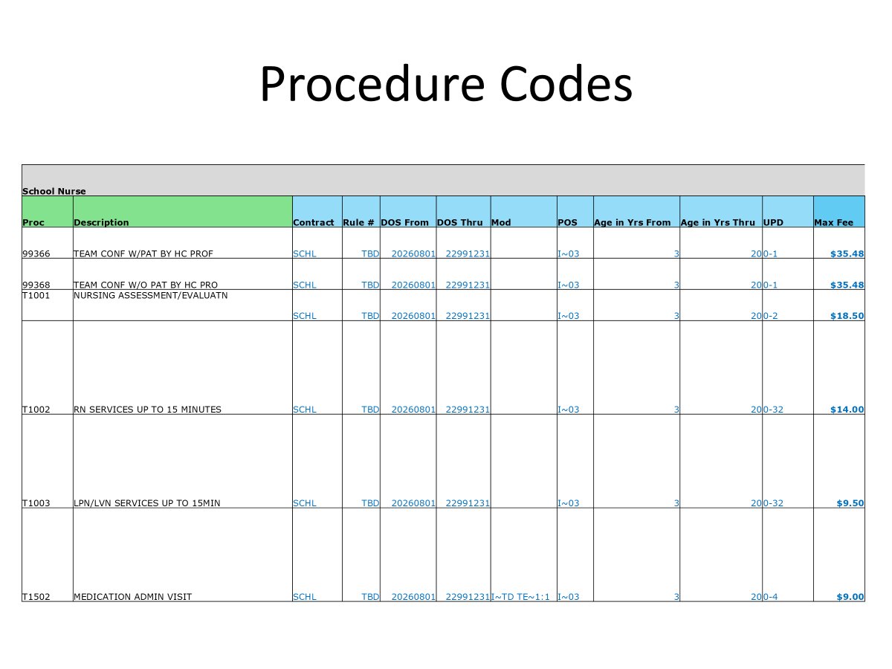
Notes:
Revenue this will add

Slide 35
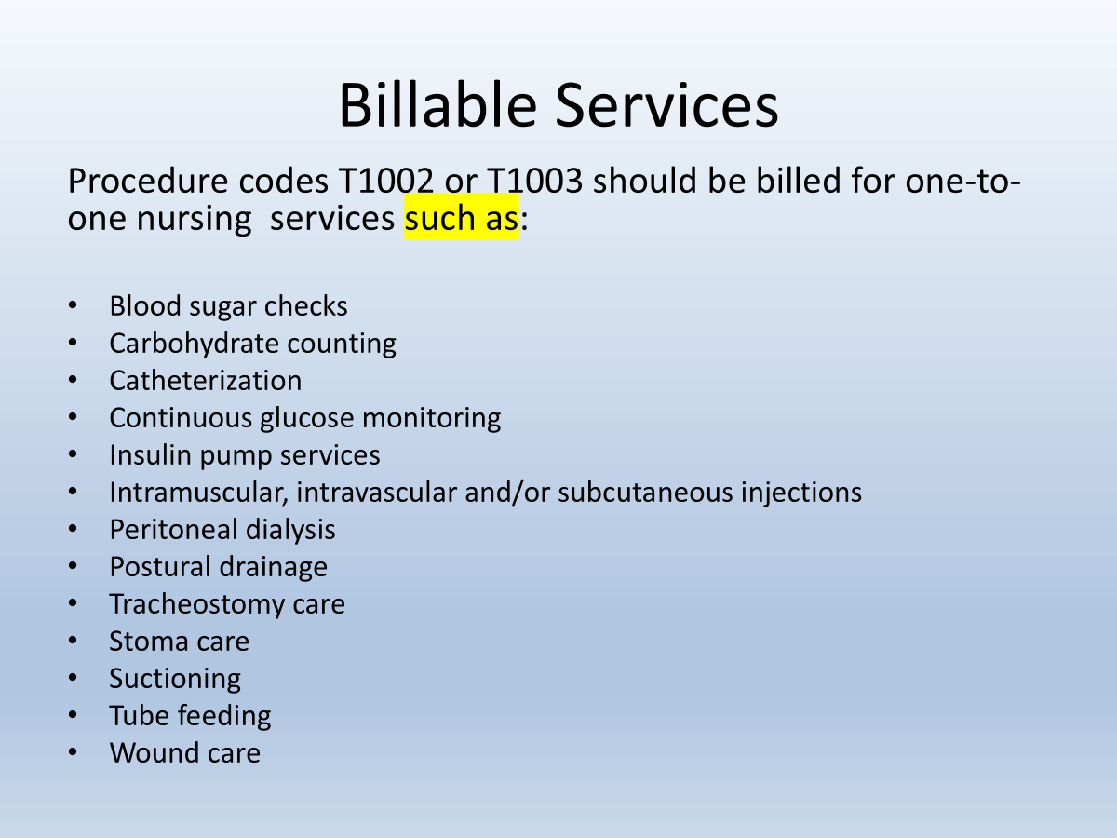

Slide 36
MITS Funding in Arkansas
Real Funding Supporting Arkansas Schools
$13.6+ million in Medicaid reimbursement supports Arkansas schools (FY2026)
Funding flows directly to districts (LEAs) for services delivered to students
Schools generate revenue through Medicaid match for eligible service
Why This Matters for School Districts
Expands access to mental and behavioral health care
Sustains school nursing and therapy services
Helps districts offset the cost of student health needs
Supports the Whole Child model
MITS brings federal dollars into Arkansas schools to support student health and learning
Notes:
In Arkansas, we’re not just identifying student needs—we have a mechanism to respond. MITS allows districts to draw down federal Medicaid dollars for services they’re already providing, especially in mental health, therapy, and nursing. That’s how this work becomes sustainable. Every time a district bills Medicaid appropriately, that’s federal funding coming back into Arkansas schools to directly support students.

Slide 37
Medicaid In The Schools (MITS)
Direct Services Revenue
Add chart

Slide 38





The Importance of School Health Data
School Health Data helps districts:
Understand student needs
Identify trends and gaps in services
Make informed decisions about resource allocation
Improve access to health-related supports
Measure the impact of interventions
School health data helps us understand student needs. ARMAC helps provide the resources needed to respond to those needs and expand services that support student health and success.
School Health Data Identify Needs Connect Services Healthier Students Student Success
School health data helps us understand student needs. ARMAC helps provide the resources needed to respond to those needs and expand services that support student health and success.
Notes:
Sustaining Programs and Services

Slide 39



What is ARMAC?
Arkansas Medicaid Administrative Claiming
Medicaid Administrative Claiming is a federally funded program administered by the Centers for Medicare and Medicaid Services (CMS). This program provides school districts with the ability to receive reimbursement for certain administrative services which address student health needs.
The revenue generated by the ARMAC program may be used to facilitate, improve and expand the level and quality of health, and medical services provided to all students within the district.
Notes:
What is ARMAC? Medicaid Administrative Claiming is a federally funded program administered by the Centers for Medicare and Medicaid Services (CMS). This program provides school districts with the ability to receive reimbursement for certain administrative services which address student health needs.
The revenue generated by the ARMAC program may be used to facilitate, improve and expand the level and quality of health and medical services provided to all students within the district.
When districts are trying to decide what to spend ARMAC funds on, I always refer them to this statement. Does the expenditure facilitate, improve or expand the health and medical services to all students?

Slide 40
Regional MITS Program Advisors
Erbey Gomez
Northwest Region
erbey.gomez@ade.arkansas.gov
Cell: 870-308-6094
Whitney Gifford
Southern Region
whitney.gifford@ade.arkansas.gov
Cell: 501-681-6087
Ronnie Scott
ARMAC Specialist
Ronnie.scott@ade.arkansas.gov
Office: 501-682-4238
Keena Smith
Northeast Region
keena.smith@ade.arkansas.gov
Cell: 501-951-0114
*Vacancy*
Central Region
**Contact any advisor for assistance
*Vacancy*
MITS Specialist
**Contact any advisor for assistance
Notes:
WOW MOMENT: You don’t have to wait for state-level reports - this data is available to you right now. The real power is when districts use their own data to make targeted decisions that directly impact their students. Scan the QR Code to access School Health Services page on DESE.

Slide 41
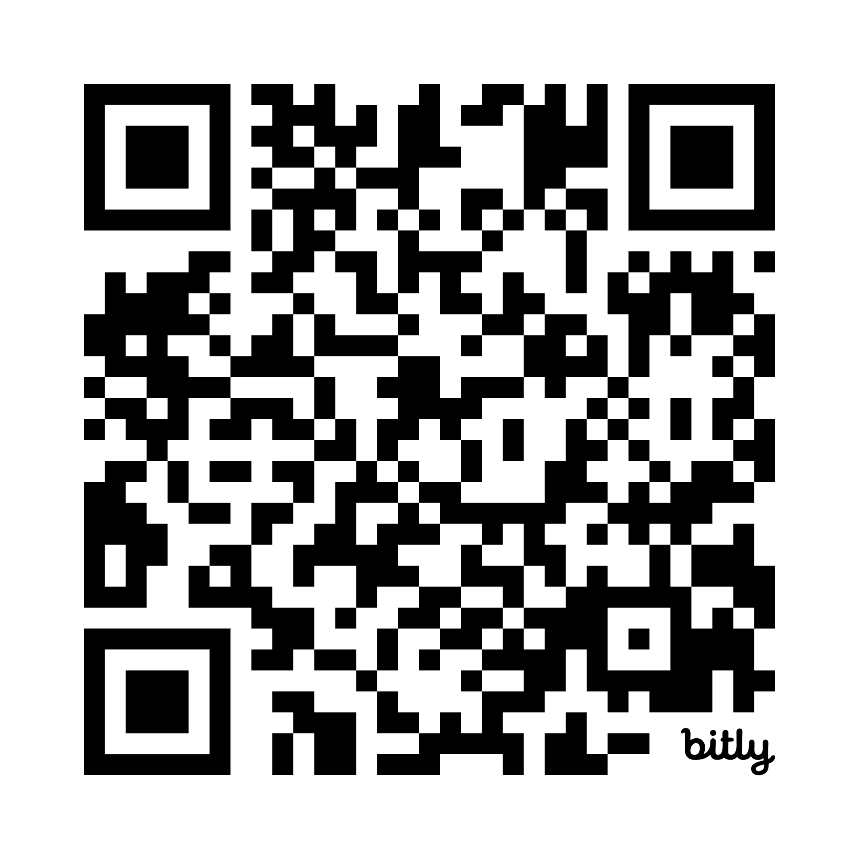
Live Demo: Using Your Data
Your Data - Your Decisions - Your Impact
Step 1: Access the Data
YRBS Explorer Link
  YRBS Explorer (2023) | CDC
Profiles Explorer Link
  School Health Profiles Explorer – Dashboard
School Health Link
  School Health Survey
MITS Link
  MITS Profiles
Step 2: Select Your View (Same steps for both YRBS and Profiles)
Choose Arkansas as your State
Filter by topic (mental health, substance use, etc.)
Step 3: Explore Key Questions
What are your top student health risks?
How does your state compare to the national or other states averages?
Where are the gaps between need (YRBS) and support (Profiles and School Nursing) and Funding (MITS)?
Step 4: Apply It
Identify priority student needs
Align MITS + school nursing services
Inform funding and planning decisions
DESE-School Health Services
Notes:
WOW MOMENT: You don’t have to wait for state-level reports - this data is available to you right now. The real power is when districts use their own data to make targeted decisions that directly impact their students. Scan the QR Code to access School Health Services page on DESE.

Slide 42
Resources
School Health Services:
Division of Elementary and Secondary Education - Offices - Learning Services - School Health Services
Arkansas MITS Data & Reports:
https://dese.ade.arkansas.gov/Offices/learning-services/school-health-services/arkansas-medicaid-in-the-schools--medicaid-billing-profiles
Division of Elementary and Secondary Education - Offices - Learning Services - School Health Services - Arkansas Medicaid in the Schools
Arkansas School Health Nursing:
Division of Elementary and Secondary Education - Offices - Learning Services - School Health Services - School Nursing
Arkansas YRBS:
Division of Elementary and Secondary Education - Offices - Learning Services - School Health Services - Youth Risk Behavior Survey (YRBS)
Arkansas School Health Profiles:
Division of Elementary and Secondary Education - Offices - Learning Services - School Health Services - School Health Profiles
Arkansas Center for Health Improvement (ACHI)
Body Mhttps://www.ed.gov/teaching-and-administration/supporting-students/chronic-absenteeismass Index Program - ACHI
America’s Health Rankings:
Explore Health Measures and Rankings in Arkansas | AHR
Notes:
Links to School Health Services on DESE

Slide 43
Resources
Congressional Research Service. (2025, April 17). Teen births in the United States: Overview and recent trends (CRS Report No. R45184). U.S. Library of Congress. https://www.congress.gov/crs-product/R45184
Morris, S. R. (2023). Teen mothers forgotten: The gap between high school and higher education. Journal of Higher Education Policy and Leadership Studies, 4(2), 107-117. https://dx.doi.org/10.61186/johepal.4.2.107
U.S. Department of Education. (n.d.). Chronic absenteeism. Office of Elementary and Secondary Education. https://www.ed.gov/teaching-and-administration/supporting-students/chronic-absenteeismnic Absenteeism | U.S. Department of Education
Ward, Z. et al. (2019). Projected U.S. State-Level Prevalence of Adult Obesity and Severe Obesity. New England Journal of Medicine. https://www.nejm.org/doi/full/10.1056/NEJMsa1909301
Notes:
APA formatted resources for data provided.

Slide 44

THANK YOU
CONTACT US
Cheria McDonald, APRN, NCSN, State School Nurse Consultant
Cheria.McDonald@ade.arkansas.gov
501-607-4208
Dana Bennett, RN, MITS Asst Director
Dana.Bennett@ade.arkansas.gov
501-683-2729
Taylor James, MPH, CDC Surveillance Coordinator
Taylor.James@ade.arkansas.gov
870-260-3567
Notes:
YRBS/Profiles: Explain this data is through CDC Surveillance Grant and reflects data on a state-level/allowing capability to compare data on a national-level, as well.
School Health Survey: shows audience what their local schools are exhibiting.
MITS: Ties in the financial piece, how much we are spending towards these supports, how much is available, etc.

