Slide 1
Bridging State and National Expectations:
Arkansas's AI Alignment Study with NAEP
Notes:
AP+KM+HM to introduce

Slide 2
VISION & MISSION
The Arkansas Department of Education is transforming
Arkansas to lead the nation in student-focused education.
The Arkansas Department of Education provides leadership, support, and service to schools, districts, and communities so every student graduates prepared for college, career, and community engagement.
Notes:
Presenter: Kisa Morman
Time: 1 minute

Slide 3
Session Objectives & Purpose
Understand NAEP and its implications for student learning and readiness
Analyze alignment between Arkansas standards and NAEP, and its impact on cognitive complexity and the student experience
    Coverage Alignment Quality
    Cognitive Complexity
    Coverage Timing
Use NAEP intentionally to strengthen instructional rigor, system coherence, and alignment.
Notes:
Holly

Slide 4

What is NAEP?
National Assessment of Educational Progress
About The Nation's Report Card
The National Assessment of Educational Progress (NAEP), first administered in 1969, is the largest continuing and nationally representative assessment of what our nation’s students know and can do in subjects such as mathematics, reading, science, and writing.
Students Grades 4, 8, and 12
Reports reported at:
  National Level
  State Level
  Trends in Urban District Assessment (TUDA) Level
Notes:
Holly: We just finished a Main NAEP in Spring 2026. Hopefully, we will have results by the end of year.

Slide 5
NAEP Report Card
National Trends and Student Skills
Mathematics
Grade 4: Higher average mathematics score in 2024 reflected in score increases for middle- and higher-performing students
Grade 8: No significant change in average mathematics scores for eighth-graders compared to 2022; scores increase for higher-performing students and decrease for lower-performing students
Reading
Grade 4: Lower average reading score in 2024 reflected in score declines at all but 90th percentile
Grade 8: Lower average reading score in 2024 reflected in score declines for lower- and middle-performing students
Notes:
Holly: Overall National trends: Concern about the gap widening in percentiles

Slide 6
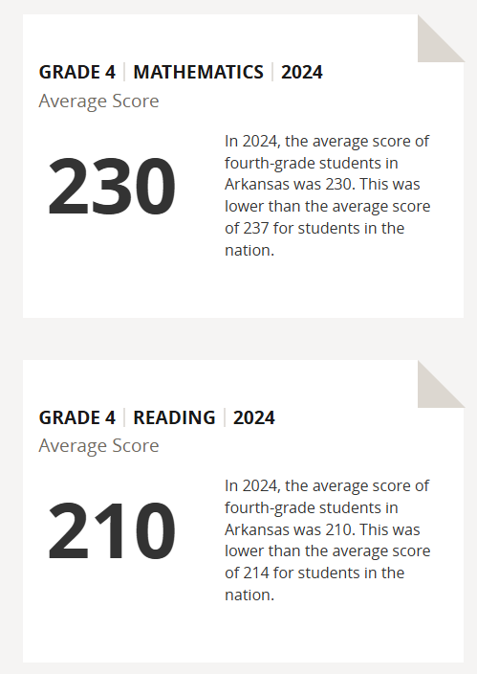
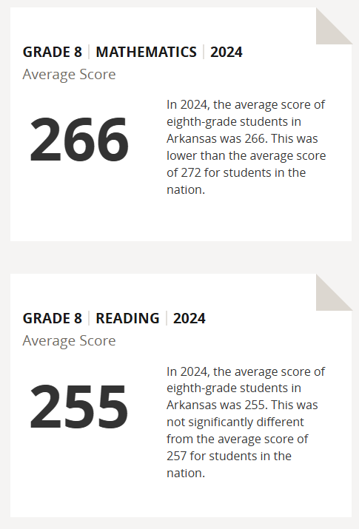
NAEP Report Card
Arkansas Overview
Notes:
Holly:
Note:
Mathematics:
We were lower than the national average in both grade 4 and grade 8
Reading:
We were lower in Grade 4, but not significantly different in grade 8 (even though score is lower)

Slide 7


Who is Prometric?
Partnership
Building the workforce of tomorrow
Prometric is a global leader in credentialing and
skills development, leveraging 30 years of
expertise, innovation, and industry-leading
solutions to create pathways for tomorrow’s
workforce.
Notes:
Holly: We knew we wanted to do an alignment. So we did Request for Proposals - received two that were extremely high cost - due to meetings in person, etc…
So - Prometric had worked with Michelle, so we thought of seeing if this would be possible through AI

Slide 8

Who is Prometric?
Partnership
Research Questions:
How well do Arkansas standards and ALDs cover NAEP standards for grade 4 and grade 8 reading & mathematics?
Is Arkansas content at appropriate cognitive complexity?
Will Arkansas students have opportunity to learn by the time they take NAEP?
Notes:
Holly

Slide 9
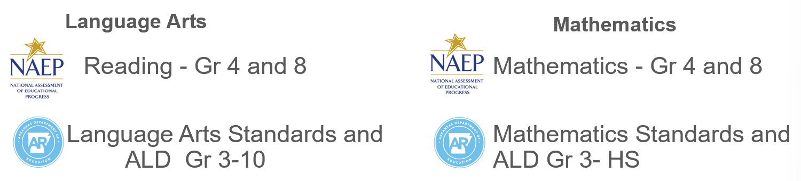
Inputs
Standards | Achievement Categories | Level Descriptors
Students know and do | Describe how students scored based on assessment results | Description of the level of understanding by standard and category
NAEP Standards Reading Grades 4 and 8 Mathematics Grade 4 and 8 | Achievement Levels: NAEP Basic NAEP Proficient NAEP Advance
Arkansas Department of Education Standards: Language Arts for Grades 3-10 Mathematics for Grades 3 - 8, Algebra & Geometry | ATLAS Performance Levels: Level 1 Level 2 Level 3 Level 4 | Achievement Level Descriptors (ALDs) includes: Standards Sample Performance Level Description
Notes:
Holly
Turn and Talk
Leave up and let them process and discuss with neighbor

Slide 10

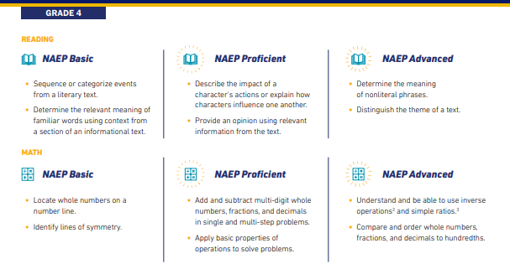
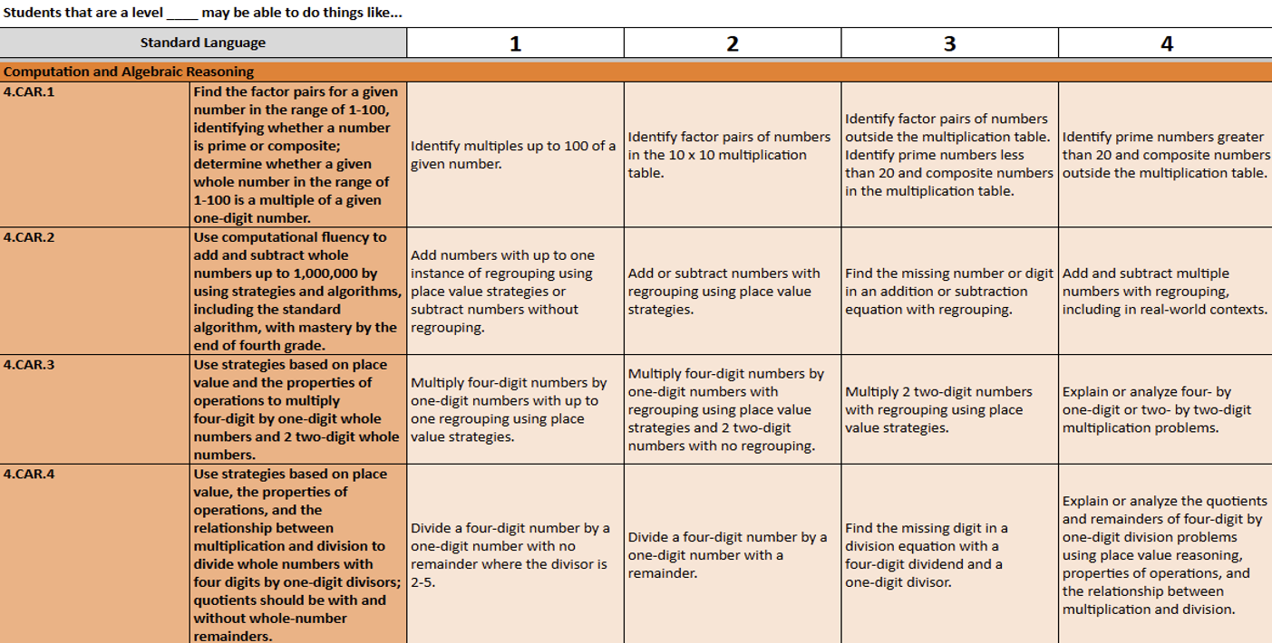
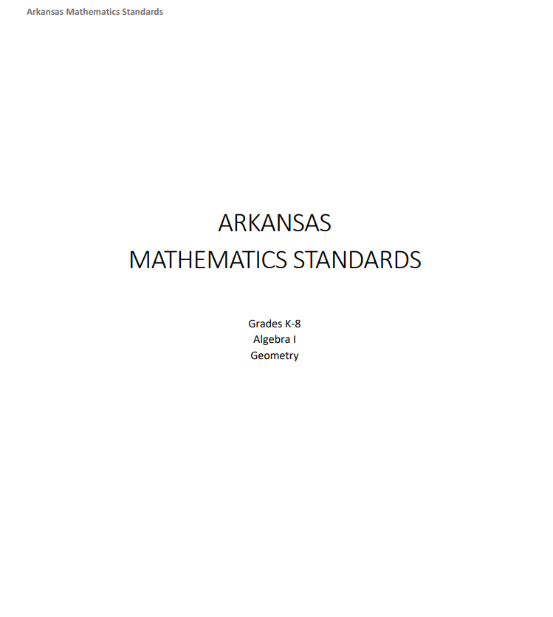
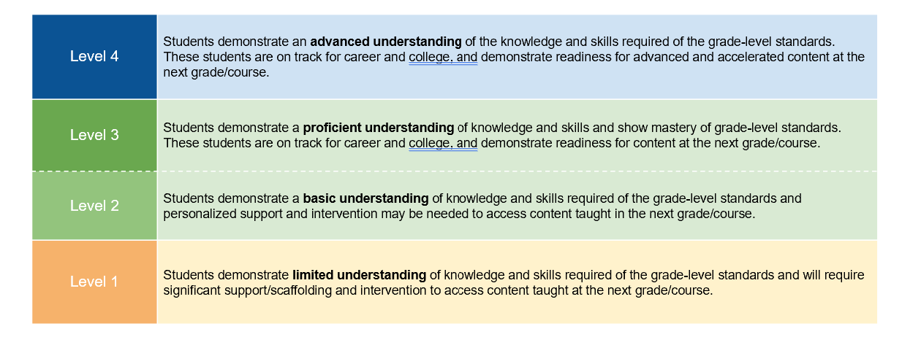
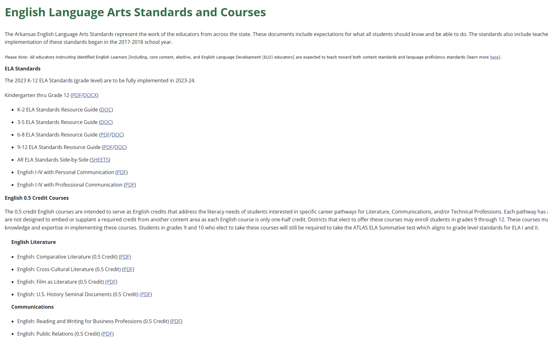
Inputs
Standards | Achievement Categories | Level Descriptors
Notes:
Holly: Note: this was a lot of information that was put into the algorithm

Slide 11
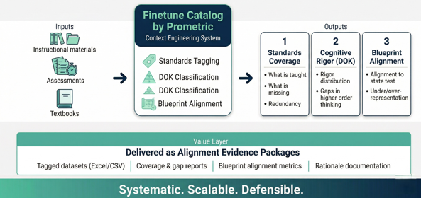
How the Catalog Works?
Systematic. Scalable. Defensible.
Notes:
Holly: Not something we could do with Co-Pilot, Gemini or Chat GPT

Slide 12
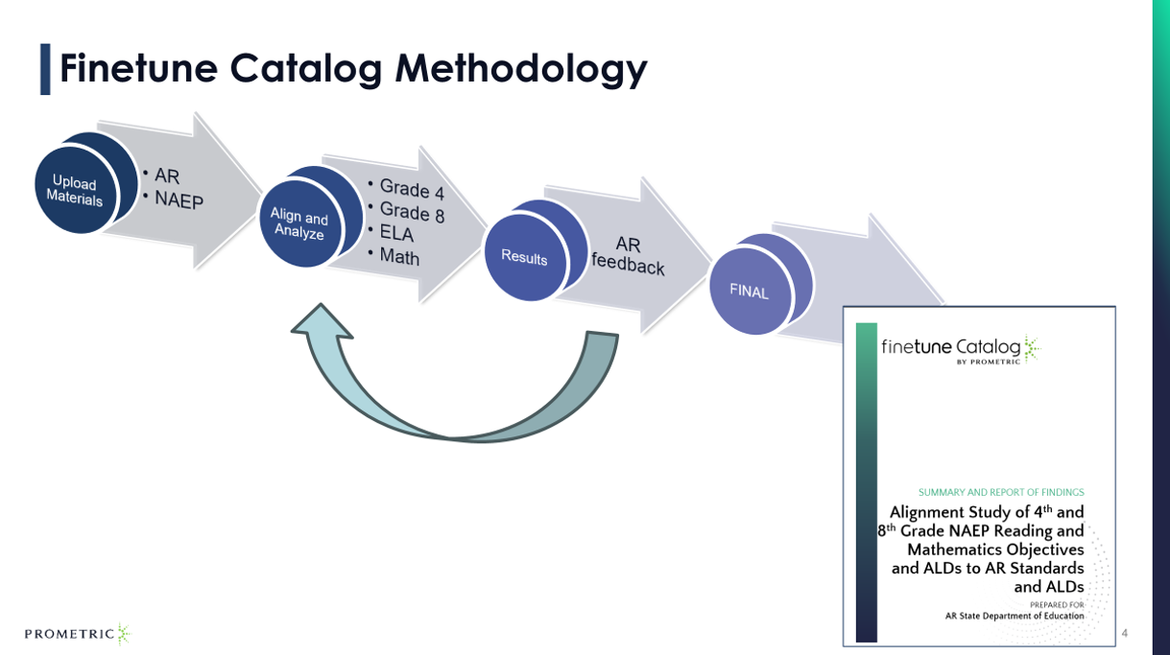
Notes:
Holly: Input, meet and review, feedback applied - then repeat

Slide 13
Findings for Grades 4 and 8

Slide 14
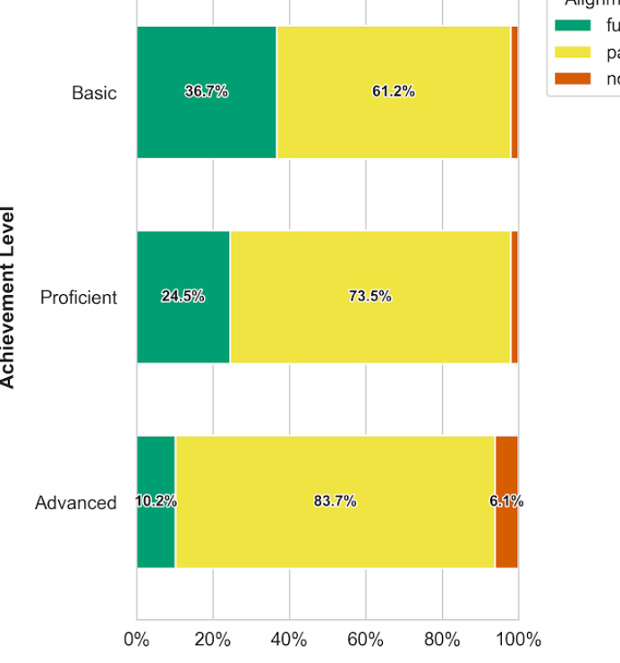
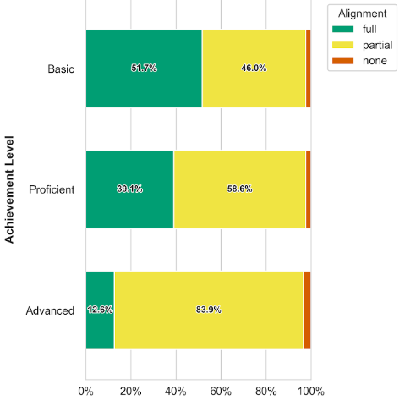
How do Arkansas standards align with NAEP objectives?
Coverage Alignment Quality
Math Findings: Arkansas standards align with NAEP objectives for the proficient achievement level at 99% for Grade 4 and 98% for Grade 8.
Grade 4
Grade 8
Notes:
Kisa:
Review and the discuss the key legend for the data: Green, Yellow, and Red
The math findings indicates that the Arkansas Standards meets the expectations for student coverage of what students should know and be able to do for the Grades 4 and 8. The alignment dial was set at high level and for full alignment the standards had to match. The partial alignment may be full, considering the research is based a sole standards.
Proficient for NAEP is grade-level

Slide 15
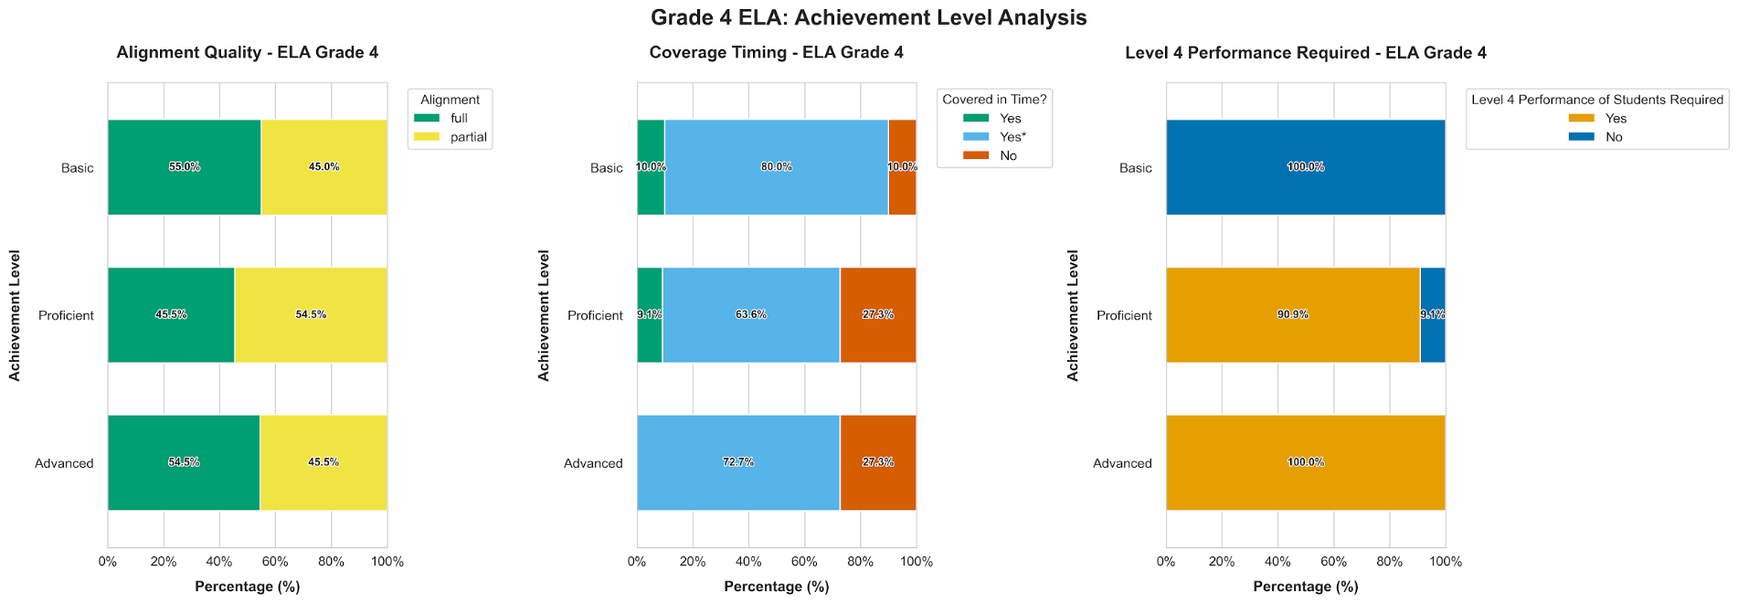
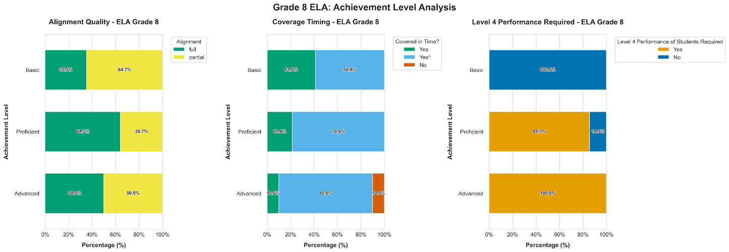
How do Arkansas standards align with NAEP objectives?
Coverage Alignment Quality
ELA Findings: Arkansas standards align with NAEP objectives for the proficient achievement level at 100% for both Grades 4 and 8.
Grade 4
Grade 8
Notes:
Amber - Review and the discuss the key legend for the data: Green, Yellow, and Red
The math findings indicates that the Arkansas Standards meets the expectations for student coverage of what students should know and be able to do for the Grades 4 and 8. The alignment dial was set at high level and for full alignment the standards had to match. The partial alignment may be full, considering the research is based a sole standards.

Slide 16
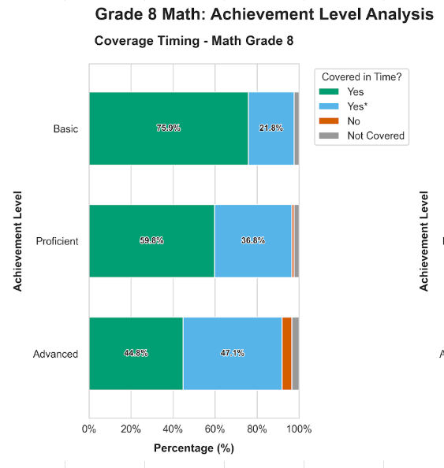
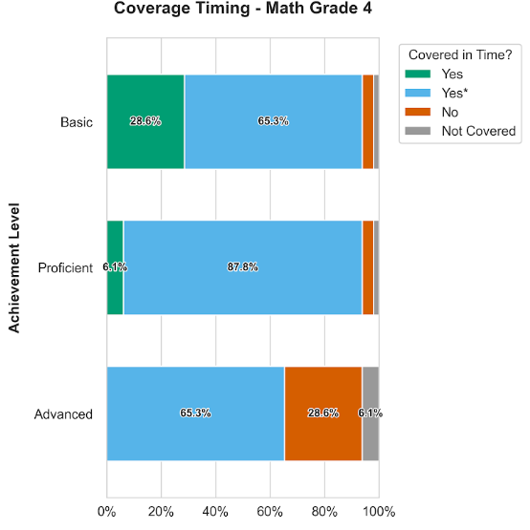
Will Arkansas grade-level content be covered on time?
Covering Time
Math Findings: 94% of Grade 4 and 98% of Grade 8 Arkansas standards are taught prior or during the grade level in which the NAEP assessment is administered.
Grade 4
Grade 8
Notes:
Review and the discuss the key legend for the data: Green, Blue, Read, and Gray
The alignment indicates strong alignment of the coverage time for both grades. However, the NAEP is given prior in January and February of the school year. The ARkansas Standards are expected to be covered by the end of the school year. Therefore, acceleration may assiti with the Grade 4 and Grade 8. Keep in mind that Grade 8 coverage occurs prior to 8th grade, students are expected to have master the standards.

Slide 17
Will Arkansas grade-level content be covered on time?
Covering Time
ELA Findings: 72.7% of Grade 4 and 100% of Grade 8 Arkansas standards are taught prior or during the grade level in which the NAEP assessment is administered.
90%
Grade 4
Grade 8
Notes:
Amber - Review and the discuss the key legend for the data: Green, Yellow, and Red
Notice and WOnder
The math findings indicates that the Arkansas Standards meets the expectations for student coverage of what students should know and be able to do for the Grades 4 and 8. The alignment dial was set at high level and for full alignment the standards had to match. The partial alignment may be full, considering the research is based a sole standards.

Slide 18
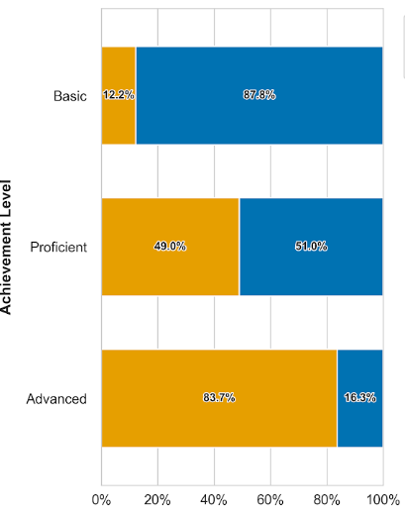
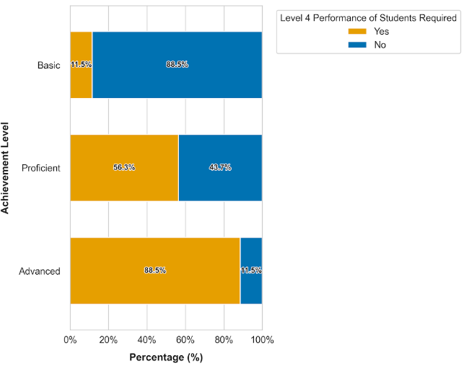
Is Arkansas content at appropriate cognitive complexity?
NAEP Proficient Level vs ALDs
Math Findings: Approximately 49% of 4th grade and 56% of 8th grade Arkansas standards should be taught at Level 4 to boost students' chances of reaching NAEP “Proficient” levels."
Grade 4
Grade 8
Notes:
Review and the discuss the key legend for the data: Orange and Blue
Approximately half the standards need be mastered with deep understanding of content and reasoning skills. The blue indicates Levels lower the 4, but study indicates a strong percentage of students needing exposure to rich task that requires multiple responses, multiple skills, and integration of skills an application.

Slide 19
Is Arkansas content at appropriate cognitive complexity?
Coverage Alignment Quality
ELA Findings: Almost 85-91% of Arkansas standards should be taught at Level 4 to boost students' chances of reaching NAEP “Proficient” levels."
Grade 4
Grade 8
Notes:
Review and the discuss the key legend for the data: Green, Yellow, and Red
Turn and Talk - HQIM implications
The math findings indicates that the Arkansas Standards meets the expectations for student coverage of what students should know and be able to do for the Grades 4 and 8. The alignment dial was set at high level and for full alignment the standards had to match. The partial alignment may be full, considering the research is based a sole standards.

Slide 20
Overall Findings for Grades 4 and 8
Recap
High-Level Findings
For both NEAP Reading and Mathematics, the Arkansas standards demonstrate a high degree of alignment.
For both Reading and Mathematics NAEP assessments, Arkansas standards need to target instruction at a higher level of cognitive complexity, addressing Level 4.
Arkansas standards covers a large amount of content before or during the grade that prepares students for the NAEP assessment. (*end -of-year)
NAEP Mathematics showed a consistent coverage across nearly all standards.
NAEP Reading objectives shows heavy coverage of reading comprehension standards.
Notes:
Amber

Slide 21
Strengthening Instruction

Slide 22
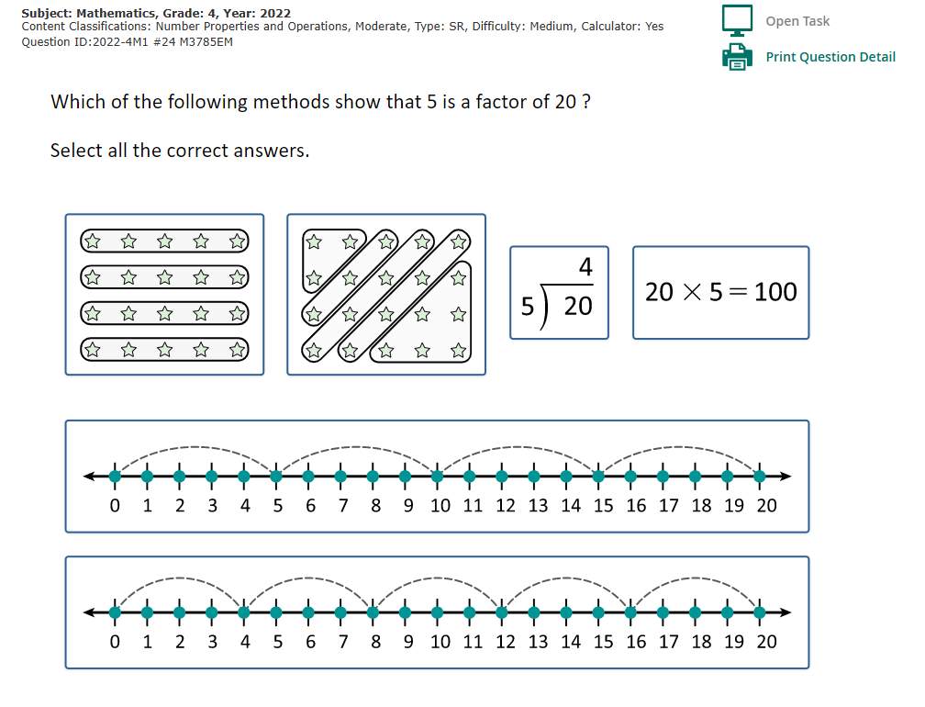
Mathematics - Grade 4
Question Types
Access to 481 different items, including similar ATLAS question types:
Select All that Apply
Multiple Choice
Drag and Drop
Short Constructed Response
Arkansas Standards:
3.CAR.1 and 4.CAR.1
Notes:
Kisa Morman

Slide 23
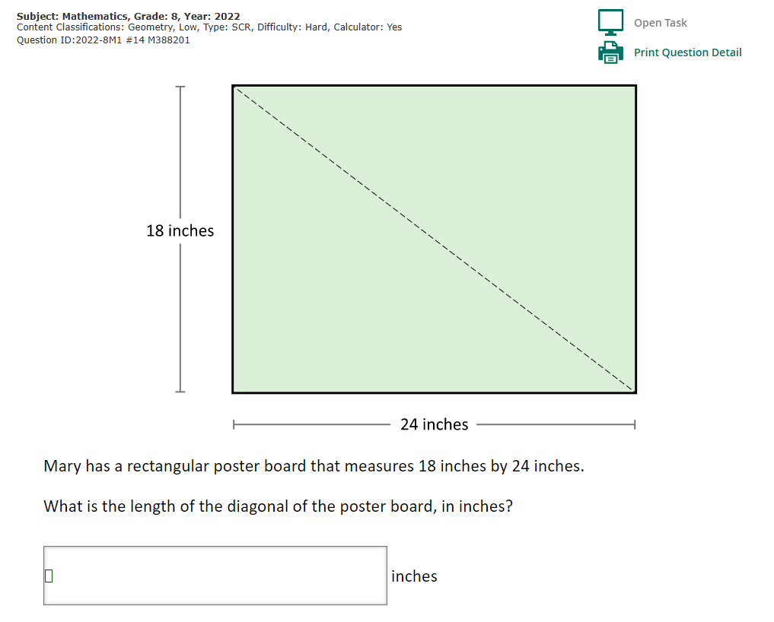
Mathematics - Grade 8
Question Types
Access to 531 different items, including similar ATLAS question types:
Select All that Apply
Multiple Choice
Drag and Drop
Short Constructed Response
Arkansas Standards:
8.GM.7
Notes:
Kisa

Slide 24
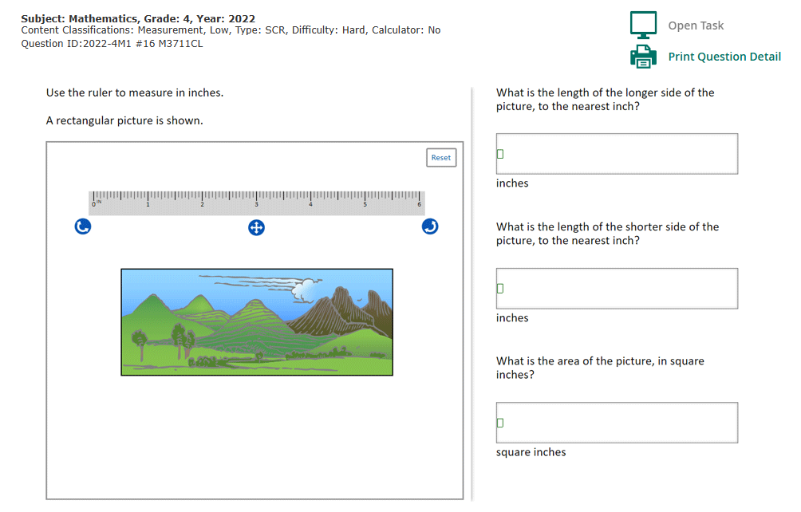
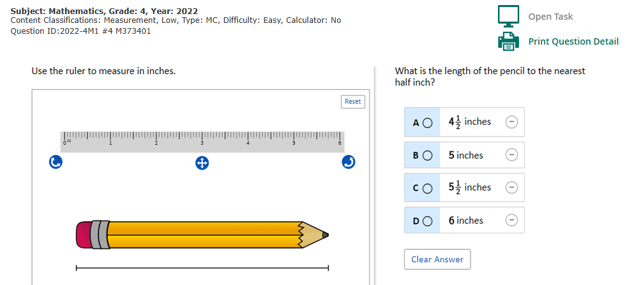
Mathematics - Grade 4
Cognitive Complexity
Access to different level of difficulty:
Easy
Medium
Hard
Arkansas Standards:
3.GM.4 and 3.GM.7
Notes:
Kisa :

Slide 25
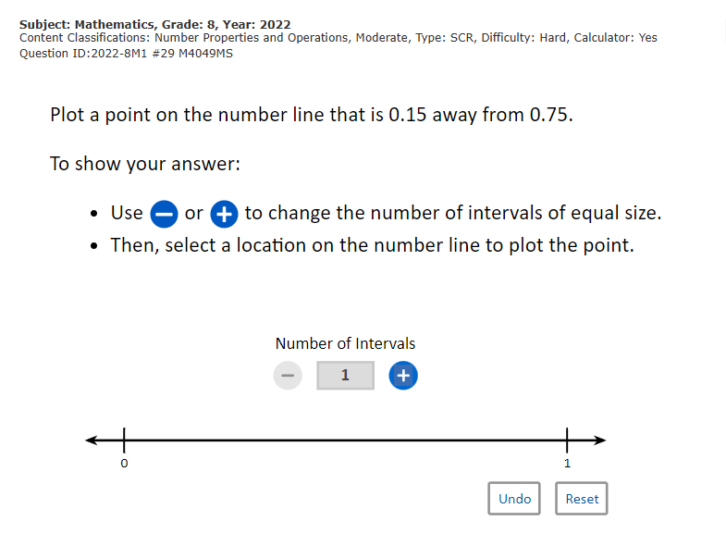
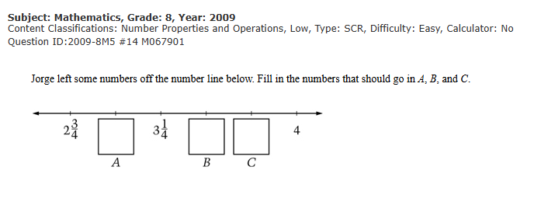
Mathematics - Grade 8
Cognitive Complexity
Access to different level of difficulty:
Easy
Medium
Hard
Arkansas Standards:
6.NCC.2
Notes:
Kisa

Slide 26
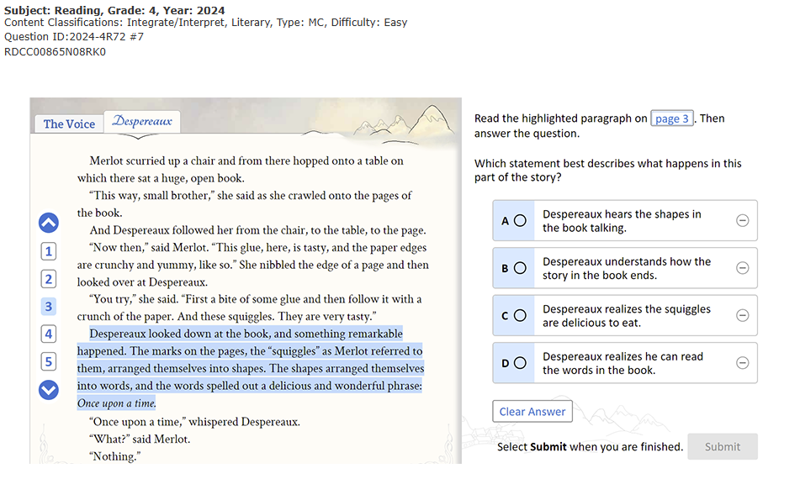
ELA - Grade 4
Question Types
Access to 256 different items, including similar ATLAS question types:
Select All that Apply
Multiple Choice
Drag and Drop
Short Answer
4.RC.2.RF: Answer explicit and inferential questions, using details from a text.
Notes:
Amber

Slide 27
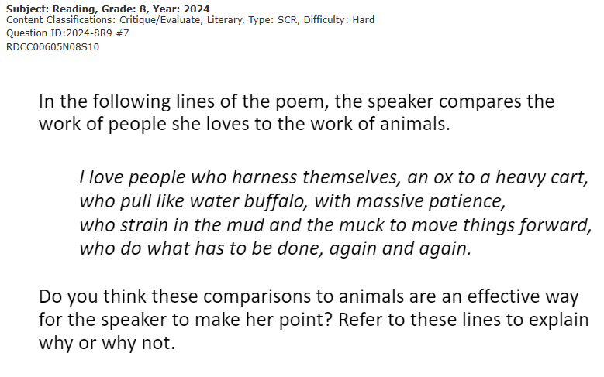
ELA - Grade 8
Question Types
Access to 288 different items, including similar ATLAS question types:
Select All that Apply
Multiple Choice
Drag and Drop
Short Answer
8.RC.3.RF: Cite text evidence that most strongly supports an analysis of what a text states, using background knowledge to justify inferences drawn from the text.
8.RC.5.RL: Examine how specific lines of dialogue propel the plot, reveal aspects of a character, or inform a character’s decision.
Notes:
Amber

Slide 28
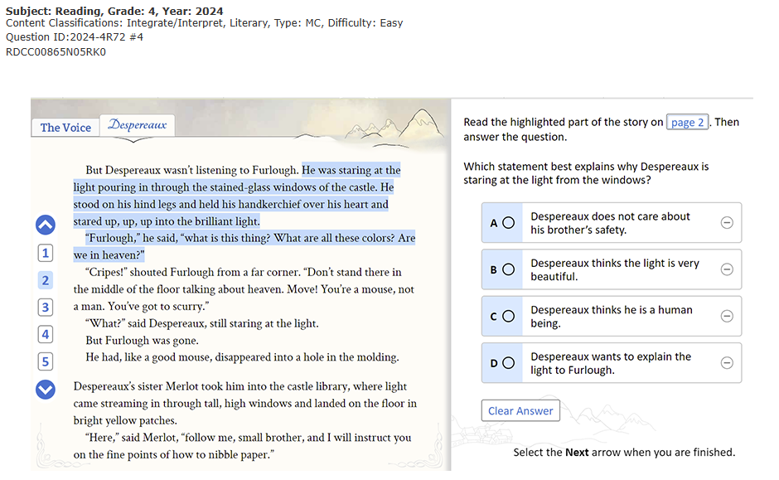
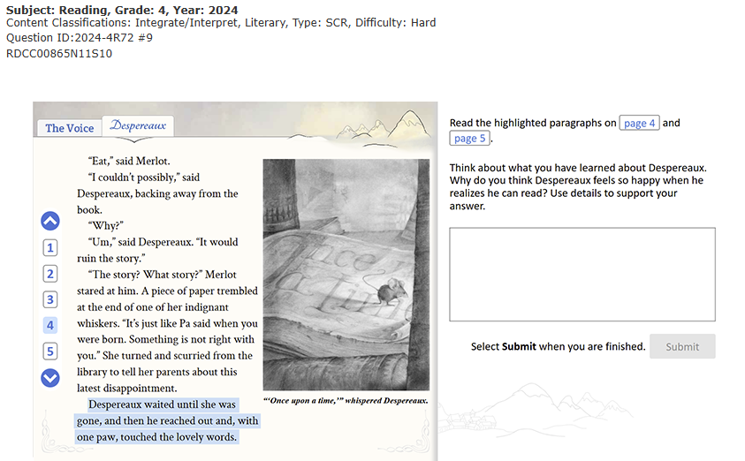
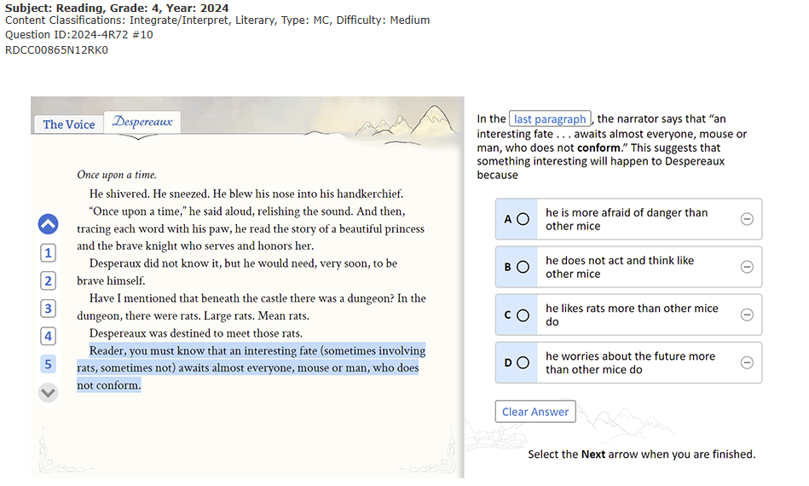
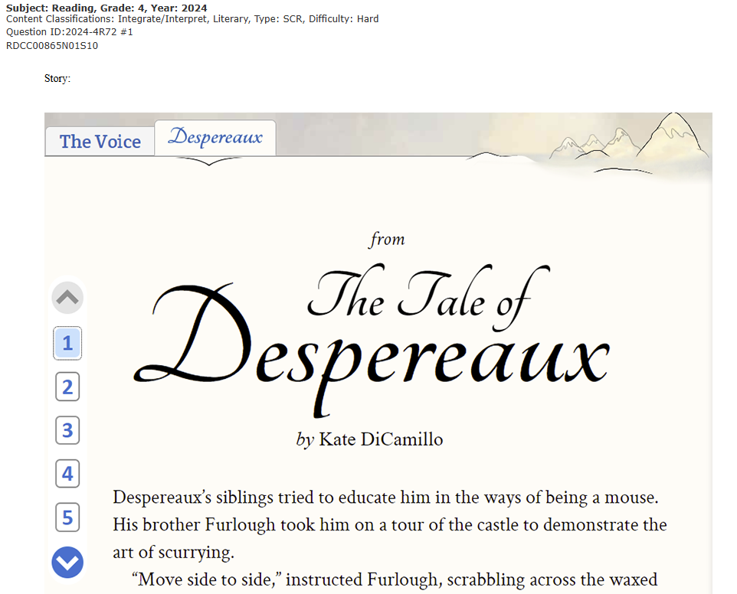
ELA - Grade 4
Cognitive Complexity
Access to different level of difficulty:
Easy
Medium
Hard
Notes:
Amber
Notes:
The largest continuing, nationally representative assessment of student achievement in the U.S.

Slide 29
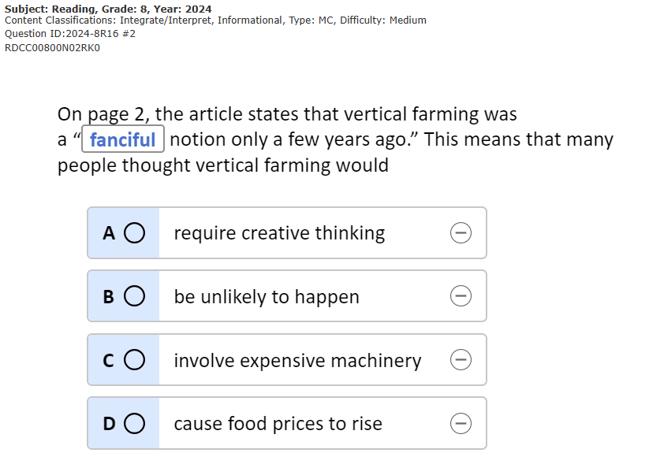

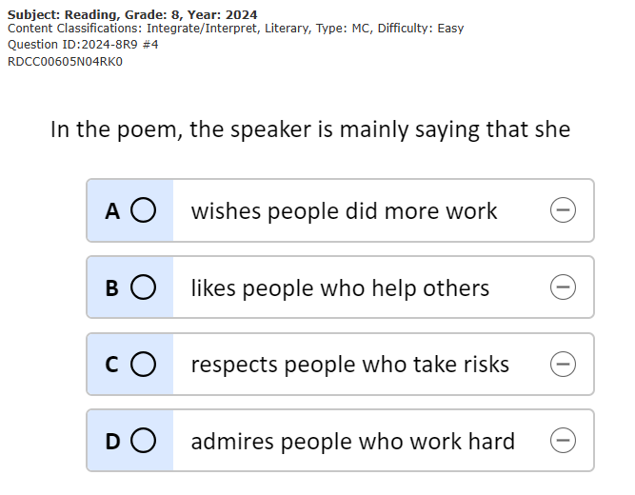
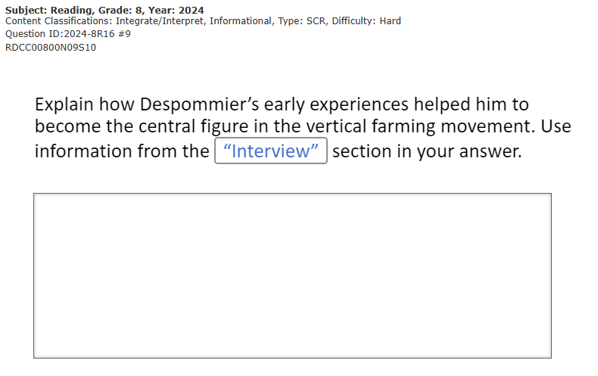
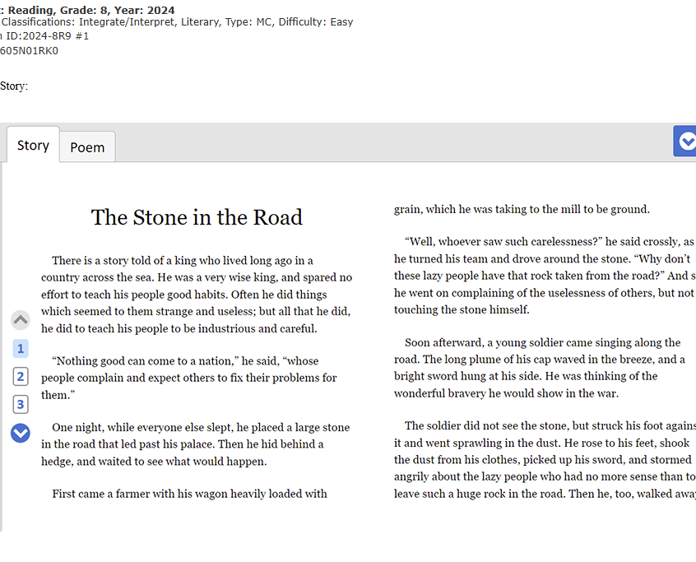
ELA - Grade 4
Cognitive Complexity
Access to different level of difficulty:
Easy
Medium
Hard
Notes:
Amber
Notes:
The largest continuing, nationally representative assessment of student achievement in the U.S.

Slide 30
NAEP Question Tool
Benefits
The benefits of using NAEP questions to strengthen instruction for ALL:
Access to free resource
Access to approximately 2,000 additional questions to assess student understanding in nine subjects
Access to similar question types like ATLAS
Access to questions closely align to Arkansas Standards
  at or above grade-level content standards
Access to a variety of level of difficulties
Access to a question bank used nationally with student responses
By leveraging NAEP, educators can strengthen instruction for all students, ensuring that every learner has the opportunity to succeed.
Notes:
Holly:
NOTE: there are NAEP questions in the ATLAS classroom tool - not all but you can add them in there as well.

Slide 31
Resources:
NAEP Data Tool
NAEP Item Mapping
NAEP Questions
NAEP Matters! - Engagement Guide
ATLAS Question Bank
NAEP and DESE
Notes:
Holly

Slide 32
Recommendations

Slide 33
Recommendations
Call To Action
Aim to teach at higher complexity
  Why: About 49% of Arkansas standards need to be taught at Achievement Level Descriptor (ALD) 4 to match NAEP "Proficient" targets
  Action: Shift from rote memorization to rich tasks that require multiple steps, real-world application, and student explanations.
Use the free NAEP Questions Tool
  Why: Teachers have free access to 2,000 real NAEP items that match the "Tech-Enhanced" formats (like Drag and Drop or Select All) similar to the ATLAS state test.
  Action: Use these items for bell-ringers or exit tickets, and review the tool's national data to anticipate common student misconceptions.

Slide 34
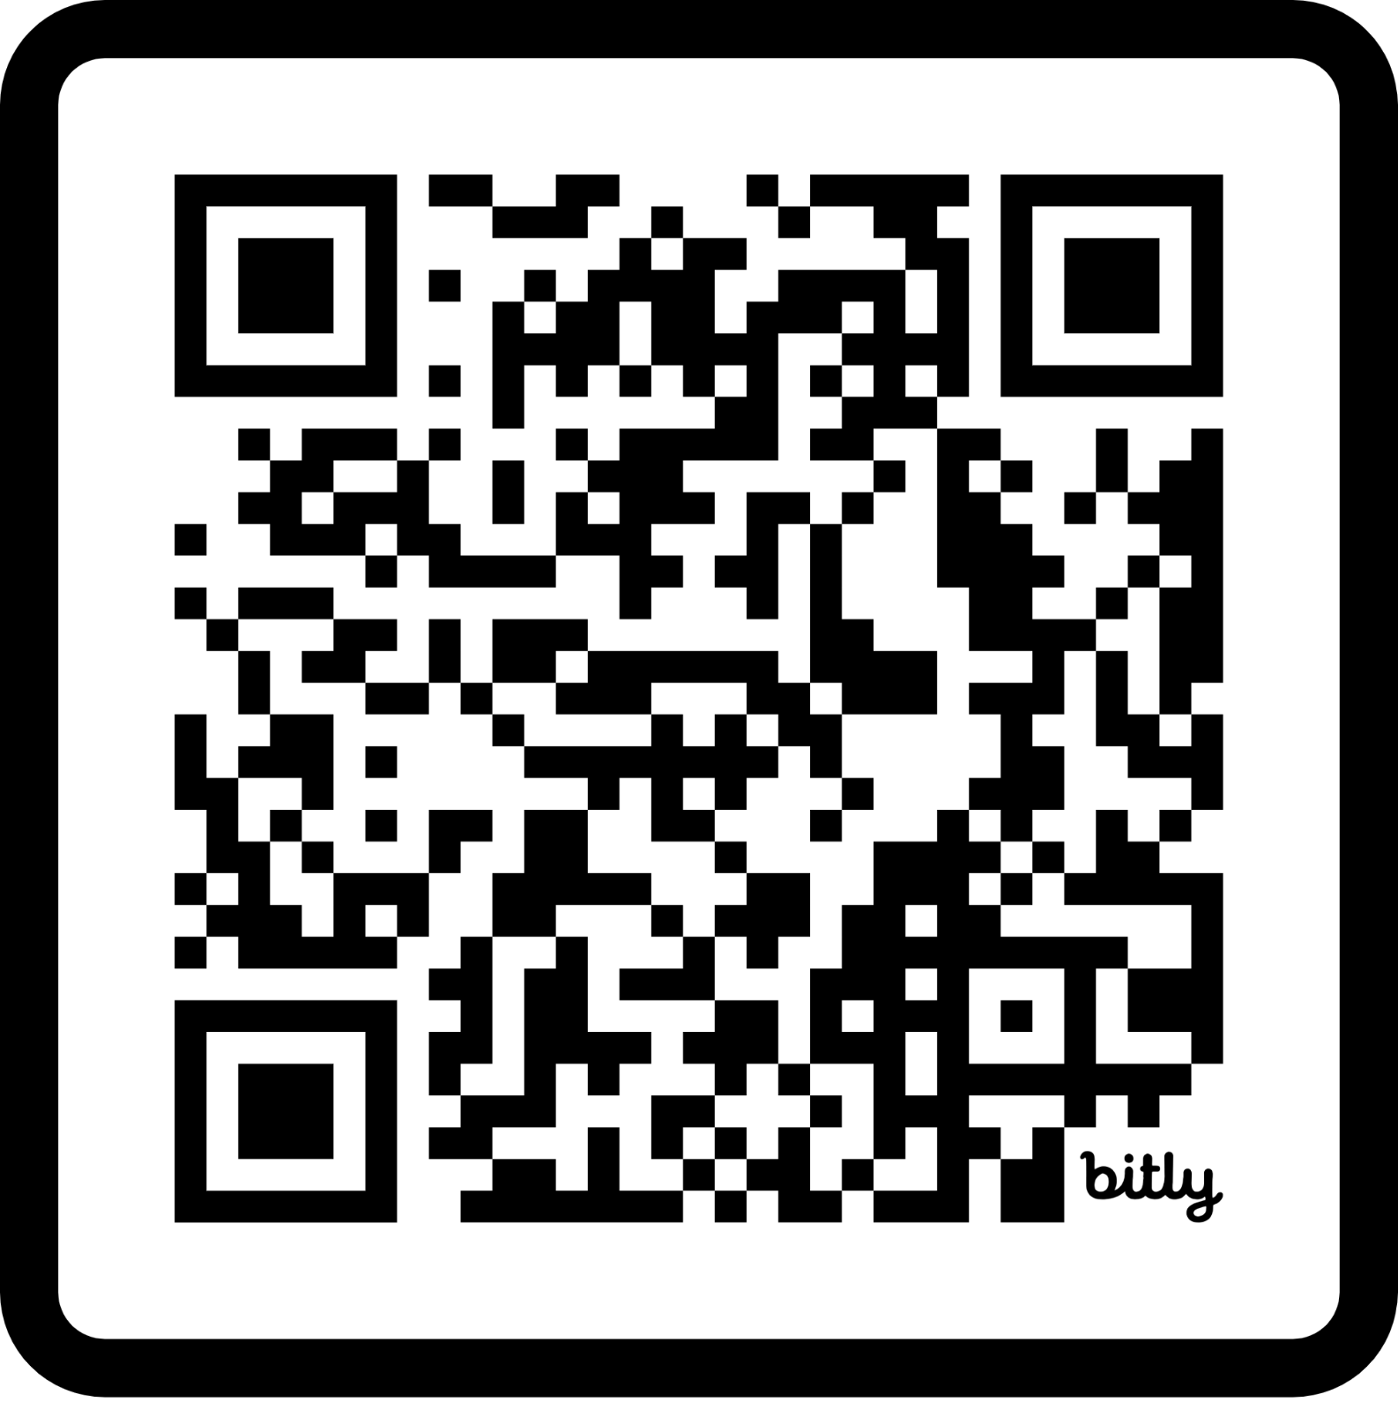
Thank you for attending.
https://bit.ly/LSPLSurvey
Holly Morado email: holly.morado@ade.arkansas.gov
Kisa Morman email: kisa.morman@ade.arkansas.gov
Amber Pirnique email: amber.pirnique@ade.arkansas.gov
Public School Accountability & Learning Services
Division of Elementary & Secondary Education

Slide 35
Q & A
Notes:
Everyone!

