Slide 1
Staffing with Intention
Understanding Long-Term Budget Impacts

Slide 2
“
The best way to predict the future is to create it.
— PETER DRUCKER

Slide 3

Agenda
State Funding Forecast
Using Enrollment & ADM Trends to Forecast Revenue
I
VI
Long-Term Cost of Salary Schedule Increases
Long-Term Impact on Budgets
II
VII
Program vs. Position Cost Analysis
Maximizing Funding Sources
III
VIII
Avoiding Unsustainable Staffing Growth
Fiscal Tools Available to District Leaders
IV
IX
State Restricted Funds – How Do They Apply to Salaries?
Closing
V
X

Slide 4
Key Questions
1
2
3
What percentage of your operating budget is salaries and benefits? How many are above 80%?
How many positions have been added in the last five years?
How many could be eliminated without impacting services?
Most districts do not get into financial trouble because of one bad purchase—they get into trouble because of years of staffing decisions that become difficult to sustain.
Every staffing decision should be viewed as a multi-year financial commitment, not a one-year expense.

Slide 5
Staffing with Intention
I. State Funding Forecast
Funding is Enrollment-Driven
The Temporary-Money Trap
Arkansas funding is primarily enrollment driven.
Districts will receive $8,037 per student in FY27.
Revenue rises and falls based on:
ADM, Foundation Funding rate, and Categorical funding
State restricted funds and Federal funds
Staffing decisions are often made during years of:
Temporary Funding (ESSER funding)
Enrollment spikes and One-time grants
Temporary state initiatives
Revenue disappears but positions remain.
Questions leaders should ask before adding positions:
Is this recurring revenue or one-time revenue?
What happens if enrollment declines?
Can we afford this position 3 years from now?

Slide 6
Example Scenario
REVENUE INCREASE
$200,000
Additional revenue due to enrollment growth
EXPENSE INCREASE
$225,000
3 positions hired immediately at $75,000 each with benefits
STRUCTURAL DEFICIT
−$25,000
Expenses of $225,000 outrun revenue of $200,000 in Year 1
Revenue fluctuations are temporary. Staffing obligations are long-term.

Slide 7
Staffing with Intention
II. Long-Term Cost of Salary Schedule Increases
Many districts evaluate salary increases only for the current year—a costly mistake. Always consider the long-term impact before committing.
What will the cost be in 3 years? 5 years?
How will this increase be covered?
Example: A district employs 100 teachers with a $2,000 average raise. Watch the true cost grow.
YEAR 1
$200,000
100 teachers × $2,000 raise
WITH BENEFITS
$240,000
True annual cost per year
BY YEAR 5
$1.2M
Cumulative cost of the decision

Slide 8
II. Long-Term Cost of Salary Schedule Increases
Unlike a one-time purchase
Before approving salary changes
Salary schedule adjustments continue forever.
Every salary adjustment becomes the new floor, not the new ceiling.
How will this affect future budgets?
What is the five-year cost?
Is revenue growth keeping pace?
★ Best practice!

Slide 9
Staffing with Intention
III. Program vs. Position Cost Analysis
Before adding a position, you must first determine what is needed.
What is the cost vs. student impact?
Do we need the position or do we need the service?
Program | Position
A service provided to students | A specific employee (one way)
Reading Intervention Mental Health Services Dyslexia Services Career Education | Interventionist Counselor Coordinator

Slide 10

III. Program vs. Position Cost Analysis
Before creating any new position, ask:
What student need are we trying to address?
Is this need permanent or temporary?
Is hiring an employee the best solution?
Are there other ways to provide this service?
What happens if funding declines?
Positions exist to support programs.
When districts start protecting positions instead of evaluating programs, staffing costs can grow faster than revenue.
“Never create a program simply to justify a position.”

Slide 11
Example Scenario
District reading scores decline, so an emphasis is now placed on improving reading scores across grade levels. What are the district’s “next steps”?
Program Driven Approach
Position Driven Approach
First determine:
What grades are struggling?
How many students need intervention?
What services are currently being provided?
Can existing staff be retrained?
Could tutoring meet the need?
Immediately hire a Reading Specialist
$75,000
The district may still hire a reading specialist—but they make that decision because the program requires it, not because hiring someone was the first solution considered.

Slide 12
III. Position vs. Program
Positions exist to support programs.
When districts start protecting positions instead of evaluating programs, staffing costs can grow faster than revenue.
“Never create a program simply to justify a position.”

Slide 13
Staffing with Intention
IV. Avoiding Unsustainable Staffing Growth
Staffing creep — districts keep adding positions even as enrollment stays flat or declines.
TWO WAYS IT HAPPENS
Enrollment stays flat, but positions keep being added.
Enrollment declines, while staffing holds steady or grows.
1
2
The result
Student-to-staff ratios shrink while financial pressure rises.
Expenses begin to exceed revenue.

Slide 14
IV. Avoiding Unsustainable Staffing Growth
Staffing decisions should reflect enrollment trends.
What are some indicators that a district needs to “right-size”?
Warning Signs | Questions Leaders Should Ask
Declining ADM Growing Salary Expenditures Increasing dependence on Building Fund Transfers Positions that originally had a temporary SOF, but are now permanent | What positions can be eliminated through attrition? Are staffing ratios aligned with enrollment? What do master schedules look like and who monitors these for efficiency? Do we have programs operating below capacity?

Slide 15
Example Scenario
ENROLLMENT DECLINES
900 → 750
students enrolled
-150 students · -17%
1 Staffing remains unchanged
2 Revenue declines while expenses stay fixed
3 Budget falls out of balance
4 Structural deficits begin
KEY TAKEAWAY: Staffing should follow students.

Slide 16
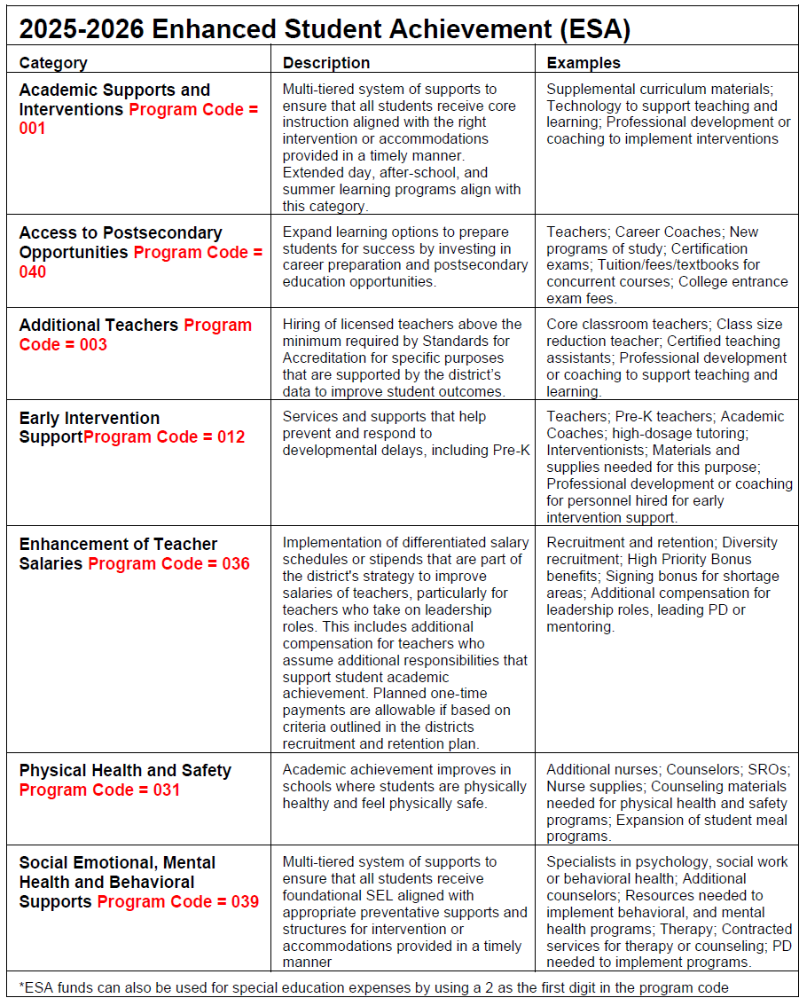
Staffing with Intention
V. State Restricted Funds: How Do They Apply to Salaries?
Some restricted funds may support salaries when the employee is directly connected to the allowable purpose.
ESA
May support personnel directly delivering services to qualifying students.
Alternative Learning Environment
Personnel supporting ALE programs.
English Learner Funding
Personnel serving English Learners.
Career and Technical Education
Certain approved CTE positions.

Slide 17
V. State Restricted Funds: How Do They Apply to Salaries?
Just because a restricted fund can pay a salary does not mean it should permanently fund that position.
ASK BEFORE YOU COMMIT
?
?
?
What if funding decreases?
What if the program changes?
What if student eligibility declines?
Key Takeaway
Always identify the sustainability plan before hiring personnel with restricted funds.

Slide 18
Staffing with Intention
VI. Using Enrollment & ADM Trends to Forecast Revenue
Enrollment data is one of the strongest forecasting tools available.
Districts are funded on their prior-year 3Q ADM.
If a district loses students, its funding drops the following year.
$8,037
per ADM
FY27 FOUNDATION AMOUNT
A budget shouldn’t be built on hope — build it on:
Data
Forecasting
Trend analysis

Slide 19
Example Scenario
DISTRICT A
▼ Loses 50 students / year
over the last 3 years
DISTRICT B
▲ Gains 50 students / year
over the last 3 years
School Year | Foundation Funding | District A ADM | District A revenue | District B ADM | District B Revenue
2024-25 | $7,771 | 1,000 | $7,771,000 | 1,000 | $7,771,000
2025-26 | $8,162 | 950 | $7,753,900 | 1,050 | $8,570,100
2026-27 | $8,037 | 900 | $7,233,300 | 1,100 | $8,840,700
Enrollment drives funding.
A district cannot rely on foundation funding increases alone to offset sustained enrollment declines.
Long-term fiscal health requires aligning staffing and expenditures with student enrollment trends.

Slide 20
Staffing with Intention
VII. Long-Term Impact on Budgets
What does adding one new position really cost?
TODAY
TOMORROW
The obvious, immediate costs
Salary
Benefits
The costs that keep compounding
Salary schedule movement
Retirement obligations
FICA
Insurance
Substitutes
Future raises

Slide 21
VII. Long-Term Impact on Budgets
What is the total five-year cost of adding one teacher?
Salary
$50,000
FIVE-YEAR COMMITMENT
$350,000+
Approximate total — and this does not include raises.
+
Benefits
$20,000
=
Annual cost
$70,000
Districts rarely hire a position for one year. They hire financial commitments that may last decades.

Slide 22
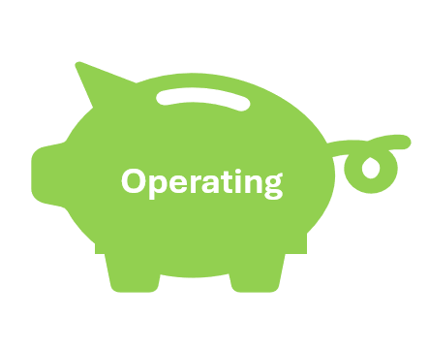
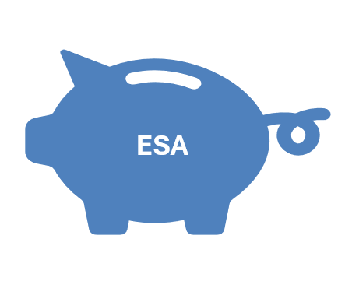

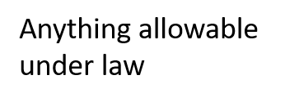
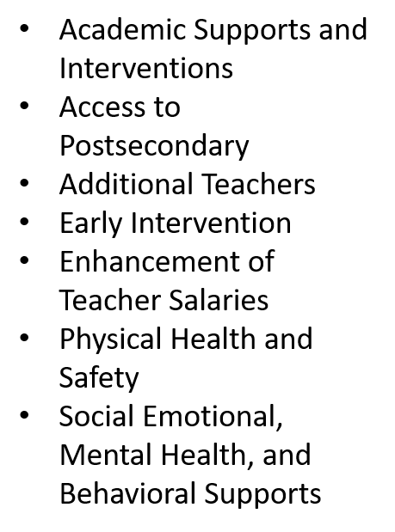
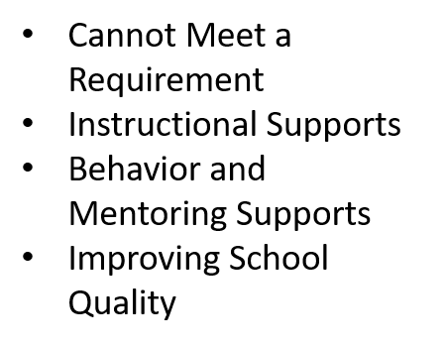
Staffing with Intention
VIII. Maximizing Funding Sources

Slide 23
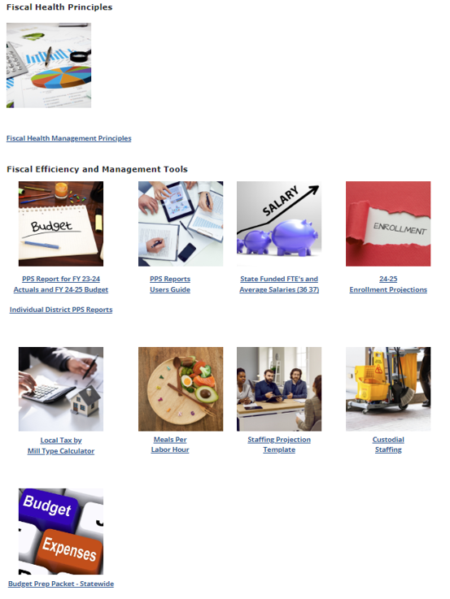

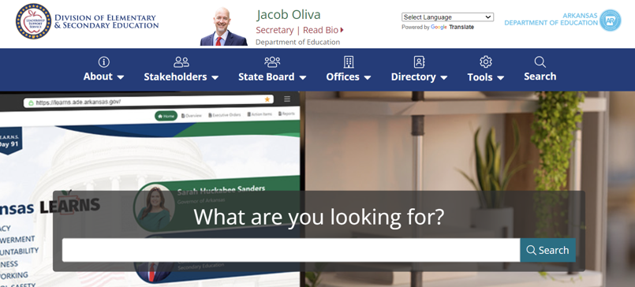
Staffing with Intention
IX. Fiscal Tools Available to District Leaders
DESE Homepage
Offices
District Operations
Fiscal Services and Support

Slide 24
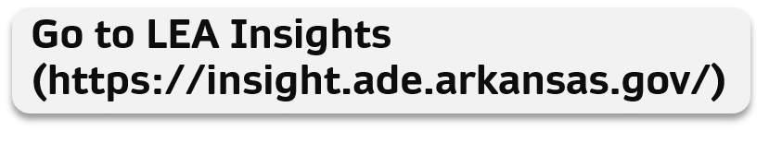
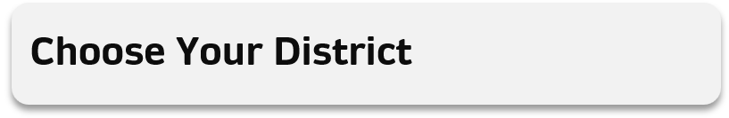
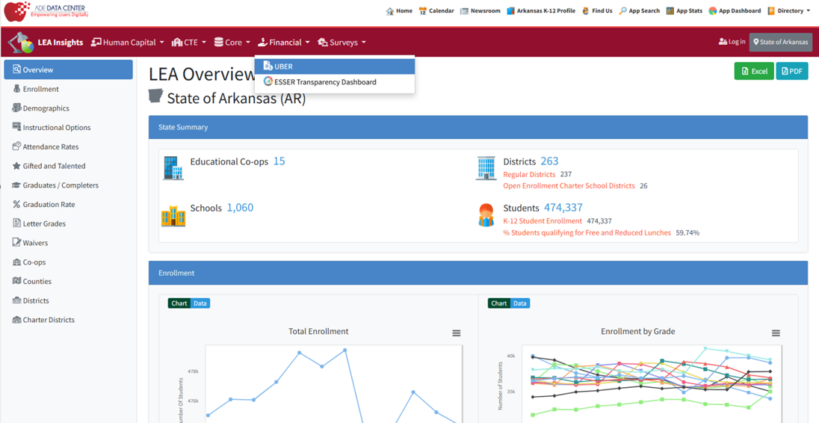

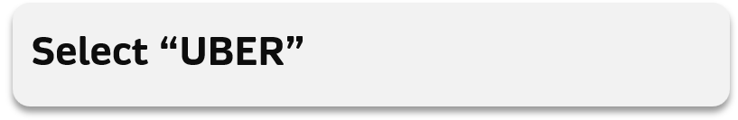
UBER

Slide 25
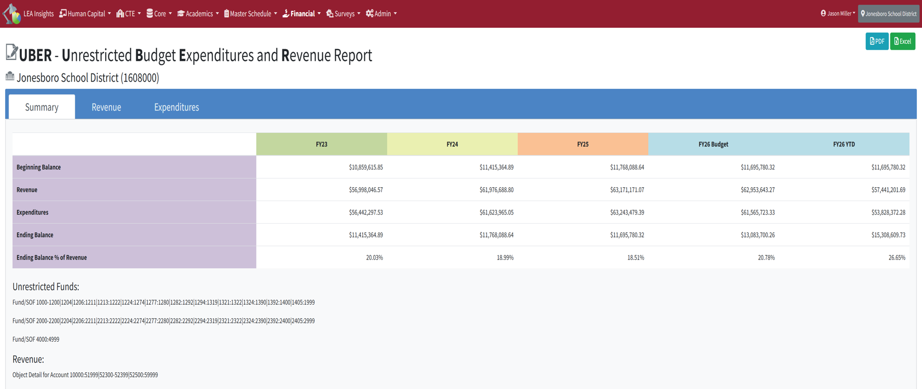
UBER

Slide 26
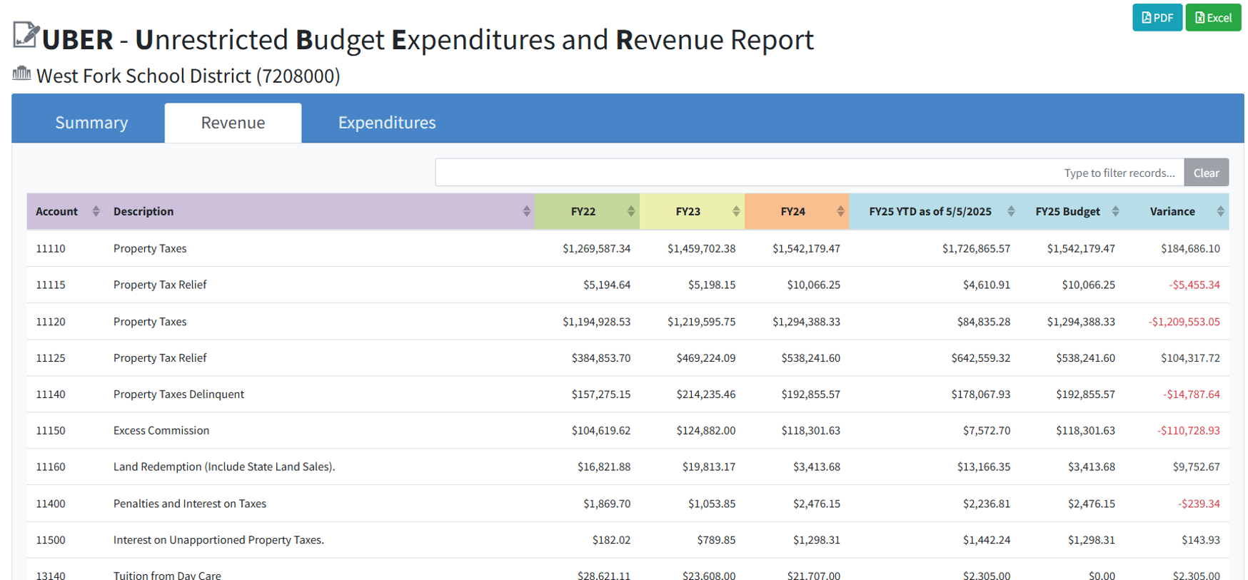
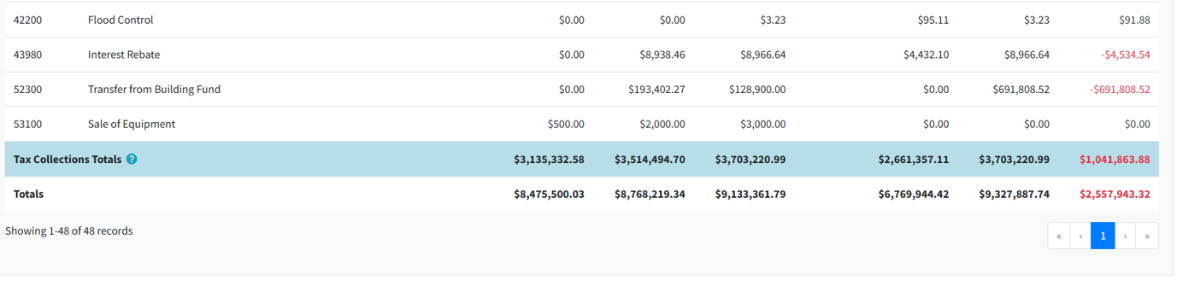
UBER

Slide 27
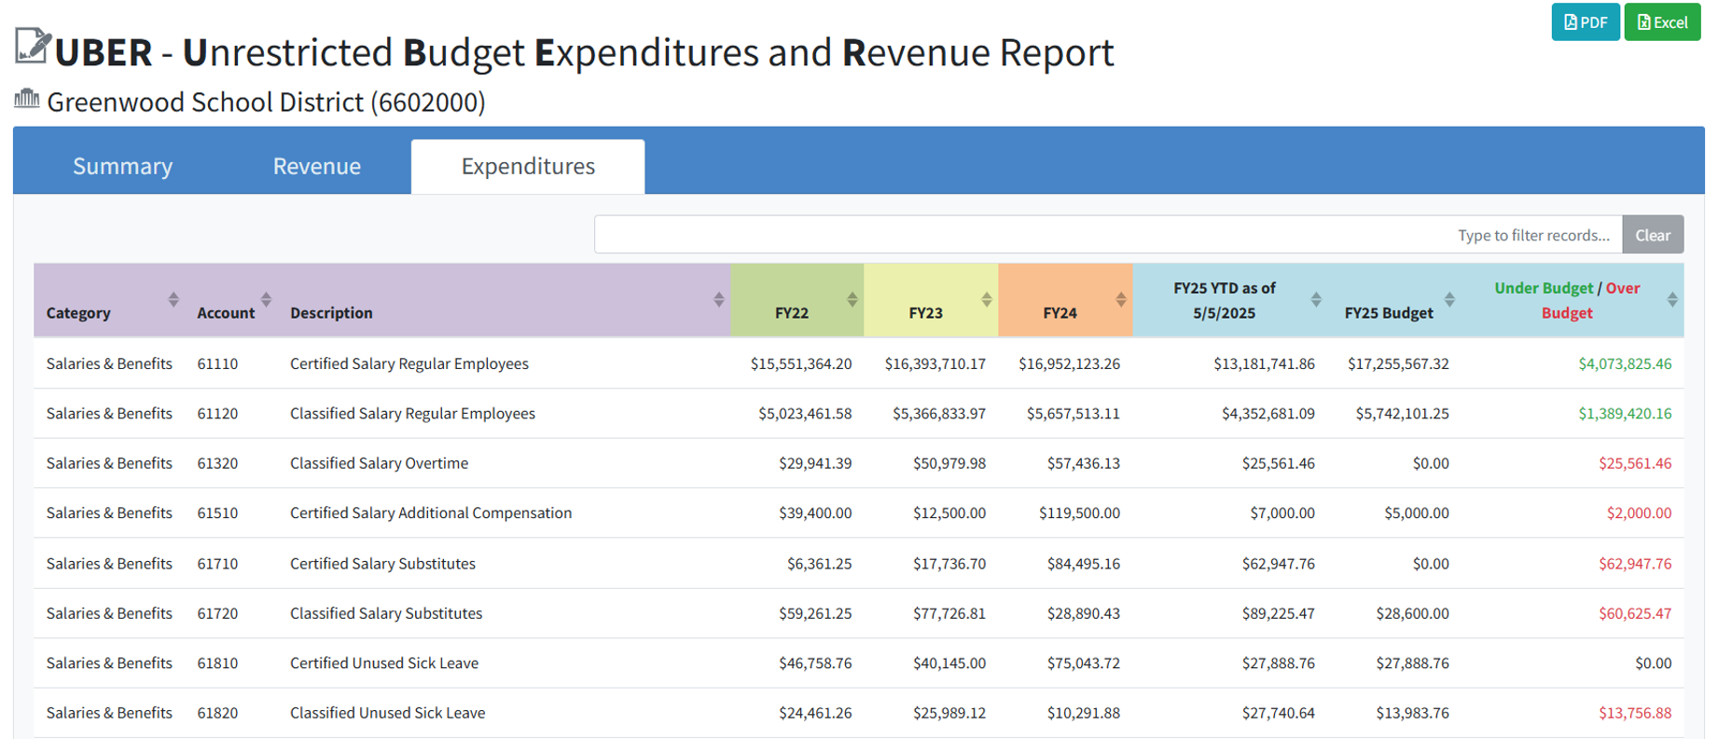
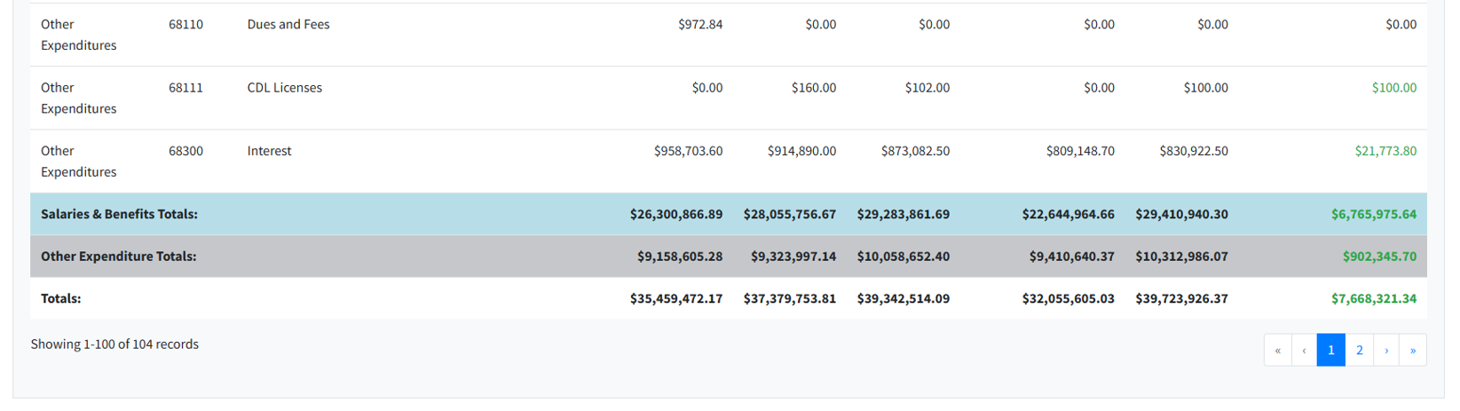
UBER

Slide 28
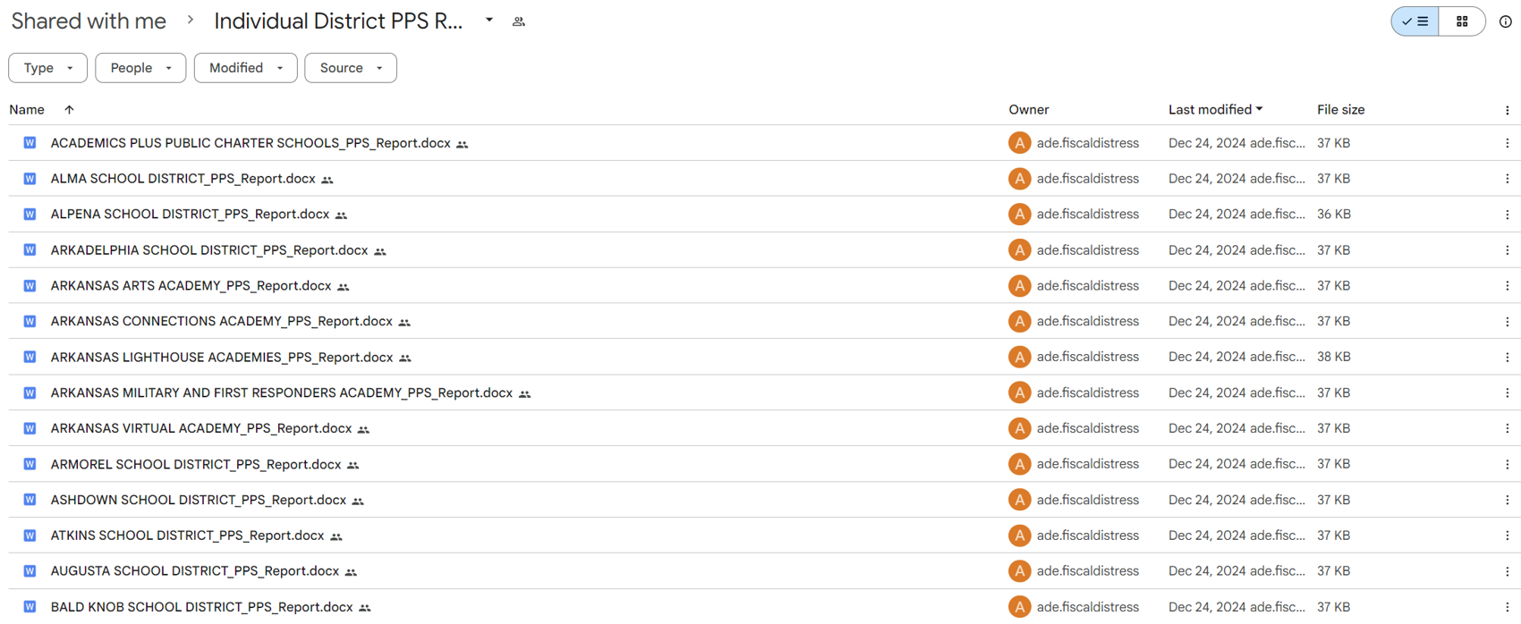
Per Pupil Spending (PPS)

Slide 29
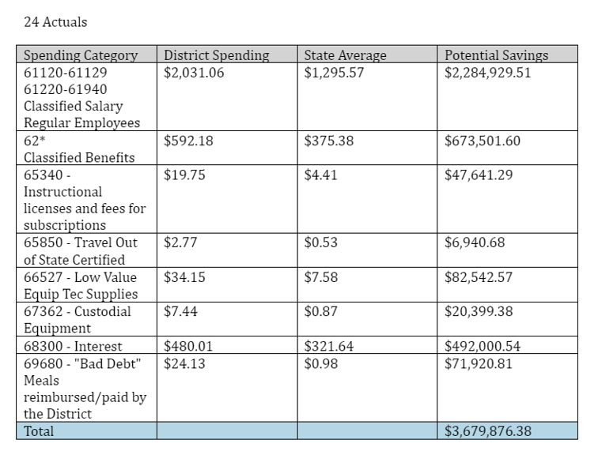
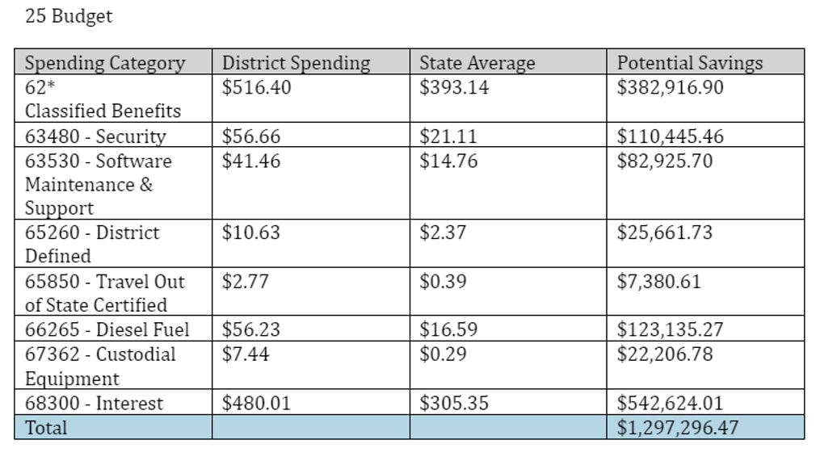
PPS

Slide 30
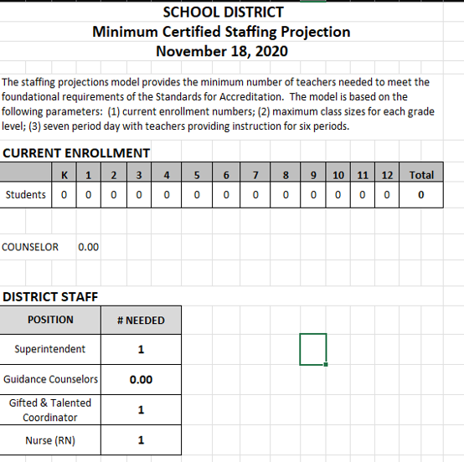
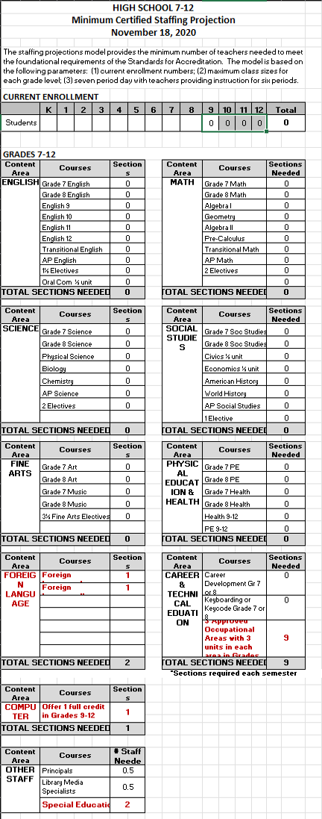
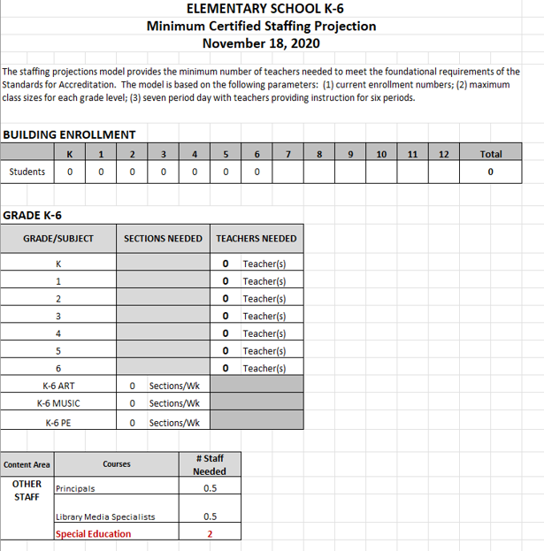
Staffing Projections

Slide 31
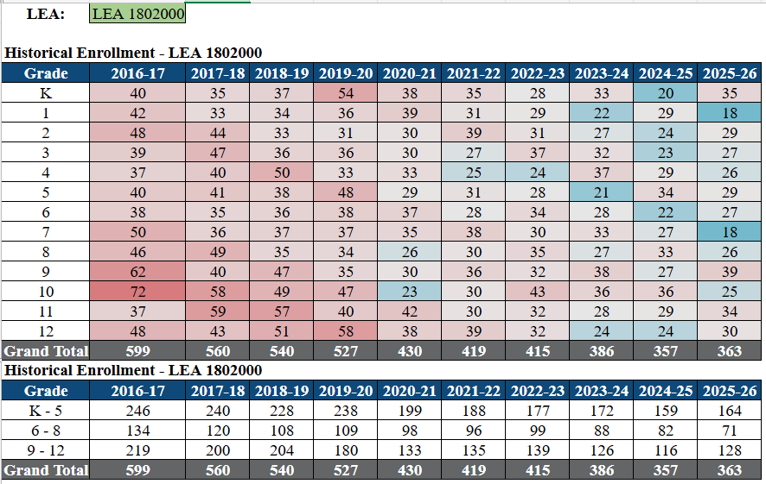
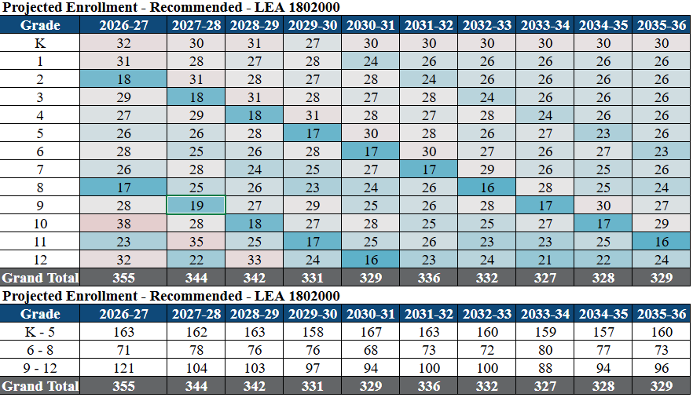
Enrollment Projections

Slide 32
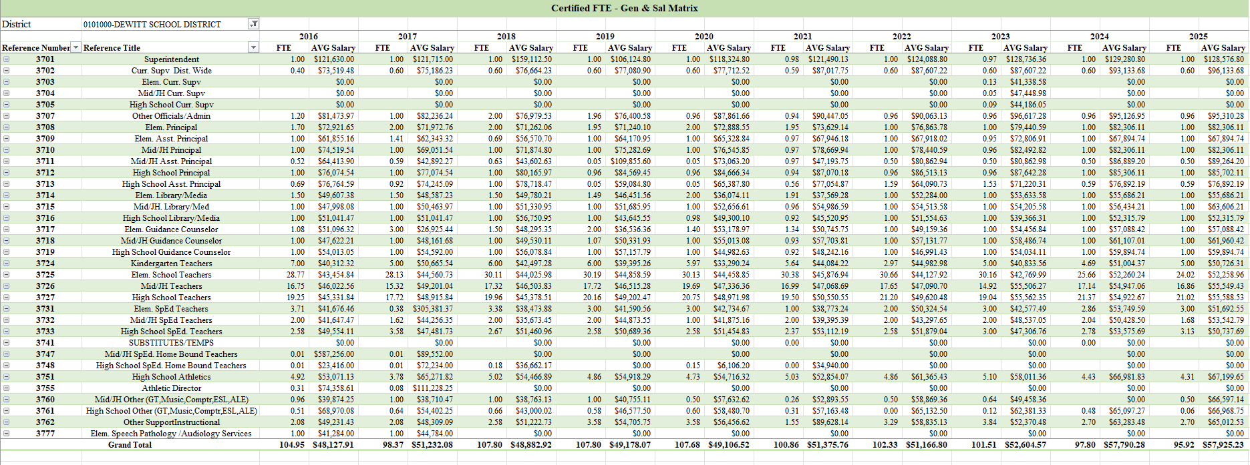
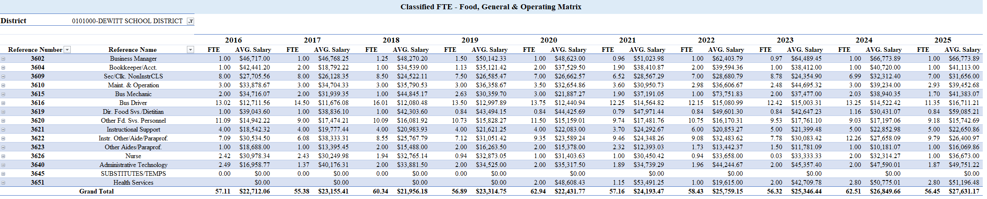
FTE’s and Average Salaries

Slide 33
Staffing with Intention
Enrollment Drives Revenue. Staffing Drives Sustainability.
Questions Every District Should Be Asking
✅ What are our enrollment projections for the next 3-5 years?
✅ Are staffing levels aligned with student needs?
✅ Are we building recurring expenditures on one-time funding sources?
✅ Can our current budget be sustained if enrollment continues to change?
✅ Are we making decisions based on today's reality or yesterday's enrollment?
The most financially healthy districts are not necessarily the ones receiving the most funding. They are the districts that continuously align staffing, resources, and expenditures with enrollment trends.

Slide 34
Closing
KEY TAKEAWAYS
✓
Foundation funding changes matter, but enrollment has a much larger long-term impact on district revenue.
Success is not determined by the resources you have, but by how well you align those resources to your mission.
✓
Growth brings opportunities and challenges.
✓
Decline requires difficult but necessary staffing and expenditure decisions.
District leaders who monitor enrollment trends early can make gradual adjustments rather than facing fiscal distress later.
✓
✓
Sustainable districts continuously align people, programs, and resources with the students they serve.
!
Hope is not a strategy.

Slide 35
Thank You!
Jason Miller
OCSS State Leadership Development
DESE Fiscal Services
Jason. Miller@ade.arkansas.gov

