Slide 1
Every Day Counts: Leveraging the New Guidance Document to Reduce Chronic Absenteeism
Capri Bell Salaam, State Director of the Education Renewal Zones
Dr. Roger Guevara, Education Renewal Zone Director - Southern Arkansas University

Slide 2
A Prevention and Intervention Guide for Districts and Schools
Features:
Understanding Chronic Absenteeism
Arkansas Attendance Data
Prevention-Focused Approaches
Data-Driven Decision Making
School & District Improvement Strategies
Family & Community Engagement
Real Arkansas Success Stories
Resources for Schools & Districts

Slide 3

Why Attendance Matters
Regular attendance helps students reach educational milestones, whereas poor attendance contributes to lost learning time, lower achievement, and higher dropout rates.
Attendance is directly connected to academic achievement.
Regular attendance promotes engagement, relationships, and success.
Significant absences can disconnect students from learning.

Slide 4
“One of the clearest strategies for improving student achievement is improving student attendance. Attendance must be seen as a shared responsibility between schools, families, students, and the community. When we improve attendance, we increase access to learning, strengthen student support, and give students a better opportunity to graduate prepared for college, career, and life.”
-Jeffrey Burton,
Principal, Prescott Junior High School

Slide 5
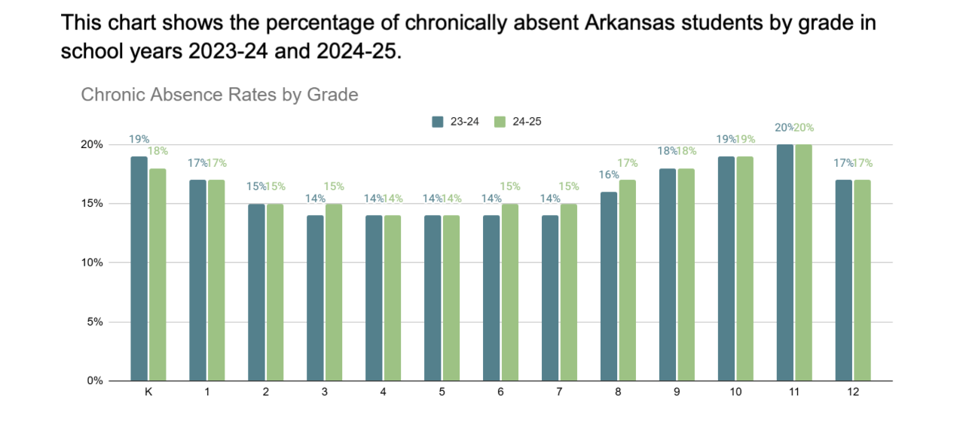
Chronic Absence Rates by Grade
2023-2024
2024-2025
Comparison

Slide 6
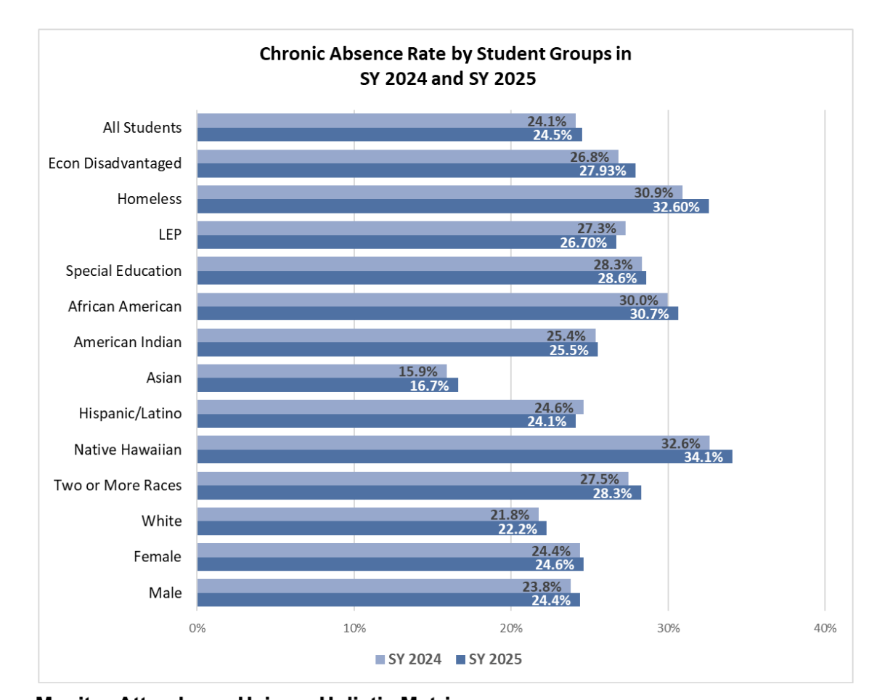
Chronic Absence Rate by Groups
SY 2024
SY 2025
Comparison

Slide 7
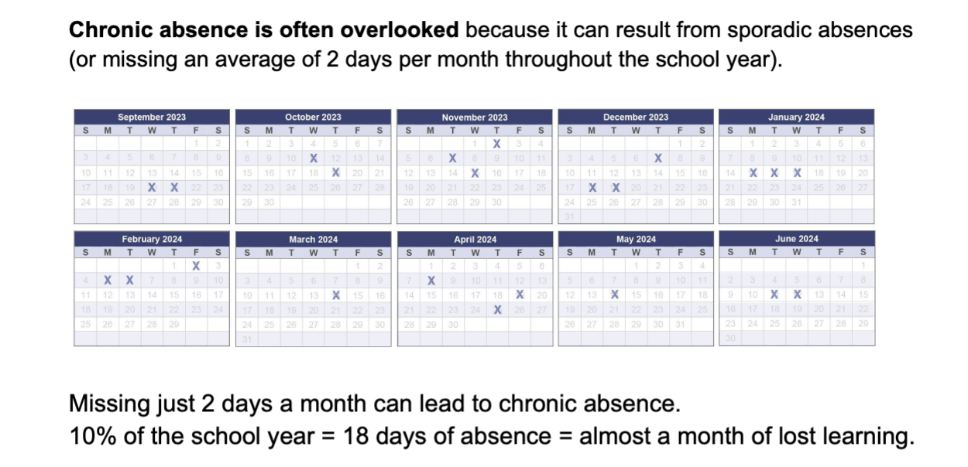
Sporadic Absences

Slide 8

Students missing 2-4 days by the first month of school are 5 times more likely to be chronically absent throughout the year.

Slide 9
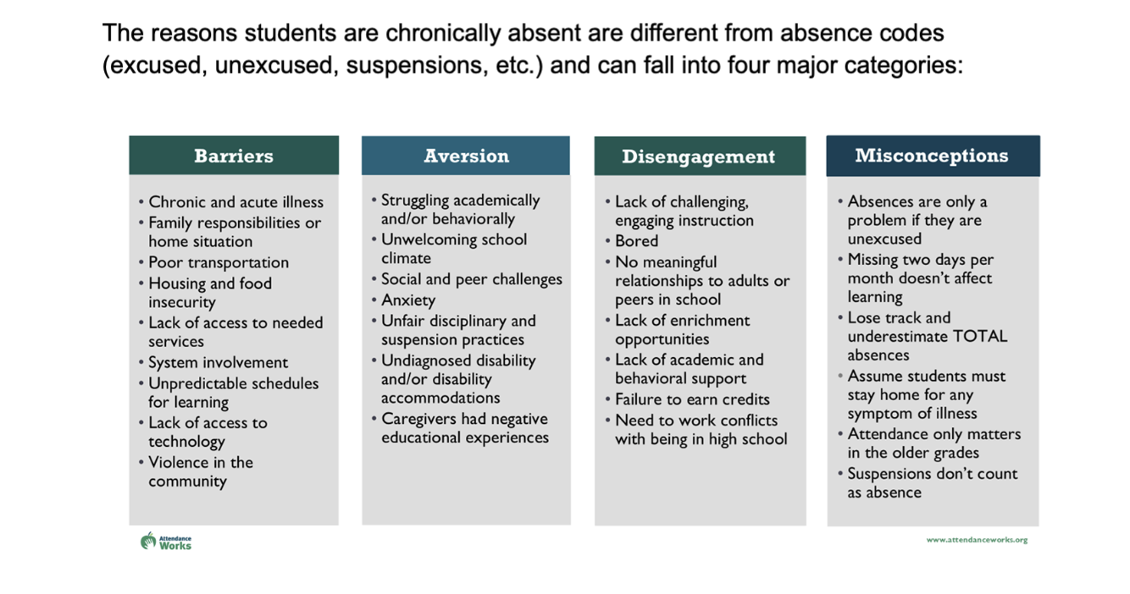
Major Categories of Why Students are Chronically Absent

Slide 10
Attendance concerns usually have a root cause. Students need trusted adults who are paying attention, asking questions, removing barriers when possible, and helping them see that their presence matters.
-DarShauna Shepard
Principal, Drew Central High School

Slide 11
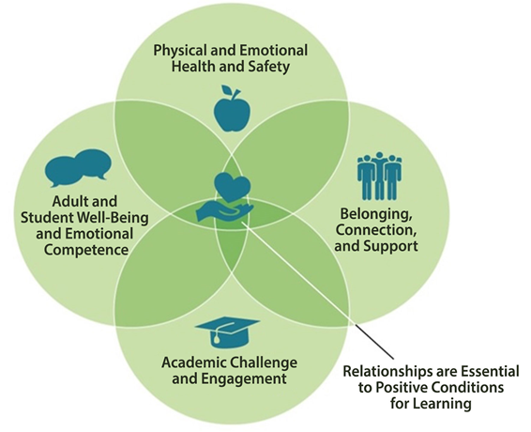
Foundational Supports: Analyze Connections between attendance, academics, and behavior

Slide 12
What Would You Do?
It is October. The attendance team at Pine Ridge Middle School reviews its attendance data and identifies a seventh-grade student, Alex, who has already missed 12 days of school.
The school's records show:
5 absences were due to transportation challenges.
3 absences were related to a family member's illness.
4 absences were unexplained.
Alex's grades have begun to decline.
He recently stopped participating in extracurricular activities.
His teachers report that he appears withdrawn and disengaged when present.
The school has already:
Sent attendance letters home.
Made two phone calls to the family.
Discussed attendance concerns during a parent conference.
Despite these efforts, Alex's attendance continues to decline.
What additional information would you want to gather before determining next steps?
How would you partner with the family while maintaining a supportive rather than punitive approach?
How would you monitor progress and determine whether interventions are working?

Slide 13
Upcoming Guide & Resources
A Prevention and Intervention Guide for Districts and Schools will be available on the ADE website upon final approval.

Slide 14
Contact Information
Capri Salaam, Capri.Salaam@ade.Arkansas.gov
Dr. Roger Guevara, RCGuevara@saumag.edu

